Slide 1
Airway assessment
By Dr Saleha Jabali
General&Pediatric Anesthesia consultant

Slide 2
WHY???
Difficult airways
Sensitive patient to sedative
Call expertise for consultation and help

Slide 3
HOW ?

Slide 4
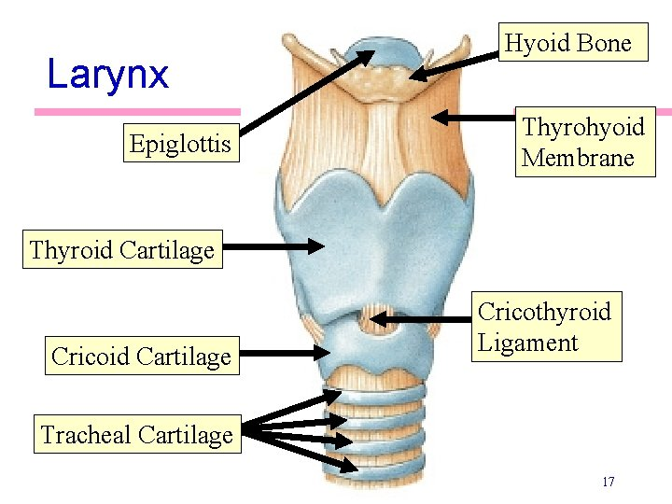
Anatomy of airway

Slide 5
LEMON
assessment for difficult airway

Slide 6
L= Look externally
Dysmorphic features of syndromes ,retrognithia micrognitheia , course featurs of face (Mucopolysacradosis ), anotia ,microtia ,short neck , protruded teeth , hemangioma masses over face or neck
Hydrocephalus
Trauma
Mouth breather
Tracheostomy (especially uncuffed)
Obesity

Slide 7
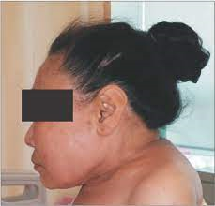

Slide 8
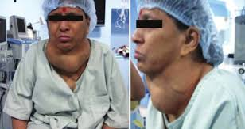

Slide 9
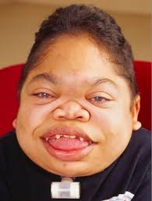
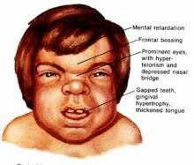
MPS

Slide 10
E= evaluate
3-3-2 rule
An assessment tool used to predict difficult intubations based on characteristics of difficult airways :

Slide 11
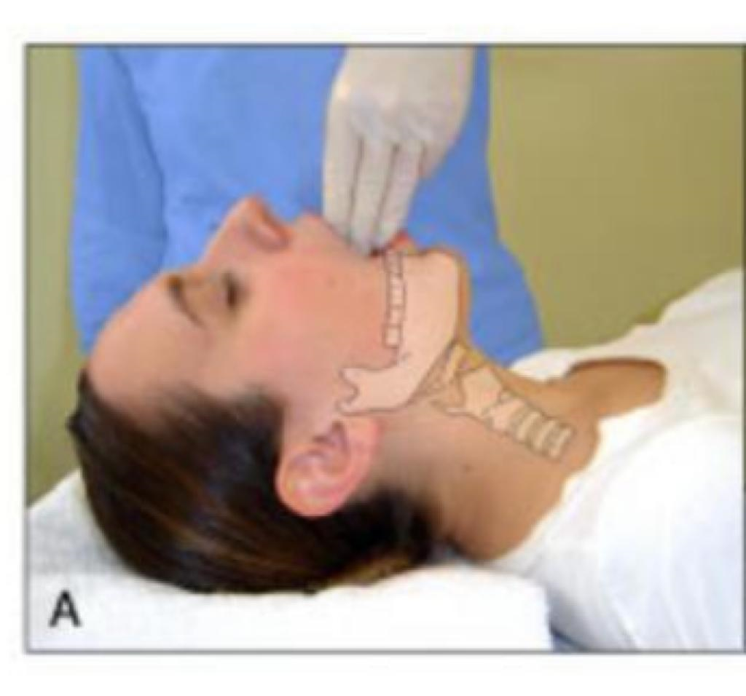
E= evaluate
3-3-2 rule
Mouth opening =3 fingers breadths
A typical patient can open their mouth sufficiently to permit placement of three patient sized fingers held together between the incisors. (inter-incisor distance). Adequate mouth opening facilitates both insertions of the laryngoscope and obtaining a direct view of the glottis.

Slide 12
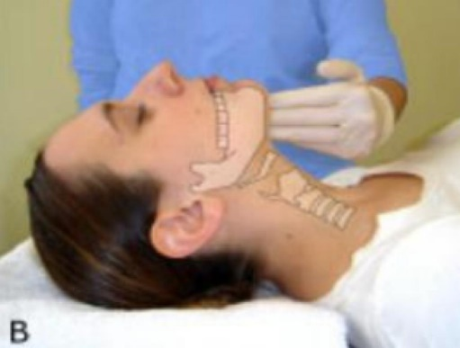
E= evaluate
3-3-2 rule
Chin to hyoid bone distance =3 finger or not< than 6 cm
A typical patient can place three patient sized fingers held together on the floor of the mandible between the mental angle and the neck near the hyoid bone. (hyoid-mental distance).

Slide 13
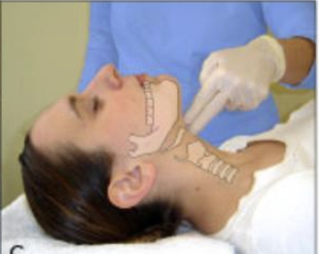
E= evaluate
3-3-2 rule
Thyroid notch to floor of the mouth =2 fingers
A typical patient can place two patient sized fingers held together in the superior laryngeal notch.(hyoid-thyroid cartilage distance)

Slide 14
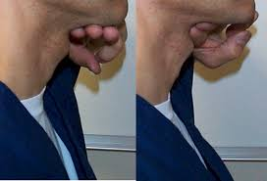
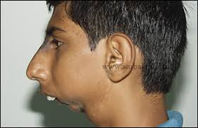

Slide 15
A likely indication of difficult intubation is present if the inter-incisor(mouth opening ) or hyoid-mental distance is less than three fingers or the hyoid-thyroid cartilage distance is less than two fingers.

Slide 16
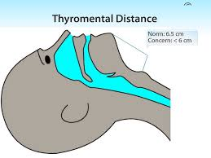
Thyromental distance TMD
is defined as the distance from the chin (mentum) to the top of the notch of the thyroid cartilage with the head fully extended
It is extra test other than 3-3-2 rule and easy to assess in the patient
If it is less than 6 cm that mean possible difficult intubation

Slide 17
M=Mallampati
The Mallampati classification is a simple scoring system that relates the amount of mouth opening to the size of the tongue and provides an estimate of space available for oral intubation by direct laryngoscopy.
This test is performed while the patient is in the sitting position, awake and cooperative.
Simply have the patient open his mouth maximally with out phonation and stick out his tongue while his head is in neutral position and assess based upon the pharyngeal structures that are visible.

Slide 18
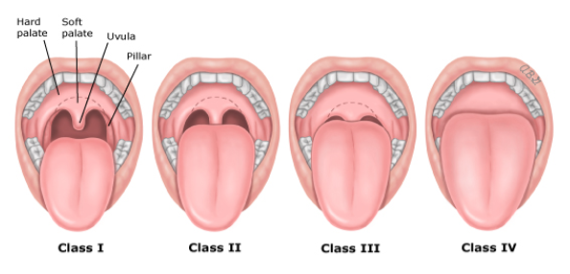
AIRWAY ASSESSMENT FOR PROCEDURAL SEDATION AND ANALGESIA
MALLAMPATI CLASSIFICATION

Slide 19
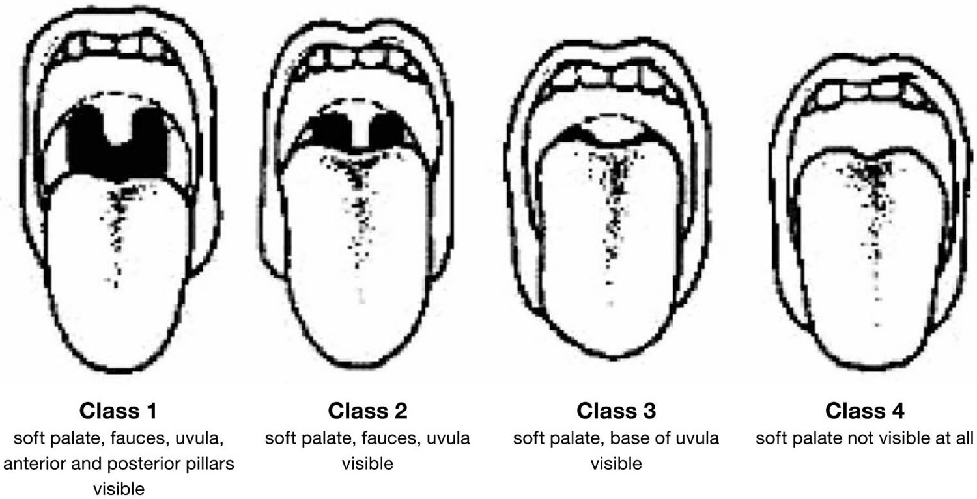
Anatomical structures can be seen with each class

Slide 20
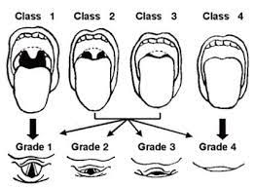
Vocal cord view during intubation

Slide 22
According to the Mallampati scale:
Class I : hard palate, soft palate, uvula, and pillars are visible.
Class II : hard palate, soft palate, uvula are visible;
Class III: hard palate, soft palate and base of the uvula are visible.
Class IV : only the hard palate is visible.
In class III and IV patients , difficult ventilation and intubation should be anticipated and expert consultation is required

Slide 23
O=Obstruction
Trauma (Burn)
Infection(epiglottis ,Croup)
Oedema (allergy)

Slide 24
N=Neck mobility
Neck collar = difficult mobility
DM
RA
Syndromes (MPS)
Old burn or Radiotherapy to Head & neck

Slide 25
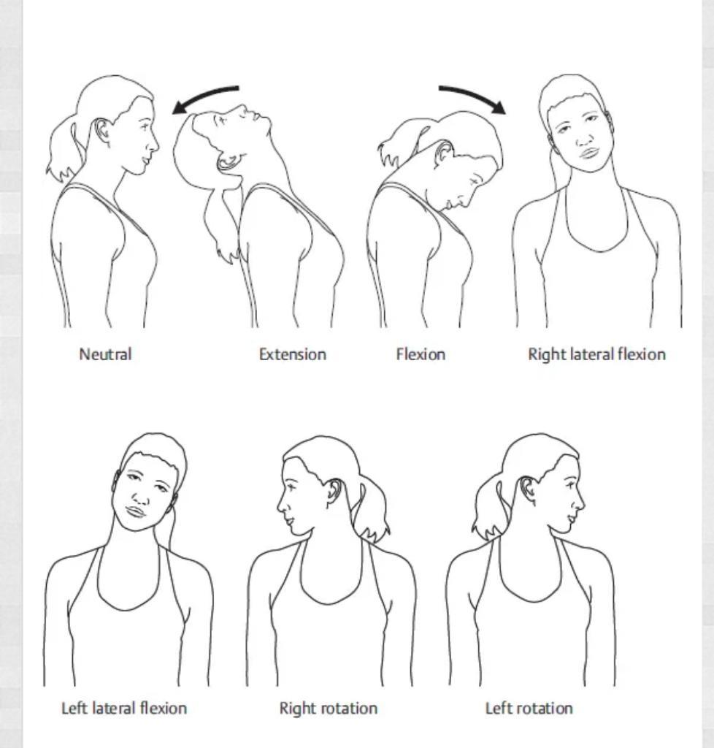
Neck mobility examination

Slide 26
Pediatric & Adult Airway
Unique airway
Special concern regarding
High larynx at C3
Large floppy epiglottis
Funnel shape trachea ??
Narrowest area is at cricoid cartilage
Alignment is difficult =cannot do sniffing position because of large head
Easley can get obstructed ,and hypoxia

Slide 27
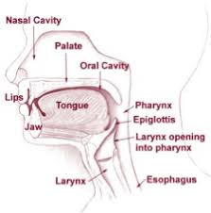

Slide 28
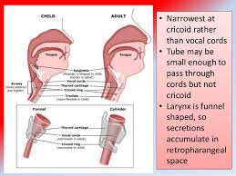

Slide 29
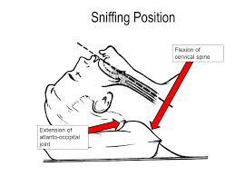
Sniffing position

Slide 30
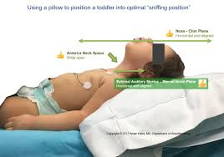
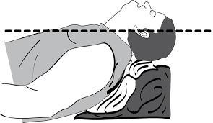

Slide 31
Cases
12 year old child with tracheostomy for LP
4 years old mouth breather for CT
2 year old down syndrome for Echo
50 years old IDDM ,RA for diagnostic Endoscopy
un cooperative 20 years lady need tooth extraction H/O Burn only
14 year girl BMI 40 for MRI
6 year old MP for EEG

Slide 32
Important Airway Anatomy innervation for awake intubation
The larynx is innervated bilaterally by the superior laryngeal nerve (supplies
mucosa from the epiglottis to the level of the cords) and the recurrent
laryngeal nerve (supplies mucosa below the cords), both branches of
the vagus nerve(CN X).
The recurrent laryngeal nerves supply all of the intrinsic muscles of the larynx except for the cricothyroid muscle and any damage to the recurrent laryngeal can result in vocal cord dysfunction. The cricothyroid muscle is innervated by the external branch of the superior laryngeal nerve.
Other nerves which may need to be anesthetized for awake fiberoptic intubations include the maxillary branch of the trigeminal nerve which supplies sensory innervations to the nasopharynx and
the glossopharyngeal nerve which supplies sensory innervations to the post 1/3 of the tongue, pharynx, and areas above the epiglottis.

Slide 33
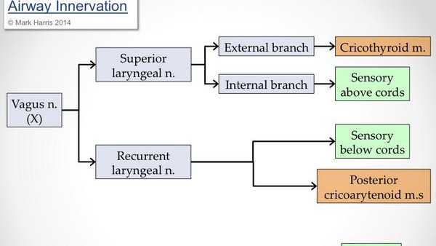

Slide 34
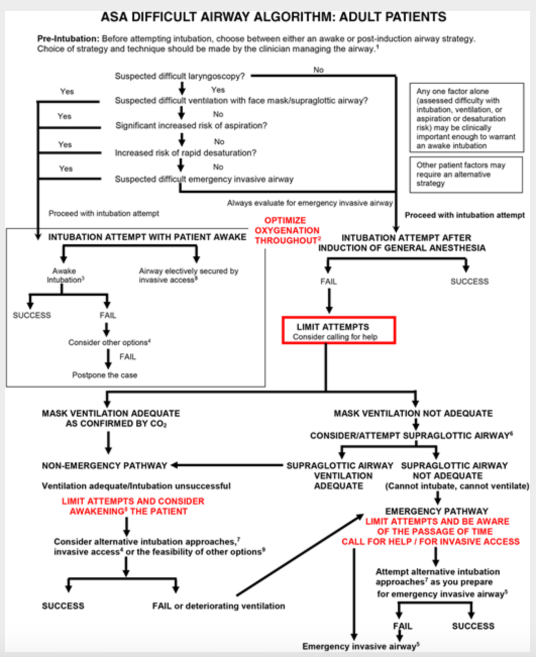
Difficult airway algorithm

Slide 35
Physical Examination
Vital signs (BP ,HR , Spo2,Temp )
BMI = obesity
General look for signs of (trauma ,burn , deformity , abnormal movement ,airway feature , neck and thyroid goiter
Fat distribution ,lower limb oedema , skin abnormality or abnormal color ,assess for difficult cannulation )
CVS = S1+S2+ murmur ??
Respiratory = clear or wheezing or decrease air entry ,crepitation ,transmitted sound , Stridor, Grunting
Joint or back deformity
CNS = muscle weakness and power examination
All must be documented

Slide 36
General Emergency Airway Management
Learn technique
Open Airway
Mask Bag ventilation (BLS)
100 % oxygen
Call for help
Intubation may waste time

Slide 37
General Emergency Airway Management
OXYGENATION Positive VENTILATION
With bag mask
No intubation (wasting of time and patient will develop hypoxia)

Slide 38

Thank YOU

