Slide 1
Basic ECG
By Dr Saleha Jabali 2022

Slide 2
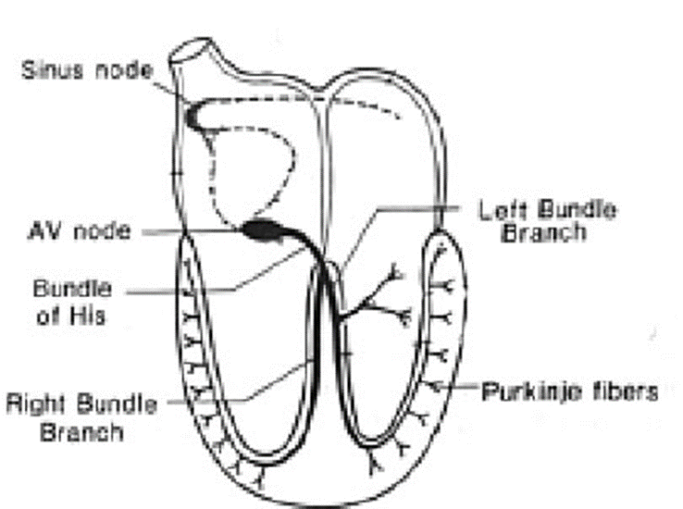
ELECTROCARDIOGRAM
Normal Impulse Conduction
Sinoatrial node
AV node
Bundle of His
Bundle Branches
Purkinje fibers

Slide 3
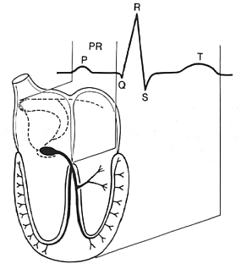
The “PQRST”
P wave - Atrial depolarization
QRS - Ventricular depolarization
T wave - Ventricular repolarization

Slide 4
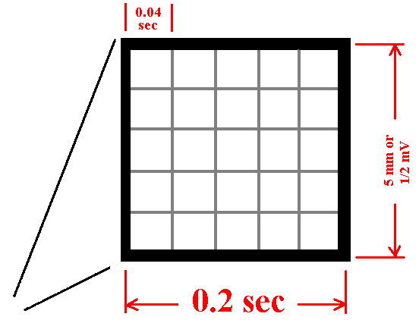
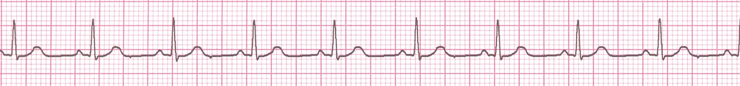
The ECG Paper
Horizontally
  One small box - 0.04 s
  One large box - 0.20 s
Vertically
  One large box - 0.5 mV

Slide 5
Rhythm Analysis
Step 1: Calculate rate.
Step 2: Determine regularity.
Step 3: Assess the P waves.
Step 4: Determine PR interval.
Step 5: Determine QRS duration.

Slide 6
Step 1: Calculate Rate
Regular
  Find a R wave that lands on a bold line.
  300/ large box
  Find a R wave that lands on a bold line.
  1500/ small box
  Irregular
  Count number of QRS in 6 second xX12 = QRS in 30 big box X12= rate
  1 second = 5 big box

Slide 7
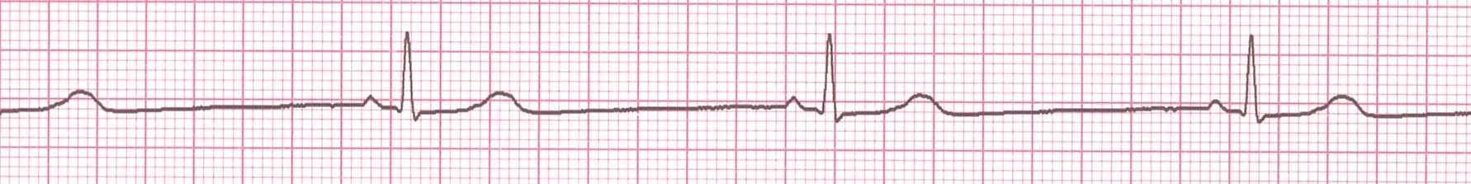
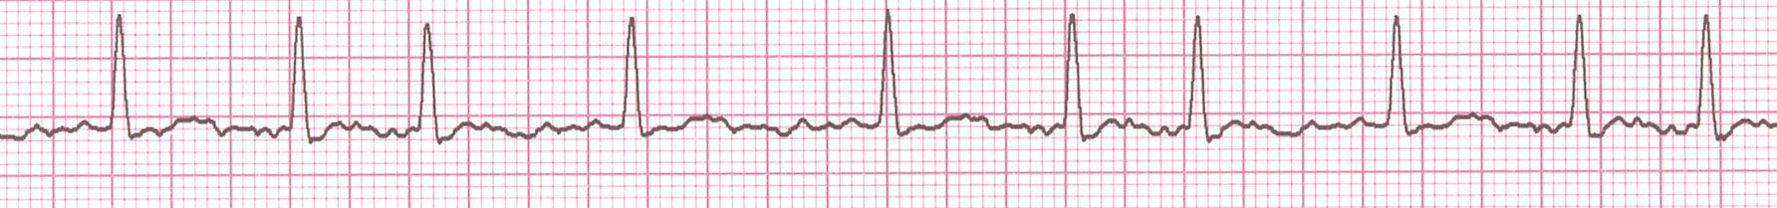

Slide 8
Step 2: Determine regularity
R
R
Look at the R-R distances (using a caliper or markings on a pen or paper).
Regular (are they equidistant apart)? Occasionally irregular? Regularly irregular? Irregularly irregular?
Interpretation?
Regular

Slide 9
Step 3: Assess the P waves
Are there P waves?
Do the P waves all look alike?
Do the P waves occur at a regular rate?
Is there one P wave before each QRS?
Interpretation?
Normal P waves with 1 P wave for every QRS

Slide 10
Step 4: Determine PR interval
Normal: 0.12 - 0.20 seconds.
(3 - 5 boxes)
Interpretation?
0.12 seconds

Slide 11
Step 5: QRS duration
Normal: 0.04 - 0.12 seconds.
(1 – 3 boxes)
Interpretation?
0.08 seconds

Slide 12
Rhythm Summary
Rate 90-95 bpm
Regularity regular
P waves normal
PR interval 0.12 s
QRS duration 0.08 s
Interpretation?
Normal Sinus Rhythm

Slide 13
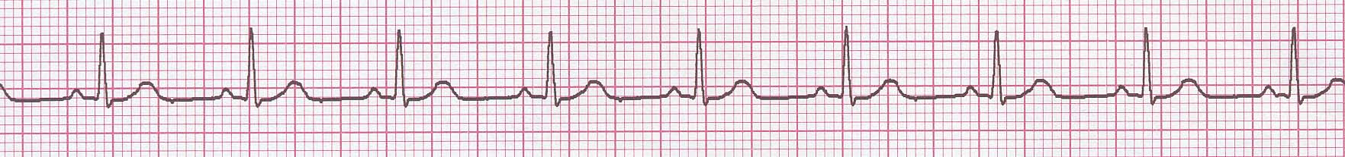
NSR Parameters
Rate 60 - 100 bpm
Regularity regular
P waves normal
PR interval 0.12 - 0.20 s
QRS duration 0.04 - 0.12 s
Any deviation from above is sinus tachycardia, sinus bradycardia or an arrhythmia

Slide 14
Thank you

Slide 15
ECG interpretations

Slide 16
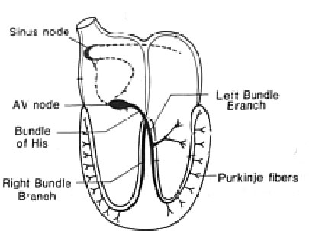
Normal Impulse Conduction
Sinoatrial node
AV node
Bundle of His
Bundle Branches
Purkinje fibers

Slide 17
The “PQRST”
P wave - Atrial depolarization
QRS - Ventricular depolarization
T wave - Ventricular repolarization

Slide 18
Rhythm Analysis
Step 1: Calculate rate.
Step 2: Determine regularity.
Step 3: Assess the P waves.
Step 4: Determine PR interval.
Step 5: Determine QRS duration.

Slide 19
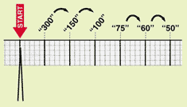
Step 1: Calculate Rate
Option 2
  Find a R wave that lands on a bold line.
  300/ large box
R wave

Slide 20
Step 5: QRS duration
Normal: .(1 - 3 boxes)

Slide 21
Arrhythmia Formation
  Sinus node =brady /tachy
  Atrial cells=supraventricular
  AVjunction=supraventricular
  Ventricular cells

Slide 22
Supraventricular arrhythmia
Atrial cells can:
fire from a focus
a looping re-entrant circuit
Atrial Flutter

Slide 23
Atrial Cell Problems
Atrial Fibrillation

Slide 24
Ventricular Cell Problems
Premature Ventricular Contractions (PVCs)
Ventricular Fibrillation
Ventricular Tachycardia

Slide 25
Rhythm #1
Rate?
30 bpm
Regularity?
regular
P waves?
normal
PR interval?
0.12 s
QRS duration?
0.10 s
Interpretation?
Sinus Bradycardia

Slide 26
Sinus Bradycardia
Deviation from NSR
- Rate < 60 bpm

Slide 27

Rhythm #2
Rate?
130 bpm
Regularity?
regular
P waves?
normal
PR interval?
0.16 s
QRS duration?
0.08 s
Interpretation?
Sinus Tachycardia

Slide 28
Rhythm #5
Rate?
100 bpm
Regularity?
irregularly irregular
P waves?
none
PR interval?
none
QRS duration?
0.06 s
Interpretation?
Atrial Fibrillation

Slide 29
Atrial Fibrillation
Deviation from NSR

Slide 30
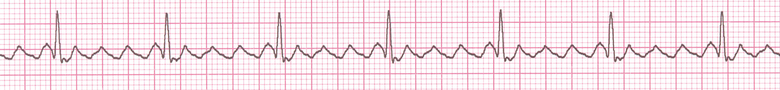
Rhythm #6
Atrial flutter
Rate more than 250 up to 320 b/min.
Sawtooth pattern on ECG.
Associated with organic heart disease .
Interpretation?
Atrial Flutter

Slide 31
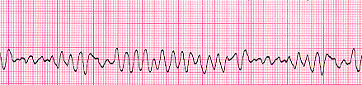
Ventricular Fibrillation
Rhythm: irregular-coarse or fine, wave form varies in size and shape
Fires continuously from multiple foci
No organized electrical activity
No cardiac output
Causes: MI, ischemia, untreated VT, underlying CAD, acid base imbalance, electrolyte imbalance, hypothermia,

Slide 32
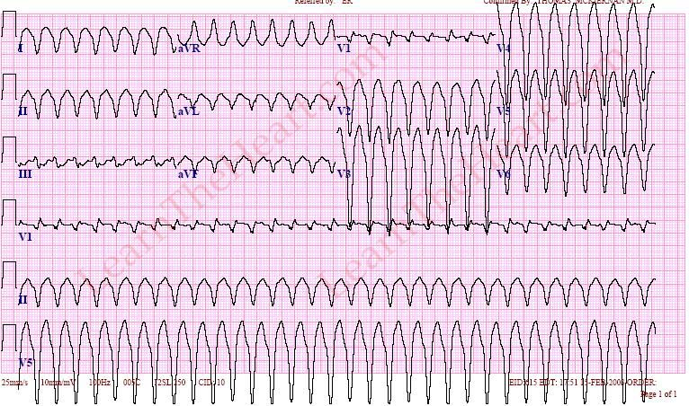
Ventricular Tachycardia
Ventricular cells fire continuously due to a looping re-entrant circuit
Rate usually regular, 100 - 250 bpm
P wave: may be absent, inverted or retrograde
QRS: complexes bizarre, > .12
Rhythm: usually regular

Slide 33
