Slide 1
Anesthesia Course
By Dr Saleha Jabali 2024
General and Peadiatric aneasthesia consultant /Al-Driyah Hospital C3
Assistant professor AlMaarefa University /college of Applied Sciences
Head of Peadiatric Anesthesia SCFHS fellowship final exam Committee/KSA
AHA PALS Instructor KSAU /NG Riyadh
AHA BLS instructor /KFMC CRESENT

Slide 2
Objectives
Related important definitions to anaesthesia speciality
What is different between general anaesthesia and regional anaesthesa
How to perform anesthesia
Pharmacology
Equipment
Complications
Important ECG

Slide 3
History of anesthesia
World Anaesthesia Day commemorates the birth of anaesthesia on 16th October 1846. When doctors at Massachusetts General Hospital demonstrated the use of ether for the first time on a patient.

Slide 4
Definition of General Anesthesia
It is reversible
Triad of unconsciousness (hypnosis),analgesia (no reflex to pain ),and muscle relaxation (no movement) .
Depress central nervous excitability through modulation of normal ion-channel function

Slide 5
Steps of GA
Induction (hypnotic, analgesia ,muscle relaxant
Maintenance
Recovery (reversal )

Slide 6
Types of induction of general anesthesia
Intravenous
Inhalational

Slide 7
Physiological changes during General anesthesia
Depress ventilatory control ,depress ventilation and muscles movement which lead to hypercapnia and hypoxemia
Loss of airway reflex and gag response because of CNS depression which may lead to aspiration of stomach contents
Patient need to immediately support his airway and start controlled ventilation
Anesthesia agent lead to depress myocardial contractility and rate which lead to hypotension and organ hypoperfusion
It lead do either direct or indirect SVR reduction which also lead to hypotension and organ injury
Patient will not move ,this may lead to body injury if not monitored and protected by anesthesiologist during surgery

Slide 8
Risks (complication) of GA
General Anesthesia (GA)
Common risks to General Anesthesia:
1- Sore throat due to gas or tube used for breathing may notice difficulty in speaking but improve with time
2 Temporary pain in the muscle
3 Hypothermia for preterm and newborns leading to a drop in blood circulation and respiratory
4- The risk of apnea in preterm infants aged less than 60 weeks, which requires the need to enter ICU

Slide 9
Uncommon risks of general anesthesia / sedation:
1. Awareness of the operating room activity during surgery such as caesarean section, cardiac operations
2. Eye contact may be accompanied by pain and may need medical treatment
3. Damage teeth, lips and tongue
4- memory dysfunction

Slide 10
Rare risks of general anesthesia that may cause brain damage, neurological disability or death:
1. Airway obstruction that cannot be controlled quickly and difficulty intubation, leading to sever lack of oxygen
2 - pulmonary aspiration causing, pneumonia,hypoxia and death,.risk is more with obesity and in pregnant women and in non-fasting patients
3-Severe allergic reactions to anesthetics and other medications may cause difficulty breathing, skin rashes,hypotension and cardiac arrest
Risks increases with elderly patients, premature infants and children under one year of age who suffer from chronic diseases such as heart disease, chest, arteries, pressure, diabetes, liver and kidney disease, smokers and obesity

Slide 11
(ASA) defines of (level of sedation /analgesia) American society of Anesthesiology
Description | Minimal Sedation | Moderate Sedation /Analgesia | Deep Sedation /Analgesia | General Anesthesia
Responsiveness | Normal response to verbal stimulation | Purposeful response to verbal or tactile stimulation | Purposeful response following repeated or painful stimulation | Unarousable even with painful stimulus
Airway | Unaffected | No intervention required | Intervention may be required | Intervention often required
Spontaneous Ventilation | Unaffected | Adequate | May by inadequate | Frequently inadequate
Cardiovascular | Unaffected | Usually maintained | Usually maintained | May be impaired

Slide 12
Thank you

Slide 13
Anesthesia related pharmacology 1

Slide 14
Intravenous Anesthetic Agents.
Intravenous Anesthetics (Hypnotic): Barbiturates, Propofol, Etomidate, Ketamine.
Opioids.
Neuromuscular blocking drugs. .

Slide 15
Barbiturates
Thiopental
Primary Use:Induction of anesthesia
Mechanism of action
Facilitate inhibitory neurotransmission by enhancing GABAA receptor function.
Pharmacokinetics
Metabolism and elimination is hepatic. Multiple doses or prolonged infusions may produce prolonged sedation or unconsciousness

Slide 16
Barbiturates
Pharmacodynamics
CNS
Dose-dependent CNS depression. ↓ in (CMRO2) cause ↓ in ICP and (CBF).
Cardiovascular system
Depress myocardial contractility, leading to dose-dependent ↓ in BP
Respiratory system
Laryngeal reflexes remain more intact compared to propofol so higher incidence of cough and laryngospasm.
Dose dependent histamine release. contraindicated in asthmatic patient

Slide 17
Barbiturates
.
Advantages:
Rapid onset & short duration ; due to redistributed from brain to muscle resulting in return of consciousness.
It has potent anticonvulsant properties.

Slide 18
PROPOFOL (2, 6- diisopropylphenol)
It is the most widely used induction hypnotic agent.
Mechanism of action
Facilitates inhibitory neurotransmission by enhancing the function (GABAA) receptors in CNS .
Pharmacokinetics
Hepatic and extrahepatic metabolism leads to inactive metabolites which are excreted by renal route .

Slide 19
PROPOFOL (2, 6- diisopropylphenol)
Pharmacodynamics
CNS
Induction : rapid onset of unconsciousness (30 to 45 seconds), followed by a rapid termination of effect by redistribution,
Cardiovascular System
Dose-dependent ↓ in preload, afterload, and contractility lead to ↓ in (BP) and COP.

Slide 20
PROPOFOL (2, 6- diisopropylphenol)
Respiratory system
Dose-dependent decrease in (RR) and (TV).
↓Ventilatory response to hypoxia and hypercarbia

Slide 21
PROPOFOL (2, 6- diisopropylphenol)
Advantages:
Antiemetic properties.
Suitable for day case surgery
Situations where volatile anesthetics cannot be used (MH,
No histamin release
--

Slide 22
Etomidate
It is a carboxylated imidazole.
Mechanism of action
Facilitates inhibitory neurotransmission by enhancing the function (GABAA) receptors.
Pharmacokinetics
Effects of a single bolus dose are terminated by
redistribution.

Slide 23
Etomidate
Primary Uses
Induction of anesthesia in patients with cardiovascular problems.

Slide 24
Etomidate
Advantages
Short acting and potent, with CVS and RS stability, suitable for elderly and shocked patients.
Adverse effects
Cause Nausea and vomiting .
Adrenal suppression,.
A single dose suppresses adrenal steroid synthesis
No analgesic properties.

Slide 25
Ketamine
It is phencyclidine derivative causing ‘dissociative anesthesia’
Mechanism of action
Mainly attributed to noncompetitive antagonism of NMDA receptors in the CNS
Pharmacokinetics
Unconsciousness in 30 to 60 s after an IV.
Terminated by redistribution in 15 to 20 minutes.

Slide 26
Ketamine
Primary Uses
Induction of general anesthesia.
analgesia.
Advantages
CVS stability makes it suitable for shocked patients.
Preservation of airway reflexes & less respiratory depression
Potent bronchodilator .
Adverse effects
↑ HR, and BP not good for hypertensive patient
↑ salivation, PONV.agitation & hallucinations.
Contraindicated in patients with head trauma.

Slide 27
Benzodiazepines
Mechanism of action
Enhance inhibitory neurotransmission by increasing the affinity of GABAA receptors for GABA.
Pharmacokinetics
Effects are terminated by redistribution.
Pharmacodynamics
Amnestic, anticonvulsant, anxiolytic, and sedative-hypnotic (dose-dependent manner).
No analgesia.

Slide 28
Flumazenil
A competitive antagonist at the benzodiazepine binding site of GABAA receptors in the CNS.

Slide 29
Opioids
Opioids produce moderate sedation and profound analgesia.
Fentanyl, Sufentanil, Alfentanil, Remifentanil, Meperidine, Morphine.
Mechanism of action
They exert their effects by binding with opioid receptors

Slide 30
Adverse effects
Miosis
Nausea & vomiting,
Drowsiness or sedation
respiratory depression
Bradycardia in large doses
Itching
Urinary retention

Slide 31
Fentanyl
A potent synthetic opioid agonist with100 times, the analgesic potency of morphine.
No histamin release
Ability to maintain cardiac stability.
Sufentanil citrate (Sufenta)
10 times as potent as fentanyl
Rapid elimination
Relatively more rapid recovery as compared with fentanyl.
Alfentanil
Shorter duration of action compared to fentanyl and sufentanil,

Slide 32
Remifentanil (Ultiva)
Ultra short acting and rapidly cleared
widespread metabolism by blood and tissue esterases
Morphine
May produce hypotension and bronchoconstriction as
a consequence of its histamine-releasing action.
Morphine may be a poor choice for a patient with bronchial asthma
Meperidine (pethidine)
Sympathmimatic like effect

Slide 33
Naloxone
A specific opiate receptor antagonist, binding the receptor.
Adverse effects
Reversal of analgesia
( tachycardia, hypertension, pulmonary edema, and cardiac dysrhythmias).

Slide 34

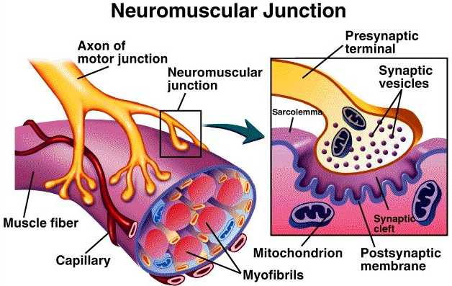
Neuromuscular blocking drugs
Primary Uses
Perform tracheal intubation.
Facilitate ventilation.
Provides optimal surgical operating conditions.

Slide 35
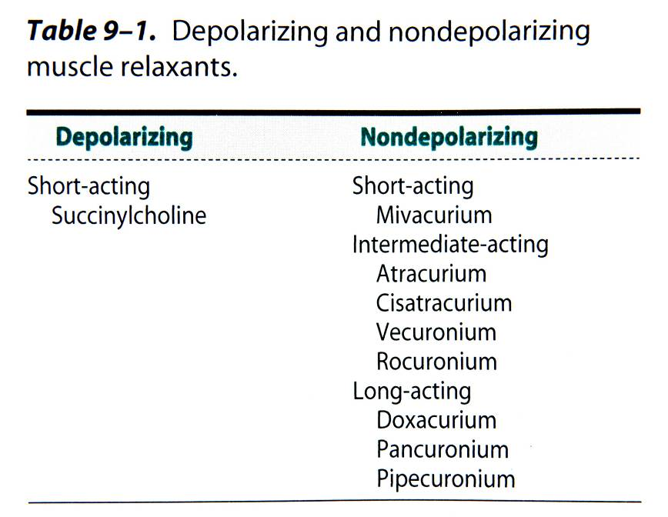
Neuromuscular blockers

Slide 36
Depolarizing (Succinycholine) Suxamethonium
Structurally similar to acetylcholine … activate the acetylcholine receptors (Ach) … depolarization of post junctional membrane.
Very short duration of action (onset 60 seconds/ duration 10 minutes)
For short time intubation (Rapid sequence induction)
Metabolized very quickly by plasma cholinesterase.
Characterized by transient muscle fasciculations followed by relaxation.
Acetylcholine esterase (AChE) inhibitors potentiate rather than reverse the block.

Slide 37
Adverse Effects
Cardiac dysrhythmias: sinus bradycardia, , and even asystole
Hyperkalemia.( burns, RF, muscular dystrophies & paraplegia)
A transient increase in intraocular pressure
Increase in intracranial & intragastic pressure.
Myalgia : abdomen, back, and neck.
Histamine release.
Dual block.
Succinylcholine apnea Low levels of plasma cholinesterase (severe liver or kidney disease)
Anaphylaxis.
Malignant hyperthermia (MH).

Slide 38
Nondepolarizing blockers
They act by competitively blocking the binding of ACh to its receptors
It is characterized by :
- Absence of fasciculations.
- Reversal by AChE inhibitors.

Slide 39
ATRACURIUM: Widely used and have an intermediate onset and duration of action.
Histamine release.
Metabolism is by ester hydrolysis in the plasma.

Slide 40
CISATRACURIUM:
Metabolism is by ester hydrolysis in the plasma
Relatively slow onset of action.
Does not release histamine.
ROCURONIUM:
Intubating conditions can be achieved in 60-90 seconds after an induction dose of 0.6 mg/Kg. Increasing the dose to 1.2 mg/kg shortens the time can be used for rapid sequence induction when Suxamethonium is contraindicated .
Histamine is not released.

Slide 41
Anticholinesterases (Neostigmine)
They inhibit the action of the acetylcholinesterase enzyme at the NMJ by increasing the concentration of Ach at NMJ.
Clinical tests of adequate resolution of neuromuscular block include the ability to lift the head from the bed for 5 seconds.
Intravenous injection at a dose of 0.05 mg/kg (maximum 5mg).
To minimize adverse effects such as bradycardia, miosis, GI upset, nausea, bronchospasm, increased sweating, salivation & bronchial secretions, an an antimuscarinic such as glycopyrronium 0.01 mg/kg or atropine 0.02 mg/kg must be administered along with the anticholinesterase.

Slide 42
Sugammadex sodium
Selective reversal of neuromuscular blockade (NMB) induced by rocuronium or vecuronium in adults undergoing surgery
Can be used in pediatric

Slide 43
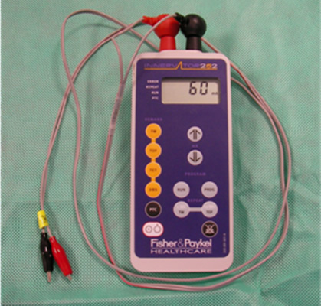
Peripheral nerve stimulator
Check the depth of neuromuscular blockade
Determine that neuromuscular blockade is reversed
At least 3 twitches on a train of four should be detected before attempting reversal.

Slide 44
General Anesthesia related pharmacology 2

Slide 45
Inhalational Anesthetics

Slide 46
Characteristics of the ideal inhaled anesthetic agent:
- Non - toxic, non-.allergenic, non - irritant.
- Stable in storage, non – flammable & no extra specialist equipment required.
- Low solubility in blood and tissues.
- Resistance to physical and metabolic degradation.
- Analgesic.
- CVS stable.
- No respiratory depression.
- Environmentally inert.
- No reaction to soda lime/ breathing circuit.
- Not a malignant hyperthermia (MH) trigger.

Slide 47
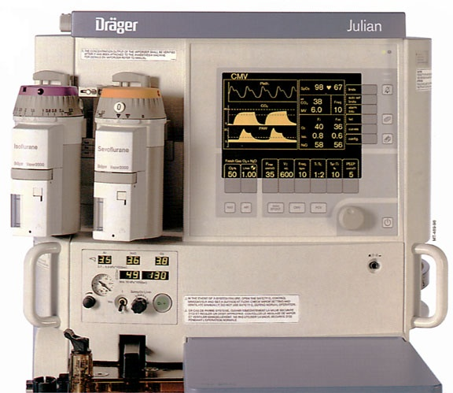
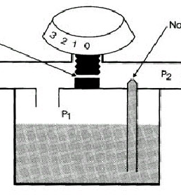
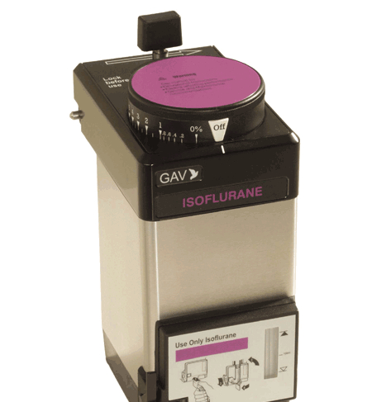
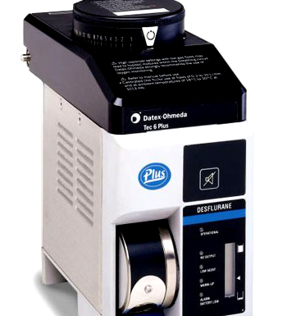
Volatile anesthetics
Present as liquids at room temperature and pressure.
Vaporized into gases for administration

Slide 48
The minimum alveolar concentration (MAC)
‘ The amount of vapour (%) needed to render 50% of spontaneously breathing patients unresponsive to a standard painful surgical stimulus.’
Halothane, isoflurane, sevoflurane, and desflurane are 0.75%, 1.15%, 1.85%, and 6.0% at one atmosphere.

Slide 49
Mechanism of action
Various ion channels in the CNS involved in synaptic transmission (including GABA_{A}, glycine, and glutamate receptors) may play a role.
Pharmacokinetics
The higher the vapor pressure, the more volatile the anesthetic.
Blood solubility determines the speed of build-up / elimination from blood / brain
Lower blood solubility means (faster induction/recovery)
Inspired air → Alveolar air → Blood → Brain
Metabolism: hepatic .
Exhalation:This is the predominant route of elimination:

Slide 50
Pharmacodynamics
CNS
Unconsciousness and amnesia . ↑ cerebral blood flow (CBF).
Respiratory System
Dose-dependent respiratory depression
Airway irritation and, during light levels of anesthesia, may precipitate coughing, laryngospasm, or bronchospasm (sevoflurane makes it more suitable )
Bronchodilator (with the exception of desflurane).
Inhibit hypoxic pulmonary vasoconstriction.
Renal system.
↓ renal blood flow .

Slide 51
Cardiovascular System
Myocardial depression & systemic vasodilation.
HR tends to be unchanged, except desflurane
Sensitize the myocardium to the arrhythmogenic effects of catecholamines.
Neuromuscular system
Dose-dependent ↓ in skeletal muscle tone.
May precipitate malignant hyperthermia … A dramatic increase in body temperature, acidosis, electrolyte imbalance and shock.
Management is removal of triggering agent, 100% Oxygen,
active cooling measures & Dantrolene (1 to 10 mg/kg)
Hepatic System
↓ hepatic perfusion.

Slide 52
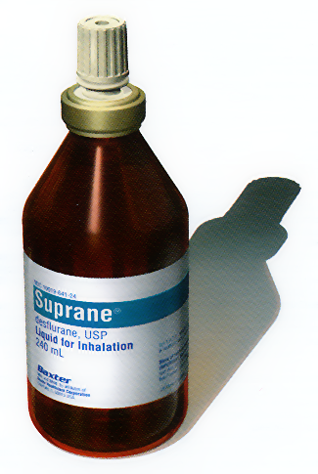
Desflurane
Advantages
Rapid onset and recovery of anesthesia
(outpatient procedures)
One of least metabolized to toxic byproducts
Disadvantages
Requires a special vaporizer
Pungent and irritating to the airway (leading to more coughing, laryngospasm)
High inspired gas concentrations lead to a significant ↑ in the patient’s BP & HR.

Slide 53
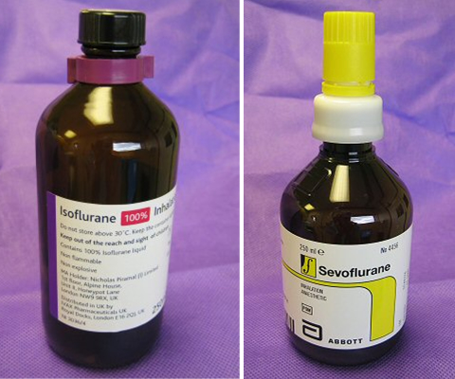
Sevoflurane
Advantages
Low solubility in blood-- produces rapid induction and emergence
Pleasant smelling (suitable for children)
Has good bronchodilating properties
Agent of choice in asthma, bronchitis, and COPD.
It has little effect on the heart rate.
Mild respiratory and cardiac suppression
Disadvantages
Carbon dioxide absorbents in anesthesia machines degrade sevoflurane to Compound A

Slide 54
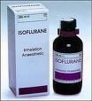
Isoflurane:
Advantages:
It causes peripheral vasodilation and increased coronary blood flow .
Disadvantages:
Moderate solubility, so recovery from anesthesia may be delayed
Isoflurane can make the heart “more sensitive” to circulating catecholamines (like epinephrine).

Slide 55
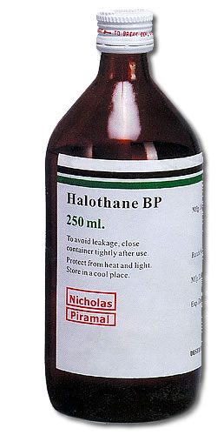
Halothane
Used for induction in children (sweet pleasant odor);
Sensitize the myocardium to the arrhythmogenic effects of catecholamines.
Blood pressure usually falls.
Very soluble in blood and adipose tissue
Prolonged emergence
“Halothane hepatitis” (rare).

Slide 56
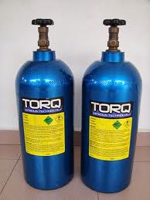
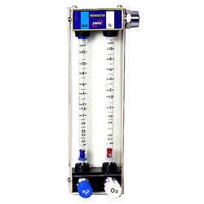
Nitrous Oxide
MAC is 104% at one atmosphere
CNS
Antagonism of NMDA receptors in CNS. Weak anesthetic, produce analgesia.
Usually combined with other anesthetics.
Used alone e.g. dental procedures.
Cardiovascular system Mild myocardial depressant & a mild sympathetic stimulant. HR and BP are usually unchanged. ↑ pulmonary vascular resistance. Respiratory system
Little effect on respiration

Slide 57
Nausea/vomiting.
Risk of bone marrow depression
Inhibits vitamin B-12 metabolism
Expansion of closed gas spaces. Nitrous oxide is 35 times more soluble in blood than nitrogen. Contraindicated in (e.g. air embolus, pneumothorax, Middle Ear Surgery etc)
Diffuse into the cuff of ETT.
Diffusion hypoxia. After discontinuation, its rapid elimination from the blood into the lung may lead to a low partial pressure of oxygen in the alveoli.

Slide 58
Thank You

Slide 59
Local Anesthesia related pharmacology 3

Slide 60
Local anesthetics (LAs)

Slide 61
Local anesthetics
LAs are drugs which reversibly prevent the transmission of pain
stimuli locally at their site of administration.
Mechanism of action
Reversibly blocking sodium channels to prevent depolarization
Lipid solubility: potency, plasma protein binding determines, duration of action of local anesthetics.
Addition of vasoconstrictor:
Prolongation of anesthetic action, decreased risk of toxicity and decrease in bleeding from surgical manipulation.

Slide 62
1. Esters (metabolized by plasma cholinesterase)
Cocaine (out of date)
Benzocaine
Procaine
Tertracaine
2. Amides (metabolized by cytochrome p-450)
Lidocaine
Bupivacaine
Mepivacaine
Prilocaine
Ropivacaine

Slide 63
Applications of local anesthesia
Nerve block: (e.g., dental and other minor surgical procedures)
Topical application: To skin for analgesia (e.g., benzocaine) or mucous membranes (for diagnostic procedures)
Spinal & epidural anesthesia:
Local infiltration: At end of surgery to produce long-lasting post-surgical analgesia (reduces need for narcotics)
I/V: For control of cardiac arrhythmias (e.g., lidocaine for ventricular arrhythmias)

Slide 64
Choice of local anesthetics
Onset
Duration
Sensory vs. motor block
Potential for toxicity

Slide 65
LIDOCAINE: The most commonly used amide type local anesthetic.
Rapid onset and a duration of 60-75 minutes, extended with epinephrine for up to 2 hours.
Metabolized in the liver and excreted by the kidneys.
Contraindicated in patients with a known sensitivity.
Has also antiarrhythmic action.
BUPIVACAINE: Onset of action is slower than lidocaine and anesthesia is long acting - 2-4 hours, extended with epinephrine for up to 7 hours.
More cardio-toxic than lidocaine, difficult to treat.
Metabolized in the liver and excreted by the kidneys
Contraindication: known hypersensitivity

Slide 66
ROPIVACAINE: Less toxic, long-lasting LA.
Undergoes extensive hepatic metabolism, with only 1% of the drug eliminated unchanged in the urine.
Ropivacaine is slightly less potent than bupivacaine.
Local Anesthetic Toxicity
CNS: Initially circumoral numbness, dizziness, tinnitus, visual change. Later drowsiness, disorientation, slurred speech, loss of consciousness, convulsions & finally respiratory depression
Cardiovascular System: Myocardial depression and vasodilation-- hypotension and circulatory collapse
Allergic reactions: rare (less than 1%) rash, bronchospasm

Slide 67
Prevention and Treatment of Toxicity
All Cases: Assure adequate ventilation & administer supplemental Oxygen.
Seizures: Midazolam
Hypotension: Trendelenburg position (head down , legs up),
IV fluid bolus (Isotonic Saline or LR),
Vasopressor (Dopamine if refractory to above).
Dysrhythmias: As per ACLS protocol (but do not administer further Lidocaine)

Slide 68
Adjunct to local anesthesia for neuraxial block
Adrenalin
Opioid
Alpha 2 agonist (clonidine)
Ketamin
Neostigmine
Steroid
All must be preservative free

Slide 69
Thank You

