Slide 1
SPINAL ANATOMY
By Dr Saleha Jabali 2023

Slide 2
The structure of the spina provides stability , protection of spinal cord ,and weight -bearing movement in the upright posture .
The spine consist of vertebra which are 33 in number ,being divided by structural similarity in to cervical (7) , thoracic (12) , lumber(5) , sacral (5),and coccygeal regions (4) .
Each vertebra consist of the same structure :body ,transverse process, spinous process ,lamina and pedicles

Slide 3
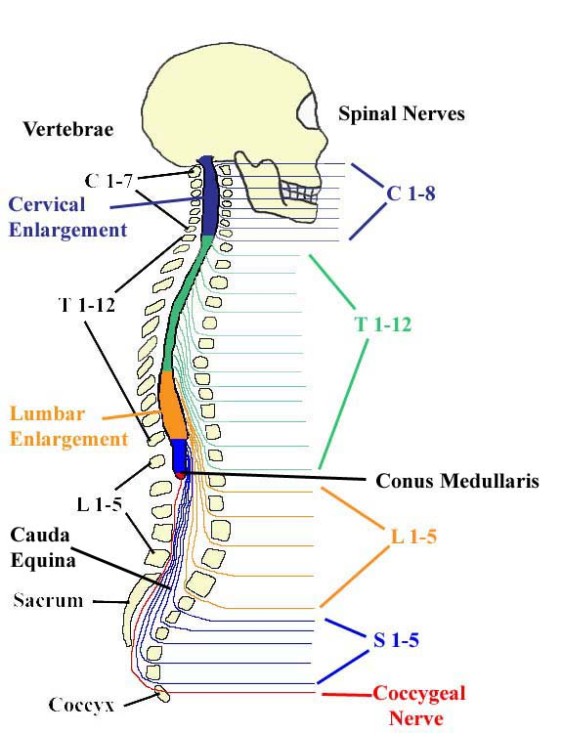
Spinal columen vertebra and spinal cord segments

Slide 4
The spinal cord is located within the spinal canal which is created by bony vertebra structures and ligamentous network and that canal will provide stability and protection for the spinal cord which is extending from foramen magnum to approximately the 1st or 2nd lumber (L1-L2) vertebral inter-space in adults. It ends called conus medullaris
Fibrous band extend from conus medullaris to fix the spinal cord to the coccyx
The tissues surrounding the spinal cord are called meninges ,the outer most area called epidural space ,the next layer is the dura mater which is a tube that contain cerebrospinal fluid and it is may extend up to S1 level in adult and S3 in infant
.

Slide 5
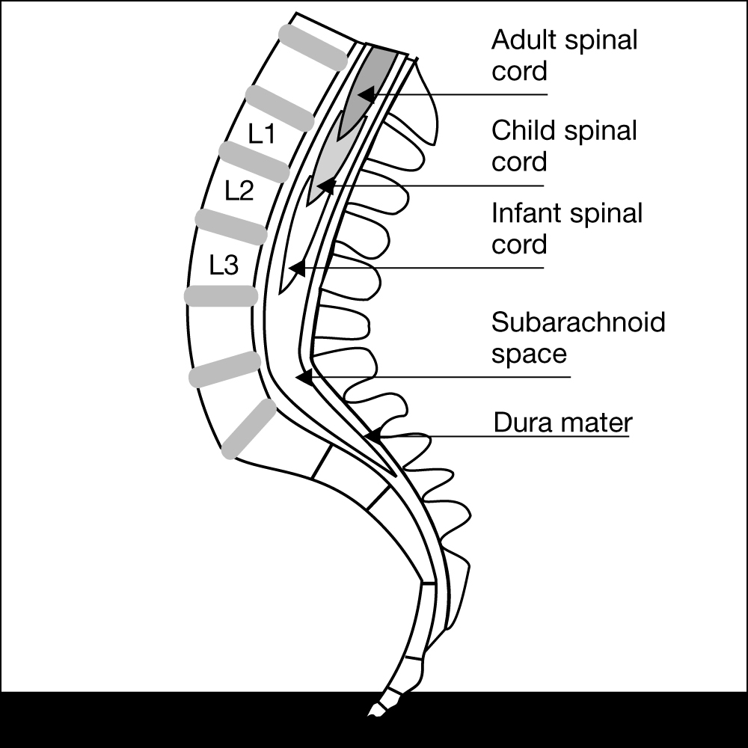
Termination of Spinal Cord
adults usually ends at L1.
Infants L3
There are anatomical variations. For most adults it is generally safe to place a spinal needle below L2

Slide 6
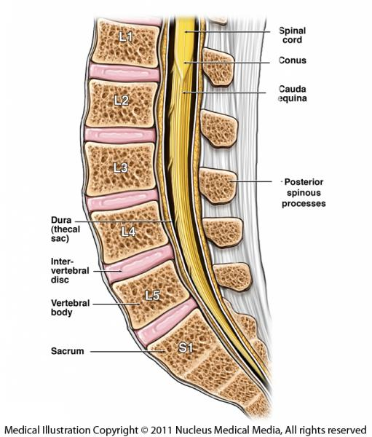

Slide 7
There are 31 pairs of spinal nerves , named and numbered according to the region and level of the spinal cord from which they emerge .
all spinal nerves are mixed( motor and sensory ) except C1 . At each vertebral body , nerve roots exit from the spinal cord bilaterally , specific skin area ( DERMATOME) are innervated by single or group of spinal nerves
Assessing the dermatomes assists in determining the region of the block ( numbness) .

Slide 8
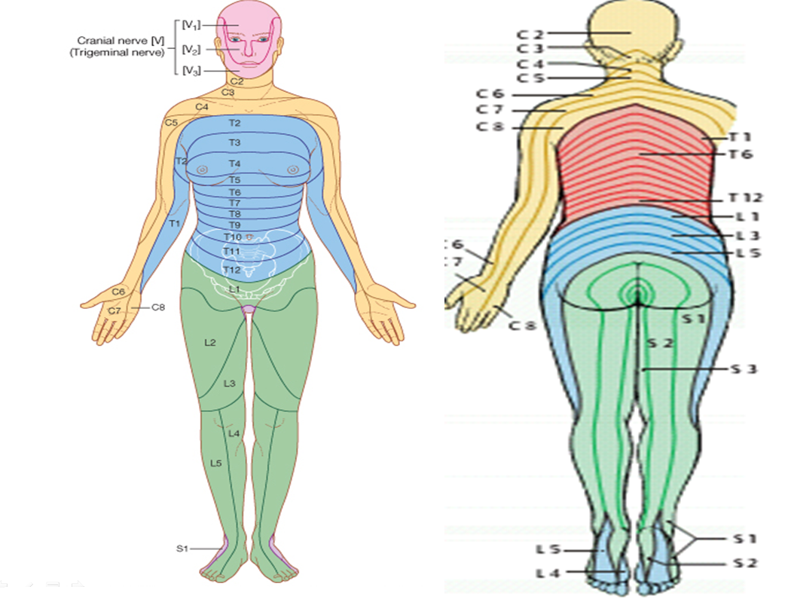
Dermatome map

Slide 9
Important dermatomes and anatomical land marks:
L1-L2 front of thigh
T10 Umbilicus
T 6 Xyphisternum
T4 Nipple
C6 thumb ,C7 middle fingers , C8little finger

Slide 10
Note
To avoid complication the level of the block should be at T4 and no numbness on the upper limbs or fingers

Slide 11
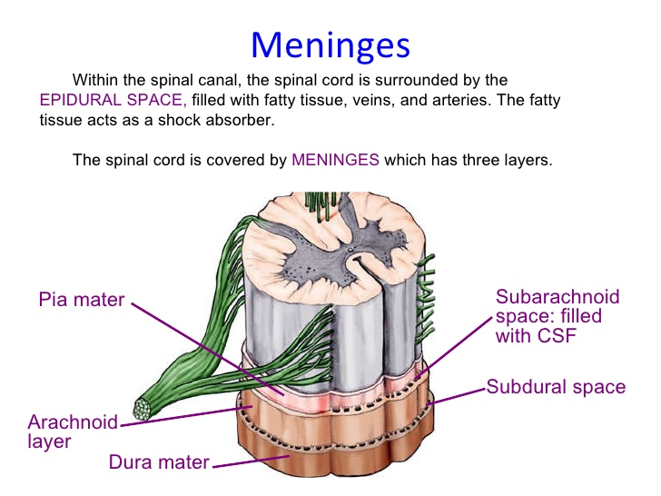

Slide 12
Note
** *Epidural anesthesia : means administration of medication(high dose and volume of local anesthetic ) into the epidural space ( extradural) .
* Spinal (intrathecal ) anesthesia : means administration of medication (small dose and volume of local anesthetic ) into the subarachnoid space

Slide 13
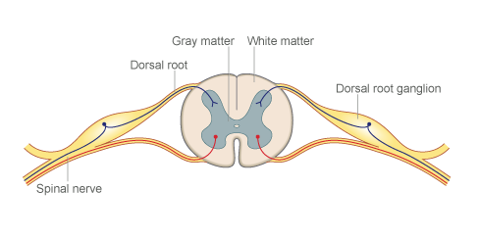
Local anesthetic blocks the pain impulse at the dorsal root ganglion (DRG) just before the pain impulse enter the spinal cord .
Local anesthetic blocks the pain impulse at the dorsal root ganglion (DRG) just before the pain impulse enter the spinal cord .

Slide 14
Thank you

Slide 15
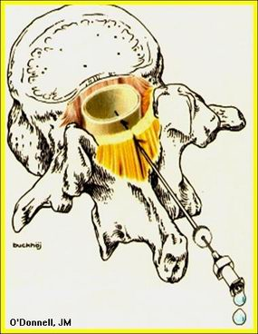
Neuraxial Blokade

Slide 16
Surface Anatomy and Landmarks

Slide 17
Locating prominent cervical and thoracic vertebrae
C2 is the first palpable vertebrae
C7 is the most prominent cervical vertebrae
With the patients arms at the side the tip of the scapula generally corresponds with T7

Slide 18
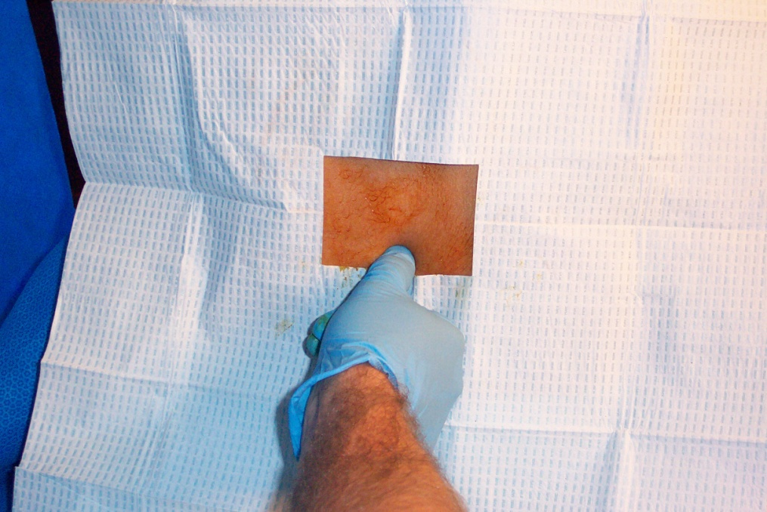
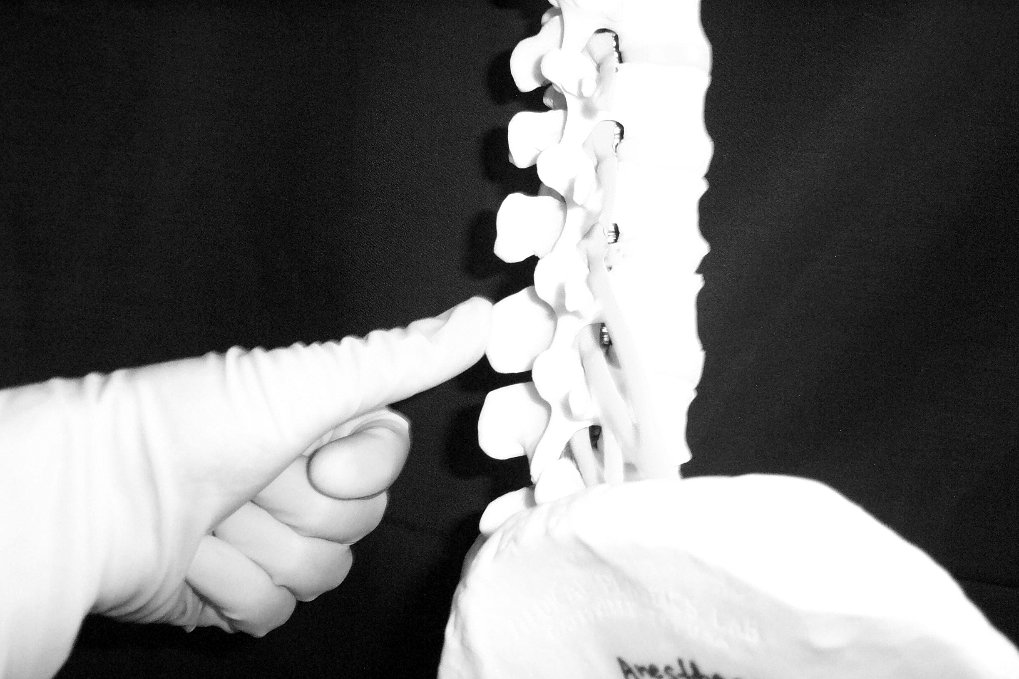
Palpation of Spinous Process

Slide 19
Spinous Processes
Generally are palpable to help identify the midline
If unable to palpate the spinous process one can look at the upper crease of the buttocks and line up the midline as long as there is no scoliosis or other deformities of the spine

Slide 20
What is Tuffier’s Line?
A line drawn between the highest points of both iliac crests will yield either the body of L4 or the L4-L5 interspace.

Slide 21
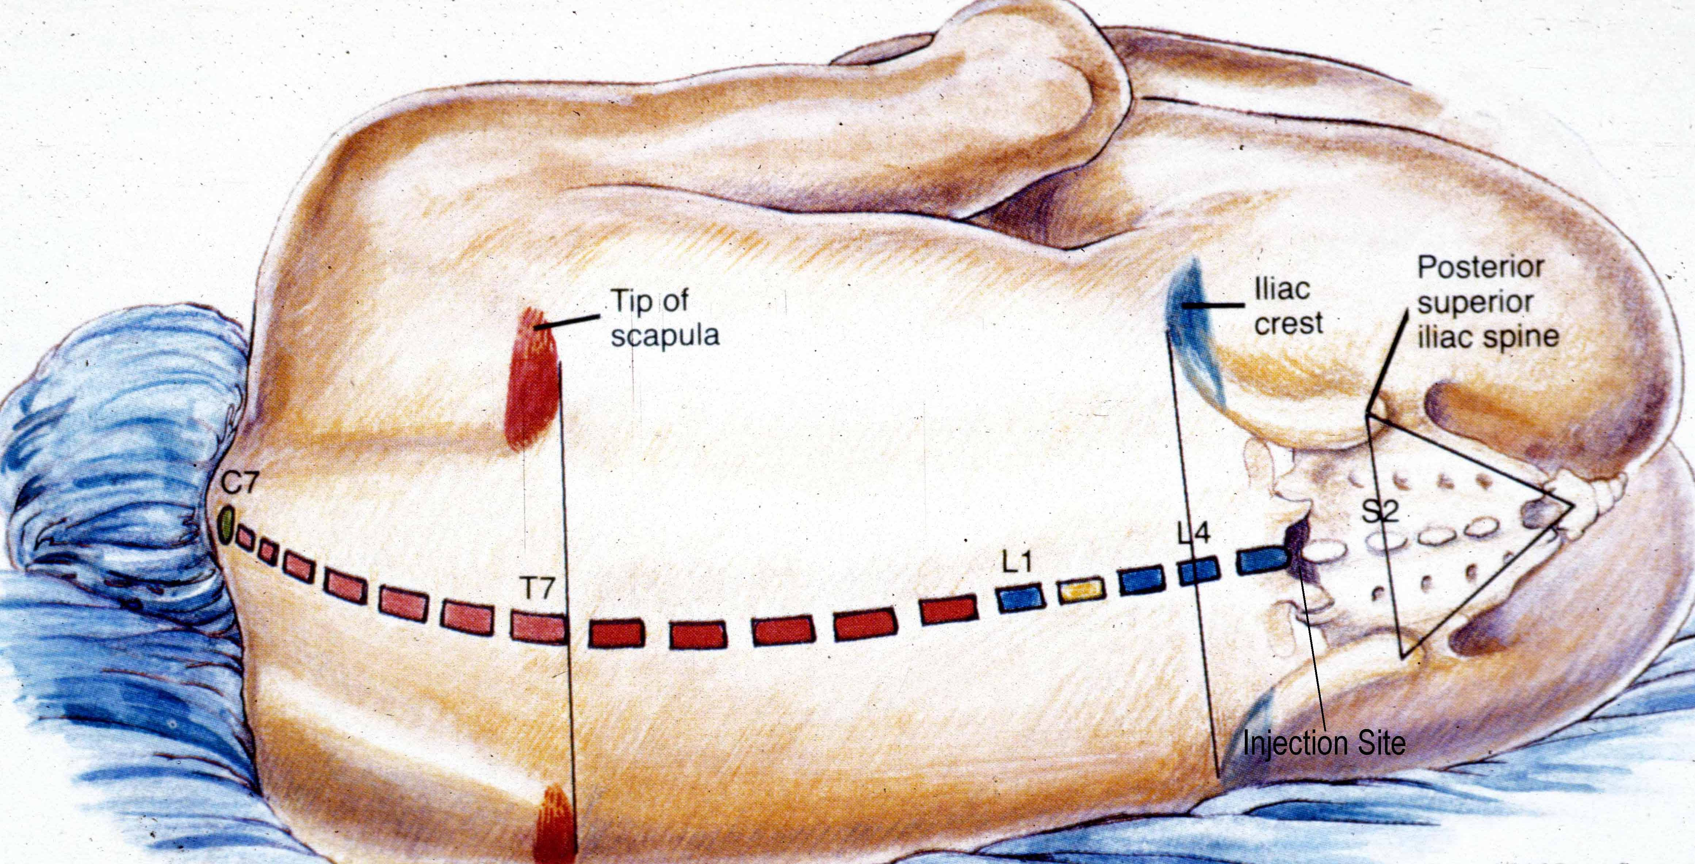

Slide 22
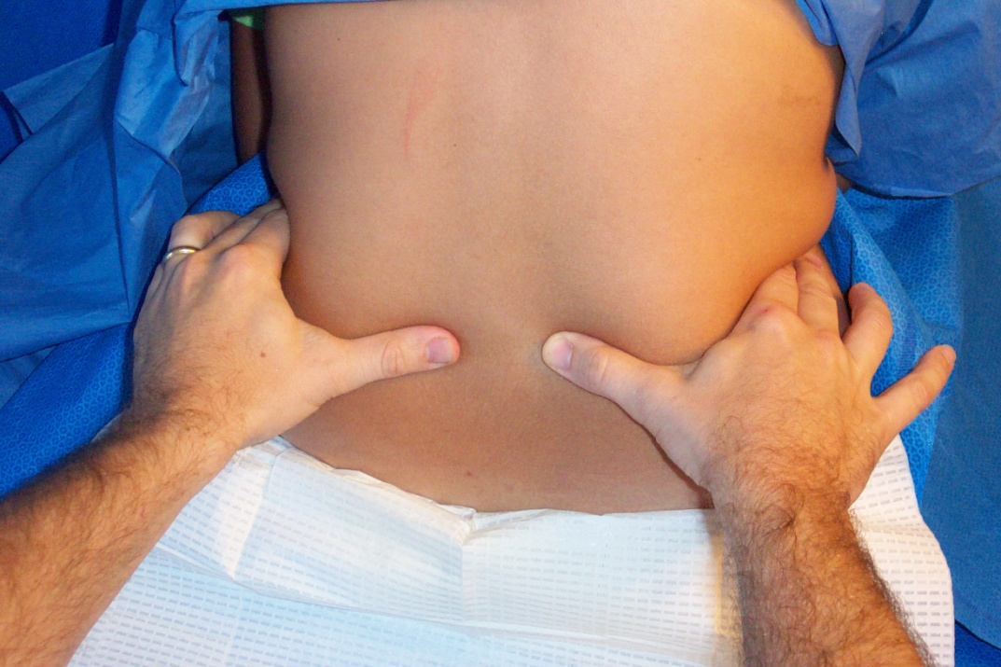
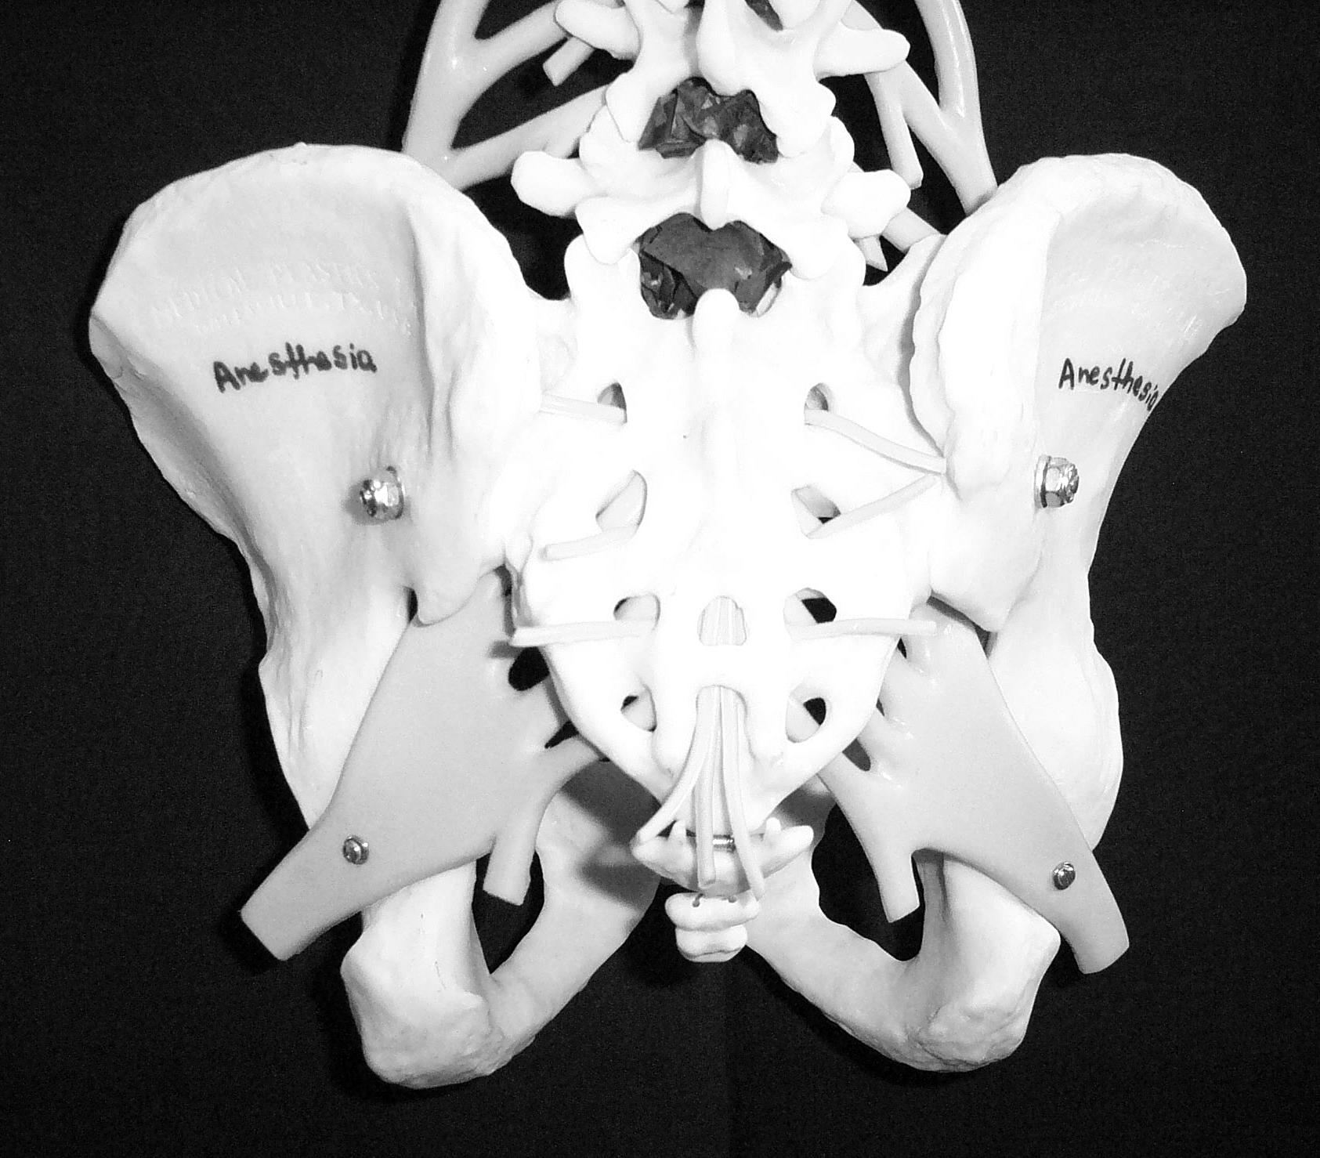

Slide 23
Anatomical Considerations of the Spinal Cord and Neuraxial Blockade.

Slide 24
The Subarachnoid Space is a continuous space that contains
CSF
Spinal cord & nerves

Slide 25
CSF
Clear fluid that fills the subarachnoid space
01
Total volume in adults is ~100-150 ml (2 ml/kg)
02
Volume found in the subarachnoid space is ~35-45 ml
03
Continually produced at a rate of 450 ml per 24 hour period replacing itself 3-4 times
04

Slide 26
CSF
Reabsorbed into the blood stream by arachnoid villi.
01
Specific gravity is between 1.003-1.007 (this will play a crucial role in the baracity of local anesthetic that one chooses)
02
CSF plays a role the patient to patient variability in relation to block height and sensory/motor regression (80% of the patient to patient variability)
03

Slide 27
Membranes that surround the spinal cord
Pia mater- highly vascular, covers the spinal cord and brain, attaches to the periosteum of the coccyx ( Filum terminalis)
1
Arachnoid mater- non vascular and attached to the dura mater. Principal barrier to the migration of medications in and out of the CSF.
2
Dura mater (“tough mother”)- extension of the cranial dura mater, extends from the foramen magnum to S2.
3

Slide 28
Epidural Space Anatomy

Slide 29
Ligamentum Flavum
Posterior to the epidural space
Extends from the foramen magnum to the sacral hiatus
Distance from skin to ligament varies from 3-8 cm in the lumbar area. It is 4 cm in 50% of the patients and 4-6 cm in 80% of the patients.
Thickness of the ligamentum flavum also varies. In the thoracic area it can range from 3-5 mm and in the lumbar it can range from 5-6 mm

Slide 30
Contents of the Epidural Space
Fat
Areolar tissue
Lymphatics
Blood vessels including the Batson venous plexus

Slide 31
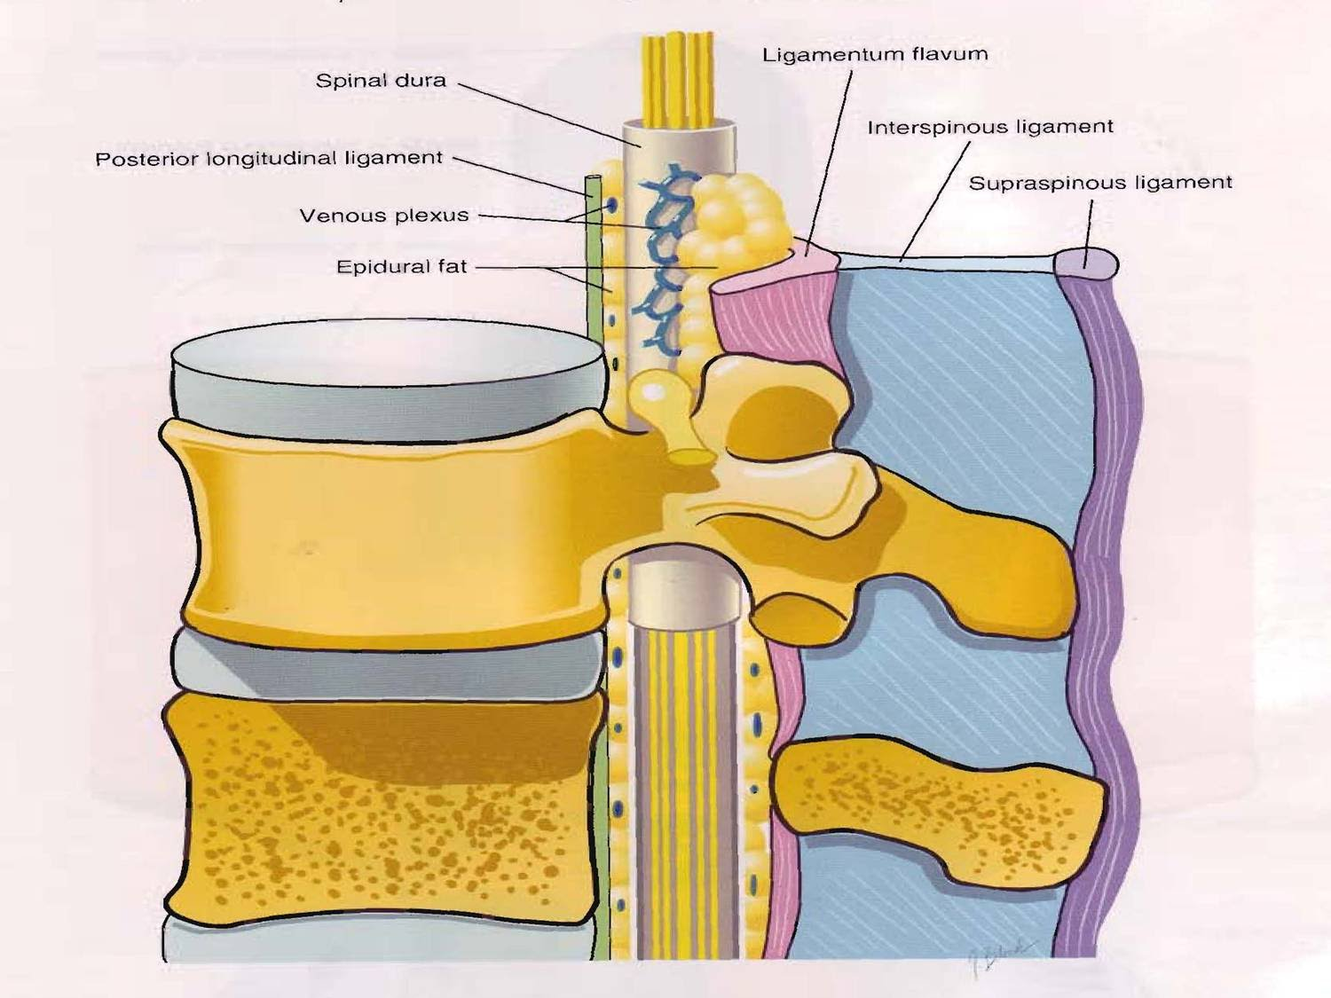

Slide 32
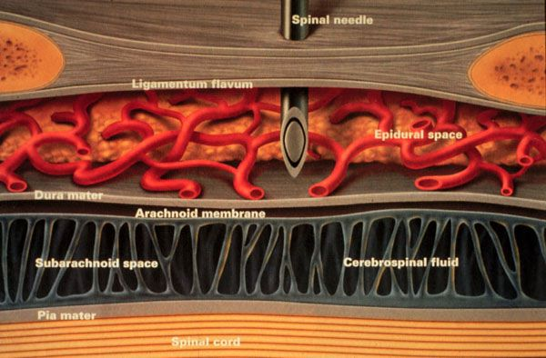

Slide 33
Definition
Spinal anesthesia :
Injection of small amounts ( 2-3 ml) of local anaesthetics into the CSF at the level below ( L2 ) ,where the spinal cord ends, anesthesia of the lower body part below the umbilicus is achieved.
Indication
Operations below the umbilicus: hernia repairs, gynaecological, urological operation, orthopedics,
Any operation on the perineum or genitalia.

Slide 34
Spinal Anesthesia
Contraindications
Refusal
Infection
Coagulopathy & anticoagulated patient
Severe hypovolemia
Increased intracranial pressure
Severe aortic or mitral stenosis

Slide 35
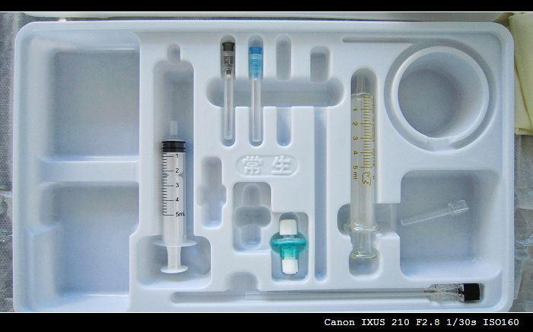
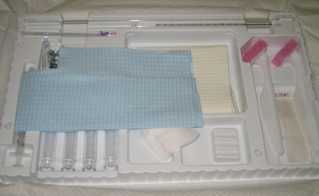
Sterility

Slide 36
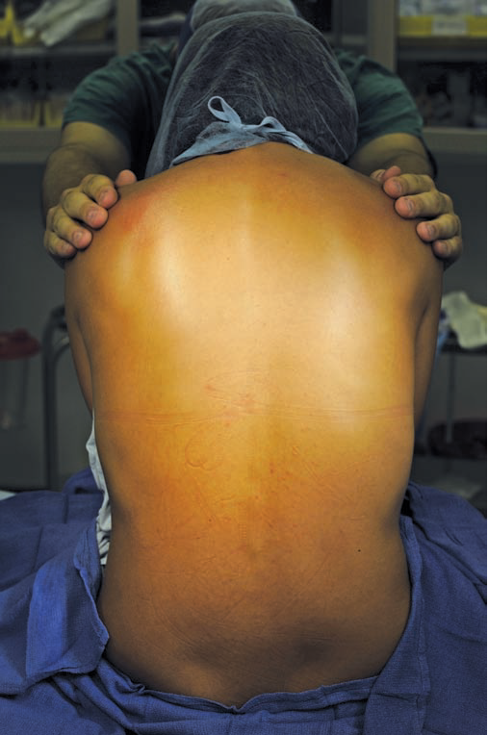
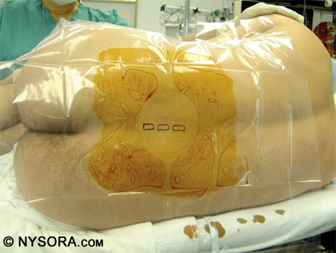
Sitting Vs. Lateral decobitus

Slide 37
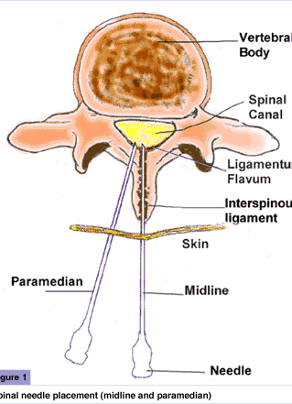
Spinal Technique
Midline Approach
Skin
Subcutaneous tissue
Supraspinous ligament
Interspinous ligament
Ligamentum flavum
Epidural space
Dura mater
Arachnoid mater
Paramedian or Lateral Approach
Same as midline excluding supraspinous & interspinous ligaments

Slide 38
PDPH
Develop 12-48 hours after spinal anesthesia.
Headache improve when lying supine.

Slide 39
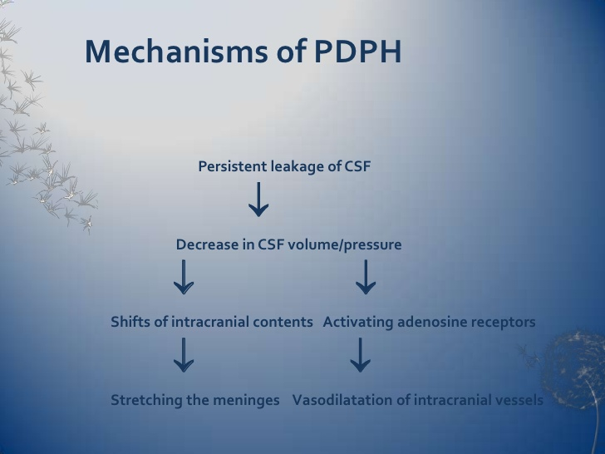

Slide 40
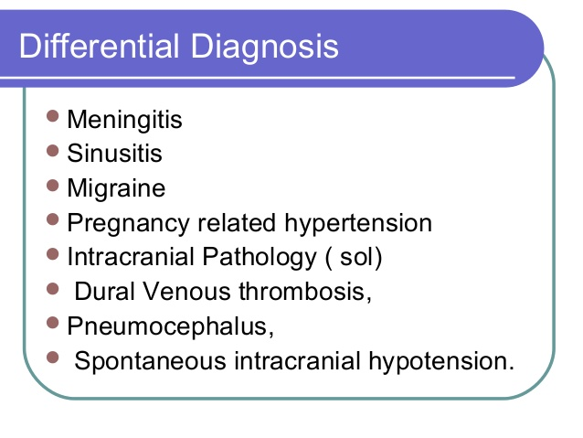

Slide 41
PDPH; Treatment
Conservative.
Epidural blood patch.

Slide 42
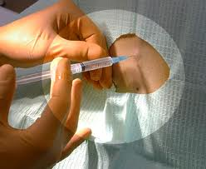
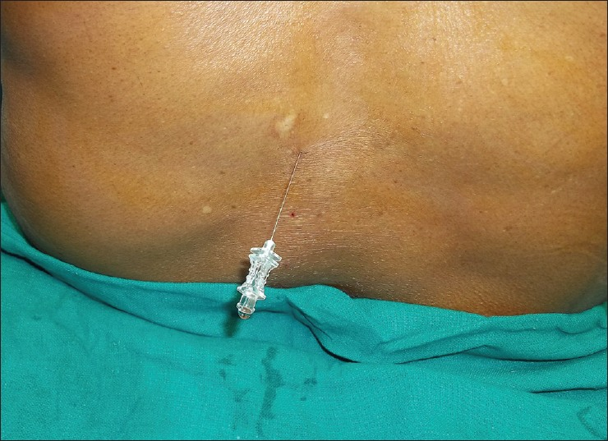
Spinal anesthesia; single shot technique

Slide 43
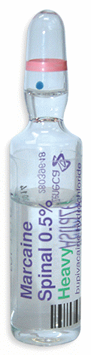
Hyperbaric bupivacaine is prepared by mixing it with dextrose
Sterile, clear
Preservative free
3 ml ampoules
See the expiry date
Be sure it is bupivacaine??

Slide 44
Sympathetic, Sensory & Motor Blockade
Spinal Injection
Sympathetic block is 2 dermatomes higher than sensory block
Motor block is 2 dermatomes lower than sensory block
Detect the sensory level by cold sensation test,
( Ice cubes).

Slide 45
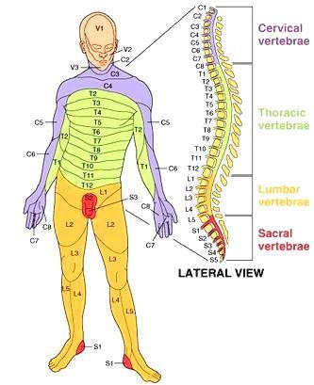
Dermatomes of the Body

Slide 46
Spinal Anesthesia
Complications
Failed block
Back pain (most common)
Spinal head ache
More common in women ages 13-40
Larger needle size increase severity
Onset typically occurs first or second day post-op
Treatment:
Bed rest
Fluids
Caffeine
Blood patch

Slide 47
Spinal Anesthesia
Complications
Epidural hematoma
Epidural abscess
Meningitis
Cauda equina
Neurological deficit
TNS
Bradycardia--- Cardiac arrest

Slide 48
Hypotension
Treatment
Best way to treat is physiologic not pharmacologic
Primary Treatment
Increase the cardiac preload
Large IV fluid bolus within 30 minutes prior to spinal placement, minimum 1 liter of crystalloids
Secondary Treatment
Pharmacologic
Ephedrine

Slide 49
EPIDURAL ANESTHESIA
EPIDURAL ANESTHESIA

Slide 50
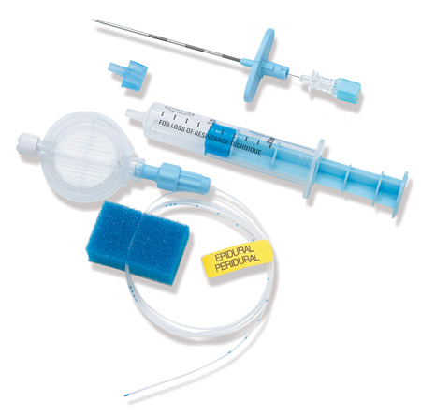
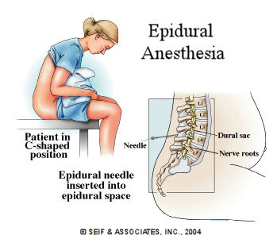
Epidural anesthesia; catheter technique

Slide 51
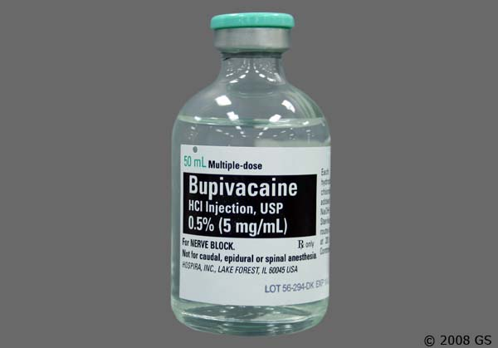
Isobaric bupivacaine (20 ml)

Slide 52
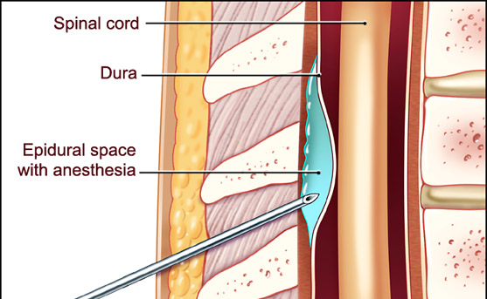
Slow onset (30 min), less dense block

Slide 53
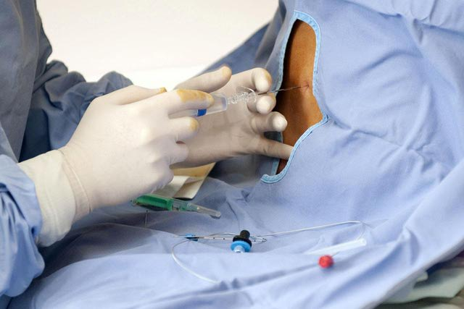
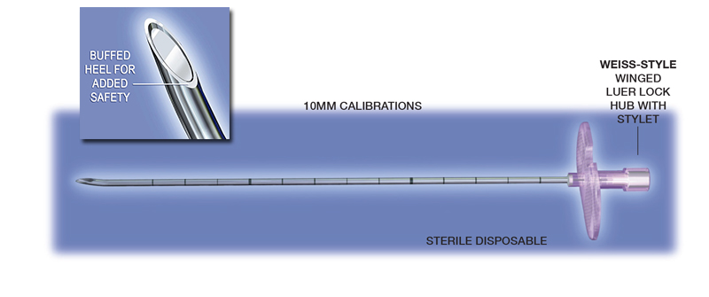
Touhy needle

Slide 54
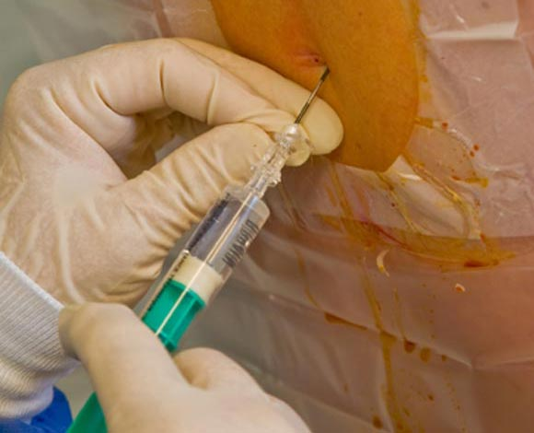
Loss of resistance technique

Slide 55
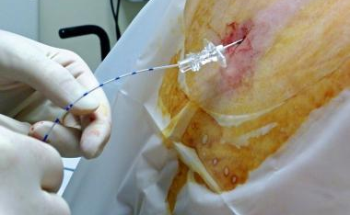
Catheter technique

Slide 56
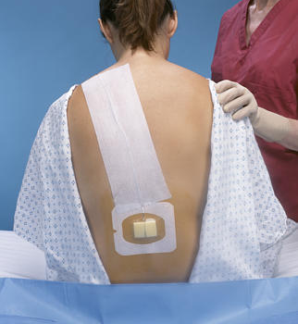


Slide 57
Peripheral nerve block

Slide 58
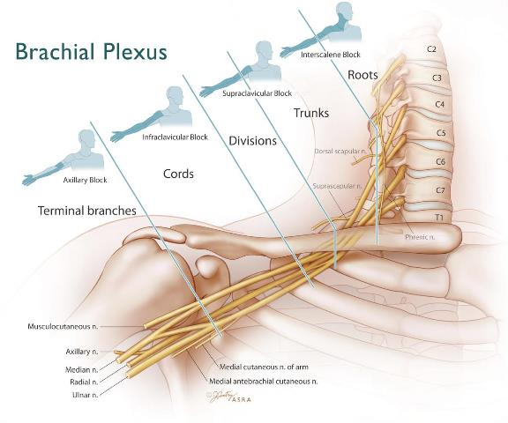
Upper limb block

Slide 59
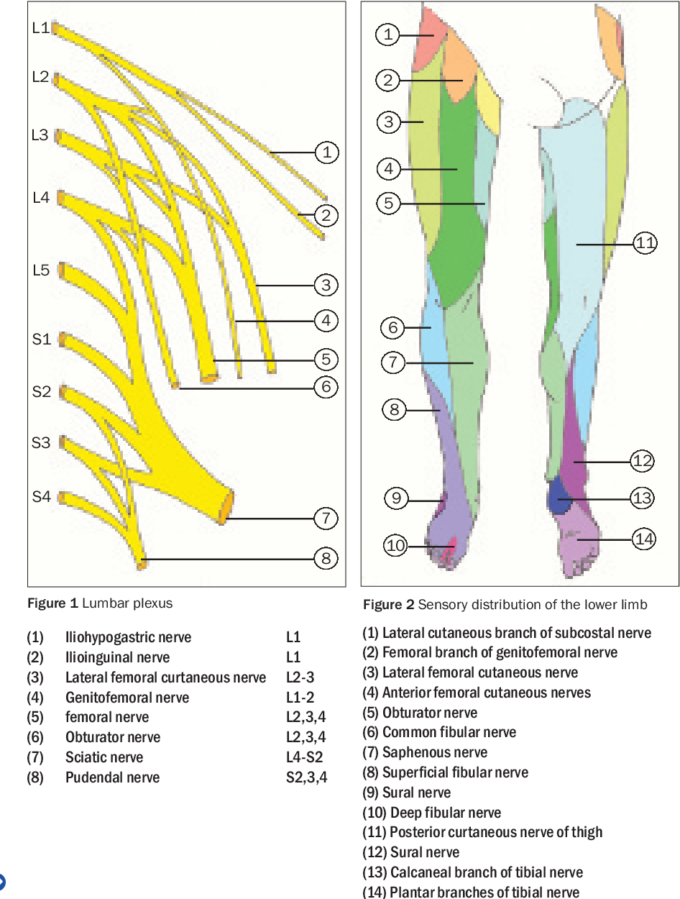
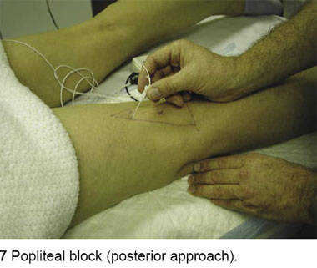
Lower limb block

Slide 60
LAST
Exceeding the maximum save dose( Bupivacaine 2mg/kg), Lidocaine (5mg/kg)
Intravascular injection

Slide 61
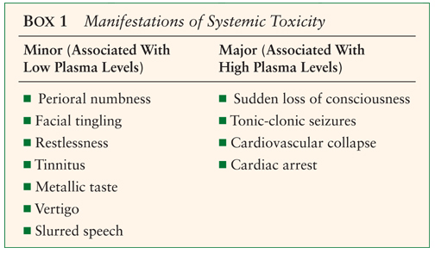
LAST(CNS)

Slide 62
LAST (CVS)
Tachycardia & Hypertension
Hypotension
Wide QRS
VF
Cardiac arrest

Slide 63
Management stop ACLS SPECIFIC 20% INTRLIPID

Slide 64
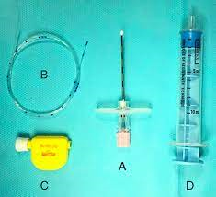
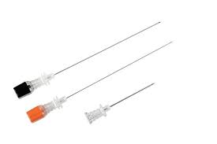
Neuraxial block needle

Slide 65
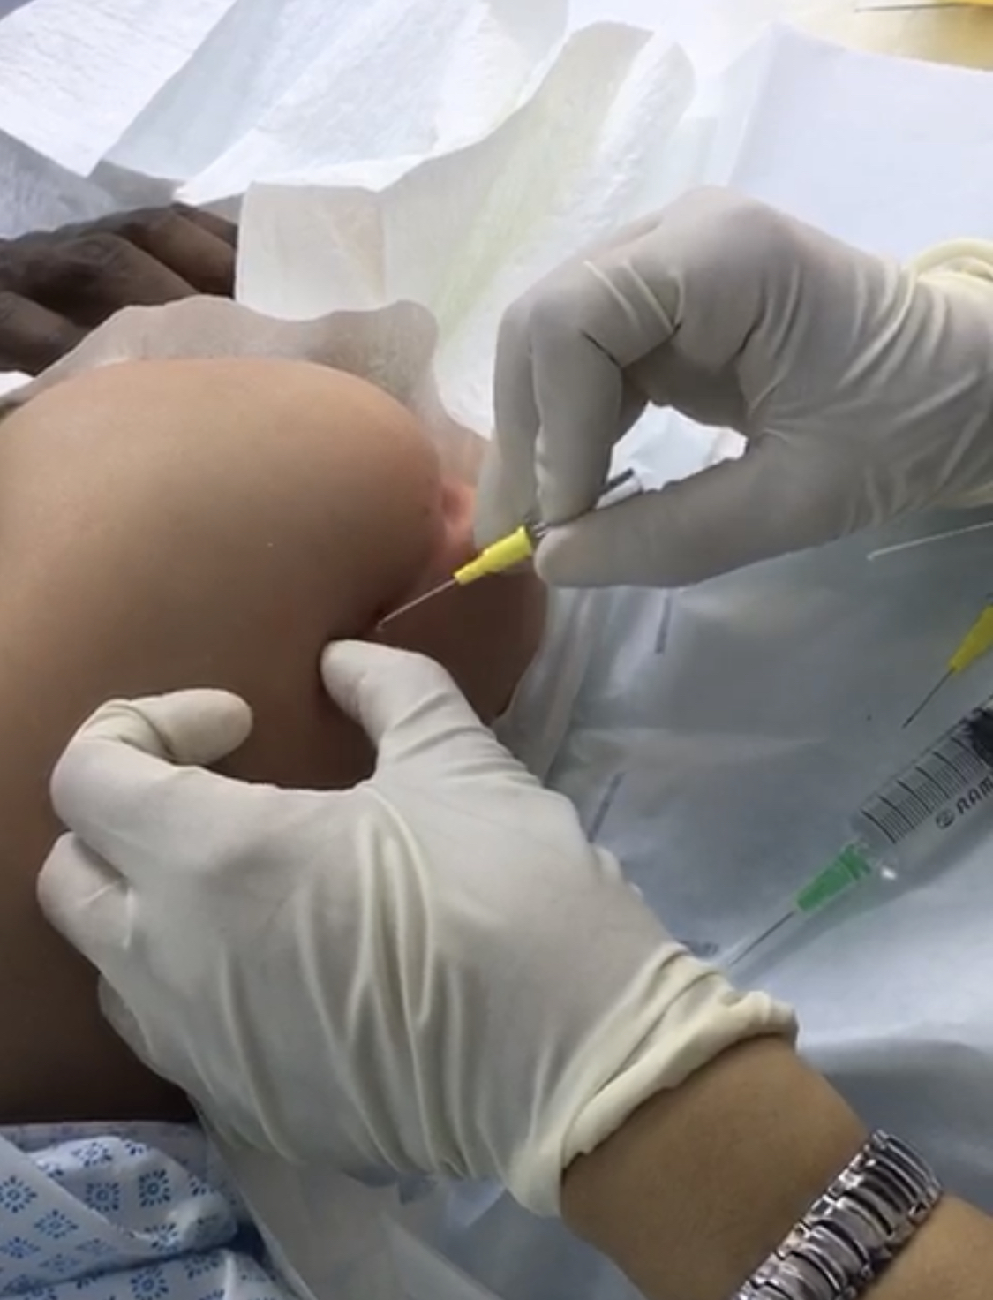
Thank you

