Slide 1
Prioperative Assessment and preparation
By Dr Saleha Jabali

Slide 2
anesthesiologists have increasingly taken on a leadership role in preoperative evaluation and preparation, well in advance of the scheduled procedure which may be up to 3 month with frequent visit and follow up with anesthesia clinic till optimization (Complex surgery , more elderly patient )
A rapid transformation in practice from hospital admission of patients the night before surgical procedures to admission on the morning of surgery.

Slide 3
Goals and Benefits of Preanesthesia Evaluation
Ensure that the patient can safely tolerate anesthesia for the planned surgery and mitigate perioperative risks such as pulmonary or cardiovascular complications.

Slide 4
Current known medical problems,
past medical issues,
previous surgeries, anesthesia types, and anesthesia-related complications .
A detial notation of diseases or symptoms such as hypertension, diabetes mellitus, ischemic heart disease, shortness of breath, or chest pain , their associated severity, stability, associated activity limitations, exacerbations (current or recent), prior treatments, and planned interventions should be clearly documented. All related diagnostic test results, interventions, should be reviewed. The patient’s responses to these initial questions may elicit further inquiry to establish a complete history.
l

Slide 5
list any allergies to medications and other substances (e.g., latex, radiographic dye),
Tobacco, alcohol, or illicit drug use must be documented.
A personal or family history of pseudocholinesterase deficiency and malignant hyperthermia
standardized general review of all organ systems should then be performed. For example, patients should be asked whether they ever had problems with their heart, lungs, kidneys, liver, and nervous system. In addition, they should be asked about any history of cancer, anemia

Slide 6
MET (functional capacity assessment )
Assessment of the patient’s cardiopulmonary fitness or functional capacity is an integral component of the preoperative clinical examination. estimate a patient’s risk for major postoperative morbidity or mortality, and to determine whether further preoperative testing is required
*One metabolic equivalent of task (MET) is the amount of oxygen consumed while sitting at rest, and is equivalent to an oxygen consumption of 3.5 mL/min/kg body weight

Slide 7
Special Issues in Preoperative Evaluation

Slide 8
MALIGNANT HYPERTHERMIA (MH)
A known history or suggestive history (e.g., hyperthermia or rigidity during anesthesia) of malignant hyperthermia in a patient or family member must be clearly documented in the preoperative assessment
Team must be informed so MH protocol must be ready
Patient are asymptomatic until they are exposed to triggering agents (Volatile & SUX).
Certain neuromuscular diseases are associated with elevated risks of MH , including some muscular dystrophies (i.e., Duchenne, Becker, myotonic),

Slide 9
Smokers and Second-Hand Smoke Exposure
-It increase risks for a range of postoperative complications, including mortality, cardiac complications, pulmonary complications, acute stroke, and surgical site infections.
-Child is a passive smoker if any at home is smoking and this will increase respiratory complication

Slide 10
Special group of patient
OLDER ADULTS
geriatric-specific risk factors such as functional and cognitive impairment are associated with poor postoperative outcomes.

Slide 11
Peadiatric
History of prematurity , low birth wight ,and neonatal intensive care admission
Gestational age(GA) less than 37 week is a premature infant and at high risk or respiratory complication (RDS) and other organ dysfunction
Post general anesthesia apnea till age of 60 week post conceptional age (GA +age after birth )
May presented with syndromes or congenital anomalies
Less than 2 year old have high vagotonic effect over symathatic system and child is heart rate cardiac output dependent ,so bradycardia is a risk

Slide 12
HTN
To identify any secondary causes of hypertension, presence of other cardiovascular risk factors (e.g., smoking, diabetes mellitus), and evidence of end-organ damage(ECG, Creatinine concentration )
Risk of cardiovascular complication is generally not evident for systolic blood pressure values less than 180 mm Hg or diastolic blood pressure values less than 110 mm Hg
long-term antihypertensive treatment should be continued up to the day of surgery, with the possible exception of angiotensin-converting enzyme inhibitors (ACEIs) and angiotensin receptor blockers (ARBs).If given within 24 hours before surgery is consistently associated with increased risks of intraoperative hypotension

Slide 13
Patient on anticoagulant
Risk of intraoperative bleeding
It is a contraindication for neuraxial blook
-Antiplatelet agent
Must be hold for 7-10 day
Exept Mini Aspirin is safe
Anti thrombotic agent
Heparin LMWH = at least 12-24 h hold
Unfractionated heparine = 2-4 h hold and check coagulation status
Warfarin = 4-5 day hold and INR must be normal

Slide 14
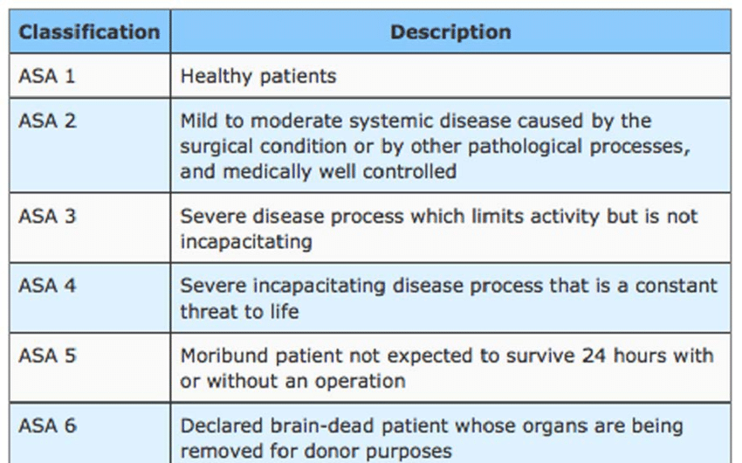
The ASA Classification is a physical status classification used to determine a patient’s risk with anaesthesia

Slide 15
Patient preparation
Informed Anesthesia consent
Fasting order pre anesthesia to reduce risk of aspiration
Blood request based on trype of surgery
Post operative care location (Day case , admission ,ICU)

Slide 16
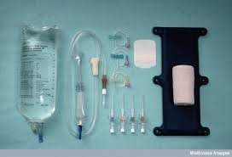
Perioperative fluid management

Slide 17
Total body water (tbw)
Varies with age and gender.
60% of body weight in males.
50% of body weight in females.
80% of body weight in infants.
Less in obese: fat contains little water.

Slide 18
Body water compartments
Intracellular water: 2/3 of TBW.
Extracellular water: 1/3 of TBW:
- Intravascular: ¼
- Extravascular: ¾

Slide 19
Electrolyte contents.
Primary ECF cation is Na
Very small contribution from K, Ca, Mg
Primary ICF cation is K
smaller contribution from Mg, Na

Slide 20
Fluid & electrolyte regulation
Volume regulation:
- Antidiuretic hormone.
- Renin/angiotensin/aldosterone system.
- Baroreceptors in carotid arteries and aorta.
- Stretch receptors in atrium and juxtaglomerular apparatus.
- Cortisol.

Slide 21
Why it is important?
The final goal is delivery of adequate oxygen to the tissues.
Factors affecting oxygen delivery includes:
- Cardiac output. ( stroke volume x heart rate )
- Hemoglobin concentration.
- Oxygen saturation.

Slide 22
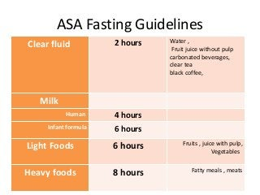
Asa FASTING guidEline
Clear liquid and water = 2 h
Brest milk= 4 h
Formula milk=6 h
Light meal = 6 h
Heavy meal = 8 h

Slide 23
Perioperative fluid requirements
Maintenance fluid requirements.
1
Fluid deficits. (NPO time and other deficits)
2
Third space losses.
3
Blood loss.
4
Special additional losses. (e.g. diarrhea)
5

Slide 24
Maintenance fluid requirements
Insensible losses such as evaporation of water from respiratory tract, sweat, feces, and urinary excretion.
Occurs continually.
” 4-2-1 Rule”:
- 4 ml/kg/hr for the first 10 kg of body weight.
- 2 ml/kg/hr for the second 10 kg of body weight.
- 1 ml/kg/hr for each subsequent kg of body weight.

Slide 25
Fluid deficits.
NPO deficit =
number of fasting hours x maintenance fluid requirement
01
Bowel prep may result in up to one liter fluid loss.
02
Measurable fluid losses. (e.g. Ostomy output, NGT suctioning, Vomitus)
03

Slide 26
Third space losses
Isotonic transfer of ECF from functional to non-functional body fluid compartments.
Depends on location and duration of surgical procedure, amount of tissue trauma, temperature.

Slide 27
Replacing third space losses
Superficial surgical intervention: 1-2 ml/kg/hr
1
Minimal surgical trauma: 3-4 ml/kg/hr ( head and neck, hernia, knee).
2
Moderate surgical trauma: 5-6 ml/kg/hr ( hysterectomy, chest surgery).
3
Sever surgical trauma: 8-10 ml/kg/hr (AAA repair, nephrectomy).
4

Slide 28
Blood loss
Every ONE ml of blood loss is replaced by THREE ml of crystalloid solution
(WHY??)
When using PRBCs or colloids: replace blood loss as volume per volume.

Slide 29
Special additional losses
Ongoing fluid losses from other sites:
- gastric drainage.
- ostomy output.
- others.
Replace as volume per volume using crystalloid solutions.

Slide 30
example
62 years old gentleman, 70 kg, going for open hemicolectomy at 08:00 am.
NPO after 22:00, received bowel prep.
Expected procedure duration is 3hrs.
Expected blood loss is 500 ml.
What are his estimated intraoperative fluid requirements?

Slide 31
example
Maintenance: Use rule 4,2,1
10kg x 4=40ml
10x2=20ml
50x1=50ml
40+20+50=110mls x 3hrs = 330mls
Fluid deficit:maintenaceXNPO hours
- NPO (110 x 10hrs = 1100mls)
- Bowel prep (1000ml)
- Total deficit = 2100mls
Third space losses: surgical trauma typexwt x surgery duration 8ml/kg/hr (8 x 70 x 3) = 1680mls
Blood loss: 1:3 role
500ml x 3 = 1500mls
Total: 330 + 2100 + 1680 + 1500 = 5610mls

Slide 32
Intravenous Fluids:
Conventional Crystalloids
Colloids
Blood/blood products and blood substitutes

Slide 33
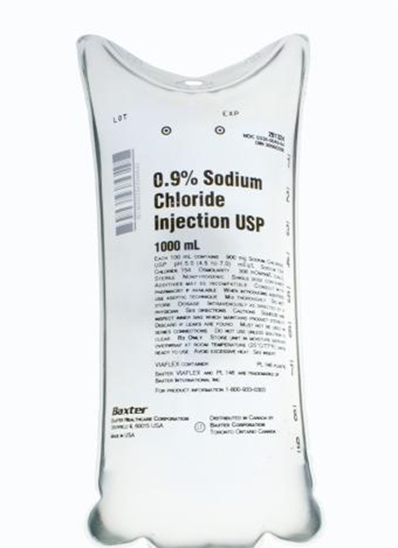
Crystalloids
Combination of water and electrolytes
  Isotonic salt solution:
  Hypotonic salt solution:
  Hypertonic salt solution

Slide 34
Crystalloids in trauma
Advantages:
-Balanced electrolyte solutions
-Buffering capacity (Lactate)
-Easy to administer
-No risk of adverse reactions
-No disturbance of hemostasis
-Promote diuresis
-Inexpensive

Slide 35
Colloids
Fluids containing molecules sufficiently large enough to prevent transfer across capillary membranes.
Solutions stay in the space into which they are infused (remain intravascular).
Examples: hetastarch (Hespan), albumin, dextran.

Slide 36
Colloids
Advantages:
-Prolonged plasma volume support
-Moderate volume needed
-minimal risk of tissue edema
-enhances microvascular flow

Slide 37
Colloids
Disadvantages:
Risk of volume overload
Adverse effect on hemostasis
Adverse effect on renal function
Anaphylactic reaction
Expensive

Slide 38
(up to 30% of blood volume can be treated with crystalloids)
If blood loss exceeds 20% of blood volume and still there is on going bleeding this will necessitate blood transfusion.
Blood volume formula
Neonate - 90 ml/kg
Infants and child - 80ml/kg
Adult male - 70ml/kg
Adult female - 60ml/kg

Slide 39
Blood Transfusion
WHY?
-Improvement of oxygen transport
-Restoration of red cell mass
-Correction of bleeding caused by platelet dysfunction
-Correction of bleeding caused by factor deficiencies

Slide 40
When is Transfusion Necessary?
“Transfusion Trigger”: Hgb level at which transfusion should be given.
  - Varies with patients and procedures

Slide 41
Oxygen Delivery
Oxygen Delivery (DO₂) is the oxygen that is delivered to the tissues
DO₂= COP x CaO₂
Cardiac Output (CO) = HR x SV
Oxygen Content (CaO₂):
  - (Hgb x 1.39)O₂ saturation + PaO₂(0.003)
  - Hgb is the main determinant of oxygen content in the blood

Slide 42
Oxygen Delivery (cont.)
Therefore: DO₂ = HR x SV x CaO₂
If HR or SV are unable to compensate, Hgb is the major determinant factor in O₂ delivery
Healthy patients have excellent compensatory mechanisms and can tolerate Hgb levels of 7 gm/dL.
Compromised patients may require Hgb levels above 10 gm/dL.

Slide 43
Blood Components
Whole blood is separated by differential centrifugation
  Packed Red Blood Cells (pRBC’s)
  Platelets
  Fresh frozen Plasma, Contain all clotting factors
  Cryoprecipitate contain factor VIII and fibrinogen
  Factor VIII
  Albumin
  Others, antibody concentrate, Plasma protein fraction

Slide 44
Packed Red Blood Cells
1 unit = 250 ml. Hct. = 70-80%.
1 unit pRBC’s raises Hgb 1 gm/dL.
Mixed with saline: LR has Calcium which may cause clotting if mixed with PRBC’s.

Slide 45
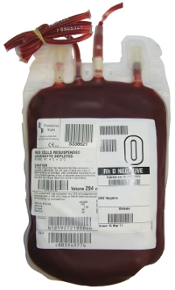
RBC Transfusions
Administration
Dose
  Usual dose of 10 cc/kg infused over 2-4 hours
  Maximum dose 15-20 cc/kg can be given to hemodynamically stable patient
Procedure
  Filter use—routinely
  Monitoring
  Do NOT mix with medications
Complications
  Rapid infusion may result in Pulmonary edema
  Transfusion Reaction

Slide 46
Transfusion Complications
Hemolytic Reactions (acute or delayed)
Febrile Reactions (FNHTR)
Allergic Reactions
TRALI
Coagulopathy with Massive transfusions
Infection

Slide 47
Complications of Blood Therapy (cont.)
Signs:
    hypotension,
    fever, chills
    dyspnea, skin flushing,
    substernal pain , Back/abdominal pain
    Oliguria Dark urine Pallor
  Signs are easily masked by general anesthesia.
  Free Hgb in plasma or urine
  Acute renal failure
  Disseminated Intravascular Coagulation (DIC)

Slide 48
Massive Blood Transfusion
Massive transfusion is generally defined as the need to transfuse one to two times the patient's blood volume. For most adult patients, that is the equivalent of 10–20 units

Slide 49
Anesthesia monitoring

Slide 50
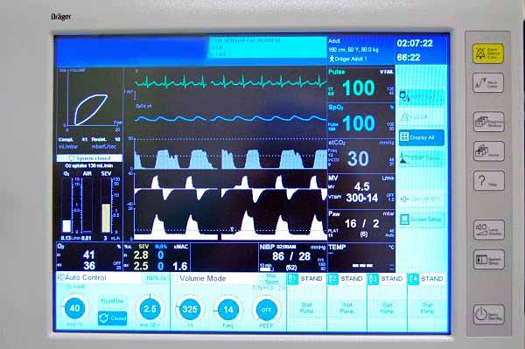

Slide 51
Patient Monitoring and Management
Involves …

Slide 52
ASA Monitoring Guidelines
STANDARD I
Qualified anesthesia personnel shall be present in the room throughout the conduct of all general anesthetics, regional anesthetics and monitored anesthesia care.

Slide 53
ASA Monitoring Guidelines
STANDARD II
During all anesthetics, the patient’s oxygenation, ventilation, circulation and temperature shall be continually evaluated.

Slide 54
Basic Monitoring equipment:
Blood Pressure,
Heart Rate, ECG
  Airway Pressure
  Capnogram
  Pulse Oximeter
Temperature
Peripheral nerve stimulator

Slide 55
Monitoring ETCO2
Confirms the movement of air in and out of the lungs
Reflect alveolar CO2
Indicate adequacy of ventilation

Slide 56
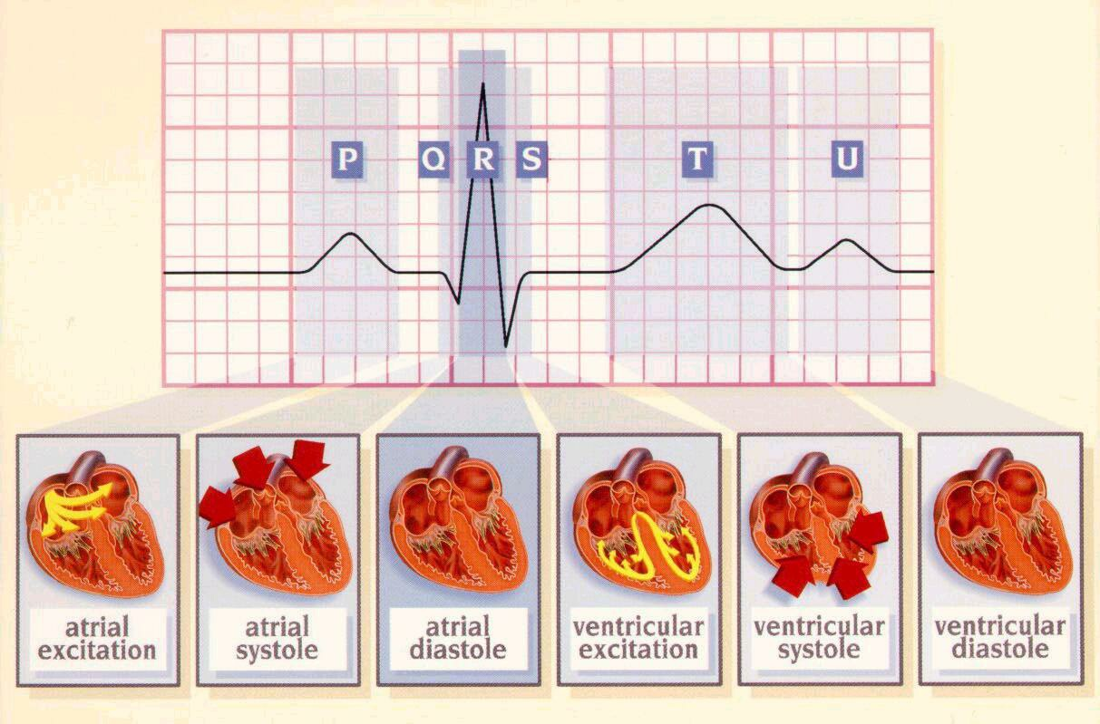
ECG
  The electrocardiogram only monitors the electrical activity of the heart and the heart rate
  Essential for diagnosis and treatment of arrhythmias .

Slide 57
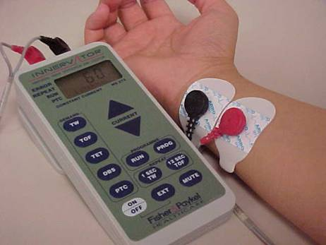
Peripheral Nerve Stimulation
Neuromuscular blockade

Slide 58
Temperature Monitoring
Indications:
Hypothermia
Hyperthermia

Slide 59
Overview of Anesthesia Machines

Slide 60
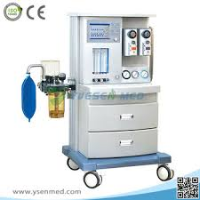
INTRODUCTION
The anesthesia machine has been developed over
time from a basic gas delivery apparatus to an
integrated system of components used to provide
a safe anesthetic.
It is the most important piece of
equipment in the operating room.

Slide 61
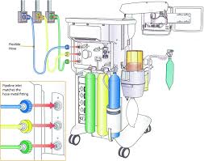
SUPPLY PIPELINE AND CYLINDER GAS
Oxygen (O2), air, and nitrous oxide (N2O) are
provided from two sources: central pipeline
supply and gas cylinders mounted on the back of the machine.

Slide 62
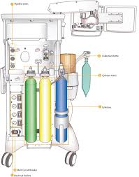
Color coding standard
Gas tanks and the pressure hoses, are color coded.
The US color-coding standard differs from some colors used internationally;
O2= green
Air = yellow
N2O = blue

Slide 63
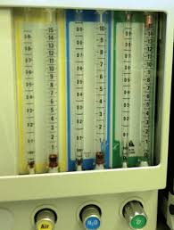
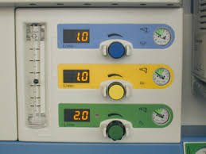
FLOWMETERS
The flow meters on the anesthesia machine display the flow of the specified gas in liters per minute.
Flow meters can be either manual or mechanical.

Slide 64
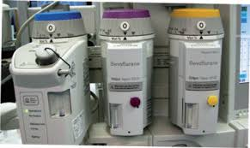
VAPORIZERS
The purpose of a vaporizer is to convert the volatile anesthetic medication from a liquid to a set concentration of gas
for delivery to the patient.

Slide 65
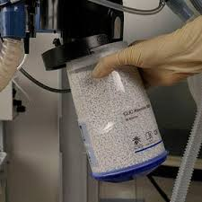
CARBON DIOXIDE ABSORBER
The carbon dioxide (CO2) absorber is a critical
part of the anesthesia machine that reduces the
amount of exhaled CO2 that is inhaled by the
patient.

Slide 66
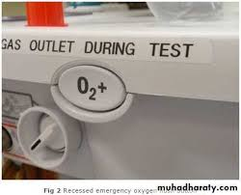
OXYGEN FLUSH VALVE
The oxygen flush valve delivers high-pressure
high-flow oxygen to the common gas outlet
from either the tank or pipeline.

Slide 67
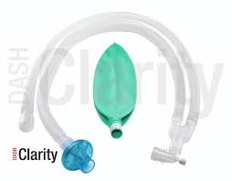
BREATHING CIRCUIT
The breathing circuit is the critical connection
between the anesthesia machine and the patient.

Slide 68
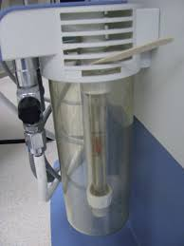
SCAVENGING
Scavenging systems remove the waste anesthetic
gases from the operating room. This helps reduce exposure to nitrous oxide and halogenated anesthetic agents, which are potentially hazardous gases.

Slide 69
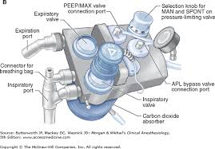
VENTILATOR
A critical aspect of the practice of anesthesiology
is the ability to ventilate patients. Anesthesia machines
integrate the ventilator and its various controls and alarms.

Slide 70
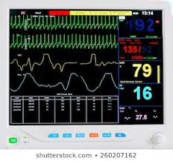
MONITORS
Monitors form a critical connection between the
patient, the anesthesia machine, and the anesthesia provider.

Slide 71
SUMMARY
The anesthesia machine is a critical component of
the anesthesia work environment. These devices
have grown in complexity and now often include
not only the components necessary to deliver gas
flows and anesthetic agents, but come bundled
with sophisticated ventilators and monitoring
equipment.

Slide 72
Anesthesia instrument and tools by Dr Saleha Jabali 2022

Slide 73
Stander instrument for airway management under GA
Anesthesia face mask
Advantage
Facilitate GA inhalational induction and maintenance with out airway instrumentation and irritation
Adequately sealing the mouth and nose to allow positive pressure ventilation
Variable sizes and disposable
Disadvantage
Hands are not free
High positive pressure may cause gastric distention and risk of aspiration

Slide 74
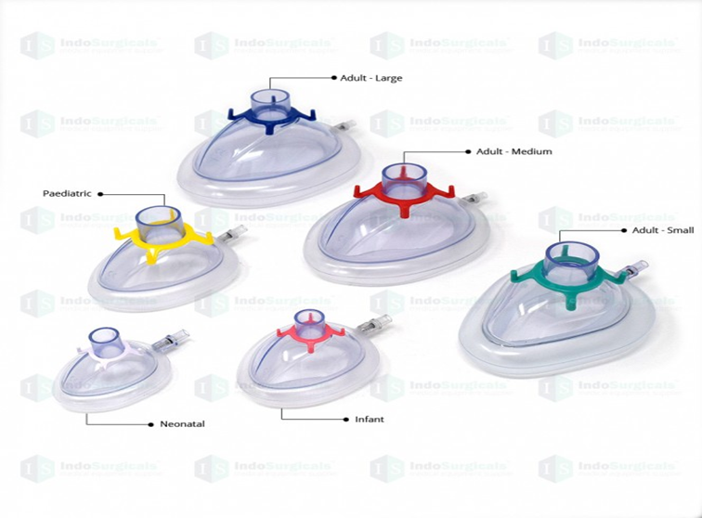

Slide 75
Oropharyngeal airway
Advantage
Variable sizes
Disposable
Adjunct to face mask and displace the tongue and open the airway
Disadvantage
Highly irritant to the airway if patient gag reflex is present it will cause vomiting and airway obstruction

Slide 76
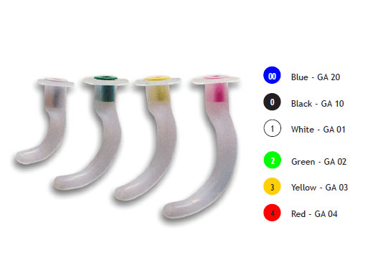
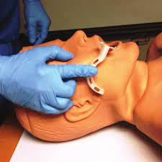

Slide 77
Nasopharyngeal airway
Advantage
-Can be used in conscious and semiconscious patient
-Variable sizes
-Disposable
Disadvantage
Nasal trauma and epistaxis

Slide 78
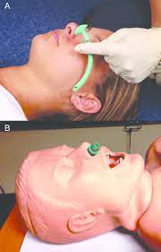
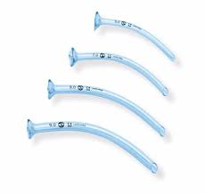

Slide 79
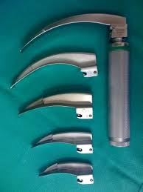
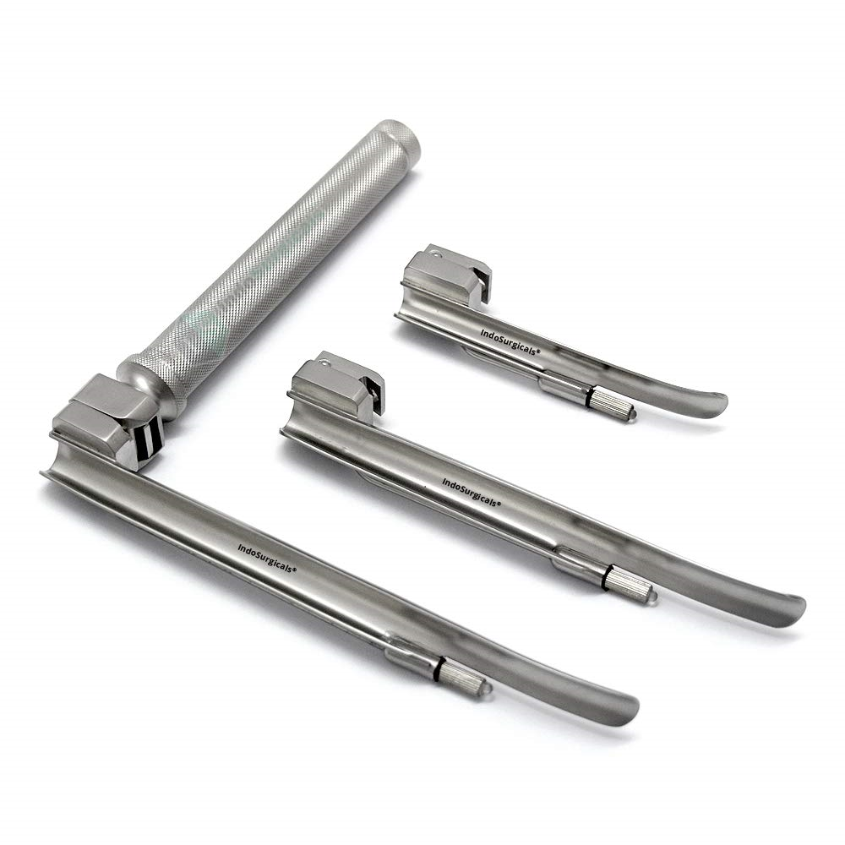
Classic or direct laryngoscopy
Macintosh (curved)
Miller (straight)

Slide 80
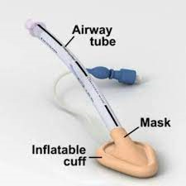
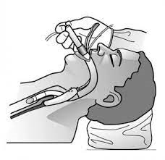
Supraglotic devices
Laryngeal mask

Slide 81
Advantage
-Does not need advance training
-Variable sizes
-Allow positive pressure ventilation (max 25 cmh2o pressure)
-Emergency tool in difficult ventilation and intubation
Disadvantage
Easily displaced causing laryngospasm and airway obstruction
Dose not protect from aspiration
High ventilation pressure lead to stomach insufflation
Not ideal for long surgical procedure or surgery in the airway

Slide 82
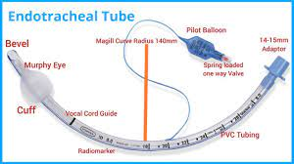
Infraglottic airway devices
Endotracheal tube

Slide 83
Advantage
Secure the airway
Allow Positive pressure ventilation with no risk od gastric insuflation
Protect from aspiration better than suprgllotic devices
Used for long surgical and airway procedure
Allow suction of the airway
Disadvantage
-Need high skill of training
-Endobronchial intubation and lung collapse
-Risk of vocal cord injury

Slide 84
Sizes
Pediatric 1- 8 year old is age/4+4 (age divided by 4 +4)
e.g 4 y old boy need ETT is 4/4+4= 1+4= 5 ID
Depth by equal chest movement
Age/2 +12 = depth from lip
e.g 4 year old boy tube will be fixed at : 4/2+12= 2+12 = 14 cm fixation at lip
Adult
Female 7 I D and fix at 19 cm
Male 7.5-8 ID fix at 21 cm

Slide 85
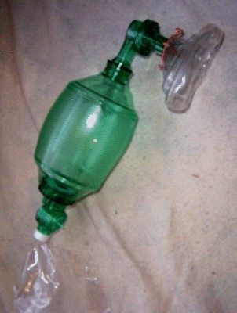
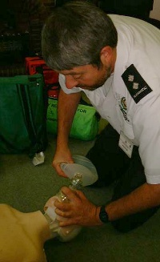
Bag Valve Mask

Slide 86
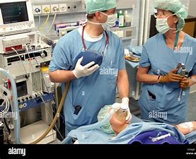
Anesthesia Breathing Circuit
The breathing circuit is the critical connection
between the anesthesia machine and the patient
Through which anesthesiologist can give positive pressure ventilation

Slide 87
Difficult Airway Mangement Tools
Fiberoptic: rigid, flexible
Video Laryngoscopy
Lightwand
Bougie
Transtracheal jet
single use Flexible Scope

Slide 88
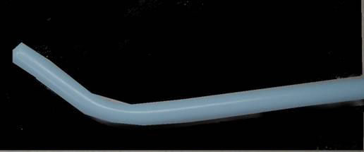
2. Intubating Stylet (Bougie)

Slide 89
Advanced video assisted Airway Devices

Slide 90
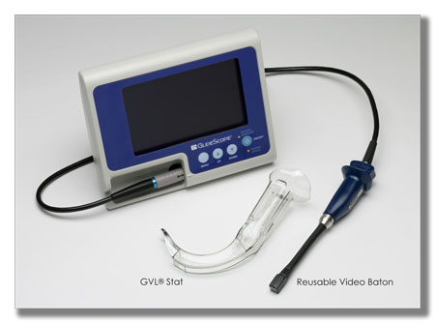
Glidescope with Disposable Blade

Slide 91
Post anesthesia care unit
“pacu”

Slide 92
Post Anesthesia Care Unit (PACU)
The role of the anesthetist is not limited to theatres. There may be a
number of postoperative responsibilities to undertake, both in the
recovery room and on the surgical ward.
After receiving anesthesia for a surgery or procedure a patient is sent to the PACU to recover and wake up .
The PACU is a critical care unit where the patient’s vital signs are closely observed ,pain management begins , and fluids are given .
The nursing staff is skilled in recognizing and managing problems in patients after receiving anesthesia .
The PACU is under the direction of the Department of Anesthesiology.

Slide 93
Admission to PACU
Steps:
Coordinate prior to arrival,
Assess airway,
Administer oxygen,
Apply monitors,
Obtain vital signs,
Receive report from anesthesia personnel.

Slide 94
Monitoring in the PACU
Baseline vital signs.
Respiration
  RR/min, Rhythm
  Pulse oximetry
Circulation
  PR/min & Blood pressure
  ECG
Level of consciousness
Pain scores

Slide 95
Aldrete Score
Score | Activity | Respiration | Circulation | Consciousness | Oxygen Saturation
2 | Moves all extremities | Breaths deeply and coughs freely. | BP + 20 mm of preanesth. level | Fully awake | Spo2 > 92% on room air
1 | Moves 2 extremities | Dyspneic, or shallow breathing | BP + 20-50 mm of preanesth. level | Arousable on calling | Spo2 >90% With suppl. O2
0 | Unable to move | Apneic | BP + 50 mm of preanesth. level | Not responding | Spo2 <92% With suppl. O2

Slide 96
