Slide 1
Alopecia
Dr Sami Aldaham

Slide 2
HAIR TYPES
Fetal hair -
Lanugo hair : soft, fine, lightly pigmented hairs.
Adult hair -
Vellus hair : fine hairs cover most of the body
of youngsters and adults.
Terminal hair: long, coarse, pigmented hairs with
larger diameters.

Slide 3
NUMBER OF HAIRS
Scalp : about 1,00,000 hairs.
Face : about 600 hairs /cm².
Rest of the body : about 60 hairs/cm².

Slide 4
LENGTH, WIDTH AND GROWTH RATE
Length : range from <1mm to > 1 meter.
Average uncut scalp hair : 25 – 100 cm.
Width : from 0.005 to 0.06mm.
Growth rate: about 1 cm/ month (terminal hair).

Slide 5
FUNCTIONS
1. Protects body surface from external injury.
2. Helps in sensory function.
Psycho – social importance.
Forensic importance.
i. Identification of race, sex, age and religion.
ii. Cause of death- can be determined.
iii. Time of death- can be determined.
5. Assist thermo- regulation: mainly in lower animals.

Slide 6
HAIR CYCLE
It is believed that each hair follicle goes
through 10-20 hair cycle in a life time.
There are four phases-
Anagen : growing phase.
Catagen: involuting phase. transition into quiescence
Telogen : resting phase.

Slide 7
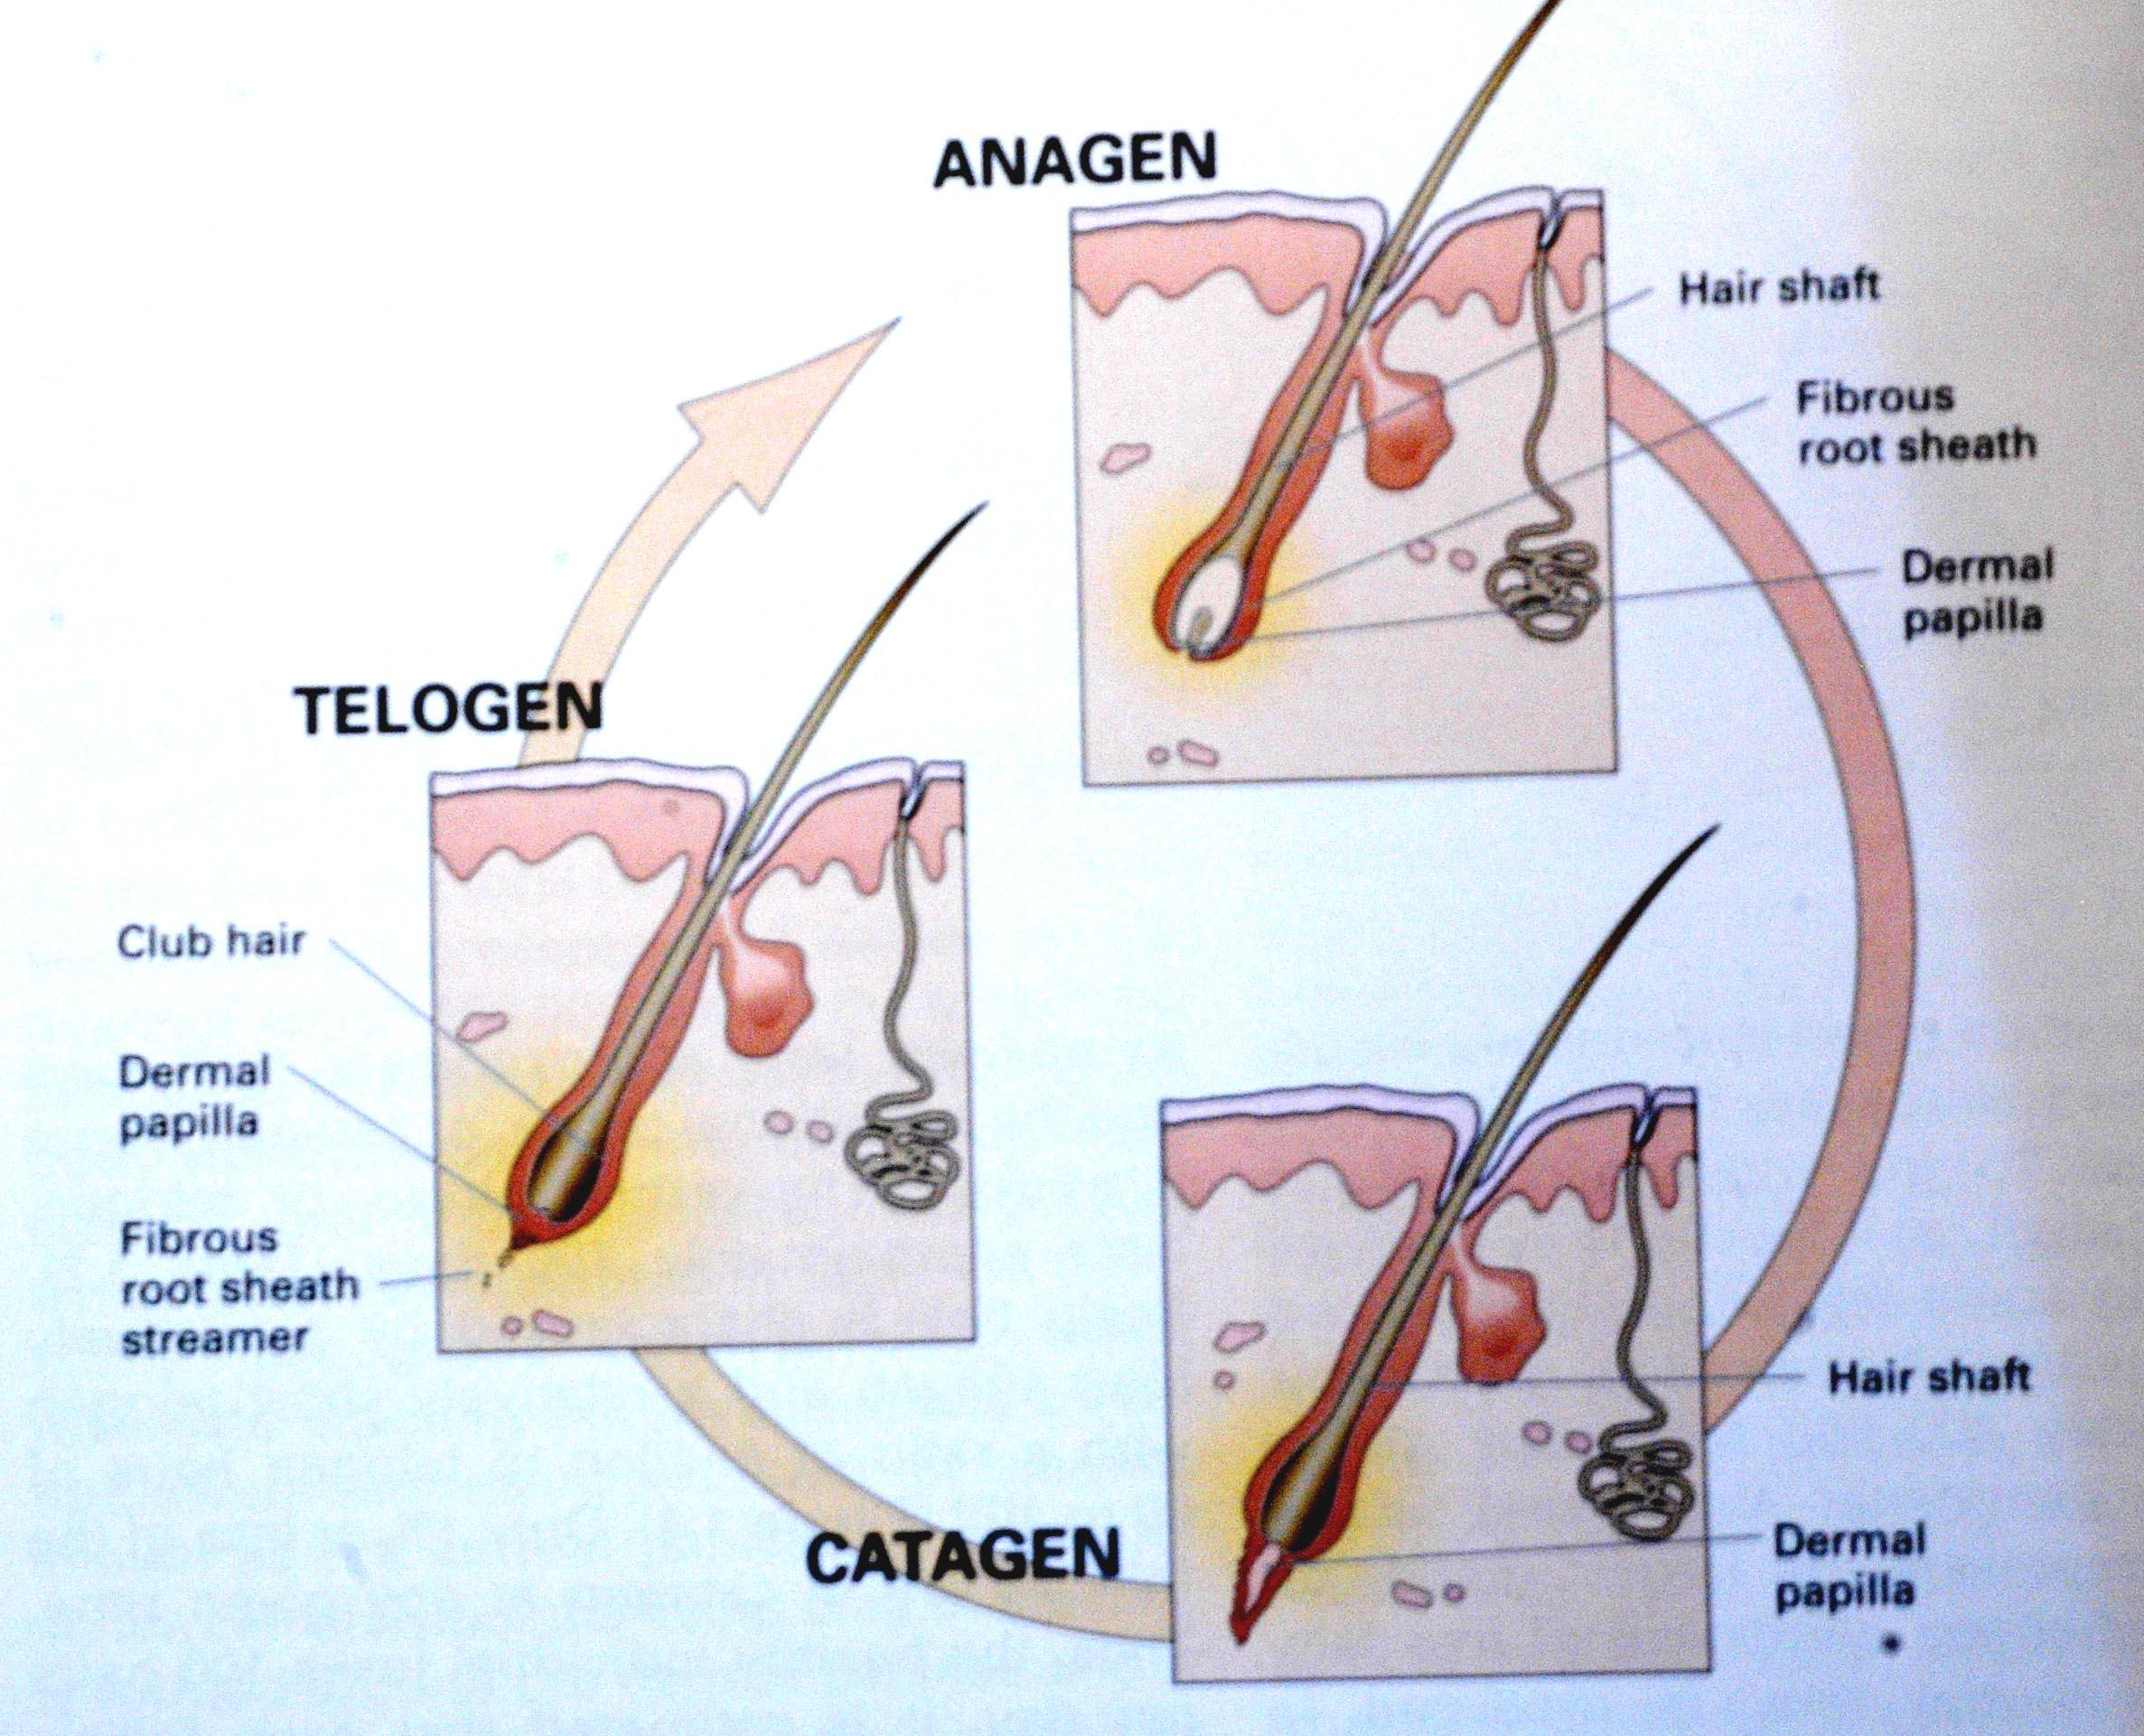

Slide 8
ANAGEN (GROWING PHASE)
Last for about 1000 days.
Follicular cells grow, divide and become keratinized to form growing phase.
A darkly pigmented portion is evident just above the hair bulb.

Slide 9
CATAGEN
Lasts for about 10 days.
Scalp hairs show a gradual thinning and decrease of the pigment.
Melanocytes cease producing melanin.

Slide 10
TELOGEN
Lasts for about 100 days.
Club-shaped proximal end shed from the follicle during telogen or subsequent anagen.
Growth of a new anagen hair leads to shedding of any remaining telogen hair.
But new hair does not “push out” the hair from the previous cycle.

Slide 11
Alopecia
None Scaring
(Reversible)
Scaring
(Irreversible)
.
X

Slide 12
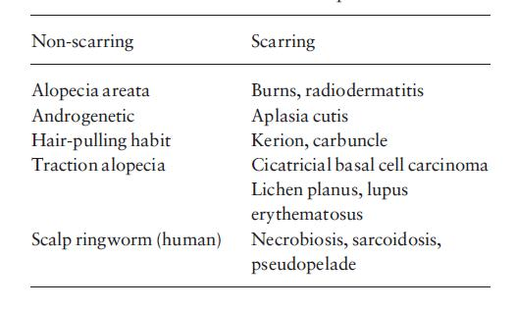

Slide 13
Alopecia Areata

Slide 14
Sudden hair loss ( localized or generalized)
Alopecia Areata affects up to 2%
75% : Self recovery, 2-6 m
Causes :
30%: +ve Family history
autoimmune

Slide 15
ALOPECIA AREATA .
  Etiology
  Exact cause is still unknown.
  It is an autoimmune disease-
  - Modified by genetic factors

Slide 16
ALOPECIA AREATA .
-Triggered by environmental factors-
        Trauma.
        Neurogenic inflammation.
        Infections agents.

Slide 17
ASSOCIATED DISEASE
Higher incidence of alopecia areata in
patients of-
1. Atopic dermatitis.
2. Autoimmune disease –
* SLE
* Thyroiditis.
* Myasthenia gravis.
* Vitiligo.
3. Lichen planus.
4. Down syndrome.

Slide 18
Clinical features
Well demarcated
Exclamation point
Normal scalp
Nail: pitting, ridges

Slide 19
CLINICAL FEATURE
  Rapid and complete loss of hair in one or several patches.
  Site – Scalp, bearded area, eyebrows, eye lashes and less commonly other areas of body.
  Size – Patches of 1-5 cm in diameter.

Slide 20
CLINICAL FEATURE
“Exclamation point” hair- at the periphery of hair loss, there are broken hairs, whose distal ends are broader than the proximal end.

Slide 21
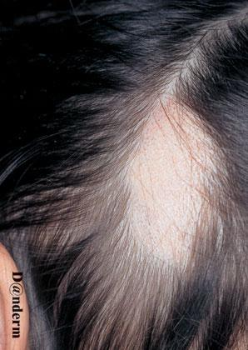
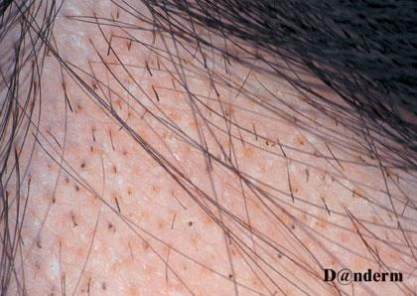

Slide 22
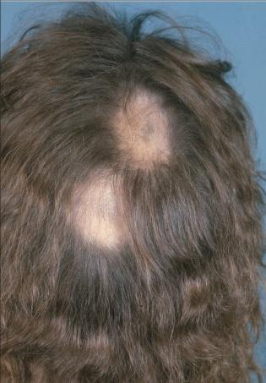

Slide 23
Types of alopecia areata
- Localized partial
- Localized extensive
- Alopecia ophiasis
- Alopecia totalis
- Alopecia universalis

Slide 24
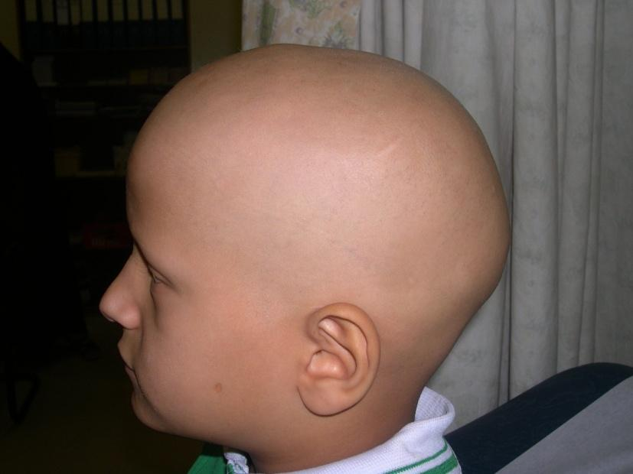
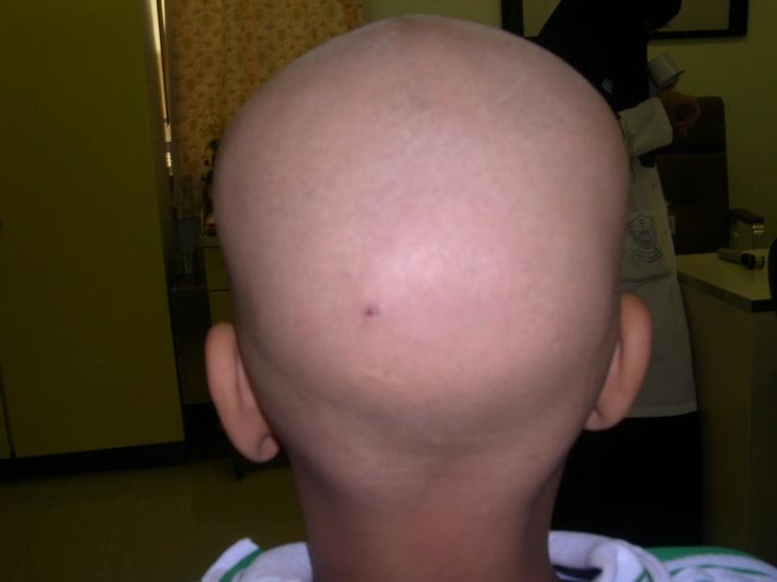

Slide 25
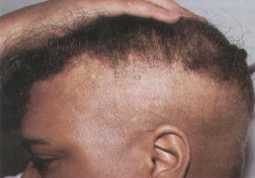
OPHIASIS PATERN OF ALOPECIA AREATA

Slide 26
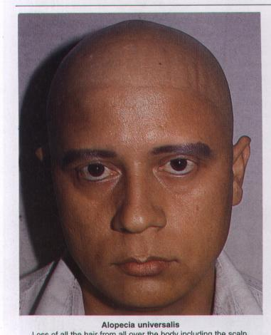
ALOPECIA UNIVERSALIS

Slide 27
Diagnosis
Clinically
H/E: sworm bees

Slide 28
DIFFERENTIAL DIAGNOSIS
1. Tinea capitis.
2. Trichotilomania.
3. Secondary syphilis

Slide 29
Treatment
1. Observation
2. Intralesional Corticosteroids
3. Skin Sensitizers
Anthraline
Diphencyclopropenone (DPCP)
others

Slide 30
Others
Topical steroids
Systemic Steroids
Cytotoxic Rx
Phototherapy
Minoxidil
Hair Transplant

Slide 31
TREATMENT
⇒Spontaneous recovery is extremely common
for patchy alopecia areata.
⇒For localized patchy alopecia areata-
• Steroid- both local (intralesional and
topical) and systemic (in short course).

Slide 32
Bad prognostic factors
Young age
Atopy
Alopecia totalis, universalis, ophiasis
Nail changes

Slide 33
Androgenetic Alopecia
(Male and Female Pattern Hair Loss)

Slide 34
ANDROGENETIC ALOPECIA
Definition : It is a very common, potentially
reversible scalp hair loss that generally spares
parietal and occipital areas (Hippocratic
wreath) of the scalp.

Slide 35
Androgen dependent loss of scalp hair
Androgenetic Alopecia affects up to 50% of males and 40% of females
Autosomal dominant with variable penetrance
85% : +ve family history

Slide 36
5 ALPHA Reductase
Testosterone
DihydorTestosterone (Active)
Miniaturization of Terminal Hairs

Slide 37
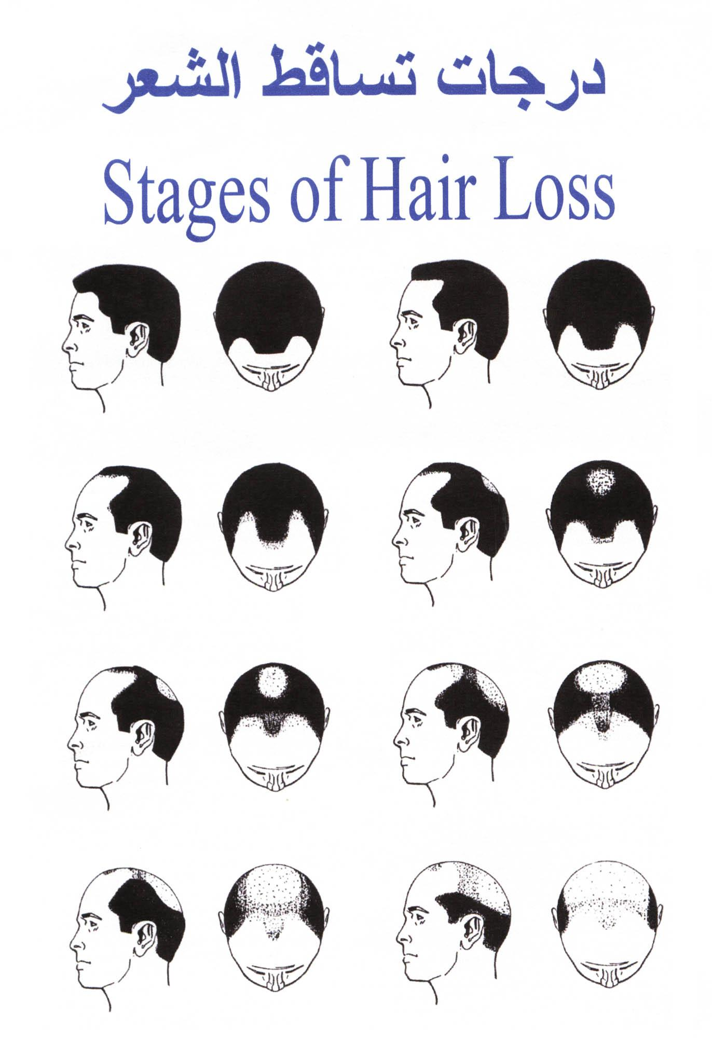
Male Pattern Hair Loss

Slide 38
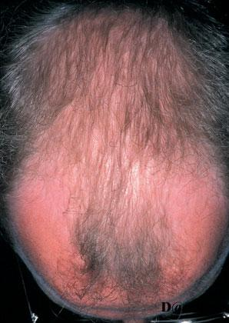

Slide 39
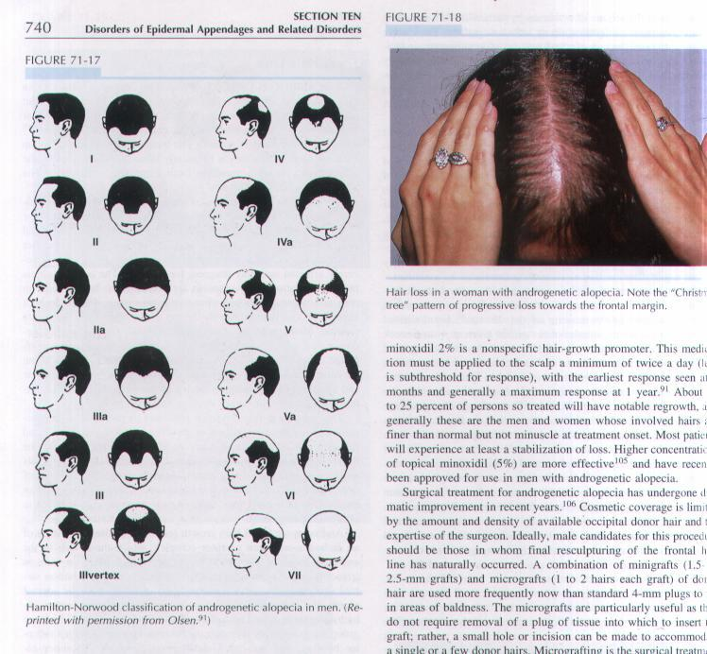
PATTERN OF HAIR LOSS

Slide 40
Androgenetic alopecia in women
Maintenance of frontal hair lines with only slight recession.
Etiology :
Genetic Predisposition,
Androgen excess,
Ovarian cause-
- Polycystic ovarian syndrome,
- Other ovarian tumor

Slide 41
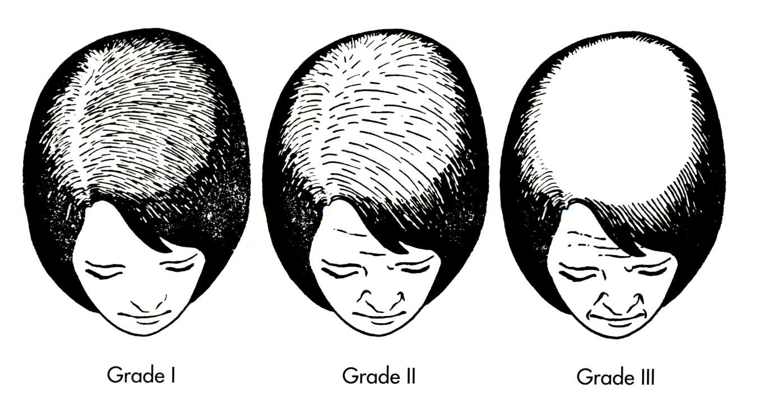
Female Pattern Hair Loss

Slide 42
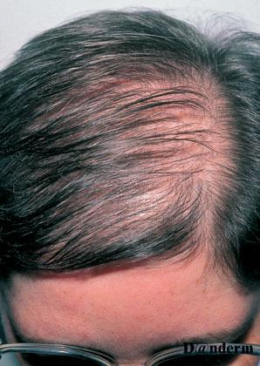

Slide 43
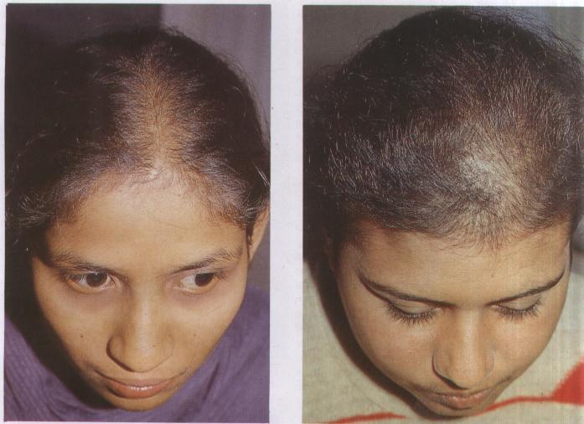
ANDROGENETIC ALOPECIA IN WOMEN

Slide 44
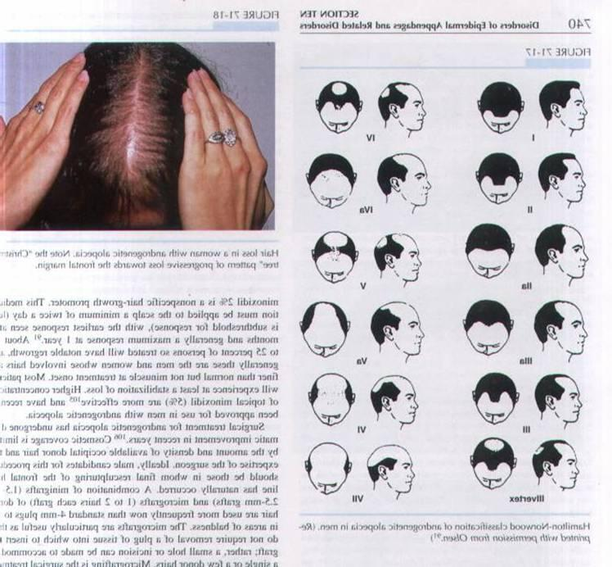

Slide 45
CLINICAL FEATURE
Other evidence of androgen excess:
    Acne.
    Hirsutism.
    Menstrual irregularities.

Slide 46
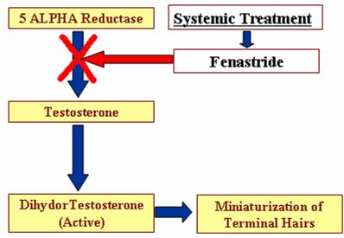
Treatment
Topical:Neoxidil 2%- 5% solution
Systemic: Fenastride or Spironolactone
Surgical treatment- Micrograft & minigraft from non-androgen dependent site (occiput).

Slide 47
TELOGEN EFFLUVIUM
It is a reaction pattern to a variety of
physical and mental stressors represents
a precipitous shift of a percentage of
anagen hairs to telogen.

Slide 48
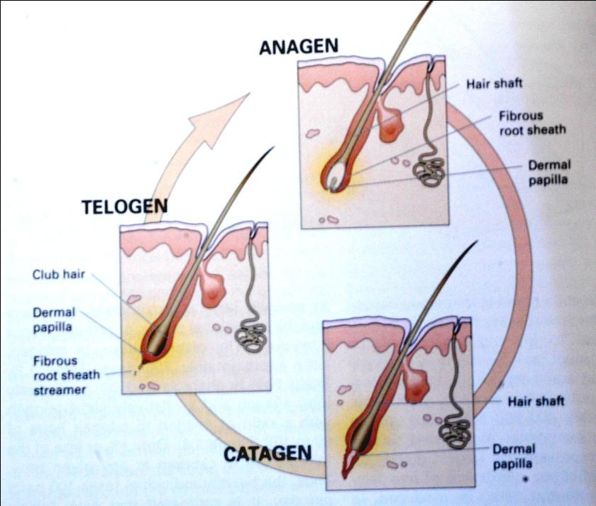
Telogen effluvium
Chronic alopecia
Reversible (but may be become chronic)
3-4 months

Slide 49
Causes of Telogen Effluvium
None specific
Endocrine
- Hypo or hyperthyroidism.
- Postpartum.
- Peri or postmenopausal state.
Nutritional
- Biotin deficiency.
- Essential fatty acid deficiency.
- Iron deficiency.
- Protein deprivation.
- Zinc deficiency.

Slide 50
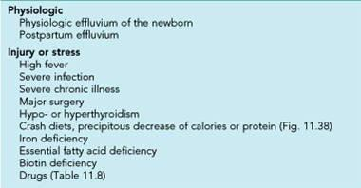
Causes

Slide 51
Causes of Telogen Effluvium (Contd.)
Drugs
Angiotensin-converting enzyme inhibitors.
Anticoagulants.
Antimitotic agents.
Benzimidazoles.
Beta blockers.
Interferon
Lithium

Slide 52
Causes of Telogen Effluvium (Contd.)
Oral contraceptives.
Retinoids.
Vitamin A excess.
Physical stress
Surgery.
Systemic illness.
Psychological stress

Slide 53
Pathology
> 12% to 15% of terminal follicles are in telogen.
Follicle itself is not diseased.
No inflammation or dystrophic changes.

Slide 54
CLINICAL PRESENTATION
Diffuse hair loss with clinically perceptible thinning of hairs usually 3-5 weeks of inciting signal and shedding continue for about 3-4 month after removal of inciting cause.
150 to > 400 hair loss daily.
Hair density may take 6-12 months to return to base line.
Pull test.
Clip test.

Slide 55
TREATMENT
No specific therapy.
In majority cases hair will grow spontaneously within few month after removing inciting cause.
In some patients with chronic telogen effluvium-
- 5% minoxidil solution .

Slide 56
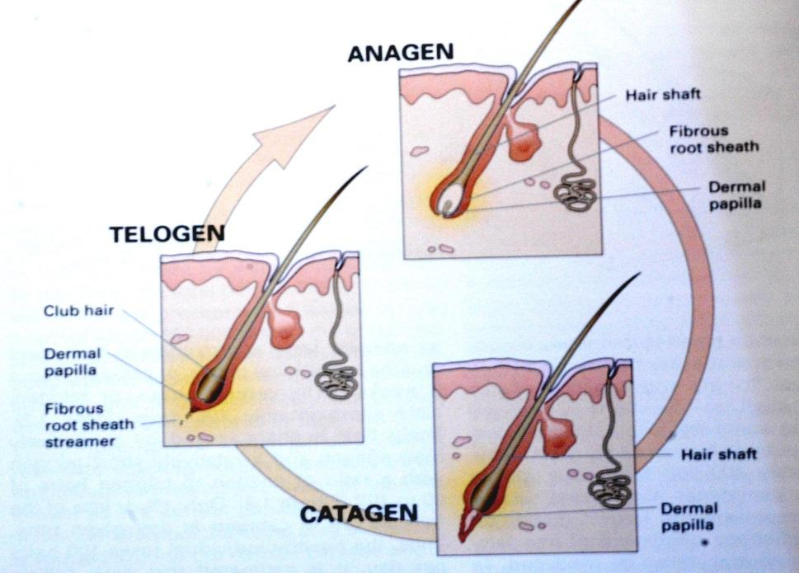
Anagen effluvium
Always related cytotoxic chemotherapy
Acute and severe alopecia
Mostly reversible but not always

Slide 57
TRICHTILLOMANIA
A neurotic practice of plucking or breaking hair from scalp or eyelash resulting usually localized or widespread areas of alopecia contains hairs of varying length.
Mostly girls under age of 10 years.
Disturbed mother- child relationship.

Slide 58
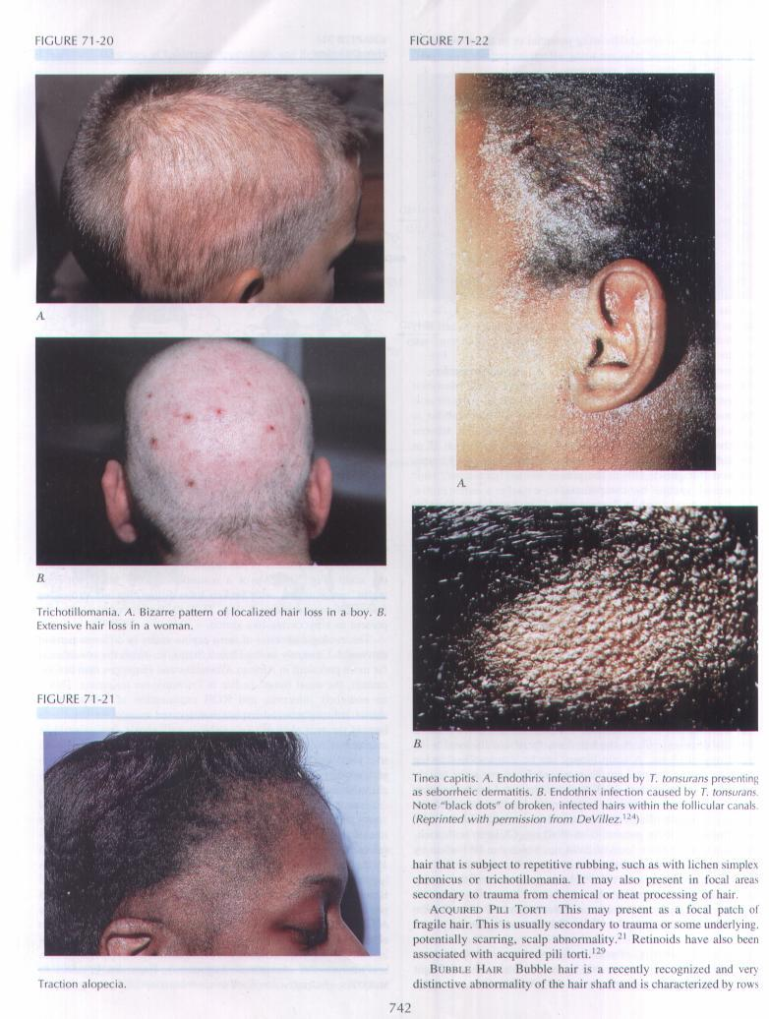
TRICHOTILOMANIA

Slide 59
Scaring Alopecia
SLE—DLE
LP
Sarcoidosis
Leprosy
Kerion - Favus
Trauma

Slide 60
THANK YOU

