Slide 1
Clinical Case One
DrSami Aldaham

Slide 2
History
HPI: Yasir is an 17-year-old healthy teenager who presents to his primary care physician with “pimples” on his face for the last 2 years. He reports a daily skin regimen of aggressive facial cleansing with a bar soap during his morning shower.
PMH: no chronic illnesses or prior hospitalizations
Allergies: no known allergies
Medications: none
Family history: father and mother had acne as teenagers
Social history: lives at home with parents, attends high school
ROS: negative

Slide 3
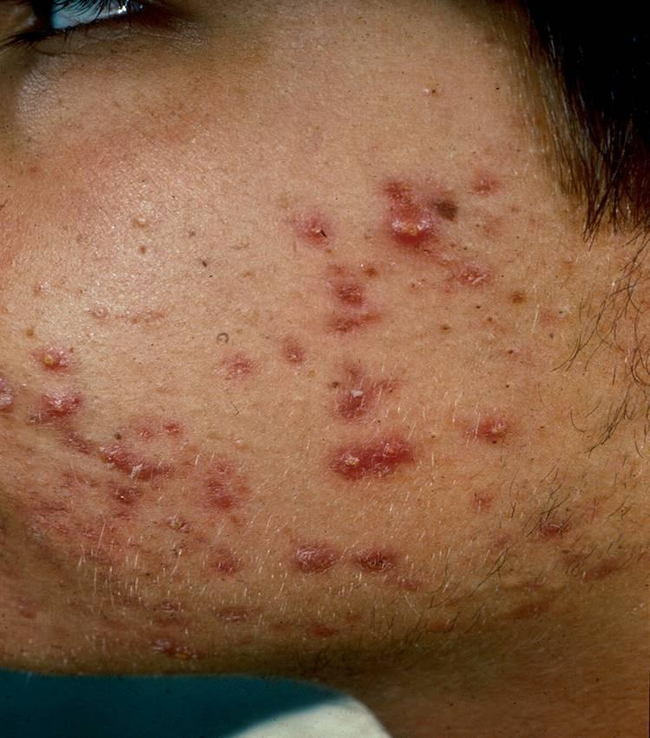
Skin Exam Findings
Exam of left cheek: numerous pustules, papules, open and closed comedones with some scarring
Open comedo
Closed comedo
Pustule
Inflamed papule
Scarring

Slide 4
Classification of Acne Vulgaris
Classification of acne is based on the morphology
  Comedonal: open and closed comedones
  Inflammatory: papules and pustules
  Nodulocystic: nodules and cysts
It is equally important to describe the severity (each type can be mild to severe depending on the amount of acne) and note the presence of scarring for each patient

Slide 5
Question 1
How would you describe Yassir’s skin exam?
  Mild comedonal acne without presence of scarring
  Mild inflammatory acne without comedones
  Moderate mixed comedonal and inflammatory acne with presence of scarring
  Moderate mixed comedonal and inflammatory acne without presence of scarring

Slide 6
Question 1
Answer: c
How would you describe Jim’s skin exam?
  Mild comedonal acne without presence of scarring
  Mild inflammatory acne without comedones
  Moderate mixed comedonal and inflammatory acne with presence of scarring
  Moderate mixed comedonal and inflammatory acne without presence of scarring

Slide 7
How Would You Describe the Following Patients’ Acne?
Remember for each patient to include the morphology, severity and presence of scarring

Slide 8
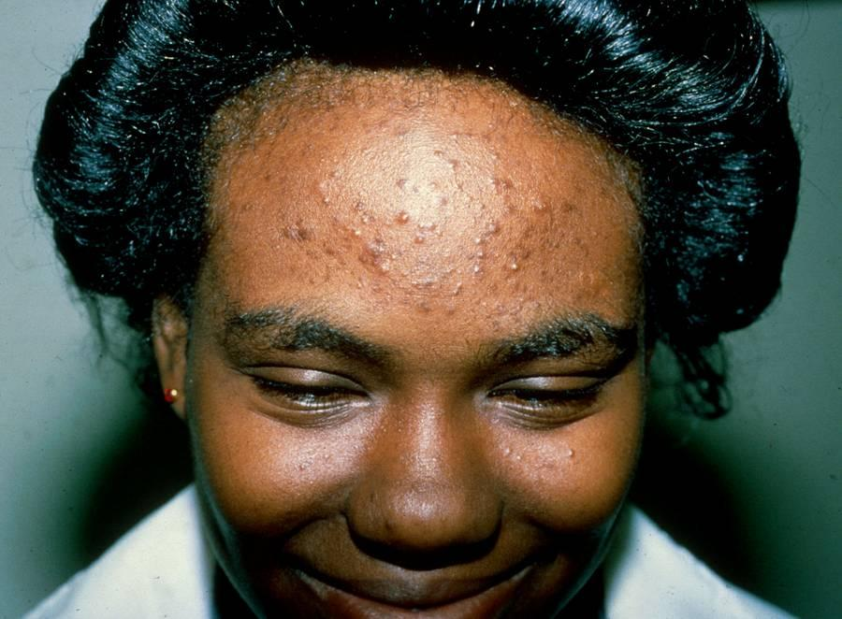
Acne Vulgaris

Slide 9
Acne Vulgaris
Moderate comedonal acne without evidence of scarring.
Note the mild post-inflammatory hyperpigmentation.

Slide 10
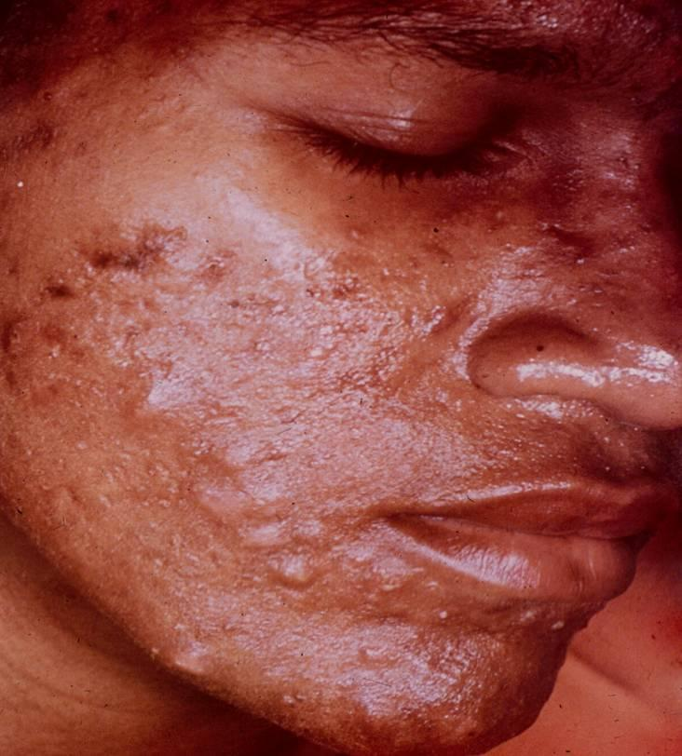
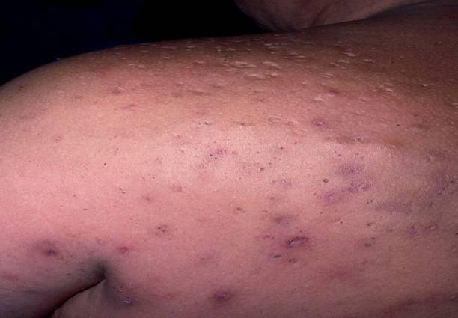
Acne Vulgaris

Slide 11
Acne Vulgaris
Severe nodulocystic acne with presence of scarring

Slide 12
Question 2
Which is (are) related to the pathogenesis of acne vulgaris?
  Androgens in the circulation
  Bacteria in the hair follicle
  Follicular plugging
  Sebum secretion
  All of the above

Slide 13
Question 2
Answer: e
Which is (are) related to the pathogenesis of acne vulgaris?
  Androgens in the circulation
  Bacteria in the hair follicle
  Follicular plugging
  Sebum secretion
  All of the above

Slide 14
Acne Vulgaris: Pathogenesis
Acne Vulgaris is related to 4 factors:
  Presence of hormones (androgens)
  Sebaceous gland activity (increased in presence of androgens)
  Plugging of the hair follicle as a result of abnormal keratinization of the upper portion (gives rise to comedones)
  P. acnes (bacteria) in the hair follicle (lives on the oil and breaks it down to free fatty acids which cause inflammation)

Slide 15
Question 3
Which of the following agents are effective in treating acne vulgaris?
  Oral antibiotics
  Topical benzoyl peroxide
  Topical retinoid creams
  All of the above

Slide 16
Question 3
Answer: d
Which of the following agents are effective in treating acne vulgaris?
  Oral antibiotics
  Topical benzoyl peroxide
  Topical retinoid creams
  All of the above

Slide 17
Treatment: Basic Principles
Systemic and topical retinoids, systemic and topical antimicrobials, and systemic hormonal therapies are the main classes of treatment
Multiple agents are often used with activity against different pathogenic causes (e.g. topical antibiotic plus retinoid)
Use topical antibiotics with benzoyl peroxide to prevent the development of antibiotic resistance
Acne scarring is difficult to treat, therefore aggressive prevention is important

Slide 18
Acne Scarring
Acne should be treated aggressively to avoid permanent scarring and cysts
Refer patients with difficult to control acne or the presence of scarring to dermatology

Slide 19
Common First-Line Treatments
Mild comedonal: topical retinoid, +/- topical benzoyl peroxide
Mild papular/pustular: topical retinoid, topical antibiotics (clindamycin, erythromycin), topical benzoyl peroxide
Moderate papular/pustular: oral antibiotics with topical retinoid and benzoyl peroxide

Slide 20
Common First-Line Treatments
Moderate nodular without scarring: oral antibiotic with topical retinoid and topical benzoyl peroxide
Severe nodular: refer to a dermatologist for oral isotretinoin
Scarring and keloids: refer to a dermatologist for oral isotretinoin

Slide 21
Patient Education
Patient education and setting expectations are important components of effective acne treatment
  Lack of adherence is the most common cause of treatment failure
  With the patient, the physician should develop the therapeutic regimen with the highest likelihood of adherence
  Acne treatment is only treating new lesions, not the ones already there

Slide 22
Patient Education
Patients should use only the prescribed medications and avoid potentially drying over-the-counter products, such as astringent, harsh cleansers or antibacterial soaps
  Recommend daily moisturizer when patients are using solutions and gels because they have more drying effects than creams and ointments
Overaggressive washing and the use of particulate abrasive scrubs often exacerbates acne and should be avoided
Cosmetics are often labeled as “non-comedogenic” or “oil-free” if they do not cause or exacerbate acne

