Slide 1
Acne Vulgaris
Dr Sami Fatehi
MBBS, MSc , PhD , MD
Dermatology Consultant & Assistant Professor

Slide 2
Classic presentation scenario
A 15-year-old boy presents with pleomorphic lesions on the central face consisting of papules, pustules, and open comedones . These began following puberty and have become progressively worse, leaving scars and red macules/patches on his face. What is the most likely diagnosis?

Slide 3
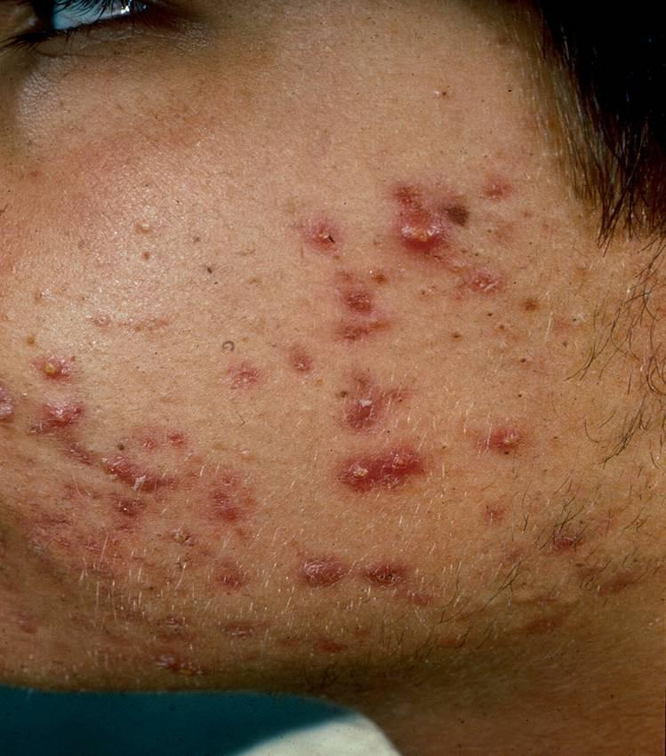
Skin Exam Findings
Exam of left cheek: numerous pustules, papules, open and closed comedones with some scarring
Open comedo
Closed comedo
Pustule
Inflamed papule
Scarring

Slide 4
What is acne ?
It is pilosebaceous disorders due to :-
Hyperproliferation of hair follicle epidermal layer (hyperkeratosis).
Increase sebum production.
Proliferation of propiobobacterium acnes.
Inflammatory responses in the dermis.

Slide 5
Body Areas with well developed sebaceous glands
Face
Upper chest
Upper back
Shoulders

Slide 6
Introduction
Common pilosebceous disorders
affect more than 85% of individuals 12 to 24 years old
15-35 % of adults especially women in their 30s and 40s.
Clinical presentation range from mild comedons to severe supportive nodules with systemic manifestations.
Tendency to develop moderate to severe acne may can run in families.
The relationship with diet is controversial particularly with high glycemic food and milk.

Slide 7
Clinical features and variants of Acne
What are the common sites of acne ?

Slide 8
1- Non-inflammatory acne
Closed comedones (whiteheads) are small (1mm) , skin-colored papules without and obvious follicular opening.
Open comedones (blackheads) , have dilated follicular opening filled with keratin plug , which has a black color due to oxidized lipid and melanin.

Slide 9
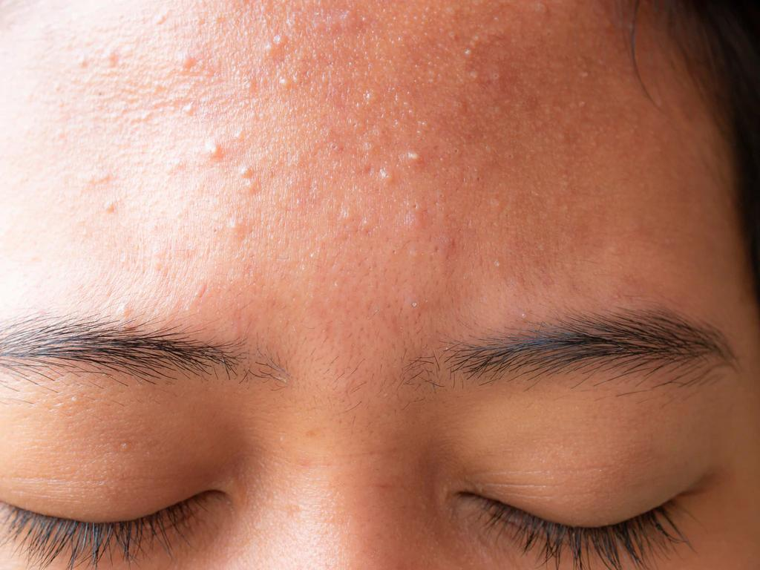
Whiteheads , Closed comedones

Slide 10
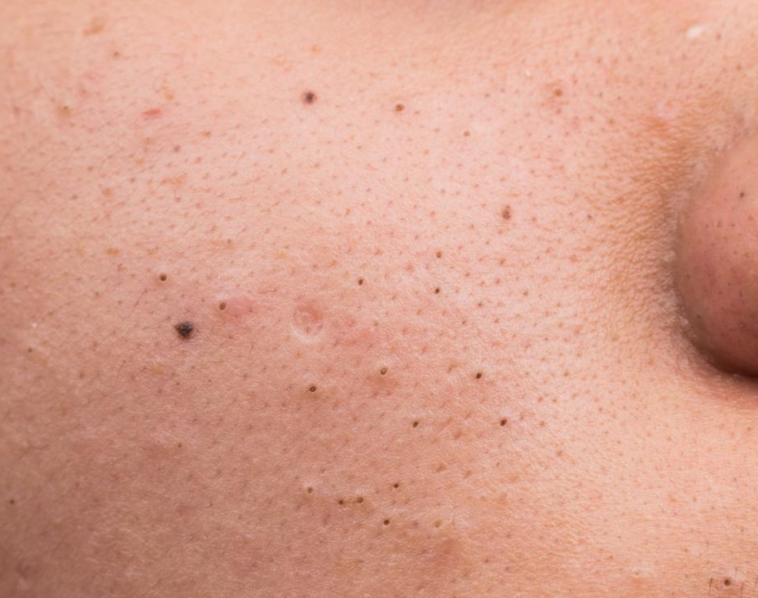
Blackheads , Open comedones

Slide 11
2-inflammatory acne
Erythematous papules and pustules .
Nodules and cysts filled with pus or serous fluids .
Acne conglobata (severe nodulocystic acne).
Usually ends by post inflammatory hyperpigmentation and pitted or hypertrophic scar

Slide 12
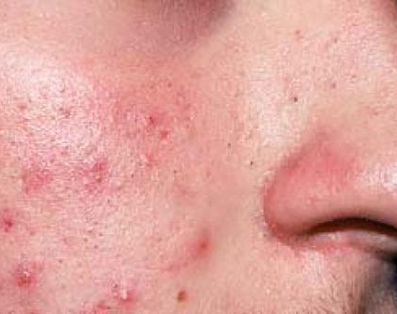
Erythematous papules and pustules

Slide 13
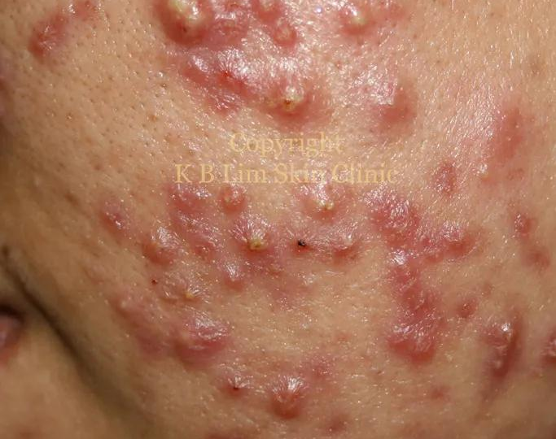
Nodules and cysts filled with pus or serous fluids

Slide 14
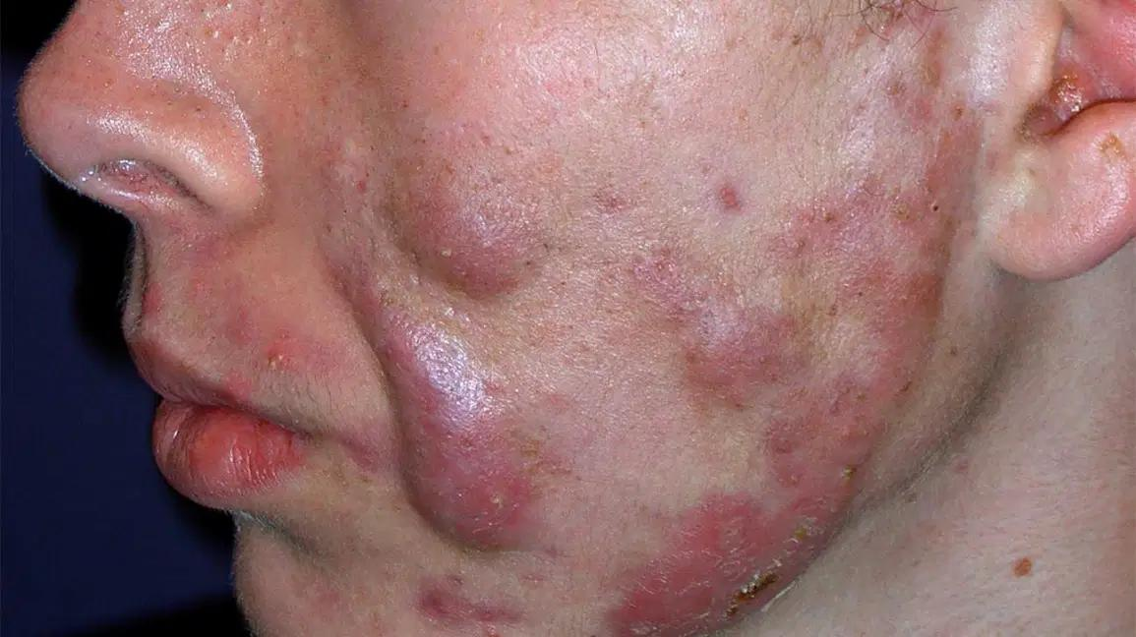
Acne conglobata (severe nodulocystic acne)

Slide 15

Exercise 1

Slide 16

What is the pathognomonic primary lesion of acne vulgaris?
Go back to previous pictures and figure out?

Slide 17
Which of the following is pathognomonic primary lesion of acne?
Pustule
Comedon
Papule
Nodule
Cyst
Vesicle
Macule
Scar

Slide 18
All primary lesions might be developed in acne except?
Go back to previous pictures and figure out?

Slide 19
All the following lesion might be developed in acne, except ?
Pustule
Comedon
Papule
Nodule
Cyst
Vesicle
Macule
Scar

Slide 20
Secondary lesions of acne
Excoriations (picked or scratched spots)
Erythematous macules (red marks from recently healed spots, best seen in in fair skin)
Pigmented macules (dark marks from old spots, mostly affecting those with dark skin)
Scars of various types

Slide 21
Acne Grading
Acne may be classified as mild, moderate or severe.
Comedones and inflammatory lesions are usually considered separately.

Slide 22
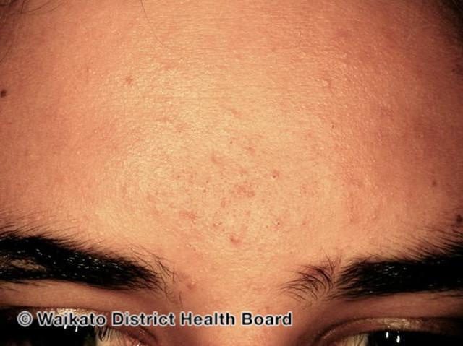
1. Mild acne
<20 comedones
<15 inflammatory lesions
Or, total lesion count <30

Slide 23
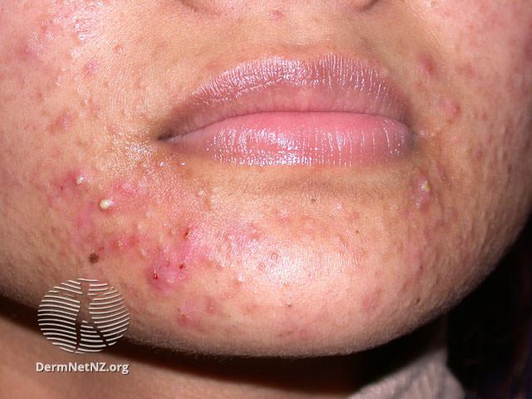
2. Moderate acne
20–100 comedones
15–50 inflammatory lesions
Or, total lesion count 30–125

Slide 24
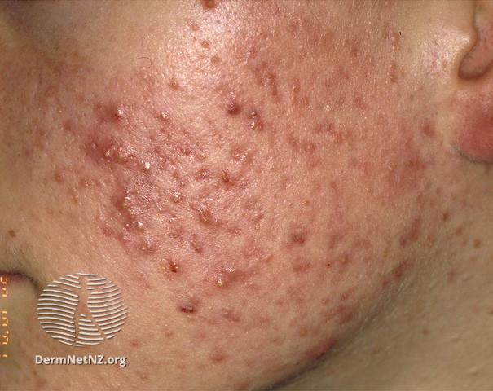
3. Severe acne
>5 pseudocysts
Total comedons count >100
Total inflammatory count >50
Nodules
Scar
Or, total lesion count >125

Slide 25
Exercise 2

Slide 26
Based on pathogenesis of acne
Suggest three treatments for acne
……………………….
………………………..
…………………………

Slide 27
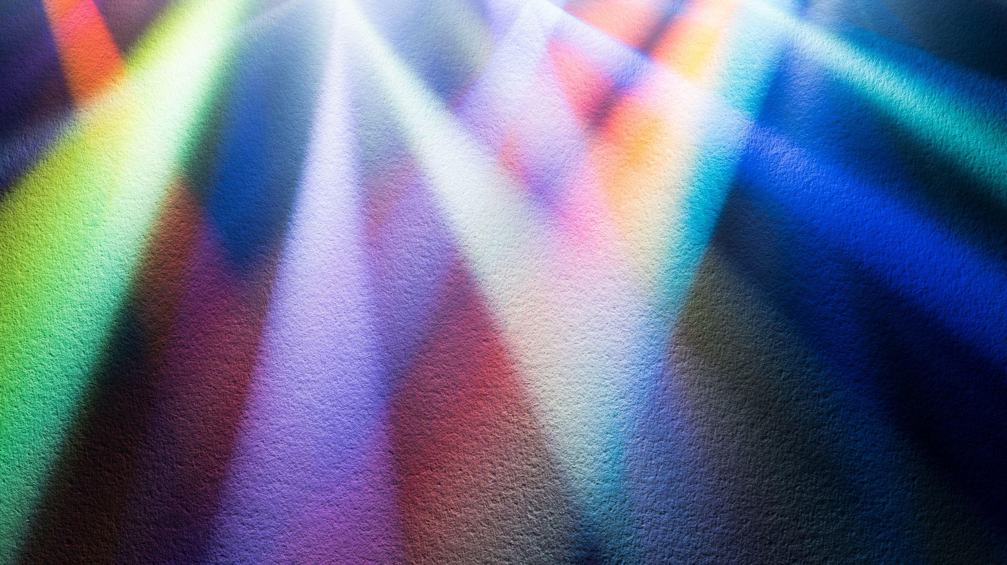
Based of grading of acne propose treatment
1. Mild acne
…………………………………………………….
2. Moderate acne
……………………………………………………..
3. Severe acne
………………………………………………………

Slide 28
Classic presentation scenario
A 15-year-old boy presents with pleomorphic lesions on the central face consisting of papules, pustules, and open comedones . These began following puberty and have become progressively worse, leaving scars and red macules/patches on his face.

Slide 29
Skin Exam Findings
Exam of left cheek: numerous pustules, papules, open and closed comedones with some scarring
Open comedo
Closed comedo
Pustule
Inflamed papule
Scarring

Slide 30
What is the severity grade ?
What is the initial treatment ?
What is the treatment if above treatment is failed?

Slide 31
Non- classic presentation scenario
HPI: Ms. M is a 22-year-old woman who was referred to the dermatology clinic for new onset acne
PMH: no major illness or hospitalizations, no pregnancies
Allergies: allergic to penicillin (rash)
Medications: occasional multivitamin
Family history: noncontributory
Social history: lives in the city and attends college
Health-related behaviors: gained 40 pounds over the past 4 years despite a healthy diet and exercise habits
ROS: new upper lip and chin hair growth, irregular menstrual cycles since menarche, last period was 4 months ago

Slide 32
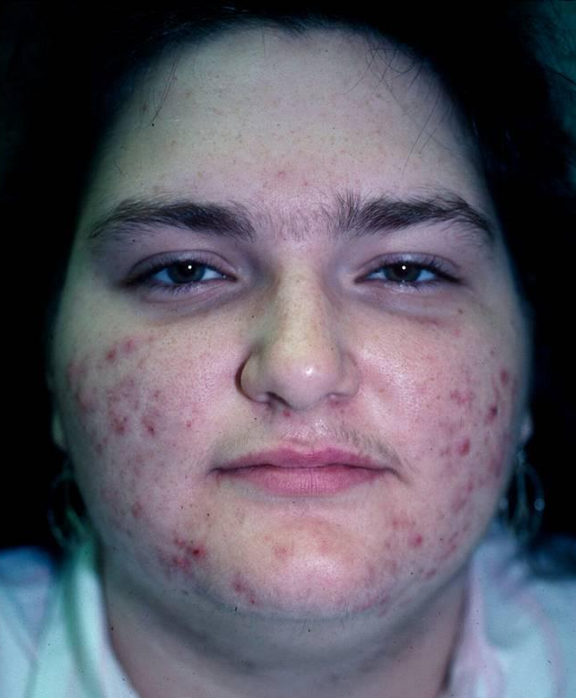
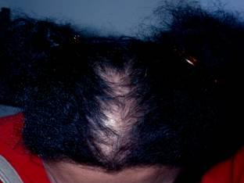
Moderate comedonal and inflammatory acne of cheeks and jaw line. Also with scattered terminal hairs on the upper lip and lower chin.
Hair loss noted on frontal and parietal scalp.

Slide 33
Ms. M was given spironolactone and her acne improved. Why did this medication work?
Spironolactone has anti-androgenic effects
Spironolactone has anti-comedonal activity
Spironolactone when used appropriately has anti-bacterial activity
The diuretic effect of spironolactone eliminated sodium resulting in less sebum

Slide 34
Based on the history and exam, what is the most likely diagnosis?
Cushing Syndrome
Gram negative folliculitis
Polycystic ovarian syndrome
S. aureus folliculitis

Slide 35
Polycystic Ovarian Syndrome
Ms M most likely has polycystic ovarian syndrome (PCOS)
Affected individuals must have two out of the following three criteria: (1) oligo- and/or anovulation, (2) hyperandrogenism (clinical and/or biochemical), and (3) polycystic ovaries on sonographic examination*
In addition to hormonal acne, increased circulating androgens also results in hirsutism
Women with PCOS also have a greater degree with insulin resistance which can cause acanthosis nigricans

Slide 36
Androgens in Acne
In many post adolescent women, antiandrogen therapy can improve acne
These women have hormonal acne; their serum hormone levels are usually normal
Hormonal acne lesions are often perioral and along the jaw line
Many women report a pre-menstrual flare
Not all women with hormonal acne are tested for hyperandrogenism
However, it should be considered in the female patient whose acne is severe, sudden in onset, or associated with hirsutism or irregular menses

Slide 37
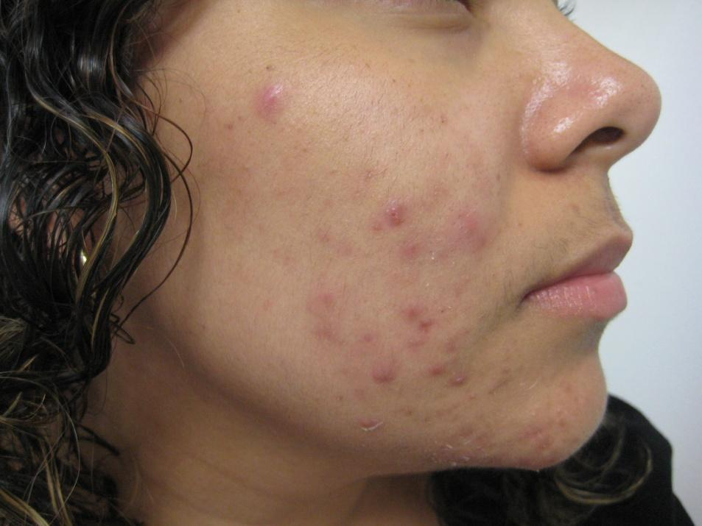
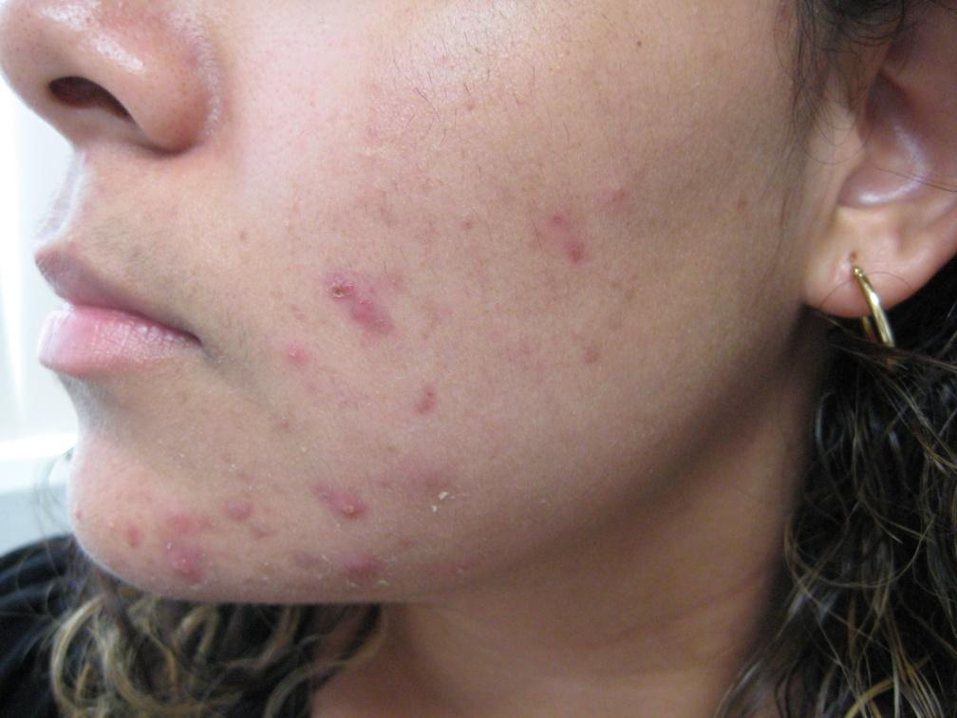
More Examples of Hormonal Acne
Inflammatory acne on the lateral and inferior face, especially along the jawline

Slide 38
Treatment of Hormonal Acne
Commonly used agents to treat hormonal acne include:
Spironolactone 50mg -100mg daily
Oral contraceptives
The following oral contraceptives have been approved by the FDA for treatment of acne: Yaz, Ortho Tri-cyclen, Estrostep
There is good evidence and consensus opinion that other estrogen-containing OCPs are also effective

Slide 39
Complications of Acne
Post inflammatory hyperpigmentation
Scarring, including keloid scars
Psychological effects of acne

