Slide 1
Clinical case
Dr Sami Aldaham

Slide 2
You are in the dermatologic clinic and this patient came seeking advise
Assuming that the patient is your colleague, Please take full dermatological history.

Slide 3
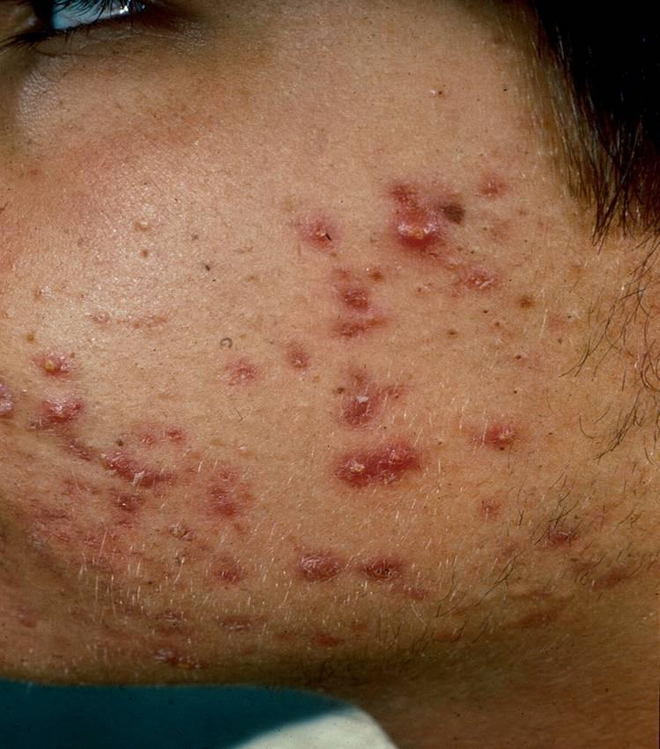
Take History from this patient

Slide 4
You and your colleague describe the dermatologic lesions you see
What is your plan of management?
Advise your patient?

