Slide 1
Physiology of the Skin
Dr Sami Fathi Billal
MBBS,MSc,MD, PhD

Slide 2
Objectives
By completing this lecture, you should be able to:
Gain familiarity with skin functions and how relevant dysfunction contributes to disease
Approach dermatologic disease with an understanding of basic skin structure and microanatomy

Slide 3
Functions of the Skin: 1- Barrier function
The skin provides a physical barrier that regulates water loss and protects against mechanical, chemical and microbial insults from the external environment.
Dysfunction of the skin barrier leads to injury, dehydration, infection and inflammation.
Notes:
3

Slide 4
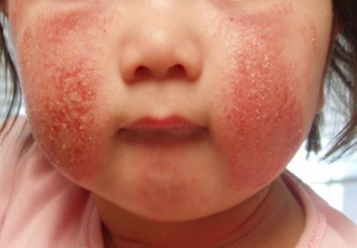
Loss of skin barrier functions
This child has atopic dermatitis, a chronic skin condition associated with barrier dysfunction.

Slide 5
2- Immunologic function
As an immunologic barrier, the skin both senses and responds to pathogens.
Dysfunction of the immunologic barrier leads to infection, skin cancer, inflammatory skin conditions and allergy.

Slide 6
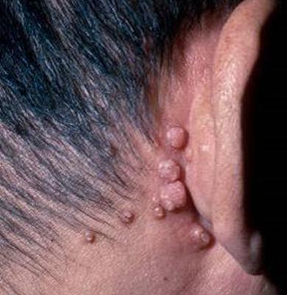
Loss of Immunologic function
This HIV-positive man has molluscum contagiosum, a skin infection caused by a virus.

Slide 7
3- Temperature regulation
The skin maintains a constant body temperature with the insulating properties of fat and sweating and a dense superficial microvasculature.
Dysfunction of temperature regulation leads to hyper- or hypothermia.

Slide 8
4- Protection from radiation
The dark pigment melanin in the epidermis protects cells against ultraviolet radiation.
Dysfunction of melanin production causes the patient to be more susceptible to skin cancer.

Slide 9
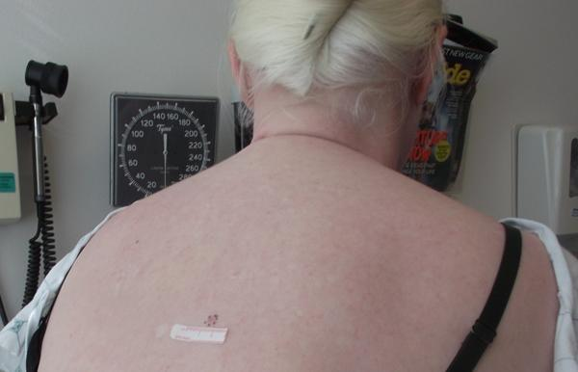
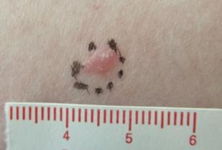
Loss of Protection from radiation
This patient with albinism has a skin cancer on the back.

Slide 10
5- Nerve sensation
Sensory receptors allow the skin to constantly monitor the environment and mechanoreceptors in the skin are important for the body’s interactions with physical objects
Dysfunction leads to pruritus (itch), dysesthesia (abnormal sensation), and insensitivity to injury (e.g. diabetes, leprosy).

Slide 11
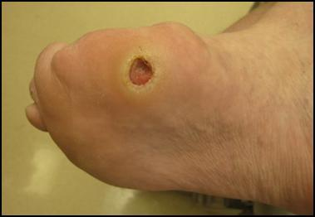
Loss of sensation function
Chronic ulcer on the foot of a patient with peripheral neuropathy related to diabetes.

Slide 12
6- Injury repair
The cutaneous wound repair process has four phases: coagulation, inflammatory phase, proliferative-migratory phase (tissue formation), and remodeling phase
Loss of ability to repair injury (e.g. post-radiation treatment) leads to delayed wound healing.

Slide 13
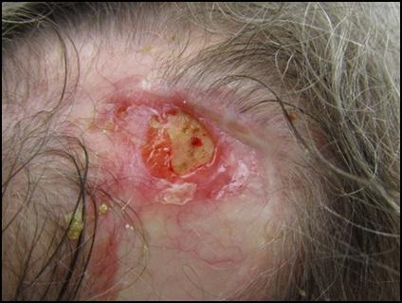
Loss of Injury repair ability
This patient has a chronic ulcer following trauma on the scalp in a site previously irradiated as part of treatment for squamous cell carcinoma.

Slide 14
7- Appearance, Quality of Life (Cosmetic impact)
Skin defects and even physiologic aging can result in considerable psychological distress, an important clinical feature of many cutaneous diseases.

Slide 15
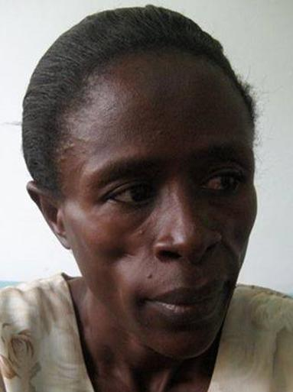

Loss of Cosmetic Impact
This patient has HIV-associated lipoatrophy, characterized by loss of fat throughout the face.
Atrophy of buccal fat pads have an impact on self-esteem.

