Slide 1
Applied Anatomy of the Skin – II
Dr Sami Fathi Billal
MBBS,MSc,MD, PhD

Slide 2
Layers of the skin
Skin is composed of three layers:
Epidermis
Dermis
Subcutis

Slide 3
Can you name the layers of the skin indicated below?
a
b

Slide 4
The epidermis is the topmost layer, and consists primarily of keratinocytes.
The dermis lies below the epidermis, and consists primarily of fibroblasts, collagen, and elastic fibers.
Epidermis
Dermis

Slide 5
Layers of the skin
Epidermis
Below the dermis lies fat, also called subcutis, panniculus, or hypodermis.
Dermis
Subcutis

Slide 6
Outline: basic anatomy of skin
Layers of the skin
Epidermis: layers, cell types, and function
Dermis: layers, cell types, and function
Subcutis
Adnexal structures

Slide 7
Can you name the four major layers of the epidermis?
4
3
2
1

Slide 8
Can you name the four major layers of the epidermis?
Stratum corneum
Stratum granulosum
(granular cell layer)
Stratum spinosum
(spiny layer)
Stratum basale
(basal cell layer)

Slide 9
Functions of the layers of the epidermis
Epidermal cells mature and differentiate over their two-week life cycle from the basal cell layer to the stratum corneum.
They are then shed two weeks after reaching the stratum corneum (for a 28-day cycle).
1. Basal layer
The basal layer is the source of epidermal stem cells.
Cell division occurs here.
Keratinocytes start in the basal layer and move upwards.

Slide 10
Functions of the layers of the epidermis
2. Spinous layer
Center of epidermis.
Has a “spiny” appearance due to desmosomal junctions which hold the keratinocytes together.
1. Basal layer

Slide 11
Functions of the layers of the epidermis
3. Granular cell layer
Lipids produced by the keratinocytes in the granular cell layer and secreted into the extracellular space between the keratinocyte forms a water barrier that keeps water in the skin
2. Spinous layer
1. Basal layer

Slide 12
Functions of the layers of the epidermis
4. Stratum corneum
Made up of desquamating keratinocytes.
Thick outer layers of flattened keratinized non-nucleated cells(corneocytes) provide a barrier against trauma and infection.
3. Granular cell layer
2. Spinous layer
1. Basal layer

Slide 13
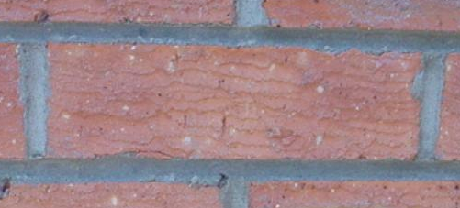
The Stratum Corneum
You can think of the stratum corneum as a wall of bricks and mortar
Bricks: flattened keratinocytes filled with keratin and filaggrin
Mortar: lipid mixture, which surrounds the keratinocytes and provides the water barrier
Lipid intercellular matrix
Keratin and
filaggrin-filled
corneocyte

Slide 14
Diseases related to dysfunction of the epidermal layers
Certain diseases cause loss of adhesion:
Bullous pemphigoid: an autoimmune blistering disease, typically affects older patients.
Autoantibodies form to antigens directly beneath the basal layer of the epidermis.
Clinically, presents as tense bullae on an erythematous base on the skin.

Slide 15
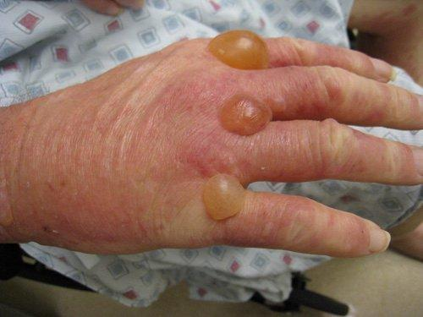
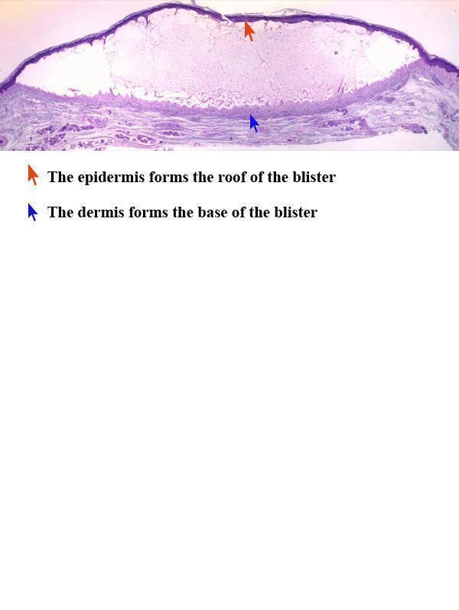

Slide 16
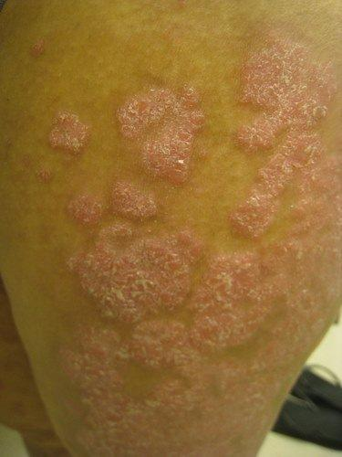
Diseases related to dysfunction of the epidermal layers
In psoriasis, the rate of epidermal turnover is increased (thickening).
The accelerated rate of movement through the epidermis doesn’t allow adequate time for differentiation, which is recognized as scale.

Slide 17
In the next pathology slide, see if you can identify this common skin cancer based on what you have learned about the layers of the skin
17

Slide 18
Can you name the type of skin cancer? (Hint: The cells composing this growth resemble what layer of the epidermis?)

Slide 19
Basal Cell Carcinoma
Most common form of skin cancer.
Composed of cells that resemble basal keratinocytes.

Slide 20
Epidermis: Types of Cells
Three main types of cells make up the epidermis:
Keratinocytes
Melanocytes
Langerhans cells

Slide 21
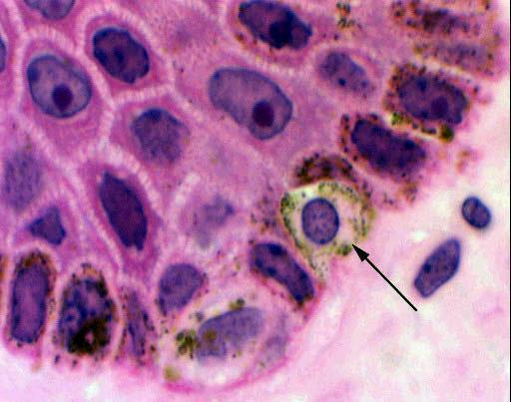
1- Keratinocytes
Keratinocytes make up the majority of cells(95%).
Keratinocytes are held together by macromolecular structures that look like stripes (or spines) between cells, called desmosomes (primarily visible in the spinous layer).

Slide 22
2- Melanocytes
The second type of cell which makes up the epidermis is the melanocyte.
Melanocytes are staggered along the basal layer at around one in every 10 keratinocytes.
They are the pigment-producing cells, and transfer their pigment, called melanin, to the keratinocytes in the basal cell layer.

Slide 23
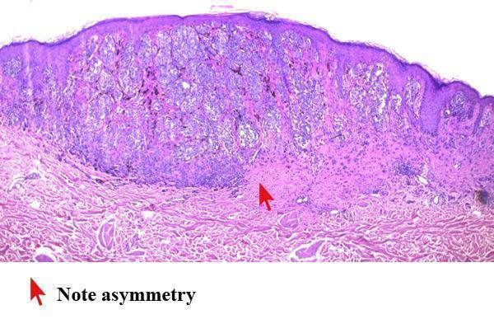
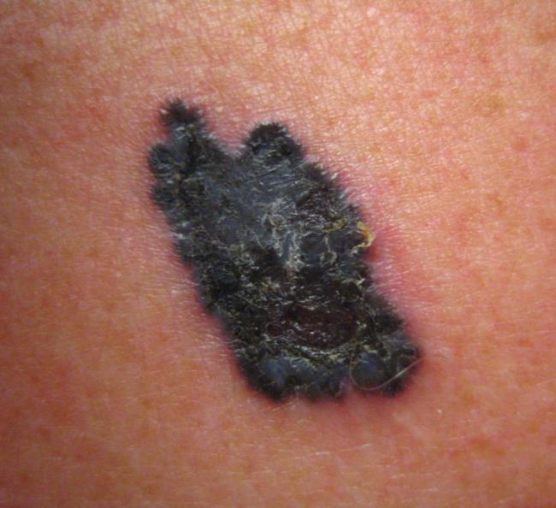
Nevi and Melanoma
Melanocytic nevi, or moles, are benign collections of melanocytes.
Melanoma, shown below, is a malignancy of melanocytes.

Slide 24
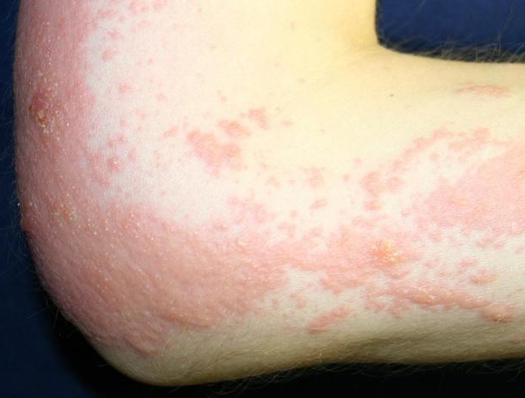
3- Langerhans Cells
Langerhans cells are the third type of epidermal cells
They are dendritic cells found in the mid-epidermis
Their main function is in the afferent limb of the immune response by providing for the recognition, uptake, processing, and presentation of antigens to sensitized T-lymphocytes, and are important in the induction of delayed-type hypersensitivity.
A common skin disease in which Langerhans cells play a prominent role is allergic contact dermatitis, such as poison oak
24

Slide 25
Langerhans Cells

Slide 26
Outline: basic anatomy of skin
Layers of the skin
Epidermis: layers, cell types, and function
Dermis: layers, cell types, and function
Subcutis
Adnexal structures

Slide 27
Move down from epidermis Name the two layers of the dermis.
a
b

Slide 28
The two layers of the dermis
Papillary
dermis
Reticular
dermis

Slide 29
The Dermis
The dermis provides a flexible but tough support structure.
It is between 1-4 mm thick (depending on age and body location), making it much thicker than the epidermis.
It contains the blood and lymphatic vessels and nerves which supply the skin, as well as sweat glands and hair follicles.

Slide 30
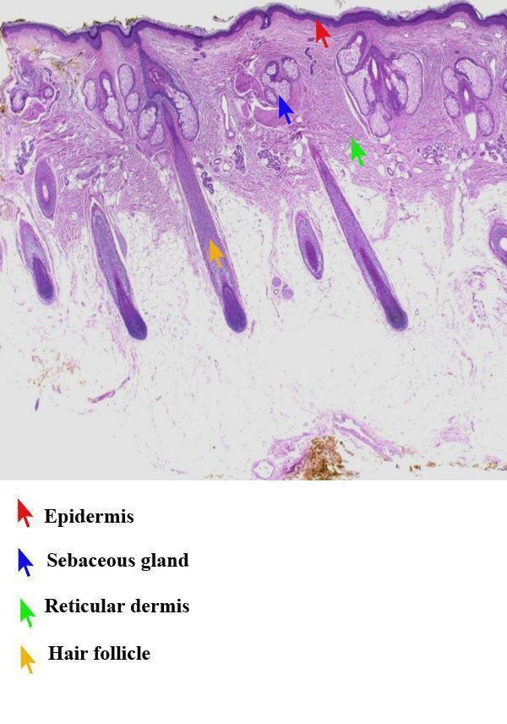
What else is in the dermis?
This is a biopsy from the scalp to show the follicles and sebaceous (oil) glands, found in the dermis.
There are many hair follicles (yellow arrow) running through the dermis.
Each follicle has associated sebaceous or oil glands (blue arrow).
Red arrow – epidermis
Green arrow – reticular dermis

Slide 31
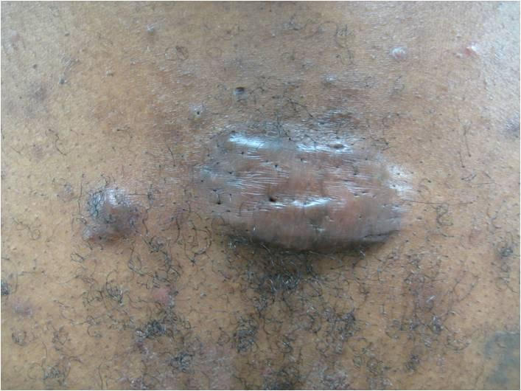
Cells of the dermis
1- Fibroblasts and mast cells reside in the dermis
Fibroblasts are responsible for the synthesis and degradation of connective tissue proteins (elastin)
They are instrumental in wound healing and scaring
Keloids (abnormal scars) result from uncontrolled synthesis and excessive deposition of collagen at sites of prior dermal injury and wound repair

Slide 32
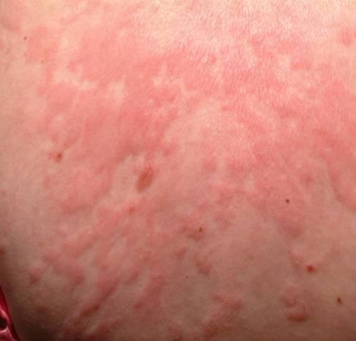
Cells of the dermis
2- Mast cells are specialized cells that are responsible for immediate-type hypersensitivity reactions in the skin
The mast cell is the major effector cell in urticaria, which is a vascular reaction of the skin characterized by wheals surrounded by a red halo or flare.

Slide 33
Mast Cells

Slide 34
Outline: basic anatomy of skin
Layers of the skin
Epidermis: layers, cell types, and function
Dermis: layers, cell types, and function
Subcutis
Adnexal structures

Slide 35
The Subcutis
The subcutis is the fat layer which separates the dermis from deeper underlying structures such as fascia and muscles
The subcutis insulates the body, serves as an energy supply, cushions and protects the skin, and allows for its mobility over underlying structures

Slide 36
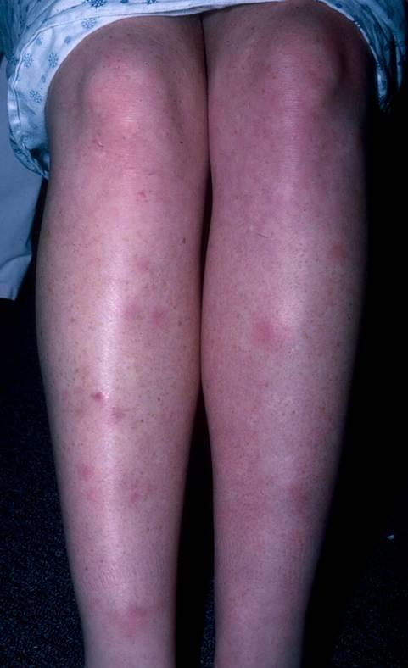
Disorder of the subcutis
Erythema nodosum is an example of panniculitis (inflammation of the subcutis)
Clinically appears as deep-seated erythematous nodules, typically on the shins
Erythema nodosum may be idiopathic or a reaction to infections, medication, or an underlying autoimmune disease (e.g. Crohn’s disease)

Slide 37
Outline: basic anatomy of skin
Layers of the skin
Epidermis: layers, cell types, and function
Dermis: layers, cell types, and function
Subcutis (fat)
Adnexal structures

Slide 38

The pilosebaceous (hair/oil gland) unit
Adnexal structures include the pilosebaceous unit and eccrine gland
Pilosebaceous unit consists of:
A hair follicle
Sebaceous (oil) glands
Apocrine* sweat glands
An arrector pili muscle (when these contract you get goosebumps)
Apocrine glands are found in the axillary and anogenital areas, which is why we do not see them on this biopsy of the scalp. These glands open directly in to the hair follicle.

Slide 39
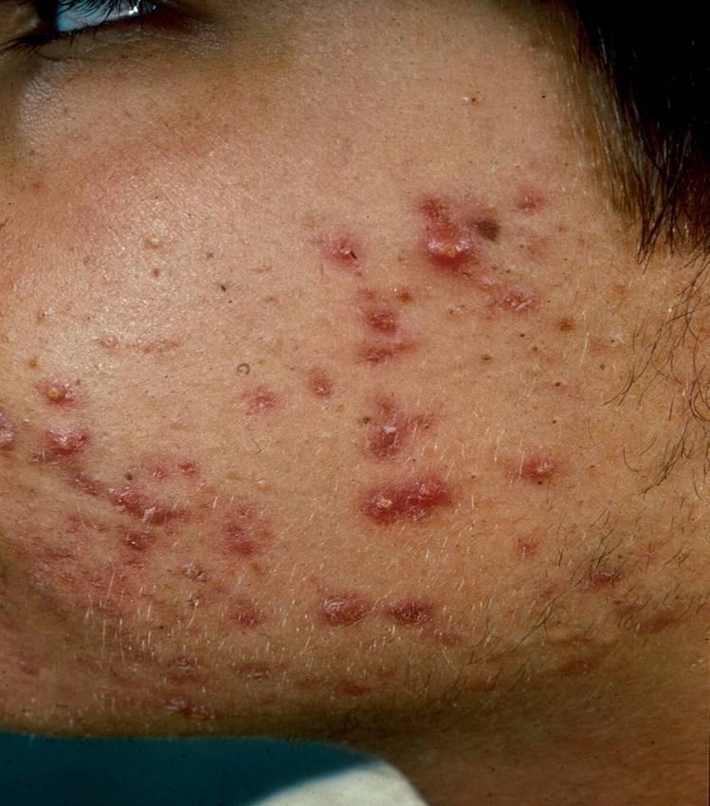
Disorder of pilosebaceous unit
Acne vulgaris is a disorder of the pilosebaceous unit.

Slide 40
Eccrine Glands
In contrast to apocrine glands, eccrine sweat glands do not involve the hair follicle.
They open directly onto the skin surface and are present throughout the body.
Eccrine glands help regulate body temperature by excreting sweat onto the skin surface, where cooling evaporation takes place.
Eccrine glands are sometimes genetically absent, which will predispose a patient to hyperthermia.

Slide 41
Review, Layers of the skin
Epidermis
Papillary dermis
Reticular dermis
Subcutis
The epidermis is the purple stripe at the top of the biopsy, and is noted with the red arrow. The reticular dermis is noted with the green arrow. The papillary dermis is the thin bright pink band visible just below the epidermis. The subcutis (fat) is the mostly clear area in the bottom half of the image.

Slide 42
Review Chart: Functions of the Skin
Tissue Layer | Function | Associated Diseases
Epidermis | Permeability barrier | Atopic dermatitis
Epidermis, dermis | Protection from pathogens | Molluscum contagiosum
Epidermis, dermis, subcutis | Thermoregulation | Hyperthermia
Epidermis | Ultraviolet protection | Albinism
Epidermis, dermis, subcutis | Sensation | Diabetic neuropathy
Epidermis, dermis | Wound repair/regeneration | Venous stasis ulcer, Keloid
Epidermis, dermis, subcutis | Physical appearance | Lipodystrophy

