Slide 1
Atopic Eczema (AD)
Dr Sami Billal
PhD , MD

Slide 2
Definition
AD is an itchy, chronic, relapsing, inflammatory skin condition.
Skin rash is characterized by itchy papules (occasionally vesicles in infants) which become excoriated and lichenified.
The eruption is associated with other atopic conditions in the individual or other family members

Slide 3
History
Ask about itching (no Atopic dermatitis without itching)
You have to ask about family or personal history of other atopic diseases as bronchial asthma ,rhinitis and hay fever
Ask about similar condition

Slide 4
Clinical Features
Macular erythema, papules / papulo-vesicles
crustations
Lichenification and excoriation
Dryness of the skin
Secondary infection

Slide 5
Clinical features
The type and distribution of the lesions varies with age:
Infantile phase
Childhood phase
Adult phase

Slide 6
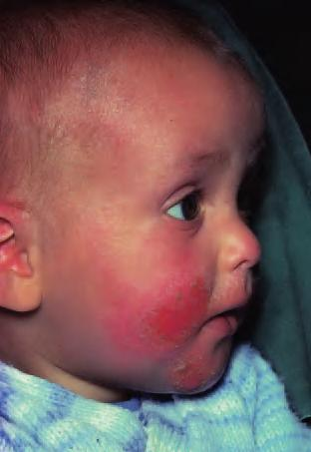
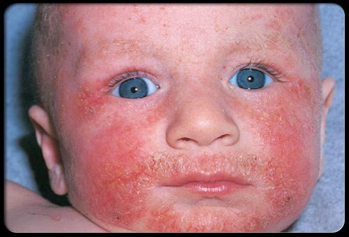
1. Infantile phase
Clinical features ...

Slide 7
1. Infantile phase
Clinical features ...
From 2 months to 2 years
Site: Lesions usually start on the face (forehead, cheeks) - but may occur anywhere
The napkin area is usually spared
Extensor aspect of the knees, are most involved

Slide 8
Infantile phase
Lesions consist of Erythema & oedematous papules
Intense itching
May become exudative & crusted
Secondary infection is not uncommon

Slide 9
2. Childhood phase
From 2 years– 10 years
Site: Elbow and knee flexures (antecubital+ popliteal) sides of the neck, wrists and ankles
The erythematous and oedematous papules tend to be replaced by lichenification.

Slide 10
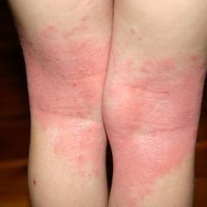
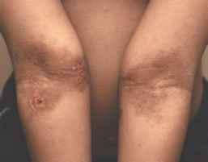
Clinical features ...
3. Adult phase

Slide 11
Clinical features ...
3. Adult phase
Commonly the flexures of limbs and the back of neck (nape) are involved.
Lichenification and excoriation

Slide 12
Management
The aim is to:
Decrease itching
Improve sleeping and family interactions
Improve school and work performance

Slide 13
Treatment
1- General advice
Education about AD.
Patients should be taught current knowledge of the
disease, the types of trigger factors, the treatment
options and their likely benefits and risks

Slide 14
Treatment ...
1. Reduction of trigger factors
Avoiding hot climate.
Avoiding contact of wool with the skin (wearing cotton clothing).
Aggravating foods (if the patient clearly identifies then).
Stress aggravates atopic dermatitis (give simple reassurance).

Slide 15
Treatment ...
3. Topical therapy
Bathing and emollients
Bathing and immediate moisturizing is helpful
Regular use of emollients will protect against inflammation.
Emollients should be applied as frequent as possible throughout the day.

Slide 16
Treatment ...
3. Topical therapy
Topical corticosteroids
Are the predominant treatment for the inflammation of AD.
The strength and mode of application depends on the severity of the dermatitis, the sites to be treated, and the age of the patient.

Slide 17
Treatment ...
3. Topical therapy
Topical corticosteroids
Less potent topical steroids used on the: eyelids, face, axillae, groins and inner thighs.
Less potent topical steroids are used in children less than 1 year old (systemic absorption occurs, even 1% hydrocortisone ointment).
In infected or crusted dermatitis: steroid/antibiotic should be used

Slide 18
Treatment ...
4. Systemic therapy
Antihistamines:
H1-receptor antagonists are used for their sedative effect for nocturnal itching
Given 1 hour before bedtime.
Are best used in short courses (10-14 days)
Non-sedating antihistamines are of little value for the pruritus of atopic dermatitis.

Slide 19
Treatment ...
4. Systemic therapy
Antibiotics:
Exudation and pustule formation indicates staphylococcal infection.
Colonization of bacteria may exacerbate the dermatitis.
In Atopic Dermatitis , antibiotics may be helpful even if frank infection is not apparent.
Antibiotics as erythromycin are indicated.

Slide 20
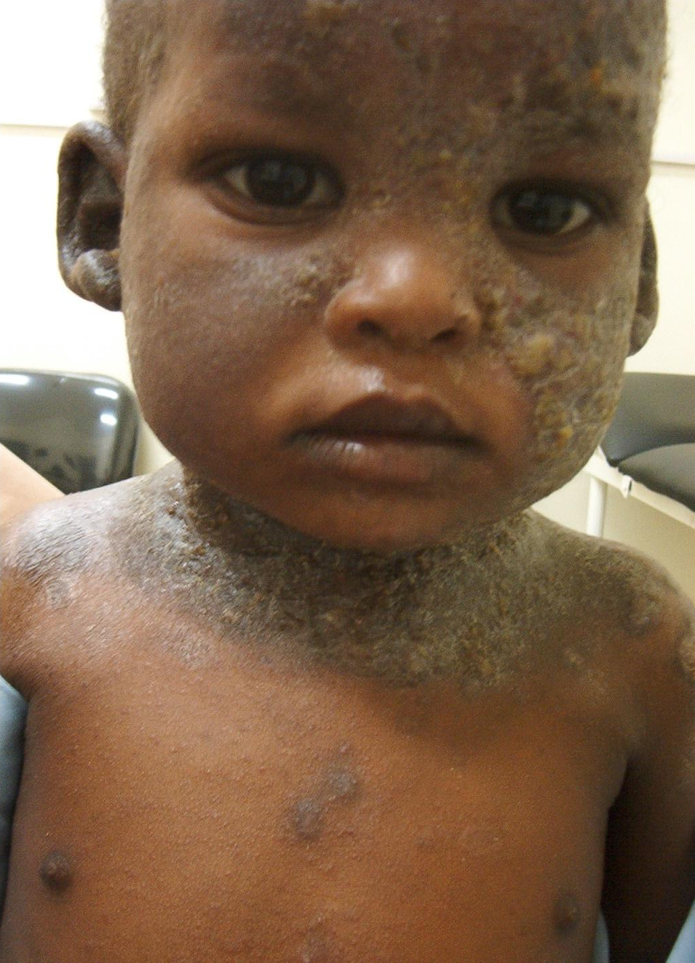
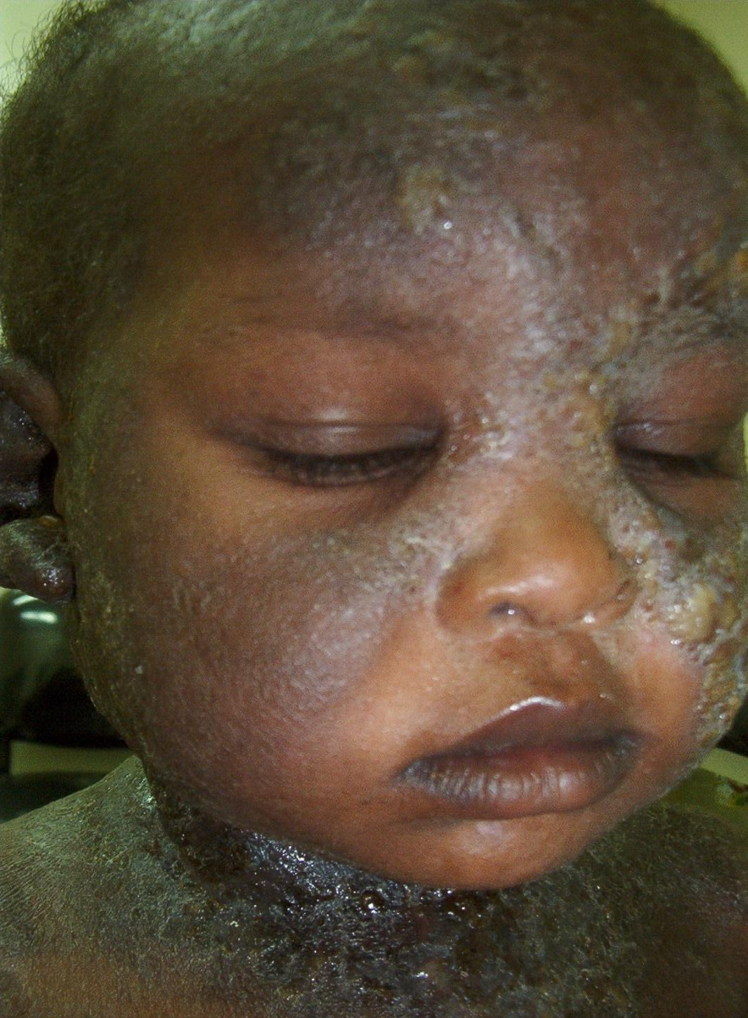

Slide 21
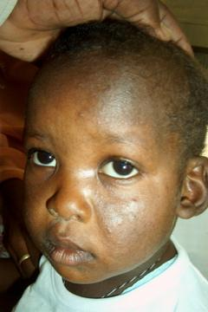
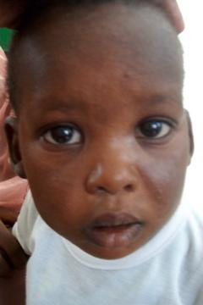
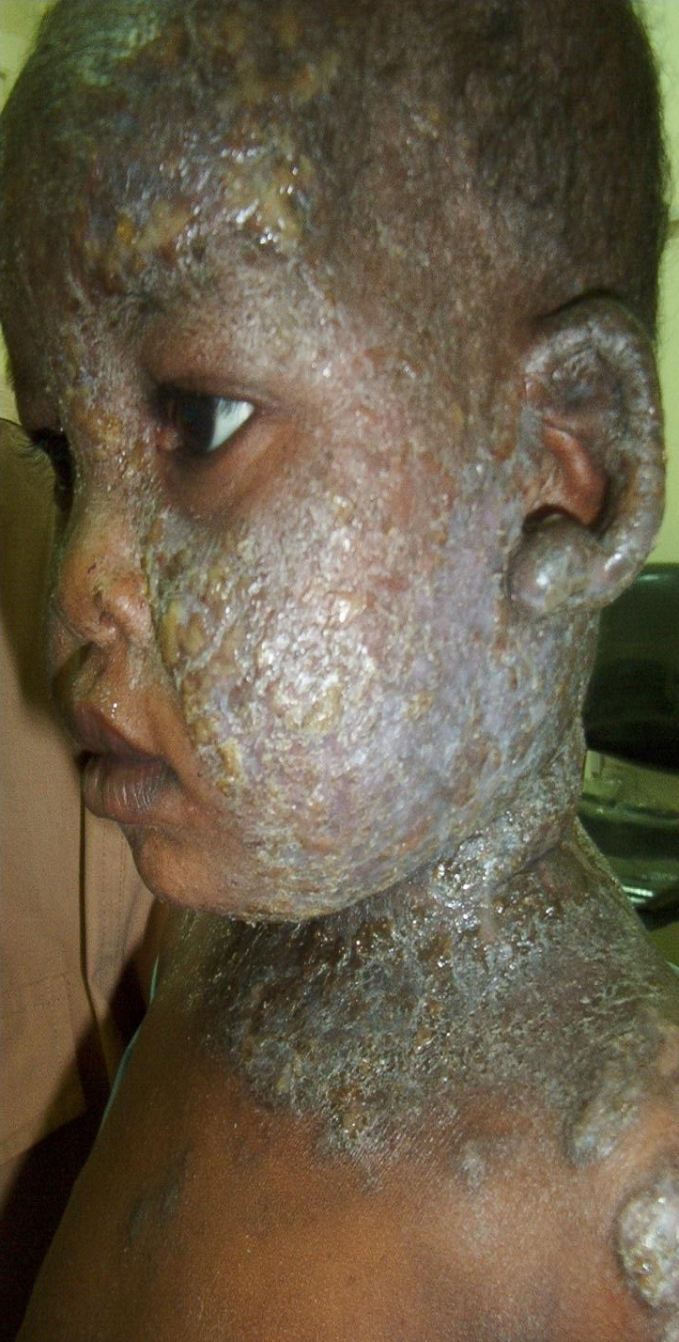

Slide 22
*****Thank you*****

