Slide 1
Vesiculobollus Skin Diseases
Dr Sami Fatehi
MD, MSc, PhD

Slide 2
Vesiculobollus Skin Diseases
Bollus diseases are skin conditions characterised by blister formation.
A Bullae (blisters )are an accumulation of fluid between cells of the epidermis or upper dermis.

Slide 3
Causes of blister could be:
Genetic → since birth or in the early life
Physical → heat or friction
Inflammatory→ eczema
Immunologic → autoimmune reaction.
Non-immunologic → drug reaction.

Slide 4
How are the keratinocytes hold together ?
There are two levels of holding:
Between keratinocytes → DESMOSOMES
Between basal keratinocytes and basement membrane (dermis) → HEMIDESMOSOMES

Slide 5
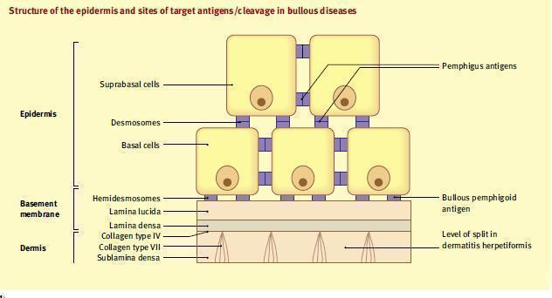

Slide 6
Keratinocytes of the epidermis are tightly bound together al around the cell by desmosomes and intercellular substance to form a barrier of high tensile strength and stability.
Basal keratinocytes bind to BMZ by hemidesmosomes.

Slide 7
BASEMENT MEMBRANE ZONE(BMZ)
BMZ lies beneath the epidermis as specialized area of cell- extracellular matrix adhesion.
Collagens & laminins traversing the zone forming hemidesmosomes and anchor the epidermis to the dermis

Slide 8
BMZ is divided into
Lamina lucida
Lamina densa
Sub lamina densa
The BMZ is vulnerable to damage or malformation and is a common site of blister formation, particularly the lamina lucida.

Slide 9
Classification and pathophysiology of bollus diseases
Intra-epidermal bulla → the base and the roof of the bulla are epidermal cells → bulla is flaccid and easy to be ruptured
Sub-epidermal bulla → the base is the dermis and the roof is the epidermis → bulla is tense and stable

Slide 10
Classification and pathophysiology of bollus diseases
1- Intraepidermal bullae :
Acantholytic bullae : This is because of the break down of desmosomes
Nonacantholytic bullae :
It is due to death of the cells or physical destruction
2- Subepidermal bullae : Lesions formed between the epiderm and the lamina propria of dermoepidermal junction like:
Bollus Pemphgoid
Epidermolysis bullosa

Slide 11
Pemphigus Vulgaris (PV)

Slide 12
1- Pemphigus Vulgaris (PV)
Pemphigus is derived from the Greek word pemphix meaning bubble or blister.
Pemphigus describes a group of chronic bullous diseases, originally named by Wichman in 1791.

Slide 13
Pathophysiology
Blisters in PV are associated with the binding of IgG autoantibodies to keratinocyte cell surface molecules.
The binding of autoantibodies results in a loss of cell-cell adhesion, a process termed acantholysis.
Pemphigus antibody binds to keratinocyte cell surface molecules desmoglein 1 .

Slide 14
PV Characters:
Histologically by intraepidermal blister
Histo-immunologically by the finding of IgGs bound keratinocytes desmosomes proteins.
Immunologically by circulating IgG autoantibodies in the serum of the patient directed against the cell surface of keratinocytes desmosomes proteins (desmoglein 1 ).
Clinically by flaccid bullae and or erosions in the mucus membranes and skin

Slide 15
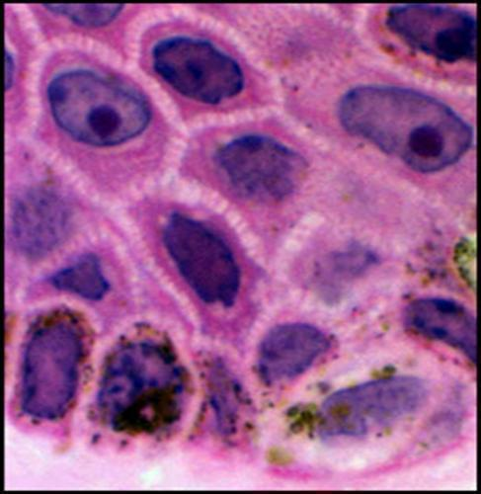
Desmosomes

Slide 16
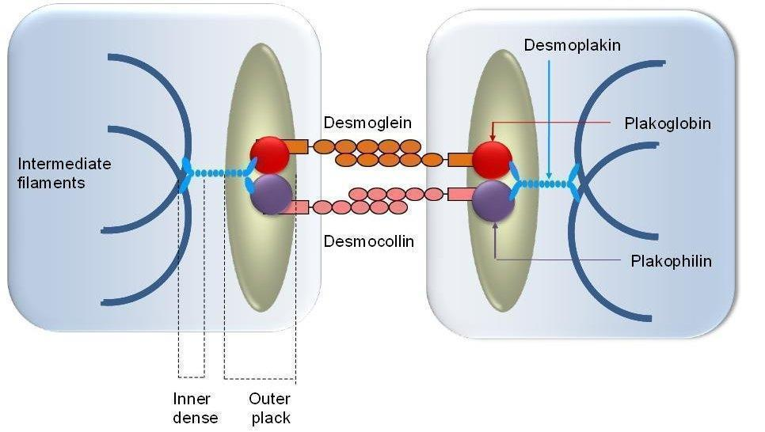

Slide 17
Clinical Presentation

Slide 18
Age: Peak age of onset is from 50-60 years.
The disease may present in childhood or in older persons.
PV may be associated with other autoimmune diseases, particularly myasthenia gravis and thymoma.

Slide 19
1- Mucous Membranes
Almost all patients have mucosal lesions.
Mucosal lesions may precede the cutaneous lesions by 6months.

Slide 20
2- Skin
Most patients develop cutaneous lesions.
The primary lesion of PV is a flaccid bulla, which usually arises on normal-appearing skin.
New bulla usually are flaccid or become flaccid quickly.
Affected skin often is painful but rarely pruritic.
Nikolsky sign is positive.
Asboe Hansen sign is positive.

Slide 21
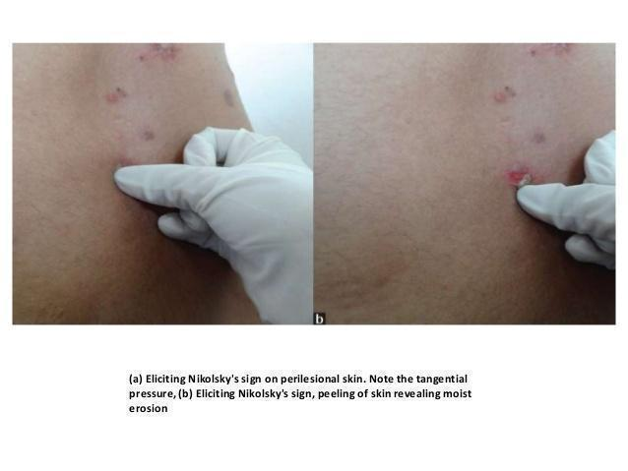
Positive Nikolsky’s Sign
Nikolsky Sign : Dislodging of epidermis by lateral finger pressure in the vicinity of lesions, which leads to an erosion.
Shearing stresses on normal skin can cause new erosions to form

Slide 22
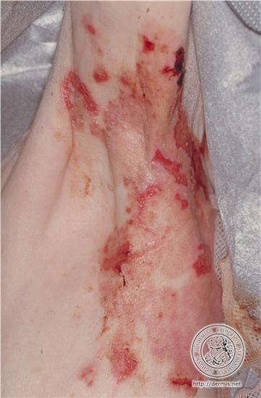
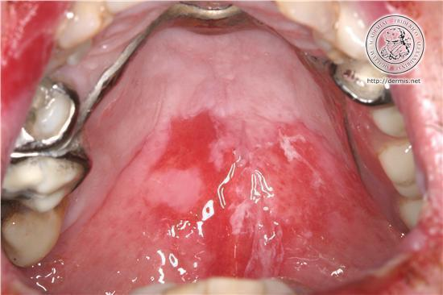
PEMPHIGUS VULGARIS

Slide 23
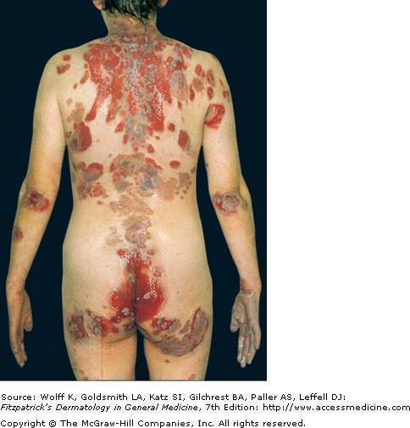

Slide 24
Differential diagnosis
Bullous Pemphigoid
Dermatitis Herpitiformis
Chronic bolus disease of childhood

Slide 25
Laboratory Studies
To establish a diagnosis of PV, perform the following tests:
Histopathology from the edge of a blister → Suprabasal epidermal cells separate from the basal cells to form clefts and blisters(the basal cells appear as tombstones).
Direct immunofluorescence (DIF)
Indirect immunofluorescence (IDIF)

Slide 26
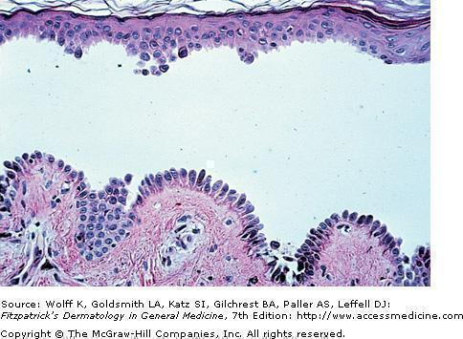
Histopathology

Slide 27
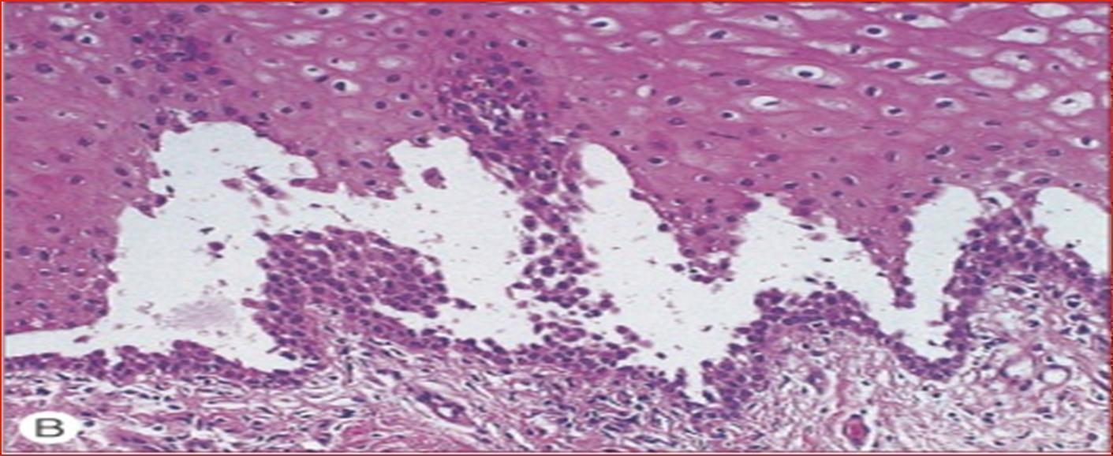

Slide 28
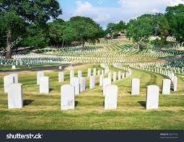

Slide 29
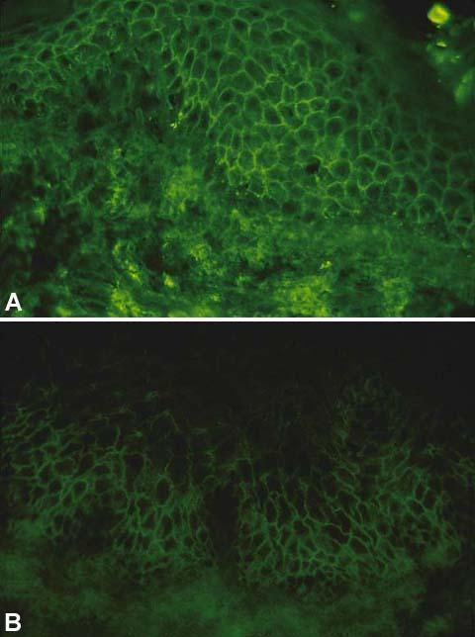
Pemphigus Vulgaris ;Immunofluorescence
1- DIF : (skin) Note deposition of IgG around epidermal cells(net appearance ).
2- IDIF: (serum) using monkey esophagus:
Note binding of IgG antibodies to the epithelial cell surface.

Slide 30
Treatment
The aim of treatment in PV is to:
Decrease blister formation
Promote healing of blisters and erosions
determine the minimal dose of medication necessary to control the disease process and taking into account preexisting and coexisting conditions.

Slide 31
DRUGS
1- Prednisone dose is 1-1.5 mg/kg/d
Immunosuppressive drugs are steroid sparing and should be considered early in the course of the disease.
2- Azathioprine (Imuran)
In conjunction with prednisone, the dose is 1 mg/kg/d

Slide 32
Prognosis
The severity and natural history of PV are variable, but before the advent of steroids, most patients with PV died.
Treatment with systemic steroids has reduced the mortality rate to 5-15%.

Slide 33
Bullous Pemphigoid(BP)
Bullous pemphigoid affected elderly people, with onset usually after 60 years of age.
The blister in BP is subepidermal with an intact roof.
Has benign course if compared to PV.

Slide 34
PATHOGENESIS
There is linear deposition of IgGs & complement factors against proteins(Ags) at the dermo-epidermal junction
The IgG antibodies bind to two main antigens, the BP Ag type 1 and BP Ag type 2 found in the hemidesmosomes and in the lamina lucida.
Complement is then activated , starting an inflammatory cascade which results on separation at lamina lucida.

Slide 35
Skin biopsy shows a deeper blister(than in pemphigus) owing to a subepidermal split through the BM
On direct IF, perilesional skin shows linear band of IgG and C3 along BMZ
Indirect IF shows IgG antibodies that reacts with the BMZ in most patients
Hematology Eosinophilia (not always)

Slide 36
Clinical features
Pemphigoid is a chronic, usually itchy, blistering disease.
Early stages of the disease is characterised by pruritus.
Bullae may be centred on erythematous and urticated base.

Slide 37
Large tense bullae found anywhere on the skin
The flexures are often affected; inner aspect of the thigh, flexure surface of forearms, axillae, groin and lower abdomen
The mucous membranes usually are not affected.
The Nikolsky and Asboe signs are negative.

Slide 38
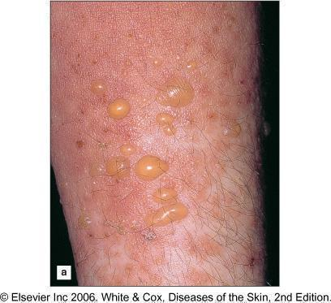
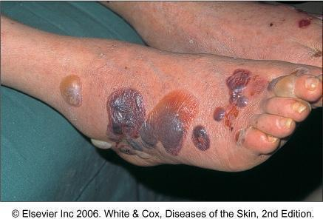
BULLOUS PEMPHGOID

Slide 39
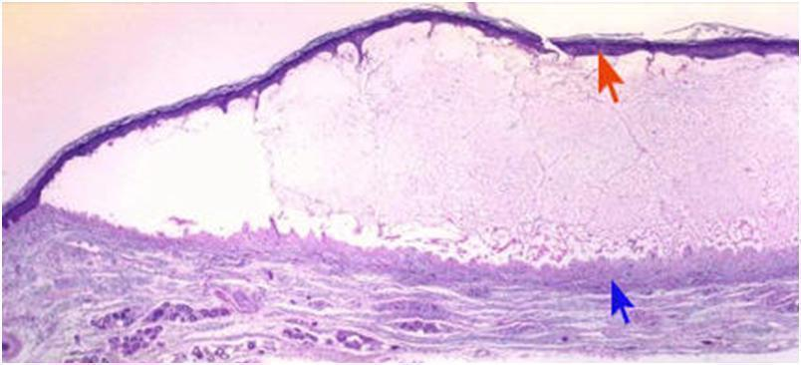
BULLOUS PEMPHIGOID HISTOLOGY

Slide 40
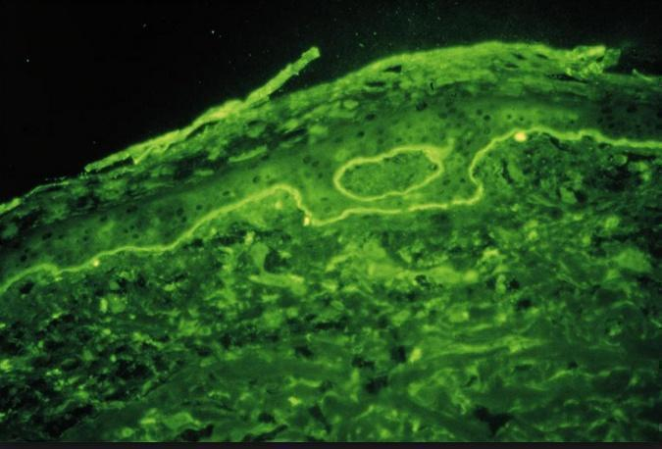

Slide 41
PROGNOSIS
Untreated bullous pemphigoid runs a chronic, self limiting course over a number of months or years.
The disease duration is usually 3-6 years, with most patients achieving complete remission off treatment.

Slide 42
TREATMENT
Topical and systemic steroids are the mainstay of treatment → For localized BP, very potent topical steroids are often sufficient
Low dose of systemic steroid 30 to 40 mg/day
Corticosteroid therapy has lowered the morbidity from the disease considerably and most patients achieve remission off all therapy

Slide 43
Pemphigus vulgaris vs Bollus Pemphigoid
Bollus Pemphigoid(BP)
Pemphigus vulgaris (PV)
Usually affects the middle age
Acute and non itchy
Seen on the trunk, flexures and scalp
Mouth Blister is common
Nature of blister is superficial and flaccid
Circulating Ab is IgG to intracellular adhesion proteins
Serum Ab Titer correlate with clinical disease activity.
Acantholysis
Nikolsky sign is positive
Elderly patients
Chronic and itchy
Usually flexural
Mouth Blister is Rare
Blister is tense and bloody
IgG to BM region
Serum Ab Titer does not correlate with clinical disease activity.
No acantholysis
Nikolsky sign is negative

