Slide 1
Infestations and Bites
Clinical
Dr Sami Aldaham

Slide 2
Case One

Slide 3
Case One: History
HPI: Marium a 6-year-old girl with a two-week history of an itchy scalp. It has not improved with over-the-counter dandruff shampoo. She recently stayed over at her cousin’s house who now has the same problem.
PMH: no chronic illnesses or prior hospitalizations
Allergies: no known allergies
Medications: none
Family history: noncontributory
Social history: lives with her parents and attends first grade
ROS: negative

Slide 4
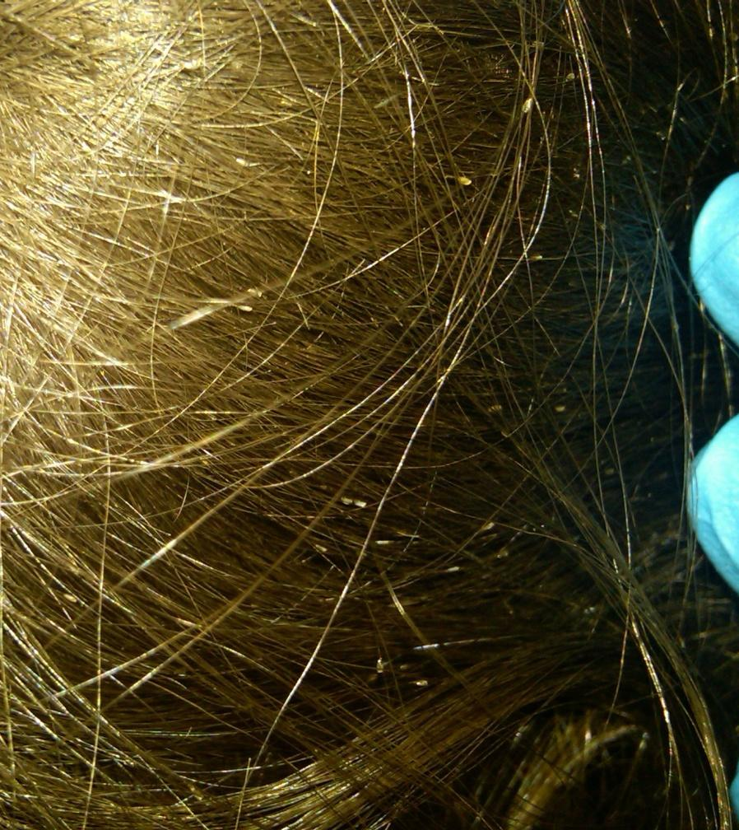

Exam of the Occipital Scalp
Structures on the hair are not freely movable

Slide 5
Case One: Question 1
How would you describe Mary’s exam?
  Multiple hair casts present. No nits or lice noted.
  Multiple lice present. No nits noted.
  Multiple nits present. No lice noted.
  Negative exam, no nits or lice noted.

Slide 6
Case One: Question 1
Answer: c
How would you describe Mary’s exam?
  Multiple hair casts present. No nits or lice noted.
  Multiple lice present. No nits noted.
  Multiple nits present. No lice noted.
  Negative exam, no nits or lice noted.

Slide 7
Exam Findings
Numerous nits (oval egg capsules) firmly fixed to the hair shaft

Slide 8
Pediculosis (Lice)
Three different varieties of lice may infest humans
  Head louse – Pediculus humanus var. capitis
  Body louse – Pediculus humanus var. corporis
  Pubic or crab louse – Phthirus pubis
Head lice are spread by close physical contact and fomites (e.g., brushes, helmets, bedding)
Commonly affects school-age children
Affects all ethnic and socioeconomic groups, but is less common in African-Americans

Slide 9
Clinical Features
Frequently has associated scalp pruritus
May also have posterior cervical lymphadenopathy
Dermatitis may be present on the posterior neck
Nits are noted more commonly than lice on exam (live lice scurry away from light)

Slide 10
Clinical Features
The most common sites to find nits are on the retroauricular and occipital scalp.
Nits within 1 cm of the scalp are typically viable. The distance may be greater in warm environments.
Nits must be distinguished from hair casts.
  Hair casts encircle the hair shaft and move freely in contrast to the nit which is cemented to the hair.

Slide 11
Pediculosis: Pathogenesis
Female adult lice live 30 days and lay 5-10 eggs (nits) per day at the base of the hair where it meets the scalp.
Eggs hatch in 8-12 days.

Slide 12
Pediculosis: Treatment
Individual patient factors should be assessed prior to choosing a topical therapy (age, allergy history, prior treatment, etc.).
First-line over-the-counter and prescription topical therapies are listed on the following slide.
  Use OTC permethrin 1% or pyrethrins when resistance is not suspected.
  Use malathion 0.5% when resistance to permethrin or pyrethrins is documented or when treatment with these products fails.

Slide 13
Case One: Question 2
Marium returns to clinic one month after treatment with topical permethrin 1% lotion. If Marium had live lice in the scalp on follow-up, which of the following answer choices would be possible causes of treatment failure?
  Did not clean daily hair care products
  Did not re-treat in 7-10 days
  Did not treat contacts
  Incorrect application of the medication
  Resistance of the organism to medication
  All of the above

Slide 14
Case One: Question 2
Answer: f
If Mary had live lice in the scalp on follow-up, which of the following answer choices would be possible causes of treatment failure?
  Did not clean daily hair care products
  Did not re-treat in 7-10 days
  Did not treat contacts
  Incorrect application of the medication
  Resistance of the organism to medication
  All of the above

Slide 15
Pediculosis: Patient Education
All persons living in the home should be examined to avoid re-infestation.
  Those with live lice or nits within 1 cm of the scalp should be treated.
  It is prudent to treat family members who share a bed with the person with infestation, even if no lice are found.
  If it is not possible to examine household members, treat without an exam if the treatment is not contraindicated.

Slide 16
Pediculosis: Patient Education
Clothing and bedding should be washed and dried on the hot cycle of the dryer.
Brushes, combs and other hair care items can be placed in hot (> 60°C) water for 10 minutes.
Non-washable items may be placed in the dryer or stored in a sealed plastic bag for 3 days.
Children should not be restricted from attending school because of lice.

Slide 17
Case Two

Slide 18
Case Two: History
HPI: S is a 21-month-old boy who was referred to the dermatology clinic for a rash that has been present for two weeks. The itch has disturbed his sleep.
PMH: no chronic illness or hospitalizations
Allergies: no known drug allergies
Medications: none
Family history: noncontributory
Social history: lives with his parents and attends day care
ROS: negative

Slide 19
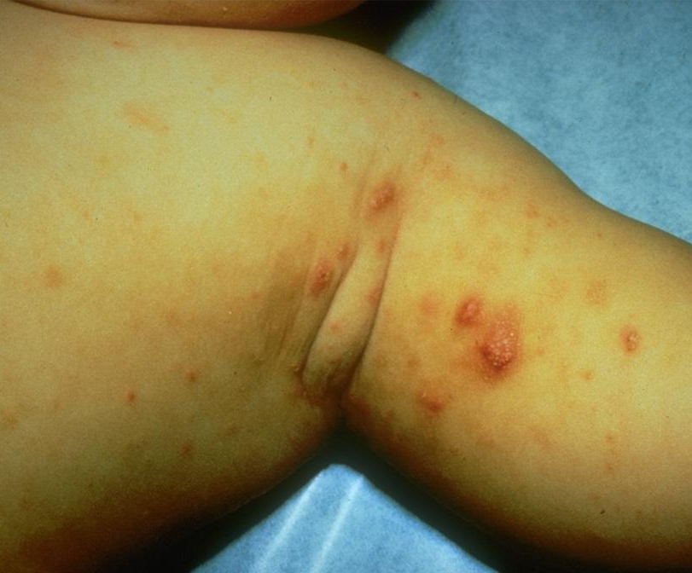
Case Two: Skin Exam
Multiple erythematous papules on the trunk, extremities and genitals.
Burrows present in the 2nd-3rd web space on the right hand.

Slide 20
Case Two: Question 1
What in-office procedure would best help to confirm the diagnosis?
  KOH preparation
  Nail clipping
  Skin scraping
  Wood’s light examination

Slide 21
Case Two: Question 1
Answer: c
What in-office procedure would best help to confirm the diagnosis?
  KOH preparation (commonly used to diagnosis fungal infections of the skin)
  Nail clipping (commonly used to diagnosis onychomycosis)
  Skin scraping (mineral oil preparation)
  Wood’s lamp examination (commonly used to assess the degree of pigment in the skin)

Slide 22
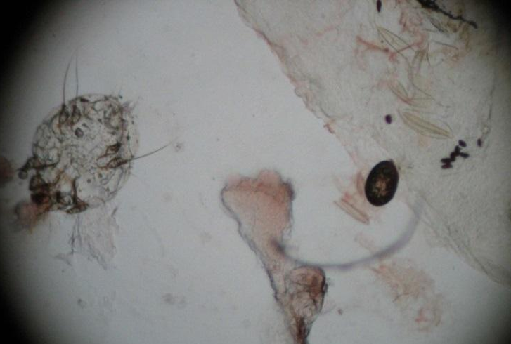
Case Two: Question 2
You perform a mineral oil preparation on the patient.
  You use a 15-blade scalpel and scrape a burrow on the skin. The scraped material is placed on a slide and a drop of mineral oil is added. A cover slip is placed on top and you see the image below when you look through the microscope.
What do you see?

Slide 23

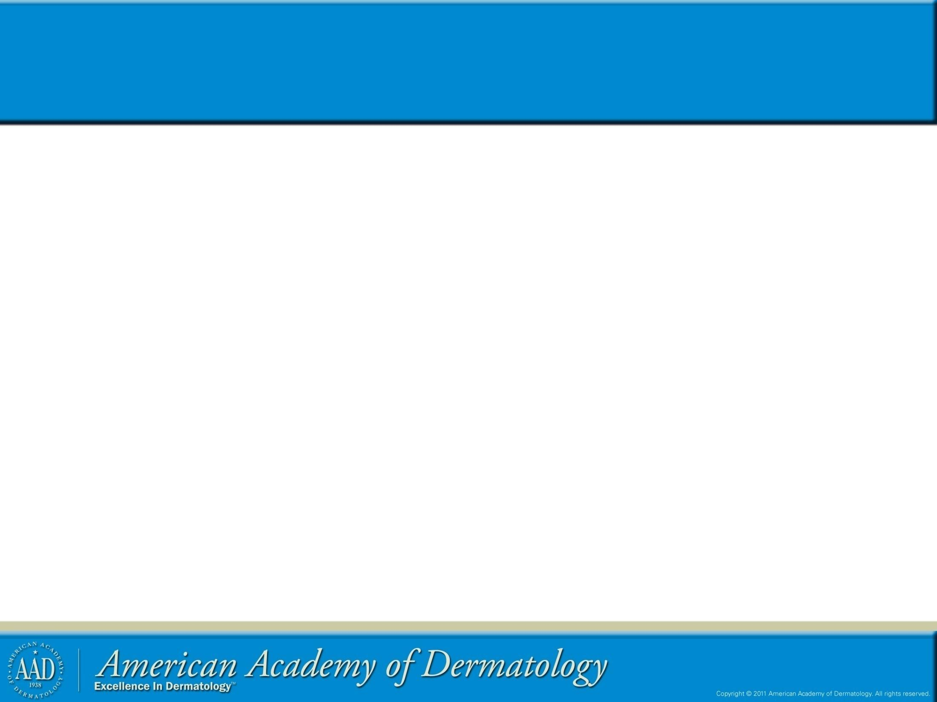
Case Two, Question 2
scabies mite
scybala (feces)
egg
28
23

Slide 24
Scabies
Sarcoptes scabiei (scabies) affects patients of all ages and all socioeconomic classes, although it is more common in women and children.
Immunocompromised individuals and those in congregated facilities (e.g., nursing homes) are more prone to infestation.
Most infections occur from direct contact with an infected individual; however, fomites can transmit infection.

Slide 25
Scabies: Clinical Features
The time from initial infestation to symptoms is typically 3-4 weeks.
    Once sensitized to the mite, re-infestation results in symptoms within 1-2 days.
  Papules may commonly involve the axillae, breasts, umbilicus, penis, scrotum, finger webs and wrists.
  The scalp and head are more frequently involved in infants, elderly and immunosuppressed individuals.
  The hallmark feature is itching at night.

Slide 26
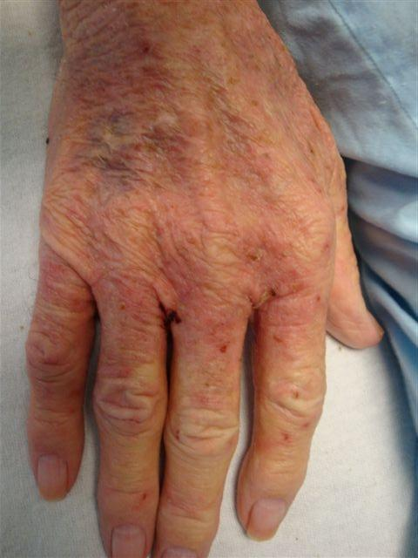
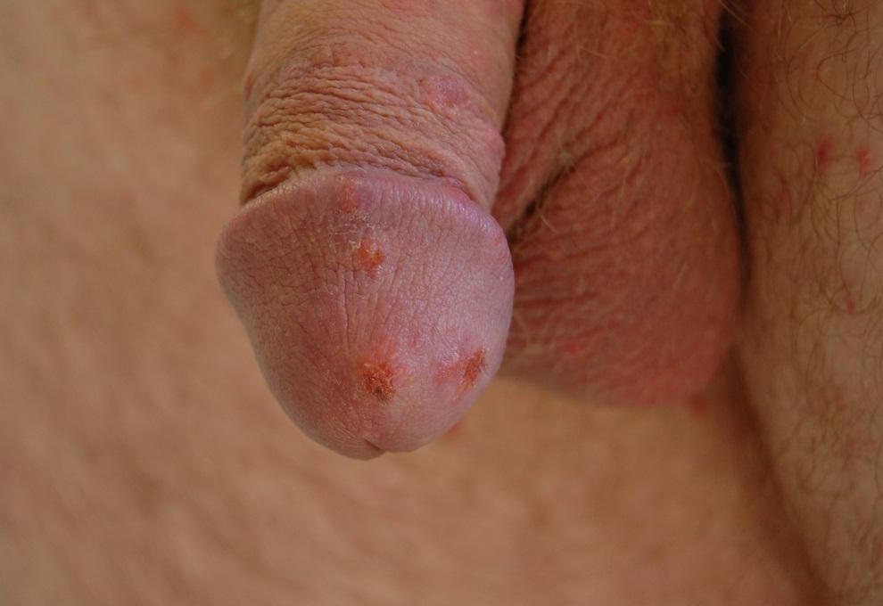
Scabies: Clinical Findings

Slide 27
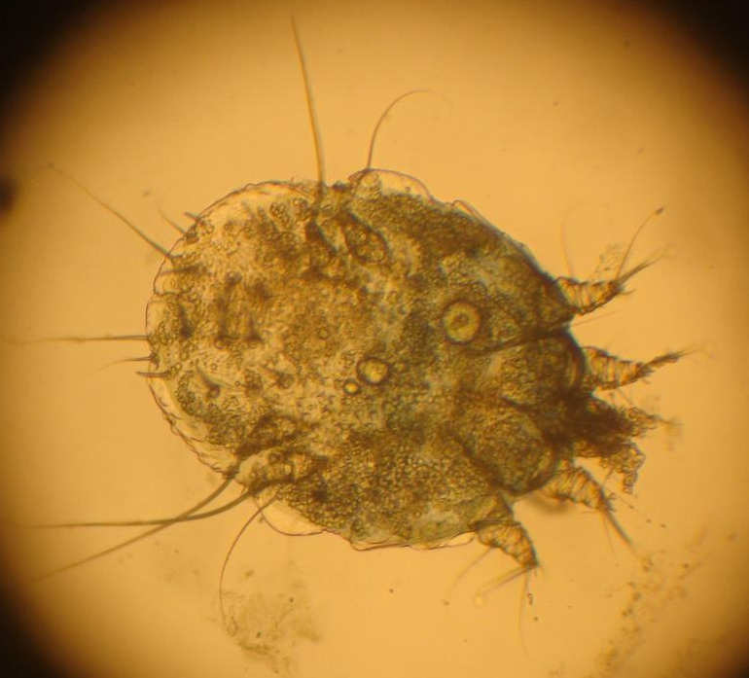
Scabies Mite
The scabies mite is 0.35 x 0.3 mm in size and too small to be seen by the naked eye.
Females lay about three eggs per day, which hatch in four days.
Most patients have less than 20 mites on the skin at a time.

Slide 28
Case Two: Question 3
Which of the following clinical findings is considered pathognomonic for scabies?
  Burrows
  Diffuse involvement
  Erythematous papules
  Sparing of the groin

Slide 29
Case Two: Question 3
Answer: a
Which of the following clinical findings is considered pathognomonic for scabies?
  Burrows
  Diffuse involvement (may be diffuse, especially in infants)
  Erythematous papules (this primary morphology is not specific to scabies infestation)
  Sparing of the groin (genital involvement is common)

Slide 30
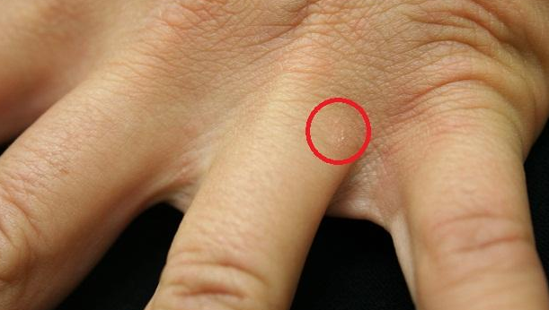
Burrows
Burrows are linear markings in the skin due to the movement of the mite. They are 1-10 mm in length and are most readily found in the interdigital spaces, wrists and elbows.

Slide 31
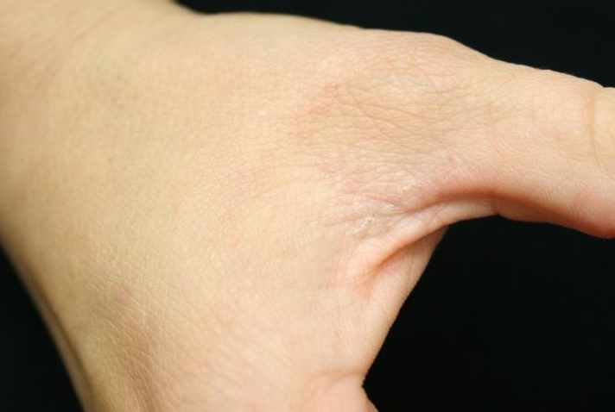
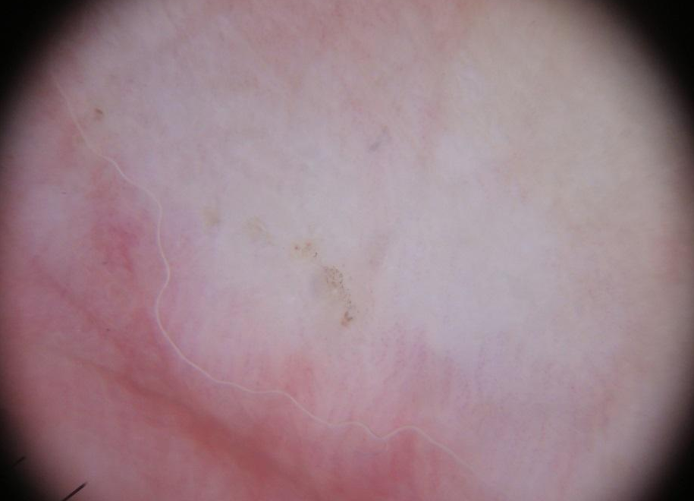
Burrows
Dermoscopy helps identify the mite at the end of a burrow

Slide 32
Case Two: Question 4
S’s mother tells you his uncle, who is HIV+, is currently hospitalized. Why is this important?
  His uncle is unlikely to have been the source of infestation
  If his uncle has scabies, it could cause an institutional outbreak
  If his uncle gets scabies, it will likely be a less severe form
  This is not relevant information

Slide 33
Case Two: Question 4
Answer: b
S’s mother tells you his uncle, who is HIV+, is currently hospitalized. Why is this important?
  His uncle is unlikely to have been the source of infestation (Immunosuppressed patients are at increased risk for infestation)
  If his uncle has scabies, it could cause an institutional outbreak
  If his uncle gets scabies, it will likely be a less severe form (Immunosuppressed patients may develop crusted scabies)
  This is not relevant information

Slide 34
Crusted Scabies
Immune suppressed or neurologically impaired individuals are at increased risk of developing crusted scabies (hyperkeratotic scabies, formerly called Norwegian scabies).
  Presents with thick, scaly, white-gray plaques with minimal pruritus that is often localized to the scalp, face, back, buttocks and feet.
  Fissures provide an entry for bacteria leading to increased risk of sepsis and death.
  Immunocompetent persons who come into contact with crusted scabies develop typical scabies.

Slide 35
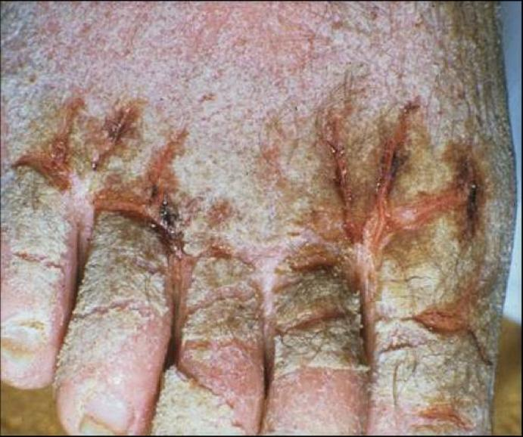
Crusted Scabies
Crusted scabies is far more difficult to treat.
There is an incredibly high mite burden.
Refer to the HIV Dermatology module for more information on crusted scabies.

Slide 36
Treatment
Scabies treatment includes a two-pronged approach.
The patient and the environment must both be treated.
  Two topical treatments separated one week apart with a prescription anti-scabietic medication are recommended.
  Apply topical medication from the neck down and leave on overnight; for infants and the elderly, include the face and scalp.
Itch and lesions can persist for 2-4 weeks after successful treatment, referred to as “post-scabietic” pruritus or dermatitis.
  This is not a treatment failure, rather it represents the body’s response to dead mites.

Slide 37
Treatment
Environmental care includes washing all clothing and linens used within the last week in hot water and drying on high heat.
For items that cannot be washed, seal items in bags for at least 3 days.
Isolation from other people is unnecessary as the causative organism cannot jump or fly, and can survive for only approximately 72 hours away from the skin.

Slide 38
First-line Treatments
1- 5% permethrin cream
Topically overnight on days 0 and 7. Apply from neck down. Include scalp and face in infants and elderly.
2- precipitated sulfur, 5-10%
Apply overnight for three days, then wash off
3- Oral ivermectin
200 mcg/kg by mouth, repeat dose two weeks later

Slide 39
Case Three

Slide 40
Case Three: History
HPI: Mrs. K is a 33-year-old woman who presented to clinic with “itchy bumps” that started over the weekend. No one else at home has a similar complaint.
PMH: GERD (Gasteroesophageal reflux disease)
Allergies: none
Medications: omeprazole
Family history: noncontributory
Social history: works in a restaurant
ROS: negative

Slide 41
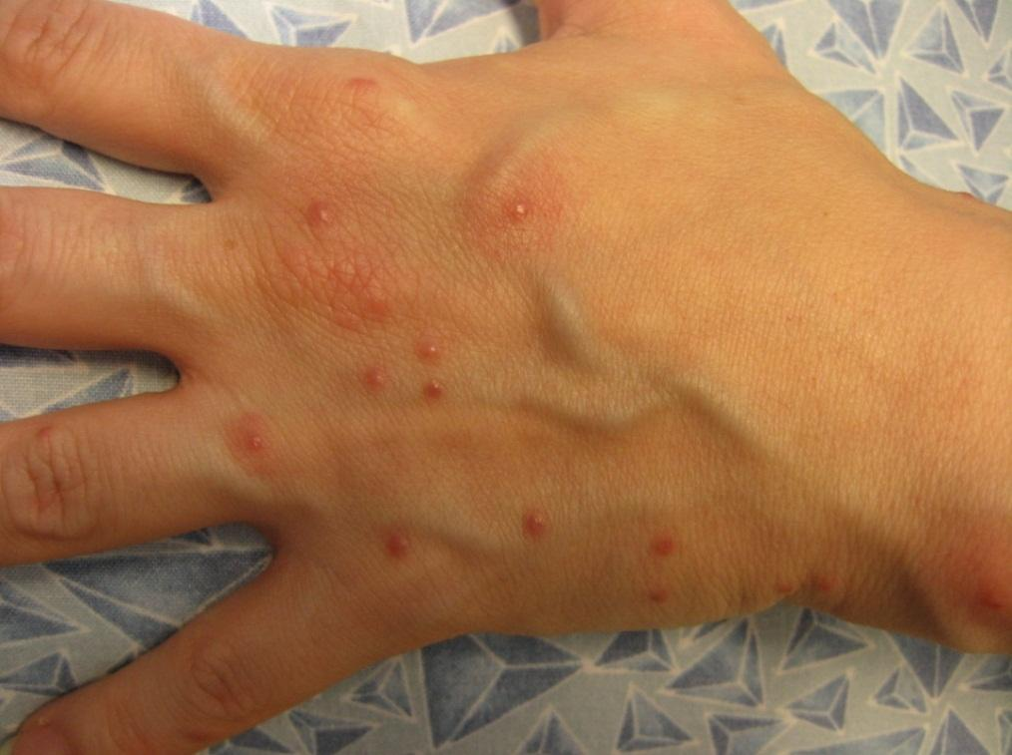
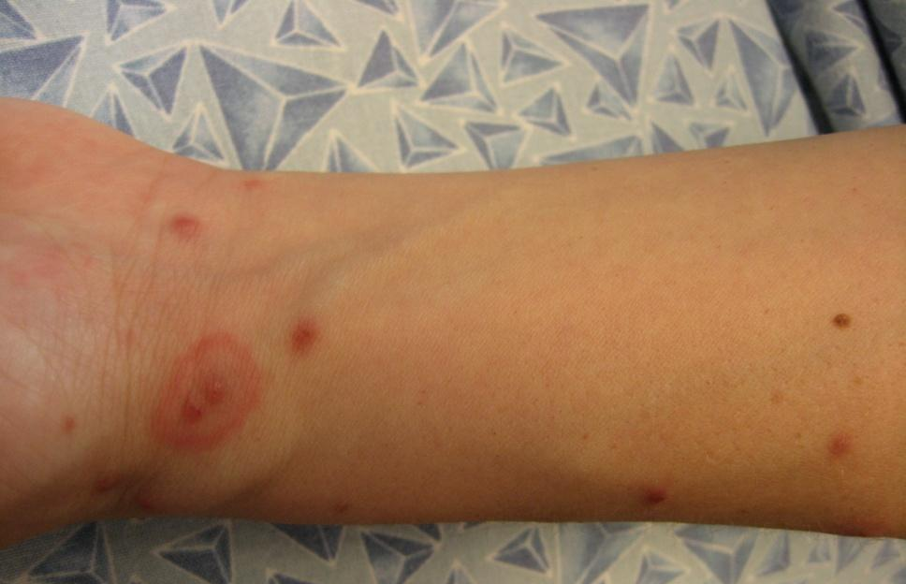
Case Three: Skin Exam
Edematous papules scattered over the body, some are excoriated

Slide 42
Case Three: Question 1
What is the most likely diagnosis?
  Bedbug bites
  Brown recluse spider bites
  Chickenpox
  S. aureus folliculitis

Slide 43
Case Three: Question 1
Answer: a
What is the most likely diagnosis?
  Bedbug bites
  Brown recluse spider bites (normally single site)
  Chickenpox (presents as erythematous macules, papules and clear vesicles. Vesicles are surrounded by narrow, red halos, referred to as “dew drops on a rose petal”)
  S. aureus folliculitis (follicular-based, may be pustular)

Slide 44
Bed Bugs
Cimex lectularius (most common type) affect people from all racial and socioeconomic groups
May be spread during travel on clothing, bedding, mattresses, and laundry, etc
Stay hidden during the day and feed at night
Bites may be multiple in a linear array; referred to as “breakfast, lunch and dinner”

Slide 45
Bed Bugs: Clinical Presentation
Usually present as pruritic, erythematous and edematous papules
Appearance and duration of lesions vary depending on the patient's degree of sensitization
  Some individuals have little or no reaction to bedbug bites
  Common for only one or a few family members (even among those sleeping in the same bed) to report lesions

Slide 46
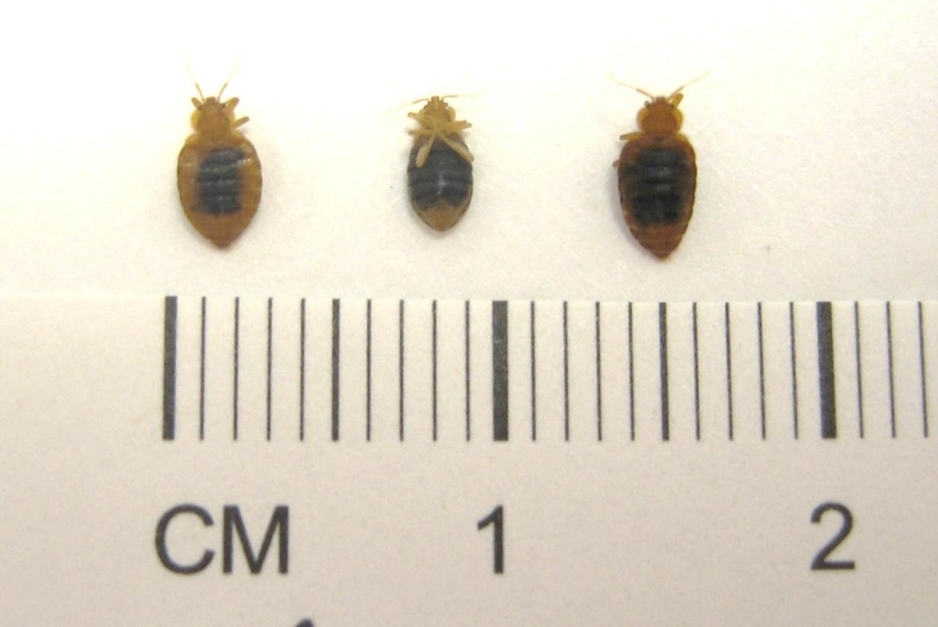
Cimex Lectularius
Red-brown in color with a segmented abdomen and vestigial wings

Slide 47
Treatment
Bites will typically resolve within 1-2 weeks
For symptomatic relief, treat with potent topical steroids and antihistamines
Ultimate treatment requires detection and eradication of the household infestation
  Bed linens need to be laundered and furniture vacuumed
  A professional exterminator may be needed to treat the home

