Slide 1
The Red Face Dr Sami Aldaham

Slide 2
Case One

Slide 3
Case One: History
HPI: Mr. L is a 56-year-old man with several years of redness and scaling on his forehead, eyebrows, and central face. He does not complain of itching but is embarrassed by his appearance. It has not gotten better with moisturizers. It does not worsen with heat, exercise, hot foods or drinks, or alcohol.
PMH: no major illnesses or hospitalizations
Allergies: none
Medications: ibuprofen as needed for headaches
Family history: noncontributory
Social history: office manager
ROS: negative

Slide 4
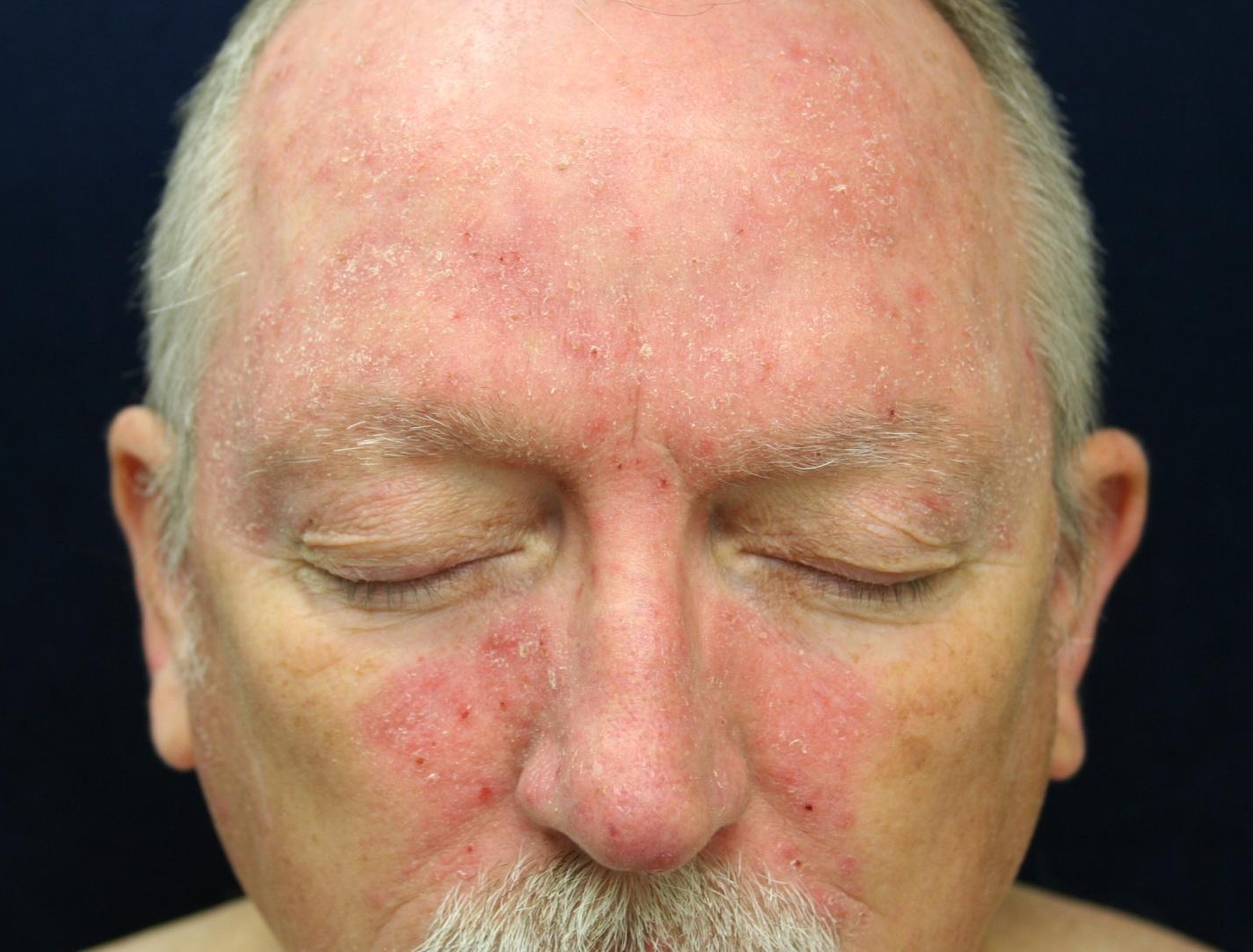
Case One: Skin Exam

Slide 5
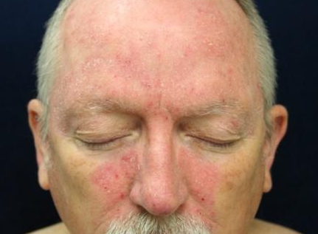
Case One, Question 1
How would you describe the rash on Mr. L ’s face?
Erythematous macules
Papules and pustules
Thin scaling plaques
Vesicles and crust

Slide 6
Case One, Question 1
Answer: c
How would you describe the rash on Mr. L’s face?
Erythematous macules
Papules and pustules
Thin scaling plaques
Vesicles and crust

Slide 7
Case One, Question 2
What is the most likely diagnosis for Mr. L?
Actinic keratoses
Allergic contact dermatitis
Atopic dermatitis
Rosacea
Seborrheic dermatitis

Slide 8
Case One, Question 2
Answer: e
What is the most likely diagnosis for Mr. L?
Actinic keratoses (scale in AK is keratotic, not greasy)
Allergic contact dermatitis (he does not itch)
Atopic dermatitis (wrong age; no history)
Rosacea (no history)
Seborrheic dermatitis

Slide 9
Seborrheic dermatitis
Seborrheic dermatitis is a very common inflammatory reaction to the Malassezia furfur (Pityrosporum ovale) yeast that thrives on seborrheic (oil-producing) skin
It presents as erythematous scaling patches on the scalp, hairline, eyebrows, eyelids, central face and nasolabial folds, external auditory canals, or central chest
It can be hypopigmented, especially in darker skin types
On the chest, it appears more central over the sternum
Seborrheic dermatitis is often worse in patients with HIV

Slide 10
Here are some examples of seborrheic dermatitis

Slide 11
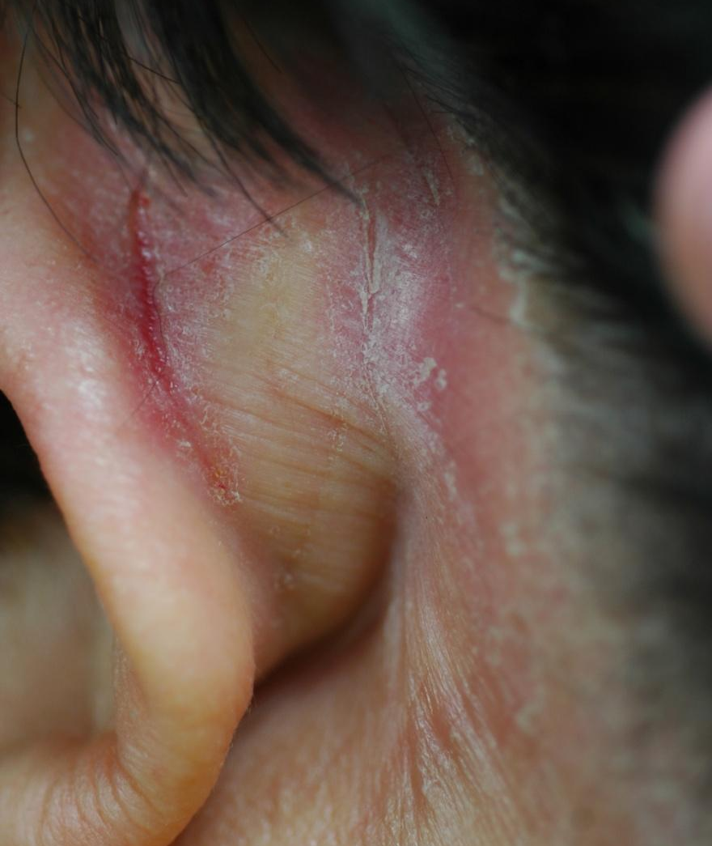
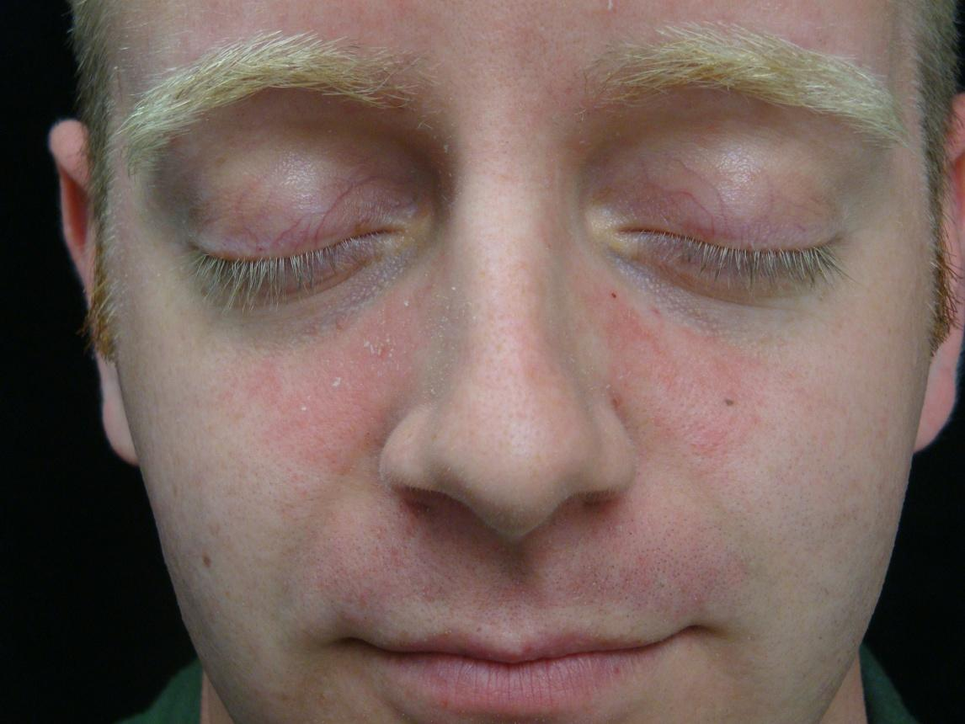
Seborrheic dermatitis

Slide 12
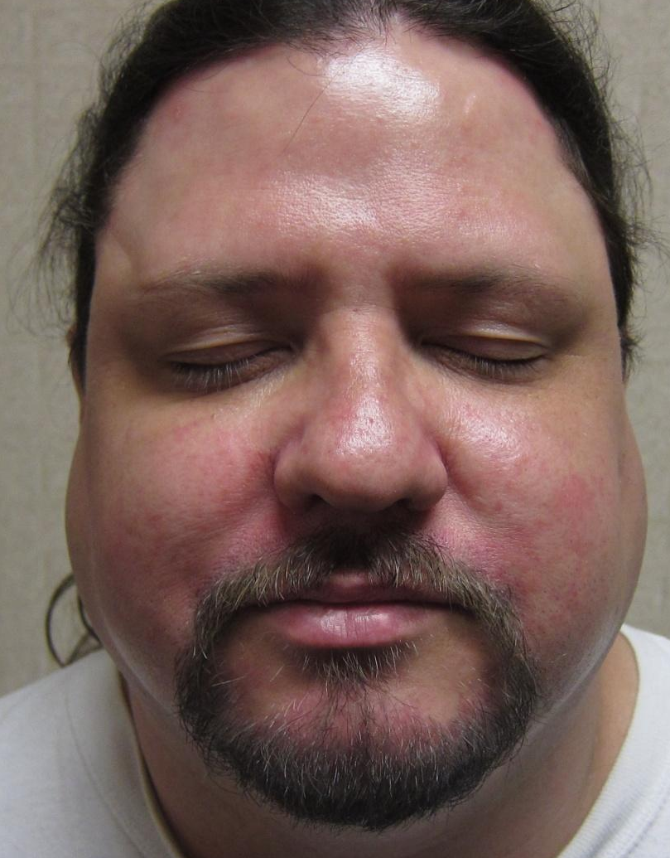
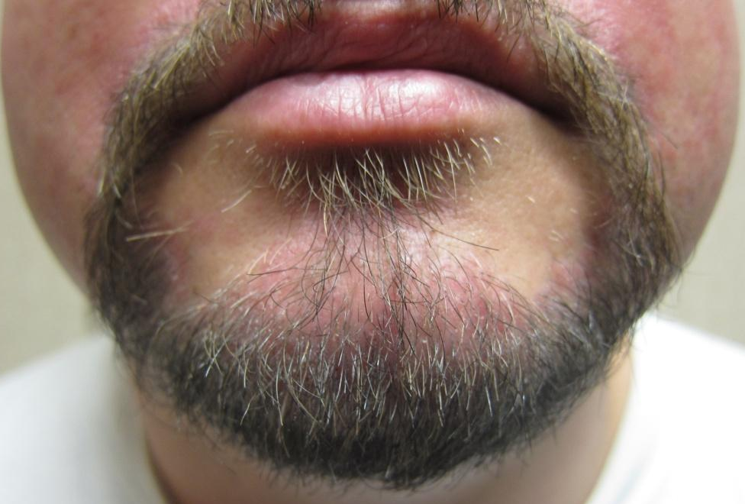
Seborrheic dermatitis

Slide 13
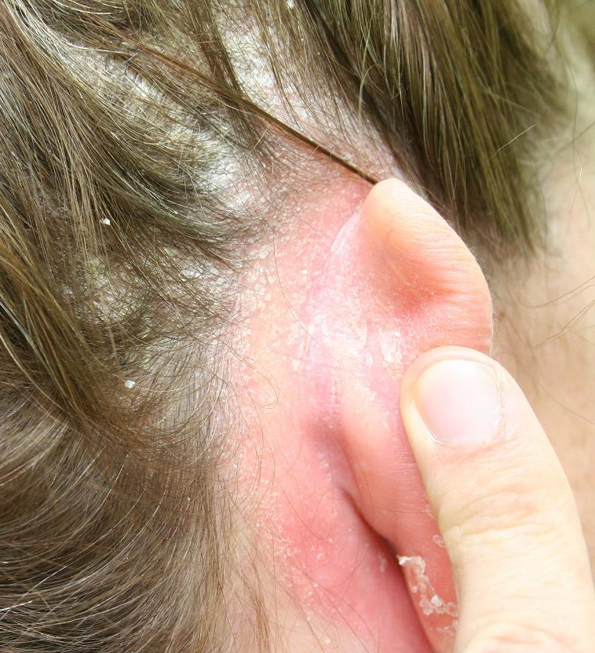
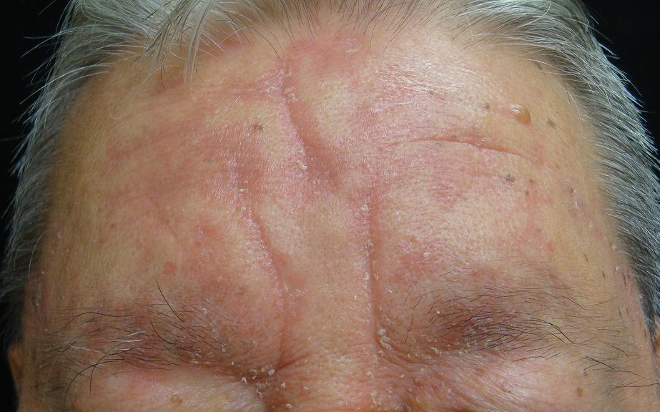
Seborrheic dermatitis

Slide 14
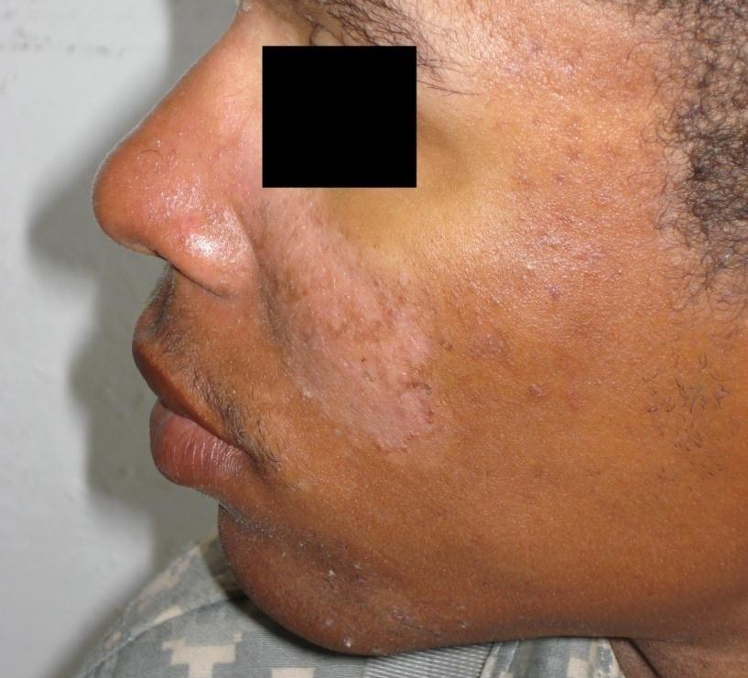
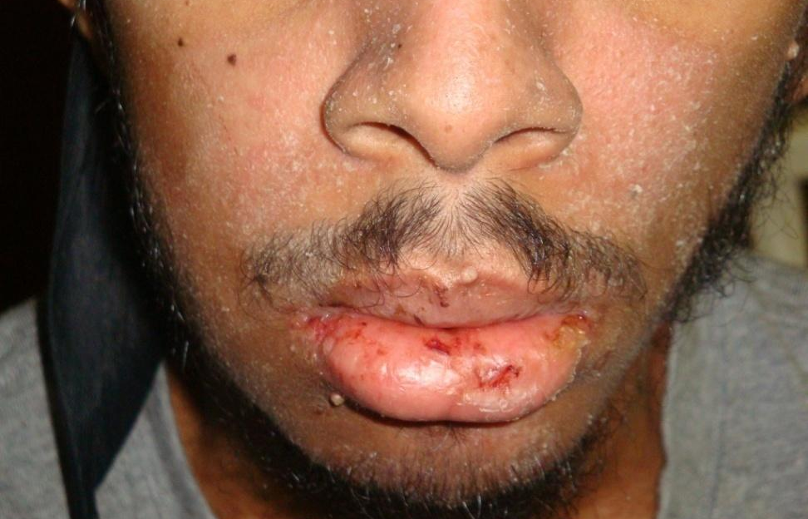
Seborrheic dermatitis
Often hypopigmented in darker skin types

Slide 15
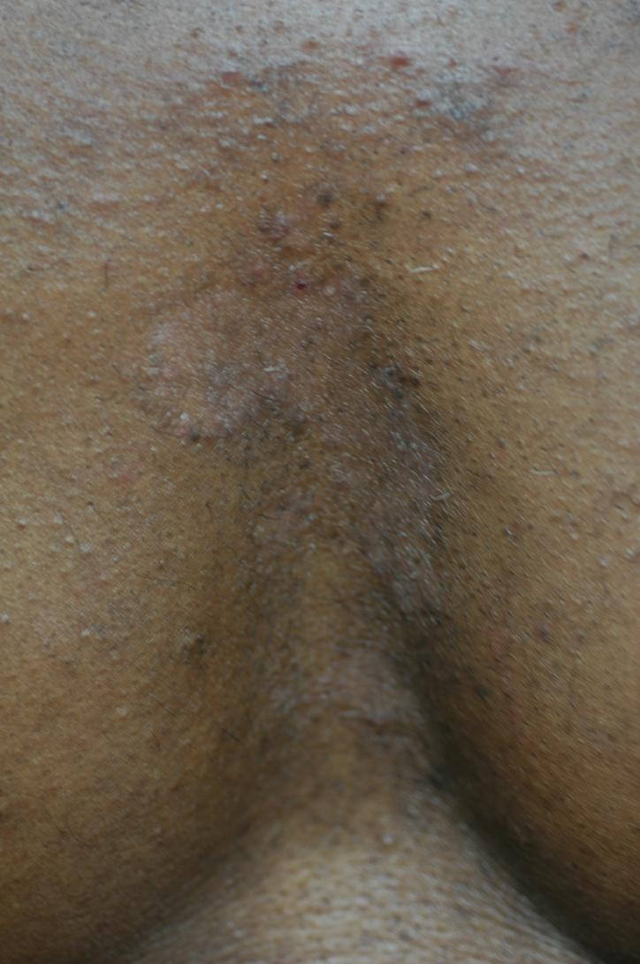
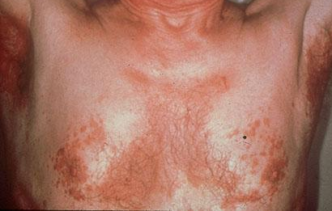
Seborrheic dermatitis
Favors central chest
May be hypopigmented or erythematous

Slide 16
Case One, Question 3
Which two of the following would be an appropriate treatment for Mr. L?
Clobetasol proprionate cream
Desonide cream
Erythromycin ointment
Ketoconazole cream
5-fluorouracil cream

Slide 17
Case One, Question 3
Answer: b or d
Which two of the following would be an appropriate treatment for Mr. L?
Clobetasol proprionate cream (too potent)
Desonide cream
Erythromycin ointment (this is not bacterial)
Ketoconazole cream
5-fluorouracil cream (for actinic keratoses)

Slide 18
Seborrheic dermatitis treatment
Low-potency topical steroids (e.g. desonide) are safe to use for flares on the face
Use twice daily for 1-2 weeks for flares
Can also use topical ketoconazole or ciclopirox, or topical pimecrolimus, in the same manner
Antidandruff shampoo for the scalp, chest
Ketoconazole (Nizoral), selenium sulfide, zinc pyrithione shampoos
Foam, leave on 10 minutes, rinse; repeat 3-5x/week
Refer patients who fail these therapies

Slide 19
Case Two

Slide 20
Case Two: History
HPI: Mr. M is a 47-year-old man who presented to clinic with “red cheeks” for the last 3 years. He reports it is more noticeable with exercise or heat. He stops alcohol because he thinks it makes it worse.
PMH: no major illnesses or hospitalizations
Allergies: none
Medications: multivitamins
Family history: noncontributory
Social history: lives with wife
ROS: negative

Slide 21
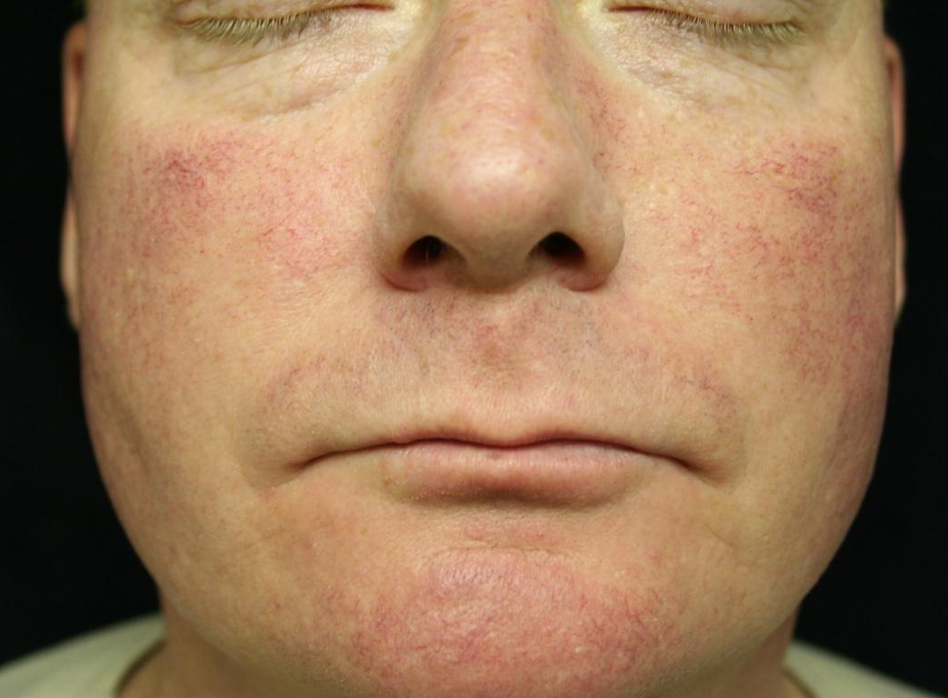
Case Two: Skin Exam
Facial erythema on the nose and cheeks as well as a few small telangiectasias within the erythema.
No comedones, papules, or pustules are noted.
There is no scale.

Slide 22

Case Two, Question 1
What is the most likely diagnosis?
Allergic contact dermatitis
Atopic dermatitis
Rosacea
Seborrheic dermatitis
Systemic lupus erythematosus

Slide 23
Case Two, Question 1
Answer: c
What is the most likely diagnosis?
Allergic contact dermatitis (no itching)
Atopic dermatitis (no itching, ho past history, wrong age)
Rosacea
Seborrheic dermatitis (erythematous patches with greasy scale on the central face)
Systemic lupus erythematosus (negative review of systems; SLE is not triggered by alcohol)

Slide 24
Case Two, Question 2
Which of the following might trigger Mr. M’s rosacea?
Alcohol
Heat/hot beverages
Hot, spicy foods
Sunlight
All of the above

Slide 25
Case Two, Question 2
Answer: e
Which of the following might trigger Mr. M’s rosacea?
Alcohol
Heat/hot beverages
Hot, spicy foods
Sunlight
All of the above

Slide 26
Clinical Features of Rosacea
Rosacea is typically located on the mid face including the nose and cheeks with occasional involvement of the brow, chin, eyelids, and eyes
Patients have erythema and telangiectasias
Patients can have papules and pustules
The absence of comedones helps to distinguish acne vulgaris from rosacea
May also present with rhinophyma (dermal and sebaceous gland hyperplasia of the nose)
Patients can have ocular rosacea: keratitis, blepharitis, conjunctivitis

Slide 27
The Following Photos Illustrate Different Types of Rosacea

Slide 28
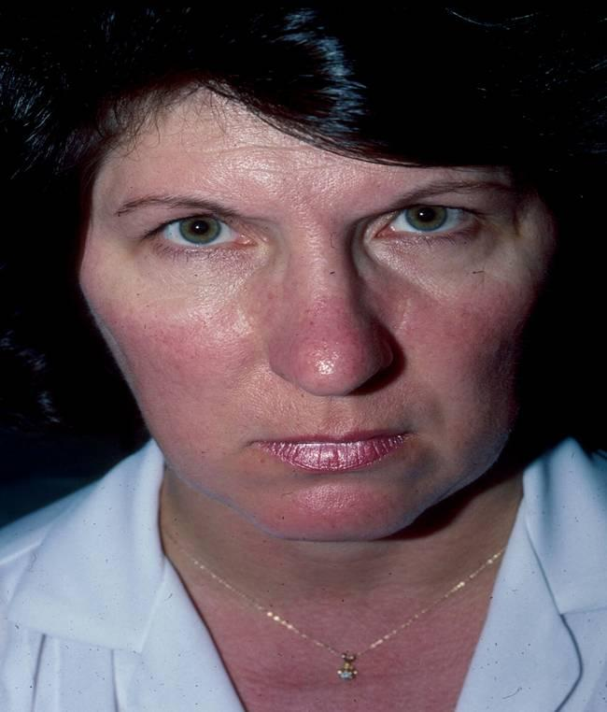
Erythematotelangietatic Rosacea
Erythema and telangiectasias scattered on the nose and cheeks.
There are no papules, pustules, or comedones present.

Slide 29
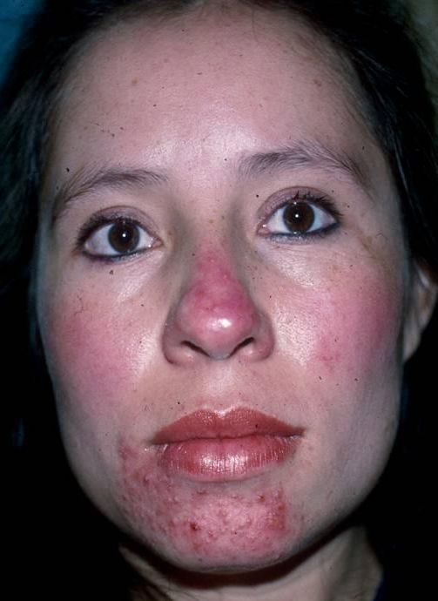
Papulopustular Rosacea
Erythema with papules and pustules on the nose and chin.
Patient also has erythematous patches on the cheeks bilaterally.

Slide 30
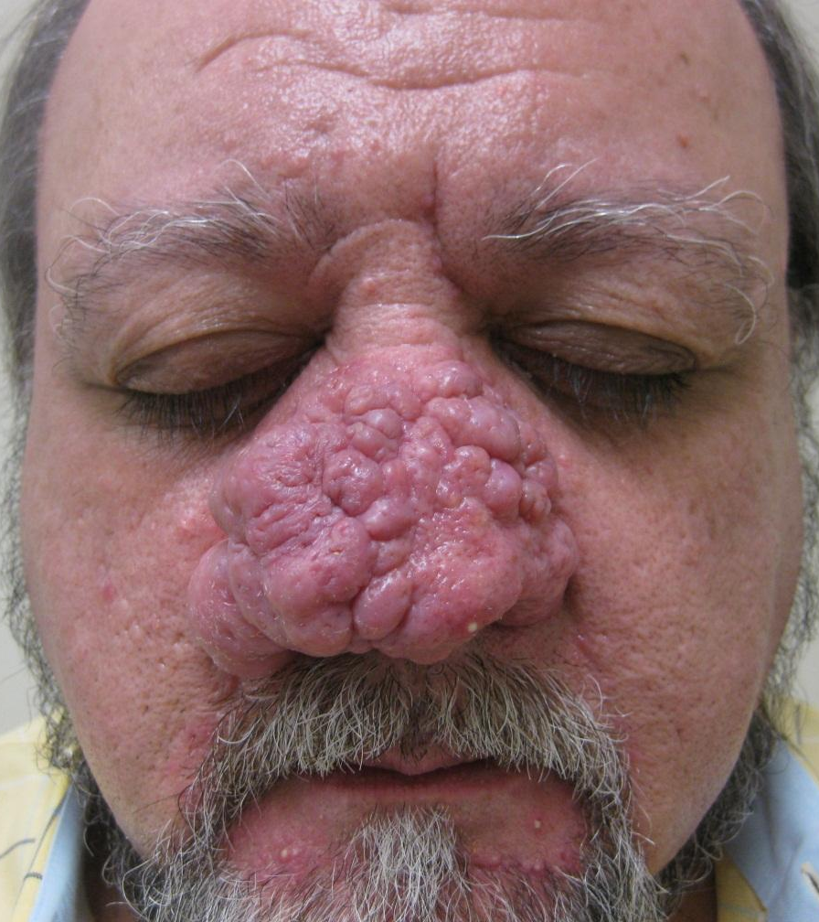
Phymatous Rosacea
Facial erythema, scattered papules, pustules on the nose, forehead, cheeks and chin. Thickened, highly sebaceous skin.
This patient also has severe rhinophyma.

Slide 31
Rosacea Treatment
Therapy is often long-term
Most treatments are directed at specific findings manifested by rosacea patients
Types of treatment include:
Topical products: metronidazole, sodium sulfacetamide, azelaic acid, sulfur cleansers
Oral antibiotics for pustular and papular lesions
All patients should use sunscreen daily

Slide 32
The “butterfly” rash
Many facial rashes are described as “malar” or “butterfly” rashes
Most “butterfly” rashes are seborrheic dermatitis or rosacea, not lupus, which is classically described as “malar” or “butterfly”
Butterfly rash: think rosacea or seborrheic dermatitis first

Slide 33
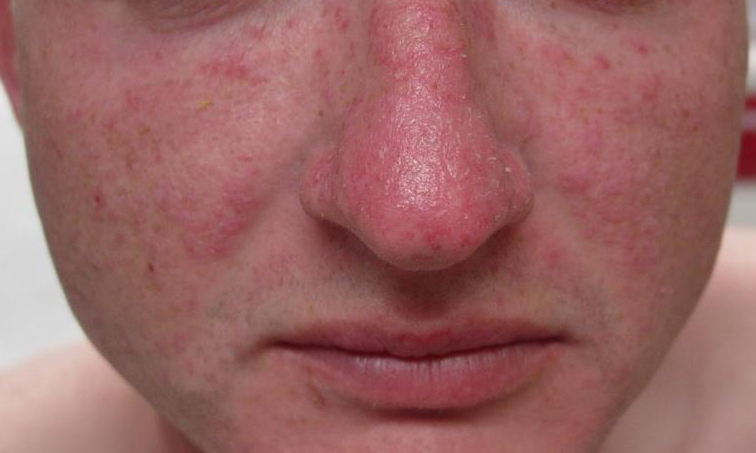
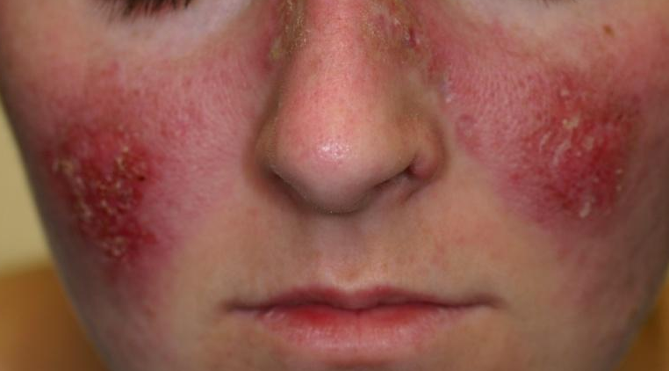
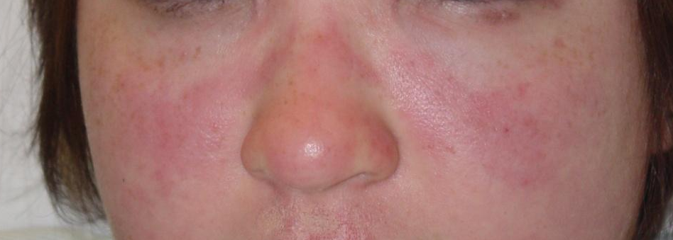
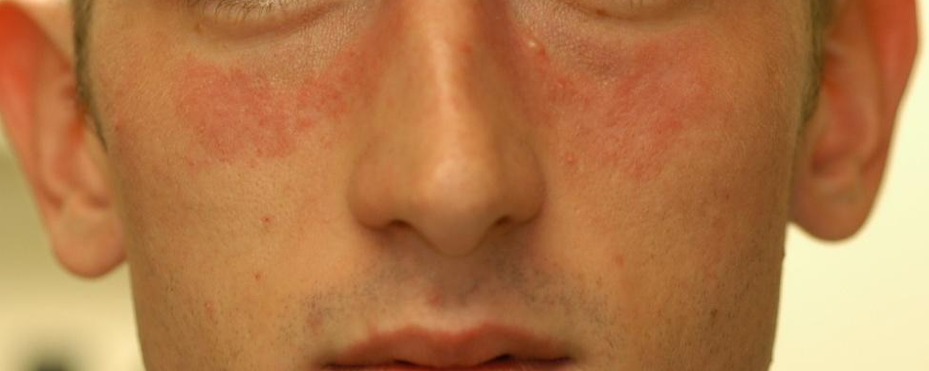
The “butterfly rash” of lupus

Slide 34

Key elements of facial lupus rash
Photodistributed
Often scaly, scarring
Spares nasal creases (unlike seborrheic dermatitis)
May mimic rosacea
Refer these patients
Four SLE criteria are dermatologic:
Photosensitivity
Discoid lesions
Oral ulcerations
Malar rash

Slide 35
Case Three

Slide 36
Case Three: History
HPI: Magid is a healthy 5-month-old boy whose mother reports a scaly rash on the face that she says he scratches. She wants to make sure it’s not infected.
PMH: normal birth history
Allergies: none
Medications: none
Family history: brother with asthma, mother with seasonal allergic rhinitis
Social history: lives at home; does not attend daycare
ROS: negative

Slide 37
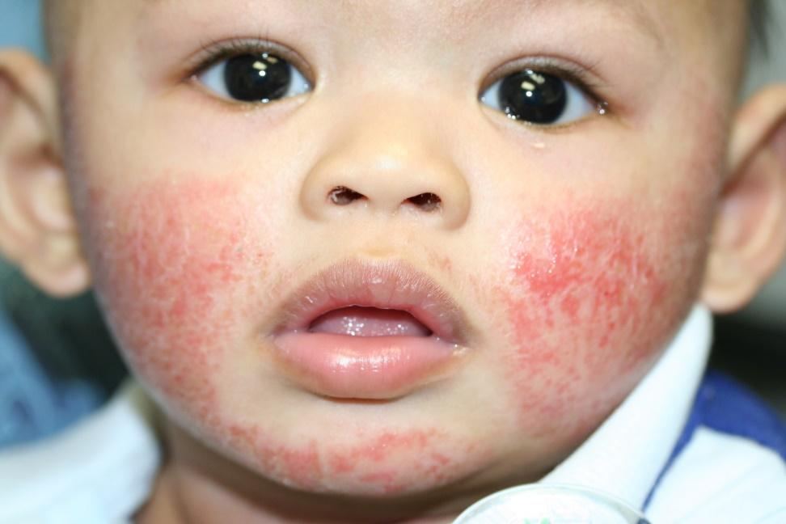
Case Three: Skin Exam

Slide 38

Case Three, Question 1
What is the most likely diagnosis?
Atopic dermatitis
Bacterial cellulitis
Neonatal lupus
Tinea faciei
Seborrheic dermatitis

Slide 39
Case Three, Question 1
Answer: a
What is the most likely diagnosis?
Atopic dermatitis
Bacterial cellulitis (more indurated and tender, not usually itchy or bilateral)
Neonatal lupus (erythematous annular patches and plaques, usually periorbital)
Tinea faciei (rare in infants, not symmetric)
Seborrheic dermatitis (wrong distribution)

Slide 40
Atopic Dermatitis Basics
Atopic dermatitis is a chronic, itchy, eczematous condition in patients with a personal or family history of atopy
The “atopic triad” includes seasonal allergic rhinitis, asthma, and atopic dermatitis
Distribution of involvement varies by age
In infants and toddlers, eczematous plaques appear on the cheeks and chin and dorsal hands and feet
Older children and adolescents develop more classic lichenified, eczematous plaques in flexural areas such as antecubital and popliteal fossae and posterior neck
Itch is the primary symptom of atopic dermatitis
Atopic dermatitis is often called “the itch that rashes”

Slide 41
Case Three, Question 2
Which of the following treatments would you recommend to Magid’s parents?
Astringent facial scrubs
Clindamycin gel
Hydrocortisone valerate ointment
Ketoconazole cream
Tretinoin cream

Slide 42
Case Three, Question 2
Answer: c
Which of the following treatments would you recommend to Magid’s parents?
Astringent facial scrubs
Clindamycin gel
Hydrocortisone valerate ointment
Ketoconazole cream
Tretinoin cream

Slide 43
Treatment for Atopic Dermatitis
Patients with atopic dermatitis have a deficient lipid barrier that has to be replaced
Emollients (moisturizers) are critical to treatment of the underlying dry skin of atopic dermatitis
Atopic patients are sensitive to irritants, so recommend fragrance-free products and moisturizing soaps
Some patients have flares to irritants (wool clothes, etc.)
Food allergies may rarely exacerbate infantile atopic dermatitis
If this is suspected, refer to allergist for a food antigen challenge

Slide 44
Treatment for Atopic Dermatitis
Topical corticosteroids are the mainstay of therapy for acute flares of atopic dermatitis
Using stronger steroid for short periods and milder steroid for maintenance helps reduce risk of steroid atrophy
Antimicrobials may be needed for bacterial or viral infections that complicate atopic dermatitis
Impetigo often complicates atopic dermatitis in infants, as does widespread herpes infections (eczema herpeticum)
Antihistamines are used for their sedative effect to control nighttime itching
Refer patients who do not respond to standard therapy, or have extensive involvement

Slide 45
Case Four

Slide 46
Case Four: History
HPI: B is a 32-year-old woman who presents with three months of severe itching, redness, and scaling on her eyelids. She has tried aloe vera and tea tree oil products, but they haven’t helped.
PMH: no history of asthma, hay fever or childhood eczema
Allergies: shellfish
Medications: birth control pills
Family history: noncontributory
Social history: single; works as a bank teller
ROS: negative

Slide 47
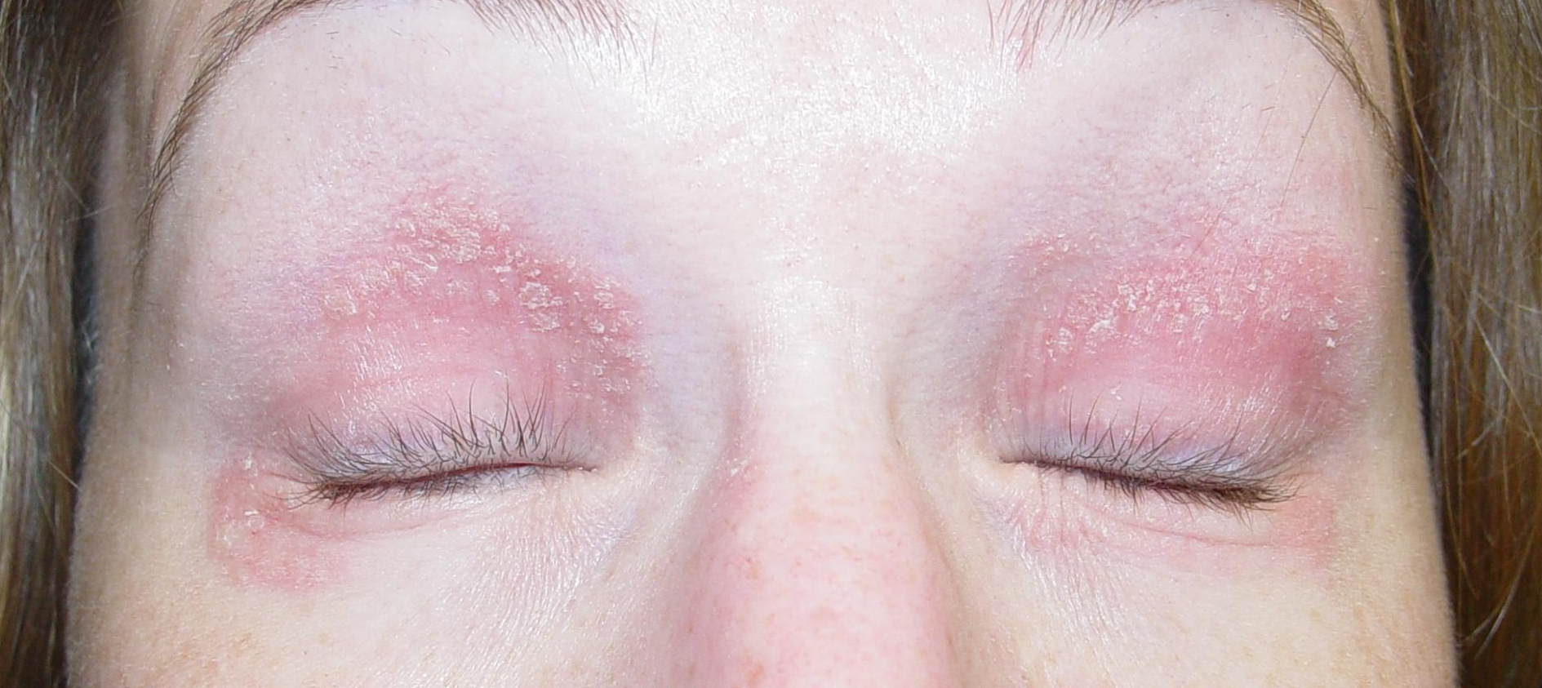
Case Four: Skin Exam

Slide 48
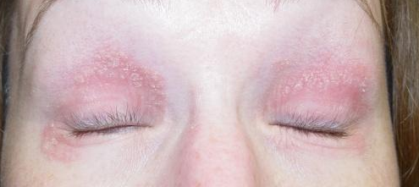
Case Four, Question 1
Ms. B has a bilaterally-symmetric, pruritic, eczematous eruption on her eyelids. What is the most likely diagnosis?
Allergic contact dermatitis
Rosacea
Psoriasis
Seborrheic dermatitis

Slide 49
Case Four, Question 1
Answer: a
Ms B has a bilaterally-symmetric, pruritic, eczematous eruption on her eyelids. What is the most likely diagnosis?
Allergic contact dermatitis
Rosacea (usually not itchy)
Psoriasis (not usually limited to the eyelids)
Seborrheic dermatitis (usually not itchy)

Slide 50
Allergic contact dermatitis
Allergic contact dermatitis (ACD) is a delayed-type hypersensitivity reaction
Poison ivy (rhus dermatitis) is the prototypic allergic contact dermatitis
Susceptible patients become sensitized to an allergen in contact with their skin
ACD is pruritic
The distribution of the rash mirrors the area of exposure

Slide 51

Eyelid dermatitis
May be adult atopic dermatitis if personal history of atopy and chronic
If no atopic history and acute onset of pruritic eyelid dermatitis, think of ACD
Allergic contact dermatitis of the eyelid is often caused by transfer from the hands
Cosmetics, metals (nickel), topical medications, and artificial nails

Slide 52
Case Four, Question 2
On further questioning, Ms B recently changed her eye shadow and moisturizer. What treatment would you recommend other than avoidance?
Desonide cream
Clobetasol ointment
Fluocinonide gel
Ketoconazole cream

Slide 53
Case Four, Question 2
Answer: a
On further questioning, Ms B recently changed her eye shadow and moisturizer. What treatment would you recommend other than avoidance?
Desonide cream
Clobetasol ointment (too potent)
Fluocinonide gel (too potent)
Ketoconazole cream (not fungal)

Slide 54
Steroid strengths
Topical steroids are classified by potency
For the face, low-potency steroids (e.g., desonide) can safely be used intermittently for flares
Potent steroids can be used in severe cases for a few days, but limit the amount given

Slide 55
Case Four, Question 3
Ms. B has an allergic contact dermatitis that responds to topical steroids. What is the best test to confirm the cause of her rash?
Allergen-specific IgE antibodies
Indirect immunofluorescent antibody (IIF) test
Patch testing
Prick skin testing
Radioallergosorbent test (RAST)

Slide 56
Case Four, Question 3
Answer: c
Ms. B has an allergic contact dermatitis that responds to topical steroids. What is the best test to confirm the cause of her rash?
Allergen-specific IgE antibodies
Indirect immunofluorescent antibody (IIF) test
Patch testing
Prick skin testing
Radioallergosorbent test (RAST)

Slide 57
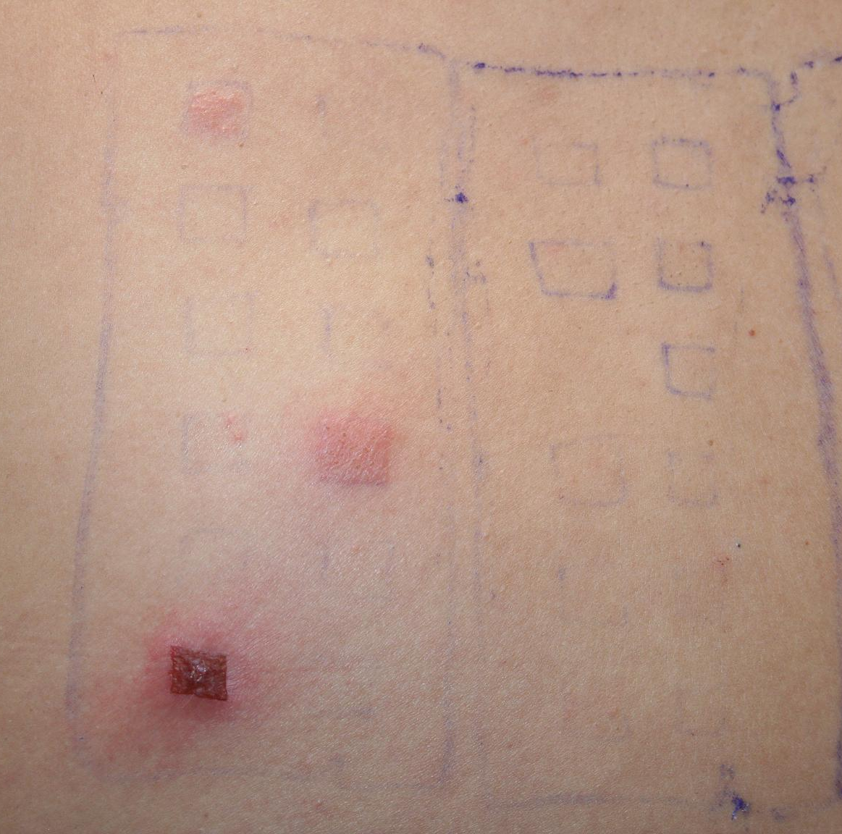
Case Four, Patch Test
The patient underwent patch testing for ACD
There were three positive reactions on day 4
Nickel, Balsam of Peru, and Fragrance
Avoidance of these allergens should improve her rash
Refer patients to a dermatologist who performs patch testing when the allergen is unclear or the dermatitis is chronic

Slide 58
Case Five

Slide 59
Case Five: History
HPI: Ahmed is an 18-year-old man who presents with four years of bad acne on his face and chest. He has been taking oral minocycline 100 mg BID, topical tretinoin, and a combination of benzoyl peroxide and clindamycin for 18 months without improvement.
PMH: none
Allergies: Sulfa (rash)
Medications: minocycline, tretinoin cream, benzoyl peroxide/clindamycin gel
Family history: both parents had acne
Social history: high school senior in three Advanced Placement courses

Slide 60
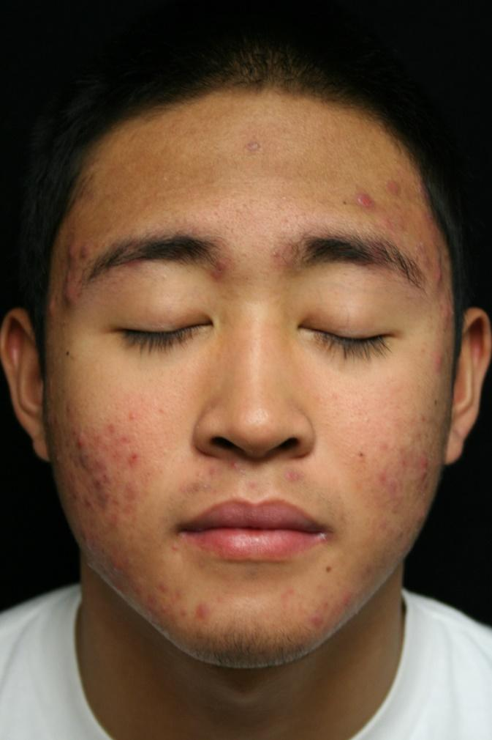
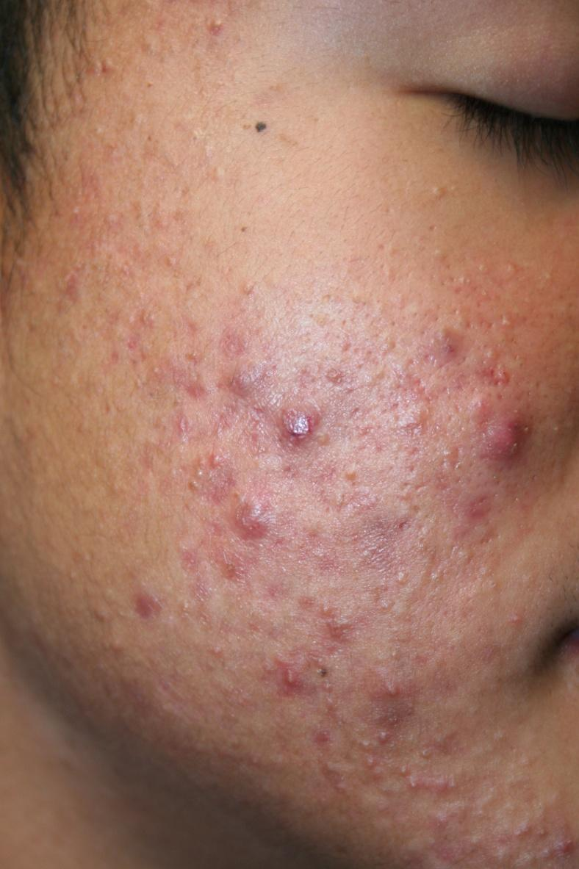
Case Five: Skin Exam

Slide 61
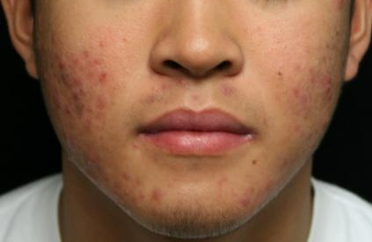
Case Five, Question 1
Ahmed clearly has acne vulgaris. He has nodules and some early scarring. What is the next appropriate therapy?
Bactrim for gram negative acne
Change from minocycline to tetracycline
Glycolic acid peels
Isotretinoin

Slide 62
Case Five, Question 1
Answer: d
Ahmed clearly has acne vulgaris. He has nodules and some early scarring. What is the next appropriate therapy?
Bactrim for gram negative acne (allergic to sulfa medications)
Change from minocycline to tetracycline (tetracycline is not stronger than minocycline, and poorly tolerated)
Glycolic acid peels (may help mild acne, but need oral therapy for nodular, scarring acne)
Isotretinoin

Slide 63
Oral Isotretinoin Indications:
Severe, recalcitrant nodular cystic acne
Severe acne refractory to oral antibiotics
Scarring acne

Slide 64
Isotretinoin side effects
Teratogenicity / birth defects
Dry lips, dry eyes
Nosebleeds
Hypertriglyceridemia
Myalgias and elevated creatinine kinase
Other rare side effects

Slide 65

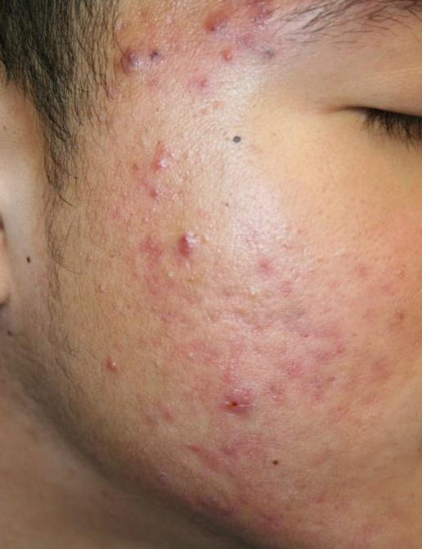
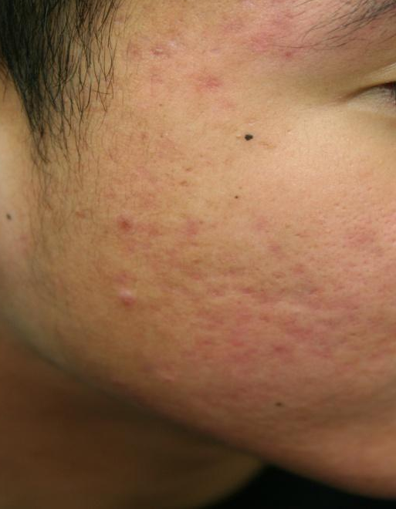
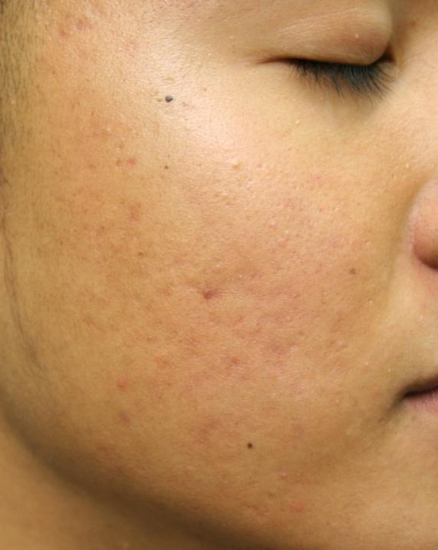
Before therapy
Isotretinoin improves severe, refractory nodular acne
2 months of isotretinoin
Before therapy
4 months of isotretinoin
After therapy

Slide 66
Summary of the red face: likely causes by age
Red rashes on the face are common throughout life, but the causes differ by age
In infants, atopic dermatitis is more likely
In adolescents, acne vulgaris is very common
Acne rosacea presents in the 30s-40s
Seborrheic dermatitis occurs at any age

Slide 67
Summary of the red face: clues in the history
Itch precedes onset:
Allergic contact dermatitis, Atopic dermatitis
Greasy scale and redness:
Seborrheic dermatitis
Tender papules:
Acne vulgaris, Rosacea
Worse with exercise, heat, hot foods, alcohol:
Rosacea

Slide 68
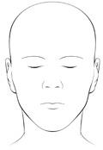
Summary of the red face: clues by location
Eyebrows, nasal creases, external auditory canals
Seborrheic dermatitis
Cheeks and chin:
Acne vulgaris, acne rosacea, atopic dermatitis
Nose
Involved in acne vulgaris, acne rosacea
Spared in atopic dermatitis

Slide 69
Location
Seborrheic dermatitis
Acne rosacea
Atopic dermatitis (infants)
Acne vulgaris

Slide 70
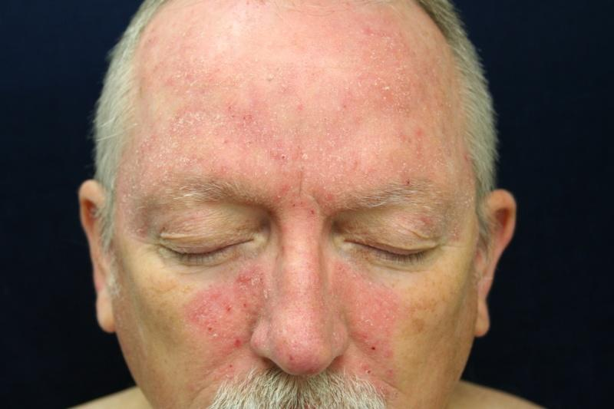
Location
Seborrheic dermatitis
Acne rosacea
Atopic dermatitis (infants)
Acne vulgaris

Slide 71

Location
Seborrheic dermatitis
Acne rosacea
Atopic dermatitis (infants)
Acne vulgaris

Slide 72

Location
Seborrheic dermatitis
Acne rosacea
Atopic dermatitis (infants)
Acne vulgaris

Slide 73

Location
Seborrheic dermatitis
Acne rosacea
Atopic dermatitis (infants)
Acne vulgaris

Slide 74
Take Home Points
Location, history, and age help differentiate red rashes on the face
Seborrheic dermatitis is common and chronic
Ask about and inspect key locations: external auditory canals, eyebrows, scalp, behind ears, central chest
Treatment with ketoconazole cream or dandruff shampoos or low-potency steroid like desonide cream for flares
Heat, exercise, hot liquids, spicy foods, and alcohol, are triggers for acne rosacea

Slide 75
Take Home Points
Atopic dermatitis in infants often involves the face
Allergic contact dermatitis itches and mirrors the source of exposure
Acne vulgaris typically arises in puberty; see acne module for detailed management recommendations
Butterfly rash of connective tissue disease is most frequently seen in flares of SLE and often has other manifestations of lupus at that time

