Slide 1
Bacterial Skin Infections

Slide 2
Case One

Slide 3
History
HPI: Mr. Nwaf is a 55-year-old man who presents with 5 days of worsening right lower extremity pain and a red rash. He reports recent fevers and chills since he returned from a camping trip last week.
PMH: arthritis
Medications: occasional NSAIDs, multivitamin
Allergies: no known drug allergies
Family history: father with history of melanoma
Social history: lives in the city with his wife, two grown children
Health-related behaviors: no alcohol, tobacco or drug use
ROS: negative

Slide 4
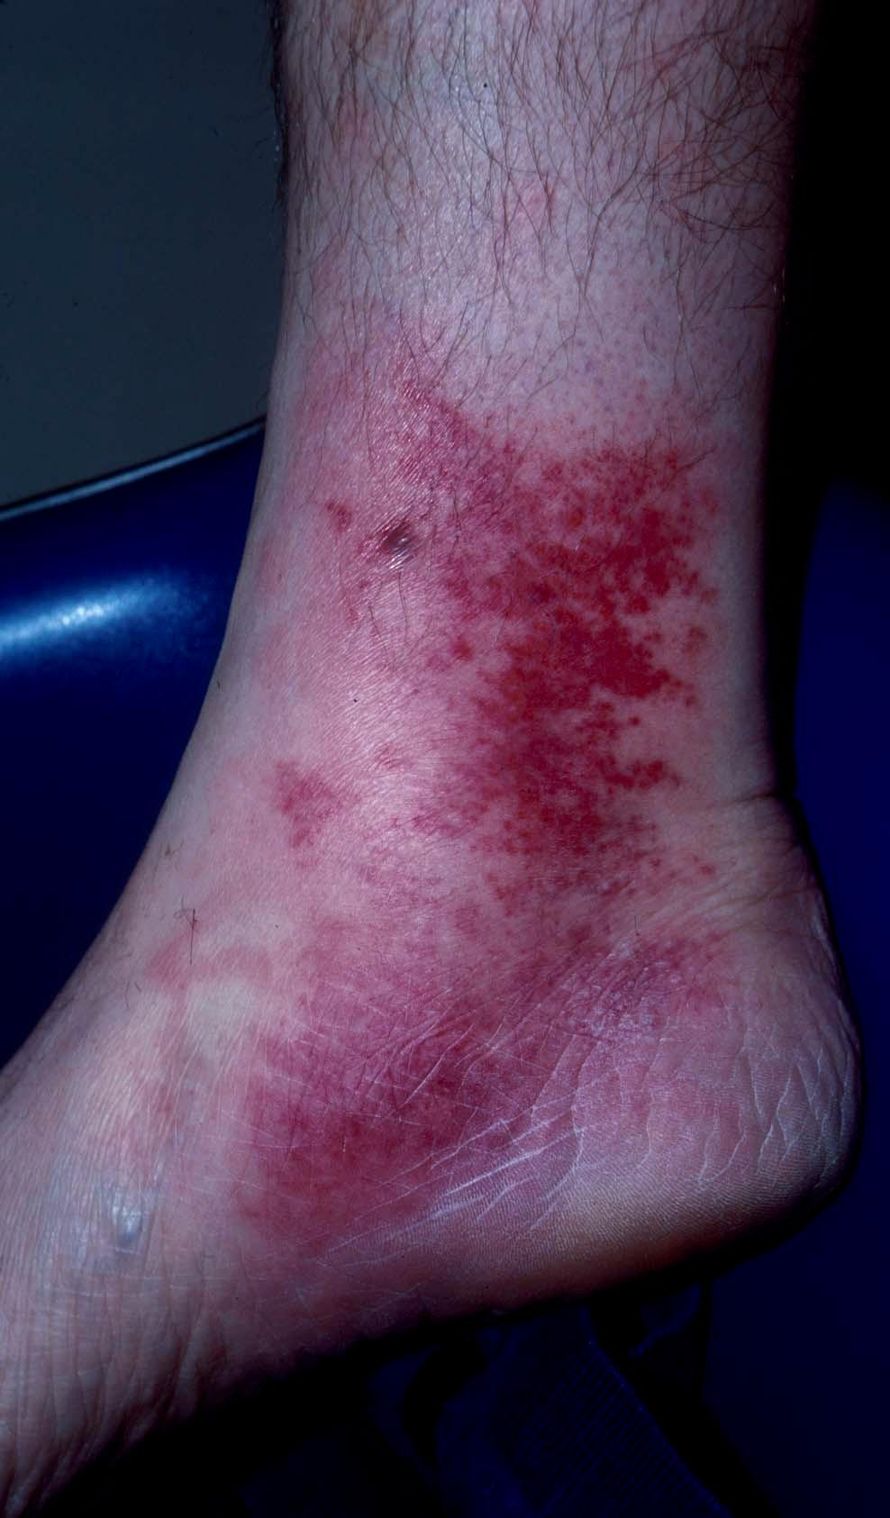
Exam
Vital signs: T 100.4, HR 90, BP 120/70, RR 14, O₂ sat 97% on RA
Skin: erythematous plaque with ill-defined borders over the right medial malleolus. Lesion is tender to palpation. With lymphatic streaking (not shown).
Tender, slightly enlarged right inguinal lymph nodes (not shown)
Laboratory data: Wbc 12,000 (75% neutrophils, 10% bands), Hct 44, Plts 335

Slide 5
Question 1
What is the most likely diagnosis?
Bacterial folliculitis
Cellulitis
Necrotizing fasciitis
Stasis dermatitis
Tinea corporis

Slide 6
Question 1
Answer: b
What is the most likely diagnosis?
Bacterial folliculitis (Would expect pustules and papules centered on hair follicles. Without systemic signs of infection)
Cellulitis
Necrotizing fasciitis (Would expect rapidly expanding rash, usually appears as a dusky, edematous, red plaque)
Stasis dermatitis (Although found in similar location, stasis dermatitis often presents with pruritus and scale, which may erode or crust. Without fever or elevated wbc)
Tinea corporis (Would expect annular plaque with elevated border and central clearing. Painless, without fever or elevated wbc)

Slide 7
Diagnosis: Cellulitis
Cellulitis is a very common infection occurring in up to 3% of people per year
Results from an infection of the dermis that often begins with a portal of entry that is usually a wound or fungal infection (e.g., tinea pedis)
Presents as a spreading erythematous, non-fluctuant tender plaque
More commonly found on the lower leg
Streaks of lymphangitis may spread from the area to the draining lymph nodes

Slide 8
Cellulitis: Risk Factors
Risk factors for cellulitis include:
Local trauma (bug bites, laceration, abrasion, puncture wound)
Underlying skin lesion (furuncle, ulcer)
Inflammation (local dermatitis, radiation therapy)
Edema and impaired lymphatics in the affected area
Preexisting skin infection (impetigo, tinea pedis)
Secondary cellulitis from blood-borne spread of infection, or from direct spread of subjacent infections (fistula from osteomyelitis) is rare

Slide 9
Cellulitis: Etiology
80% of cases are caused by gram positive organisms
Group A streptococcus and Staphylococcus aureus are the most common causal pathogens

Slide 10
Question 2
What is the next best step in management?
Apply topical antibiotics
Apply topical steroids, compression wraps, and encourage leg elevation
Begin antibiotics immediately with coverage for gram positive bacteria
Order an imaging study

Slide 11
Case One, Question 2
Answer: c
What is the next best step in management?
Apply topical antibiotics (not effective)
Apply topical steroids, compression wraps, and encourage leg elevation (this is the treatment for stasis dermatitis, not cellulitis)
Begin antibiotics immediately with coverage for gram positive bacteria
Order an imaging study (radiographic examination is not necessary for routine evaluation of patients with cellulitis)

Slide 12
Treatment
It is important to recognize and treat cellulitis early as untreated cellulitis may lead to sepsis and death
Broad spectrum antibiotic

Slide 13
Treatment
Monitor patients closely and revise therapy if there is a poor response to initial treatment
Elevation of the involved area
Treat tinea pedis if present
Cultures from abscesses and other purulent skin and soft tissue infections (SSTIs) are recommended in patients treated with antibiotic therapy

Slide 14
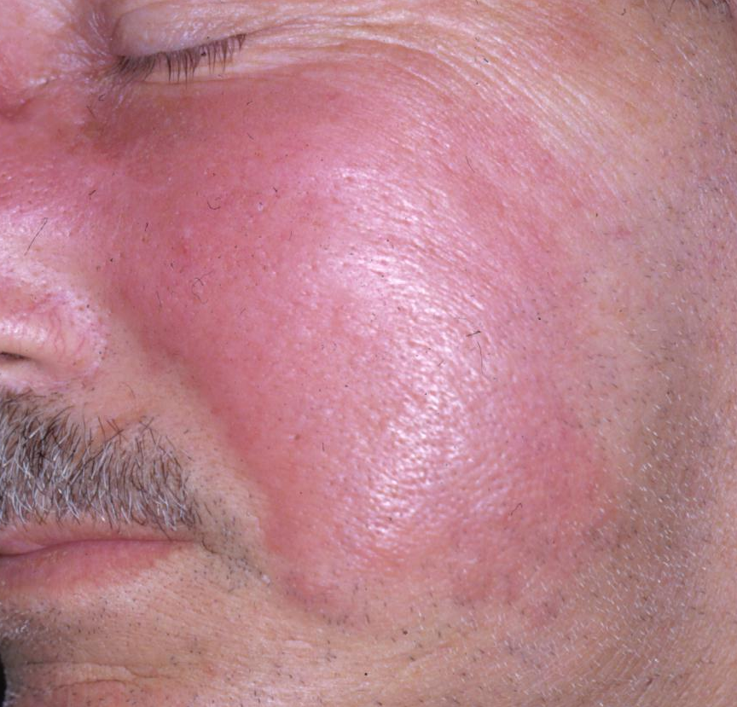
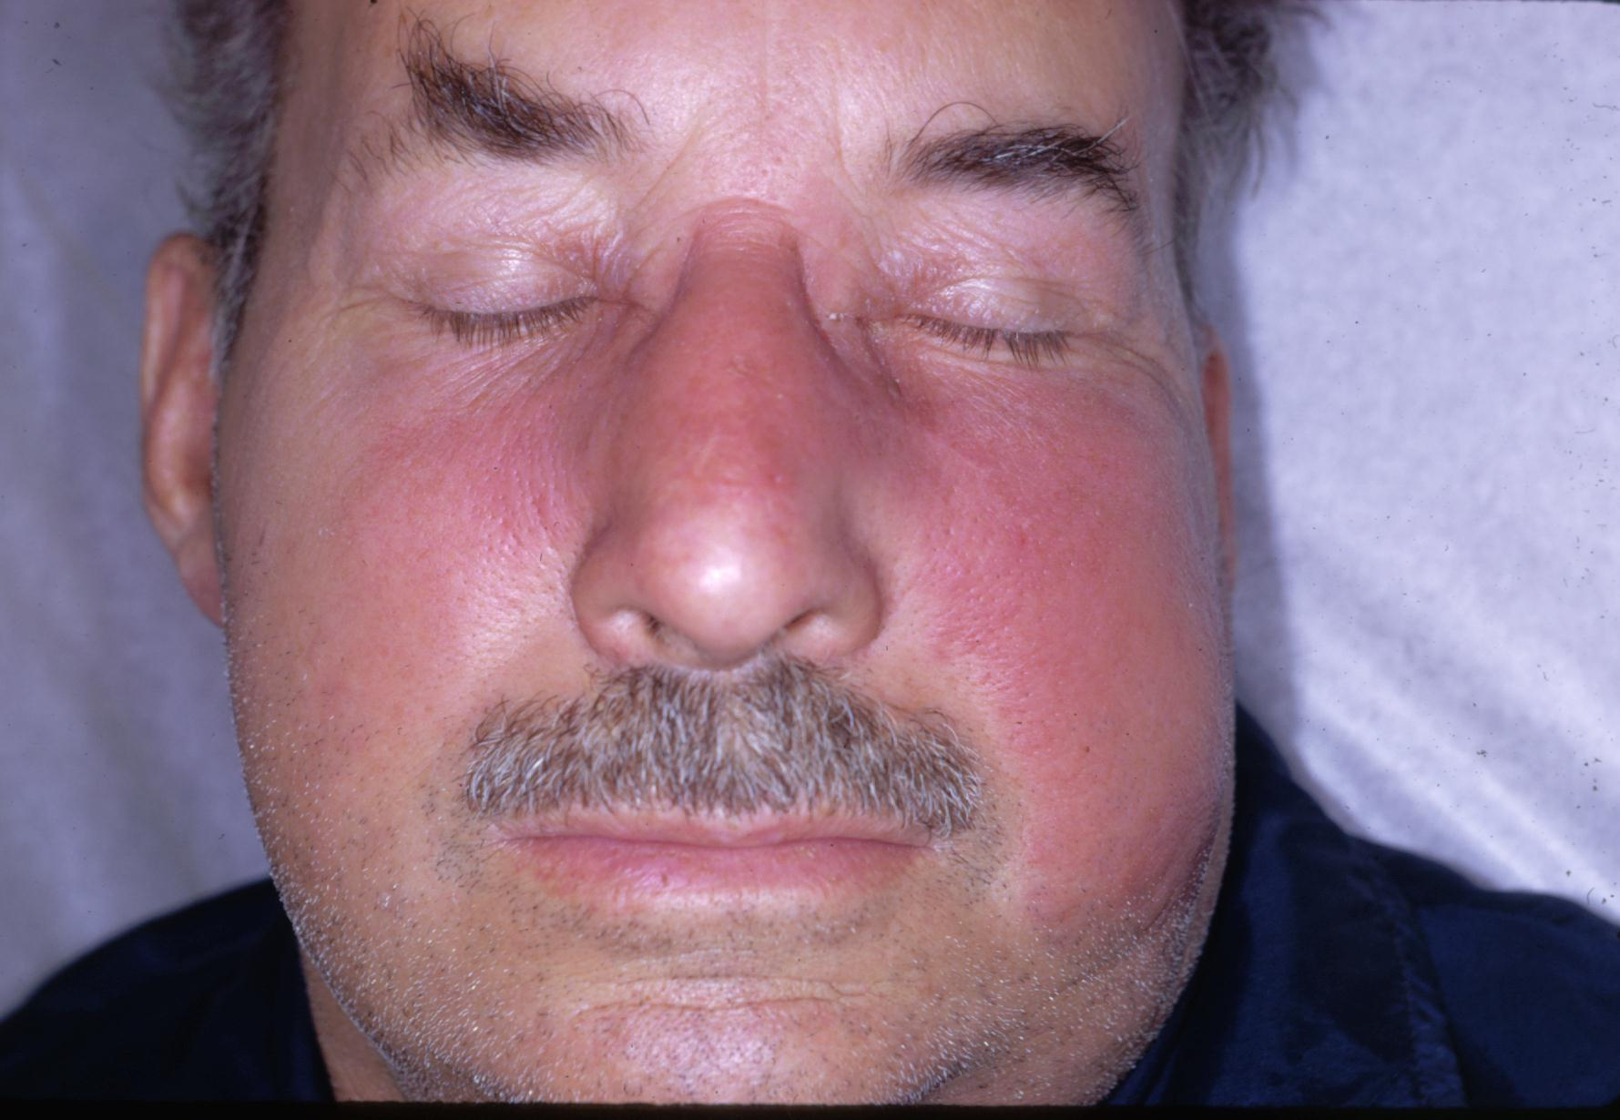
Question 1 What does this person have?

Slide 15
A skin infection called Erysipelas

Slide 16
Erysipelas
Erysipelas is a superficial cellulitis with marked dermal lymphatic involvement (causing the skin to be edematous or raised)
Main pathogen is group A streptococcus
Usually affects the lower extremities and the face
Presents with pain, superficial erythema, and plaque-like edema with a sharply defined margin to normal tissue
Plaques may develop overlying blisters (bullae)
May be associated with a high white count (>20,000/mcL)
May be preceded by chills, fever, headache, vomiting, and joint pain

Slide 17
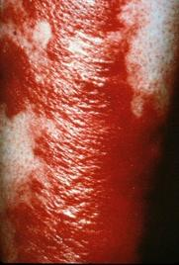
Example of Erysipelas
Large, shiny erythematous plaque with sharply demarcated borders located on the leg

Slide 18
Question 2
What is the most appropriate treatment?
Oral antibiotics
Oral steroids
Topical antibiotics
Topical moisturizers
Topical steroids

Slide 19
Question 2
Answer: a
What is the most appropriate treatment?
Oral antibiotics
Oral steroids
Topical antibiotics
Topical moisturizers
Topical steroids
Oral antibiotics are the most appropriate therapy in uncomplicated erysipelas.

Slide 20
Erysipelas: Treatment
Immediate empiric antibiotic therapy should be started (cover most common pathogen - Streptococcus)
Monitor patients closely and revise therapy if there is a poor response to initial treatment
Elevation of the involved area

Slide 21
Case Three

Slide 22
History
HPI: Mr. Hammed is a 27-year-old man with a history of “skin popping” (subcutaneous or intradermal injection of drug) who presents to the emergency department with a painful, enlarging mass on his right arm for the last two days.
PMH: History of skin and soft tissue infections
Medications: none
Allergies: no known drug allergies
Family history: father with diabetes, mother with hypertension
Social history: lives with friends in an apartment, works in retail
Health-related behaviors: IVDU (intravenous drug use), including skin popping. No tobacco or alcohol use.
ROS: no fevers, sweats or chills

Slide 23
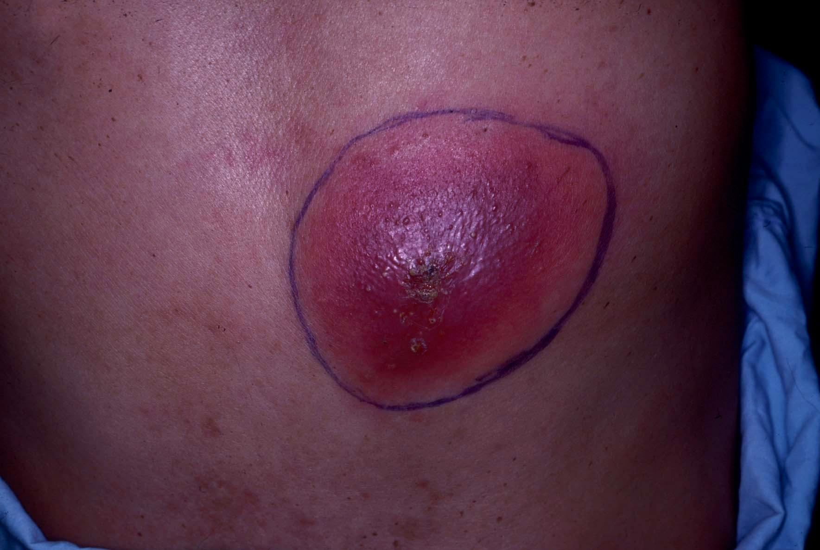
Case Three: Skin Exam
Erythematous, warm, fluctuant nodule with several small pustules throughout the surface
Very tender to palpation

Slide 24
Diagnosis: Abscess
A skin abscess is a collection of pus within the dermis and deeper skin tissues
Present as painful, tender, fluctuant and erythematous nodules
Often surmounted by a pustule and surrounded by a rim of erythematous edema
Spontaneous drainage of purulent material may occur

Slide 25
Question 1
What is the next best step in management?
Incision and drainage
Topical antibiotics
Offer HIV test
a and b
a and c

Slide 26
Question 1
Answer: e
What is the next best step in management?
Incision and drainage (incision and drainage is the treatment of choice for abscesses)
Topical antibiotics (not effective)
Offer HIV test (patients with risk factors for HIV should be offered an HIV test, e.g. IVDU in this patient)
a and b
a and c

Slide 27
Abscess: Treatment
Abscesses require incision and drainage (I & D)
Most experts recommend irrigation, breaking of loculations, and packing following incision and drainage
Antibiotics are recommended for abscesses associated
Wound cultures should always be sent

Slide 28
Do you know the following diagnoses?
Hint: these skin infections involve hair follicles

Slide 29
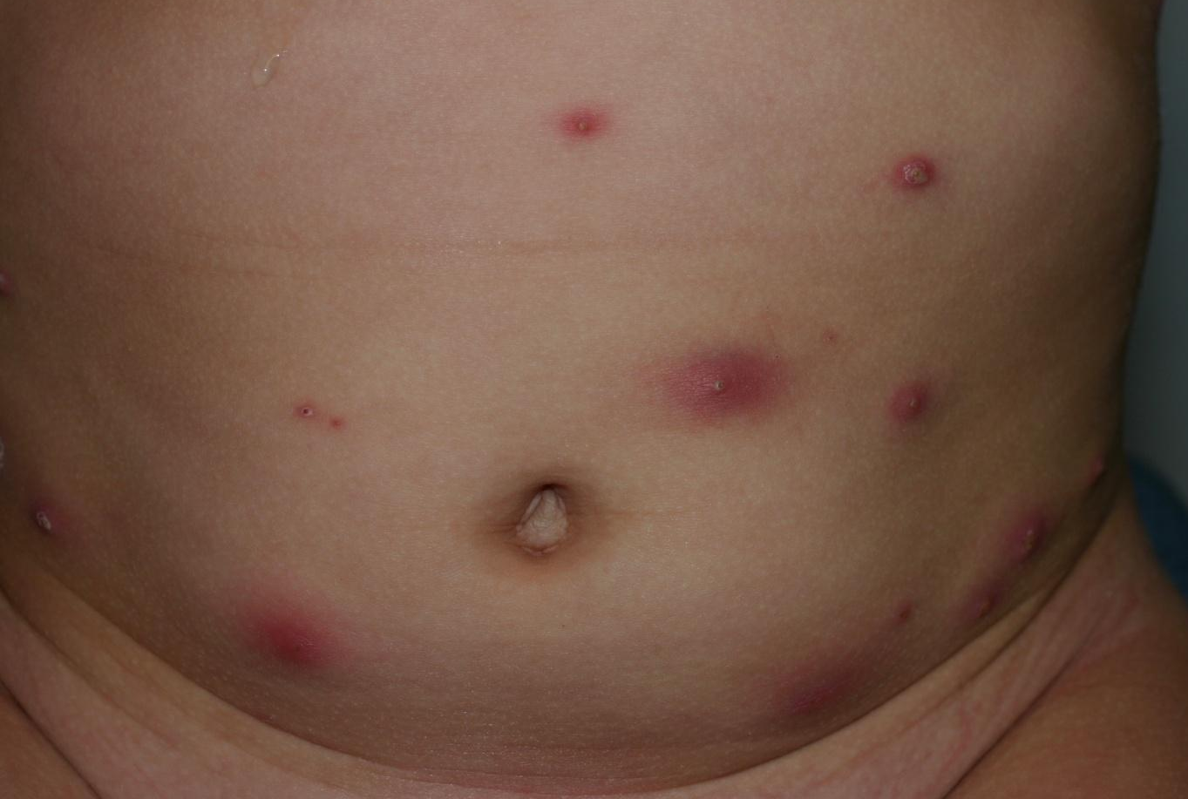
What is the diagnosis?

Slide 30
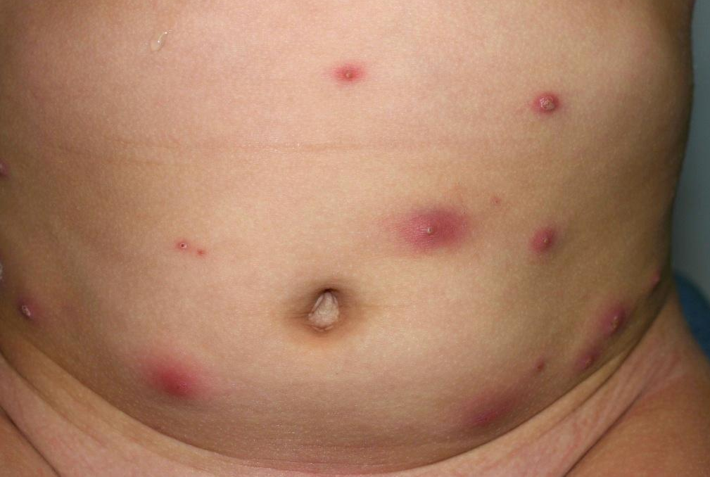
Furunculosis
A furuncle (boil) is an acute, round, tender, circumscribed, perifollicular abscess that generally ends in central suppuration

Slide 31
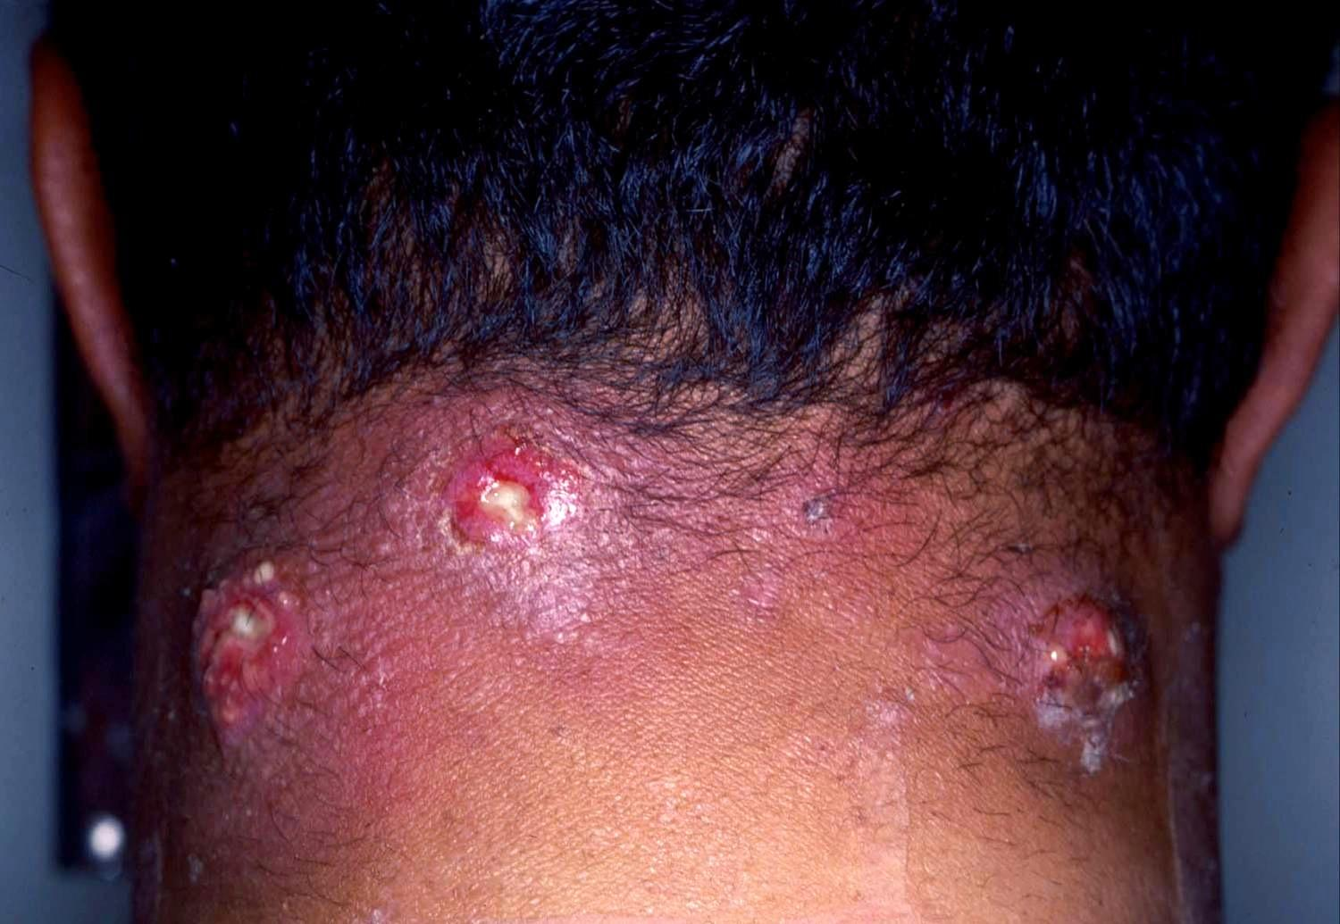
What is the diagnosis?

Slide 32
Carbunculosis
A carbuncle is a coalescence of several inflamed follicles into a single inflammatory mass with purulent drainage from multiple follicles

Slide 33
Furuncle, Carbuncle
Furuncles and carbuncles are a subtype of abscesses, which preferentially occur in skin areas containing hair follicles exposed to friction and perspiration
Common areas include the back of the neck, face, axillae, and buttocks
Usually caused by Staphylococcus aureus
Patients are commonly treated with oral antibiotics
For a solitary small furuncle: warm compresses to promote drainage may be sufficient
For larger furuncles and carbuncles: manage as you would an abscess

Slide 34
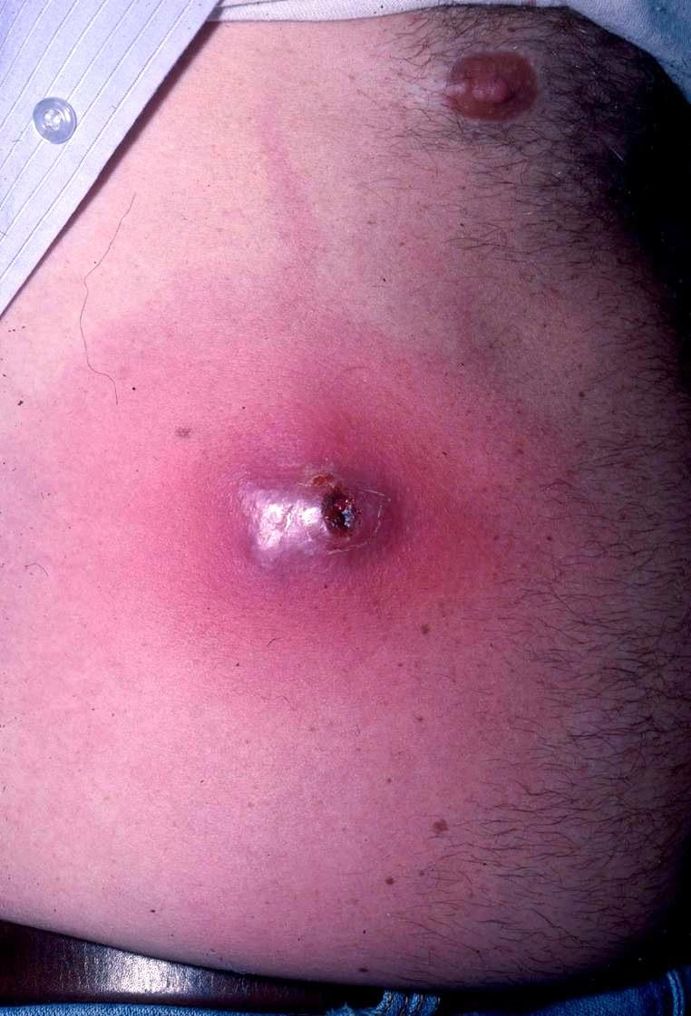
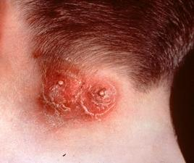
More Examples: Furuncle and Carbuncle

Slide 35
Case Four

Slide 36
History
Mr. Y is a 19-year-old man who presents to dermatology clinic with two weeks of multiple “pimples” in his groin. He is concerned he has an STD.
When asked, he reports occasionally shaving his pubic hair
Sexual history reveals one female partner in the last year

Slide 37
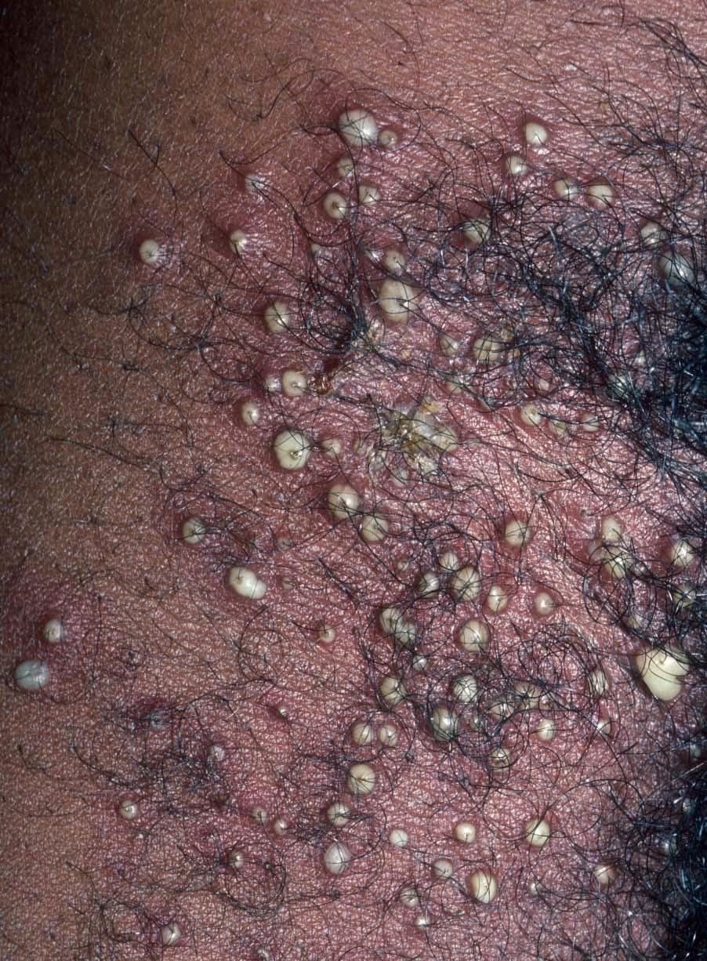
Skin Exam
Multiple follicular pustules with surrounding erythema in the right groin

Slide 38
Question 1
Which of the following recommendations would you provide Mr. Y?
Prescribe oral antibiotics
Stop shaving that area
Wash the area (antibacterial soap may be used)
All of the above

Slide 39
Question 1
Answer: d
Which of the following recommendations would you provide Mr. Y?
Prescribe oral antibiotics
Stop shaving that area
Wash the area daily (antibacterial soap may be used)
All of the above

Slide 40
Folliculitis
Folliculitis is a superficial bacterial infection of the hair follicles
Presents as small, raised, erythematous, occasionally pruritic pustules less than 5 mm in diameter
Genital folliculitis may be sexually transmitted
Pathogens:
Majority of cases are due to Staphyloccus aureus
Pseudomonas folliculitis if there has been exposure to a hot tub or swimming pool.
Pustules associated with marked erythema and scaling may represent genital candidiasis

Slide 41
Management
Thoroughly cleanse the affected area with antibacterial soap and water 3x/day
Superficial pustules will rupture and drain spontaneously
Oral or topical anti-staphylococcal agents may be used
Deep lesions of folliculitis represent small follicular abscesses and should be drained

Slide 42
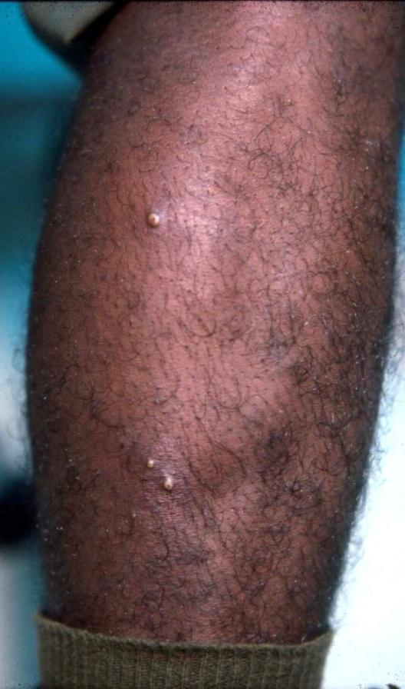
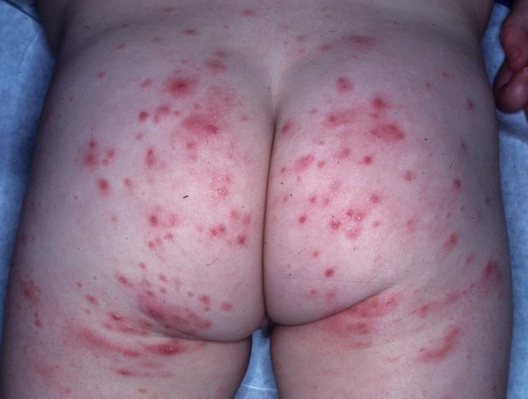
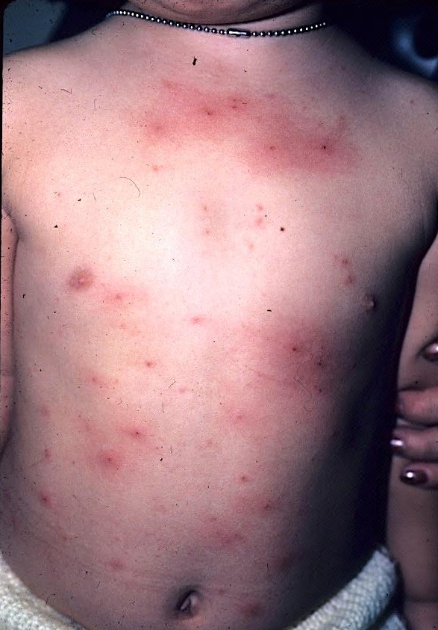
More Examples of Folliculitis

Slide 43
Case Five

Slide 44
History
Mr. H is a 17-year-old man who presents to his primary care provider with a three-week history of a facial rash. The rash is not painful, but occasionally burns and itches.
He tried over the counter hydrocortisone cream with no relief.

Slide 45
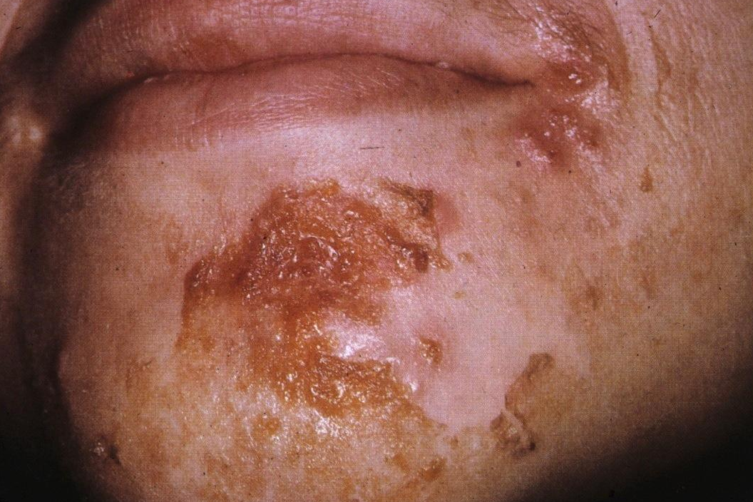
Skin Exam
Peri-oral papules and plaques with overlying honey-colored crust
Minimal surrounding erythema

Slide 46
Question 1
What is the most likely diagnosis?
Acne vulgaris
Impetigo
Orolabial HSV
Seborrheic dermatitis

Slide 47
Case Five, Question 1
Answer: b
What is the most likely diagnosis?
Acne vulgaris (would expect comedones and pustules, but not crusted plaques)
Impetigo
Orolabial HSV (would expect grouped and confluent vesicles with an erythematous rim; can evolve to crusting and easily be confused with impetigo)
Seborrheic dermatitis (would expect erythematous patches and plaques with a greasy, yellow scale)

Slide 48
Diagnosis: Impetigo
Impetigo is a common superficial bacterial skin infection
Most commonly seen in children ages 2-5, but older children and adults can be affected
Impetigo is contagious, easily spread among individuals in close contact
Most cases are due to S. aureus with the remainder either being due S. pyogenes or a combination of these two organisms

Slide 49
Clinical variants of impetigo
The three clinical variants
Non-bullous impetigo
Bullous impetigo
Ecthyma

Slide 50
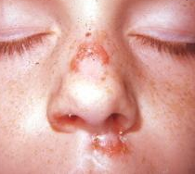
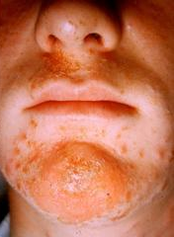
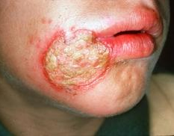
1- Non-bullous Impetigo(contagiosum )
Also called impetigo contagiosum
Lesions begin as papules surrounded by erythema
They progress to form pustules that enlarge and break down to form thick, adherent crusts with a characteristic golden appearance

Slide 51
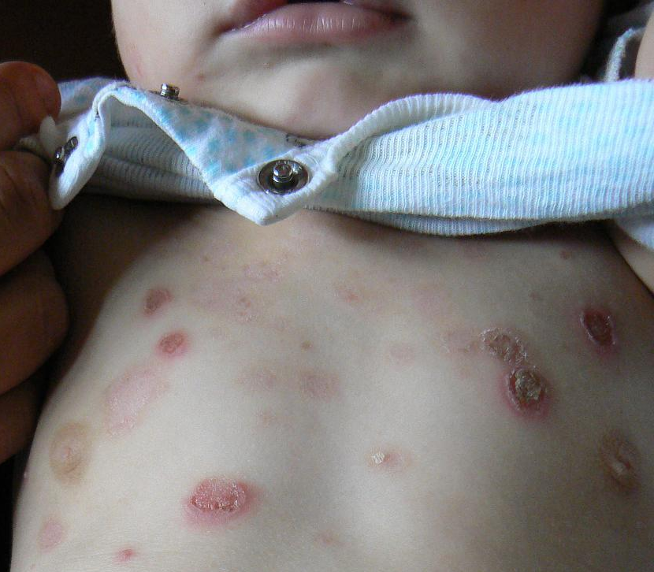
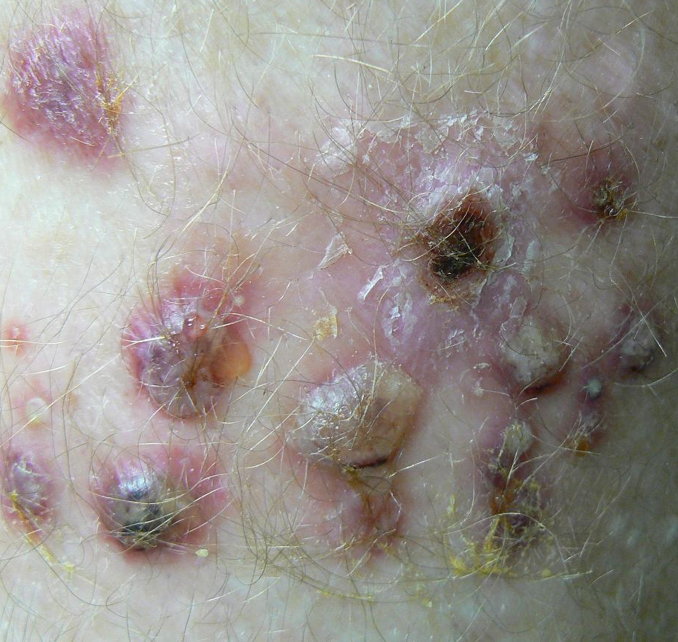
2- Bullous Impetigo
A form of impetigo seen in young children is characterized by flaccid bullae with clear yellow fluid, which later becomes purulent.
Ruptured bullae leave a thick brown crust

Slide 52
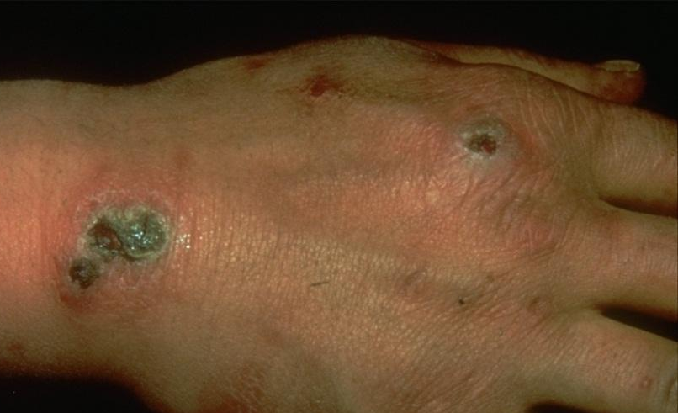
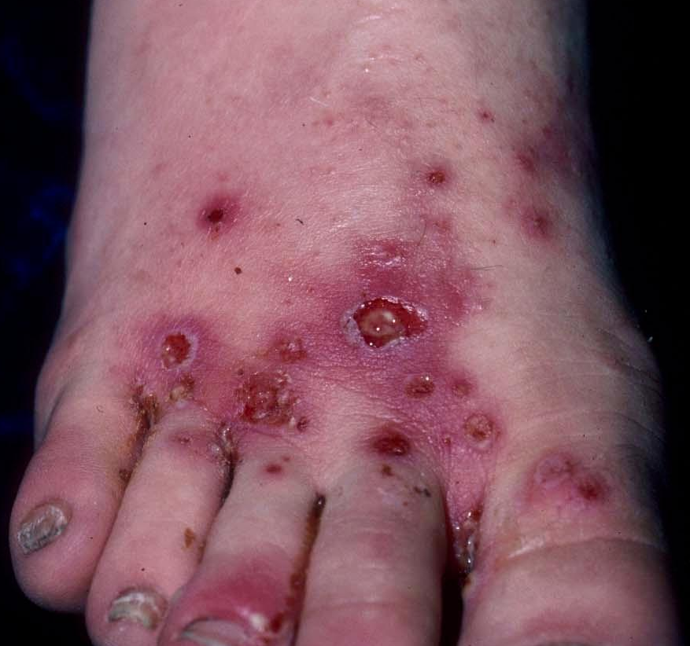
3-Ecthyma (deep imptigo)
Ecthyma is an ulcerative form of impetigo in which the lesions extend through the epidermis and deep into the dermis.
They consist of “punched out” ulcers covered with yellow crust surrounded by raised margins.

Slide 53
Back to Case Five
Mr H was diagnosed with non-bullous impetigo based on clinical findings

Slide 54
Case Five, Question 2
Which of the following treatment recommendations is most appropriate for him?
Hand washing to reduce spread
Topical or oral antibiotics
Wash the affected area with antibacterial soap
All of the above

Slide 55
Case Five, Question 2
Answer: d
Which of the following treatment recommendations is most appropriate for Danny?
Hand washing to reduce spread
Topical or oral antibiotics
Wash the affected area with antibacterial soap
All of the above

Slide 56
Impetigo: Treatment
Oral antibiotics used to treat impetigo include:
Dicloxacillin
Cephalexin
Erythromycin (some strains of Staphyloccocus aureus and Streptococcal pyogenes may be resistant)
Clindamycin
Amoxicillin/clavulanate

Slide 57
Impetigo: Treatment (cont.)
Dosing guidelines will vary according to age
Topical therapy with mupirocin ointment may be equally effective to oral antibiotics if the lesions are localized in an otherwise healthy patient

Slide 58
Case Six

Slide 59
History
HPI: Mr. G is a 66-year-old man who was admitted for an inguinal hernia repair. His surgery went well and he was recovering without complication until he was found to have an expanding red rash on his left thigh. The dermatology service was consulted for evaluation of the rash.
PMH: hypertension, diabetes mellitus type 2
Medications: lisinopril, insulin, oxycodone
Allergies: none
Family history: noncontributory
Social history: retired, lives with his wife
Health-related behaviors: no alcohol, tobacco, or drug use
ROS: febrile, fatigue, rash is painful

Slide 60
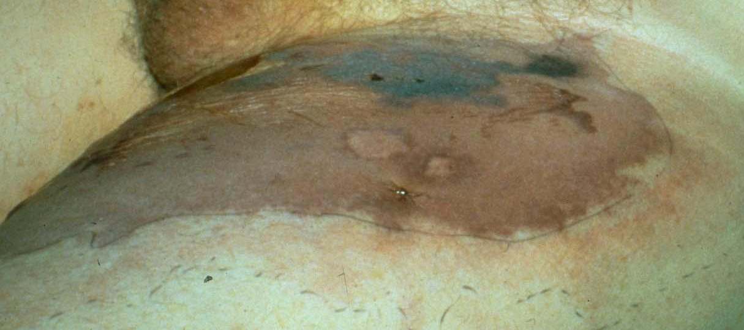
Examination
Vital signs: T 101.1, HR 110, BP 90/50, RR 18, O2 sat 98%
General: ill-appearing gentleman lying in bed
Skin: ill-defined, large erythematous plaque with central patches of dusky blue discoloration, which is anesthetic, upon re-examination 60 minutes later the redness had spread

Slide 61
Question 1
Which of the following do you recommend for initial management?
Call an urgent surgery consult
Give IV fluids and antibiotics
Image with stat MRI
Obtain a deep skin biopsy
All of the above

Slide 62
Case Six, Question 1
Answer: e
Which of the following do you recommend for initial management?
Call an urgent surgery consult (The suspected diagnosis is a surgical emergency)
Give IV fluids and antibiotics (Patients quickly become hemodynamically unstable)
Image with stat MRI (To assess degree of soft tissue involvement. Appropriate, but do not delay surgical intervention)
Obtain a deep skin biopsy (Helps confirm diagnosis)
All of the above

Slide 63
Diagnosis: Necrotizing Fasciitis
Necrotizing fasciitis is a life-threatening infection of the fascia just above the muscle
Progresses rapidly over the course of hours and may follow surgery or trauma, or have no preceding visible lesion
Expanding dusky, edematous, red plaque with blue discoloration
May turn purple and blister
Anesthesia of the skin of the affected area is a characteristic finding
Caused by group A streptococcus, Staphyloccocus aureus or a variety of other organisms

Slide 64
Necrotizing Fasciitis: Treatment
Considered a medical/surgical emergency with up to a 20% mortality rate
If suspect necrotizing fasciitis: consult surgery immediately
Treatment includes widespread debridement and broad-spectrum systemic antibiotics
Poor prognostic factors include: delay in diagnosis, age>50, diabetes, atherosclerosis, infection involving the trunk

Slide 65
Take Home Points
Cellulitis is a bacterial infection of the dermis that often begins with a portal of entry that is usually a wound, insect bite, or fungal infection (tinea pedis)
It is important to recognize and treat cellulitis early as untreated cellulitis may lead to sepsis and death
Erysipelas is a superficial cellulitis with marked dermal lymphatic involvement
A skin abscess is a loculated infection within the dermis and deeper skin tissues and is best treated with I&D
Furuncles and carbuncles are a subtype of abscesses, which preferentially occur in skin areas containing hair follicles exposed to friction and perspiration

Slide 66
Take Home Points (cont.)
Folliculitis is a superficial bacterial infection of the hair follicles presenting as follicular pustules
In impetigo, papules and vesicles progress to form pustules that enlarge and break down to form thick, adherent crusts with a golden or honey-colored appearance
Necrotizing fasciitis presents as an expanding dusky, edematous, red plaque with blue discoloration
Anesthesia of the skin of the affected area is a characteristic finding
Necrotizing fasciitis is a medical/surgical emergency

