Slide 1
Skin Tumors
Dr Sami Fathi
MBBS,MSc,MD, PhD

Slide 2
Arises from any part of the skin
Skin cancer may involve the:-
epidermis
dermis
neural crest
epidermal appendages
nerves
blood vessels
any specialized cellular elements

Slide 3
Most Common
1- Non-melanoma skin cancer (NMSC)
Basal cell carcinoma
Squamous cell carcinoma
2- Melanoma

Slide 4
The three most common types of skin cancer really arise from within the epidermis
Squamous cell carcinoma within the spinous layer
Basal cell carcinoma within the basal layer of the epidermis and hair follicles
Melanoma from the melanocytes of the epidermis.

Slide 5
Incidence
Skin cancer comprises one third of all cancers diagnosed
Approximately 800,000 new NMSC annually in the US
Approximately 36,000 new Melanoma annually in the US

Slide 6
Epidemiology
More common in:
fair skinned individuals
outdoor workers or those with significant UV exposure
certain genetic syndromes
Albinism
Xeroderma Pigmentosa

Slide 7
Death Rates
1- Basal cell carcinoma
very rare, only with tumors > 10cm with rodent ulcers
2- Squamous cell carcinoma
approximately 2100 annually in US
3- Melanoma
approximately 7300 annually in US

Slide 8
Basal Cell Carcinoma
Malignant neoplasm of germinative basal layer of epidermis and hair follicles
Rarely metastasize (<0.025%) but can cause extensive tissue damage
BCC/SCC ratio is 4:1

Slide 9
BCC Types
Nodular
Superficial
Morpheaform
Pigmented

Slide 10
1- Nodular Basal Cell Carcinoma
Most common variant
Pearly, waxy papule, nodule, or plaque
Superficial telangiectasia
Frequent superficial ulceration

Slide 11
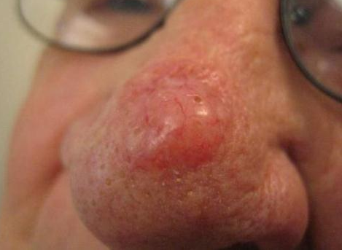
Nodular BCC

Slide 12
2- Morpheaform Basal Cell Carcinoma
Scar-like plaque
whitish dermal plaque with atrophy
More extensive subclinical spread

Slide 13
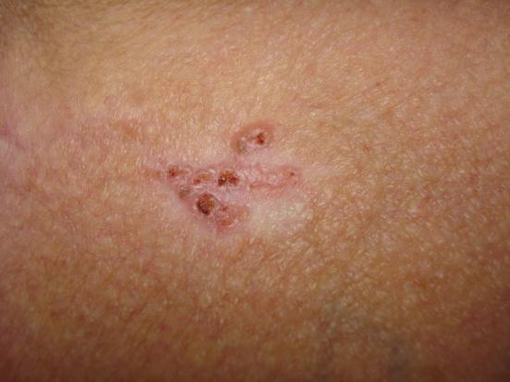
Morpheaform BCC

Slide 14
3- Superficial Basal Cell Carcinoma
Red scaly plaque, mimics superficial dermatitis
Most common on the trunk and extremities
Seen with chronic arsenic and areas of radiation damage

Slide 15
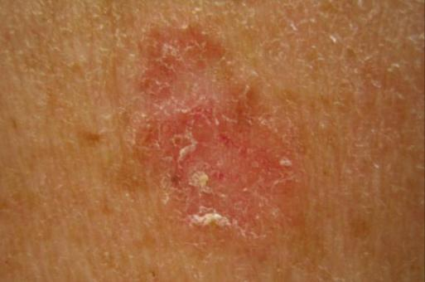
Superficial BCC

Slide 16
4- Pigmented Basal Cell Carcinoma
Dark brown or blue pearly papule
Mimics dysplastic nevus or nodular melanoma
Seen with darker skin types

Slide 17
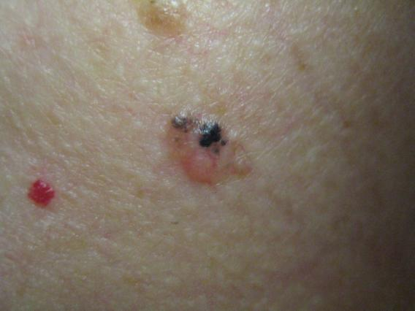
Pigmented BCC

Slide 18
Basal Cell Carcinoma epidemiology
95% Caucasians
95% between ages 40-79 years old
85% head and neck
Nose most common site, approximately 30% of all tumors

Slide 19
Squamous Cell Carcinoma
Malignant tumor of epithelial cell keratinocytes (skin and mucus membranes)
Second most common skin cancer
20% of all cutaneous malignancies
Risk for metastasis greater than for BCC

Slide 20
Clinical Features of SCC
Invasive SCCs are usually slowly-growing, tender, scaly or crusted lumps.
The lesions may develop sores or ulcers that fail to heal.
Most SCCs are found on sun-exposed sites, particularly the face, lips, ears, hands, forearms and lower legs.

Slide 21
SCC lesions vary in size from a few millimeters to several centimeters in diameter.
Sometimes they grow to the size of a pea or larger in a few weeks
But more commonly they grow slowly over months or years.

Slide 22
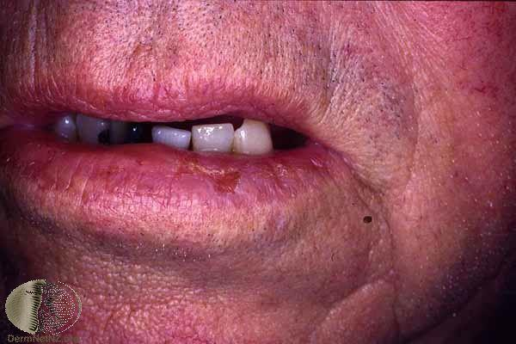

Slide 23
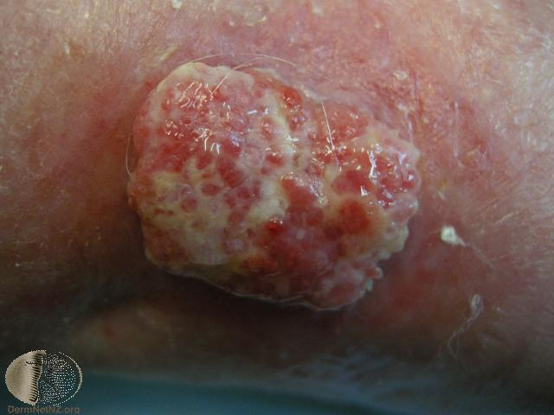

Slide 24
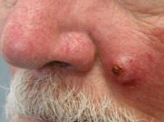

Slide 25
Squamous Cell Carcinoma Histology
Graded on degree of cellular differentiation
Less differentiated tumors show more aggressive growth pattern and have greater chance of metastasis
Metastatic rate is less that 1-2% for small lesions
Metastatic rate is up to 20% for tumors >4cm on the lips and ears

Slide 26
Squamous Cell Carcinoma Pathogenesis
Ultraviolet Radiation
Chronic arsenic exposure
Radiation treatment
Human papilloma virus
Immunosuppression
-transplant patients
-underlying cancer
6. Chronic scars: burns, chronic ulcers, chronic osteomyelitis

Slide 27
Melanoma
Arise from epidermal melanocytes
Skin is most common site also seen in mucosa, retina, and leptomeninges
Incidence tripled in last 4 decades
All ages affected, median age 53

Slide 28
Etiology:
Cumulative and prolonged UVB and/or UVA exposure
UVA exposure from tanning beds increases risk for melanoma

Slide 29
Melanoma Risk Factors
Numerous nevi (common or atypical)
Atypical nevi
Family or personal history of melanoma
Immunosuppression
Intermittent intense sun exposure

Slide 30
Melanoma Clinical Presentation
Typically appears as a pigmented papule, plaque or nodule.
Demonstrates any of the ABCDEs
It may bleed, be eroded or crusted
Patients may give history of change
Majority located in sun-exposed areas, but also occur in non-sun-exposed areas, such as the buttock
Also occur on mucous membranes (mouth, genitalia)

Slide 31
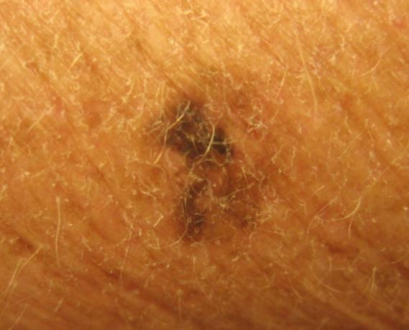

Slide 32
The ABCDEs of Melanoma Suspicious moles may have any of the following features:
BORDER
DIAMETER
>6 mm, or “larger than a pencil eraser”
EVOLVING
Irregular or notched
Very dark or variegated colors
Evolution or change in any of the ABCD features
Blue, Black, Brown, Red, Pink, White
COLOR
Diameter that is rapidly changing
With regard to shape or color
ASYMMETRY

Slide 33
Diagnosis of Skin Cancer Skin Cancer
1- Biopsy
i- Shave or punch (NMSC)
Need only enough tissue to get representative sample
ii- Excisional biopsy(Melanoma)
iii- Physical exam including lymph nodes if melanoma suspected

Slide 34
Treatment of Skin Cancer Nonmelanoma Skin Cancer
1- Excision with 4-5mm margins ("gold standard")
-cure rate 90-95%
2- Cryosurgery
-application of liquid nitrogen
3- Electrodesiccation and curettage
-combination of mechanical curettage and electrodesiccation,
4- Mohs Micrographic Surgery
-specialized technique for removing high risk NMSC

Slide 35
Treatment of Melanoma
1- Excision
margin: based on thickness of tumor
2- Chemotherapy for extensive tumors

