Slide 1
Bacterial Skin Infections

Slide 2
Cellulitis
Cellulitis is a very common infection occurring in up to 3% of people per year
Results from an infection of the dermis that often begins with a portal of entry that is usually a wound or fungal infection (e.g., tinea pedis)
Presents as a spreading erythematous, non-fluctuant tender plaque
More commonly found on the lower leg

Slide 3
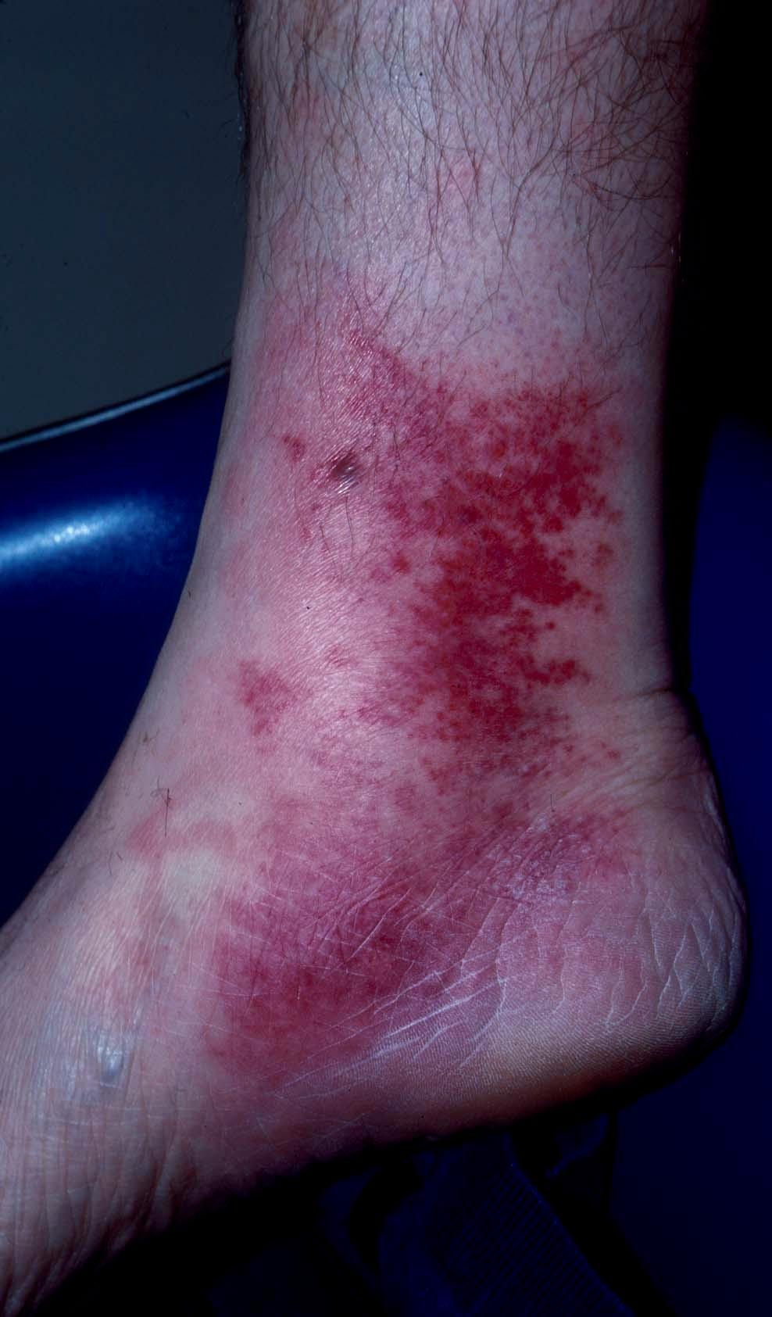
Cellulitis

Slide 4
Risk Factors
Local trauma (bug bites, laceration, abrasion, puncture wound)
Underlying skin lesion (furuncle, ulcer)
Inflammation (local dermatitis, radiation therapy)
Edema and impaired lymphatics in the affected area
Preexisting skin infection (impetigo, tinea pedis)

Slide 5
Etiology
About 80% of cases are caused by gram positive organisms:
1- Group A streptococcus
2- Staphylococcus aureus are the most common causal pathogens

Slide 6
Treatment
It is important to recognize and treat cellulitis early as untreated cellulitis may lead to sepsis and death
Broad spectrum antibiotic
Elevation of the involved area

Slide 7
Erysipelas
Erysipelas is a superficial cellulitis with marked dermal lymphatic involvement (causing the skin to be edematous or raised)
Main pathogen is group A streptococcus
Usually affects the lower extremities and the face
Presents with pain, superficial erythema, and plaque-like edema with a sharply defined margin to normal tissue
Plaques may develop overlying blisters (bullae)
May be associated with a high white count (>20,000/mcL)
May be preceded by chills, fever, headache, vomiting, and joint pain

Slide 8
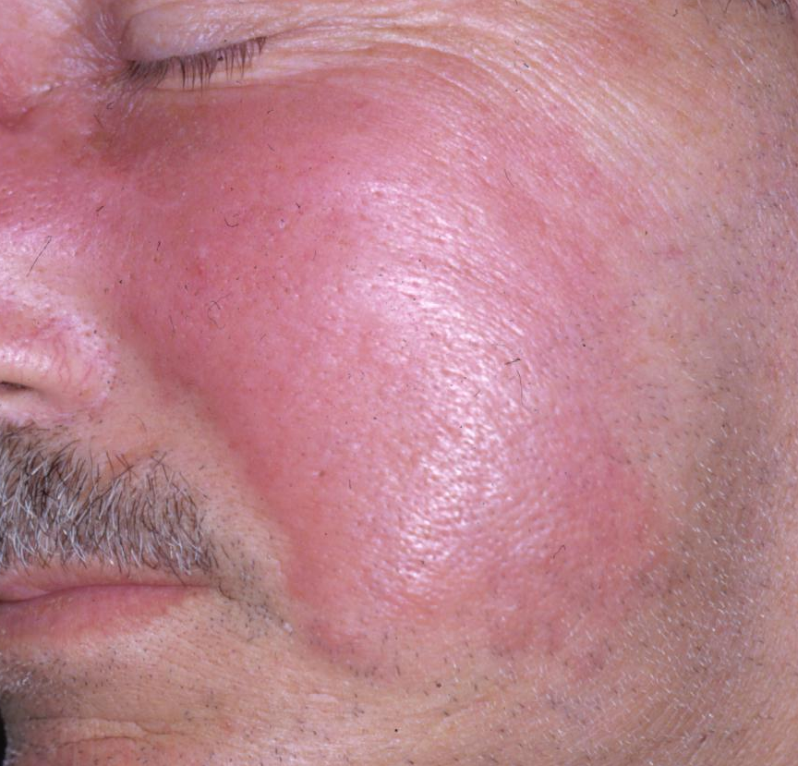
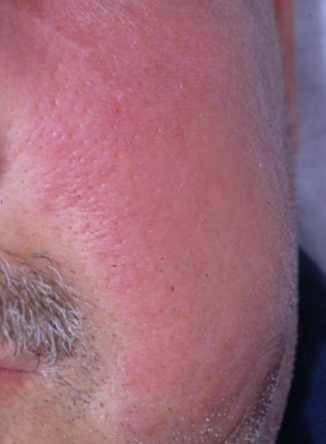
Erysipelas

Slide 9
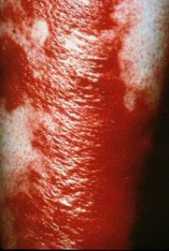
Example of Erysipelas
Large, shiny erythematous plaque with sharply demarcated borders located on the leg

Slide 10
Treatment
Immediate empiric antibiotic therapy should be started (cover most common pathogen - Streptococcus)
Elevation of the involved area

Slide 11
Abscess
A skin abscess is a collection of pus within the dermis and deeper skin tissues
Present as painful, tender, fluctuant and erythematous nodules
Often surmounted by a pustule and surrounded by a rim of erythematous edema
Spontaneous drainage of purulent material may occur

Slide 12
Treatment
Abscesses require incision and drainage (I & D)
Most experts recommend irrigation, breaking of loculations, and packing following incision and drainage
Antibiotics are recommended for abscesses associated systematic symptoms
Wound cultures should always be sent

Slide 13
Infections involve hair follicles

Slide 14
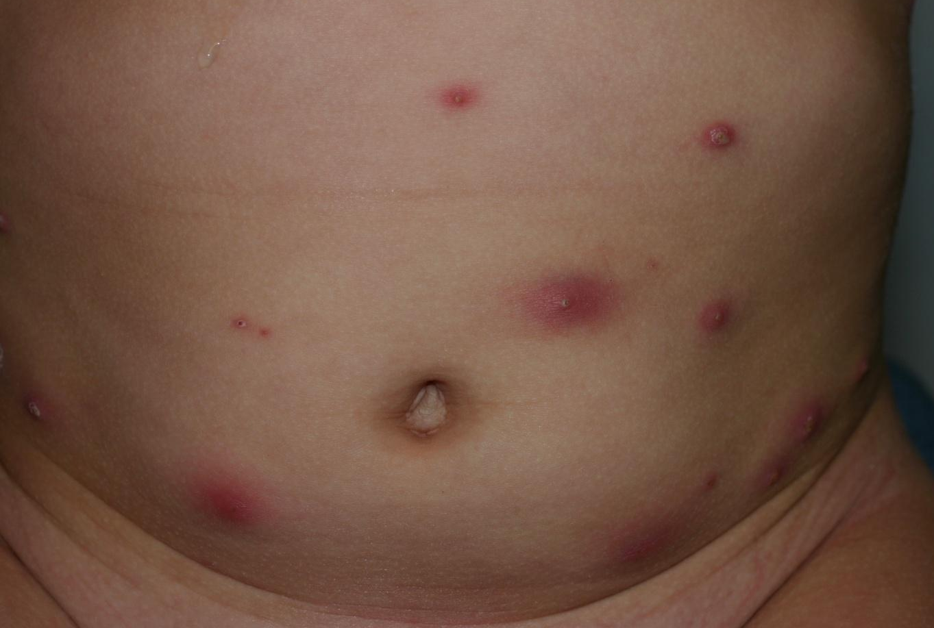
What is the diagnosis?

Slide 15
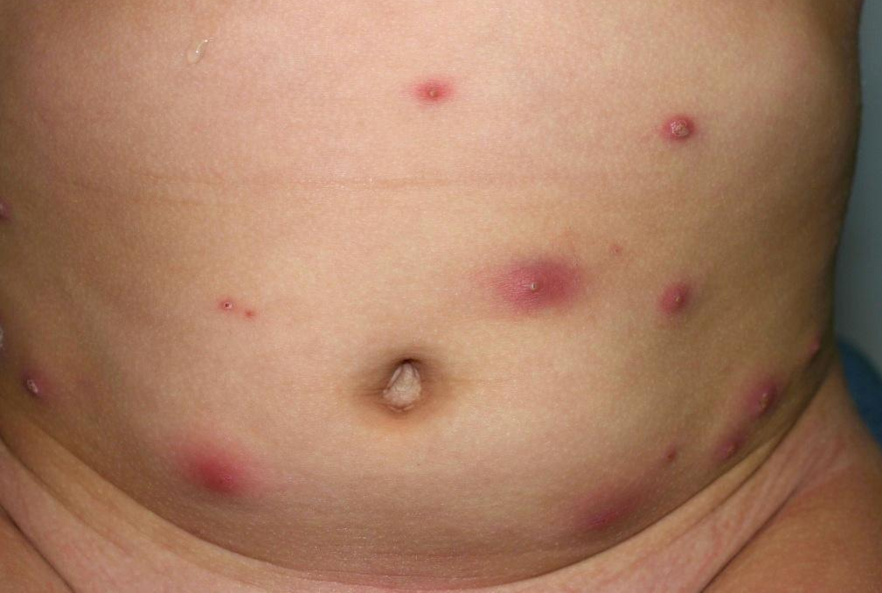
Furunculosis
A furuncle (boil) is an acute, round, tender, circumscribed, perifollicular abscess that generally ends in central suppuration

Slide 16
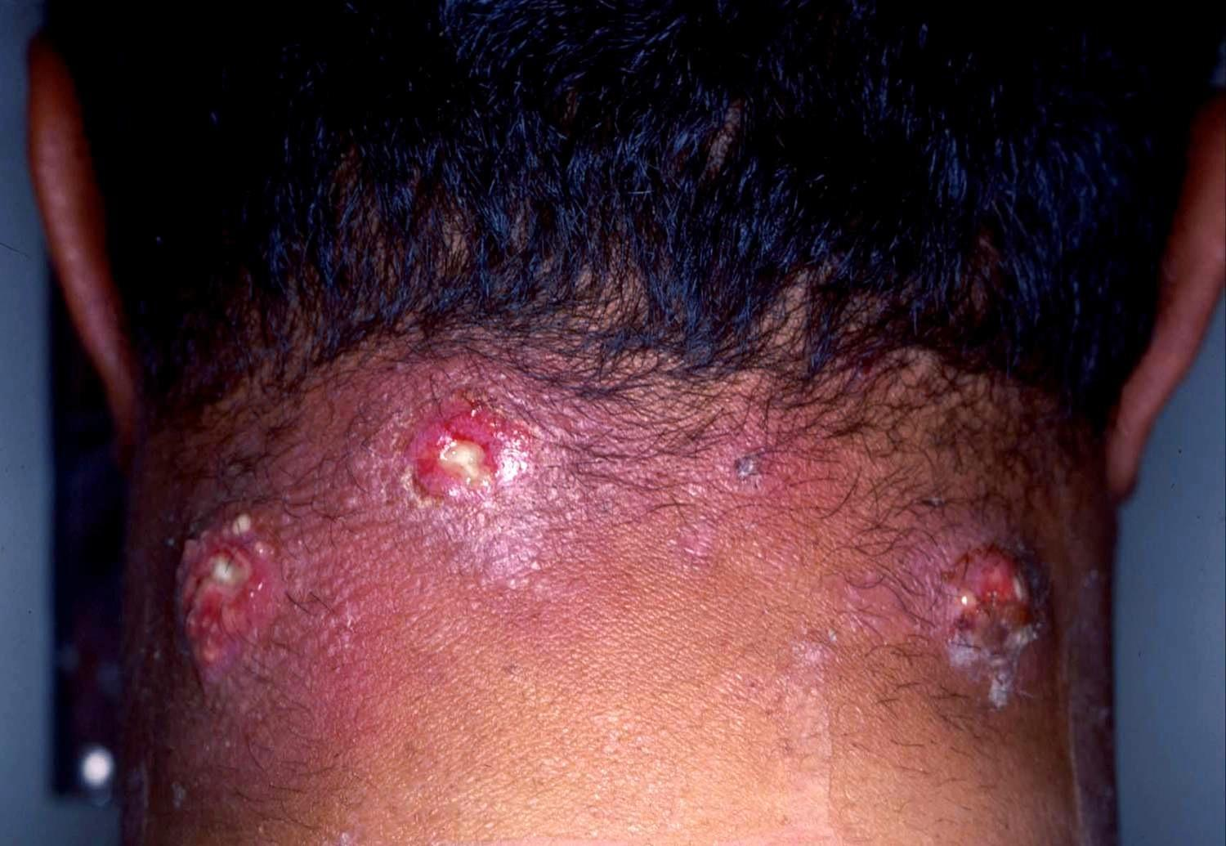
Carbunculosis
A carbuncle is a coalescence of several inflamed follicles into a single inflammatory mass with purulent drainage from multiple follicles

Slide 17
Furuncle, Carbuncle
Furuncles and carbuncles are a subtype of abscesses, which preferentially occur in skin areas containing hair follicles exposed to friction and perspiration
Common areas include the back of the neck, face, axillae, and buttocks
Usually caused by Staphylococcus aureus
Patients are commonly treated with oral antibiotics
For a solitary small furuncle: warm compresses to promote drainage may be sufficient
For larger furuncles and carbuncles: manage as you would an abscess

Slide 18
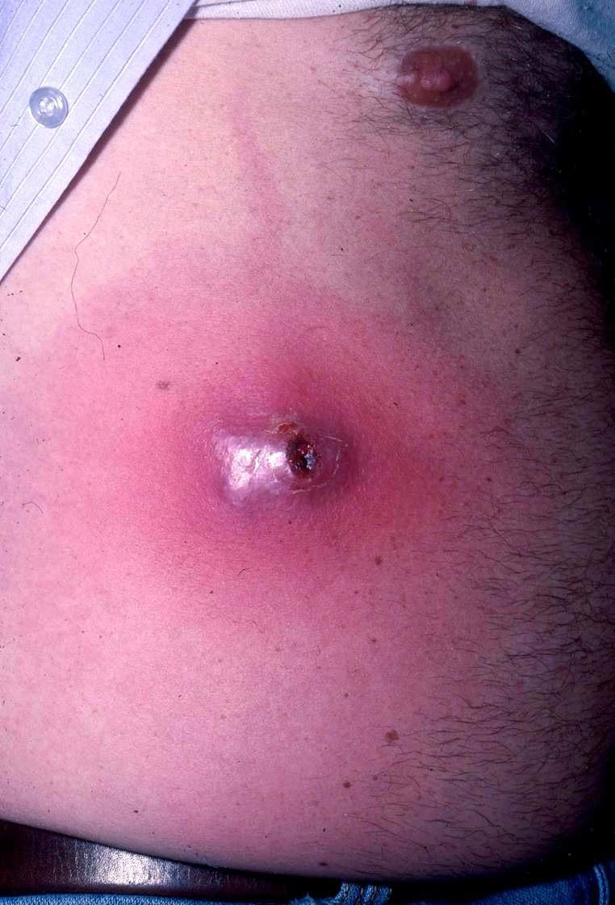
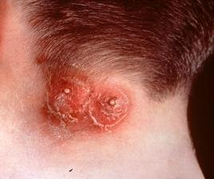
More Examples: Furuncle and Carbuncle

Slide 19
Folliculitis
Folliculitis is a superficial bacterial infection of the hair follicles
Presents as small, raised, erythematous, occasionally pruritic pustules less than 5 mm in diameter
Genital folliculitis may be sexually transmitted
Pathogens:
Majority of cases are due to Staphyloccus aureus
Pseudomonas folliculitis if there has been exposure to a hot tub or swimming pool.
Pustules associated with marked erythema and scaling may represent genital candidiasis

Slide 20
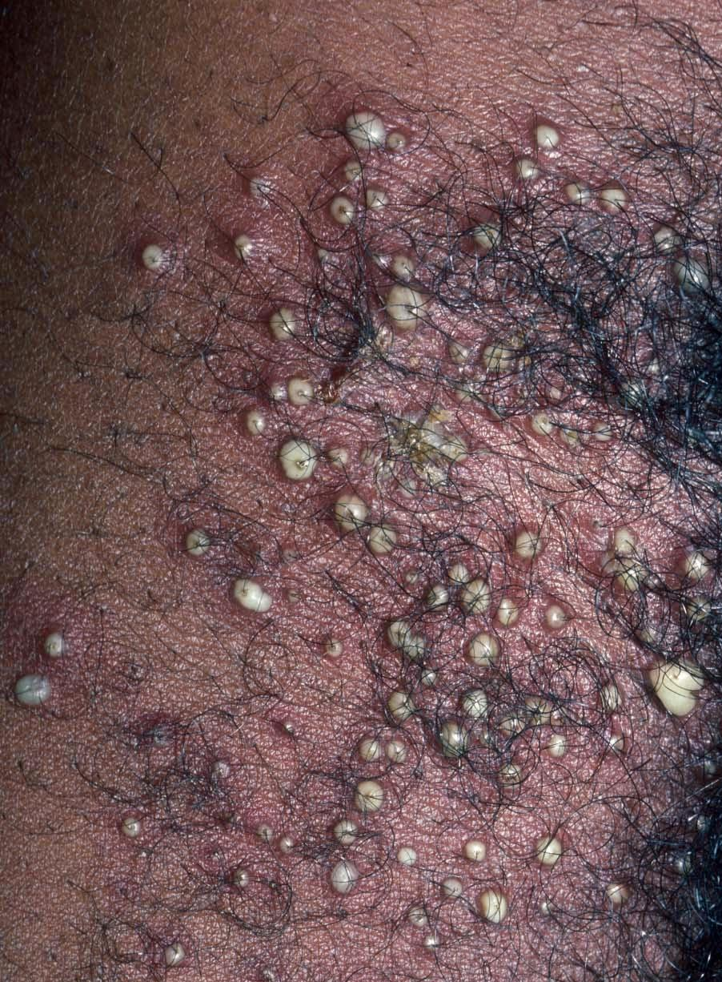
Skin Exam
Multiple follicular pustules with surrounding erythema in the right groin

Slide 21
Management
Thoroughly cleanse the affected area with antibacterial soap and water 3x/day
Superficial pustules will rupture and drain spontaneously
Oral or topical antibiotics
Deep lesions of folliculitis represent small follicular abscesses and should be drained

Slide 22
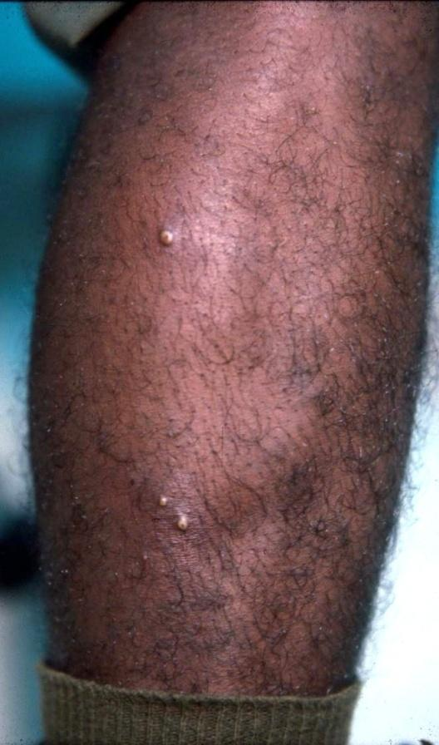
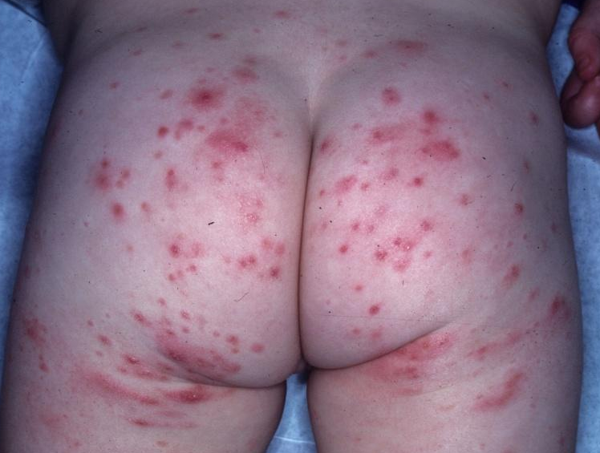
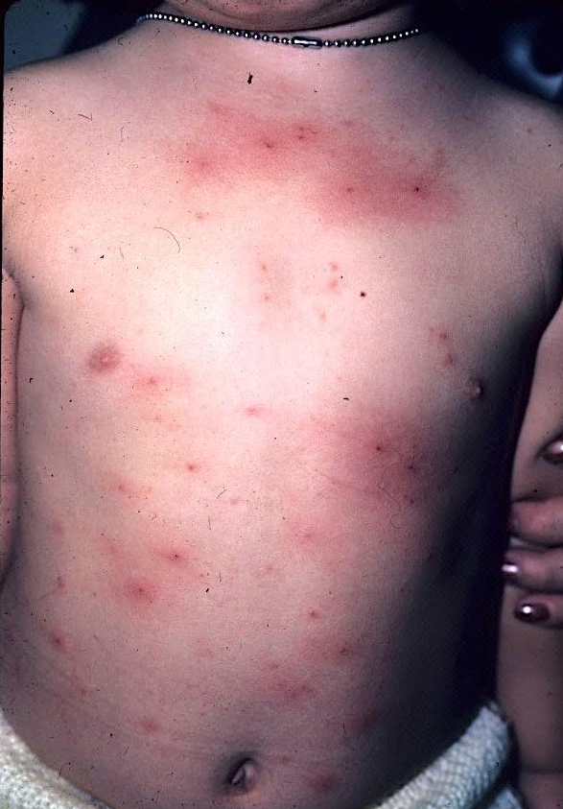
More Examples of Folliculitis

Slide 23
Impetigo
Impetigo is a common superficial bacterial skin infection
Most commonly seen in children ages 2-5, but older children and adults can be affected
Impetigo is contagious, easily spread among individuals in close contact
Most cases are due to S. aureus with the remainder either being due S. pyogenes or a combination of these two organisms

Slide 24
Clinical variants of impetigo
The three clinical variants
Non-bullous impetigo
Bullous impetigo
Ecthyma

Slide 25
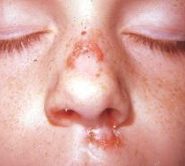
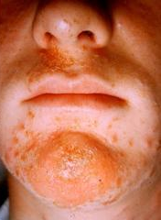
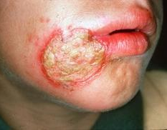
1- Non-bullous Impetigo(contagiosum )
Also called impetigo contagiosum
Lesions begin as papules surrounded by erythema
They progress to form pustules that enlarge and break down to form thick, adherent crusts with a characteristic golden appearance

Slide 26
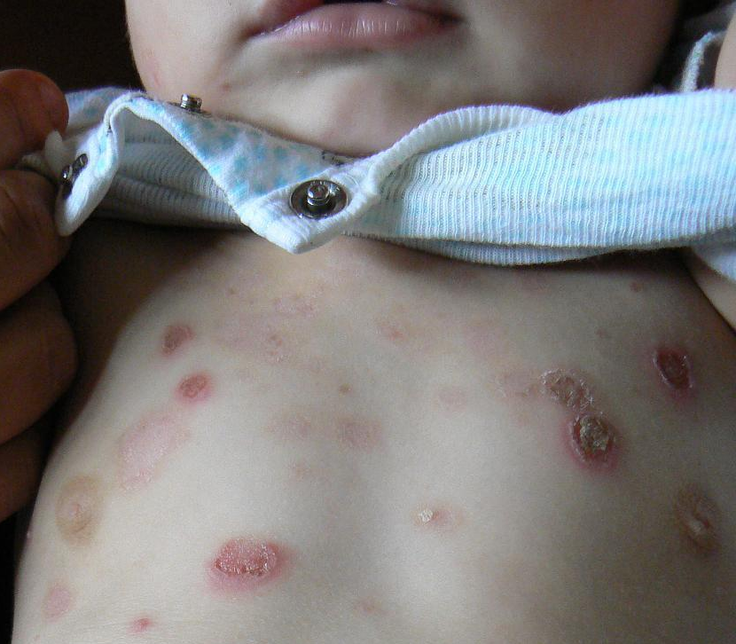
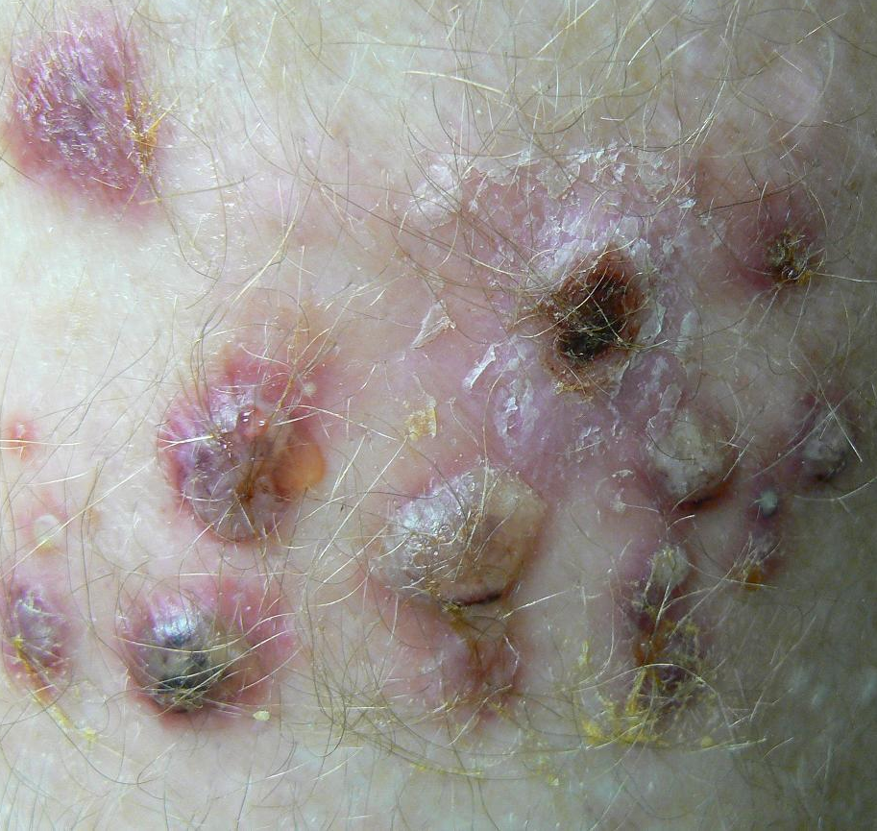
2- Bullous Impetigo
A form of impetigo seen in young children is characterized by flaccid bullae with clear yellow fluid, which later becomes purulent.
Ruptured bullae leave a thick brown crust

Slide 27
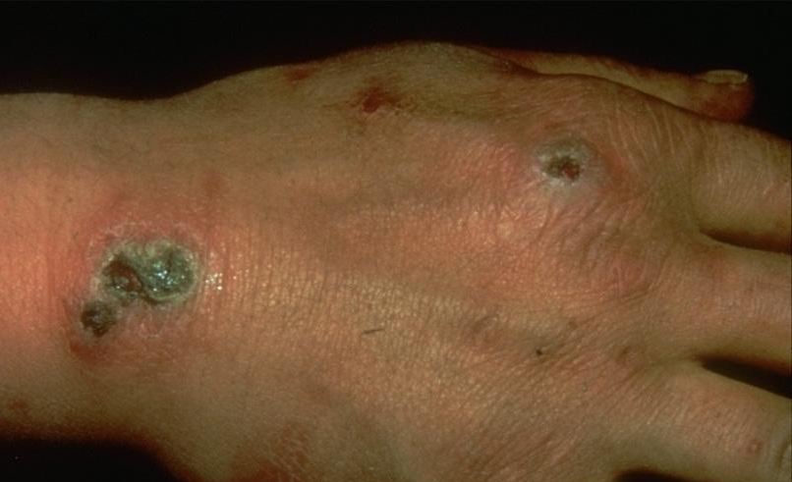
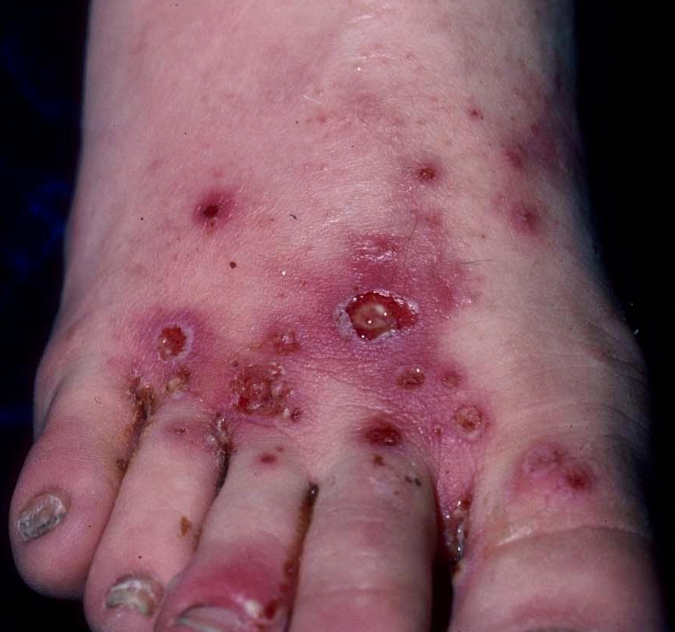
3-Ecthyma (deep imptigo)
Ecthyma is an ulcerative form of impetigo in which the lesions extend through the epidermis and deep into the dermis.
They consist of “punched out” ulcers covered with yellow crust surrounded by raised margins.

Slide 28
Treatment
1- Topical therapy with mupirocin ointment may be equally effective to oral antibiotics if the lesions are localized in an otherwise healthy patient
2- Oral antibiotics used to treat impetigo include:
Dicloxacillin
Cephalexin
Erythromycin

Slide 29
Necrotizing Fasciitis
Necrotizing fasciitis is a life-threatening infection of the fascia just above the muscle
Progresses rapidly over the course of hours and may follow surgery or trauma, or have no preceding visible lesion
Expanding dusky, edematous, red plaque with blue discoloration
May turn purple and blister
Anesthesia of the skin of the affected area is a characteristic finding
Caused by group A streptococcus, Staphyloccocus aureus or a variety of other organisms

Slide 30
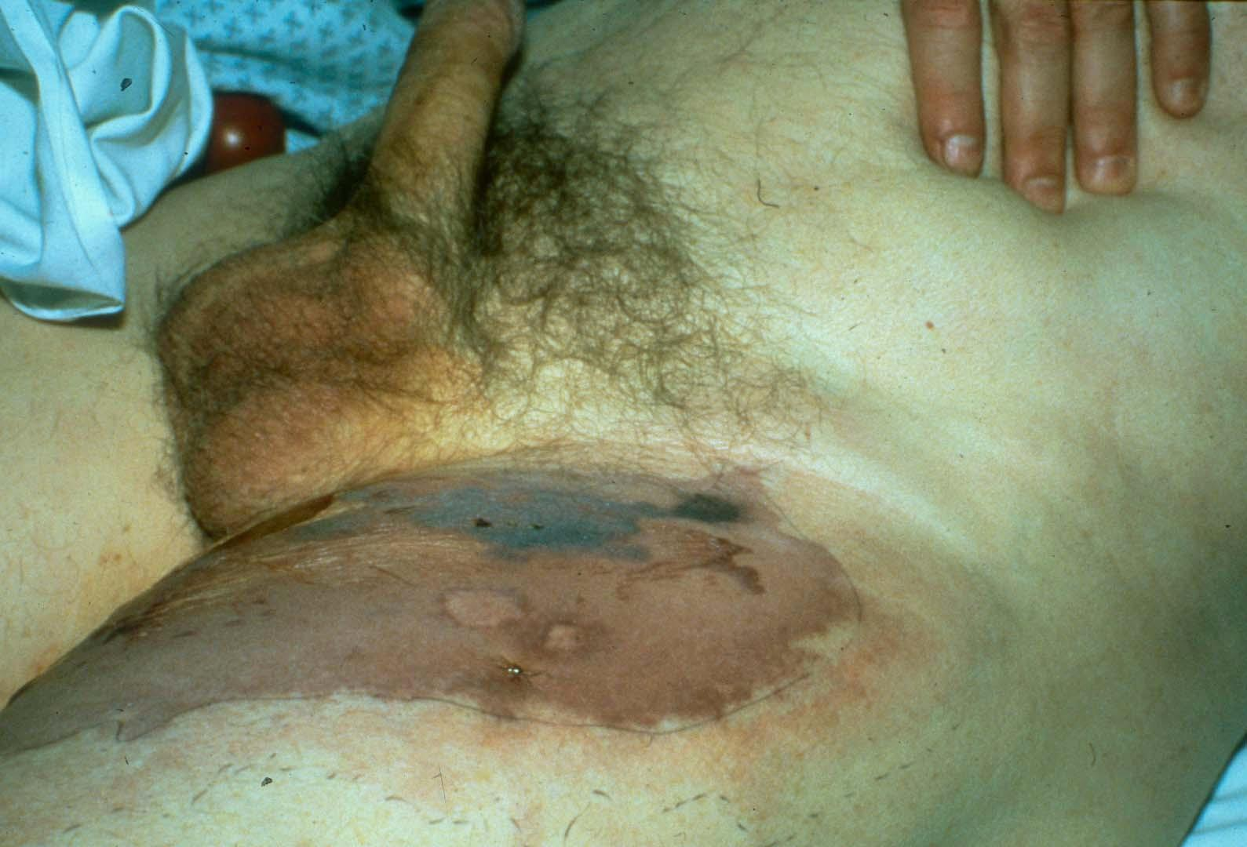
Necrotizing Fasciitis

Slide 31
Treatment
Considered a medical/surgical emergency with up to a 20% mortality rate
If suspect necrotizing fasciitis: consult surgery immediately
Treatment includes widespread debridement and broad-spectrum systemic antibiotics
Poor prognostic factors include: delay in diagnosis, age>50, diabetes, atherosclerosis, infection involving the trunk

Slide 32
Take Home Points
Cellulitis is a bacterial infection of the dermis that often begins with a portal of entry that is usually a wound, insect bite, or fungal infection (tinea pedis)
It is important to recognize and treat cellulitis early as untreated cellulitis may lead to sepsis and death
Erysipelas is a superficial cellulitis with marked dermal lymphatic involvement
A skin abscess is a loculated infection within the dermis and deeper skin tissues and is best treated with I&D
Furuncles and carbuncles are a subtype of abscesses, which preferentially occur in skin areas containing hair follicles exposed to friction and perspiration

Slide 33
Take Home Points (cont.)
Folliculitis is a superficial bacterial infection of the hair follicles presenting as follicular pustules
In impetigo, papules and vesicles progress to form pustules that enlarge and break down to form thick, adherent crusts with a golden or honey-colored appearance
Necrotizing fasciitis presents as an expanding dusky, edematous, red plaque with blue discoloration
Anesthesia of the skin of the affected area is a characteristic finding
Necrotizing fasciitis is a medical/surgical emergency

