Slide 1
Drug Eruptions
Dr sami billal
MBBS,MSc,MD, PhD

Slide 2
Drug Eruptions
1- DRESS Syndrome
2- Urticaria
3- Angioedema/anaphylaxis
4- Drug-induced exanthems
5- Hypersensitivity vasculitis
6- Exfoliative dermatitis/Erythroderma
7- SJS/TEN
8- Fixed drug eruption
9- Photosensitivity

Slide 3
DRESS Syndrome
Drug Rash with Eosinophilia and Systemic Symptoms
Formerly called Hypersensitivity Syndrome (HSS)
Typically presents with rash and fever (87%), classically erythematous follicular papules and pustules, but may also include bullae or purpura.
Other severe systemic manifestations such as hepatitis (51%), arthralgias, lymphadenopathy (75%), interstitial nephritis (11%), or hematologic abnormalities (30%).

Slide 4
Common causes of dress
Carbamazepine
Phenytoin
phenobarbital
sulfonamides
Dapsone
metronidazole
minocycline

Slide 5
DRESS Syndrome
Usually occurs 2-6 weeks after initiation of the medication, which is later than most drug eruptions.
Treatment is supportive.
Medication should be stopped as soon as the diagnosis is suspected.
Severity is dependent upon the amount of time the drug is continued after hypersensitivity occurs.
Corticosteroids have been required in some cases, but their use is controversial.

Slide 7
Urticaria
Time to onset: immediate, accelerated (hours), or delayed (days).
Type I hypersensitivity reactions: antibiotics ( cephalosporins, and sulfonamides), local anesthetics, radiocontrast media, blood products, and gamma globulin.
Non-immune urticaria: radiocontrast media and long-acting ACE-inhibitors (due to changes in vascular response to bradykinin).
Mast cell degranulation by non-IgE mechanisms: opiate analgesics, anesthetic muscle relaxants, and Vancomycin (Red Man Syndrome, which can be worsened by concommitant opiate use).

Slide 8
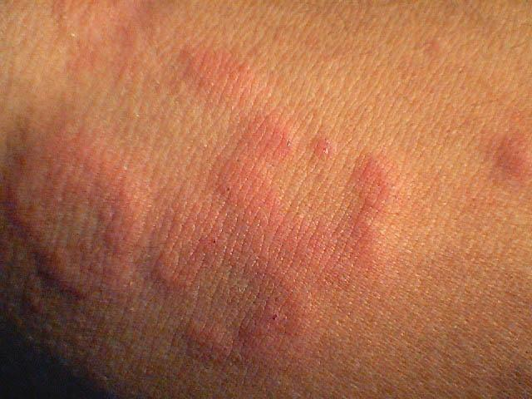

Slide 9
Angioedema/Anaphylaxis
Caused by degranulation of mast cells in the deeper dermis and subcutaneous tissues.
May occur along with urticaria (50% of cases)
Can be life-threatening if it causes laryngeal edema or tongue swelling.
Can be non-mast cell mediated, as in the case of ACE-inhibitors.

Slide 10
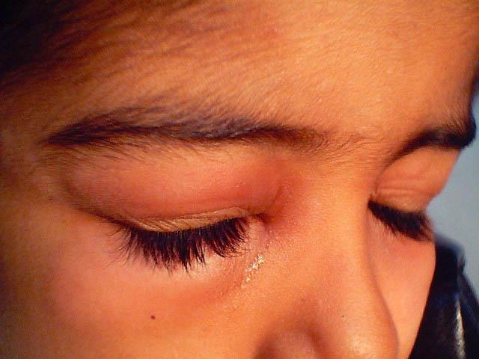

Slide 11
Drug-induced Exanthems
Account for close to 75% of all drug eruptions.
Morbilliform, maculopapular eruptions.
Most commonly implicated medications are the most commonly prescribed medications (antibiotics, sulfa).
Often associated with pruritis, low-grade fever, eosinophilia.
Onset within 2 weeks of starting a new drug, or within days of re-exposure.
Delayed (type IV) hypersensitivity is most likely etiology.
Treatment is dicontinuation of the drug. Antihistamines, topical steroids, and topical antipruritics may also help.
May be the early stage of more severe reactions such as toxic epidermal necrolysis, DRESS

Slide 12
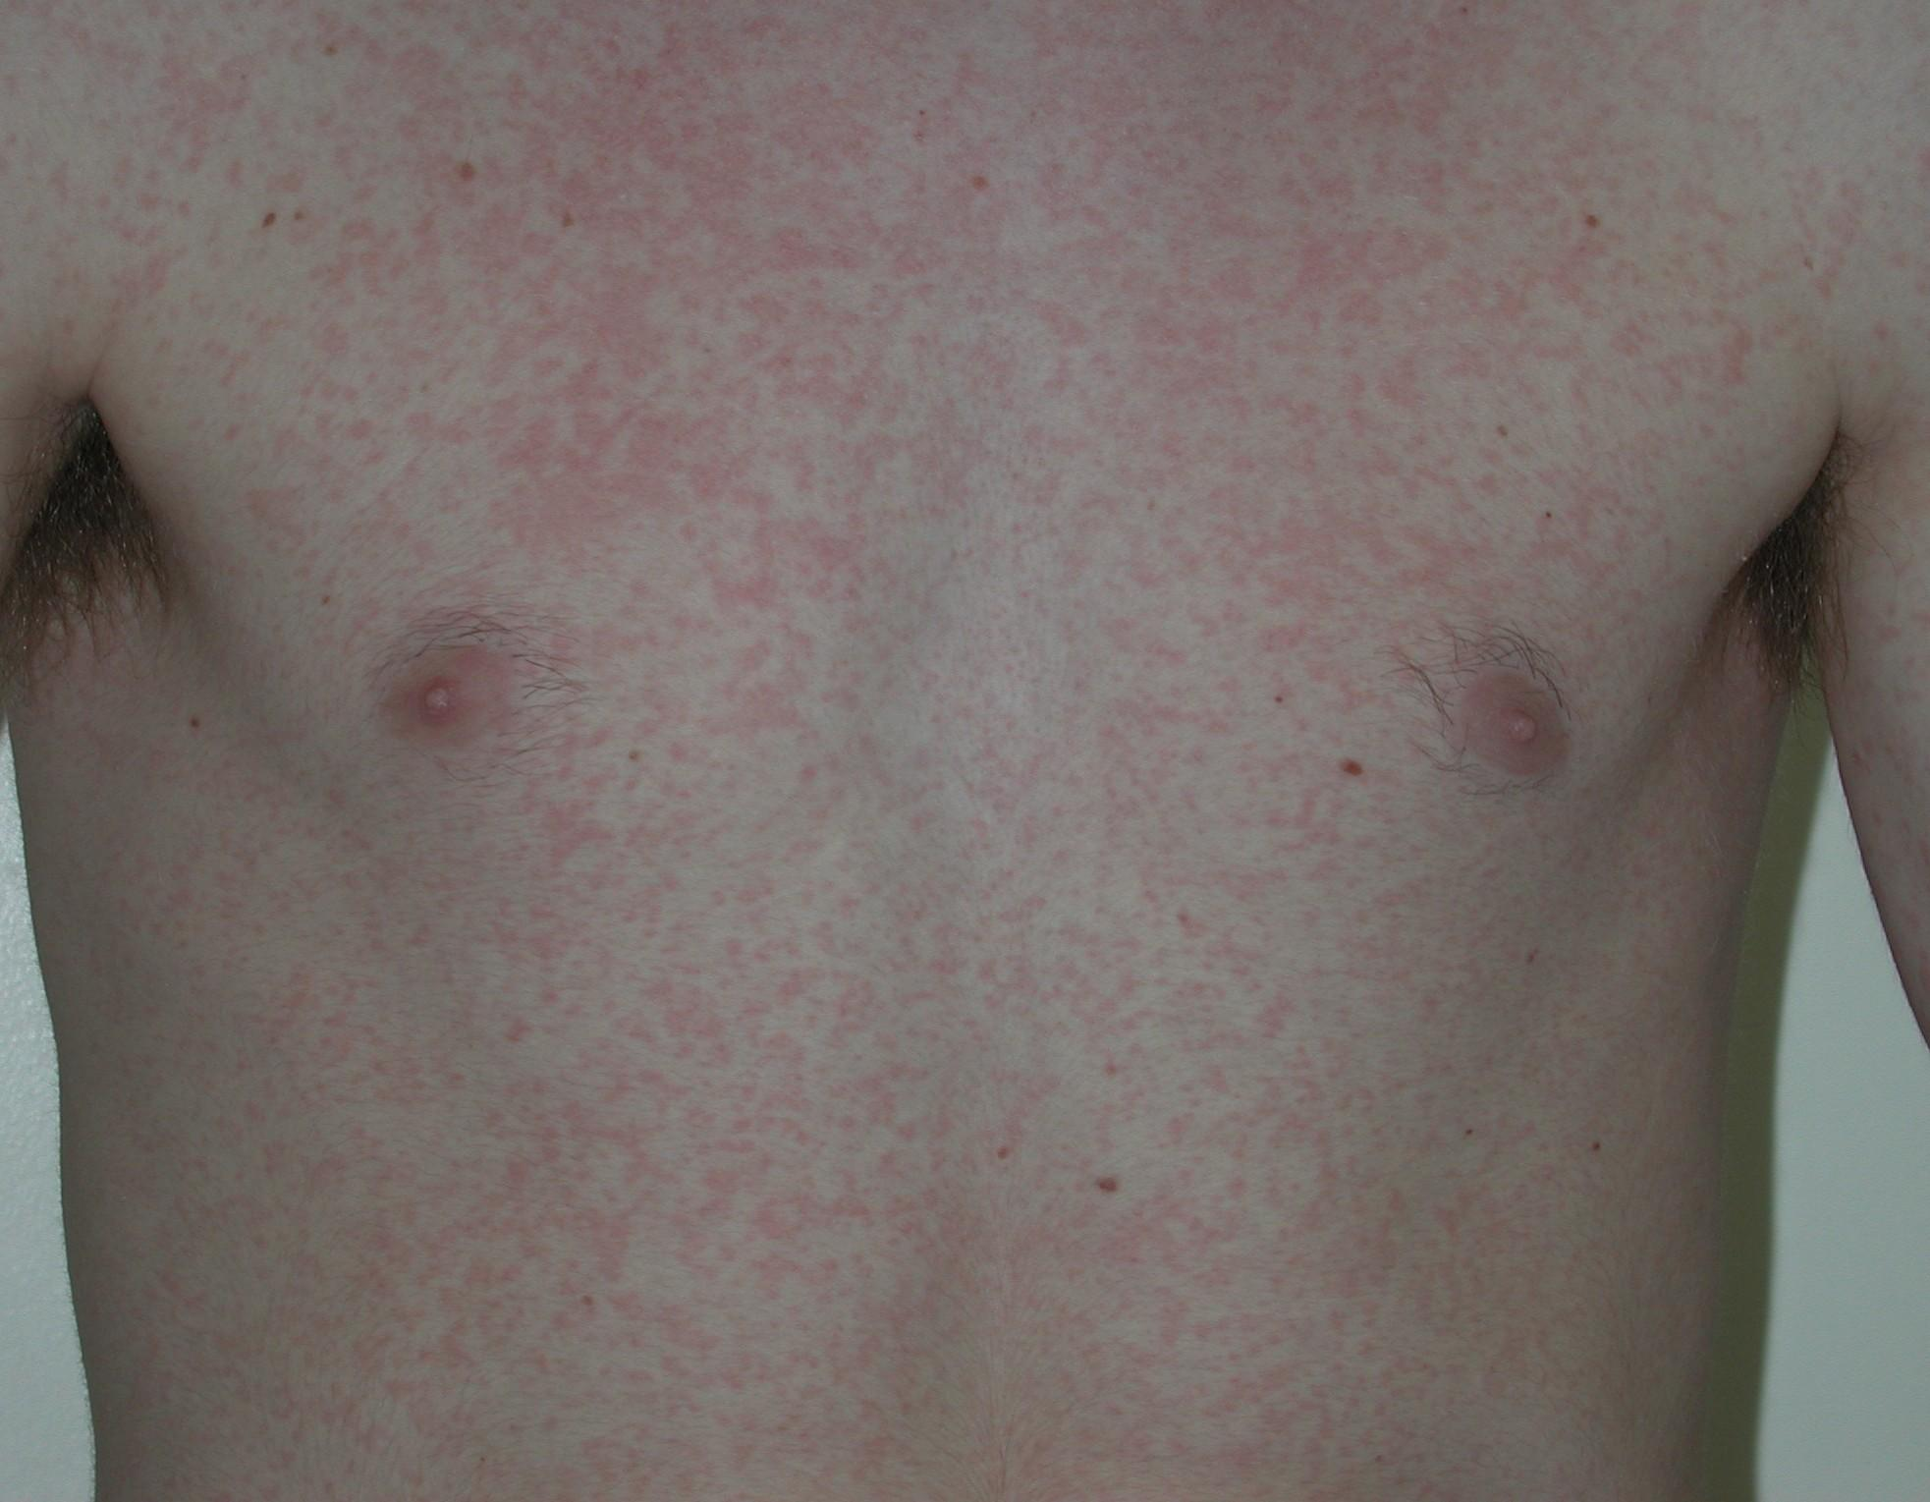

Slide 13
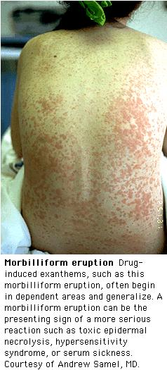

Slide 14
Hypersensitivity vasculitis
Hypersensitivity vasculitis should be expected if the following criteria is fulfilled
Age > 16
Use of possible offending drug in temporal relation to symptoms
Palpable purpura
Maculopapular rash
Biopsy of a skin lesion showing neutrophils around an arteriole or venule.
Most likely due to : Cephalosporins, Sulfonamides, Phenytoin, and Allopurinol.
Additional Clinical features : fever, urticaria, arthralgias, elevated ESR.

Slide 15
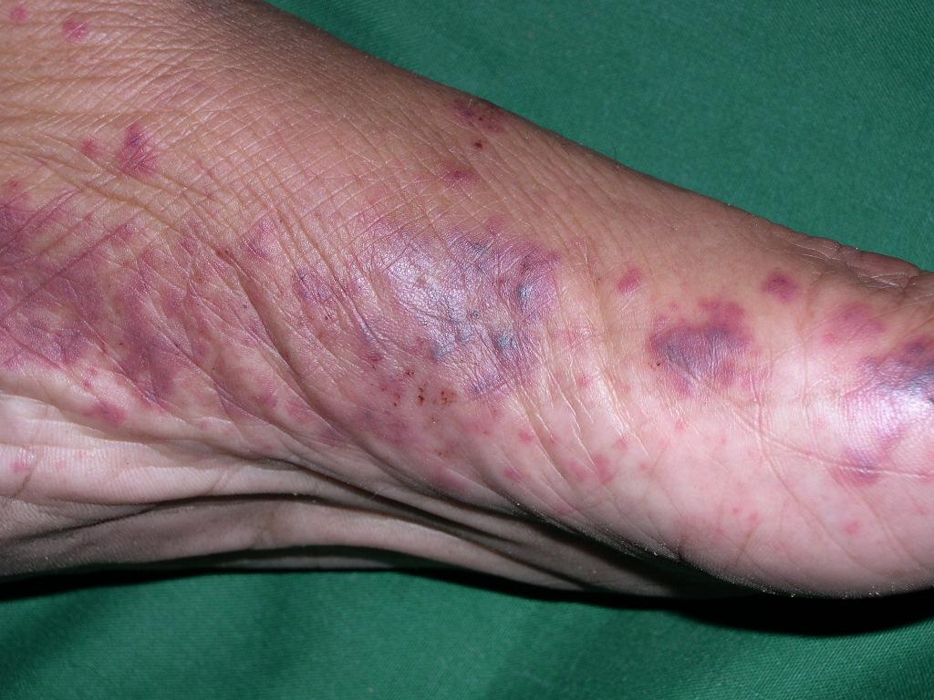

Slide 16
Erythroderma
Erythroderma is defined as a cutaneous reactional state with chronic erythema and scale involving greater than 50% of the body surface area.
It can result from drugs, atopic dermatitis, psoriasis, and malignancies such as cutaneous T-cell lymphoma.
Drugs, including gold, arsenic, mercury, and barbituates, are implicated in about 10% of cases.
Usually begins as an eczematous or morbilliform eruption and progresses.

Slide 17
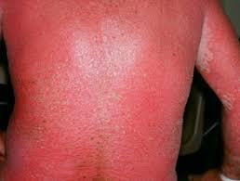
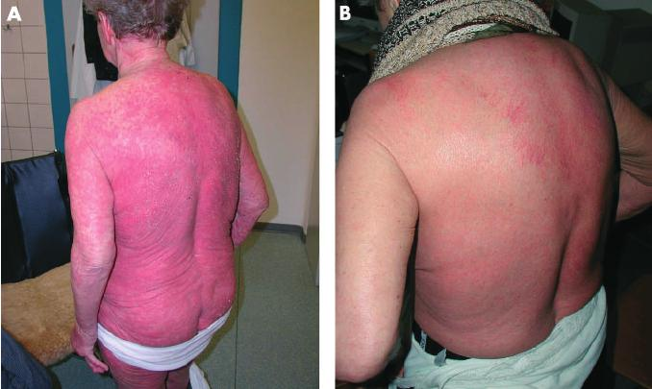

Slide 18
Steven johnson syndrome (sjs)& toxic epidermal necrolysis(ten)
Stevens-Johnson Syndrome and toxic epidermal necrolysis are likely two manifestations on the same spectrum.
The disease is best termed SJS when epidermal detachment involves less than 10% of the body surface area, whereas TEN involves greater than 30%.
SJS is usually drug induced and can be fatal.
SJS and TEN usually occur 1-3 weeks after exposure, but can occur more rapidly with re-exposure, which suggests an immunologic mechanism.
Mucosal involvement is seen in 90% of cases, including painful crusts and erosions on the oral mucosa, conjuntivae, and genital mucosa.

Slide 19
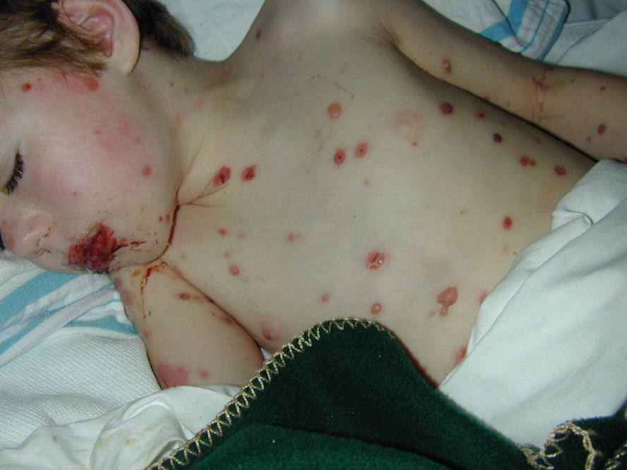
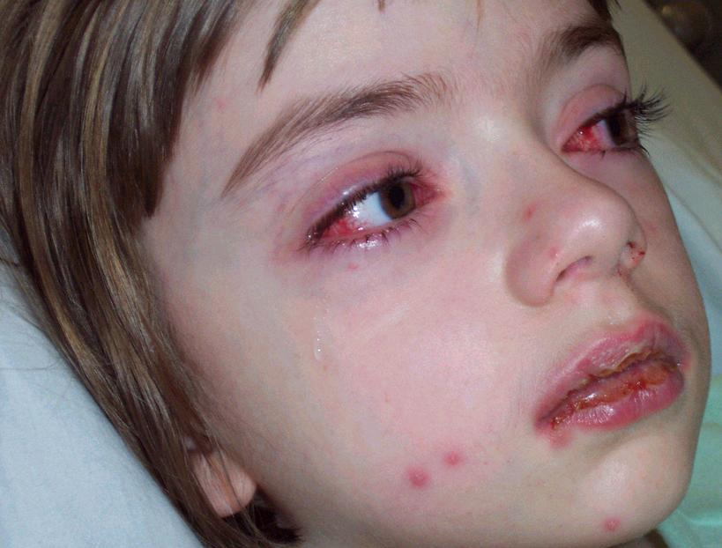
Steven Johnson syndrome

Slide 20
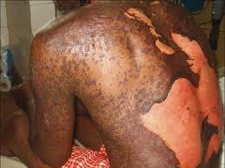
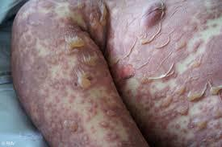
Toxic epidermal necrolysis

Slide 21
Fixed Drug Eruptions
Drug eruption that occurs at the same location every time a particular medication is used.
Sites include the mouth, genetalia, face, and acral areas.
Causes include phenolphthalein, tetracyclines, barbituates, sulfonamides, NSAIDs, and salicylates.
Begins as an erythematous, edematous plaque with a grayish center or frank bullae, then progresses to dark, post-inflammatory pigmentation.

Slide 22
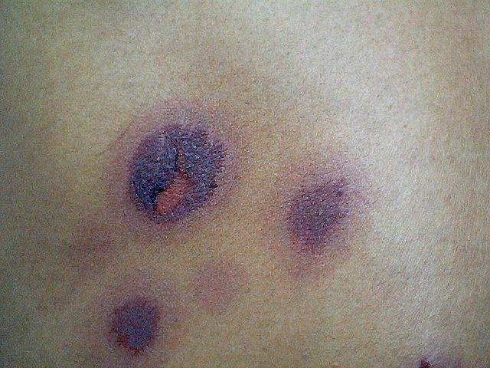

Slide 23
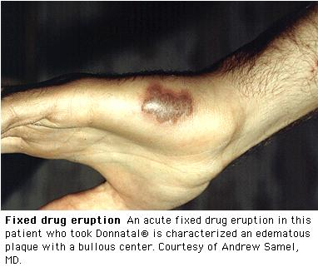

Slide 24
Photosensitivity
Two types include phototoxic eruptions and photoallergic eruptions.
Phototoxic eruptions are due to absorption of UV light (usually UVA) by the drug, which causes a release of energy and damage to cells. Looks like a bad sunburn, which may blister.
Photoallergic eruptions are a lymphocyte-mediated reaction caused by exposure to UVA, which converts the drug to an immunologically active compound that activates lymphocytes, causing an eczematous reaction in a photodistribution.
Usually due to topical agents including fragrances and biocides in soaps.
Both types can be caused by phenothiazines, chlorpromazine, sulfa, and NSAIDS, although phototoxic reactions are more common with these agents.

Slide 25
