Slide 1
ECZEMA
Dr Sami Billal
Phd, MD

Slide 2
Terminology
Dermatitis / Eczema
Dermatitis = Derma + titis
Derma: refers to skin; itis: means “inflamed”
thus, inflamed skin
other examples: arthritis, encephalitis.
Eczema = Greek term “To boil over”
Usually refers to severely inflamed dermatitis, and associated signs and symptoms (itching, sting, burning of the skin with drainage from lesions)

Slide 3
Terminology …
The terms ‘dermatitis’ and ‘eczema’ are nowadays generally regarded as the same.
The term ‘dermatitis’ to include all types of cutaneous inflammation.
So that all eczema is dermatitis, but not all dermatitis is eczema.
E.g. Dermatitis Herpetiformis (a bullous disease)

Slide 4
Eczema
Eczemas are a group of diseases which have different types/skin manifestations
The patient usually is a known atopic or has a family history of atopy (e.g.Bronchial asthma)

Slide 5
Classification of Eczema
Eczema is divided into two groups:
Exogenous E.
Endogenous E.
1- Exogenous eczemas
Are related to clearly defined external trigger factors
Inherited tendencies can also play a part.

Slide 6
Classification of Eczema …
Eczema is divided into two groups:
Exogenous E.
Endogenous E.
2- Endogenous eczema
The eczematous condition is not a result of exogenous or external environmental factors
Mediated by processes originating within the body.

Slide 7
Exogenous eczemas
Contact dermatitis
Eczematous polymorphic light eruption
Infective dermatitis

Slide 8
Endogenous eczemas
Atopic dermatitis
Seborrhoeic dermatitis
Discoid eczema
Palmoplantar dermatosis
Pityriasis alba

Slide 9
DIAGNOSIS OF ECZEMA
The diagnosis of eczema is usually clinically but in some cases histopathology may be needed to confirm diagnosis.

Slide 10
Clinical Features of Eczema
The lesions of eczema take different forms:
In the acute eczema:
Erythematous papules,
Vesicles, and
Oozing with crusting.
In the subacute eczema:
-Lesions are reddish with scaly papules.
In the chronic eczema :
- Chronicity leads to thickened epidermis with accentuated skin markings (lichenification).

Slide 11
Clinical Features of Eczema
Excoriations due to scratching are the commonest secondary lesions.
Conditions are usually associated with itching.
Eczema not associated with constitutional symptoms unless there is secondary bacterial infection

Slide 12
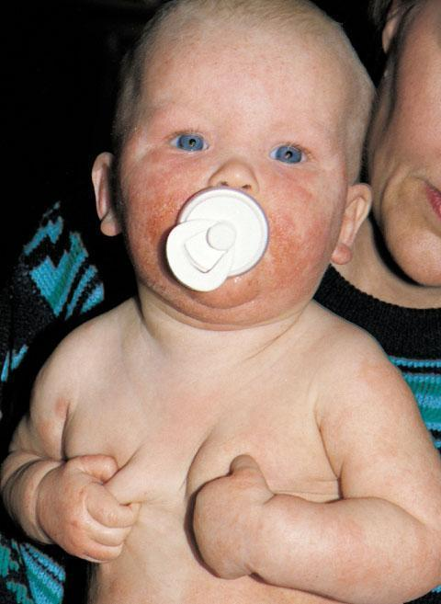
Atopic Dermatitis in an infant

Slide 13
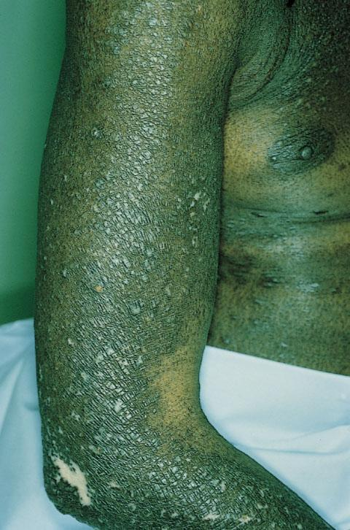
Chronic Eczema with lichenification

Slide 14
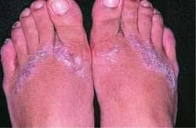
Contact Dermatitis

Slide 15
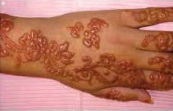
Contact Dermatitis

Slide 16
Histopathology of eczema
The histopathological features reflect a dynamic sequence of changes resulting from inflammation of the epidermis and the underlying dermal structures.
These vary with the intensity and the stage of the eczematous process

Slide 17
Histopathological features of eczema …
Spongiosis (intercellular epidermal edema) leads to stretching and rupture of the intercellular attachments, with the formation of vesicles→ ACUTE ECZEMA
Increased epidermal mitotic activity leads to acanthosis → SUBACUTE ECZEMA
Acanthosis is associated with formation of a parakeratosis → CHRONIC ECZEMA

Slide 18
Treatment of eczema
Withdrawal or avoidance of the triggering substance if there.
Emollients
Topical steroids is the treatment of choice
How you select suitable steroid potency and vehicle?

Slide 19
*****Thank you*****

