Slide 1
Superficial Cutaneous Fungal Infections

Slide 2
Superficial Fungal Infections
DERMATOPHYTES
YEASTS
-Candida sp.
-Pityrosporum.(Malassezia furfur )

Slide 3
DERMATOPHYTE
Dermatophytes group of fungi (ringworm) have the ability to infect and survive only on dead keratin on the top layer of the skin hair and the nails.

Slide 4
CLASSIFICATION
The ringworm fungi belong to three genera (types):
Microsporum
Trichophyton
Epidermophyton
There are several species of Microsporum and Trichophyton and one species of Epidermophyton .

Slide 5
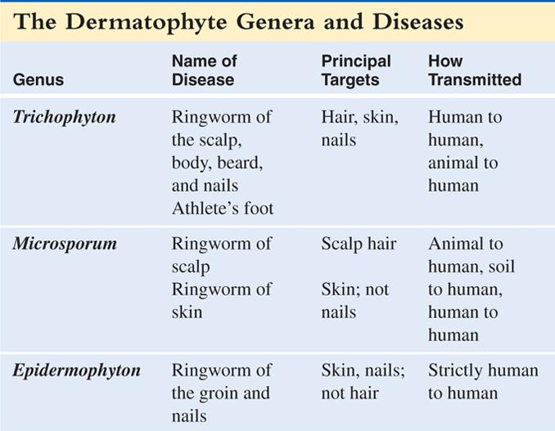

Slide 6
CLINICAL CLASSIFICATION
Tinea means fungal infection.
Clinically, dermatophyte infections are classified by body region:
T.Corporis → body
T.Cruris → groin
T.Pedis → foot
T.Unguium → nail
T.Capitis → scalp

Slide 7
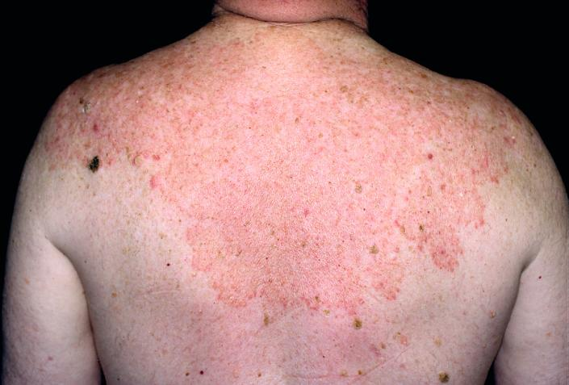
Tinea corporis

Slide 8
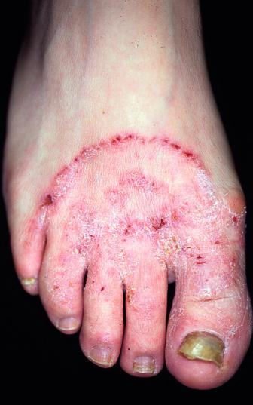
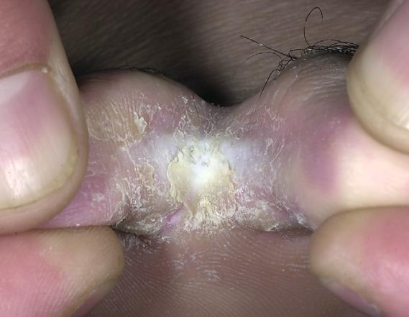
Tinea pedis

Slide 9
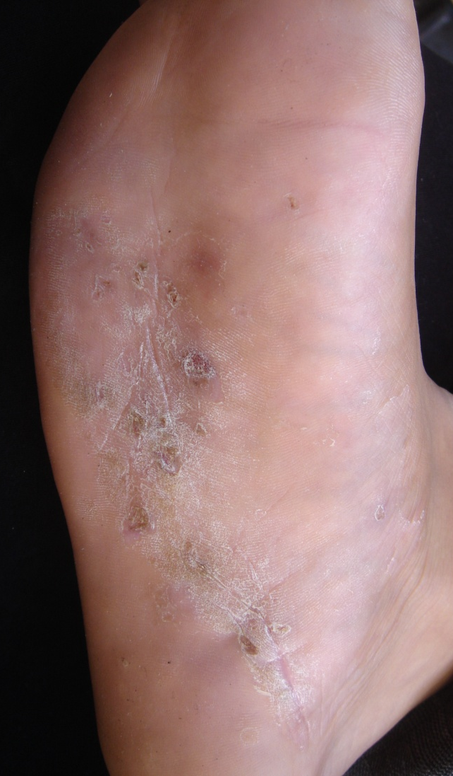
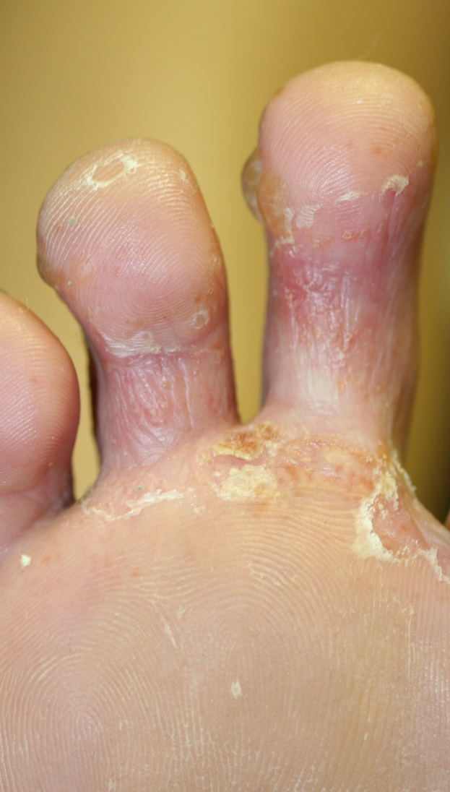
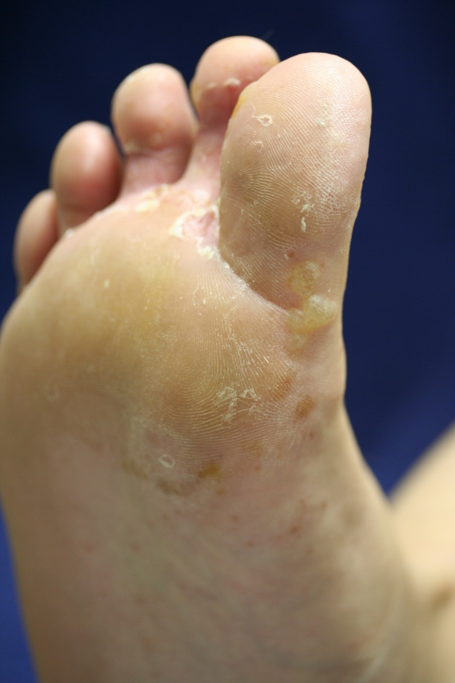

Tinea pedis

Slide 10
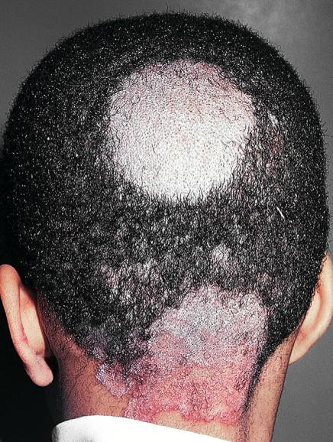
tinea capitis

Slide 11
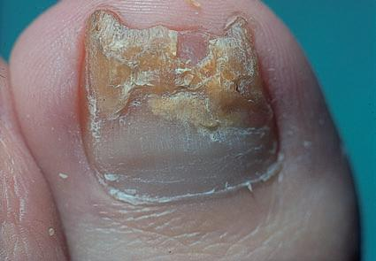
Chronic tinea of the big toe nail(T.Unguium ).

Slide 12
YEAST
Candida albicans
Pityrosporum : pityriasis versicolor & seborrheic dermatitis

Slide 13
Candida albicans
It is a commensal flora of the gut which become pathogenic when the immune status of the person changed as in the following conditions:
Physiological (old age , neonate and pregnancy)
Pathological ( DM, HIV and organ transplant)
Long course of Antibiotics

Slide 15
Mucosal Candidiasis
1. Oral candidiasis
Oral thrush
Angular cheilitis
2. Genital candidiasis

Slide 16
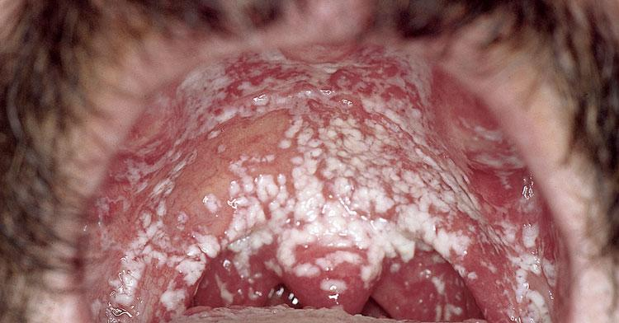
Oral candidiasis: thrush can be removed by rubbing with gauze

Slide 17
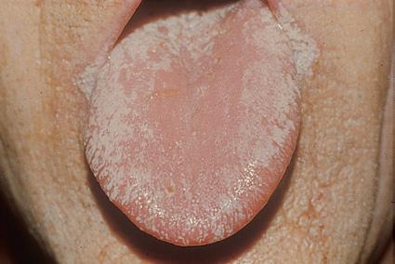
Candidiasis of the tongue

Slide 18
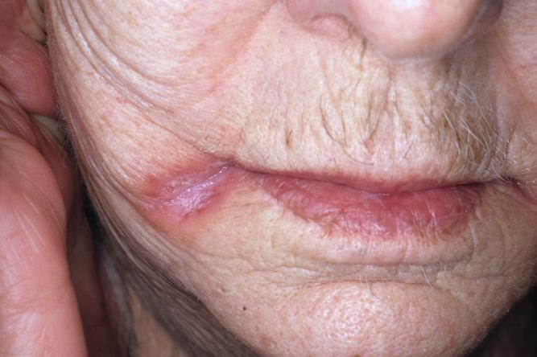
Angular cheilitis

Slide 19
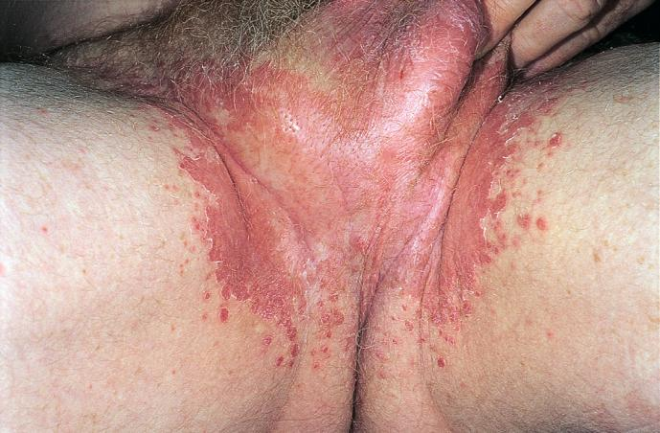
Candida groin infection.

Slide 20
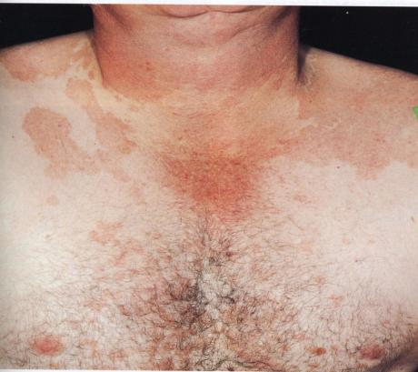
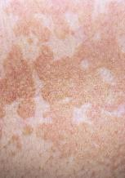
Pityriasis versicolor
Pityrosporum orbiculare
- Asymptomatic
- Well demarcated brown patches over the trunk and upper extremities

Slide 21
Mycetoma (Madura foot)
Various species of fungus or actinomycetes may be involved.
They gain access usually to the feet or legs, via a penetrating wound.
The area becomes lumpy and distorted and developing multiple sinuses.

Slide 22
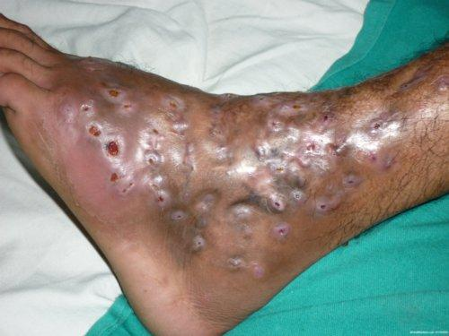

Slide 23
Pus exuding from these sinuses shows tiny diagnostic granules.
Treatment is Surgical and medical by systemic antibiotics or antifungal drugs, depending on the organism isolated

Slide 24
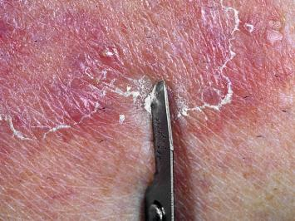
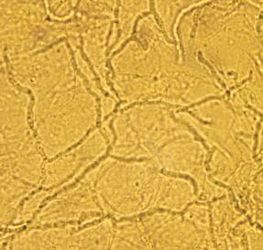
Investigation Fungal Infections
Scraping clipping and Hair sampling
KOH/microscoy
Skin biopsy Histopathology with PAS stain
Culture
Wood's lamp

Slide 25
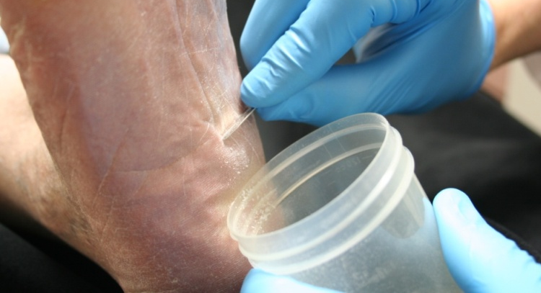
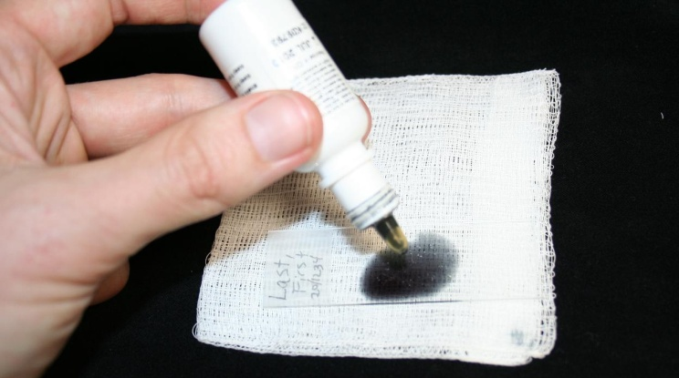

KOH exam
Excellent choice.
You decide to do a KOH exam in the office.
Scrape the leading edge for fine scale
Notes:
<number>

Slide 26
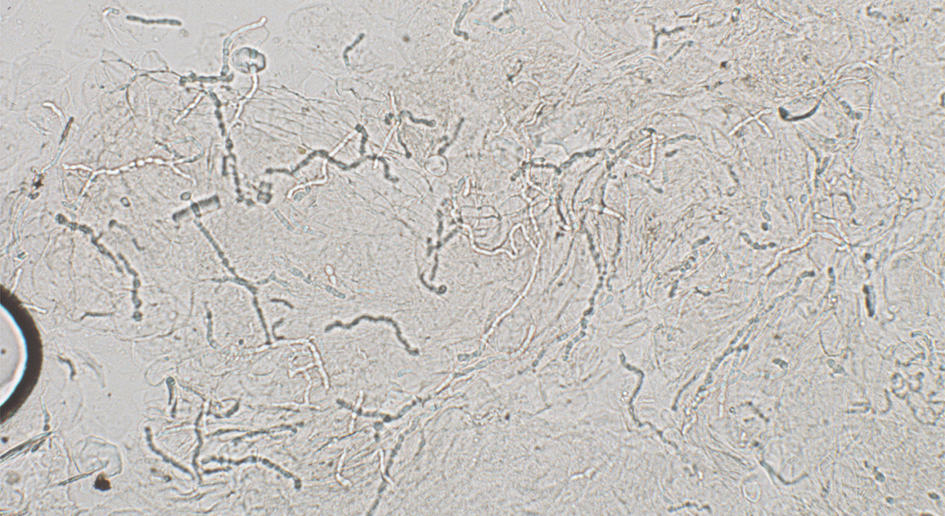

Case One, KOH exam
Translucent branching, septate hyphae
Notes:
<number>

Slide 27

Potassium hydroxide exam
The first step in diagnosing a scaling annular rash on the body is to perform a KOH exam to rule out fungus
“All that scales must be scraped”
Rule out dermatophyte infections before moving forward on scaling rashes

Slide 28
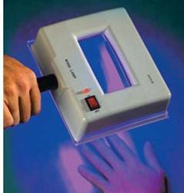
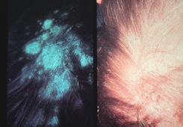
Tinea capitis with positive Wood's lamp

Slide 29
Treatment
Topical Antifungal
Nystatin preparation (oral thrush)
Imidazoles e.g. cotrimazole
Systemic Antifungal
Itraconazole and fluconazole
Allylamine e.g. Terbinafine
Griseovulvin

Slide 30
Indication of systemic treatment:
1.Tinea Capitis
2. Paronychia and Onychomycosis
3. Failure to respond to topical treatment
4. Immunocompramized pts.
5. Atypical presentations.

