Slide 1
Hair Disorders
A- hair loss (Alopecia)
Alopecia areata
Androgenic Alopecia
Telogen effluvium
Anagen effluvium
Trichotellomania
B- hair Excess
Hirsutism
Hypertrichosis

Slide 2
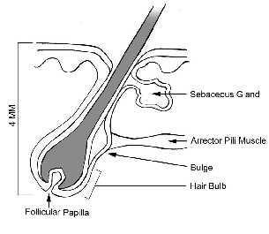

Slide 3
Hair Types
Vellous:
  in the whole body
  bright in color
  thin, and short.
Terminal:
  Thick hair like the hair on the:
  scalp, eyebrow, axilla.
Androgen dependant terminal:
  In the androgen dependent areas as axilla, groin.

Slide 4
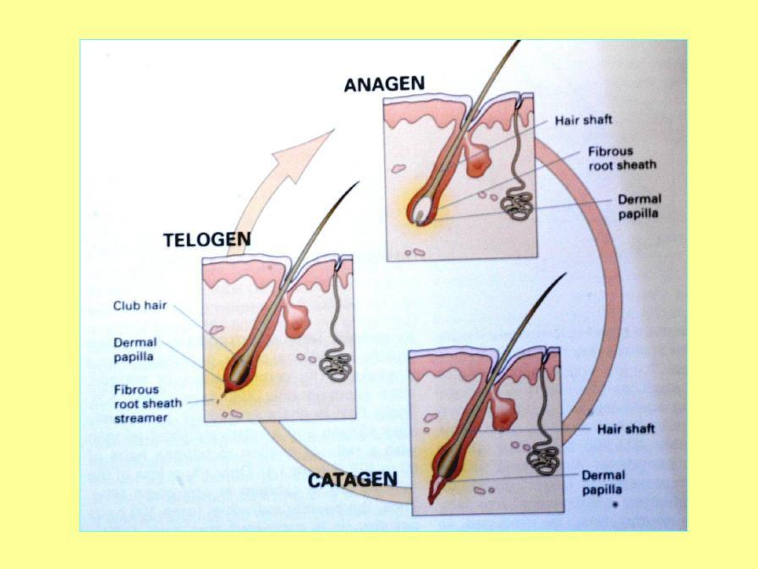
Hair Follicle Cycle

Slide 5
The hair cycle is divided into 3 stages:
1. Anagen (growth phase):
  70-80% of the hair follicle is in this phase.
  The length of this phase determines the length of the hair.
the average is 3 years in the scalp
2. Catagen (resting phase)
5% of the hair is present in this phase (the least).
It last for 3 weeks
3. Telogen (shedding phase):
  15% of the hair is in this phase
  shortening of the hair & the epidermal papillea atrophies.
  And then the hair starts to grow in the Anagen phase.
  It last for 3 months and normally the person loss 150 hair a day
  So any disturbance in this cycle will result in the hair disease

Slide 6
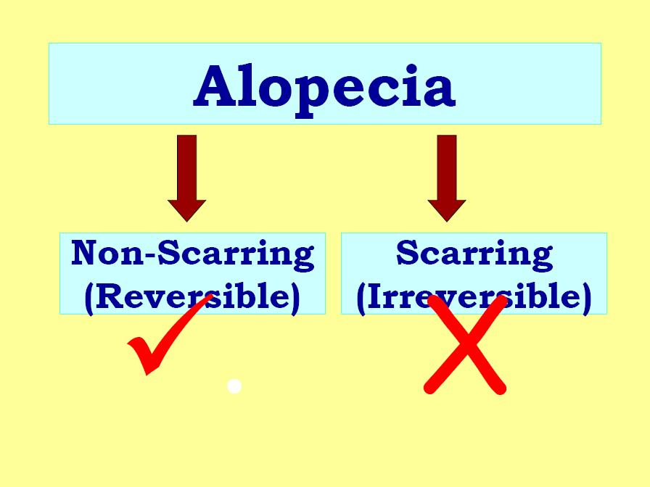

Slide 7
ALOPECIA:
Non-scarring alopecia (reversible):
  The skin is normal, so there is hope for the hair to grow again and it is treatable.
  It is called non-scarring because there is no fibrosis.
  In this type the hair follicles are Intact
Scarring alopecia (irreversible):
  There is fibrosis and severe inflammation,
  there is no hope for hair re-growth
  In this type the hair follicles are damaged
NB : How to differentiate between them clinically ?
By looking for ( hair ostia ) by the scope→ if they intact then
the alopecia is Non scaring and vise versa

Slide 8
Causes of non-scarring alopecia
Telogen effluviu : post- pregnancy, post-medication.
Anagen effluvium: It occurs after chemotherapy.
Alopecia Areata: Loss of hair in a well defined area
Androgenetic alopecia: more in male.
Hair shaft abnormality: Due to a genetic disease.
Trauma: Some people when they are in stress they pull their hairs.
Infectious disorder: e.g. Tinea pedis could be scarring or non- scaring ( more usually ). If there is inflammation, then there is scarring.
Infections: Severe infections.

Slide 9
Causes of scarring alopecia
Neoplastic disorders: Basal Cell Carcinoma.
Trauma: 2nd & 3rd degree burns.
Lichen planus: It’s a common cause of scarring
hair loss.
Discoid lupus erythromatosus

Slide 10
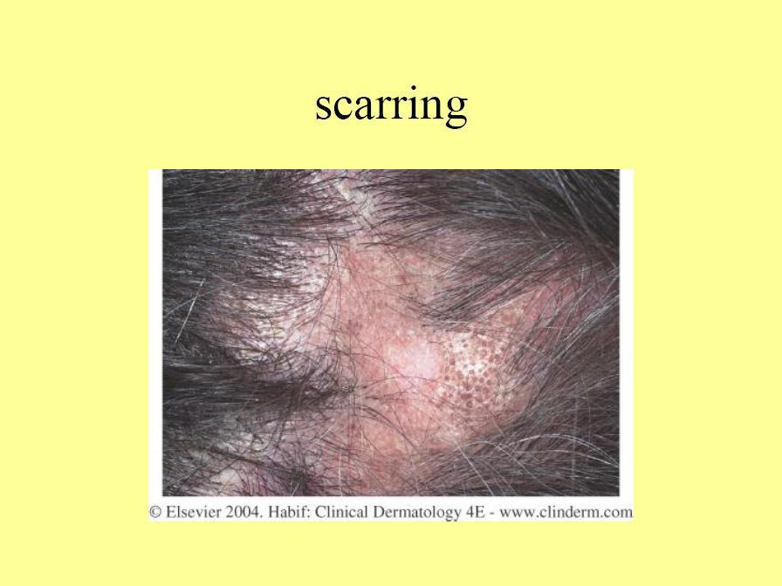

Slide 11
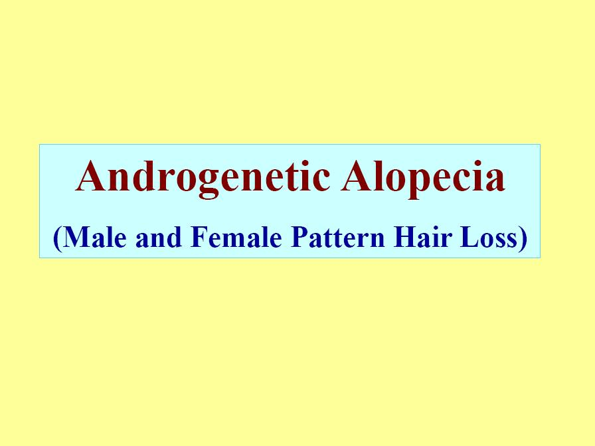

Slide 12
Features
It’s an androgen dependant hair loss.
Androgen dependent loss of scalp hair, for e.g. the crown area.
Androgenetic Alopecia affects up to 50% of males (and they end with baldness) and 40% of females (they rarely end with baldness; instead they end up with thinning).
Autosomal dominant with variable penetrance.
85%: +ve family history

Slide 13
Male pattern hair loss:
It starts with thinning, it’s called fronto-
parietal recession and then it goes upwards.
Frontal recession may occur too.
it usually spares the Temporal and occipital areas
In males: the last stage is complete baldness

Slide 14
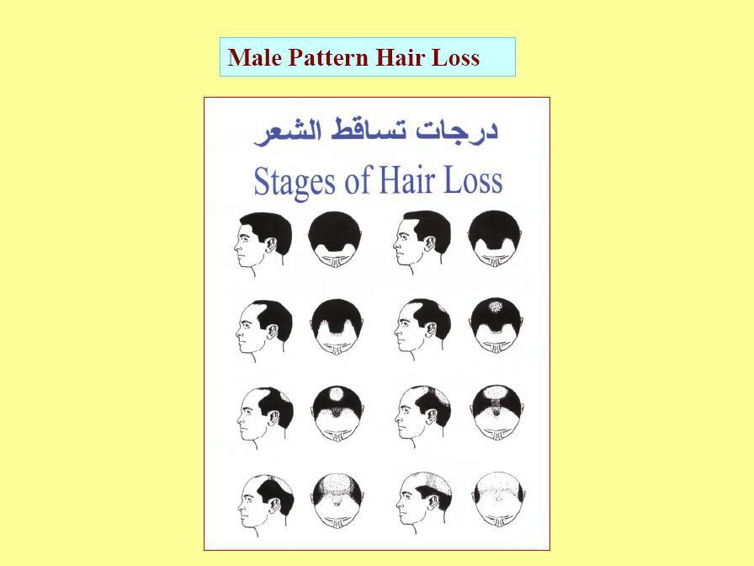
It has
7
stages

Slide 15
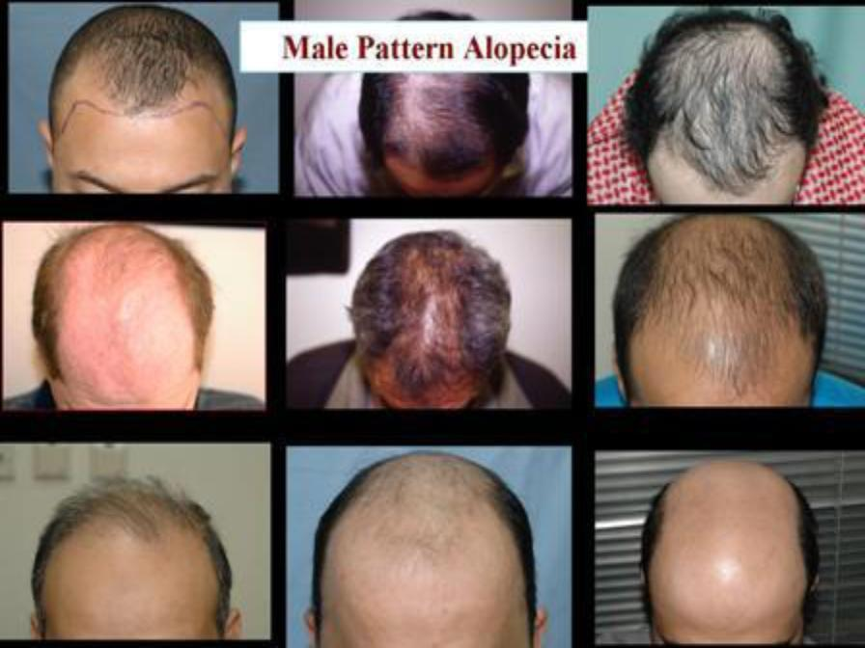

Slide 16
Female pattern hair loss:
There is no fronto-parietal recession and no frontal recession, so the frontal hair line is preserved.
In the female: There is never complete
baldness, there is thinning.
It more common in post menopausal women

Slide 17
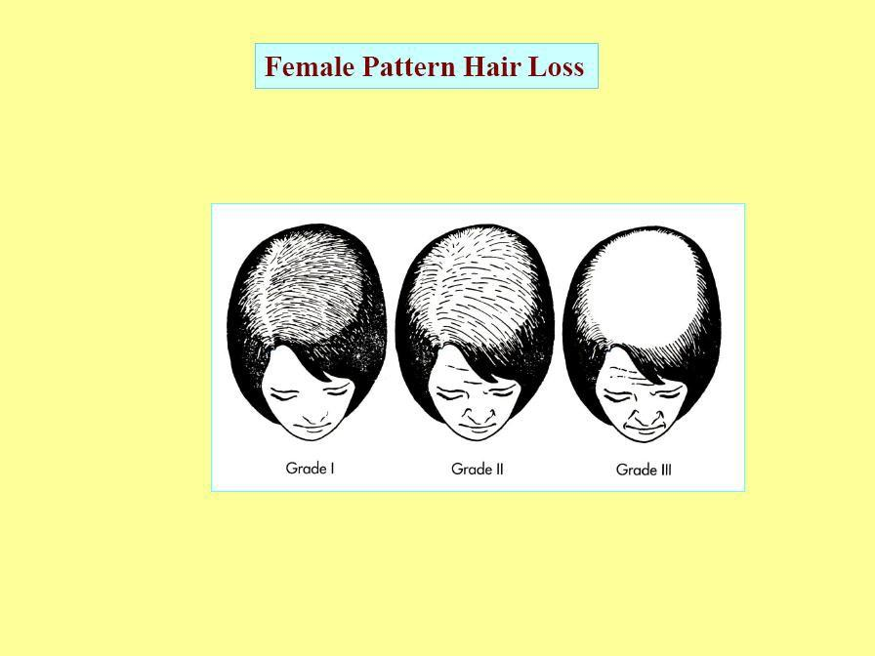

Slide 18
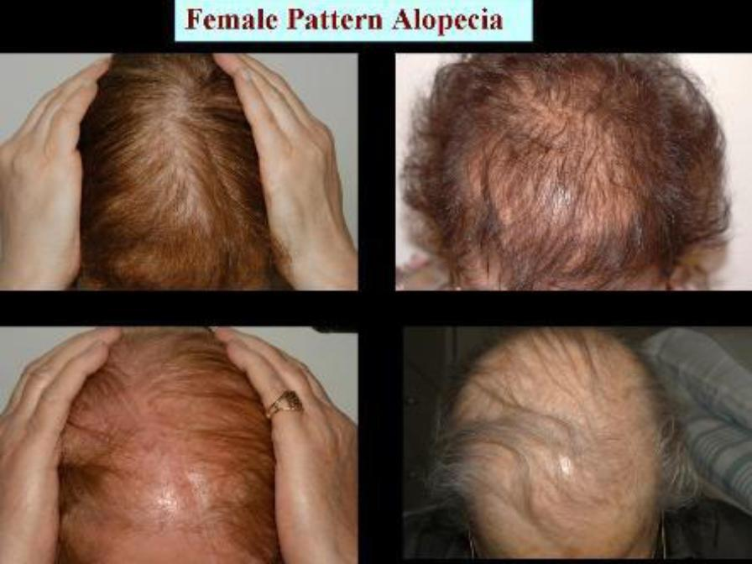

Slide 19
Pathophysiology :
The androgen is the key pathogen in this disease as following :
5 ALPHA Reductase
Testosterone -----------------------→ Dihydrotestosterone (active)
The Dihydrotestosterone causes Miniaturization of Terminal Hairs. it becomes thin and then falls
There is localized hypersensitivity to the normal circulating hormones.
In this condition the hair in the androgen dependant area becomes
very thin.
You can’t see it but if you come closer you will find thin tiny hair.
To treat this condition we have to block dihydrotestosterone, by using antiandrogens; e.g. Minoxidil. We either block it locally or systematically

Slide 20
Treatment
Lifelong treatment unlike Alopecia Areata
Topical:
  Minoxidil, 2% for females and 5% for males
  Used twice per day.
  Regarding females it shouldn’t be used during pregnancy
Systemic:
  1- Fenestride:
    It is a 5-alpha reductase inhibitor
    Side effects:
      in male : feminization
      in female : the pregnant with male infant only → ( it affect the gonads of the infant )
  2- Spironolactone: Has an anti-adrenergic effect.
  C- Hair-transplantation

Slide 21
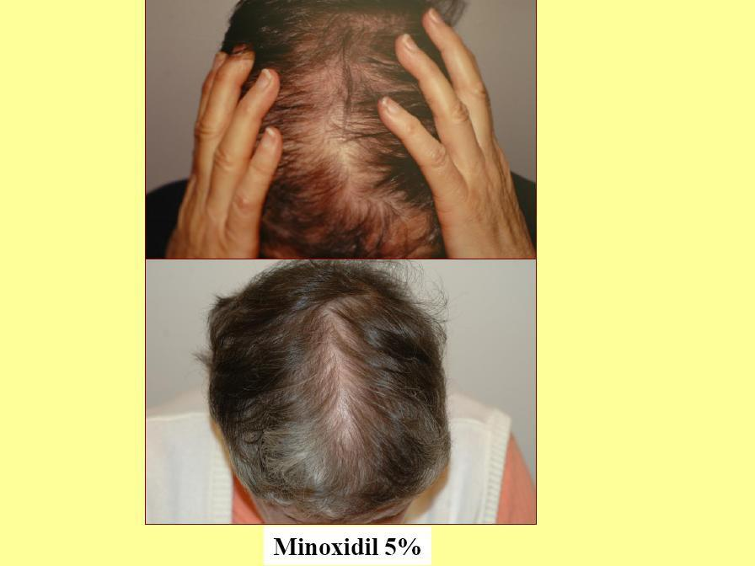

Slide 22
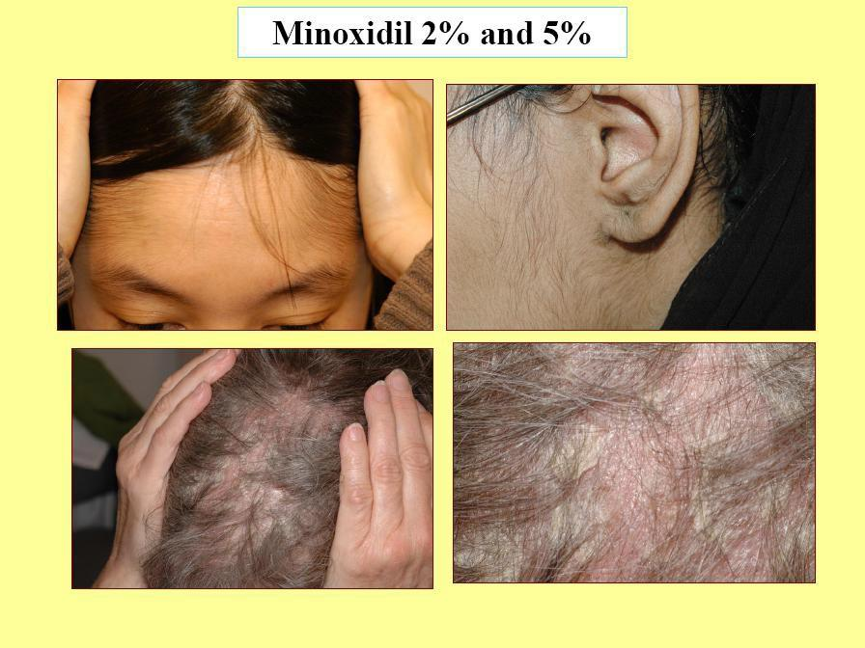
Side effects

Slide 23
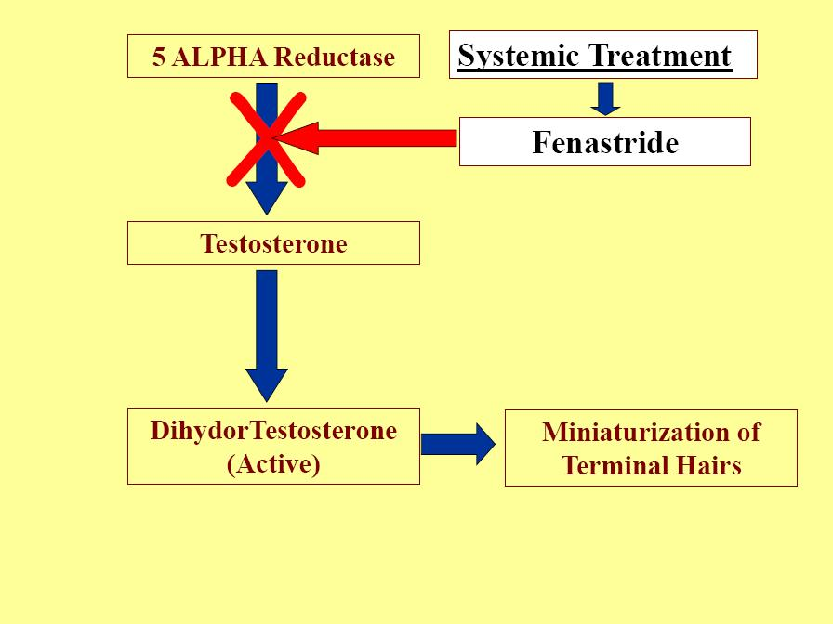




Slide 24
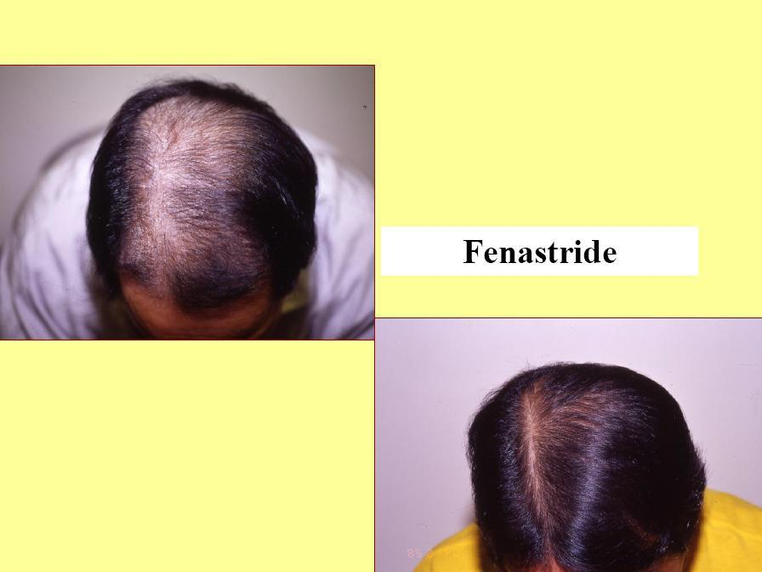

Slide 25
Alopecia Areata
(AA)

Slide 26
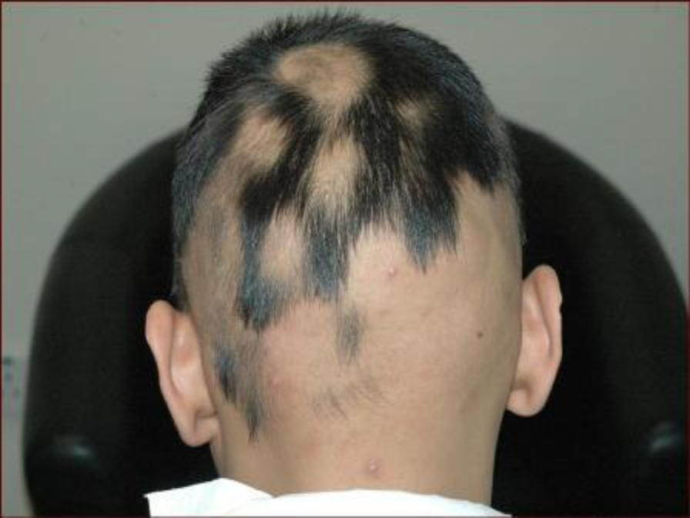

Slide 27
Alopecia Areata:
A condition characterized by either generalized or localized sudden hair loss from the scalp or other body sites
Common: It affects up to 2% of the population.
About 75% of patients show spontaneous self recovery within in 2-6 months.
It can affect any age, but most cases are children or young adults

Slide 28
Causes (multifactorial):
Psychological stress can be predisposing factor.
Genetic background as 30% has +ve family history.
Autoimmune (the strongest): as hair follicles attacked by immune cells

Slide 29
Clinical findings
Well defined and demarcated alopecic patches.
Exclamation point:
  characteristic around the hair follicle.
  Normally the hair is thick near the follicle and it becomes thinner as we go up, in this case the hair is thin near the follicle resembling an exclamation point
→ ! )
Normal scalp: no inflammation or scarring.
Nail: pitting, ridges.

Slide 30
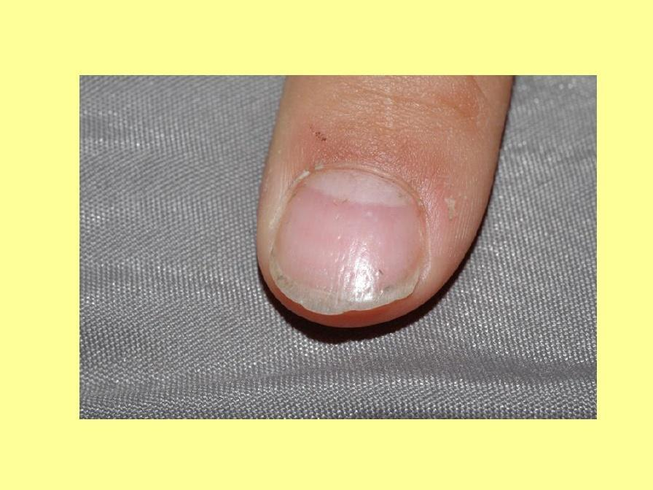

Slide 31
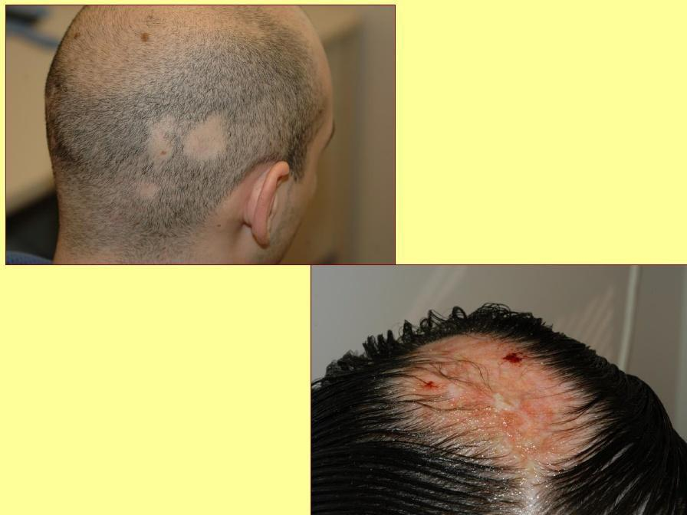

Slide 32
Types of Alopecia Areata:
Localized partial:
  1-2 patches.
  complete recovery
  most common type
Localized extensive:
  5-6 patches and could reach 10.
Alopecia ophiasis:
  At the periphery of the scalp, for e.g. in the occipital region
  Having this type of alopecia is a bad prognostic factor
Alopecia totalis: total hair loss in the scalp.
Alopecia universalis:
  The whole body is affected (e.g. no eyelashes, actually NO hair at all, all over the body).

Slide 33
Bad prognostic factors:
Young age.
Atopy. (very important)
Alopecia totalis, universalis, ophiasis.
Nail changes: because it indicates that the effect of the disease is very bad.
Loss of eyebrows and eyelashes

Slide 34
Diagnosis:
Clinically: spot diagnosis, an area with no hair
and the skin under it is normal.
History and examination

Slide 35
Treatment
1. Observation
because in most cases the hair will re grow spontaneously.
do it if the lesion small
Intralesional corticosteroid:
  It’s the drug of choice in adults.
  We can’t give it to children b/c it’s painful. So, we give them topical corticosteroids coated under occlusion.
Skin Sensitizers: Anthralin, Diphencyclopropenone (DPCP)
Topical Steroids: under occlusion
5. Systemic Steroids
  If the case was acute or an extensive case.
  We only give it for a short period of time
7. Phototherapy: Narrow band – UVB – PUVA
8. Minoxidil

Slide 36
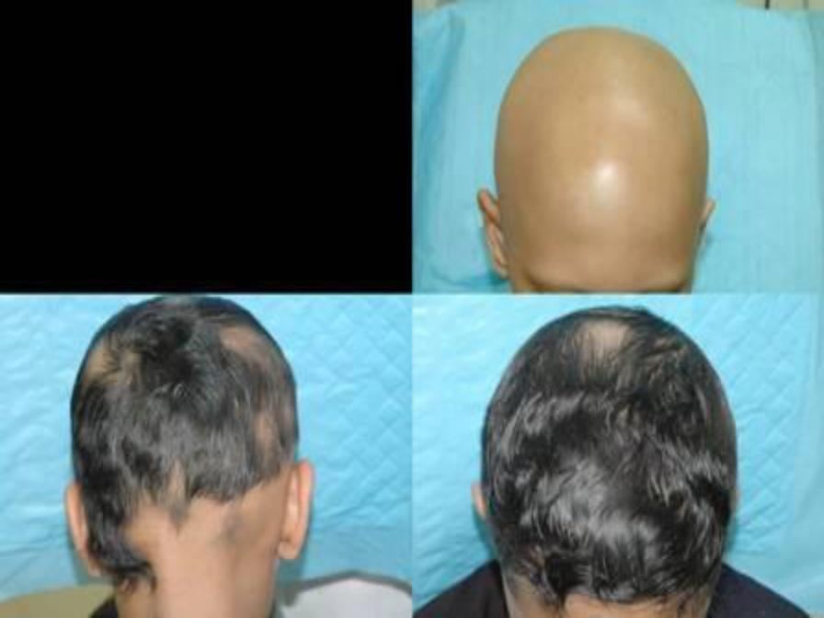

Slide 37
Anagen effluvium:

Slide 38
Anagen effluvium
Always related to cytotoxic chemotherapy.
The hair falls prematurely and all of it.
Acute and severe alopecia.
Mostly reversible but not always.

Slide 39
Telogen effluvium:

Slide 40
Telogen effluvium
Chronic alopecia.
Any stress whether it’s physiological or pychological can cause it-
anemia-chronic diseases.
There would not be complete loss of hair.
Reversible (but may be become chronic)
It takes 3-4 months for the hair to fall & may take months to regrow again.

Slide 41
Causes:
Physiologic:
  Physiologic effluvium of the newborn
  Postpartum effluvium
Injury or stress:
  High fever
  Sever infection
  Sever chronic illness.
  Major surgery
  Hypo- or hyperthyroidism
  Crash diets, precipitous decrees of calories or protein.
  Iron deficiency.
  Essential fatty acid deficiency.
  Biotin deficiency.
  Drugs.

Slide 42
Postpartum effluvium
During pregnancy blood oestrogen levels are
high
This causes the percentage of hair in Anagen phase to rise and hold the hair in anagen phase
After delivery the oestrogen drops and the hair enters the telogen phase which causes it to shed
Seen 4-9 months after delivery and is self
limiting

Slide 43
Treatment:
Remove or treat the cause: For e.g. if the patient had anemia and you didn’t treat it, her hair will keep falling.
Minoxidil 2% solution to enhance hair growth.

