Slide 1
Introduction to Medical History & Clinical Examination
Dr Sami Fatehi
MBBS, MSc, MD, PhD
Head of Clinical Department
Faculty of Medicine
Almaarefa University -KSA

Slide 2
History & Examination
History = symptoms
Symptoms are subjective information delivered by the patient so need more clarifying
Examination = signs
Signs are objectives information obtained by clinician need assistant tools, instruments and maneuvers
Symptoms and signs should be consistent and if not, recheck
Symptoms + Signs = differential diagnoses
Symptoms + Signs + Investigations = diagnosis

Slide 3
Why history & examination is important?
To reach diagnosis in order to prescribe treatment or take management decision?
To construct a medical report
Follow-up the case
Medicolegal issues
Insurance companies
Police records
Formation of summary for the case (consultation)
To pass the clinical examination
Long case scenario
Short case scenario (OSCE station)

Slide 4
Relation between history and examination
History directs the examination focusing
History should be consistent with examination findings
If they are not consistent you have to take history and repeat examination and try to find explanation

Slide 5
History Components
Establishing a good relationship with the patient (introduction& Permission)
Personal Data
Chief Complaints or presenting symptom
History of Present Illness
Review of systems
Past medical and surgical history
Family history
Drug & Allergy history
Social history
Behavioral history
Summery of the History

Slide 6
1. Establishing a good relationship with the patient (introduction& Permission)
Who are you?
Why you are here for?
Politely, ask for permission to take history and examination
Ensure privacy by closing the door or down the curtains
Sit beside the patient to be on the patient’s eye level
Don’t be harry
Address the patient respectfully, use his name or title
Little chatting about general issues may be helpful to warm up the interview.

Slide 7
2. Personal Data
Name
Age
Gender
Occupation
Marital status

Slide 8
3. Chief Complaint/s or Presenting Symptom
The main complaint causes patient seeking medical care
Write them in patients word → don’t use medical terms
Patient complaint/ duration
Ask about duration of the complaint
(chronic → months or years)(subacute→ weeks or days ) (acute→ days or hours)
When the last time you were well or free of this complaints?

Slide 9
4. History of present illness (HPI)
The backbone and guidance for the history
Utilize most time in this part
Narrative, time sequenced writing interrupted by open questions
After the patient takes time to tell story , close this session by asking direct closed questions to fill gaps in the story.
Try as you can to avoid using the medical terms when you write the story.
Many patients have their own hypothesis regarding their symptoms and disease, don’t be leaded.

Slide 10
4. History of present illness (HPI)- cont….
Analysis of the chief complaint/s
mnemonic SOCRATES
S → Site → Ask where the symptom is exactly and whether it is localized or diffuse. Ask the patient to point to the actual site on the body.
O → Onset → does the symptom came on rapidly , gradually or instantaneous and how it goes is it continuously or intermittently
C → Character → ask the patient what is meant by the symptom. If there is pain, is it sharp, dull, stabbing, boring, burning or cramp-like?
R → Radiation (pain or discomfort)
A → Alleviating factors
T → Timing → duration
E → Exacerbating factors
S → Severity → you can use scale (0 to 10)
Complete reviewing of the target system in this part.

Slide 11
5. Review of Systems (ROS)
Ask direct questions about the main symptoms for each system, except the C/O system:
CNS: headache, dizziness , blurring of vision , ??
Musculoskeletal system: joints pain or swelling, muscular pain or atrophy??
Cardiopulmonary : palpitations, shortness of breathing, cough , chest pain
GIT: weight loss, loss of appetite, abdominal pain , nausea, vomiting
Urogenital system: burning micturition , urine retention, incontinence, urethral discharge
Integumentary system: pruritus , discoloration,

Slide 12
6. Past medical and surgical history
If he had any past medical problem , analyze it regarding symptoms, treatment
History of hospitalization , cause and days of stay
Surgical history , indications, complications

Slide 13
7. Family History
Ask about any disease runs in his family
Ask about similar disease in the family
If yes , what is the degree of relationship

Slide 14
8- Drug & Allergy history
List of all drugs , topical, systemic , herbals
Do you allergic to any certain drugs or foods

Slide 15
9. Social History:
Ask about :
Socioeconomic level
Housing setting
Occupation
Travelling history
Hobbies

Slide 16
10. Behavioral History
Smoking
Drinking
Drugs (narcotics)
Sexual relations

Slide 17
Conclude the interview by asking the patient
Do you have any thing you want to ADD?

Slide 18
11. Summarization
Write down the positives information and the most important negatives information in points formatting.
Why summarization is important?
Consultation
Follow-up
Examination

Slide 19
Examination Components
General Examination
Systems Examinations
Respiratory system
Cardiovascular system
Gastrointestinal system
Musculoskeletal system
Integumentary system
Nervous system
CNS
PNS

Slide 20
The importance of general examination:
Helps to determine the most body system should be stressed during systems examination.
With proper history the general examination may be enough to obtain the diagnosis OR a short list of diagnoses.

Slide 21
A. General Examination Components
General patient condition
Face
Fever
Pallor
Jaundice
Cyanosis
Lymph nodes enlargement
Hands , Digits & Nails
Mouth , Oral cavity & Tongue
Temperature
Pulse rate
Blood pressure
Respiratory rate

Slide 22
1. The general condition of the patient
Well
unwell
ill
In pain
cachexic
Consciousness level
delirium
orientation

Slide 23
2. Face
A specific diagnosis can sometimes be made by inspecting the face
Acromegalic
Down Syndrome
Cushingoid
Parkinsonian

Slide 24
2. Fever
High grade fever
In history if it is there should be analyzed regarding its course (continuous, intermittent, remittent) , association (rigors, sweating), timing (nocturnal) , reliving (antipyretic drugs)

Slide 25
3. Pallor
Indicates anemia (low hemoglobin concentration)
Skin , mucous membranes

Slide 26
4. Jaundice
Yellowish discoloration of the sclera of the eyes, mucous membrane , and skin
Types of jaundice ?
Prehepatic
Hepatic
Post hepatic
If it is associated with pallor → indicates prehepatic
if it is associated with pruritus → indicates post hepatic
If it is associated with fever → may indicates hepatic (viral hepatitis )

Slide 27
5- Cyanosis
Bluish discoloration of the extremities and tongue
If more than 50 g/L of deoxygenated hemoglobin is present in the capillary blood, the skin will have a bluish tinge.
If the tongue is involved → central (cardiopulmonary) cyanosis
If the digits only involved → peripheral (vasoconstriction) cyanosis
Raynaud's phenomena → connective tissue diseases
Can cyanosis and pallor concomitant together in the same patient?

Slide 28
6- Lymphadenopathy
Complete examination of all LN groups
Localized
Generalize
Discrete or Matted
Tender
If it is generalized and associated with pallor → may indicates lymphoma
If it is tender → may indicates infections

Slide 29
7- Hands, Digits and Nails
Tremors
Fine of stretched hands→ hyperthyroidism
Rest tremors → Parkinsonism
Intention tremors→ cerebellar ataxia
Sweating and erythema → hyperthyroidism

Slide 30
7- Hands, Digits and Nails, cont…..
Digits bluish discoloration and ulcers→ Raynaud's phenomenon as part of scleroderma
Nail changes may indicate dermatological or systemic diseases
Dermatological changes might be due nail infection as onycholysis or a part of generalized dermatological diseases as psoriasis or lichen planus
Clubbing fingers → chronic diseases (pulmonary , hepatic ,cardiac, )

Slide 31
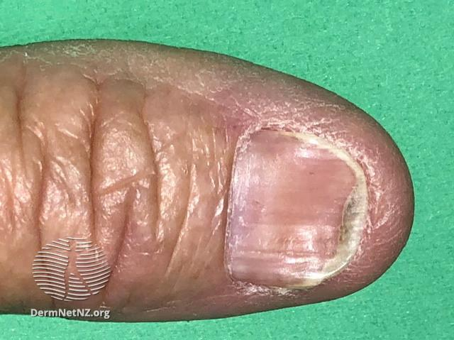
koilonychia

Slide 32
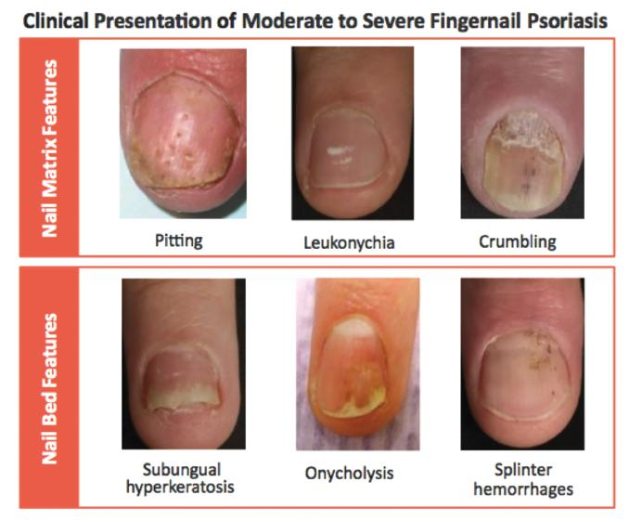

Slide 33
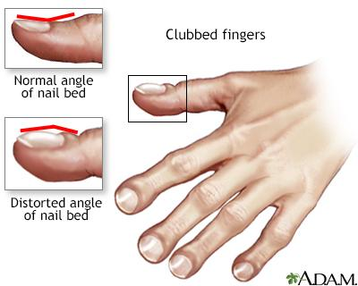

Slide 34
10- Mouth, Oral cavity & tongue
Angular cheilitis → anemia
Smooth tongue →
Hairy tongue→
Deviation of the tongue→
Ulcers →
Ulceration of the mucous membranes→
Dental cavities →
Leukoplakia →

Slide 35
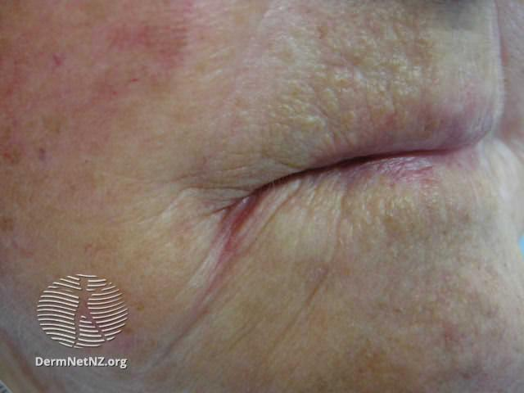
Angular cheilitis

Slide 36
13. Temperature
Measure the core temperature using thermometers
Digital
Mercury
Sites
Mouth → 36.8 c
Axilla → 36. 4 c
Rectum → 37.3 c

Slide 37
14. Pulse Rate
Peripheral arteries
Carotid arteries
Upper extremities→ radial , brachial ,
Lower extremities → femoral , popliteal , dorsalis pedis ,
Use the index and middle finger , don’t use thumb?
Rate → normal , tachy or bradycardia
Regular or irregular
Detect the character of pulse is it weak thready ,strong , synchronize , radio femoral delay
Collapsing pulse → hyperdynamic circulations (anemia, pregnancy, thyrotoxicosis )

Slide 38
15- Blood Pressure
Using the symphmomanometer (digital or mercury)
Palpation method → systolic pressure
It is better to use the two method simultaneously start by palpation method
Pulse pressure → systolic pressure - diastolic pressure < 60 mmHg

Slide 39
16. Respiratory rate
Count it for full minute
Count it while you are pretending takink pulse rate to reduce patient stress ?
Comment is it normal
Shallow , deep , apneao , regular or irregular

Slide 40
17. Neck pulsation
Arterial
Venous
How we can differentiate?

Slide 41
B. Systems Examination
The four gold standards of clinical examinations are:
Inspection
Palpation
Percussion
Auscultation
The importance and application of each standard differs from one system to other

Slide 42
The Importance of the Four Examination Standards in Different Systems
General Examination → Inspection > Palpation
CVS → Auscultation > Inspection> Palpation > Percussion
Res → Auscultation > Percussion > Palpation > Inspection
GIT → Palpation > Percussion > Inspection > Auscultation
Muscle → Inspection > Palpation
Integumentary system → Inspection > Palpation
CNS → Inspection > Palpation

Slide 43
Dermatological History and Examination

Slide 44
Key questions for a rash
HPI:
When did it start?
Does it itch, burn, or hurt?
Is this the first episode?
Where on the body did it start?
How has it spread (pattern of spread)?
How have individual lesions changed (evolution)?
Provoking/exacerbating factors?
Previous treatments and response?

Slide 45
Key questions for a rash
ROS
Any associated symptoms?
Past medical history
Ask about the atopic triad (asthma, allergies, atopic dermatitis)
Medications
Travel history
Environmental exposures
may also yield
important information

Slide 46
Key questions for a growth
How long has the lesion been present?
Has it changed and, if so, how?
Change in size?
Shape?
Color?
Any itch?
Bleeding?

Slide 47
Key questions for a growth
Further questions that may be pertinent:
PMH:
Any history of skin cancer? What type? When?
If melanoma, do you remember the tumor depth or mode of treatment?
Family history:
Any family members with skin cancer?
Have any family members had melanoma?

Slide 48
The Skin Exam
The Total Body Skin Exam (TBSE) includes inspection of the entire skin surface, including:
the scalp, hair, and nails
the mucous membranes of the mouth, eyes, anus, and genitals

Slide 49
TBSE
Do not forget the so-called “hidden areas” – places on the skin where lesions may be easily missed
Conchal bowl (concavity adjacent to the external auditory meatus), auditory canal, postauricular creases
Medial canthi (angular junction of the eyelids), alar (nasal) grooves
Intergluteal cleft and perianal skin
Interdigital spaces

Slide 50
Indications for a TBSE
1- Personal history of skin cancer
2- Increased risk for melanoma
I-Two first-degree relatives with melanoma
II- Over 100 nevi (moles)
3- Patient with concerning or changing growth
4- New rash on body
5- New patient with undiagnosed skin condition
6- Follow-up patients with extensive skin conditions such as psoriasis

Slide 51
Essential elements for the skin exam
Adequate lighting
Undressed patient, in a gown
Preferably without makeup, watches, jewelry
Privacy
Ruler
Magnifying glass
An open mind about what you are seeing

Slide 52
Getting started

Slide 53
1- Lighting
The skin exam should be performed with adequate lighting
natural sunlight is best
if windows are in the exam room, open the blinds
the best artificial source is high-intensity incandescent light
If lighting is too low, turn on as many lights as possible and position the patient directly under available lights

Slide 54
2- Undressed patient
You cannot diagnose what you cannot see
Before starting the skin exam, ask the patient to undress to their bra and underwear and put on a gown with the opening to the back
Put down a chux or exam table paper so their bare feet don’t touch the floor
Tell the patient you will step out, and ask if they would like a chaperone during the exam
If you expect to examine the breasts or genitalia of an opposite-gender patient, bring a chaperone regardless
Draw the curtain and step out of the room

Slide 55
3- Patient modesty
Undressed patients feel very vulnerable
Avoid keeping them waiting too long while undressed
Offer a second gown or blanket if it is cold
Before untying a gown or moving it, ask permission
Ask the patient to expose the area being examined, and cover the area after it has been examined
Say out loud what part of the body you want to examine next
e.g., “Okay, now let’s look at your chest and abdomen”
The patient will usually move the gown accordingly

Slide 56
4- Sanitize your hands
The skin exam is tactile as well as visual
You must palpate lesions to tell if they are raised, flat, or atrophic
Many dermatologists prefer to use gloves for moist areas (groin, axilla) or oozing, crusted lesions
Keep hands clean and nails trimmed
Remember to sanitize your hands before and after every skin exam

Slide 57
Tools we use

Slide 58
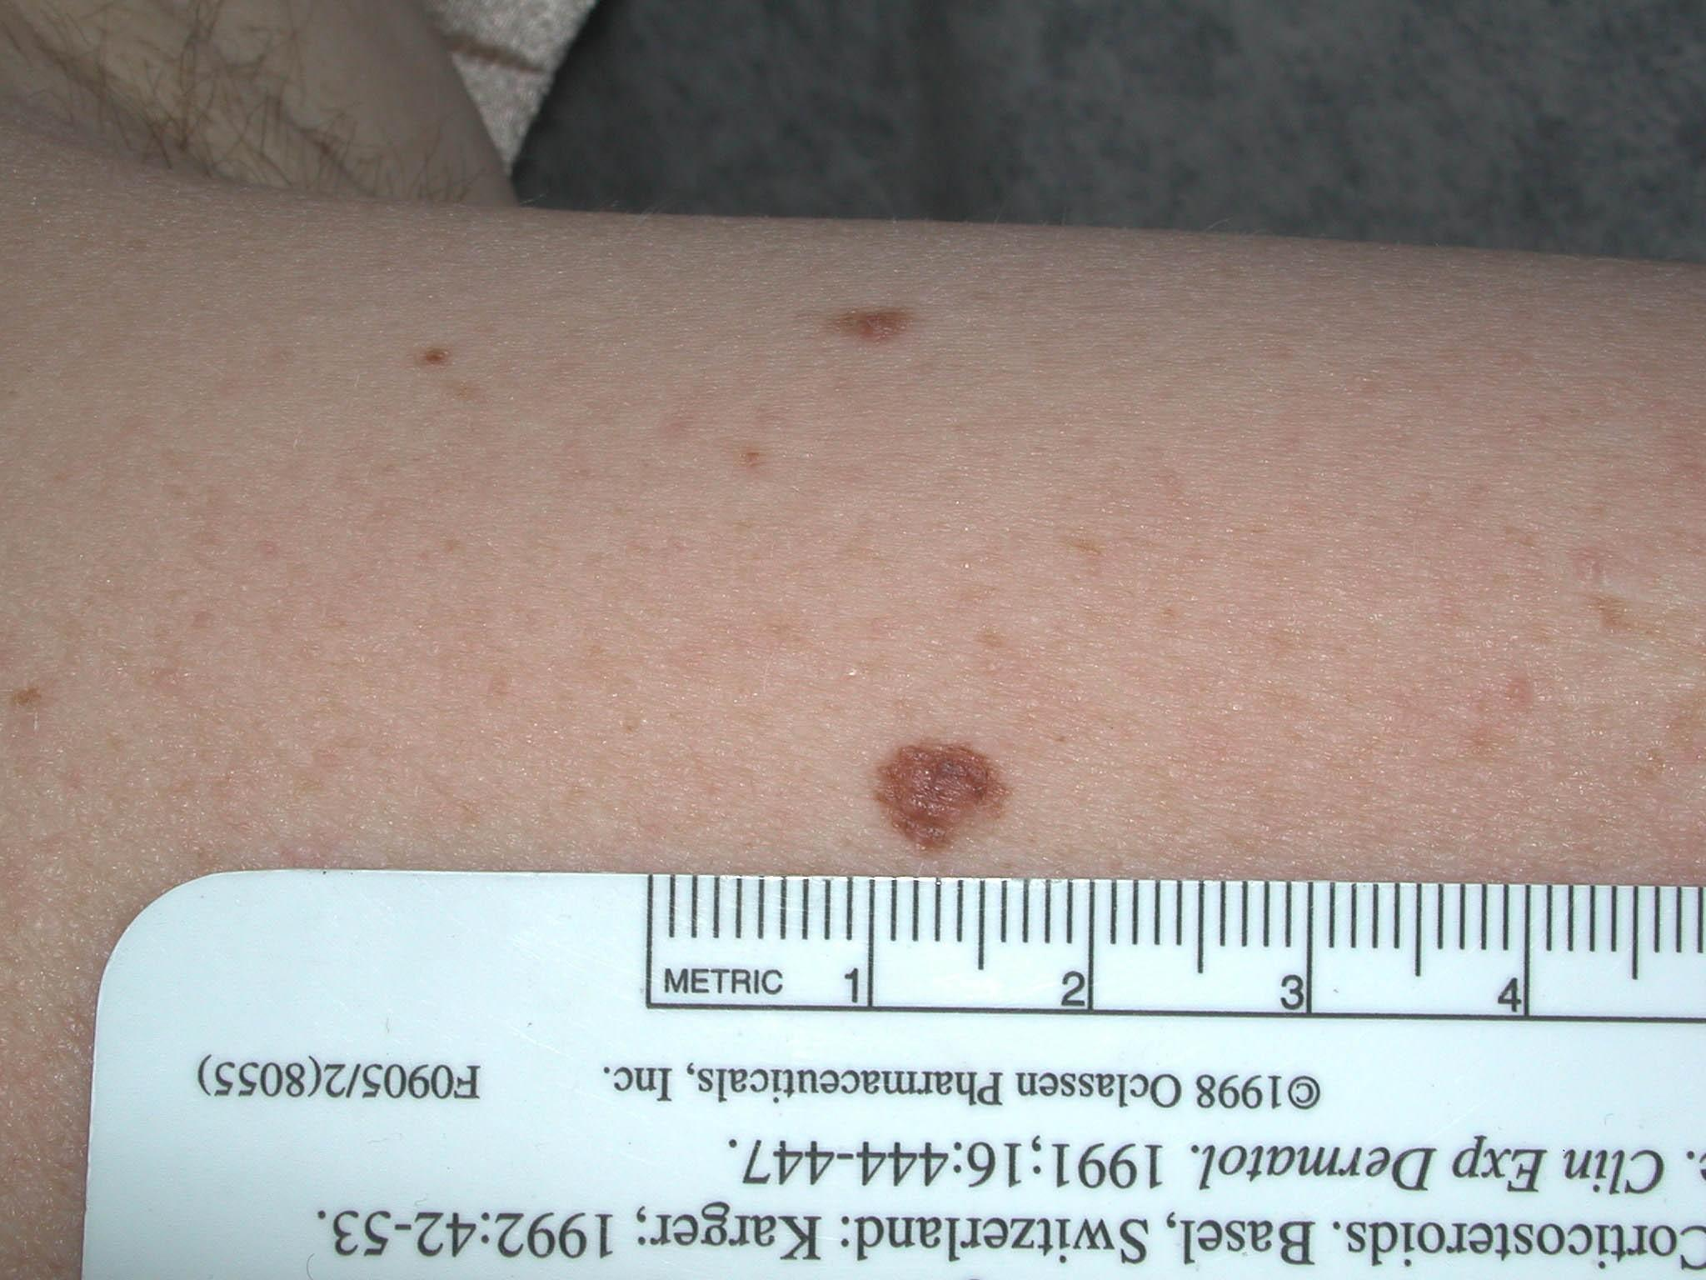
1-Ruler
Accurately records the size of a lesion on successive examinations
Measure in the longest axis first, then in the perpendicular axis
e.g., this papule is 6x4 mm

Slide 59
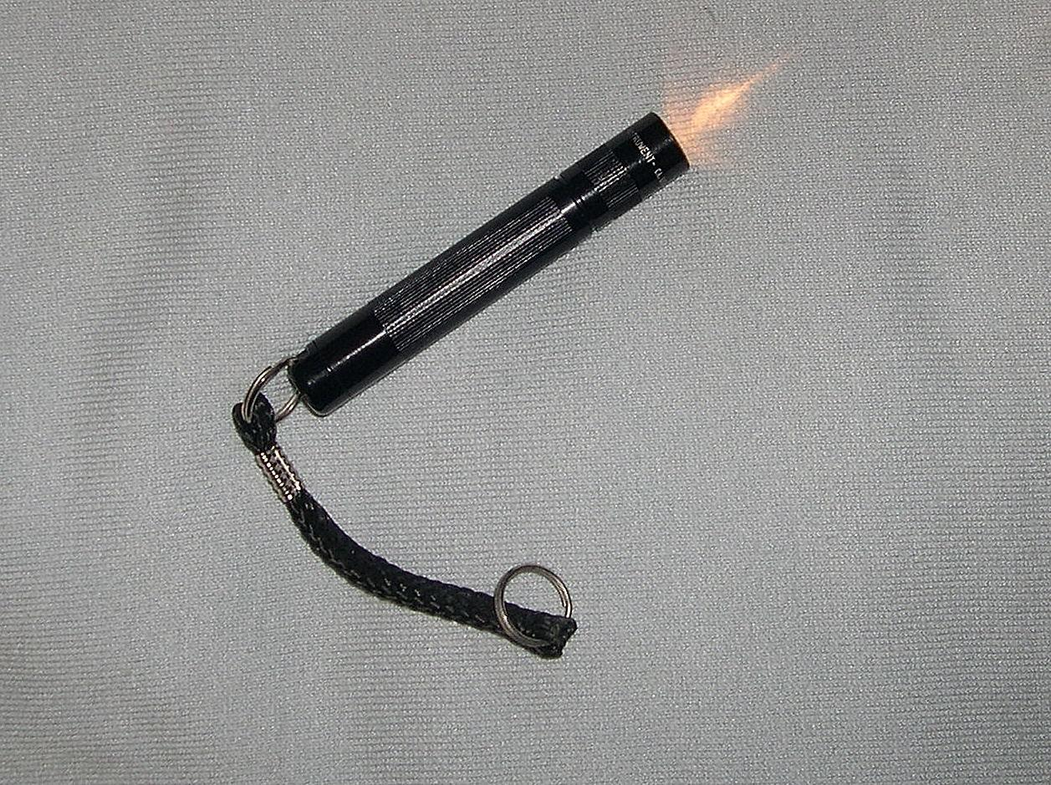
2- A penlight is used for side lighting
Detects atrophy and fine wrinkling
Distinguishes
Flat from raised lesions
Whether lesions are solid or fluid-filled
Also helps look inside the mouth

Slide 60
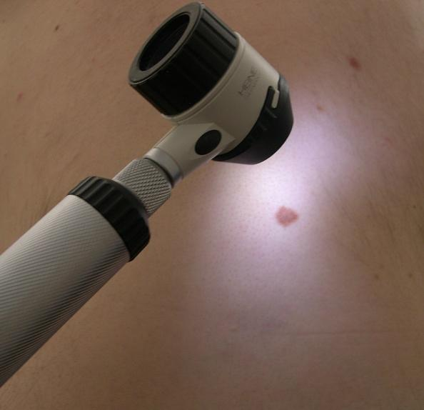
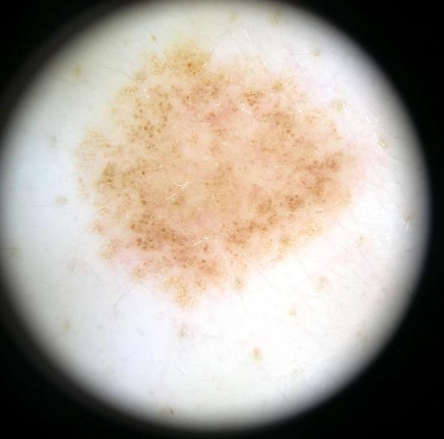
3- Magnification, Dermoscopy
Inexpensive magnifying glasses may help detect fine details
Dermatoscopes help evaluate patterns in pigmented lesions
Requires additional training to become proficient

