Slide 1
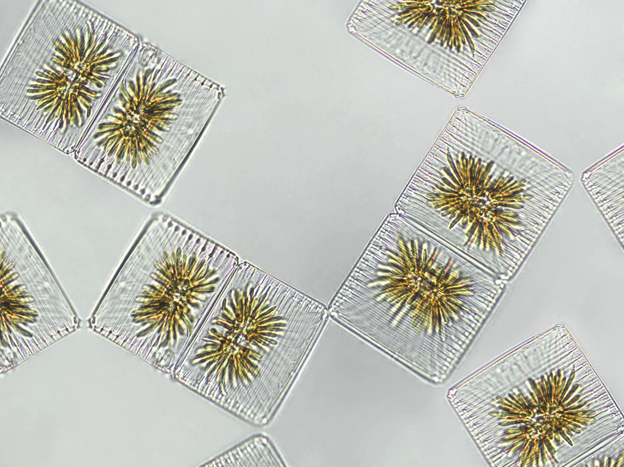
Lichen Planus

Slide 2
Lichen planus
Is a non infectious immunological mediated skin disorder.
It is a disorder in which lymphocytes attack the epidermis.
It can be associated with autoimmune disorders such alopecia areata, ulcerative collitis.

Slide 3
Aetiology.
It is unknown.
Drugs can cause it-streptomycin,chloroquine,methyldopa, phenothiazine.
It has also been linked to ,bone marrow transplant,hepatitis B infection,exposure to colour film in colour film developers.

Slide 4
Clinical Features
Typical itchy papules, demarcated by skin lines on the extremeties especially the volar aspects.
White streaky pattern on the surface of the papules (wickham’s striae).
It occurs on joint flexures especially the wrists, genitals, inner thighs.
Koebner’s phenomenon is also present.
Neighbouring papules may join together to form plaques that resembles lichen growing on trees.
White lacy plaques in the mouth.

Slide 5
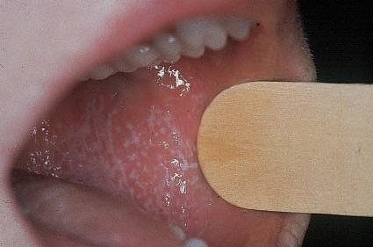

Slide 6
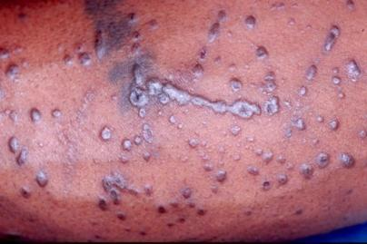
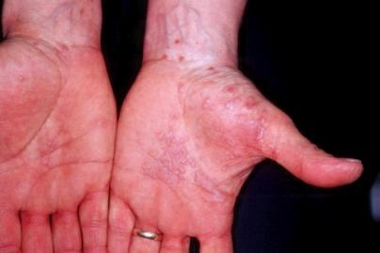
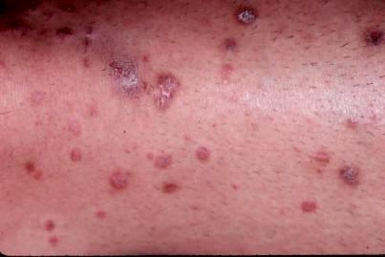
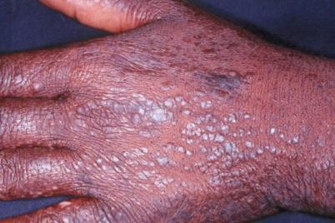
Lichen Planus

Slide 7
Variants
Annular –area of central clearing.
Atrophy-in mucous membrane.
Bullous
Follicular
Hypertrophic –around the ankles.
Ulcerative-on soles and mucous membrane.

Slide 8
Prognosis
It is a self - limiting disorder in which individual lesions lasts for months and the eruption as a whole tends to last for about a year.
As lesions resolve, they become flatter, darker and leave discrete brown macules.

Slide 9
Complications
Nail and hair loss may be permanent.
Ulcerative form in the mouth may lead to squamous cell carcinoma.
Ulceration over bony prominences may be disabling.

Slide 10
Differential Diagnosis
Lichenoid drug reactions-antimalaria, NSAIDS, b-blockers.
Discoid lupus erythematous-wickhams’s striae or oral lesions are absent.
Oral candidiasis.
Gold and heavy metals reaction.

Slide 11
Investigations.
Diagnosis is usually obvious clinically, but a biopsy can confirm the diagnosis if necessary.
Histology→ hyperkeratosis, focal hypergranulosis , thickening of the epidermis (saw toothed appearance),separation between dermis and epidermis.

Slide 12
Treatment
Stop offending agent.
Potent topical corticosteroids-to relieve the symptoms & flatten the plaques.
UV radiation-reduce pruritus , help clear the lesions.
Systemic corticosteroids-prednisolone .
Anti-histamines → for sedation

Slide 13
Pityriasis rosea
Cause is unknown.
Viral agent HHV-7 is implicated.
Not contagious.
Common in winter.
Affects young adults and children.

Slide 14
Clinical
Generalized eruptions is preceeded by an ‘herald patch’or ‘mother patch’.
The patch is larger, redder, more scaly and rounder than the later lesions.
Is itchy and run along the rib lines.
The skin lesions resemble an ‘christmas tree’

Slide 15
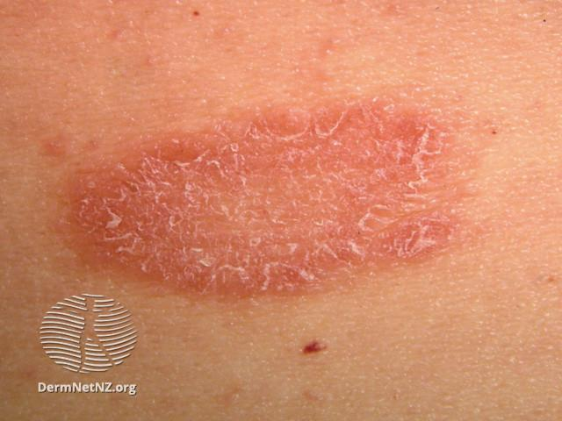
Herald Patch

Slide 16
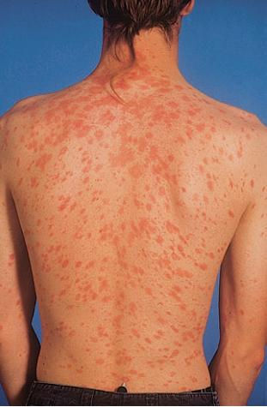

Slide 17
Prognosis
Is a self limiting skin lesion that last 2-10 wks
Resolves leaving hyperpigmented patches.

Slide 18
Differential Diagnosis
Guttate psoriasis
Tinea corporis
Pityriasis versicolor

Slide 19
Investigations
VDRL→ to exclude syphilis
Microscopic examination of scales to role out tinea corporis & pityriasis versicolor.

Slide 20
Treatment
No treatment
reassurance
But in severe cases we can give:
Steroid.
Calamine lotion.
1% salicyclic acid in white paraffin- to reduce scaling.

Slide 21
Thank You

