Slide 1
Morphology
How to describe what you see

Slide 2
Goals and Objectives
The purpose of this module is learn how to best describe skin lesions
After completing this module, the student will be able to:
Develop a systematic approach to describing skin eruptions
Utilize the appropriate terms to describe morphology
2

Slide 3
Morphology
The word morphology is used by dermatologists to describe the form and structure of skin lesions
The morphologic characteristics of skin lesions are key elements in establishing the diagnosis and communicating skin findings
There are two steps in establishing the morphology of any given skin condition:
Careful visual and tactile inspection
Application of correct descriptors
3

Slide 4
Visual and Tactile Inspection
Accumulate detailed information about the visual and tactile aspects of the skin findings
Be able to communicate an accurate description so someone on the other end of a phone can get a mental picture of what you see.
Question 1
How would you fill in the description of the item depicted on the next slide?
4

Slide 5
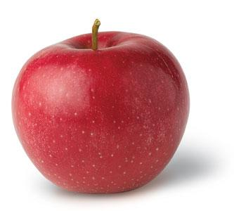
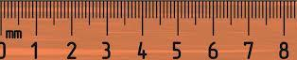
Question 1
How would you describe the object to the right?
Be as detailed as you can be!

Slide 6
Question 1
This is a red, circular, shiny object with a small invagination on top. It measures 8 cm. It is in a white background and casts a shadow.
The shadow tells us it is raised (palpable).

Slide 7
Question 1
This is a red, circular, shiny object with a small invagination on top. It measures 8 cm. It is in a white background and casts a shadow.
The above description identifies:
Palpability (indicated by shadow)
Color
Shape
Texture
Size
Location

Slide 8
Application of the correct descriptors
We have just reviewed careful visual inspection
We will now define the terms dermatologists use to describe skin lesions
We will then have a series of cases for you to practice describing so you can use the correct descriptors.

Slide 9
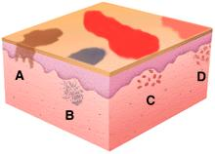
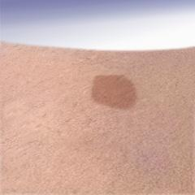
Primary lesion: Macule
(L. macula, “spot”)
A macule is flat; if you can feel it, then it is not a macule.

Slide 10
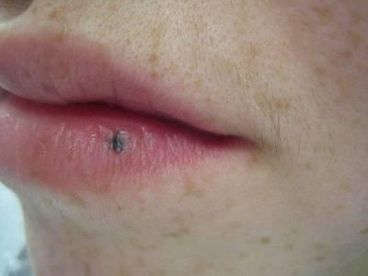
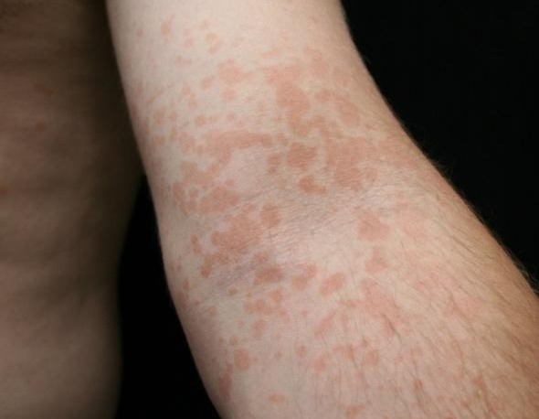
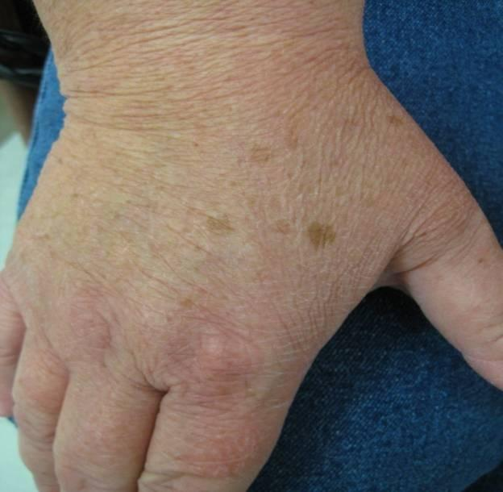
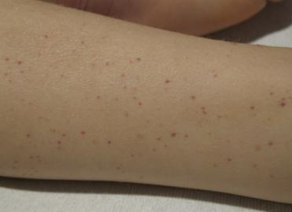
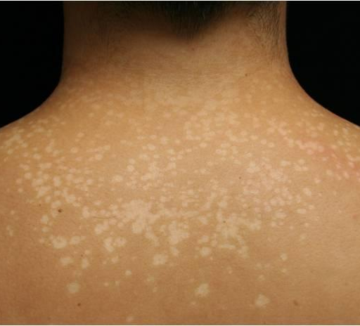
Examples of Macules

Slide 11
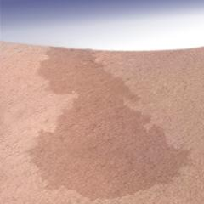
Primary lesion: Patch
Patches are flat but larger than macules
If it’s flat and larger than 1 cm, it is a patch

Slide 12
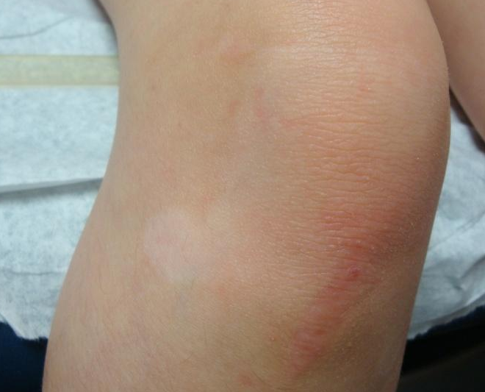
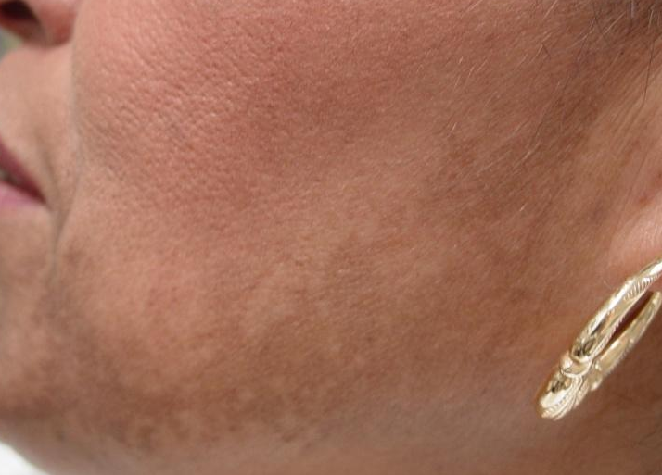
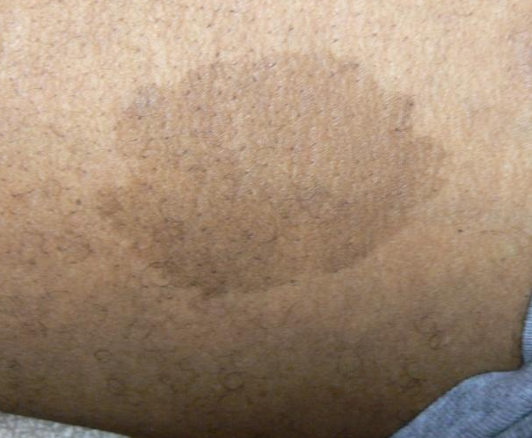
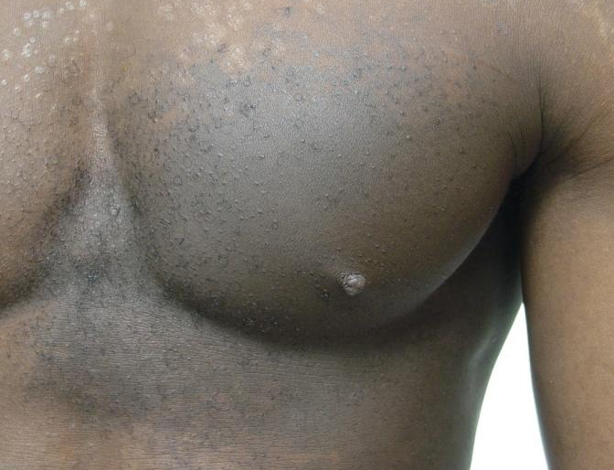
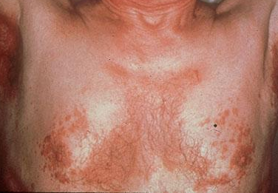
Examples of Patches
12

Slide 13
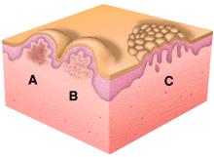
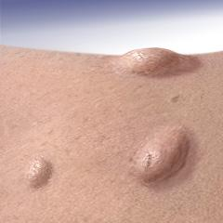
Primary lesion: Papule
(L. papula, “pimple”)
Papules are raised lesions less than 1 cm
It is caused by a proliferation of cells in epidermis or superficial dermis

Slide 14
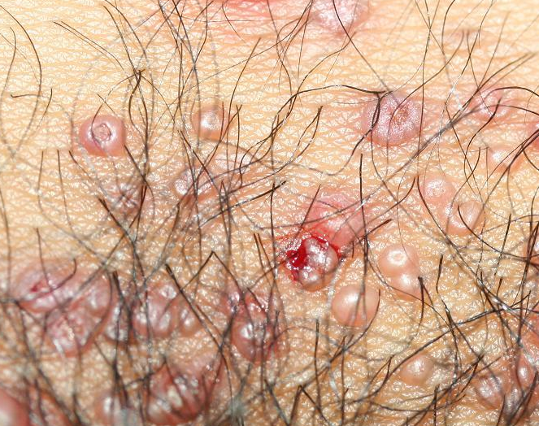
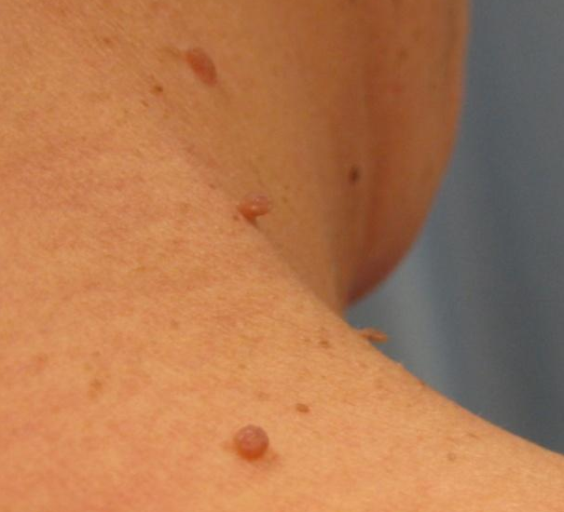
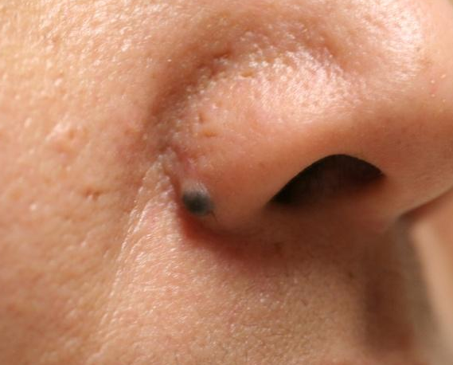
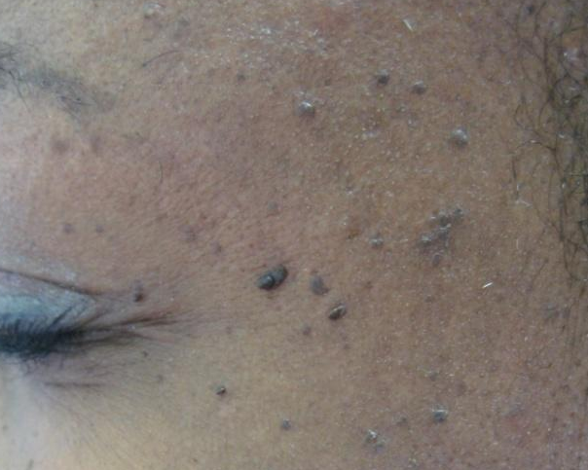
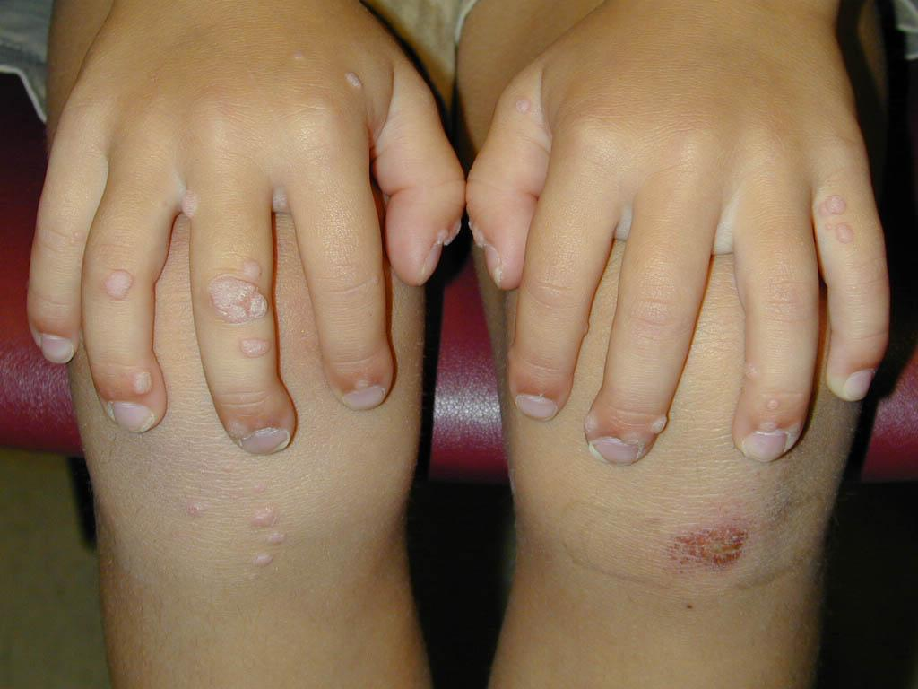
Examples of Papules

Slide 15
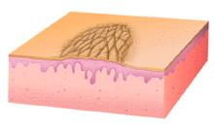
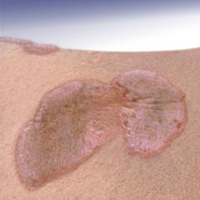
Primary lesions: Plaque
Plaques > 1 cm
You can feel them
They cast a shadow with side lighting
It is also caused by a proliferation of cells in epidermis or superficial dermis
15

Slide 16
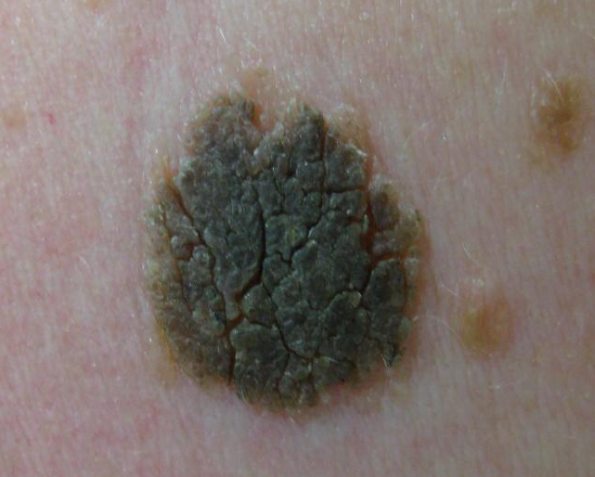
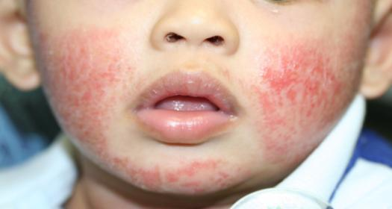
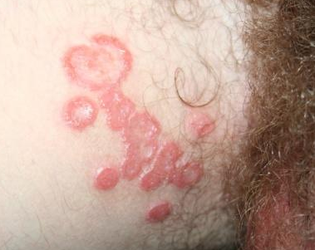
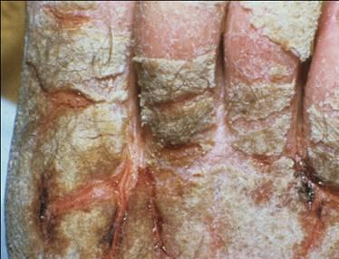
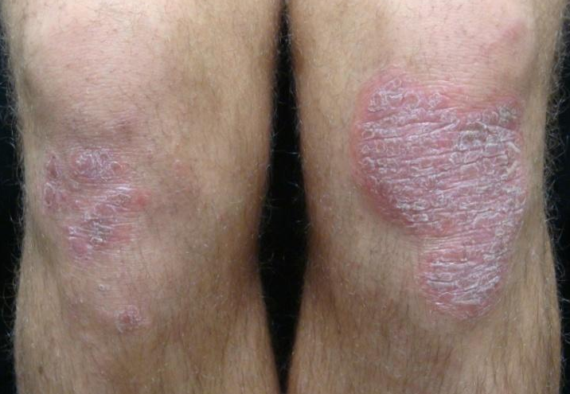
Examples of Plaques
16

Slide 17
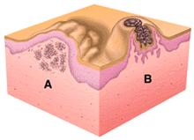
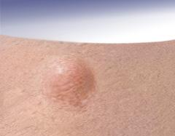
Nodule
(L. nodulus, “small knot”)
It is caused by a proliferation of cells into the mid-deep dermis
17

Slide 18
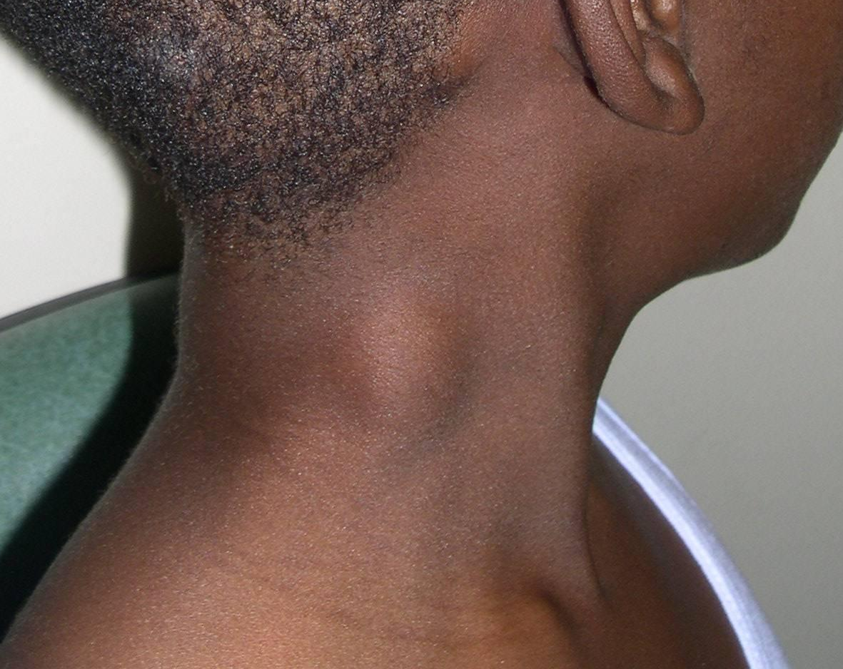
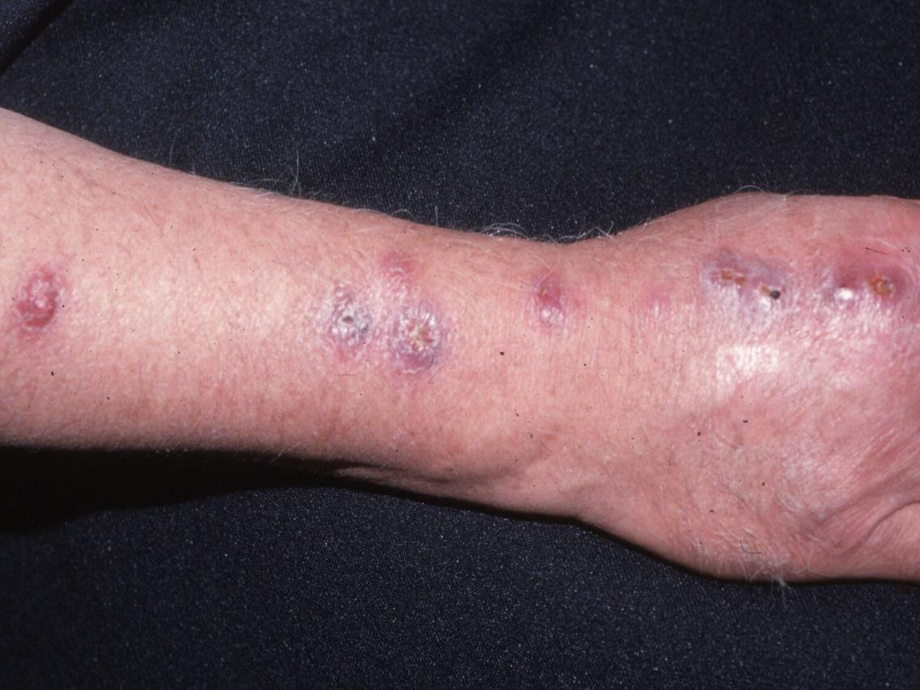
Examples of Nodules

Slide 19
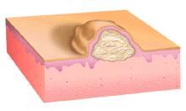
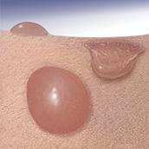
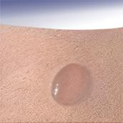
Primary lesion: Vesicle
(L. vesicula, “little bladder”; bulla, “bubble”)
Vesicles are fluid-filled papules (small blisters)
A large (> 1cm) blister is called a bulla
vesicle
bulla

Slide 20
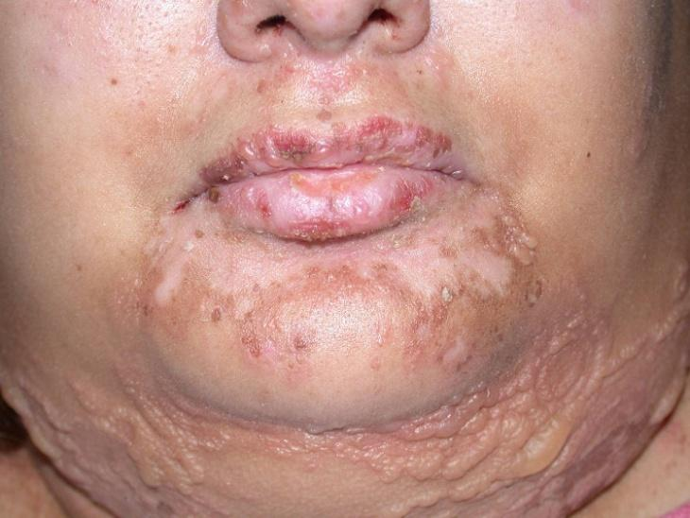
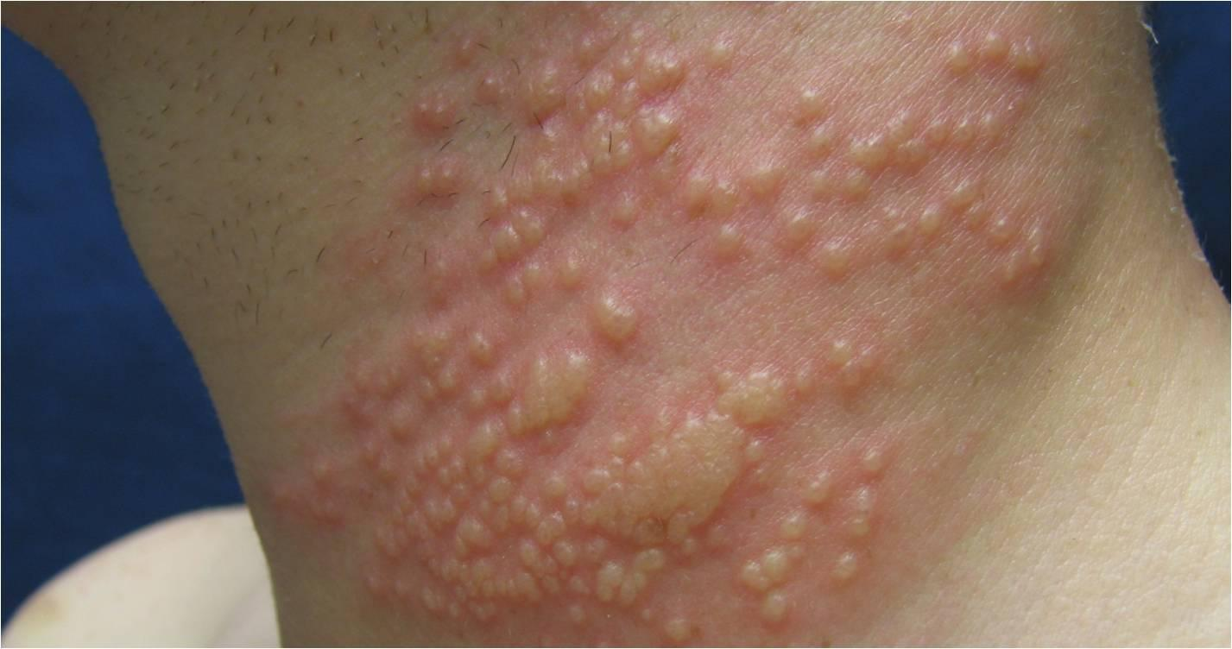
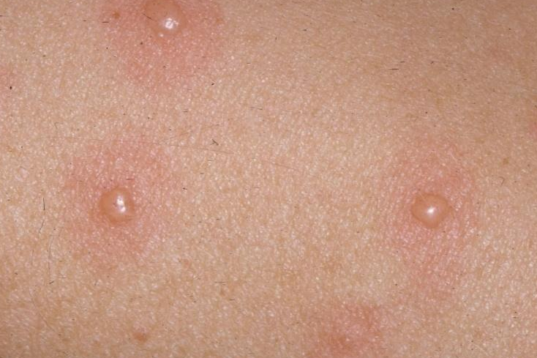
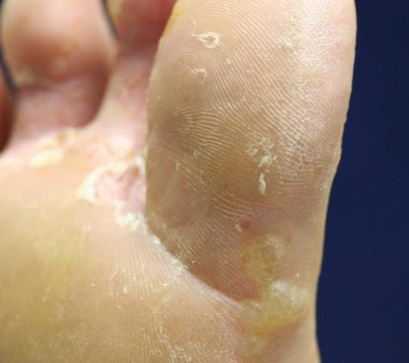
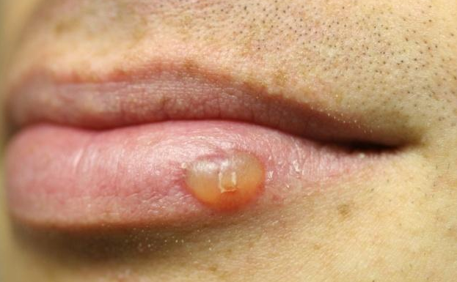
Examples of Vesicles
20

Slide 21
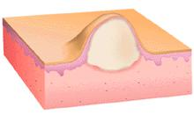
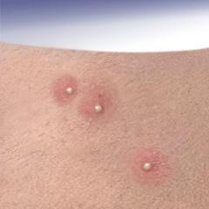
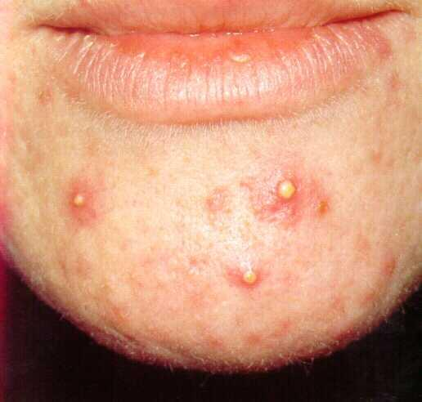
Pustule
Pus is made up of leukocytes and a thin fluid called liquor puris (L. “pus liquid”)

Slide 22
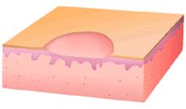
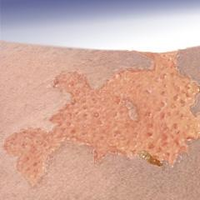
Erosion
Erosions are loss of part or all of the epidermis
They may occur after a vesicle forms and the top peels off
They weep and become crusted

Slide 23
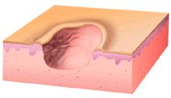
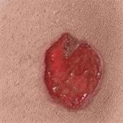
Ulcer
(L. ulcus, “sore”)
Ulcers are complete loss of the epidermis in addition to part of the dermis
They often heal with scarring; erosions usually do not heal with scars

Slide 24
Now you have the terms you need
Let’s practice your descriptions with cases
Do the best you can – like learning any new language it takes practice!

Slide 25
Case One
Mr. F

Slide 26
Case One: History
HPI: Mr. F is a 32-year-old man who presents to his primary care provider with “blotches” on his upper back, chest, and arms for several years.
They are more noticeable in the summertime.
PMH: shoulder pain from an old sports injury
Allergies: none
Medications: NSAID as needed
Family history: not contributory
Social history: auto mechanic
ROS: negative

Slide 27
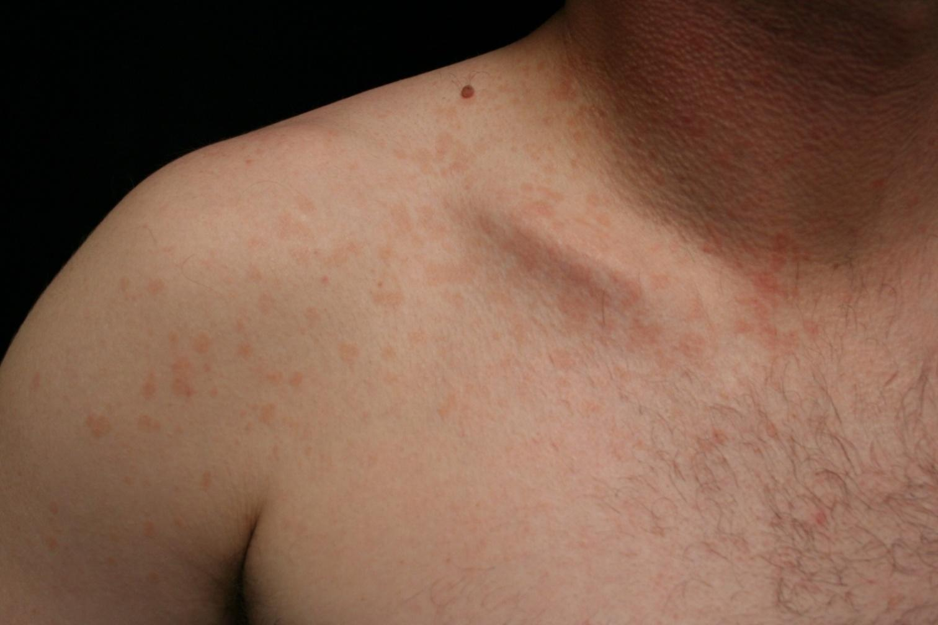

Case One: Skin Exam
27

Slide 28
Case One
How would you describe these skin findings?
What do you see? Look carefully at all clues in the photographs.
There are many right ways to describe something. Be creative.

Slide 29

Case One, Question 1
Are these lesions elevated, flat, or depressed?

Slide 30
Case One, Question 1
If you don’t feel an elevation or depression as your finger runs across the skin, they are flat
Small, flat lesions are called macules

Slide 31
Case One, Question 2
How else can you describe them?
What size are they?
What shape are they?
What color are they?
How regular and distinct is the border?
How are they configured?
How are they distributed?

Slide 32
Case One, Question 2
How else can you describe them?
3 to 10 mm

Slide 33
Case One, Question 3
How else can you describe them?
What size are they?
What shape are they?
What color are they?
How regular and distinct is the border?
How are they configured?
How are they distributed?

Slide 34
Case One, Question 3
How else can you describe them?
3 to 10 mm
Round to oval

Slide 35
Case One, Question 4
How else can you describe them?
What size are they?
What shape are they?
What color are they?
How regular and distinct is the border?
How are they configured?
How are they distributed?

Slide 36
Case One, Question 4
How else can you describe them?
3 to 10 mm
Round to oval
Pink to tan

Slide 37
Case One, Question 5
How else can you describe them?
What size are they?
What shape are they?
What color are they?
How regular and distinct is the border?
How are they configured?
How are they distributed?

Slide 38
Case One, Question 5
How else can you describe them?
3 to 10 mm
Round to oval
Pink to tan
Sharp, irregular borders

Slide 39
Case One, Question 6
How else can you describe them?
What size are they?
What shape are they?
What color are they?
How distinct are they?
How are they configured (how do the lesions relate to each other)?
How are they distributed (where are they on the body)?

Slide 40
Case One, Question 6
How else can you describe them?
3 to 10 mm
Round to oval
Pink to tan
Sharp, irregular borders
Separate, in no particular pattern

Slide 41
Case One, Question 7
How else can you describe them?
What size are they?
What shape are they?
What color are they?
How distinct are they?
How are they configured?
How are they distributed?

Slide 42
Case One, Question 7
How else can you describe them?
3 to 10 mm
Round to oval
Pink to tan
Sharp, irregular borders
Separate, in no particular pattern
On the upper chest, back, and flexures of arms

Slide 43


Skin Exam
Mr. F’s skin exam shows:
Multiple 3 to 10 mm pink to tan-colored, round, flat lesions with sharp, irregular borders and varying sizes on his upper chest, back and flexures of the arms.
Small (< 1cm) flat lesions are called macules
In this case, the primary lesion is a macule

Slide 44

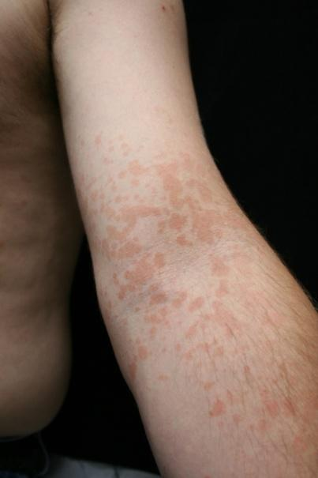
Diagnosis
Dr. D performs a potassium hydroxide exam and based on the findings, diagnoses Mr. F with tinea versicolor. The primary lesion in tinea versicolor is a macule
44
29

Slide 45
Case One, Question 8
Which of the following answers are correct? (More than one may be correct.)
Macules can:
Feel raised
Feel flat
Contain fluid
Be any shape

Slide 46
Case One, Question 8
Answer: b & d
Macules can:
Feel raised (these are papules or plaques)
Feel flat
Contain fluid (these are vesicles or bullae)
Be any shape

Slide 47

Review: Macule vs Patch
MACULE (<1cm)
PATCH (>1cm)

Slide 48
Case Two
Mr. K

Slide 49
Case Two: History
HPI: Mr. K is a 36-year-old man who presents with four years of itchy, flaky spots on his elbows, knees, and lower back. They have not improved with moisturizers.
PMH: none
Allergies: none
Medications: none
Family history: father died from heart attack at age 68
Social history: delivery truck driver
Health-related behaviors: drinks 2-3 beers a week
ROS: negative

Slide 50


Case Two: Skin Exam
50

Slide 51
Case Two
How would you describe these skin findings?
Be as detailed as you can be!

Slide 52
Case Two, Question 1
Are these lesions raised, flat, or depressed?

Slide 53
Case Two, Question 1
Imagine running your finger over them.
These are raised
Large (>1cm), plateau-like, raised lesions are called plaques

Slide 54
Case Two, Question 1
How else can you describe them?
Size?
Shape?
Color?
Sharp borders?
Texture?
Configuration?
Distribution?

Slide 55
Case Two, Question 1
How else can you describe them?
3 to 10 cm
Round to geographic (like outlines on a map)
Pink
Sharply circumscribed
Scaly
Symmetrical
Extensor surfaces (knees, elbows), back, gluteal cleft

Slide 56


Diagnosis
Mr. K’s skin exam shows:
Several 3-10 cm pink round sharply circumscribed scaly plaques on his extensor elbows, knees, lower back, and gluteal cleft
Mr. K has psoriasis.
The primary lesion in this case of psoriasis is a plaque because it is elevated and over 1 cm in diameter.

Slide 57

Review: Papule vs Plaque
PAPULE (<1cm)
PLAQUE (>1cm)

Slide 58
Case Three
Mr. B

Slide 59
Case Three
HPI: Mr. B is a 28-year-old man who presents with four days of pain and blisters on his left chest.
PMH: none
Allergies: none
Medications: none
Family history: noncontributory
Social history: single; works as a personal trainer
ROS: negative

Slide 60


Case Three

Slide 61

Case Three, Questions
How would you describe these skin findings?
Are these lesions raised, flat, or depressed?
Do they have fluid in them?

Slide 62
Case Three, Questions
These are raised
They also have fluid in them
Remember - small, raised, fluid-filled lesions are called vesicles

Slide 63
Case Three
How else can you describe them?
Size?
Shape?
Color?
Texture?
Configuration?
Distribution?

Slide 64
Case Three
How else can you describe them?
2 – 5 mm
Round to oval
Clear, with a background erythematous patch
Fluid-filled
Grouped vesciles
Unilateral dermatomal distribution on the left chest

Slide 65

Distribution / Configuration
Part of describing lesions is noting distribution and configuration
Distribution means location(s) on the body
Configuration means how the lesions are arranged or relate to each other
Lesions are grouped but also follow a linear pattern around the trunk
This is an example of a segmental or dermatomal distribution

Slide 66


Diagnosis
Mr. B’s skin exam shows:
Grouped 2-5 mm vesicles on an erythematous base in a unilateral, dermatomal configuration on the left chest
Small, fluid-filled lesions are called vesicles
Mr. K has shingles. The primary lesion in shingles is a vesicle.

Slide 67
Review: Seeing the skin
To describe what you see on the skin, first determine the primary lesion
Is it raised, flat, or depressed?
Is it small or large?
Is it fluid-filled?
The table in the next slide summarizes most of the terms used to describe the skin.

Slide 68
Terms
Raised | Flat | Depressed | Fluid-filled | Vascular
Papule | Macule | Erosion | Vesicle | Telangiectasia
Plaque | Patch | Ulcer | Bulla | Petechiae
Nodule |  | Atrophy | Pustule | Ecchymosis
Tumor |  | Sinus | Furuncle
Wheal |  | Stria | Abscess
Burrow
Scar

Slide 69
Review: Seeing the skin
In your descriptions, include adjectives that help describe the primary lesions. Make sure to consider:
Size
Shape
Color
Borders
Texture
Configuration
Distribution

Slide 70
Take Home Points
To describe the skin, first inspect closely
Second, determine if the lesion is raised, flat, or depressed and its size.
Then pick the term for the lesions that fits best!
Finally, use adjectives relating to the shape, color, texture, distribution, and configuration to further describe the lesion.
See the resources at the end for further reading.

