Slide 1
Morphology & Skin Lesions
Dr Sami Fatehi
MSc,MD,PhD
<number>

Slide 2
What is the skin lesion
It’s the skin change that occur due underlying pathogenic process and it should be identified in order to reach diagnosis.
Skin lesion either primary or secondary
Dermatological classified based on the primary lesions that demonate.
<number>

Slide 3
Dermatological Examination is a description of Skin lesion
Skin lesions description include:-
Morphology → shape and dimensions of the lesion
Configuration → arrangement of lesions or the relation of lesions to each others
Distribution → in which body site they are located?
<number>

Slide 4
Morphology:
Primary skin lesions : unmodified lesions
Secondary skin lesion: modified by scratching or infection
<number>

Slide 5
Skin lesions
Primary
Secondary
Macule
Patch
Papule
Plaque
Nodule
Vesicle
Bulla
Cyst
Burrow
Purpura
Weal
Telangiectasia
Crust
Scales (squamous)
Erosion
Ulceration
Excoriation
Scar
Atrophy
Fissure
Lichenification
Necrosis
<number>

Slide 6
Primary skin lesions
<number>

Slide 7
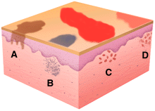
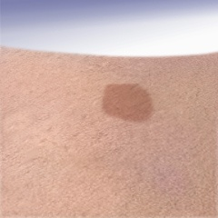
Macule
(L. macula, “spot”)
A macule is flat; if you can feel it, then it is not a macule.

Slide 8
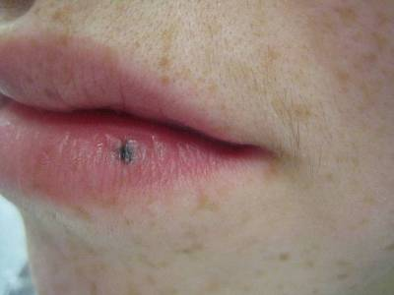
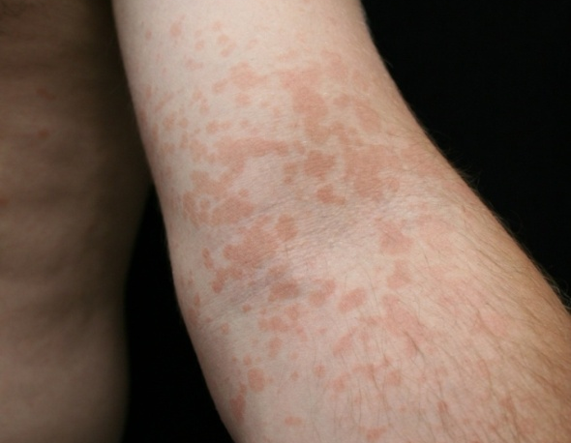
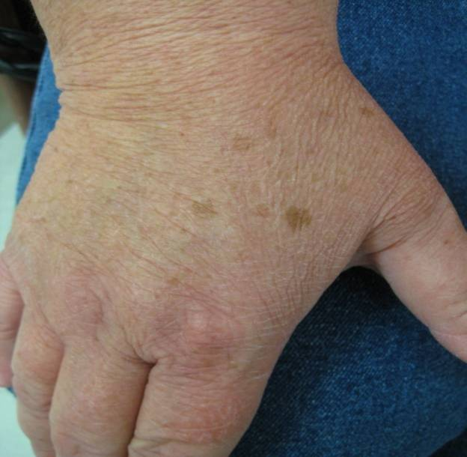
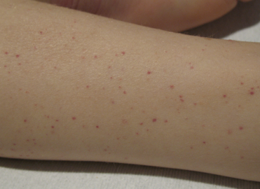
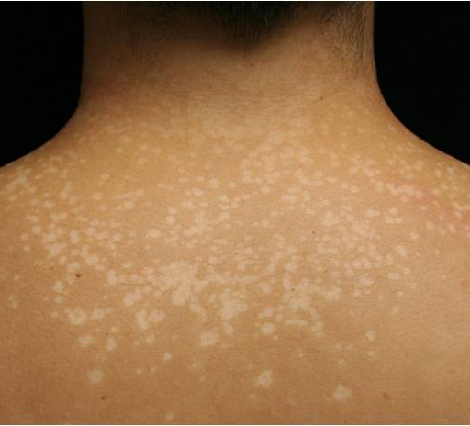
Macule
<number>

Slide 9
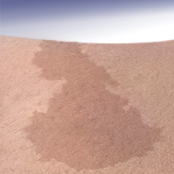
Patch
Patches are flat but larger than macules
If it’s flat and larger than 1 cm, it is a patch

Slide 10
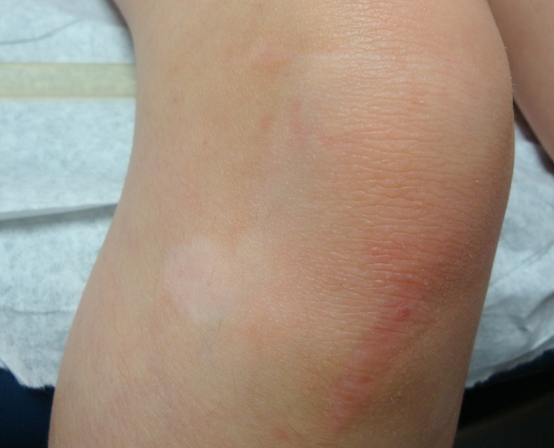
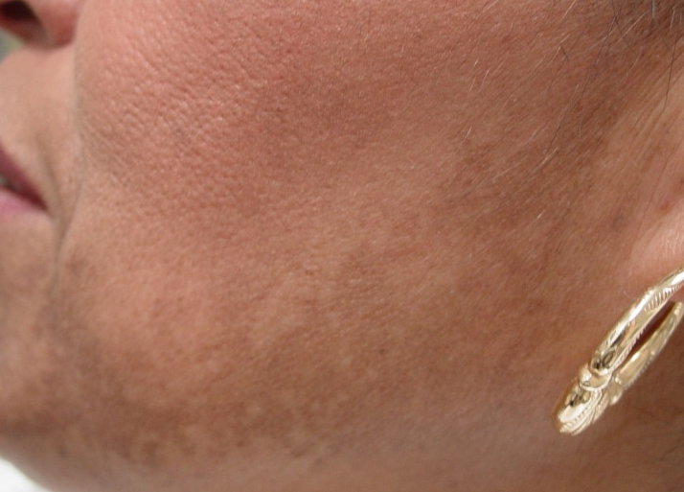
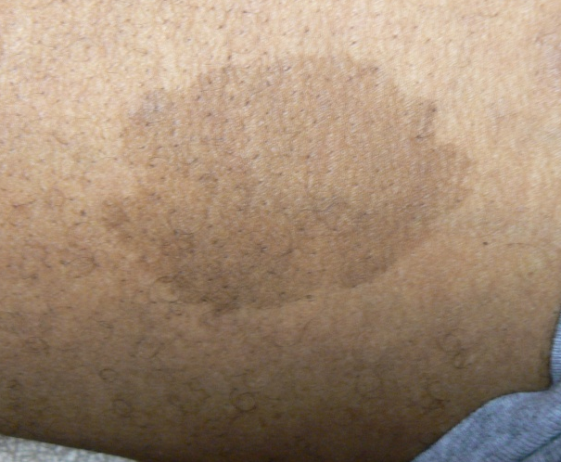
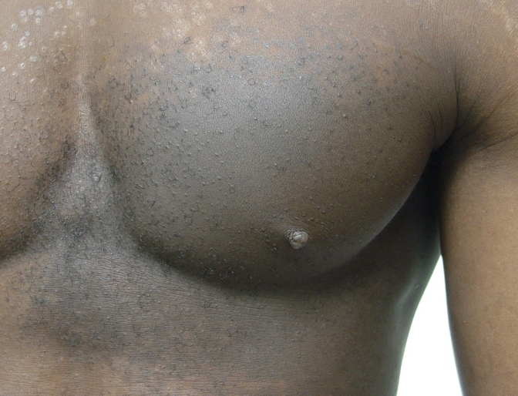
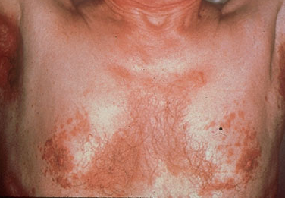
Patches
<number>

Slide 11
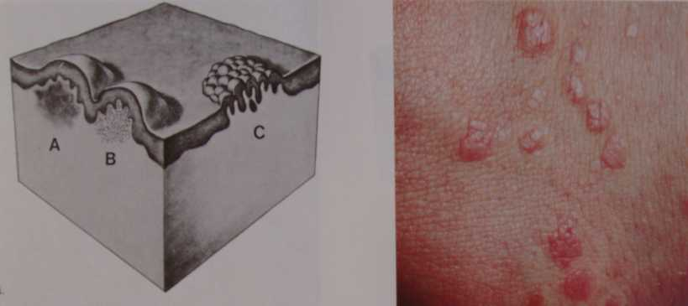
Papule
A papule is a circumscribed palpable elevation of the skin less than 1 cm in diameter
Dermal(drug eruption, lipid deposits), epidermal (warts, molluscum), or both (lichen planus)
<number>

Slide 12
Plaque
A slightly raised lesion greater than 1 cm in diameter
Papules confluence (psoriasis)
Patch thickening (mycosis fungoides the lymphoma of the skin)
<number>

Slide 13
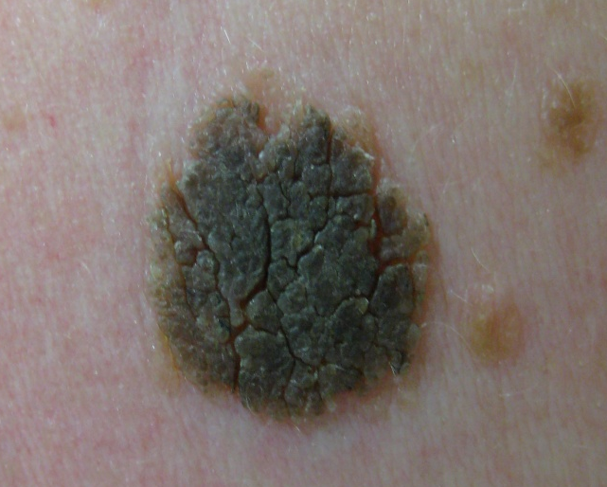
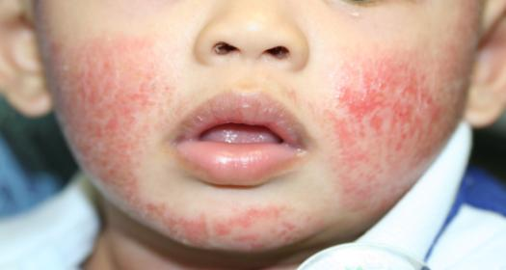
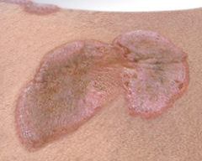
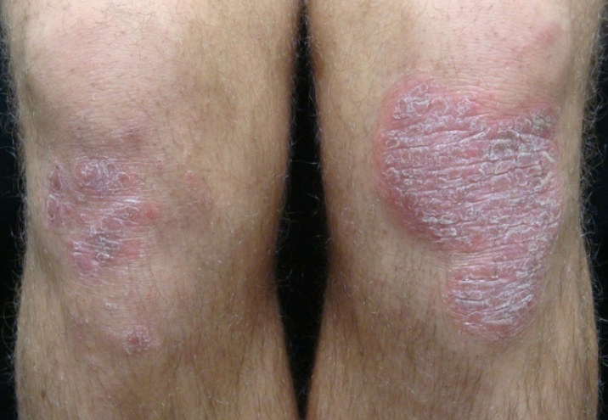
Plaques
<number>

Slide 14
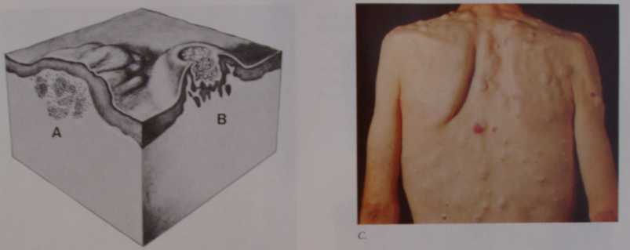
Nodule
Palpable solid deep lesion (depth> diameter)
- Epidermal
- Dermal
<number>

Slide 15
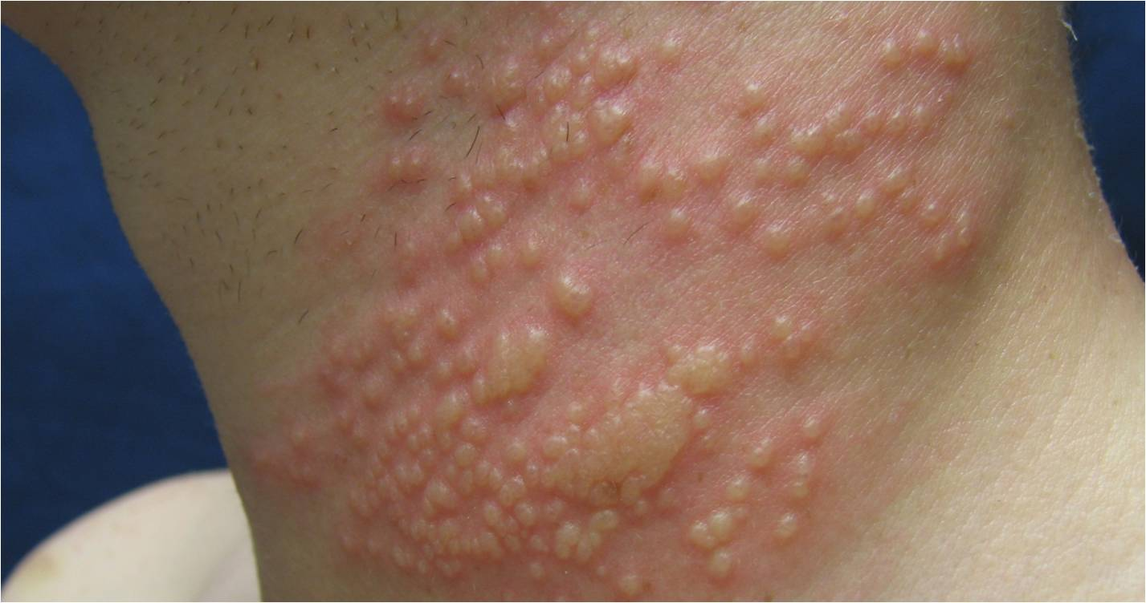
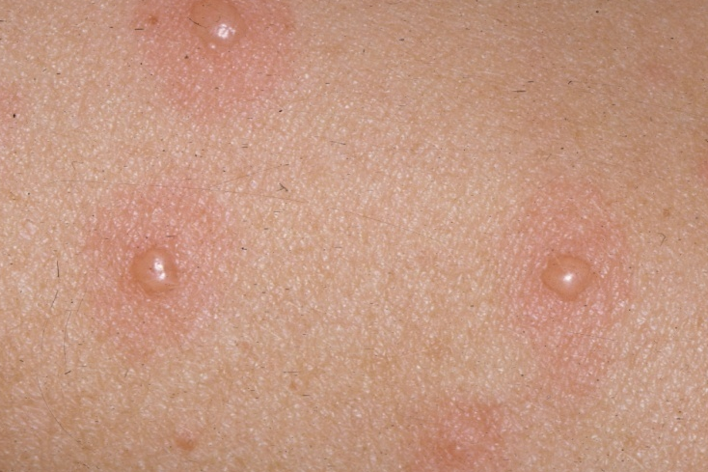
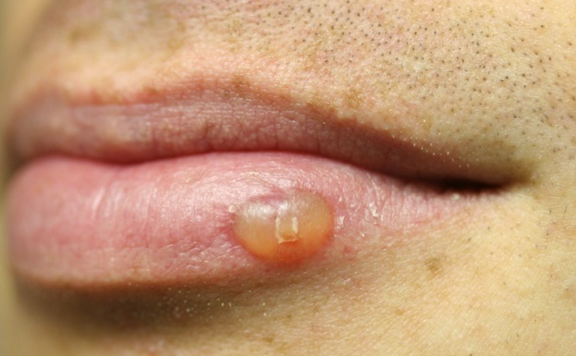
Vesicle
A raised lesion less than 0.5 cm in diameter containing clear fluid
<number>

Slide 16
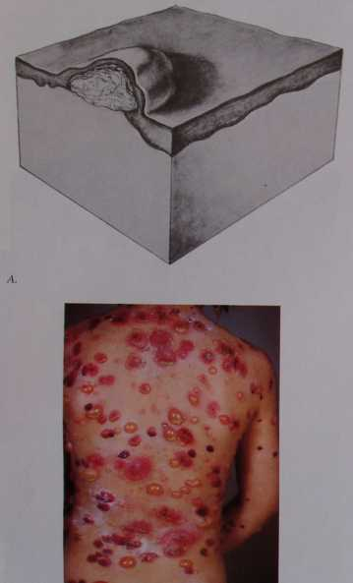
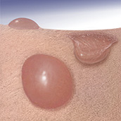
Bulla
A vesicle that is greater than 0.5 cm in diameter is known as a bulla.
<number>

Slide 17
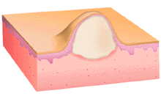
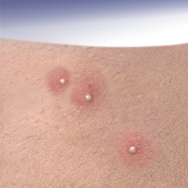
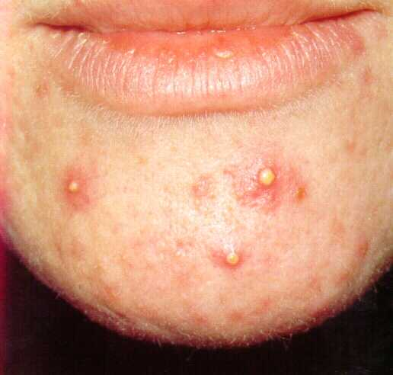
Pustule
A pustule is a raised lesion less than 0.5 cm in diameter containing yellow fluid, which may be sterile as in acne and pustular psoriasis, or infected.
<number>

Slide 18
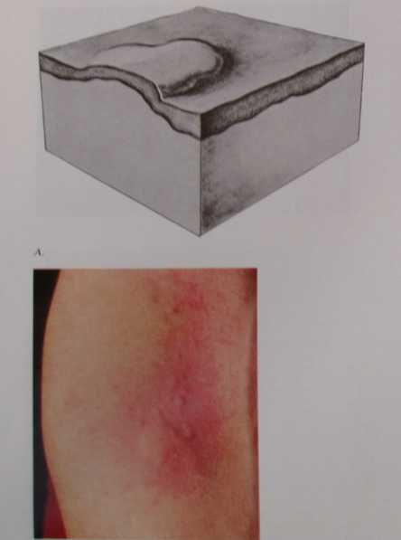
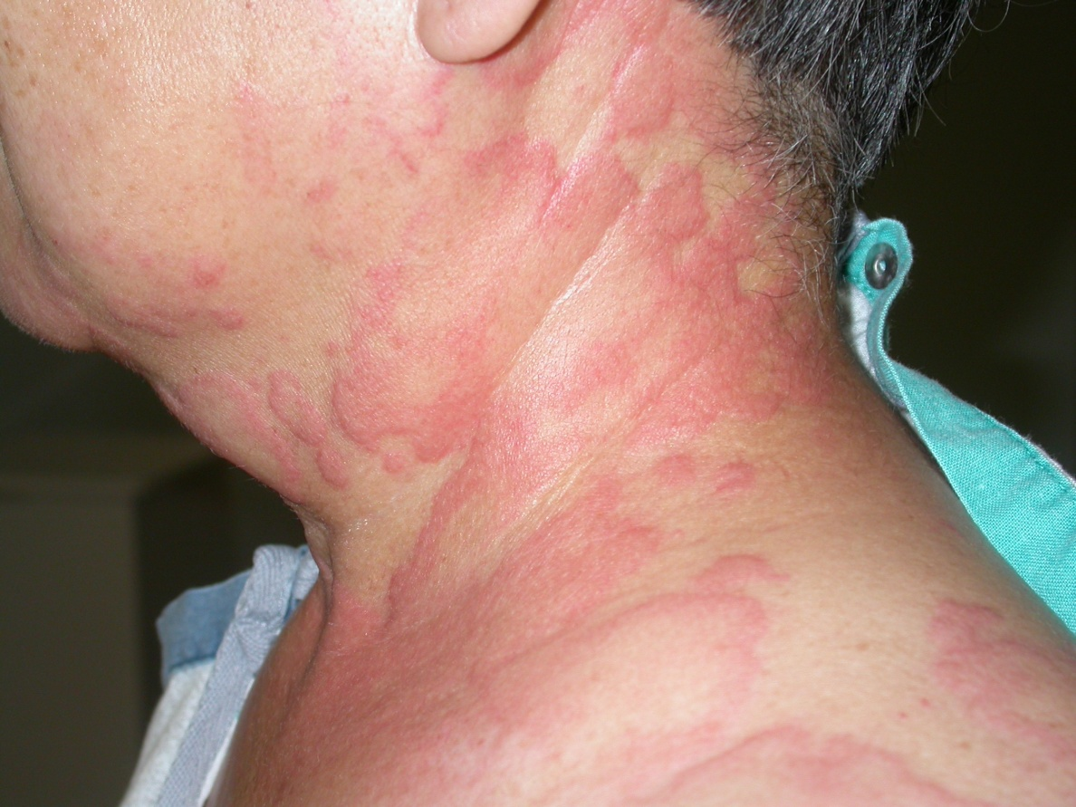
Wheal
A wheal is a transient, itchy, pink or red swelling of the skin, often with central pallor.
<number>

Slide 19
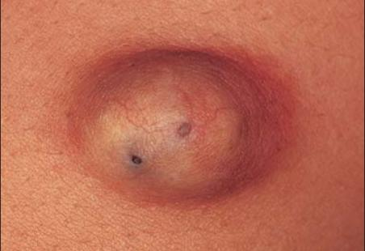
Cyst
palpable soft sac containing fluid.
- Epidermal
- Dermal
<number>

Slide 20
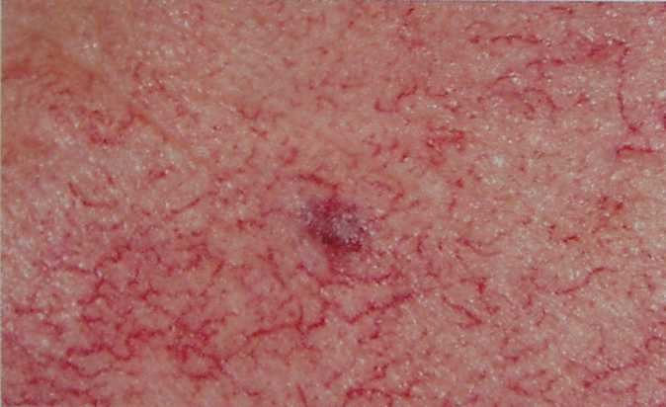
Telangiectasia
Dilatation of capillaries gives rise to this skin condition.
<number>

Slide 21
Secondary skin lesions
<number>

Slide 22
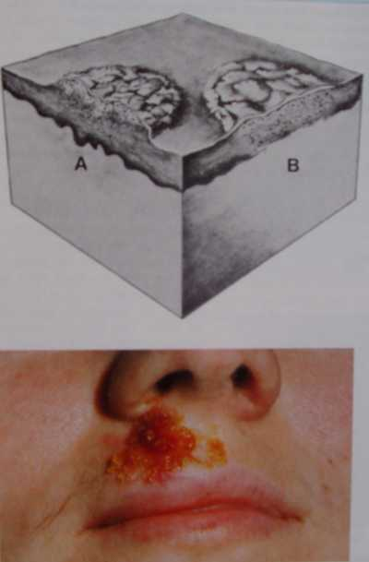
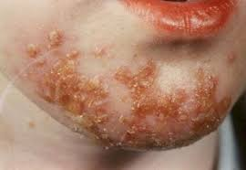
Crust
A crust is a dried exudate, which may have been serous, purulent or haemorrhagic.
<number>

Slide 23
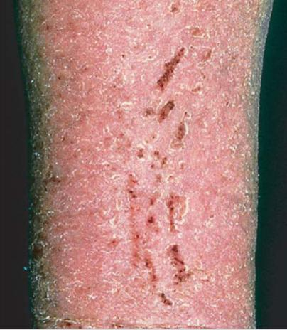
Excoriation
A haemorrhagic excavation of the skin resulting from scratching.
<number>

Slide 24
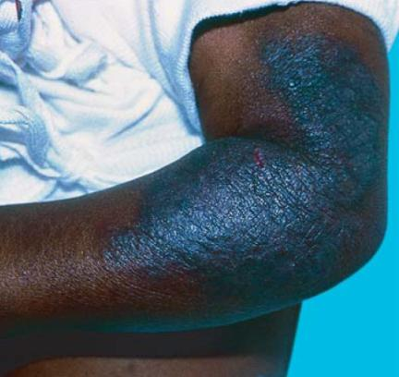
Lichenification
Thickening of the skin with exaggeration of the skin creases.
<number>

Slide 25
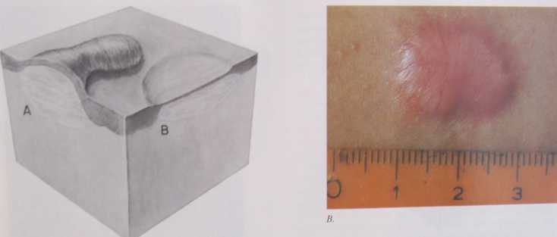
Scar
The final stage of healing of a destructive process (disease or injury) that has involved the deeper dermis results in a white, smooth, firm, shiny lesion.
Atrophic, or hypertrophic
<number>

Slide 26
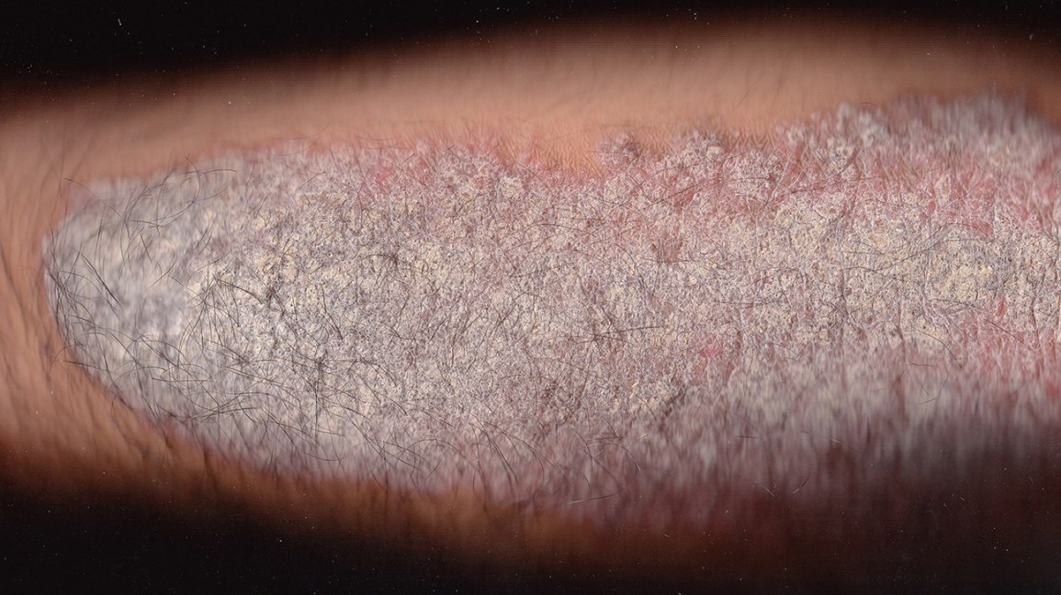
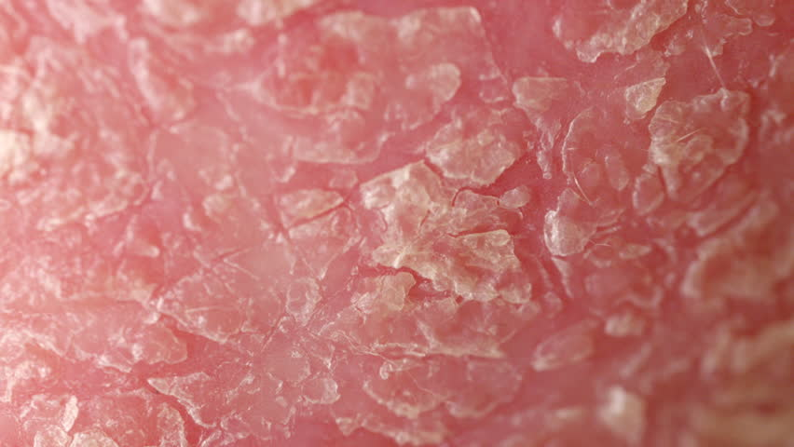
Scale
A scale is a flat plate (lamella) or flake of stratum corneum.
The epidermis is replaced every 28 days
Fine (eczema) / thick (psoriasis)
No scaling in dermal pathologies
<number>

Slide 27
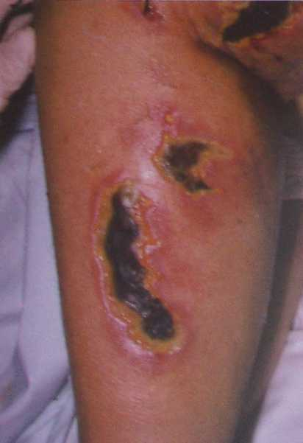
Necrosis
Death, or necrosis, of skin tissue is usually black in colour.
<number>

Slide 28
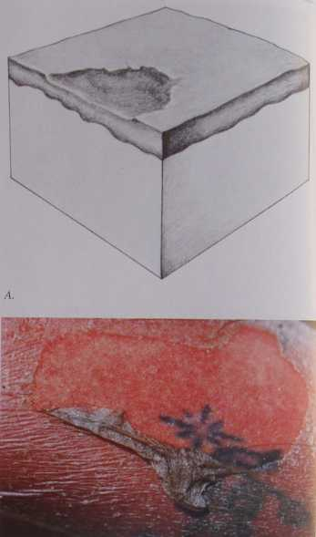
Erosion
A partial break in the epidermis is known as an erosion
It heals without scarring unless secondary infection occurs.
Commonly following a blister
<number>

Slide 29
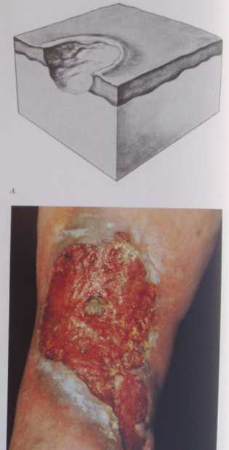
Ulcer
An ulcer is a full-thickness loss of the epidermis
Heals with scarring
<number>

Slide 30
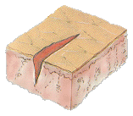
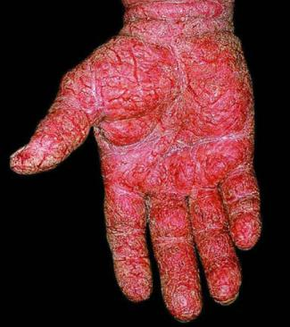
FISSURE
a linear cleavages or cracks in the skin.
<number>

Slide 31
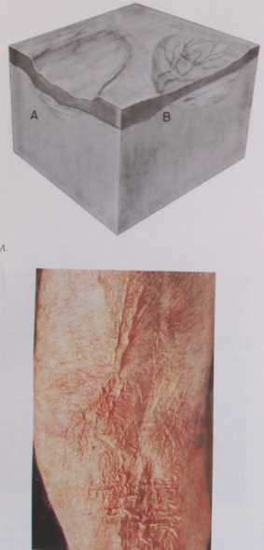
Atrophy
Thinning and transparency of the skin
Caused by diminution of the epidermis, the dermis, or both
Wrinkling and translucency
<number>

Slide 32
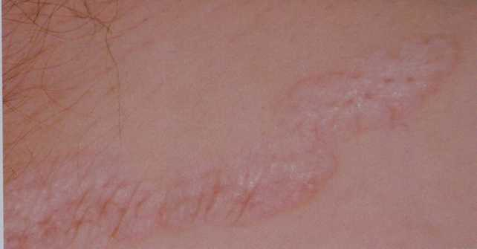
Sclerosis
A circumscribed or diffuse hardening or induration of the skin
A result of dermal or subcutaneous edema, cellular infiltration, or collagen proliferation
<number>

Slide 33
Primary Lesions
Macule: Flat circumscribed area of change in skin color
Papule: small circumscribed elevation of the skin
Nodule: Solid, circumscribed elevation of the skin whose greater part is beneath skin surface (felt more than seen)
Plaque: flat topped palpable lesion (gathering of papules)
Vesicle: collection of clear fluid (<5mm in diameter)
Bulla: like vesicle, but > 5 mm
Pustule: Collection of Pus
<number>

Slide 34
Primary Lesions
Wheal: Transient, slightly raised lesion with pale center and pink margin.Seen in urticaria.
Purpura:Visible collection of blood under the skin e.g. Vasculitis
Telangectasia: Dilated capillaries visible on skin surface
Burrow: Tunnel in the skin (e.g. Scabies)
<number>

Slide 35
Secondary lesions
Crust: Dried serum (or exudate)
Scale:Thickened, loose, readily detached fragment of cornified layer
Excoration: Shallow linear abrasion caused by scratching.
Erosion:Loss of epidermis (heals without scarring)
Ulcer: loss of epidermis and dermis (heals with scarring)
Fissure : linear crack in the skin
Scar: Permanent lesion due to abnormal formation of connective tissue following injury.
<number>

Slide 36
Secondary lesions
Atrophy:
Superficial: thining of skin with visible blood vessels
Deep : depression of skin surface
Lichenification: thickened skin with accentuated skin markings
Sclerosis: induration of skin
<number>

Slide 37
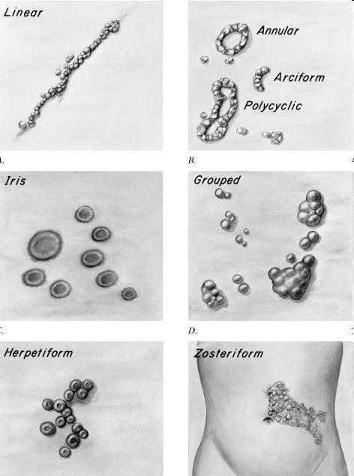
2- Configuration
<number>

Slide 38
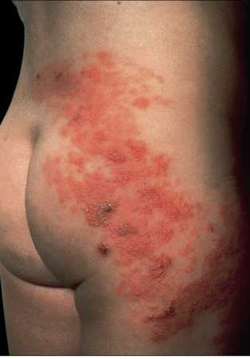
<number>

Slide 39
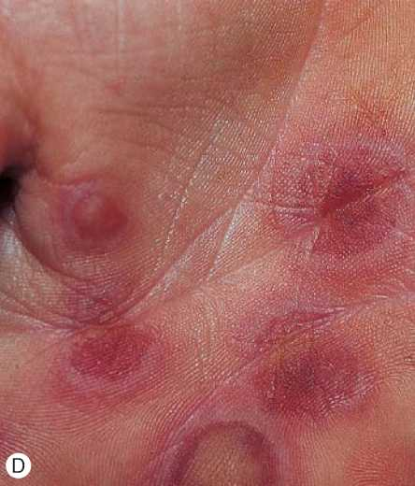
<number>

Slide 40
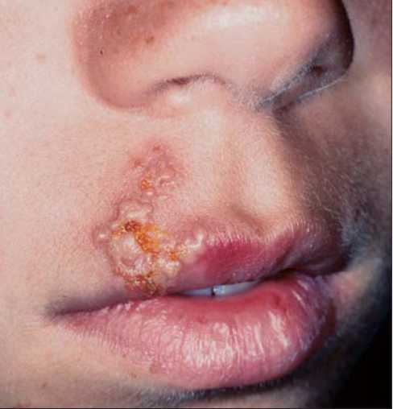
<number>

Slide 41
3- Distribution
Many diseases have predilection for specific body sites
*Psoriasis: Extensors(elbows and knees)
Scalp
*Acne : Face
Upper chest, Upper back
*Photosensitive eruption: Mainly face, forearms & V-Chest (with sparing of photoprotected areas e.g. upper eyelids, retro-auricular an sub- mental)
<number>

Slide 42
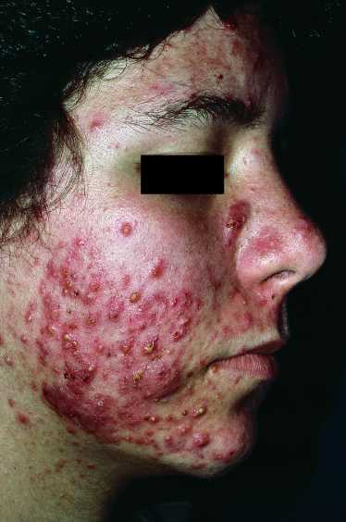
<number>

Slide 43
Colour in Dermatology
Red:Vascular lesions e.g. port wine stain
also, inflammatory disorders like psoriasis
Blue: Blue nevus
Mongolian spot
Yellow: Xanthoma
White: Vitiligo
Black: Melanocytic nevus & melanoma
Purple or (Violaceous) : Lichen planus
<number>

Slide 44

<number>

Slide 45

<number>

Slide 46
Thank you
<number>

