Slide 1
Parasitic Infestations of the Skin

Slide 2
Parasitic infestations:
Pediculosis
Scabies
Cutaneous leishmaniasis

Slide 3
1-Pediculosis

Slide 4
Definition
Humans are parasitized by three species of Anoplura:
Pediculus humanus capitis or head louse.
Pediculus humanus corporis or body louse.
Phthirus pubis or pubic louse.

Slide 5
Clinical types
Pediculosis Capitis
Pediculosis Corporis
Pediculosis Pubis

Slide 6
1) Pediculosis Capitis
Synonym: Head lice.
Cause: Pediculus humanus capitis.
Epidemiology:
Common in children & homeless people
Spread from person to person by head-to-head contact, and by shared combs or hats.
Often seen in epidemics amng kindergarten and school children

Slide 7
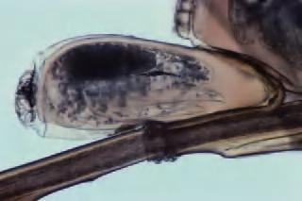
Morphology and biology
Female lifespan is approximately 40 days
Lays about 300 eggs, at the rate of 7–10 daily
Eggs are cemented to hair shafts with a material secreted by female’s accessory glands
Eggs hatch in about 8 days.

Slide 8
Pathogenesis
Lice live on the scalp and suck blood
They firmly attach their eggs (nits) to the hair shaft just at the skin surface
The head louse measures some 3–4 mm in length and is greyish, and often rather hard to find

Slide 9
Clinical features
Pruritic eruption on back of scalp and nape
Excoriations & secondary infections (lice drmt)
Hairs may become matted due repeated scratch
Lice identified especially when combing hair
Nits may be present throughout the scalp, but most common in the retroauricular region (ova close to scalp are viable)

Slide 10
Diagnostic approach:
Look for:
Nits on the hair shafts (retro-auricular),
Lice on the scalp.

Slide 11
Therapy
Effective therapeutic agents must kill/remove both lice and ova.
1) Pyrethrins and the synthetic permethrin:
1% and 5% cream
Must be applied (10 min) after shampooing and drying hair completely
No hair washing for 24 hours

Slide 12
Therapy
2) Malathion 0.5% lotion.
Has the extra value of sticking to the hair, so protecting against re-infection for 6 weeks.
3) Lindane (gama benzene hexachloride)
Has potential neurotoxicity if abused
4) Crotamiton (Eurax)10% cream or lotion

Slide 13
Therapy
Nits treatment: Nits are always a problem
No treatment is available
Re-treatment in a week is advsable for all pnts
Combing with a metal or plastic nit comb (fine-toothed) is an important adjunctive measure

Slide 14
Therapy
Other therapy methods: Oral treatment
Ivermectin
Has no ovicidal activity
Two doses separated by an interval of 10 days would be more effective.

Slide 15
2) Pediculosis Corporis
Synonym: Body lice.
Cause: Pediculus humanus corporis.
Epidemiology:
Is primarily a disease of the unwashed “Vagabond's disease”

Slide 16
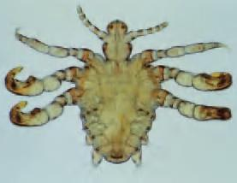
Morphology and biology
Identical in developmnt & appearance to head louse
Its natural habitat is the clothing of its host, it only visits the skin to feed.
Eggs are cemented to clothing fibres
With a preference for
clothing close to the skin.
Seams are a favoured site

Slide 17
Pathogenesis
The lice feed on the body, but live in the clothing
The parasite obtains its nourishment by descending to the skin and taking a blood meal.
Lay their eggs in the seams of clothing

Slide 18
Clinical features
Pruritus,
Itching is accompanied by erythematous and copper-colored macules, wheals
Excoriations and secondary infections (lice dermatitis) on trunk (vagabond skin) are common.

Slide 19
Diagnostic approach
Look for the lice and nits on the clothing, not on the skin.
Is differentiated from scabies by the lack of involvement of the hands and feet

Slide 20
Therapy
Same pediculicides as for Pediculus humanus capitis can be used
Lice may live in clothing for 1 month without a blood meal.
Disinfection of clothing and bedding (boiling, hot ironing).
Attempt to change living conditions.

Slide 21
Therapy
1) Pyrethrins and the synthetic permethrin:
1% and 5% cream
2) Malathion 0.5% lotion.
Has the extra value of sticking to the hair, so protecting against re-infection for 6 weeks.
3) Lindane (gama benzene hexachloride)
Has potential neurotoxicity if abused
4) Crotamiton (Eurax)10% cream or lotion

Slide 22
3) Pediculosis Pubis
Synonym: Pubic lice.
Cause:Phthirus pubis
Epidemiology:
Is found in the pubic region, as well as hairy areas of legs, abdomen, chest, axillae, arms
Spread through close physical contact
Usually transmitted by sexual contacts

Slide 23
Clinical features
Lice and nits present in the hair of pubic area
The signs and symptoms are similar to those of body louse infestation.

Slide 24
Therapy
1) Pyrethrins and the synthetic permethrin:
1% and 5% cream
2) Malathion 0.5% lotion.
Has the extra value of sticking to the hair, so protecting against re-infection for 6 weeks.
3) Lindane (gama benzene hexachloride)
Has potential neurotoxicity if abused
4) Crotamiton (Eurax)10% cream or lotion

Slide 25
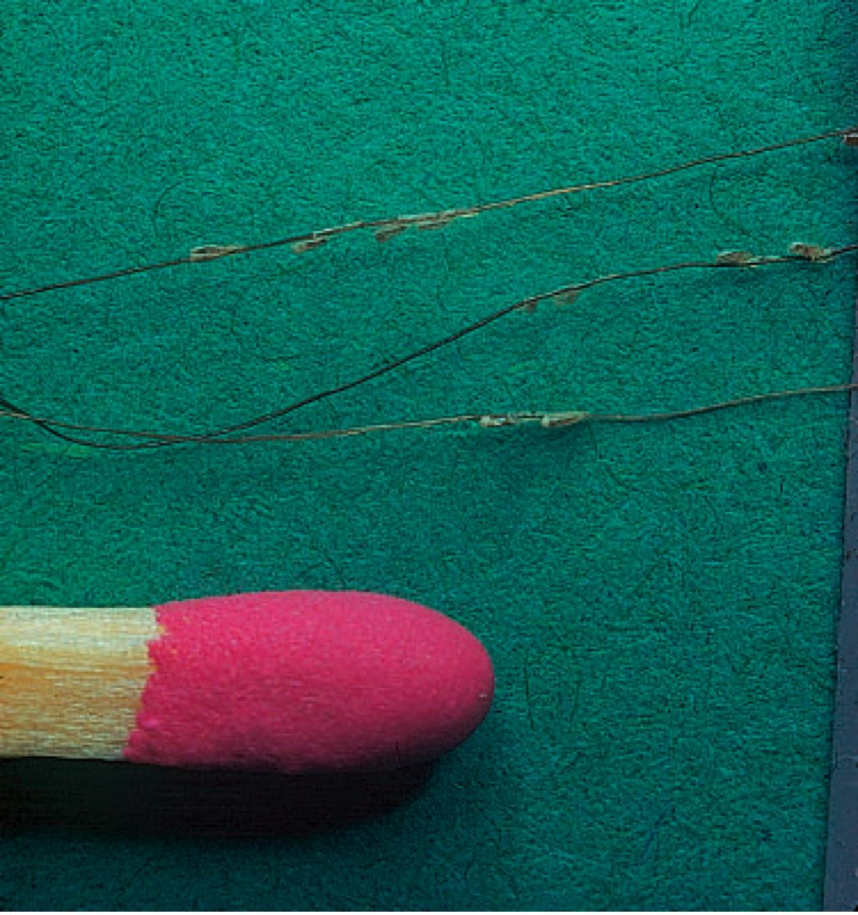
Numerous eggs (nits) seen

Slide 26
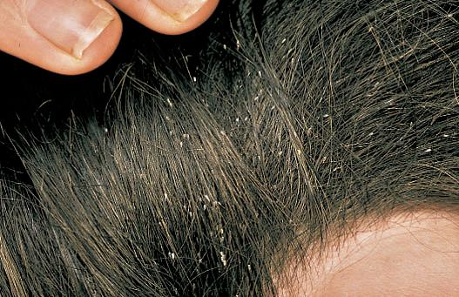

Slide 27
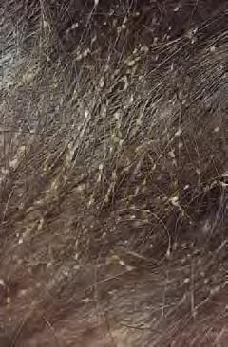

Slide 28
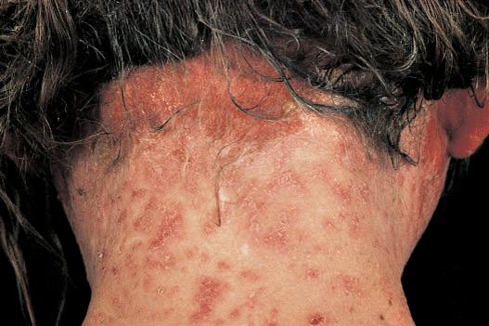

Slide 29
2- Scabies

Slide 30
Introduction
Scabies is an intensely pruritic skin infestation
A source of human infestation for thousands of yrs (2500 yrs, Roman times)
The term scabies is derived from Latin word scabere (to scratch).
Prevalence rates are higher in children and sexually active individuals than in other persons.
Caused by the host-specific mite, Sarcoptes scabiei var hominis. Is an obligate human parasite

Slide 31
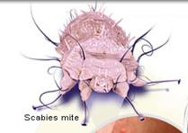

Slide 32
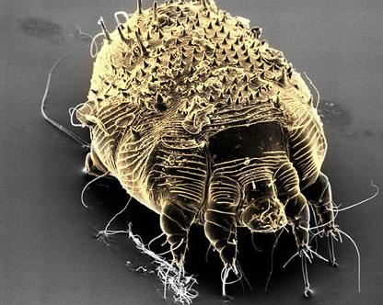

Slide 33
Pathophysiology
Transmission is via direct and prolonged contact with an infected individual (not via inanimate objects)
The entire life cycle of the mite lasts 30 days and is spent within the human epidermis.

Slide 34
Pathophysiology
After copulation, the male mite dies and the female mite burrows into the superficial skin layers
Once on the skin, fertilized female mites burrow through the stratum corneum at the rate of about 2 mm per day, and produce two or three oval eggs each day (total of 60-90 eggs).
The ova require 10 days to 3 weeks to become mature adult mites

Slide 35
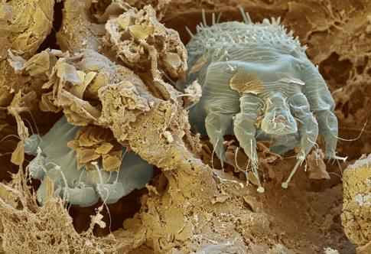

Slide 36
Pathophysiology … cont.
Mites move through the top layers of skin by secreting proteases that degrade the stratum corneum.
They feed on dissolved tissue
Scybala (feces) are left behind as they travel through the epidermis, creating linear lesions clinically recognized as burrows.

Slide 37
Pathophysiology … cont.
Upon initial infestation, a delayed type IV hypersensitivity reaction to the mites, eggs, or scybala develops over 4-6 weeks.
The hypersensitivity reaction is responsible for the intense pruritus that is the clinical hallmark of the disease.

Slide 38
Clinical features
Distribution of the lesion differs in adults and children.
Adults
Lesions manifest primarily on the flexure aspects of the wrists, the interdigital web spaces of the hands, and genitalia.

Slide 39
Clinical features … cont.
Infants and children
Lesions can appear any where and any site may be involved.
The diagnosis of scabies is considered in any patient presenting with a recent onset of intense itching that is accentuated at night.
Similar symptoms in close contacts should immediately rank scabies at the top of the clinical differential diagnosis.

Slide 40
Clinical features … cont.
Clinical Types
Classical
Crusted
Crusted scabies
Syn: Norwegian, scabies (so named because the first description was from Norway in the mid-1800s)
Is a highly contagious form of the disease.
Hundreds to millions of mites infest the host individual,
Usually immunocompromised, elderly.

Slide 41
Management
Treatment includes administration of :
Scabicidal agents
Antipruritic agent (e.g.sedating antihistamine)
Antimicrobial agent if secondarily infected
All family members and close contacts must be evaluated and treated,
All clothing, bed linens, and towels used within the last week to be launder in hot water the day after treatment and again in 1 week.

Slide 42
Management
Application of topical antiscabietic agents, with repeat application in 7 days. These include:
Permethrin 5% cream is the drug of choice, especially for infants >2 mo and small children
Lindane1% lotion or cream
Sulfur 6% in petrolatum
Crotamiton (Eurax)10% cream or lotion for treatment of scabies

Slide 43
Management … cont.
An oral agent, ivermectin is proved to be effective
Dose of 200-250 mcg/kg given at diagnosis and repeated in 7-14 days.

Slide 44
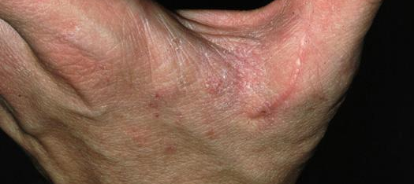
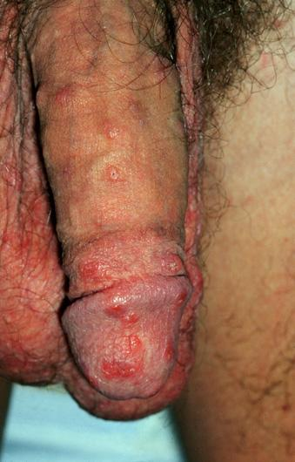
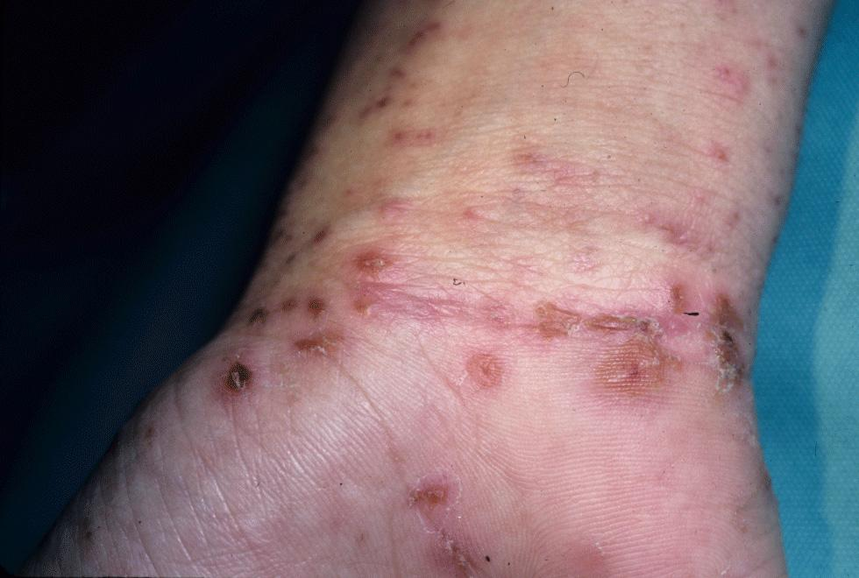
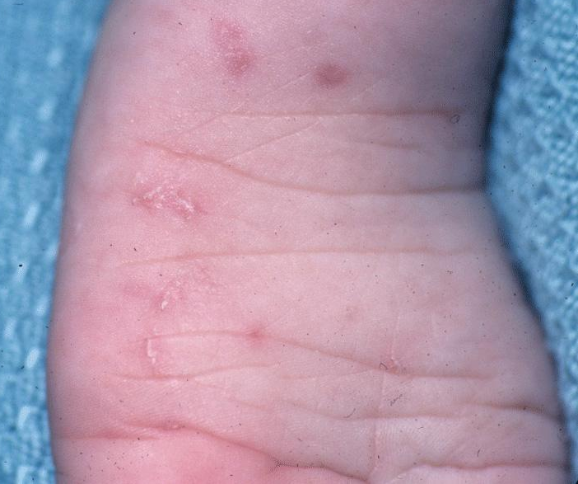

Slide 45
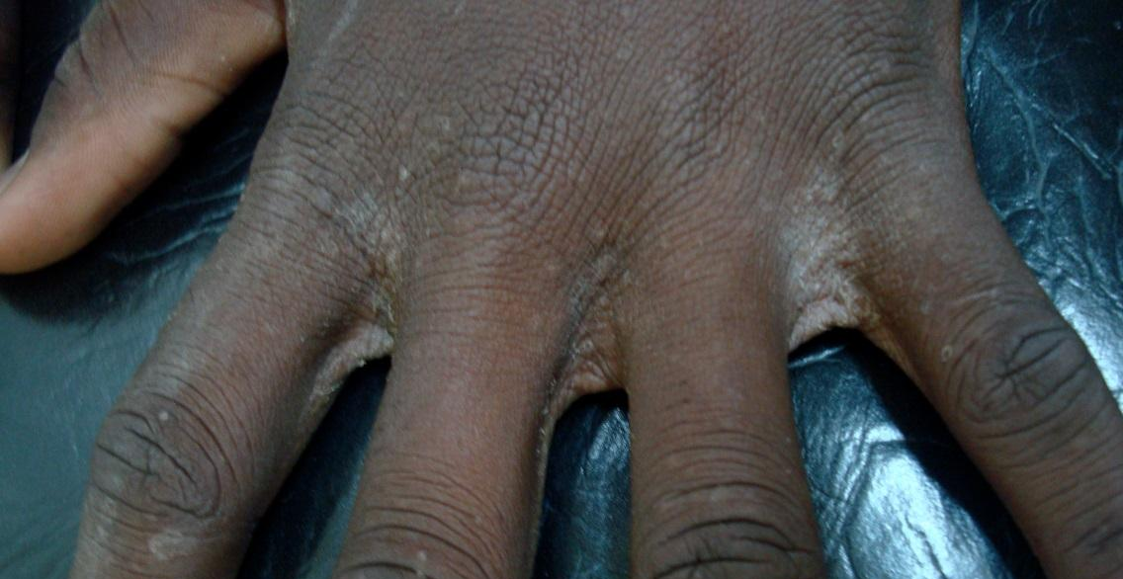
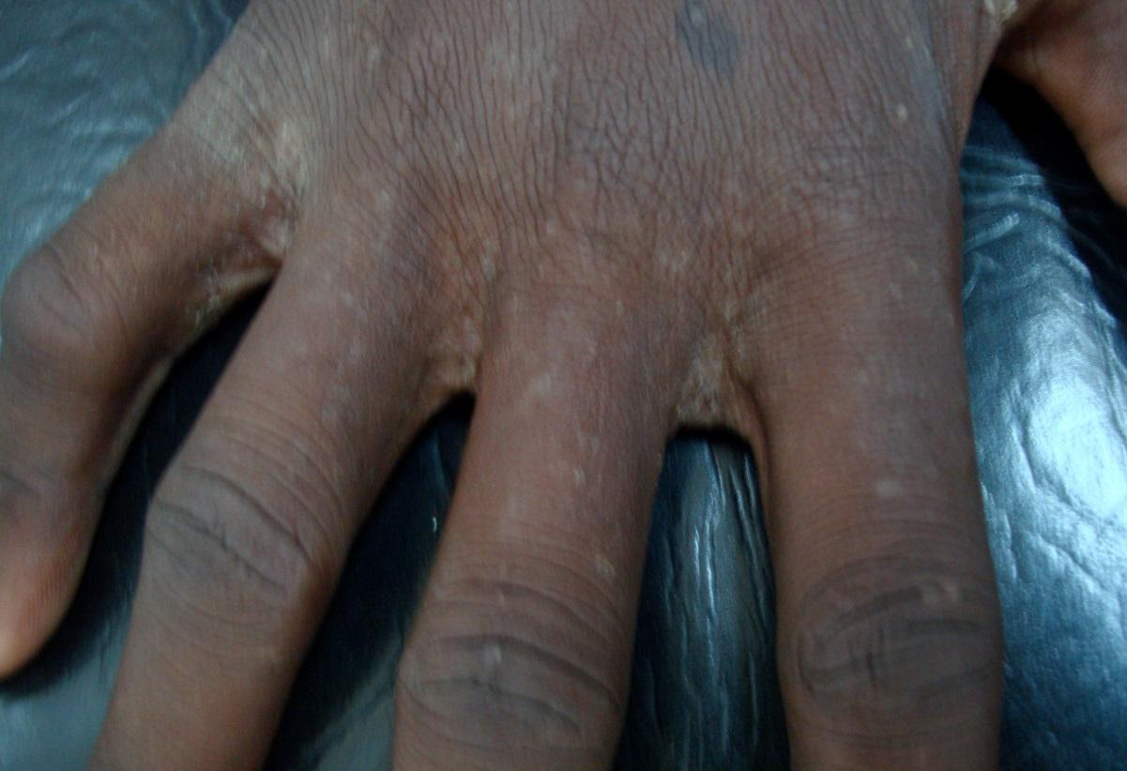

Slide 46
