Slide 1
Pregnancy Dermatoses
Dr Sami Aldaham

Slide 2
Goals and Objectives
By completing this module, the learner will be able to:
Identify and describe the morphology of specific dermatoses of pregnancy
List which dermatoses of pregnancy carry risks for the mother and the fetus
Explain basic principles in the diagnosis and treatment of specific pregnancy dermatoses

Slide 3
Pregnancy Dermatoses
There are four specific dermatoses of pregnancy, according to the most recent proposed classification:
Pemphigoid gestationis
Pruritic urticarial papules and plaques of pregnancy (PUPPP)
Atopic eruption of pregnancy
Intrahepatic cholestasis of pregnancy

Slide 4
Pregnancy Dermatoses
Each pregnancy dermatosis is distinct and carries different risks for the mother and the fetus.
A distinction must be made between dermatological diseases that happen to occur while the patient is pregnant versus specific dermatoses that occur only during pregnancy.
Pregnant patients with dermatologic conditions requiring treatment should be co-managed with an obstetrician.

Slide 5
Case One
Safa

Slide 6
Case One: History
Safa is a 34-year-old woman who presents with a one-month history of a skin eruption.
She is 31 weeks pregnant with her first child.
She says that she first noticed the eruption after she swam in a lake.
The rash started on her abdomen and rapidly spread to her arms and legs.
The eruption is very pruritic and sometimes forms blisters.
She tried applying calamine lotion, which provided temporary relief. The lesions, however, continue to progress.
She is otherwise healthy and is on prenatal multivitamins.

Slide 7
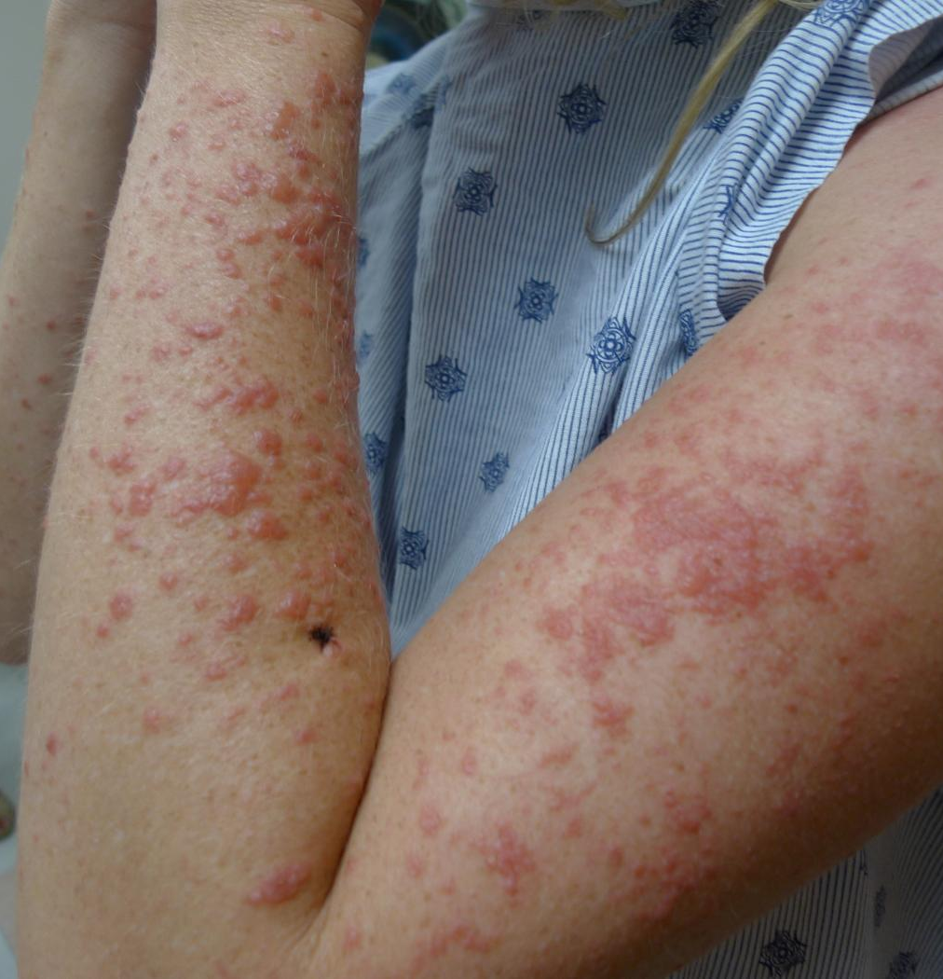
Case One: Skin Exam

Slide 8
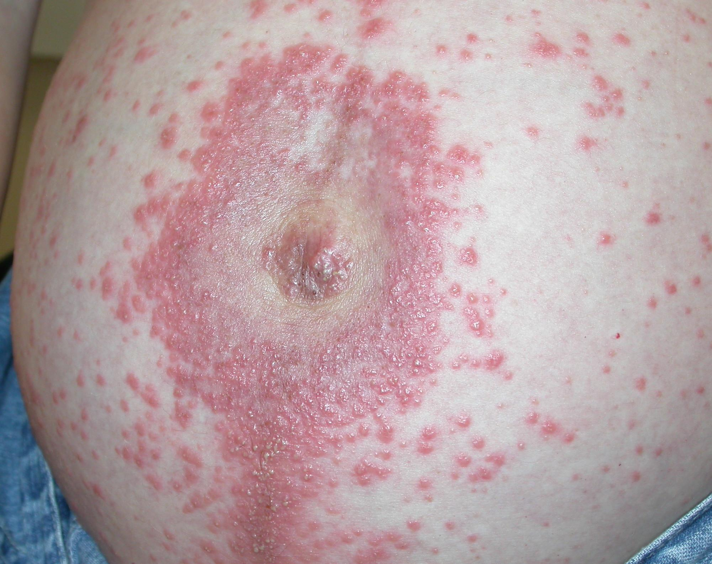

Slide 9
Diagnosis: Pemphigoid gestationis
Autoimmune blistering disease
Incidence: 1 in 10,000-50,000 pregnancies
Starts in 2nd or 3rd trimester (mean onset = 21 weeks)
Presents as pruritic papules and vesicles/bullae
Involves the umbilicus in fifty percent of cases

Slide 10
Pemphigoid gestationis
Histopathology often helps with the diagnosis. Findings include a subepidermal blister with eosinophils.
Immunofluorescence provides a definitive diagnosis with findings of a linear band of C3 +/- IgG at the basement membrane zone.

Slide 11
Pemphigoid gestationis: Treatment
1- Topical steroids can be helpful in mild disease.
2- With widespread disease, patients will often benefit from oral steroids, which are safe to use in pregnancy (category B drug).

Slide 12
Complications
1- Preterm delivery
2-Small-for-gestational age infants
3- Blisters (10% risk) in the neonate secondary to maternal transfer of antibodies.

Slide 13
Prognosis
1- There is often a flare at the time of delivery (75% of cases).
2- Pemphigoid gestationis can start postpartum (20% of cases).
3- Recurrence with menses or OCP use has been reported but is rare.

Slide 14
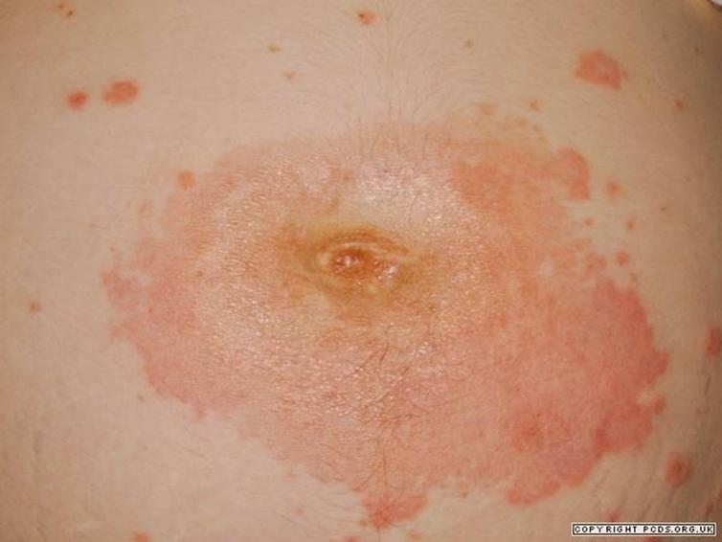

Slide 15
Case Two
Rasha

Slide 16
Case Two: History
Rasha is a healthy 28-year-old primigravid.
She is in her 34th week of gestation.
Two weeks ago, she developed a pruritic eruption on her abdomen and thighs.

Slide 17
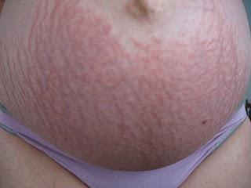
Case Two: Skin Exam

Slide 18
PUPPP
This is a case of pruritic urticarial papules and plaques of pregnancy (PUPPP)
Common dermatosis of pregnancy
Also known as Polymorphic eruption of pregnancy(PEP)
Incidence: 1 in 300 pregnancies
Onset during 3rd trimester (mean = 35 weeks)
Predominantly affects primigravids

Slide 19
Pathogenesis
The pathogenesis is unclear.
Hormonal, immunological, factors may also play a role.
One leading theory is abdominal wall distention, especially since PUPPP is more common in primigravids and multiple gestation pregnancies.

Slide 20
PUPPP: Clinical Findings
1-Typical lesions are erythematous urticarial papules surrounded by a pale halo.
2- In the vast majority of cases, the eruption starts within the abdominal striae (with periumbilical sparing) and progresses from there.
3- Less commonly, PUPPP can present with blisters and the umbilicus may be involved

Slide 21
Evaluation
The diagnosis is made based on the history and the clinical picture.
A biopsy is rarely helpful in diagnosing PUPPP.
It does, however, rule out pemphigoid gestationis, which is an important differential diagnosis.
If the patient has an atypical presentation, or if you are concerned about pemphigoid gestationis, consider referral to a dermatologist or a skin biopsy with immunofluorescence.
A skin biopsy of PUPPP would reveal non-specific findings

Slide 22
PUPPP: Prognosis
1- Has not been shown to have increased maternal or fetal risks
2- Excellent prognosis
3- Generally resolves within days postpartum
4- No reports of recurrence postpartum, with menses, or with use of oral contraceptives

Slide 23
PUPPP: Treatment
Therapeutic options are aimed at symptomatic relief:
Topical steroids
Oral prednisone
Non-sedating oral antihistamines

Slide 24
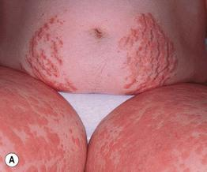
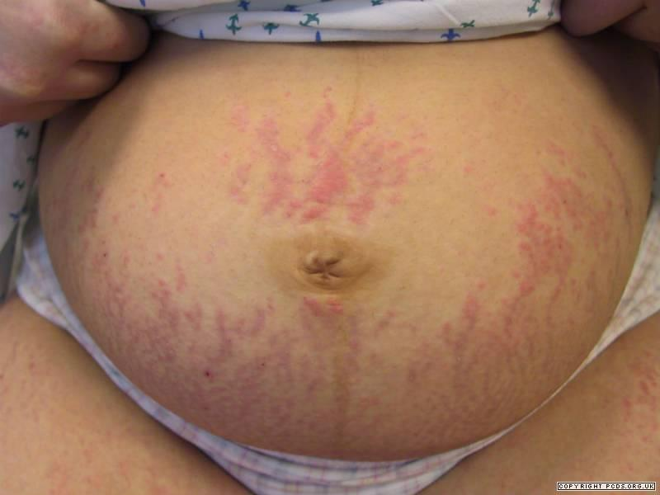

Slide 25
PG versus PUPPP
 | Pemphigoid gestationis | PUPPP
ONSET | 2nd or 3rd trimester | 3rd trimester
BLISTERS | common | rare
BIOPSY/IF | diagnostic | non-diagnostic
FETAL RISKS | SGA, preterm, blisters | none
RECURRENCE | yes | no

Slide 26
Case Three
Wala

Slide 27
Case Three: History
Wala presents with intense, non-remitting pruritus without skin lesions.
She is G3P2. Both previous pregnancies were uncomplicated. She is in her 30th week of gestation.
She says the itch is worse after a hot shower.
She is healthy, except for a history of eczema as a child and well-controlled hypothyroidism.

Slide 28
Intrahepatic Cholestasis of Pregnancy
Accounts for 20% of obstetric jaundice
Presents with
Generalized pruritus +/- jaundice
Absence of primary lesions
Biochemical abnormalities consistent with cholestasis
No history of exposure to hepatitis or hepatotoxic drugs

Slide 29
Intrahepatic Cholestasis of Pregnancy
Pathophysiology
Thought to be due to increased levels of estrogen
Estrogen Effects
1- Promotes cholestasis
2- Inhibits reuptake of bile acids into hepatocytes
3- Inhibits bile transport proteins

Slide 30
Evaluation elevation of
Raised bilirubin
Raised transaminases
Raised
alkaline phosphatase
the hallmark of ICP is elevation of serum bile acids.

Slide 31
ICP: Complications
For the mother, risks associated with ICP include
1- Bleeding
2- Intestinal malabsorption
3- Cholelithiasis
2. For the fetus risks include
Prematurity
Fetal distress
Death.

Slide 32
ICP: Treatment
Although ICP resolves after delivery, treatment is indicated.
The goal of treatment is to decrease circulating bile acids.
Vitamin K supplementation plays a role in management if bleeding parameters become abnormal.

Slide 33
ICP: Therapeutic Options
The goal of treatment is to reduce symptoms and to prevent maternal and fetal complications.
early induction of labor, commonly at 37 to 38 weeks.
When cholestasis is severe, delivery is considered earlier if fetal lung maturity is established.
Ursodeoxycholic acid
Considered 1st-line treatment

Slide 34
Case Four
Sayda

Slide 35
Case Four: History
Sayda is a 25-year-old woman who comes in for an itchy eruption that began two weeks ago.
She is 20 weeks pregnant with her second child. Her previous pregnancy was unremarkable.
She is healthy and has no history of atopy.

Slide 36
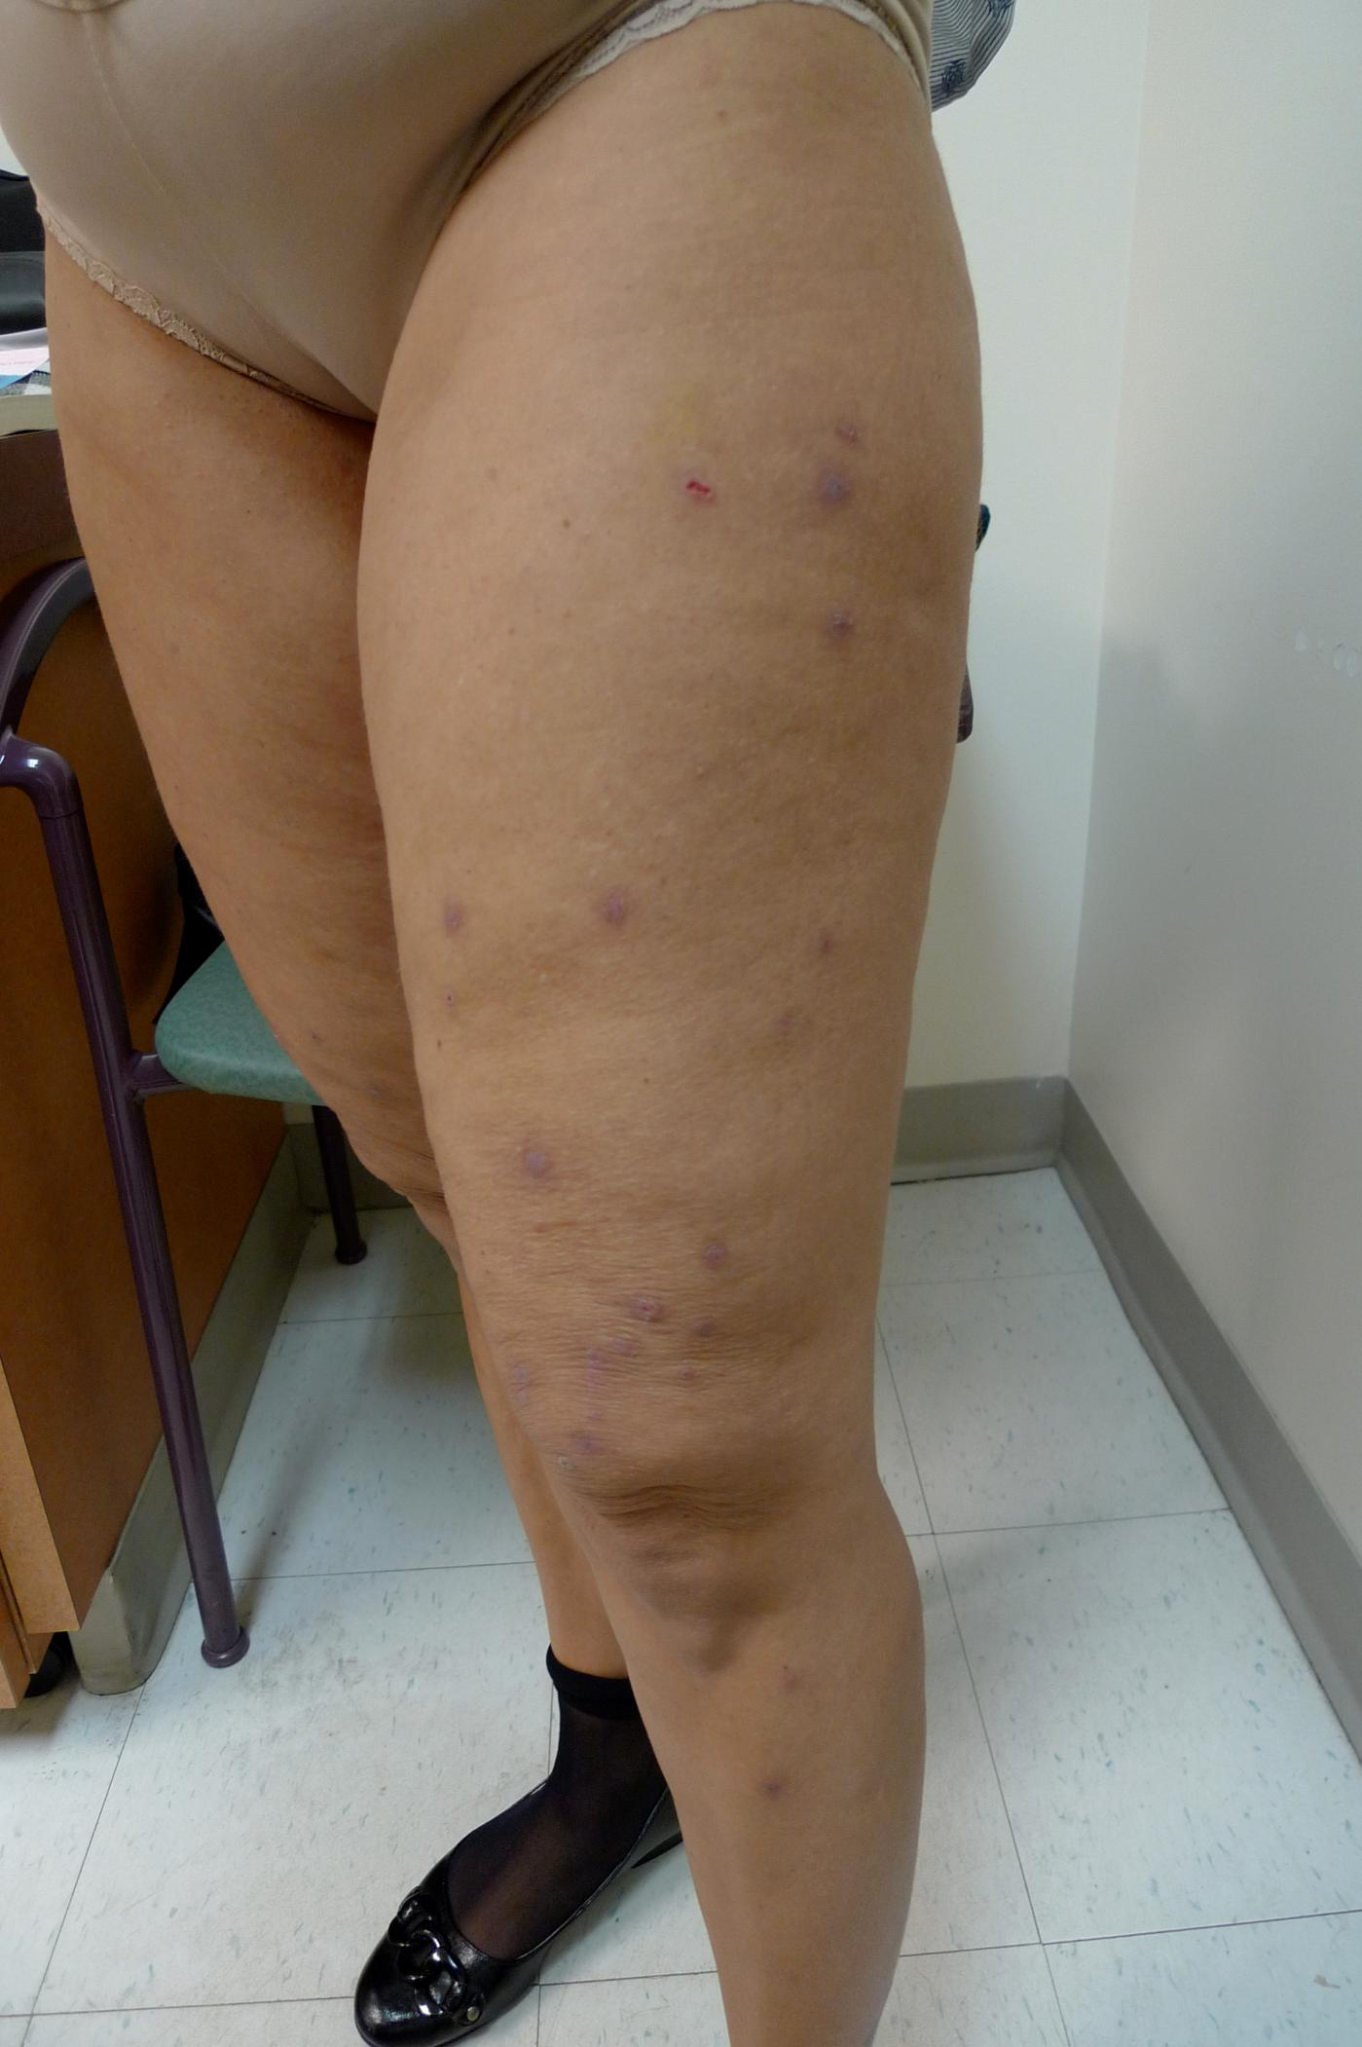
Case Four: Skin Exam

Slide 37
Case Four, Question 1
The best way to describe her lesions is:
deep-seated nodules over the legs
lichenified papules over the legs, some of which are excoriated
multiple ill-defined scaly plaques
well-demarcated, scaly macules scattered over the extremities

Slide 38
Case Four, Question 1
Answer: b
The best way to describe her lesions is:
deep-seated nodules over the legs
lichenified papules over the legs, some of which are excoriated
multiple ill-defined scaly plaques
well-demarcated, scaly macules scattered over the extremities

Slide 39
Atopic Eruption of Pregnancy
Atopic eruption of pregnancy is a term that encompasses other pruritic inflammatory dermatoses which appear or worsen during pregnancy:
Atopic dermatitis in pregnancy
Prurigo of pregnancy (Besnier)
-Prurigo = intensely itchy papules
Pruritic folliculitis of pregnancy
Pruritic folliculitis = itchy inflammation around the hair follicle

Slide 40
Diagnosis: Atopic Eruption of Pregnancy
This is an example of an atopic eruption of pregnancy (prurigo type).
Atopic eruption of pregnancy (AEP):
Eczematous in 2/3 and prurigo type in 1/3
Starts earlier in pregnancy (mean=18 weeks)
80% of patients have a previous history of atopic dermatitis while 20% do not

Slide 41
Atopic Eruption of Pregnancy
AEP is a clinical diagnosis.
Histopathology is non-specific.
Immunofluorescence is negative.

Slide 42
Case Four, Question 2
Sayda is worried that her baby will be affected by her disease. What do you tell her?
She will need to be monitored as a high-risk pregnancy.
There have been reports of fetal distress in patients with AEP.
There is a risk of small-for-gestational age births in AEP.
There is no need to worry. Fetal distress is not increased in patients with AEP.

Slide 43
Case Four, Question 2
Answer: d
Sayda is worried that her baby will be affected by her disease. What do you tell her?
She will need to be monitored as a high-risk pregnancy.
There have been reports of fetal distress in patients with AEP.
There is a risk of small-for-gestational age births in AEP.
There is no need to worry. Fetal distress is not increased in patients with AEP.

Slide 44
AEP: Treatment
AEP is a benign disease and does not carry increased maternal or fetal risks.
Treatment is largely dependent on controlling the eruption with topical steroids.
Oral steroids can be used in recalcitrant cases.
If the eruption does not respond to topical steroids, referral to dermatology is recommended.
The eruption may persist after pregnancy as a chronic dermatitis.

Slide 45
Going back to our cases: Review Question 1
Which disease is caused by specific antibodies?
Atopic eruption of pregnancy
Intrahepatic cholestasis of pregnancy
Pemphigoid gestationis
Pruritic urticarial papules and plaques of pregnancy

Slide 46
Review Question 1
Answer: c
Which disease is caused by specific antibodies?
Atopic eruption of pregnancy
Intrahepatic cholestasis of pregnancy
Pemphigoid gestationis
Pruritic urticarial papules and plaques of pregnancy

Slide 47
Review Question 2
Which of the following is true?
Atopic eruption of pregnancy only occurs in patients with a history of atopic dermatitis.
Intrahepatic cholestasis of pregnancy can have serious complications for both mother and child.
PUPPP and pemphigoid gestationis have identical findings on immunofluorescence.
There is a high risk of blisters in the neonate in pemphigoid gestationis.

Slide 48
Review Question 2
Answer: b
Which of the following is true?
Atopic eruption of pregnancy only occurs in patients with a history of atopic dermatitis.
Intrahepatic cholestasis of pregnancy can have serious complications for both mother and child.
PUPPP and pemphigoid gestationis have identical findings on immunofluorescence.
There is a high risk of blisters in the neonate in pemphigoid gestationis.

