Slide 1
PSORIASIS
Dr Sami Aldaham

Slide 2
What is Psoriasis?
Psoriasis is chronic inflammatory non contagious T-cell mediated disease.
Psoriasis may be associated with certain health related conditions as:
Cardiovascular diseases
Obesity
Smoking
Infections

Slide 3
Clinical features
Psoriasis is the most common chronic papulosquamous disease
The classic lesion of psoriasis is a well-demarcated erythematous plaque with a silvery scale
Removal of the scale commonly results in bleeding whish is Auspitz sign.

Slide 4
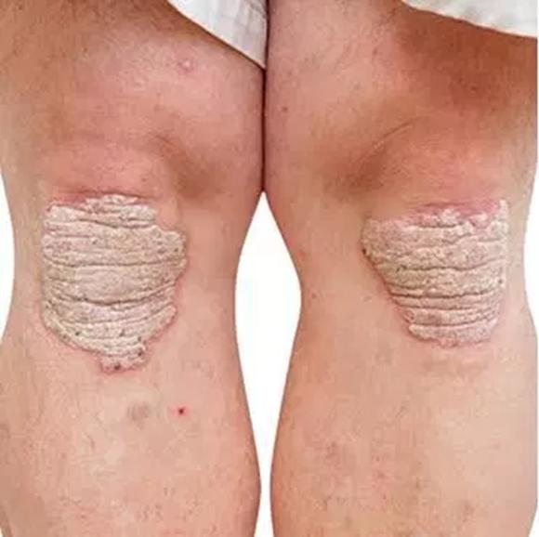
The classical presentation

Slide 5
Epidemiology
Psoriasis affects roughly 2% of the population
Equal sex distribution.
Can occur at any age, but usually the onset is bimodal, between 20-30 and 50-60 years of age.
Familial cases are not uncommon

Slide 6
Etiology/Pathogenesis
Genetic factors
Environmental trigger factors
Trauma – Koebner phenomenon
Stress
Streptococcal infection
Drugs – e.g. lithium, beta blockers, possibly antimalarial agents
Withdrawal of corticosteroid therapy as Pustular psoriasis

Slide 7
Clinical Variants
Psoriasis vulgaris
Psoriatic arthritis
Guttate psoriasis
Pustular psoriasis
Inverse psoriasis
Erythrodermic psoriasis

Slide 8
Psoriatic arthritis
Affects between 7 to 21% of patients with psoriasis
May occur prior to, concurrent with or subsequent to psoriasis
More common in patients with moderate to severe cutaneous disease and those with nail involvement

Slide 9
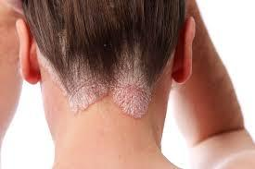
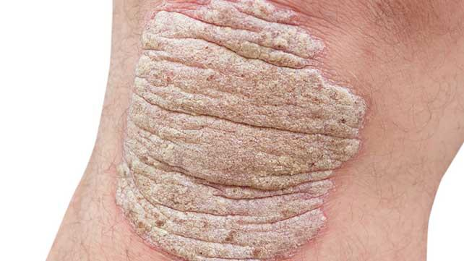
Psoriasis Vulgaris

Slide 10
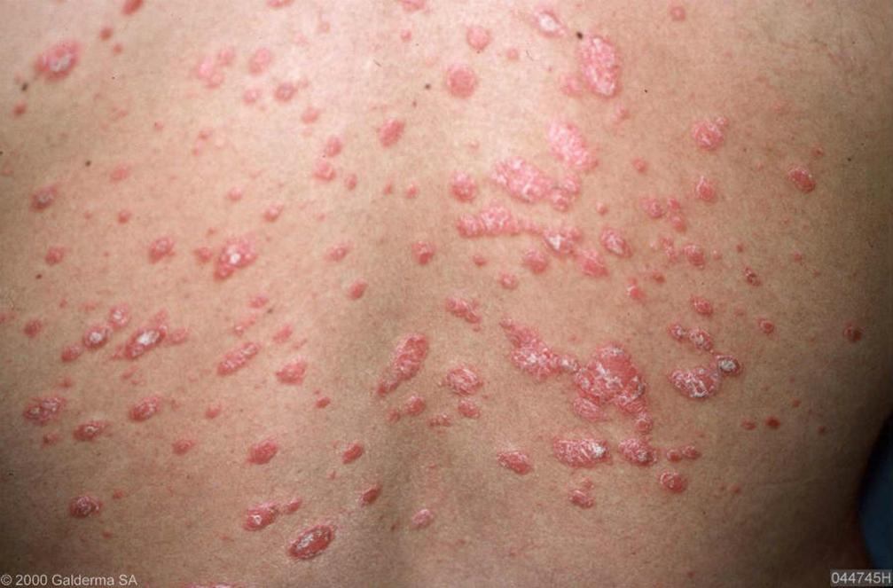
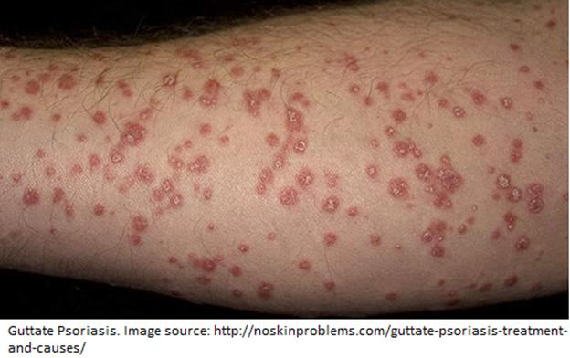
Guttate Psoriasis

Slide 11
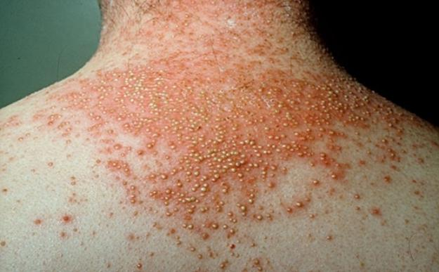
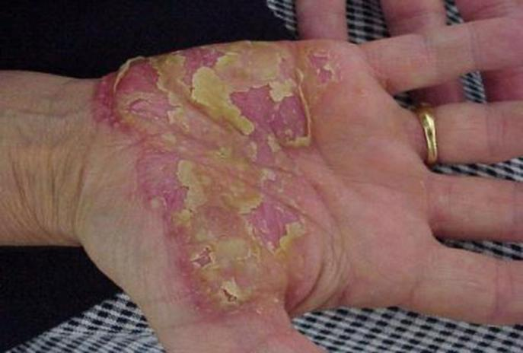
Pustular Psoriasis
Generalized Pustular Psoriasis
Localized Pustular Psoriasis

Slide 12
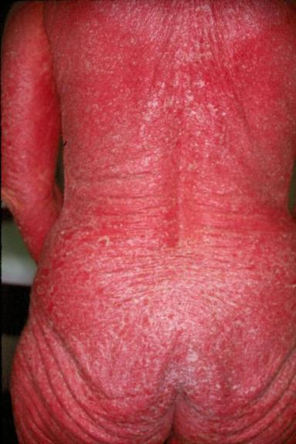
Erythrodermic Psoriasis

Slide 13
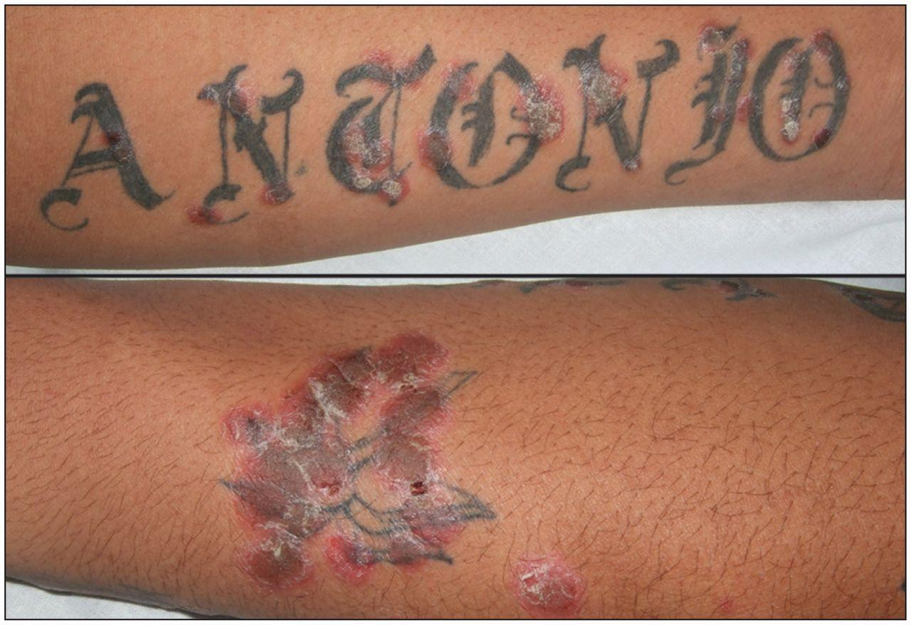
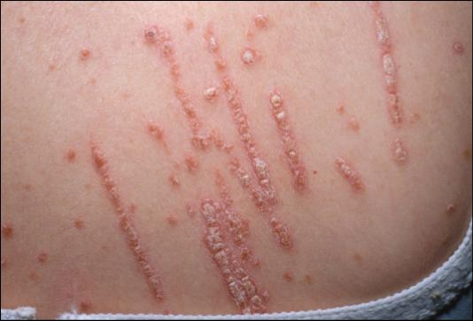
Koebner Phenomenon

Slide 14
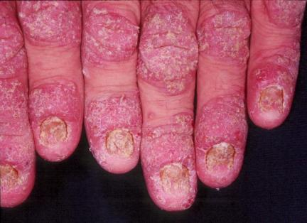
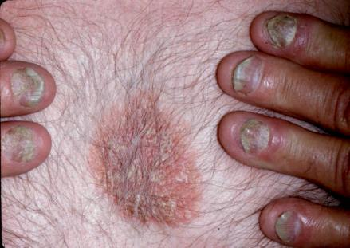
Nail Disease in Psoriasis

Slide 15
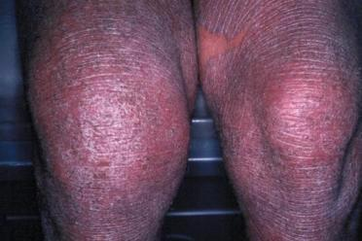
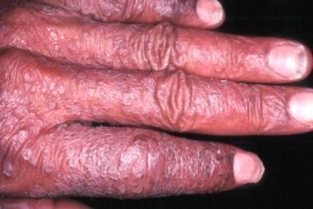
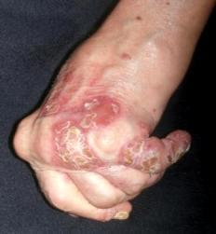
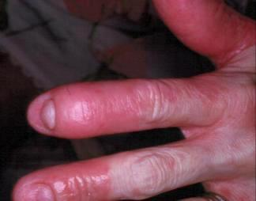
Psoriatic Arthritis

Slide 16
Diagnosis of Psoriasis
Usually is clinically diagnosis
Histopathology to confirm diagnosis and exclude other papulosquamous diseases and chronic eczemas

Slide 17
Differential Diagnosis
Chronic Dermatitis
Seborrheic Dermatitis
Pityriasis rosea
Lupus erythematosus
Dermatophyte infection
Cutaneous T-cell lymphoma (mycosis fungoides)
Lichen planus

Slide 18
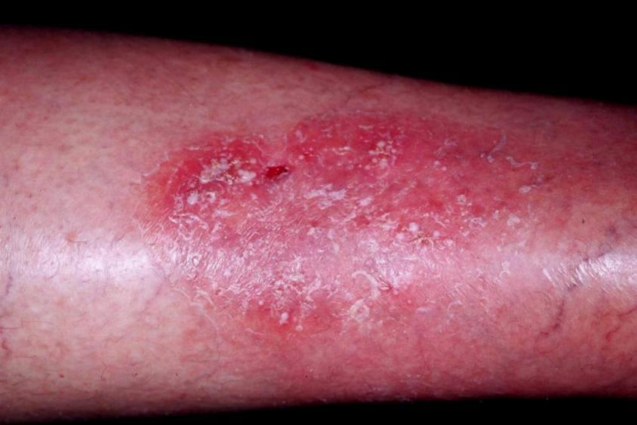
Chronic Dermatitis

Slide 19
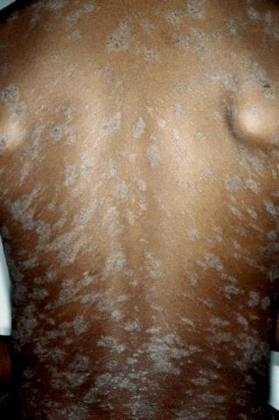
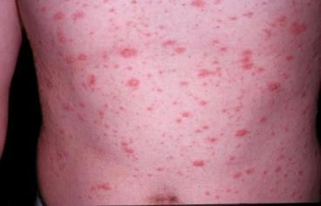
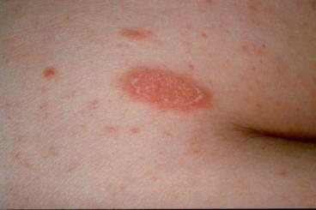
Pityriasis Rosea

Slide 20
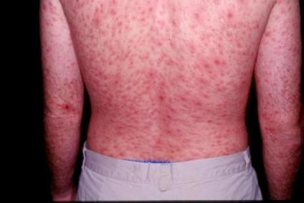
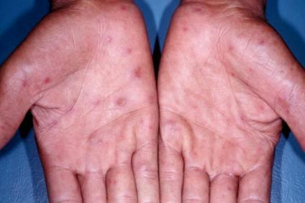
Secondary Syphilis

Slide 21
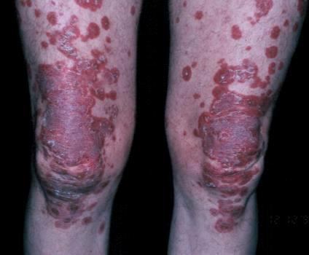
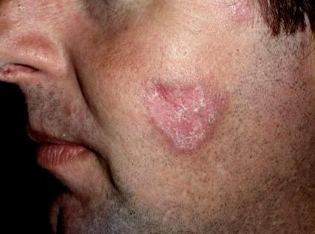
Cutaneous Lupus Erythematosus

Slide 22
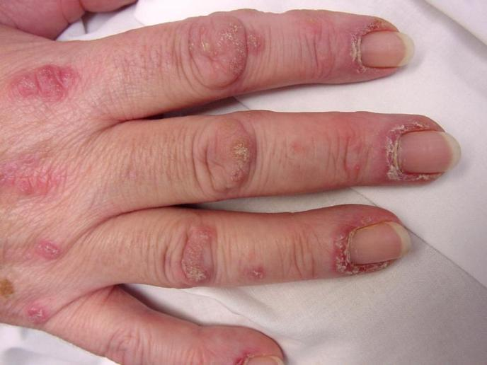
Dermatomyositis

Slide 23
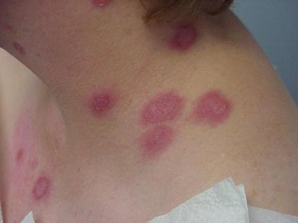
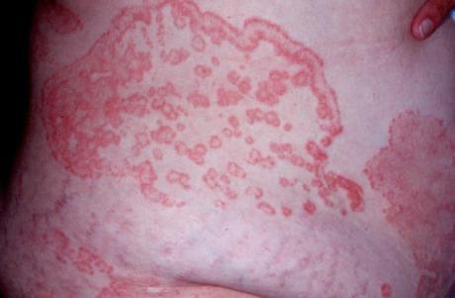
Dermatophyte Infection

Slide 24
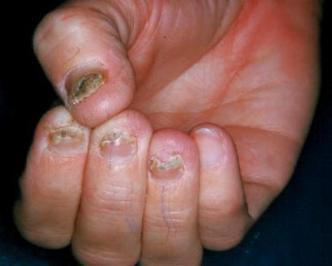
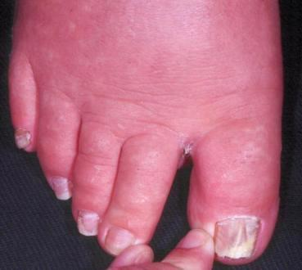
Onychomycosis

Slide 25
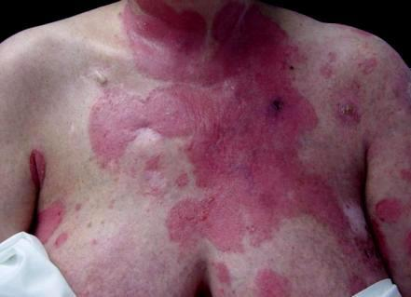
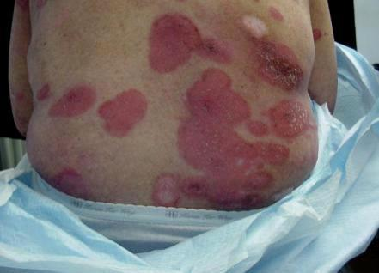
Cutaneous T-cell Lymphoma

Slide 26
Management of Psoriasis
Patient education: Patient should be know:
The disease could be not curable
Not contagious
Psoriasis is a common disorder
The exacerbating factors

Slide 27
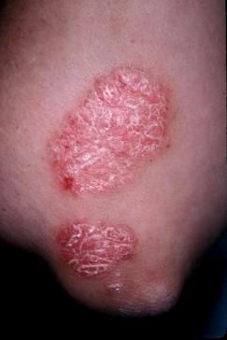
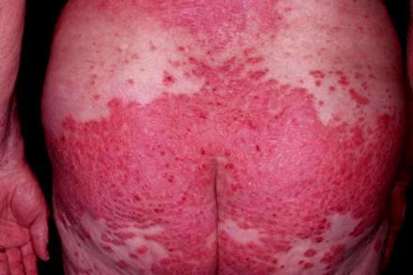
Before starting treatment psoriasis should be categorized into
Localized disease
Topical treatments
Generalized disease
Phototherapy
Systemic therapy

Slide 29
Treatment of localized Psoriasis -Topicals
Tar
Corticosteroids
Calcipotriene (vitamin D analogues)
Tacrolimus and pimecrolimus
Tazarotene
Intense light or laser therapy( excimer laser 308 nm)

Slide 31
Systemic treatment
PUVA and Narrow band UVB
Methotrexate
Acitretin
Cyclosporine
Biologics

Slide 32
Control the aggravating factors
Obesity
Smoking
Drugs

