Slide 1
Red scaly rash: the papulosquamous eruption
Dr Sami Fatehi
MBBS,MSc,MD, PhD

Slide 2
Case One

Slide 3
Case One: History
HPI: Sali is a 31-year-old woman who presents with red circles on her arms and trunk for the past 7 months. They don’t itch.
PMH: none
Allergies: erythromycin (rash)
Medications: none
Family history: noncontributory
Social history: stay-at-home mom
ROS: negative

Slide 4
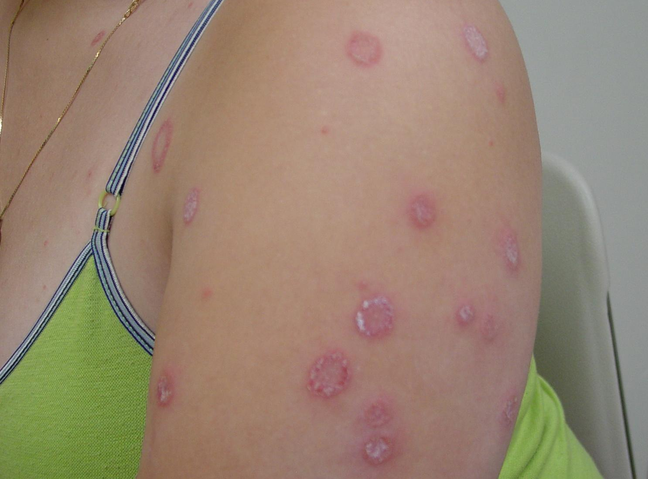
Case One: Skin Exam

Slide 5
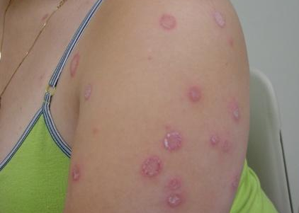
Case One, Question 1
Mrs. Sali’s exam shows annular erythematous patches with scale on the advancing edges and central clearing. Which is the best test to confirm the diagnosis?
Bacterial culture
Direct fluorescent antibody (DFA) test
Fungal culture
Potassium hydroxide (KOH) exam
Wood’s light

Slide 6
Case One, Question 1
Answer: d
Mrs. Sali’s exam shows annular erythematous patches with scale on the advancing edges and central clearing. Which is the best test to confirm the diagnosis?
Bacterial culture (would only get normal skin flora)
Direct fluorescent antibody (DFA) test (for herpes virus)
Fungal culture (more expensive, takes longer)
Potassium hydroxide (KOH) exam (can make the diagnosis in the office; inexpensive test)
Wood’s light (this does not fluoresce)

Slide 7
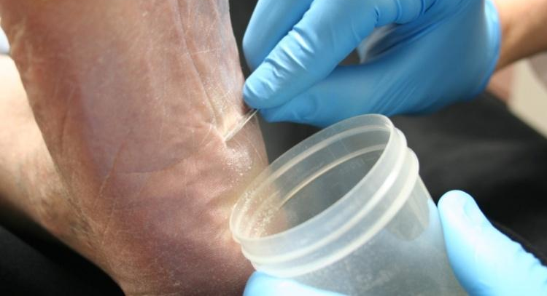
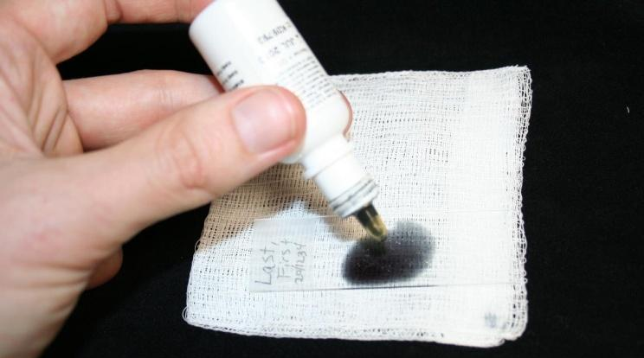
KOH exam
Excellent choice.
You decide to do a KOH exam in the office.
Scrape the leading edge for fine scale

Slide 8
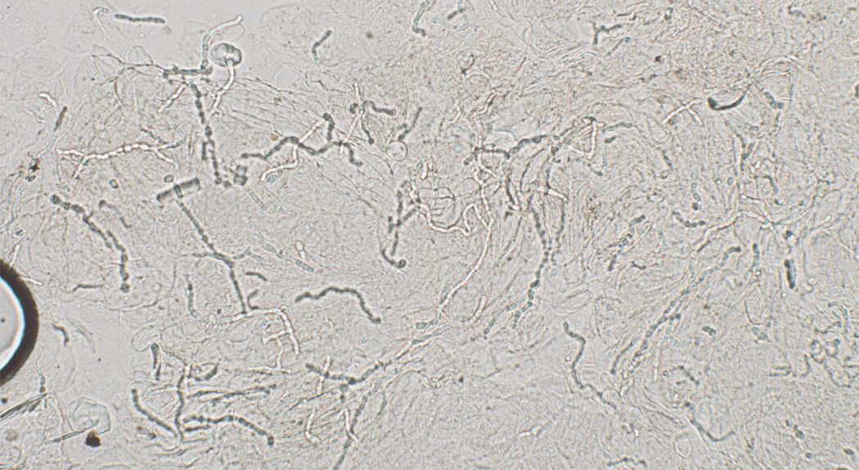
Case One, KOH exam
Translucent branching, septate hyphae

Slide 9
Potassium hydroxide exam
The first step in diagnosing a scaling annular rash on the body is to perform a KOH exam to rule out fungus
“All that scales must be scraped” is a common mantra in dermatology
Rule out dermatophyte infections before moving forward on scaling rashes

Slide 10
Case One, Question 2
Mrs. Sali’s KOH exam is positive. Which of the following questions are important to ask?
Do you have a rash in your groin?
Do you have a rash on your feet?
Do you have any pets?
Do you take care of young children?
All of the above

Slide 11
Case One, Question 2
Answer: e
Mrs. Sali’s KOH exam is positive. Which of the following questions are important to ask?
Do you have a rash in your groin? (associated tinea cruris)
Do you have a rash on your feet? (associated tinea pedis)
Do you have any pets? (cats can transmit a type of ringworm)
Do you take care of young children? (kids may have fungal infections on the scalp)
All of the above

Slide 12
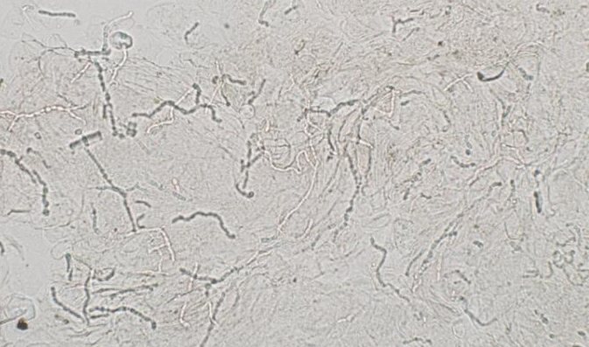
Tinea corporis
Tinea corporis (“ringworm”) classically presents as annular patches with peripheral scaling at the advancing edge and central clearing
Complete skin exam often reveals tinea cruris (“jock itch”) and tinea pedis (“athlete’s foot”). Check these areas on full skin exam.
Tinea corporis is usually caused by Trichophyton and Microsporum species.
These dermatophytes appear as translucent branching, septate hyphae. They do not have yeast forms.

Slide 13
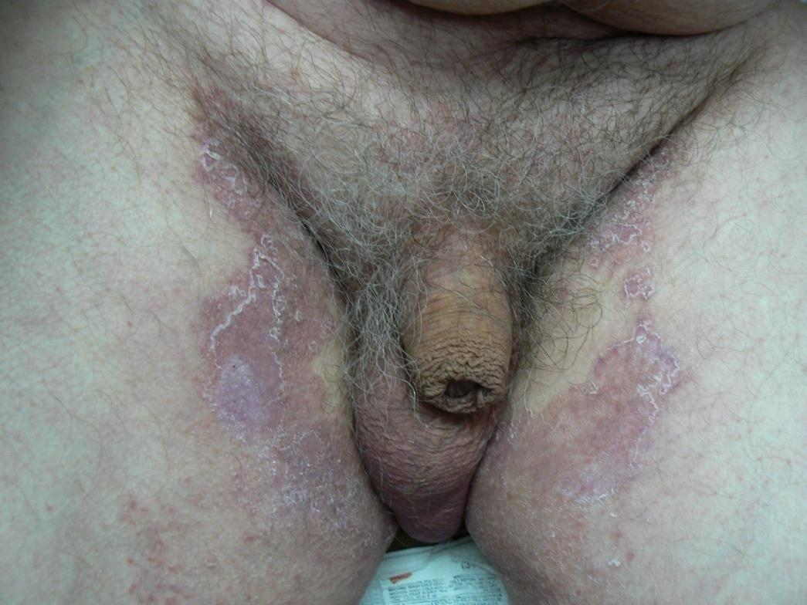
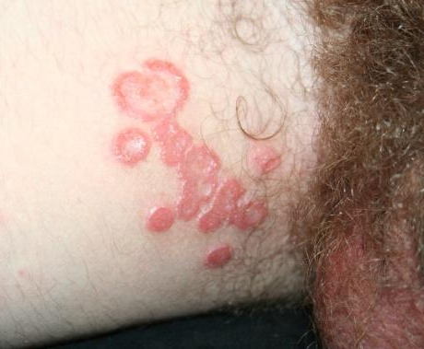
Tinea cruris

Slide 14
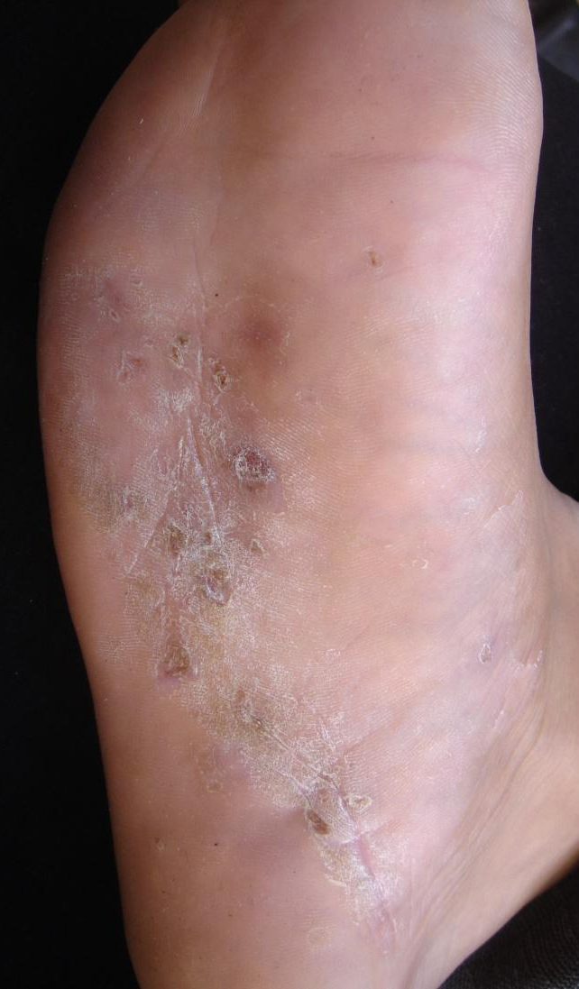
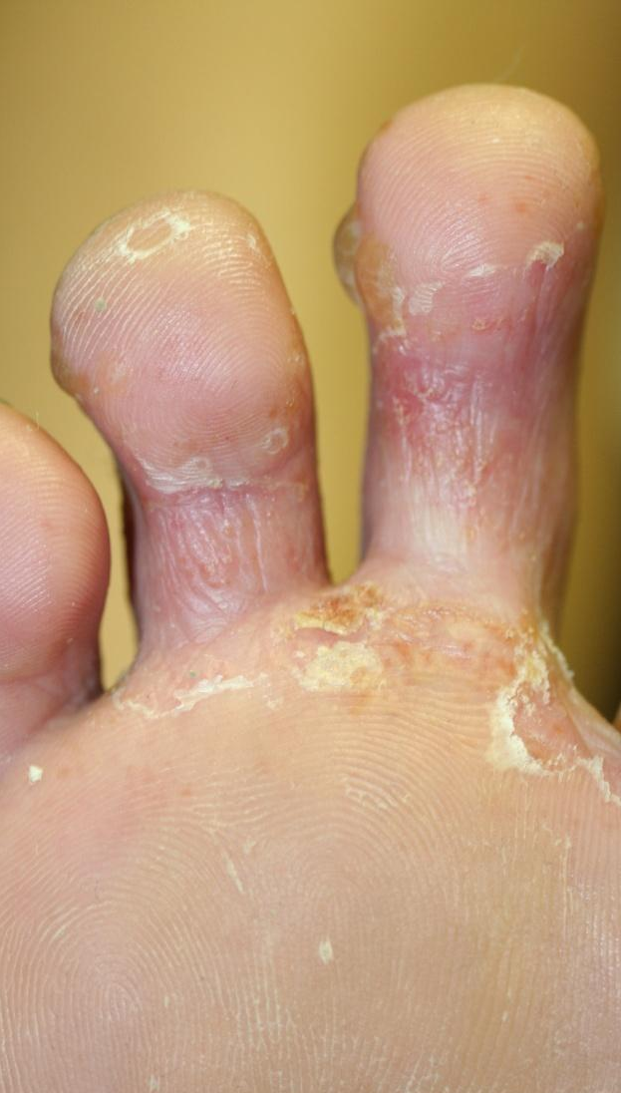
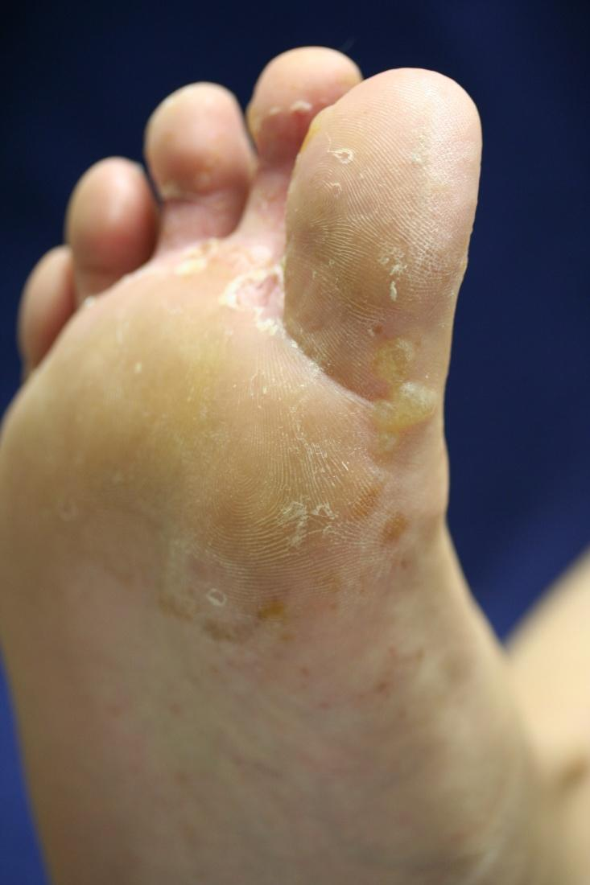
Tinea pedis

Slide 15
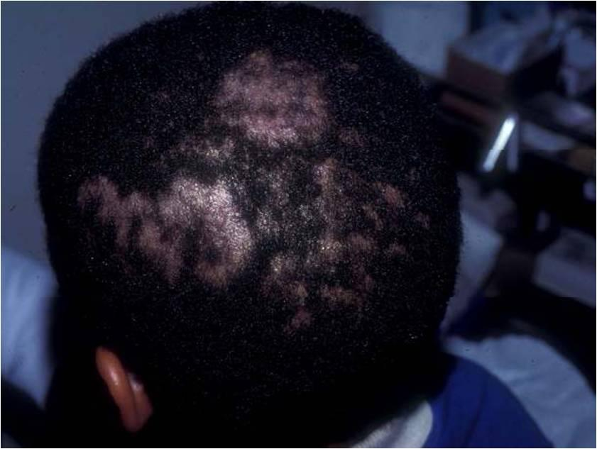
Tinea capitis

Slide 16
Case One, Question 3
Mrs. Sali has athlete’s foot and extensive tinea corporis on her abdomen, chest, back, and arms. What is the best therapy for her?
Nystatin cream
Oral terbinafine
Terbinafine cream
Triamcinolone cream
Ultraviolet B (UVB) phototherapy

Slide 17
Case One, Question 3
Answer: b
Mrs. Sali has athlete’s foot and extensive tinea corporis on her abdomen, chest, back, and arms. What is the best therapy for her?
Nystatin cream (only works for Candida species)
Oral terbinafine (necessary for extensive tinea corporis)
Terbinafine cream (not good for extensive involvement)
Triamcinolone cream (could worsen infection or create tinea incognito)
Ultraviolet B (UVB) phototherapy (will not kill fungus)

Slide 18
Tinea corporis treatment
Counsel on foot care to prevent recurrence
Localized involvement
Azoles (miconazole, clotrimazole) are fungistatic and must be used BID
Allylamines (terbinafine, naftifine) and benzylamines (butenafine) are fungicidal
Better cure rates and lower recurrence than azoles
Extensive involvement may require oral antifungals (14-28 days of terbinafine)

Slide 19
Case Two

Slide 20
Case Two: History
HPI: Ali is a 17-year-old student . He presents for a routine college physical but mentions a scaly patch on his abdomen for the past few days. It itches a little bit.
PMH: tonsillectomy as a child
Allergies: penicillin (rash)
Medications: none
Family history: noncontributory
Social history: college student; plays lacrosse; sexually active; moderate alcohol intake
ROS: recent cold symptoms after moving into dorms

Slide 21
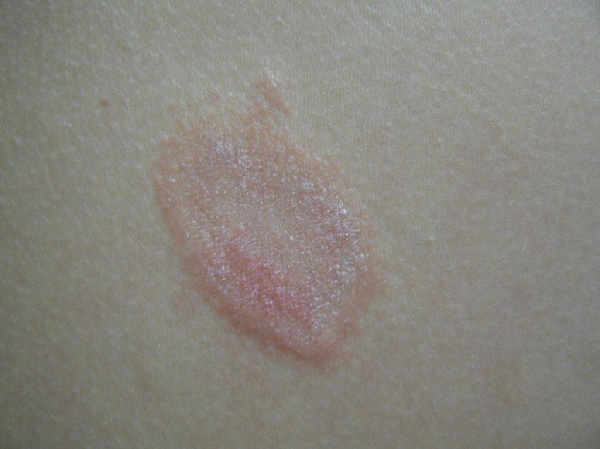
Skin Exam

Slide 22
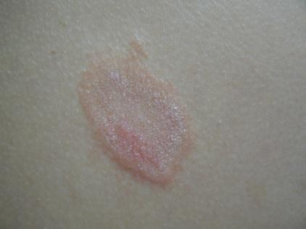
Question 1
Ali’s exam shows a single erythematous oval plaque with scaling. What is the first test should you get during his office visit?
Bacterial culture
Gonorrhea culture
Potassium hydroxide (KOH) exam
Rapid plasma reagin
Shave biopsy

Slide 23
Case Two, Question 1
Answer: c
Ali ’s exam shows a single erythematous oval plaque with scaling. What is the first test should you get during his office visit?
Bacterial culture
Gonorrhea culture
Potassium hydroxide (KOH) exam
Rapid plasma reagin
Shave biopsy

Slide 24
Potassium hydroxide exam
Great job! You remembered that “All that scales must be scraped”
Rule out dermatophyte infections before moving forward on scaling rashes
In this case, the KOH exam is negative
This does not bother him much, so you give him a mid-potency topical steroid cream to use BID as needed for itching

Slide 25
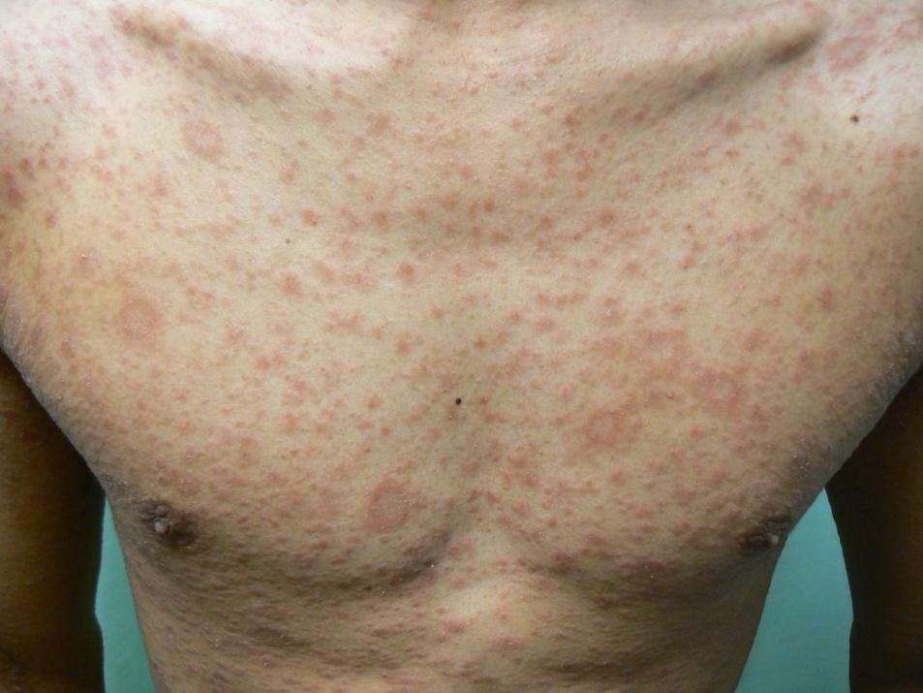
Case Two, continued
Ali returns in 3 days for a rash on his chest, abdomen, and back
It only itches a little bit
Exam shows oval salmon-colored patches with minor scale; the oval patches follow skin tension lines on the back
Palms and soles are normal
Repeat KOH exam is negative

Slide 26

Case Two, Question 2
Ali’s exam shows oval, salmon-colored scaling plaques on his trunk. What is the most likely diagnosis?
Guttate psoriasis
Nummular dermatitis
Pityriasis rosea
Secondary syphilis
Tinea corporis (tinea incognito)

Slide 27
Case Two, Question 2
Answer: c
Ali ’s exam shows oval, salmon-colored scaling plaques on his trunk. What is the most likely diagnosis?
Guttate psoriasis (doesn’t follow skin tension lines)
Nummular dermatitis (doesn’t follow skin tension lines)
Pityriasis rosea
Secondary syphilis (possible but not as common and does not have a herald patch)
Tinea corporis (tinea incognito) (KOH negative)

Slide 28
Pityriasis rosea
Pityriasis rosea (PR) is an acute exanthematous eruption that mainly occurs in young people
Most patients are between the ages of 10 and 35
The peak incidence is in late teens and early 20s
Some studies suggest a possible viral etiology, but this has not been definitively proven
Usually asymptomatic, but patients may have associated flu-like symptoms
Malaise, nausea, loss of appetite, gastrointestinal upset, upper respiratory symptoms
Less commonly fever, swollen lymph nodes, pain, or sore throat are noted

Slide 29
Pityriasis rosea
Classically starts with a “herald patch”
Annular erythematous 2-10 cm patch anywhere on the body, with peripheral scaling and central clearing
Patients often don’t remember or never had a herald patch
The secondary phase erupts in a “Christmas tree” pattern
Similar oval patches and plaques erupt symmetrically over trunk and proximal extremities
They follow relaxed skin tension lines, thus giving the appearance of a “Christmas tree” on the back

Slide 30
Now let’s look at a few examples of pityriasis rosea

Slide 31
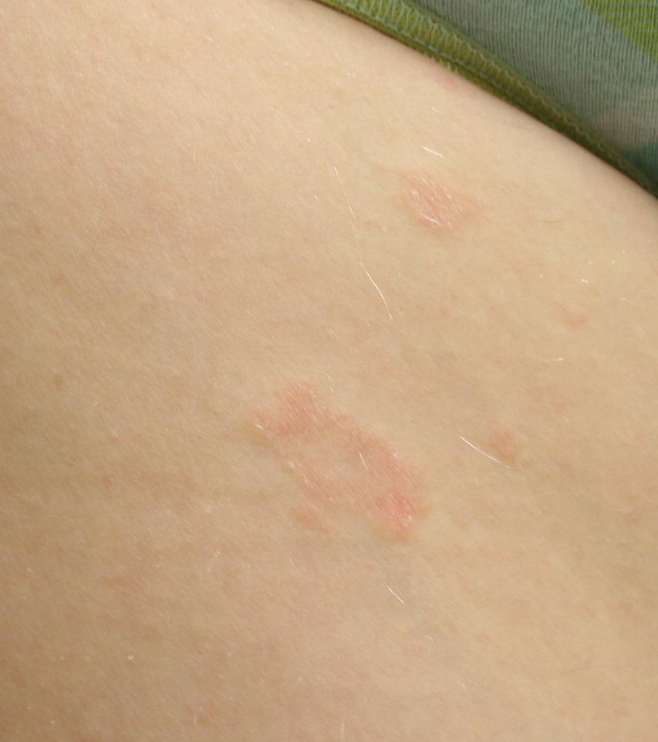
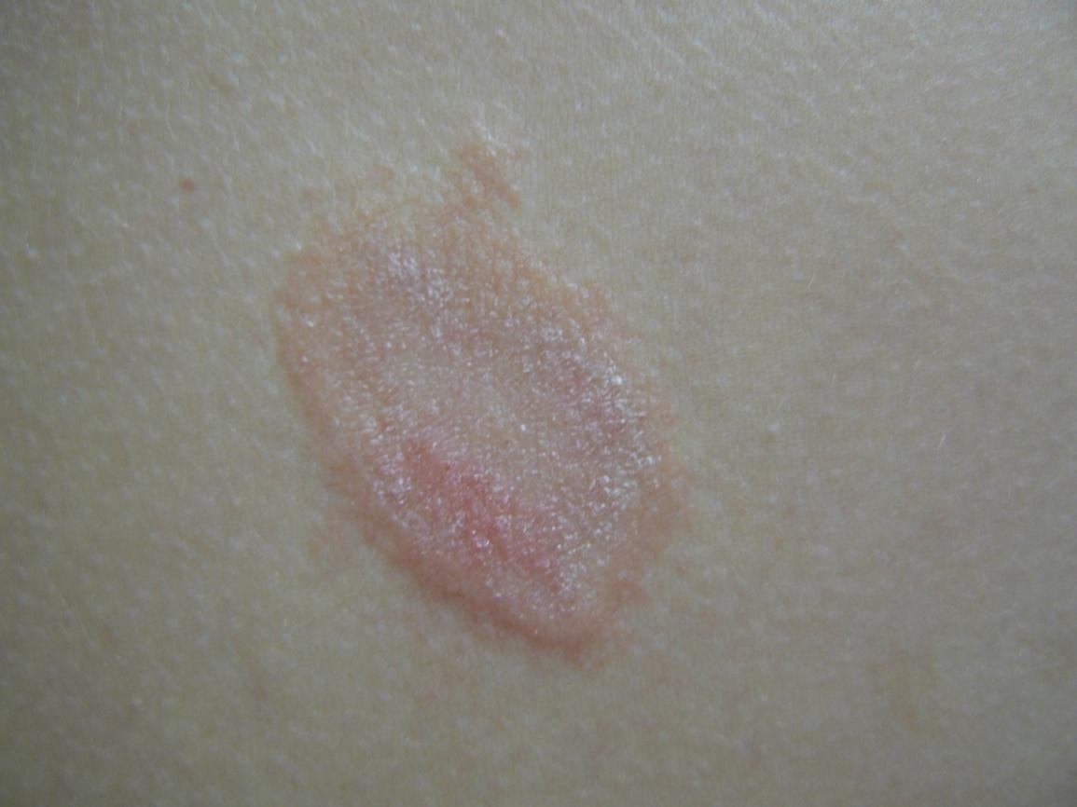
The elusive “herald patch”

Slide 32
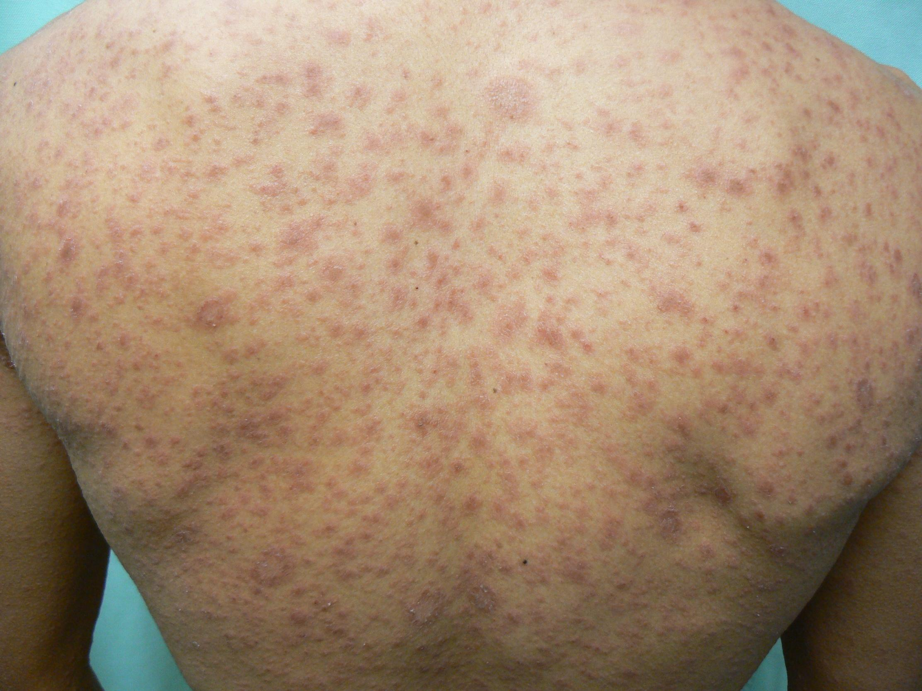

Slide 34
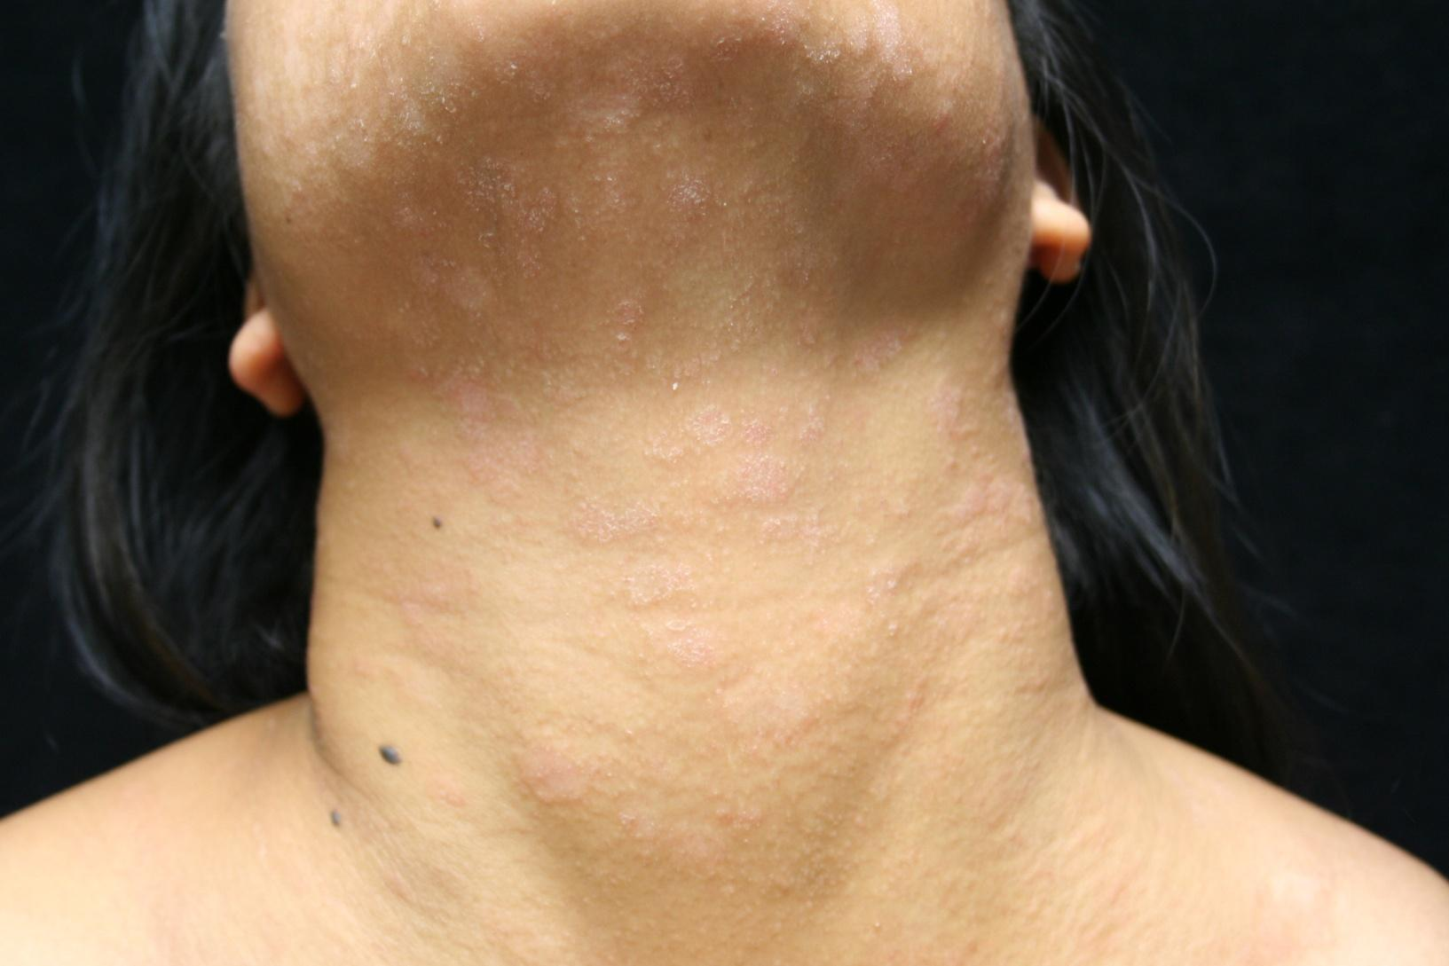

Slide 35
Pityriasis rosea treatment
Pityriasis rosea is self-limiting
The mean duration is about 5 weeks
More than 80% resolve by 8 weeks without treatment
Most patients only need to be reassured
About 25% request treatment for mild to severe pruritus
Soothing anti-itch lotions available over-the-counter, topical steroids, and oral antihistamines may help

Slide 36
Case Four

Slide 37
Case Four: History
HPI: Wleed is a 15-year-old who presents with one week of small pink scaly round spots on his chest, abdomen, back, upper arms, thighs, and forehead. They itch somewhat.
PMH: none
Allergies: none
Medications: none
Family history: sister had strep throat a month ago
Social history: lives with mother, father and three siblings (ages 3, 7, and 9)
ROS: mild sore throat for past two weeks

Slide 38
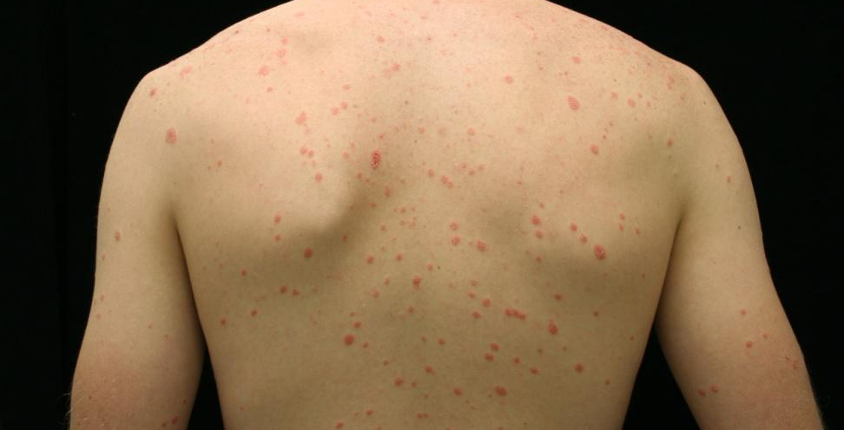
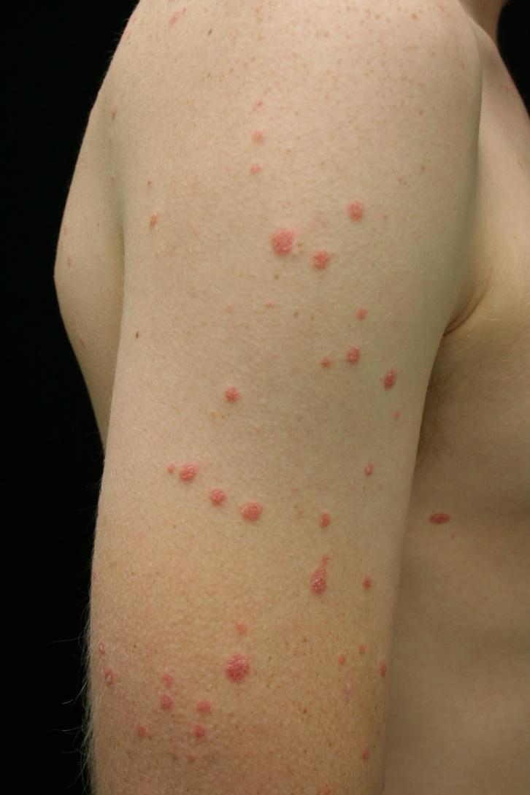
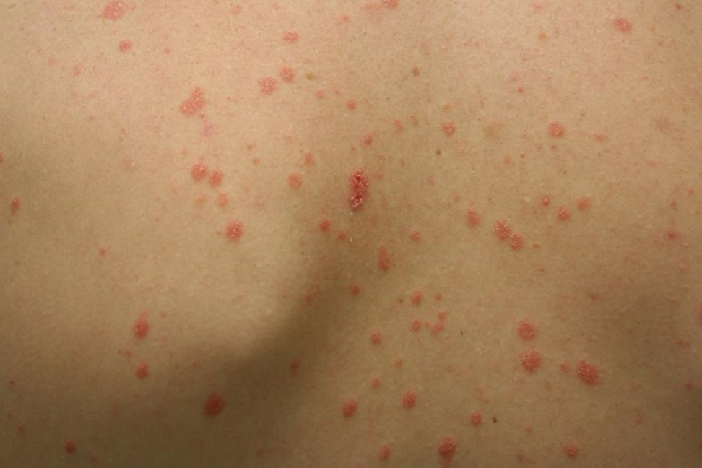
Case Four: Skin Exam

Slide 39

Case Four, Question 1
Waleed ’s exam shows many guttate (raindrop-like) scaly pink to bright red papules. They do not follow skin tension lines, and there is no oral, palm, or sole involvement. What is the first test you should perform?
Fungal culture
Potassium hydroxide (KOH) exam
Rapid plasma reagin
Shave biopsy

Slide 40
Case Four, Question 1
Answer: b
Waleed ’s exam shows many guttate (raindrop-like) scaly pink to bright red circinate papules. They do not follow skin tension lines, and there is no oral, palm, or sole involvement. What is the first test you should perform?
Fungal culture
Potassium hydroxide (KOH) exam
Rapid plasma reagin
Shave biopsy

Slide 41
Case Four, Question 2
You perform a KOH exam to rule out tinea corporis, and it is negative. What is the most likely diagnosis for Captain Koebner?
Guttate psoriasis
Nummular dermatitis
Pityriasis rosea
Secondary syphilis
Tinea corporis

Slide 42
Case Four, Question 2
Answer: a
You perform a KOH exam to rule out tinea corporis, and it is negative. What is the most likely diagnosis for Waleed?
Guttate psoriasis
Nummular dermatitis (not associated with strep throat)
Pityriasis rosea (follows skin tension lines)
Secondary syphilis (can present this way and it is never wrong to order a screening test; no strep throat)
Tinea corporis (should have positive KOH)

Slide 43
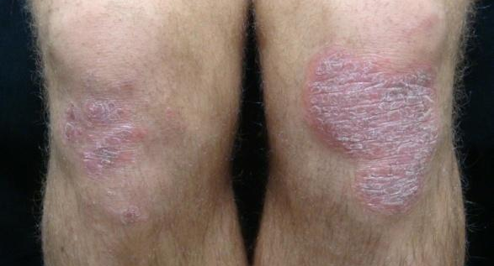
Psoriasis
Psoriasis is a common, chronic, inflammatory multi-system disease that mostly involves skin and joints
Classic plaque psoriasis presents as pink to bright red well-demarcated plaques with silvery scale
Usually located on extensor knees and elbows
Commonly involves scalp, umbilicus, gluteal cleft, and nails
Guttate psoriasis presents as small “drop-like” scaly papules and plaques mostly on the trunk and extremities
Often follows group A beta hemolytic streptococcal infections

Slide 44
Now let’s look at a few examples of different psoriasis presentations

Slide 45
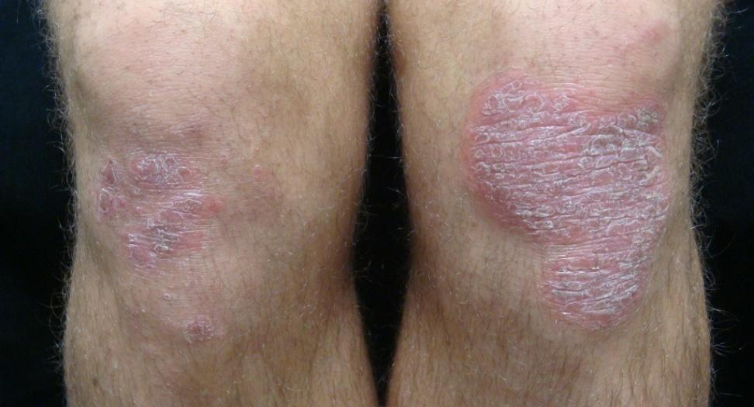
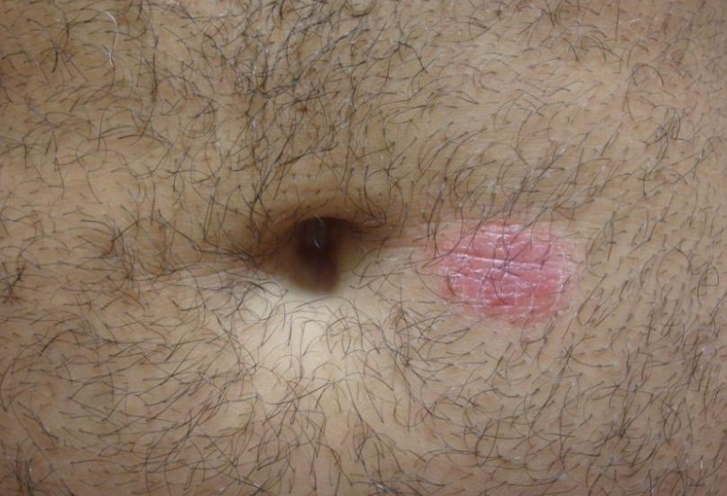
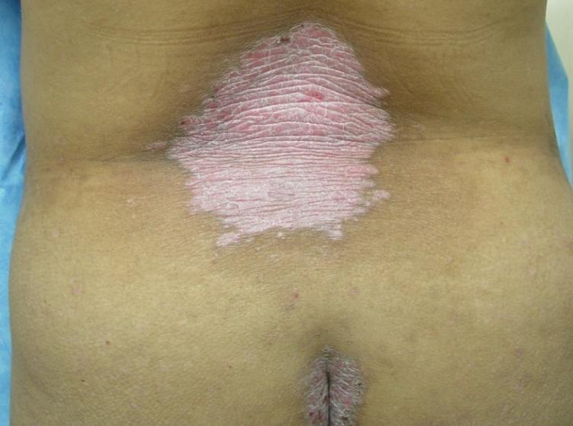
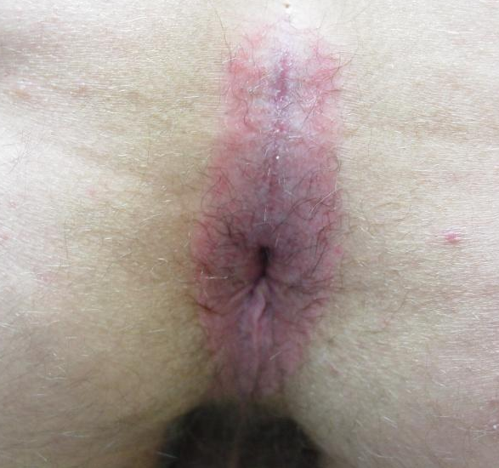
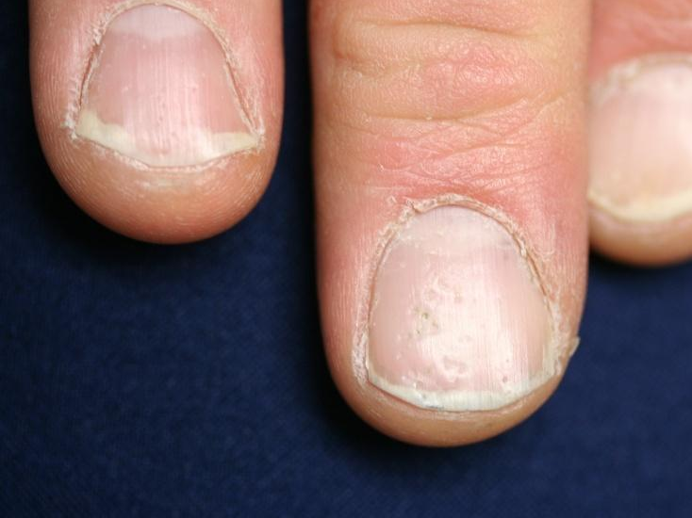
Classic psoriasis

Slide 46
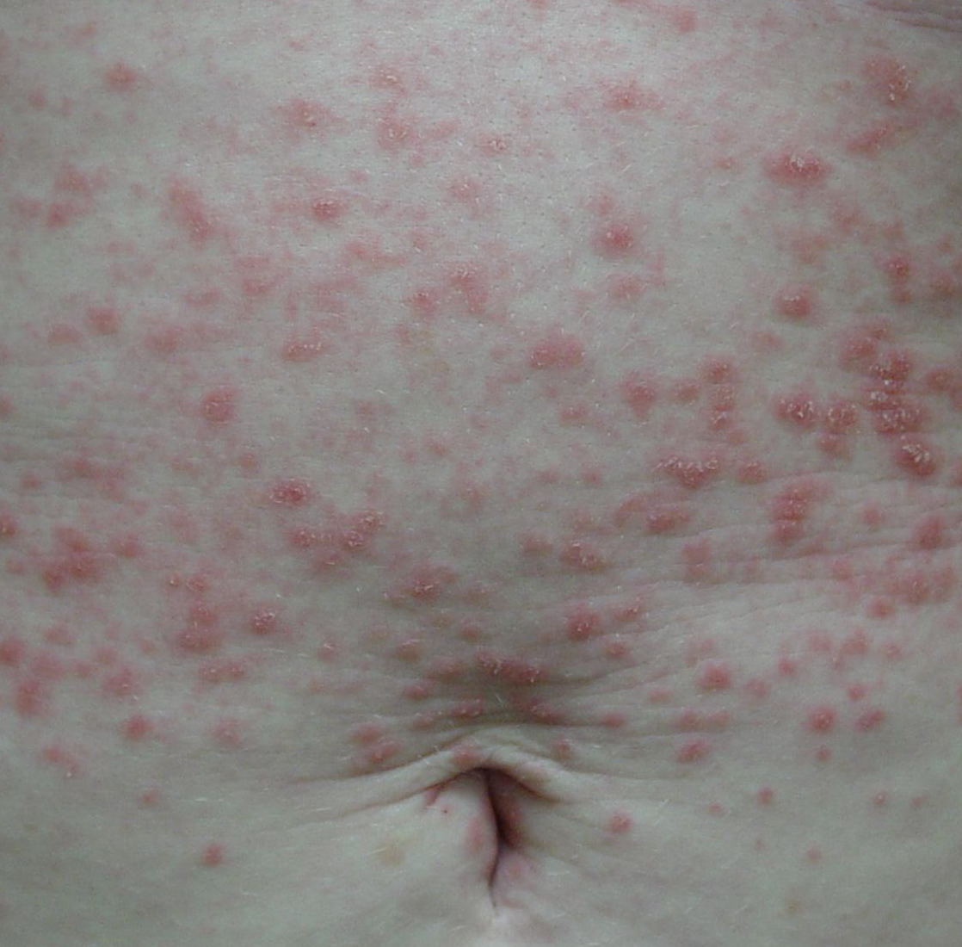
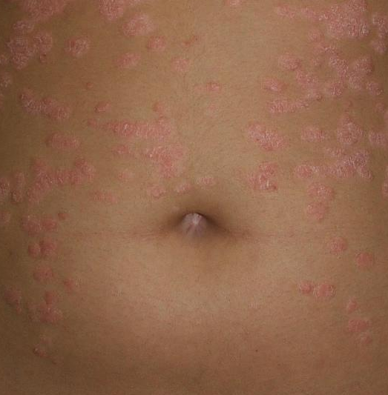
Guttate psoriasis

Slide 47
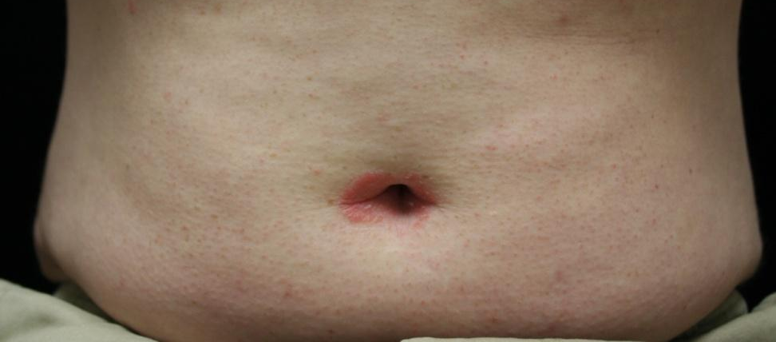
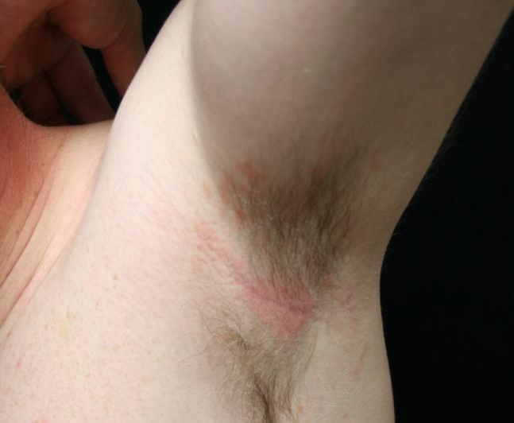
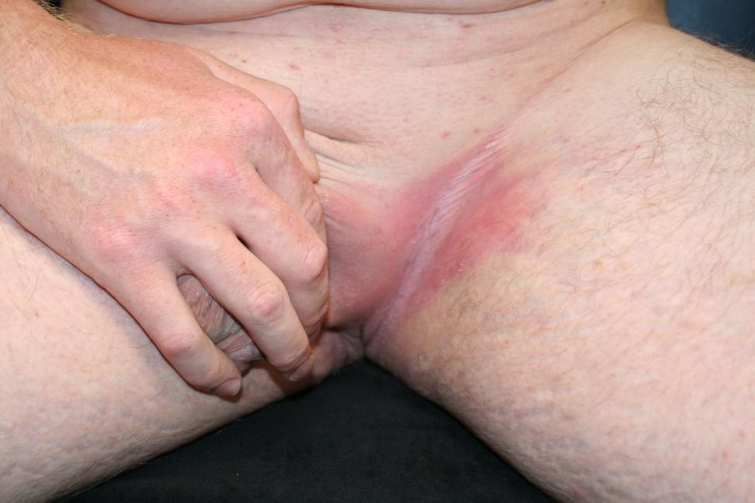
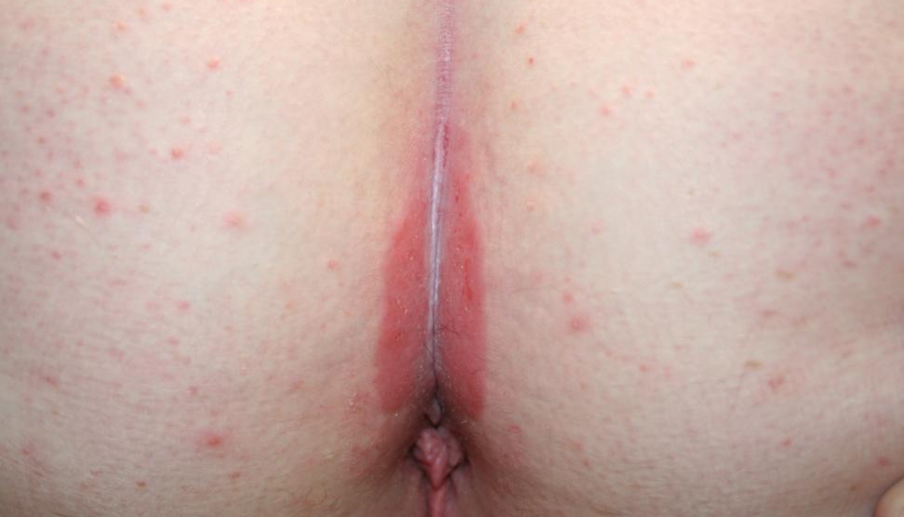
Inverse psoriasis (in the folds)

Slide 48
Psoriasis treatment
For limited psoriasis (less than 5% of BSA), topical therapies are first-line choices
Potent topical steroids should be used once or twice daily for thickened plaques on the body
For extensive psoriasis, systemic therapy is often necessary
Narrow-band ultraviolet B phototherapy is very helpful in guttate psoriasis

Slide 49
Case Five

Slide 50
Case Five: History
HPI: Kamil is a 35-year-old man who presents with three months of an extremely itchy red rash on his arms and legs.
PMH: seasonal allergic rhinitis, childhood eczema
Allergies: peanuts
Medications: loratadine
Family history: brother with asthma
Social history: lives with wife and two children
ROS: negative

Slide 51
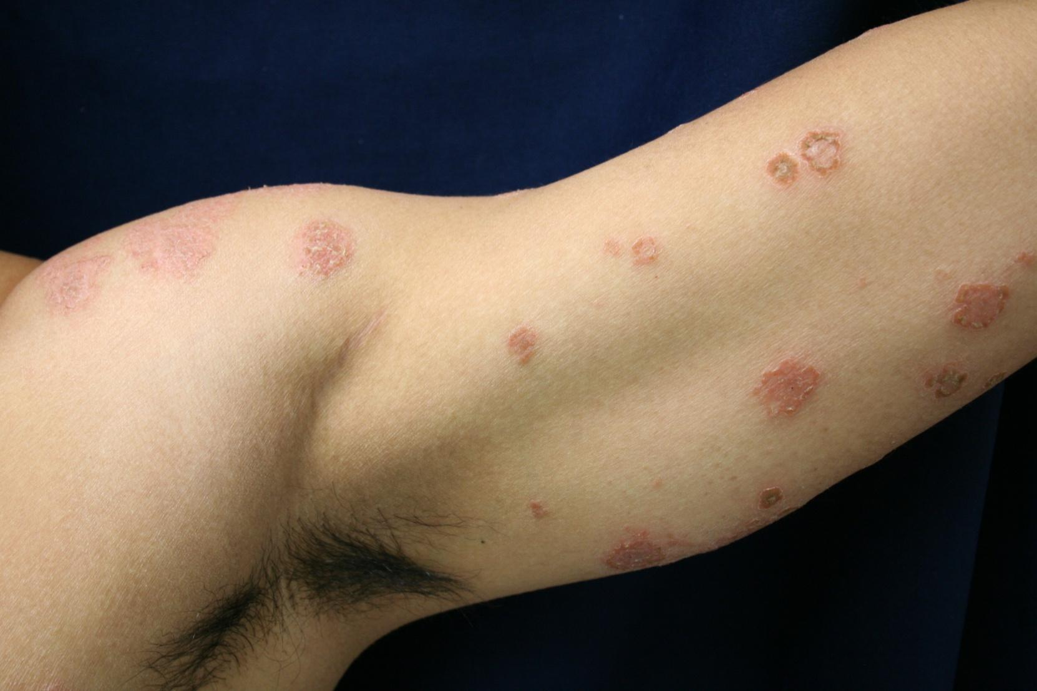
Case Five: Skin Exam

Slide 52
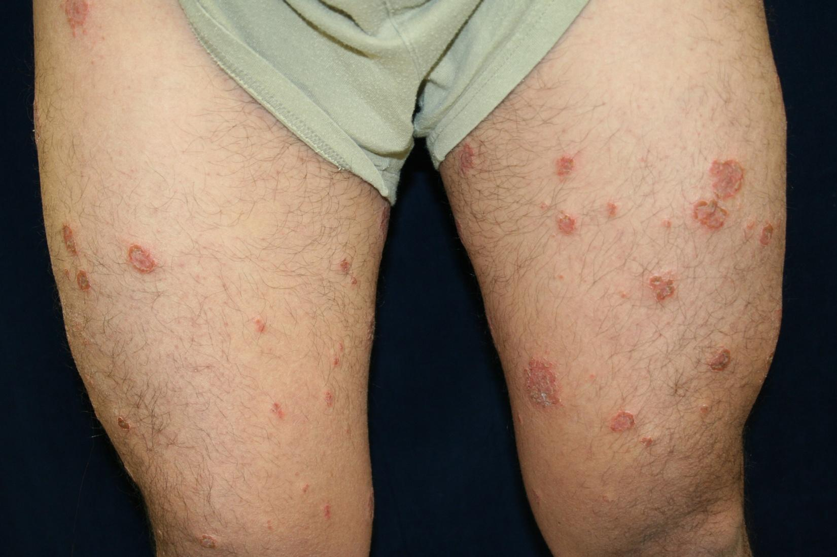
Case Five: Skin Exam

Slide 53
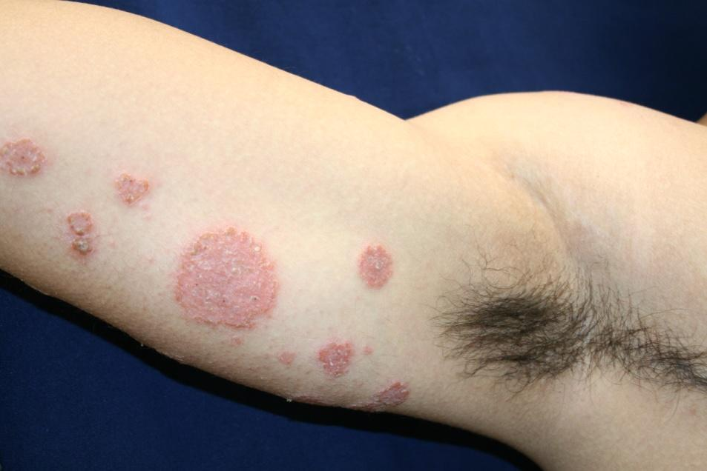
Since this rash is scaly, you correctly start with a KOH exam, which is negative.
The round eczematous plaques are on his arms, legs, and back.
His scalp, umbilicus, nails, palms, and soles are unaffected.

Slide 54

Question 1
Mr. Kamil’s exam shows erythematous, coin-like, scaling, weeping, crusted plaques on his arms and legs. What is the most likely diagnosis?
Guttate psoriasis
Nummular dermatitis
Pityriasis rosea
Secondary syphilis
Tinea corporis

Slide 55
Question 1
Answer: b
Mr. Kamil’s exam shows erythematous, coin-like, scaling, weeping, crusted plaques on his arms and legs. What is the most likely diagnosis?
Guttate psoriasis (usually not weeping, crusted)
Nummular dermatitis
Pityriasis rosea (does not last this long, or weep)
Secondary syphilis (does not last this long, or weep)
Tinea corporis (KOH is negative, no central clearing)

Slide 56
Nummular dermatitis(discoid)
Nummular dermatitis presents as multiple coin-shaped eczematous plaques on the extremities and trunk
May be scaly but lacks the central clearing seen in tinea corporis and is KOH negative
Very pruritic
May exhibit weeping, cracking, vesicles, or crusts
Pathology shows spongiotic dermatitis

Slide 57
Now let’s look at a few examples of nummular dermatitis

Slide 58
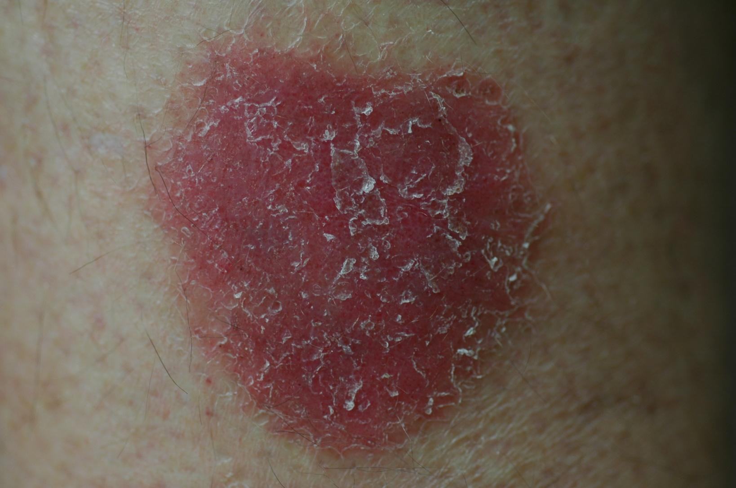
Nummular dermatitis

Slide 59
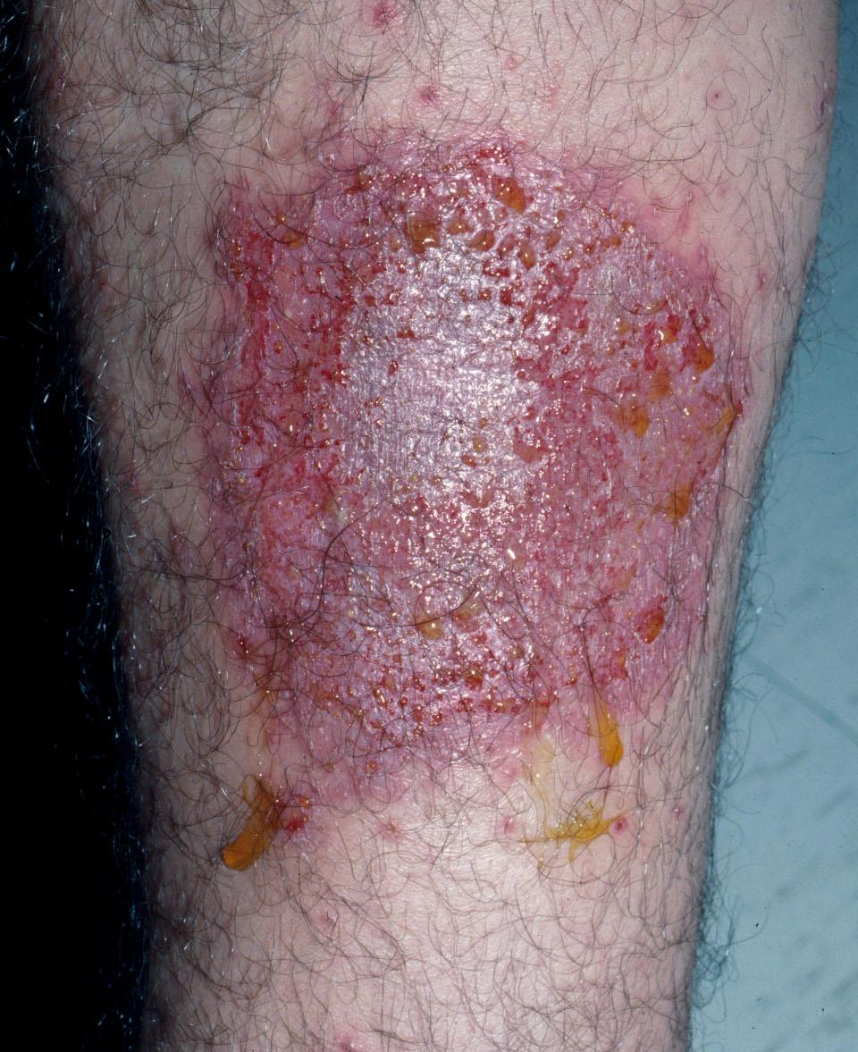
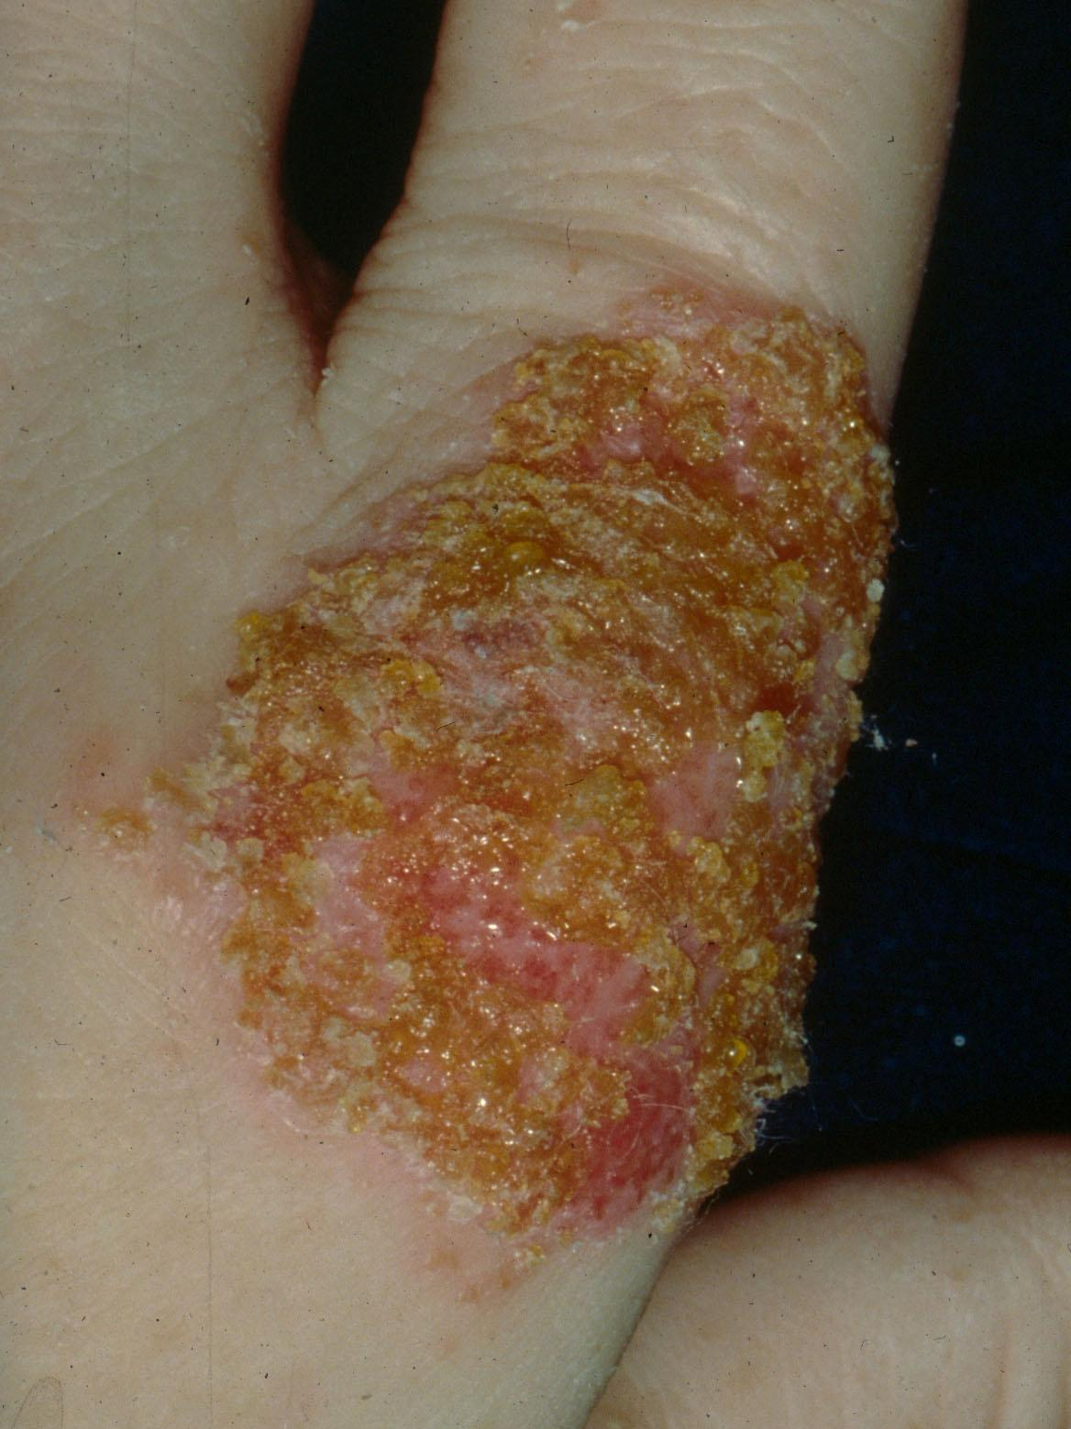
Nummular dermatitis

Slide 60
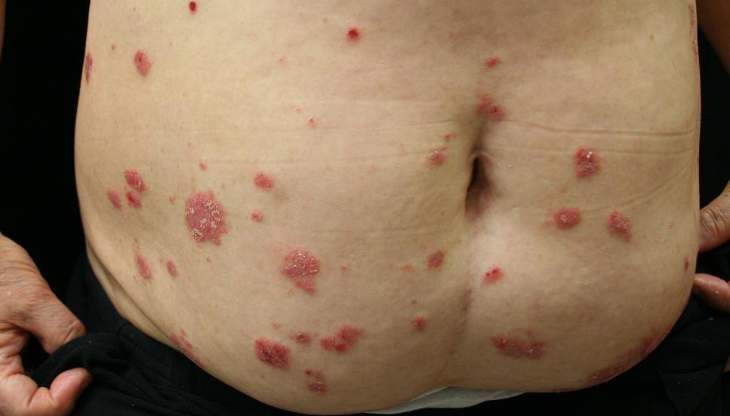
Nummular dermatitis

Slide 61
Question 2
You diagnose Mr. Kamil with nummular dermatitis. What treatment would you recommend?
Desonide cream
Clobetasol ointment (potent steroid)
Oral erythromycin
Oral terbinafine
Ultraviolet B (UVB) phototherapy

Slide 62
Question 2
Answer: b
You diagnose Mr. Kamil with nummular dermatitis. What treatment would you recommend?
Desonide cream (not strong enough)
Clobetasol ointment (potent steroid)
Oral erythromycin (for pityriasis rosea)
Oral terbinafine (not fungal)
Ultraviolet B (UVB) phototherapy (for guttate psoriasis)

Slide 63
Nummular dermatitis
Treat like atopic dermatitis or any other eczema
Potent topical steroids are necessary to control this type of eczematous eruption
Apply emollients twice a day

Slide 64
Now, can you list four common causes of the papulosquamous eruption?
Try it before moving on to the next slide.

Slide 65
Papulosquamous eruption: differential diagnosis
Common causes:
Tinea corporis
Pityriasis rosea
Psoriasis
Nummular (discoid) dermatitis
Eruptions that do not fit the clinical description of one of these should be referred to dermatology

Slide 66
Approach to red scaly rash
Is it tinea corporis? First, do KOH to rule out fungus
If KOH is negative, is it psoriasis?
Examine classic areas and ask about streptococcus infections
A biopsy at this point could confirm this diagnosis or another skin disease
Could it be pityriasis rosea?
Teens/20s, + herald patch, follows skin lines

Slide 67
Guidelines for consulting dermatology on the red scaly rash
not send a dermatology consult without first performing a full skin exam
In papulosquamous eruptions, morphology and distribution are clues to the diagnosis
All that scales must be scraped
For scaly annular patches, do a KOH first
Do not prescribe antifungals then consult dermatology.
- KOH exams are unreliable if the patient is using an antifungal.

