Slide 1

Acute Skin Failure Dermatological Emergencies
Dr Sami Fatehi
MBBS,MSc,MD, PhD

Slide 2
Objectives
By the end of this lecture you should be able to:
Find out clues to the presence of a potential dermatologic emergency
Define and identify the underlying pathophysiology consequences of the acute skin failure
Mange patient with dermatologic emergencies

Slide 3
Introduction
About 15-20 % of visits to primary care physicians and emergency departments are due to dermatologic complaints
How to differentiate simple skin conditions from the more serious, life threatening conditions that require immediate intervention ?

Slide 4
Clues to the Presence of a Potential Dermatologic Emergency
1- Fever and rash
2- Fever and blisters or denuding skin
3- Rash in immunocompromised
4- Palpable purpura
5- Full body redness

Slide 5
Definition of Acute Skin Failure
Is a failure of skin functions mainly due de novo skin disease.

Slide 6
What are Skin functions?
……………..
…………..
………….
…………
…………
……….

Slide 7
Causes of acute skin failure
Erythroderma
Steven Jonson syndrome
Acute generalized Pusular psoriasis
Immunobolous disorders (Pemphigus vulgaris)
Infections → staphylococcal scalded skin syndrome , febrile viral exanthemas

Slide 8
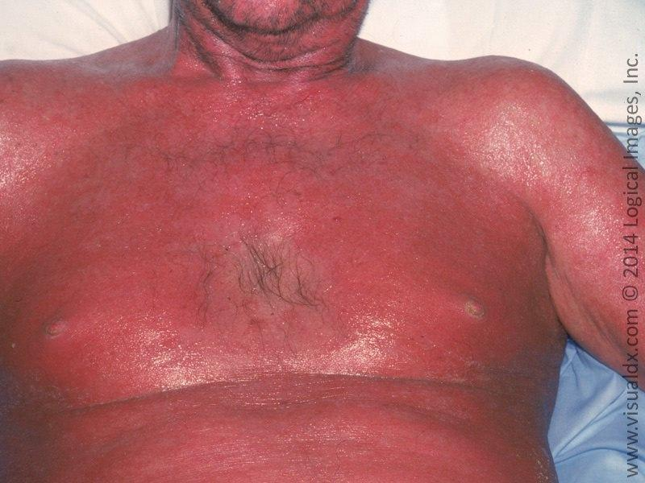
Erythroderma

Slide 9
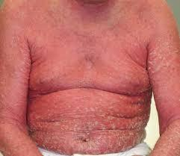

Slide 10
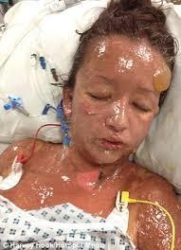
Steven Jonson Syndrome (SJS)

Slide 11
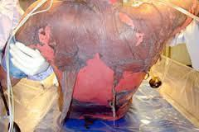
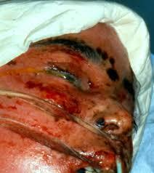
Toxic Epidermal Necrolysis (TEN)

Slide 12
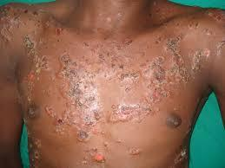
Pemphigus Vulgaris (PV)

Slide 13
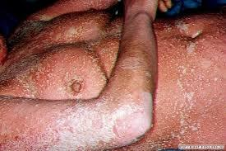
Generalized Pusular Psoriasis (GPP)

Slide 14
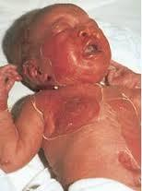
Staphylococcal Scalded Skin Syndrome (SSSS)

Slide 15
Consequences of acute skin failure

Slide 16
1- Hemodynamic alteration
Persistent inflammation of the skin →
marked peripheral vasodilatation and increased cutaneous blood flow(erythema and edema)
increased blood volume and cardiac output→
high-output cardiac failure.

Slide 17
2- Thermoregulation disturbance
Hypothermia is a very common and its sudden onset is a sign of septic shock.
Fever may be present in the absence of infection due to sweat ducts occlusion

Slide 18
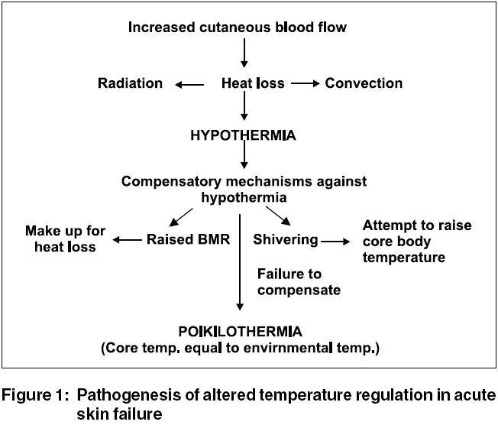

Slide 19
3- Metabolic Disturbance
High basal metabolic rate (BMR) increases energy consuming
A hyperglycemic state and glycosuria due to associated pancreatitis
Pancreatitis lead to decrease insulin secretion→ enhances caloric loss by depleting tissue protein as an energy source.
Patient shivers → is also highly energy consuming.

Slide 20
4- Fluid and Electrolyte Imbalance
In patients with acute skin failure, the daily transepidermal water loss is very high
May reaches 3-4 liters in patient who is 50% of body surface area involved.

Slide 21
Hyponatreamia, Hypophosphatemia and hyperkalaemia are common.
Leads to neurologic disturbances and diaphragmatic disturbances and respiratory failure

Slide 22
5- Altered immune function associated with TEN:
Lymphopenia
Neutropenia
Thrombocytopenia
Impaired chemotaxis and phagocytosis of granulocytes
Hypo-gammaglobulinemia

Slide 23
6- Infection
The incidence of septic complications is increased in the presence of altered body defense mechanisms
Damaged barrier function of the skin facilitates colonization and systemic entry of commensal, exogenous and endogenous (gut flora) microorganisms.

Slide 24
Care of Patients with Acute Skin Failure
Treat patient with acute skin failure as severe burned patient.
Assessment of the severity of the disease helps in planning the management.
Use role of nine to estimate the affected body surface area to calculate the fluid replacement

Slide 25
The pillars in the management of such patients are:-
Nursing care
Monitoring hemodynamic changes
Fluid, electrolyte balance and nutrition
Prevention of complication (e.g. sepsis)
identification of risk factors
Topical therapy.

