Slide 1
Topical Treatments
Dr Sami Billal
MBBS,MSc,MD,PhD

Slide 2
Goals and Objectives
By completing this module, you should be able to:
Estimate the amount of topical medication needed for therapy based on frequency of application and body surface area involved
Choose appropriate strengths of topical steroids based on age, body location and severity of dermatitis
List side effects of prolonged use of topical steroids
Discuss the basic principles of medications used to treat acne
Discuss the basic principles of topical antifungals, oral antihistamines and topical psoriasis medications

Slide 3
Principles of Dermatologic Therapy
The efficacy of any topical medication is related to:
The active ingredient (inherent strength)
Anatomic site
The vehicle (the mode in which it is transported)
The concentration of the medication

Slide 4
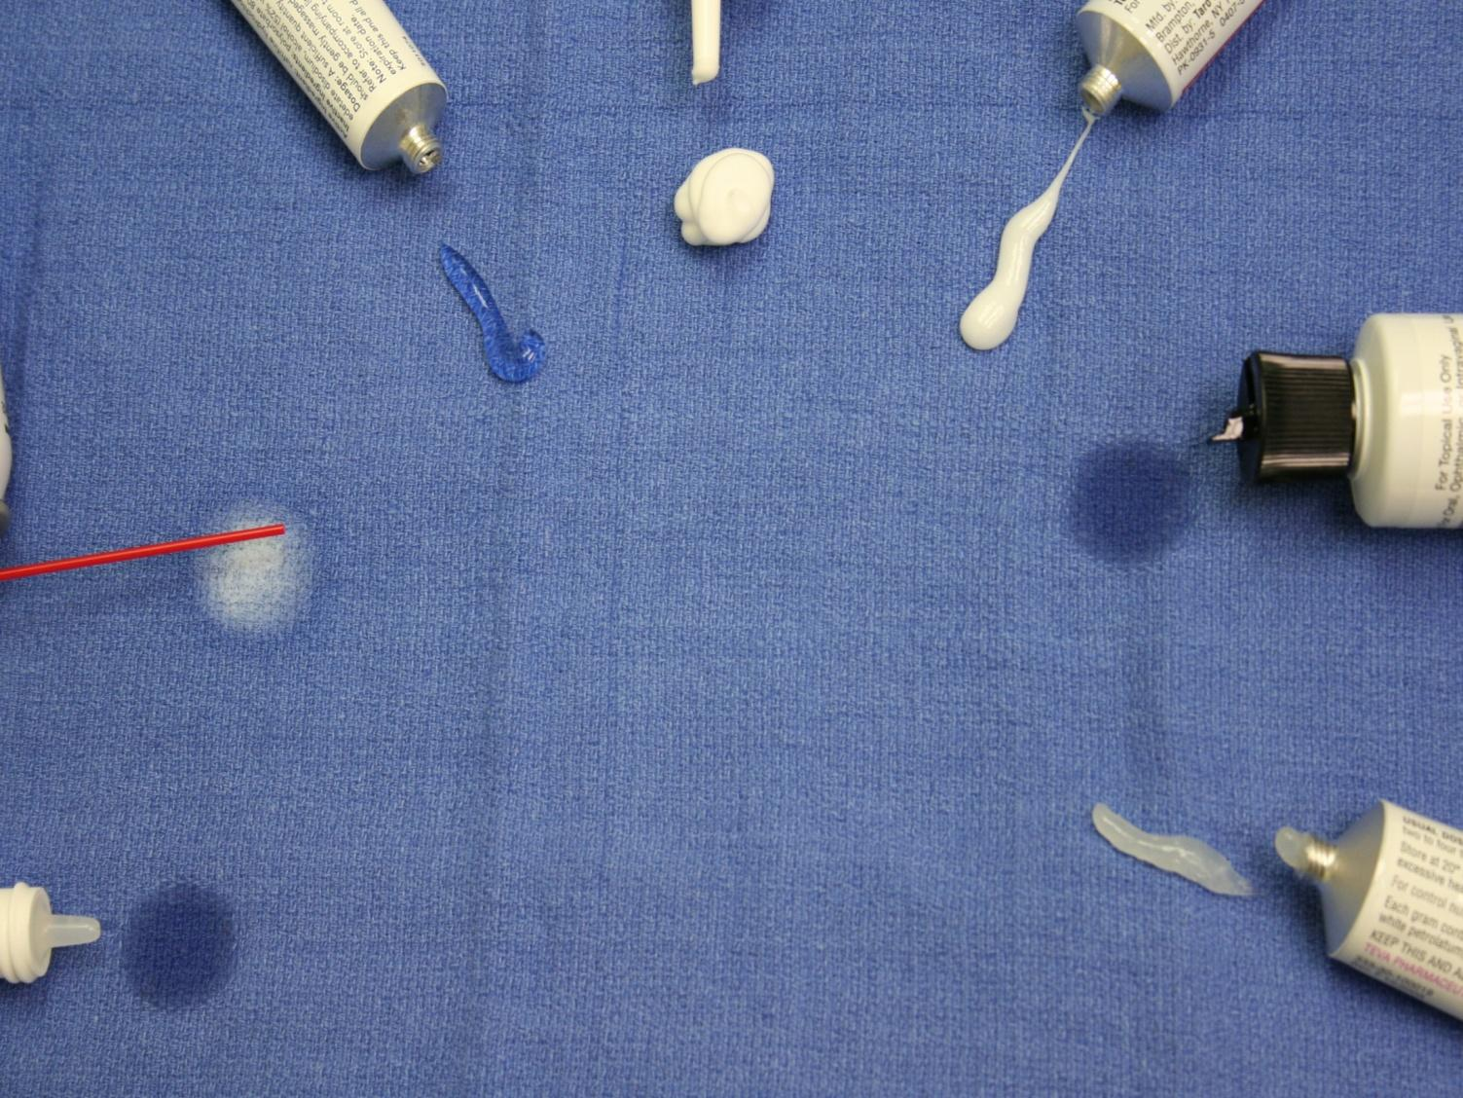
Solutions
Vehicles
Foams
Creams
Gels
Sprays
Oils
Ointments

Slide 5
Vehicles
1- Ointments
occlusive; greasy has lubricant effects (e.g. Vaseline):
USE for smooth, non-hairy skin; dry, thick, or hyperkeratotic lesions
AVOID on hairy and intertriginous areas as armpits, groin, pannus)

Slide 6
2- Creams
- Vanish when rubbed in:
- Less greasy than ointment, has drying effects; not occlusive, can sting, more likely to cause irritation USE for acute exudative inflammation, intertriginous areas

Slide 7
3- Lotion (pourable liquid): less greasy, less occlusive; may contain alcohol (drying effect on oozing lesion); penetrate easily, little residue
USE for hairy areas
4- Foams (cosmetically elegant): spread readily, easier to apply; more expensive
USE for hairy areas; inflammation
5- Sprays: Aerosols (rarely used), pump sprays

Slide 8
6- Oils: less stinging than lotions or solutions
USE for the scalp, especially for people with coarse or very curly hair
7- Gel (jelly-like): may contain alcohol, greaseless, least occlusive; dry quickly
USE for acne, exudative inflammation (e.g. acute contact dermatitis); on scalp/hairy areas without matting

Slide 9
Medication Costs
Topical medications can be very expensive
They are not all covered by insurance
Over the counter (OTC) treatments are generally cheaper than prescriptions
Generics are less expensive than brand name prescriptions
It is helpful to know the costs of the medications you prescribe and be able to tell the patient in advance what they should expect to pay

Slide 10
What goes into a topical prescription?

Slide 11
Topical prescriptions
What goes into a prescription?
Desonide cream 0.05% apply to affected area (face) BID PRN for scaling #15 Grams RF3

Slide 12
Topical prescriptions
What goes into a prescription?
Desonide cream 0.05% apply to affected area (face) BID PRN for scaling #15 Grams RF3
Generic name

Slide 13
Topical prescriptions
What goes into a prescription?
Desonide cream 0.05% apply to affected area (face) BID PRN for scaling #15 Grams RF3
Generic name
Vehicle

Slide 14
Topical prescriptions
What YOU WRITE IN a prescription?
Desonide cream 0.05% apply to affected area (face) BID for scaling #15 Grams RF3
Generic name
Vehicle
Concentration

Slide 15
Topical prescriptions
What goes into a prescription?
Desonide cream 0.05% apply to affected area (face) BID PRN for scaling #15 Grams RF3
Generic name
Vehicle
Concentration
directions

Slide 16
Topical prescriptions
What goes into a prescription?
Desonide cream 0.05% apply to affected area (face) BID PRN for scaling #15 Grams RF3
Generic name
Vehicle
Concentration
Sig
Amount

Slide 17
Topical prescriptions
What goes into a prescription?
Desonide cream 0.05% apply to affected area (face) BID PRN for scaling #15 Grams RF3
Generic name
Vehicle
Concentration
Sig
Amount
Refills

Slide 18
Common Types of Medications Used by Dermatologists

Slide 19
Topical Corticosteroids
Topical steroids produce an anti-inflammatory response in the skin
They are effective for conditions that are characterized by:
Hyperproliferation?
Inflammation?
immunologic involvement ?
provide symptomatic relief for burning and pruritic lesions?

Slide 20
Topical Corticosteroids
Corticosteroids are organized into classes based on their strength (potency)
Therefore, steroids within any class are equivalent in strength
Strength is depends on the molecule, not the concentration.
Know one steroid from each class that would be available to the majority of your patients (the generic in that class)

Slide 21
Topical Steroid Strength
Potency | Class | Example Agent
Super high | I | Clobetasol propionate 0.05%
High | II | Fluocinonide 0.05%
Medium | III – V | Triamcinolone acetonide ointment 0.1% Triamcinolone acetonide cream 0.1% Triamcinolone acetonide lotion 0.1%
Low | VI – VII | Fluocinolone acetonide 0.01% Desonide 0.05% Hydrocortisone 1%

Slide 22
Topical Steroid Strength
Remember to look at the class not the percentage
Note that clobetasol 0.05% is stronger than hydrocortisone 1%.
When several are listed, they are listed in order of strength
Note that triamcinolone ointment is stronger than triamcinolone cream or lotion because of the nature of the vehicle

Slide 23
How we select corticosteroid Class?
Super high potency (Class I) are used for severe dermatoses over nonfacial and nonintertriginous areas
Scalp, palms, soles, and thick plaques on extensor surfaces
Medium to high potency steroids (Classes II-V) are appropriate for mild to moderate nonfacial and nonintertriginous areas
Okay to use on flexural surfaces for limited periods
Low potency steroids (Classes VI, VII) can be used for large areas and on thinner skin
Face, eyelid, genital and intertriginous areas

Slide 24
Local Side Effects of Topical Steroids
The higher the potency the more likely side effects are to occur.
To reduce risk, the least potent steroid should be used for the shortest time, while still maintaining effectiveness

Slide 25
Local side effects of topical steroids include:
Skin atrophy
Telangiectasias
Striae
Acne
Steroid Rosacea
Hypopigmentation

Slide 26
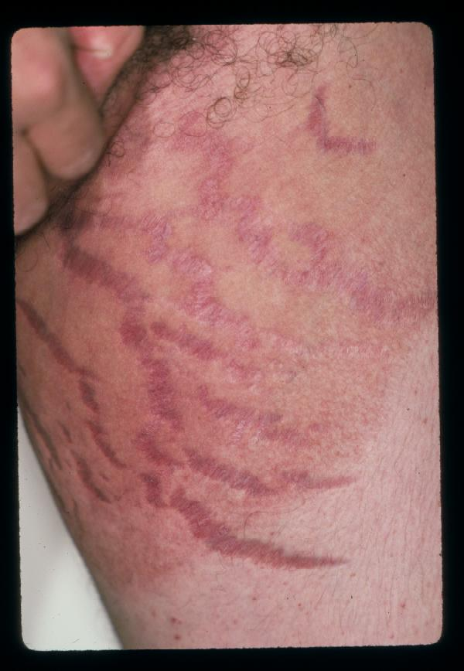
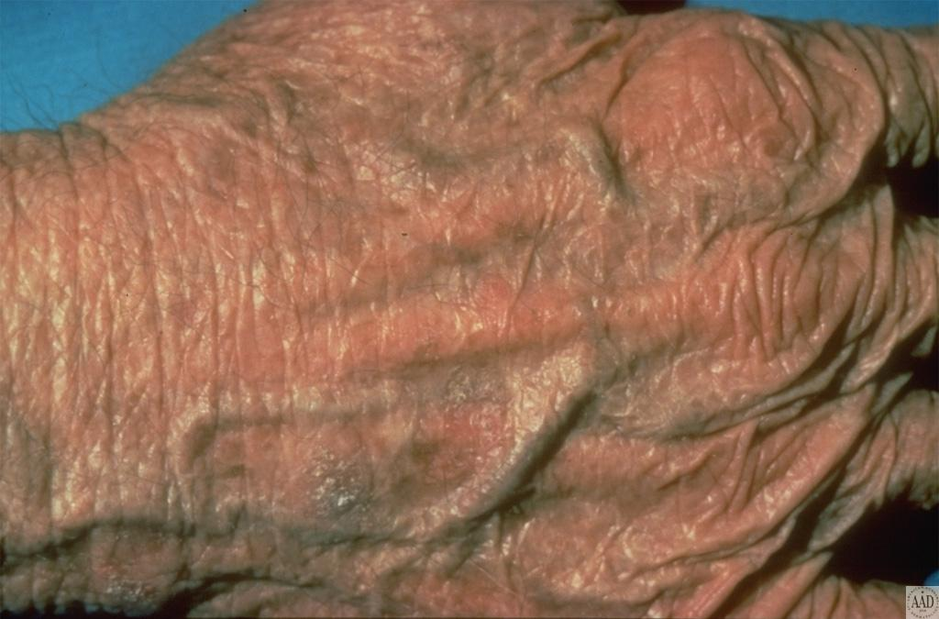
Local Corticosteroid Skin Side Effects
Skin Atrophy
Striae

Slide 27
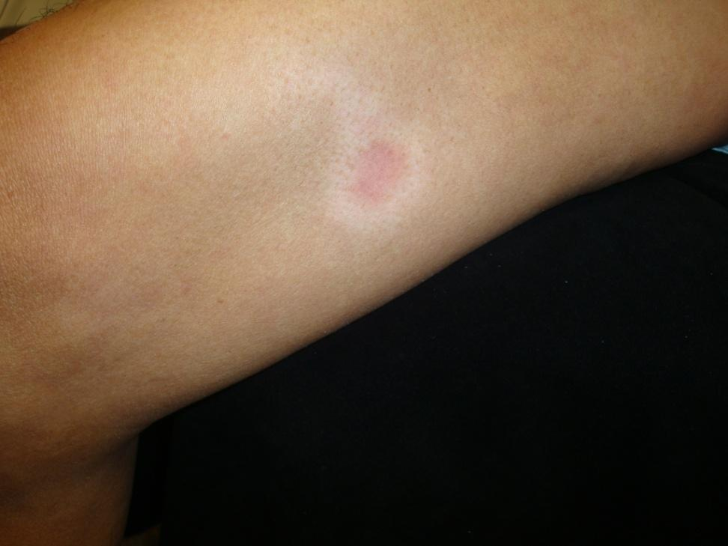
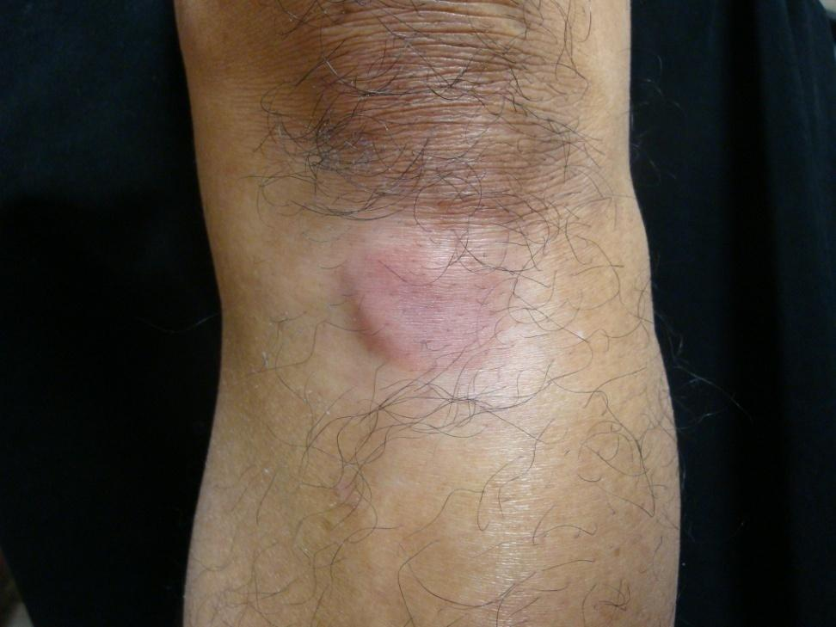
Local Corticosteroid Skin Side Effects
Hypopigmentation

Slide 28
Systemic Side Effects of Topical Steroids
Systemic side effects are rare due to low absorption
They can include:
Glaucoma (when steroid applied to the eyelid)
Hypothalamic pituitary axis suppression
Cushing’s syndrome
Hypertension
Hyperglycemia
The higher the potency the more likely side effects are to occur
To reduce risk, the least potent steroid should be used for the shortest time, while still maintaining effectiveness

Slide 29
Duration of Treatment
Duration of treatment is limited by side effects
In general:
Super high potency: treat for <3 weeks
High and Medium potency: <6-8 weeks
Low potency: side effects are rare.
Treat facial, intertriginous, and genital dermatoses for 1-2 week intervals to avoid skin atrophy, telangiectasia, and steroid-induced acne

Slide 30
Stop treatment when skin condition resolves
To avoid rebound/flares: taper with gradual reduction of both potency and dosing frequency every 2 weeks
If the patient does not respond to treatment within these guidelines, consider referral to a dermatologist

Slide 31
Topical Antifungals

Slide 32
Topical Antifungals
There are several classes of topical antifungal medications
Some classes are fungistatic (stop fungi from growing), others are fungicidal (they kill the fungi)
Not all conditions are treatable with topical antifungals (specifically, hair infections and nail infections do not respond to topical treatment and require systemic treatment)

Slide 33
Topical Antifungals
The following are some examples of topical antifungals:
Imidazoles (fungistatic): Ketoconazole (Rx & OTC), Econazole, Oxiconazole, Sulconazole, Clotrimazole (Rx & OTC), Miconazole (OTC)
Useful to treat candida and dermatophytes
Allylamines and benzylamines (fungicidal): Naftifine, Terbinafine (OTC), Butenafine
Better for dermatophytes, but not candida
Polyenes (fungistatic in low concentrations): Nystatin
Better for candida, but not dermatophytes

Slide 34
Advantages of Topical Antifungals
Topical antifungals are preferred for most superficial fungal infections of limited extent.
Advantages include:
Relatively low cost
Acceptable efficacy
Ease of use
Low potential for side effects, complications, or drug interactions

Slide 35
Take Home Points
The efficacy of any topical medication is related to the strength, location, vehicle, and concentration
Topical medications can be very expensive
When writing a prescription for a topical medication, include: generic name, vehicle, concentration, directions, amount, # of refills
Corticosteroids are organized into classes based on their strength (potency)
Skin atrophy, acne, striae, and telangiectasias are potential local side effects of corticosteroid use

