Slide 1
Urticaria
Dr Sami Aldaham
1
Notes:
1

Slide 2
Goals and Objectives
You have to be able to:
Describe the morphology of urticaria
Distinguish between acute and chronic urticaria
2
Notes:
2

Slide 3
Urticaria
Urticaria (hives) is a vascular reaction of the skin characterized by wheals surrounded by a red halo or flare (area of erythema)
Cardinal symptom is PRURITUS (itch)
Urticaria = pruritus
Urticaria is caused by swelling of the upper dermis
Up to 20% of the population experience urticaria at some point in their lives
3

Slide 4
Angioedema
Angioedema can be caused by the same pathogenic mechanisms as urticaria
The pathology is in the deep dermis and subcutaneous tissue and swelling is the major manifestation
Angioedema commonly affects the face or a portion of an extremity
4

Slide 5
Involvement of the lips, cheeks, and periorbital areas is common, but angioedema also may affect the tongue, pharynx, larynx and bowels.
May be painful or burning, but not pruritic
May last several days

Slide 6
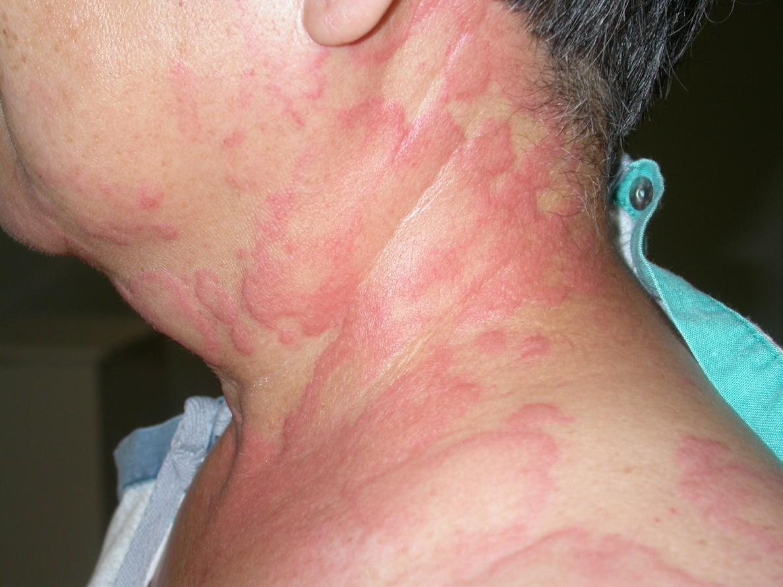
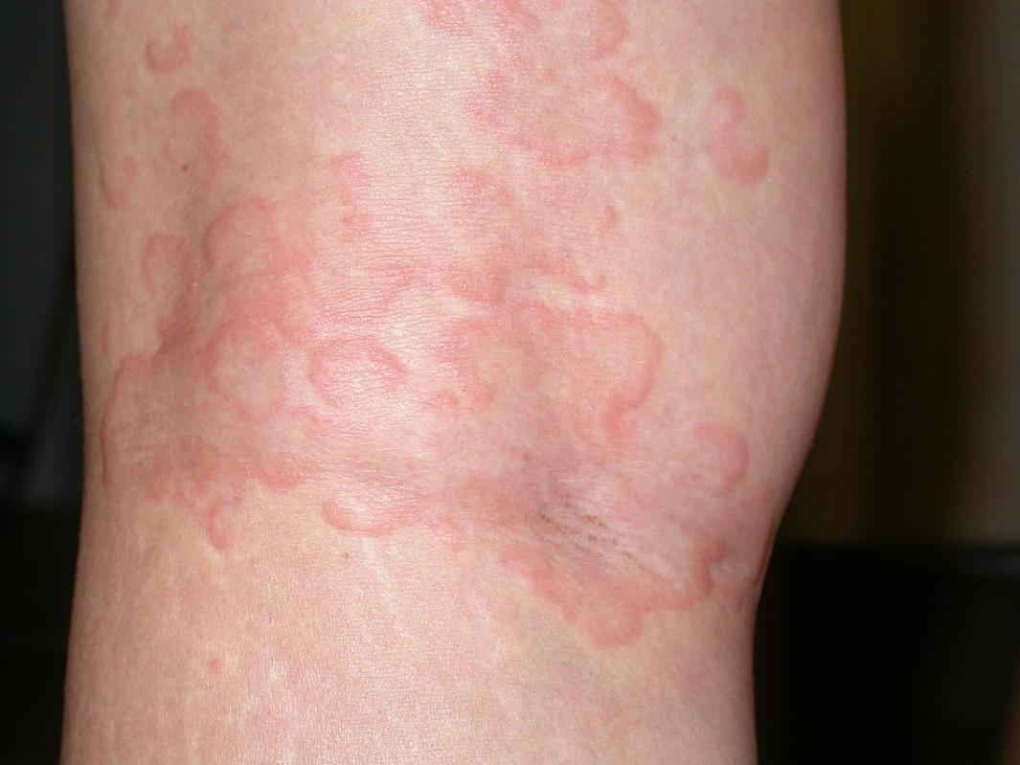
Examples of Urticaria
6
Notes:
6

Slide 7
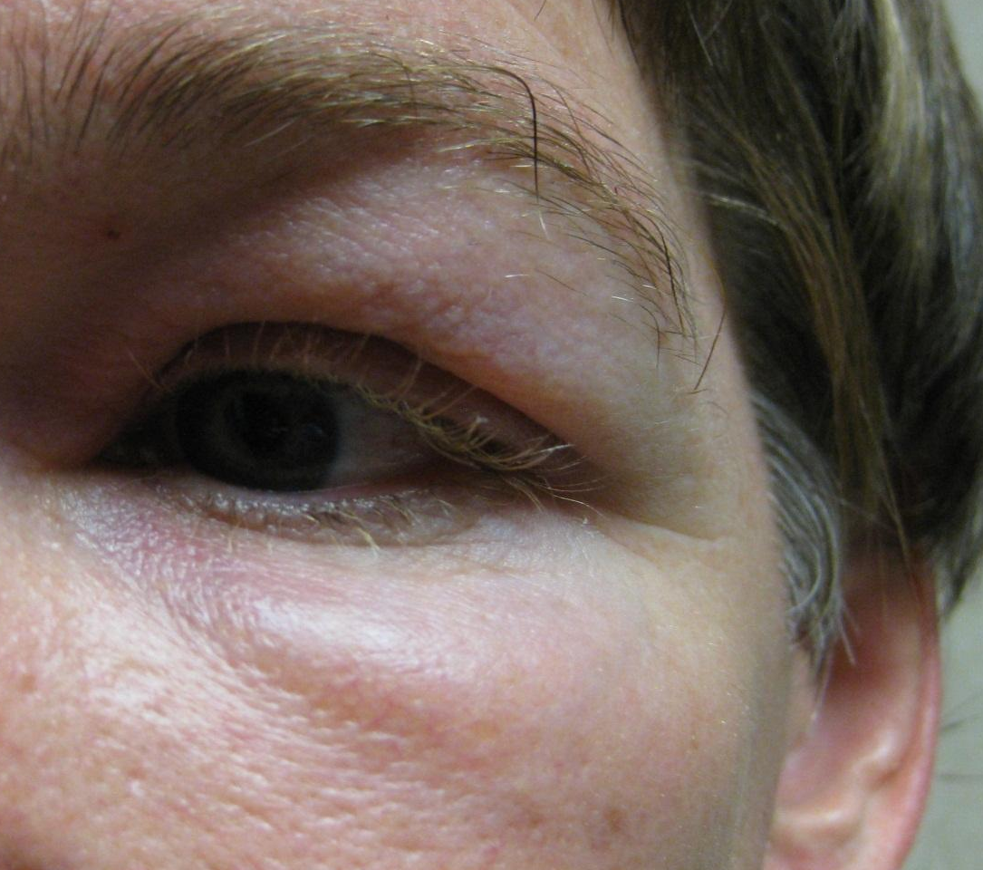
Example of Angioedema
7

Slide 8
Urticaria & Angioedema
Urticaria and angioedema may occur in any location together or individually.
Angioedema and/or urticaria may be the cutaneous presentation of anaphylaxis, so assessment of the respiratory and cardiovascular systems is vital.
8

Slide 9
Urticaria: Clinical Findings
Lesions typically appear over the course of minutes, enlarge, and then disappear within hours
Individual wheals rarely last >12hrs
Surrounding erythema will blanch with pressure
9

Slide 10
Clinical Classification of Urticaria
Acute urticaria =
new onset urticaria < 6 weeks
Chronic urticaria = recurrent urticaria (most days) > 6 weeks

Slide 11
Common Causes of Acute Urticaria
1- Idiopathic
5- IV administration
6- Blood products, contrast agents
3- Infections: Upper respiratory, streptococcal infections, helminthes
2- Food reactions: Shellfish, nuts, fruit
4- Drug reactions

Slide 12
Etiology of Chronic Urticaria
1- Idiopathic: over 50% of chronic urticaria
2- Physical urticarias: many patients with chronic urticaria have physical factors that contribute to their urticaria
These factors include pressure, cold, heat, water (aquagenic), sunlight (solar), vibration, and exercise
Cholinergic urticaria is triggered by heat and emotion
The diagnosis of pure physical urticaria is made when the sole cause of a patient’s urticaria is a physical factor
3- Chronic autoimmune: possibly a third or more of patients with chronic urticaria
4- Other: infections, ingestions, medications
12

Slide 13
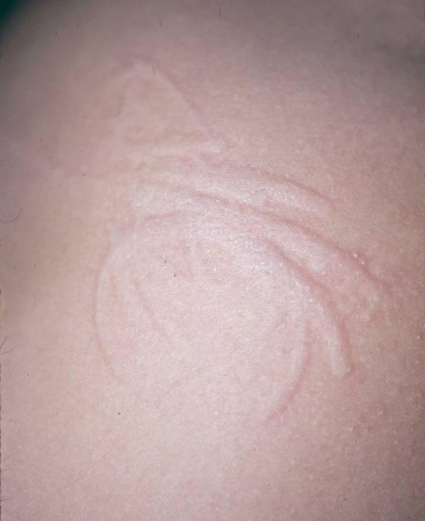
Dermatographism
Most common form of physical urticaria
Sharply localized edema or wheal within seconds to minutes after the skin has been rubbed
13

Slide 14
Pathophysiology
The mast cell is the major effector cell in urticaria
Immunologic mediated urticaria
Non – immunologic mediated urticaria
14

Slide 15
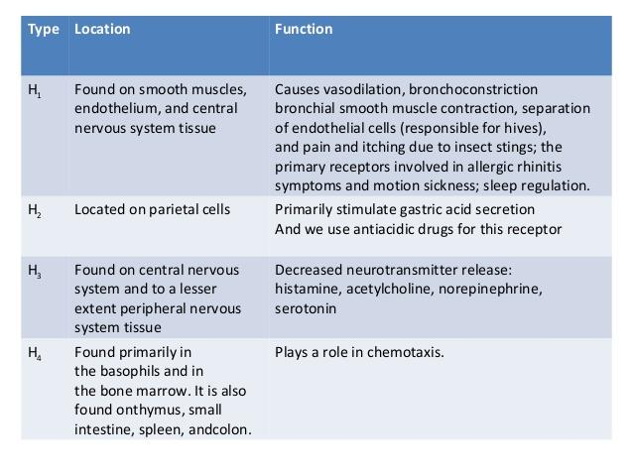

Slide 16
1- Immunologic Urticaria
Mast cell degranulation
histamine releasing
Histamine binds to H1 and H2 receptors to cause arteriolar dilatation
venous constriction
increased capillary permeability.
Antigen binds to IgE on the mast cell

Slide 17
2- Non-Immunologic Urticaria: Not dependent on the binding of IgE receptors
Some drugs (aspirin)
Unknown pharmacologic mechanism
Affect the arachidonic acid metabolism
release of histamine from mast cells.
17

Slide 18
Physical stimuli
Physical stimuli
direct mast cell degranulation
Induced histamine release

Slide 19
DIAGNOSIS
Urticaria is a clinical diagnosis
A detailed history and physical exam should be performed
Many times patients will not present with urticaria during their clinic visit
show patients photographs of urticaria and ask if their lesions appear similar
Ask patients to take photos of their lesions / bring them to their office visit
19

Slide 20
Allergy Testing
Allergy testing is not routinely performed in patients with chronic urticaria.
Skin prick testing may reveal sensitivities to a variety of allergens that may not be relevant to the patient’s urticaria.
20
Notes:
20

Slide 21
Natural History and Prognosis
Symptoms of chronic urticaria can be severe and impair the patient’s quality of life (QOL)
In most patients, chronic urticaria is an episodic and self-limited disorder
Average duration of disease is two to five years
21

Slide 22
Treatment

Slide 23
Antihistamines
Oral H1 antihistamines are the first-line treatment for acute and chronic urticaria
First-generation H1 antihistamines are less well-tolerated due to sedation
Second-generation H1 antihistamines are well tolerated with fewer sedative and anticholinergic effects
23

Slide 24
Antihistamines
The following are examples of H₁ antihistamines:
1st Generation
Diphenhydramine (OTC)
Hydroxyzine (Rx, generic)
Chlorpheniramine (OTC)
2nd Generation
Cetirizine (OTC)
Loratadine (OTC)
Fexofenadine (OTC)
24
Notes:
24

Slide 25
Referral to Dermatologist and indication of skin biopsy
Biopsy should be performed in patients with one or more of the following features:
Individual lesions that persist beyond 48 hours, are painful rather than pruritic, or have accompanying petechial characteristics
Systemic symptoms
Lack of response to antihistamines
Lesions that leave pigmentation changes upon resolution
25

Slide 26
Take Home Points
1- Urticaria (hives) is a vascular reaction of the skin characterized by wheals surrounded by a red halo or flare.
2- Urticaria is classified as acute or chronic. Acute urticaria is defined as periodic outbreaks of urticarial lesions that resolve within six weeks.
3- Over 50% of chronic urticaria is idiopathic.
4- Oral H1 antihistamines are first-line treatment for acute and chronic urticaria.
5- 1st generation H1 antihistamines can cause sedation.
6- The presence of systemic symptoms should signal the possibility that an urticarial rash is not ordinary urticaria.
26

