Slide 1
Pediatric vascular anomalies
Dr Sami Billal
MBBS,MSc,MD, PhD

Slide 2
There are two major groups of vascular anomalies
1- Vascular tumors – neoplasms of a particular type of blood vessel or other vascular tissue
Tumors will proliferate and some never stop without therapy
2- Vascular malformations – A lesion of abnormal blood vessels that does not have rapid proliferation
Malformations are static or very slow growing

Slide 3
Vascular tumors
Infantile hemangioma (IH)
Pyogenic granuloma
Congenital hemangioma
Tufted angioma
Kaposiform hemangioendothelioma
Angiosarcoma

Slide 4
Vascular malformations
Capillary malformations (CM)
Cutaneous or mucosal CM (“Port-wine” stain)
Nevus simplex (“salmon patch”)
Cutis marmorata telangiectatica congenita (CMTC)
Lymphatic malformations
Venous malformations
Arterial malformations
Arteriovenous malformations
Combined malformations

Slide 5
Infantile hemangioma (IH)
Infantile hemangiomas (IH) are common benign vascular tumors of infancy occurring in about 4% of infants
At birth, a premonitory mark may be present such as a bruise-like patch, area of vasoconstriction/pallor or telangiectasias

Slide 6
Risk factors for developing IH
Low birth weight
Female gender
Twin gestation
Fair skin

Slide 7
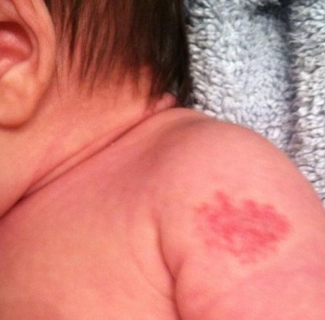
IH at 2 weeks old

Slide 8
Infantile hemangiomas proliferate during the first 2-3 months of life
Growth usually stabilizes around 4-6 months, followed by involution over years
Larger, deeper IH grow for longer and involutes more slowly.
Based on these growth characteristics, IH requiring intervention should be referred for treatment before 3 months of age

Slide 9
Types of heamangiomas
Superficial
bright red and minimally elevated
Deep
large with a bluish color
Mixed
have both components

Slide 10
Hemangiomas: clinical appearance
Hemangiomas may occur anywhere on the body
They may be localized or segmental/regional in distribution

Slide 11
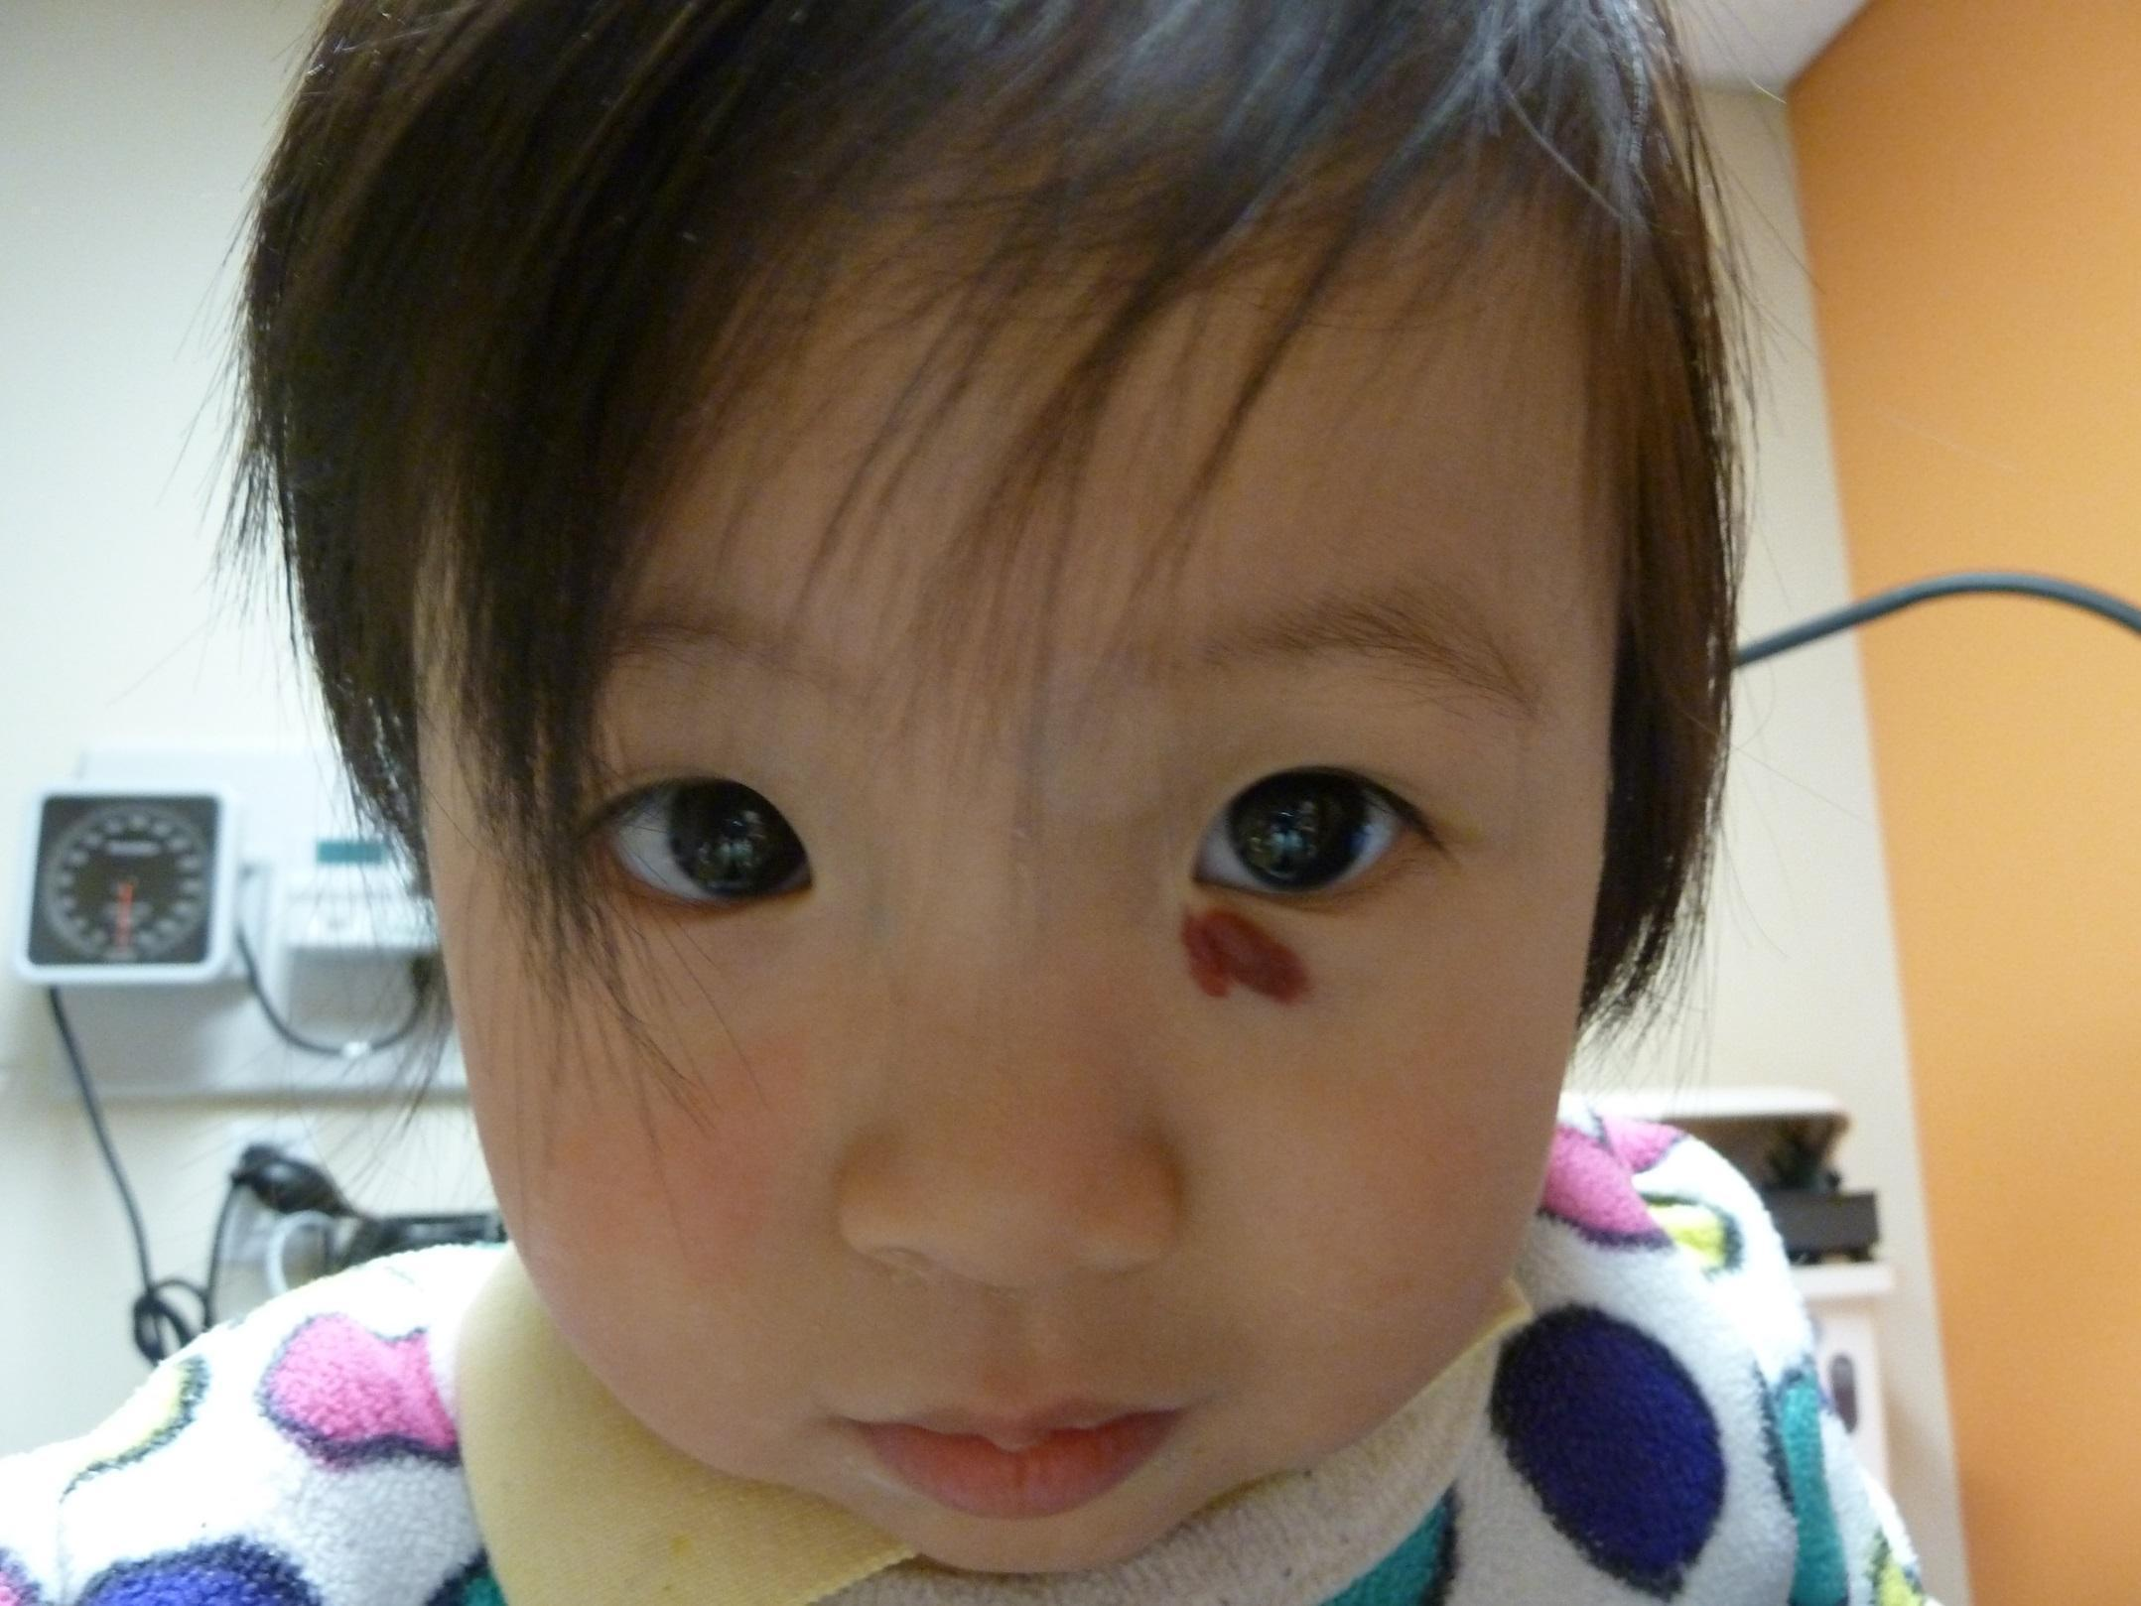
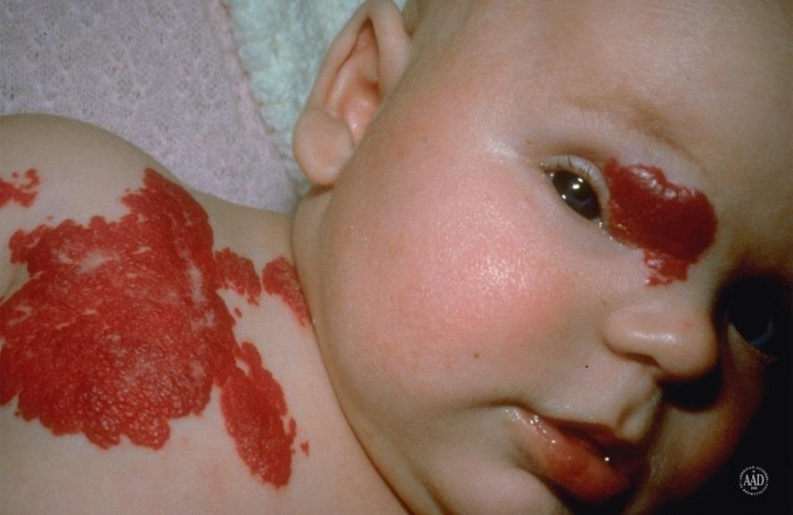

Slide 12
Complications include:
Ulceration
Visual Impairment
Airway involvement
Multifocal presentation
Aesthetic complications
Complex Associations

Slide 13
Infantile Hemangiomas: Management
Systemic Therapies
Oral propranolol
Systemic corticosteroids
Immunosuppressive or anti-neoplastic* therapies (Interferon, Vincristine)

Slide 14
Local Therapies
Topical corticosteroids
Pulsed dye laser for ulceration or residual lesions
Intralesional corticosteroids
Topical beta blockers

Slide 15
Clinical Case
HPI: This is an 8 day old baby boy who presents for evaluation of a large, pink mark on his forehead present at birth.
His parents are concerned by the size and location of the birthmark.
PMH: Born full term to healthy mother, no pregnancy or labor complications, received all vaccinations

Slide 17
Nevus simplex
Nevus simplex (salmon patch) is a type of faint, transient capillary malformation
Present in 30-40% of newborns, it is the most common pediatric vascular lesion
Children often have multiple
The redness will become accentuated during episodes of increased internal pressure (crying, straining with defecation or physical exertion)
Flat, pink to bright red patches typically on the midline forehead, scalp, upper eyelids, posterior neck and back.

Slide 18
Management
In general, there are no findings associated with nevus simplex that require workup or evaluation
95% of facial lesions fade within 1-2 years making treatment unnecessary

Slide 19
Clinical Case
HPI: This is a 6 month old baby who presents with a lesion on her face that has been present since birth and has been growing in size.
The lesion is not itchy or painful.
PMH: Born at 38 weeks to healthy mother via C-section, no pregnancy or labor complications. No medical conditions.

Slide 20
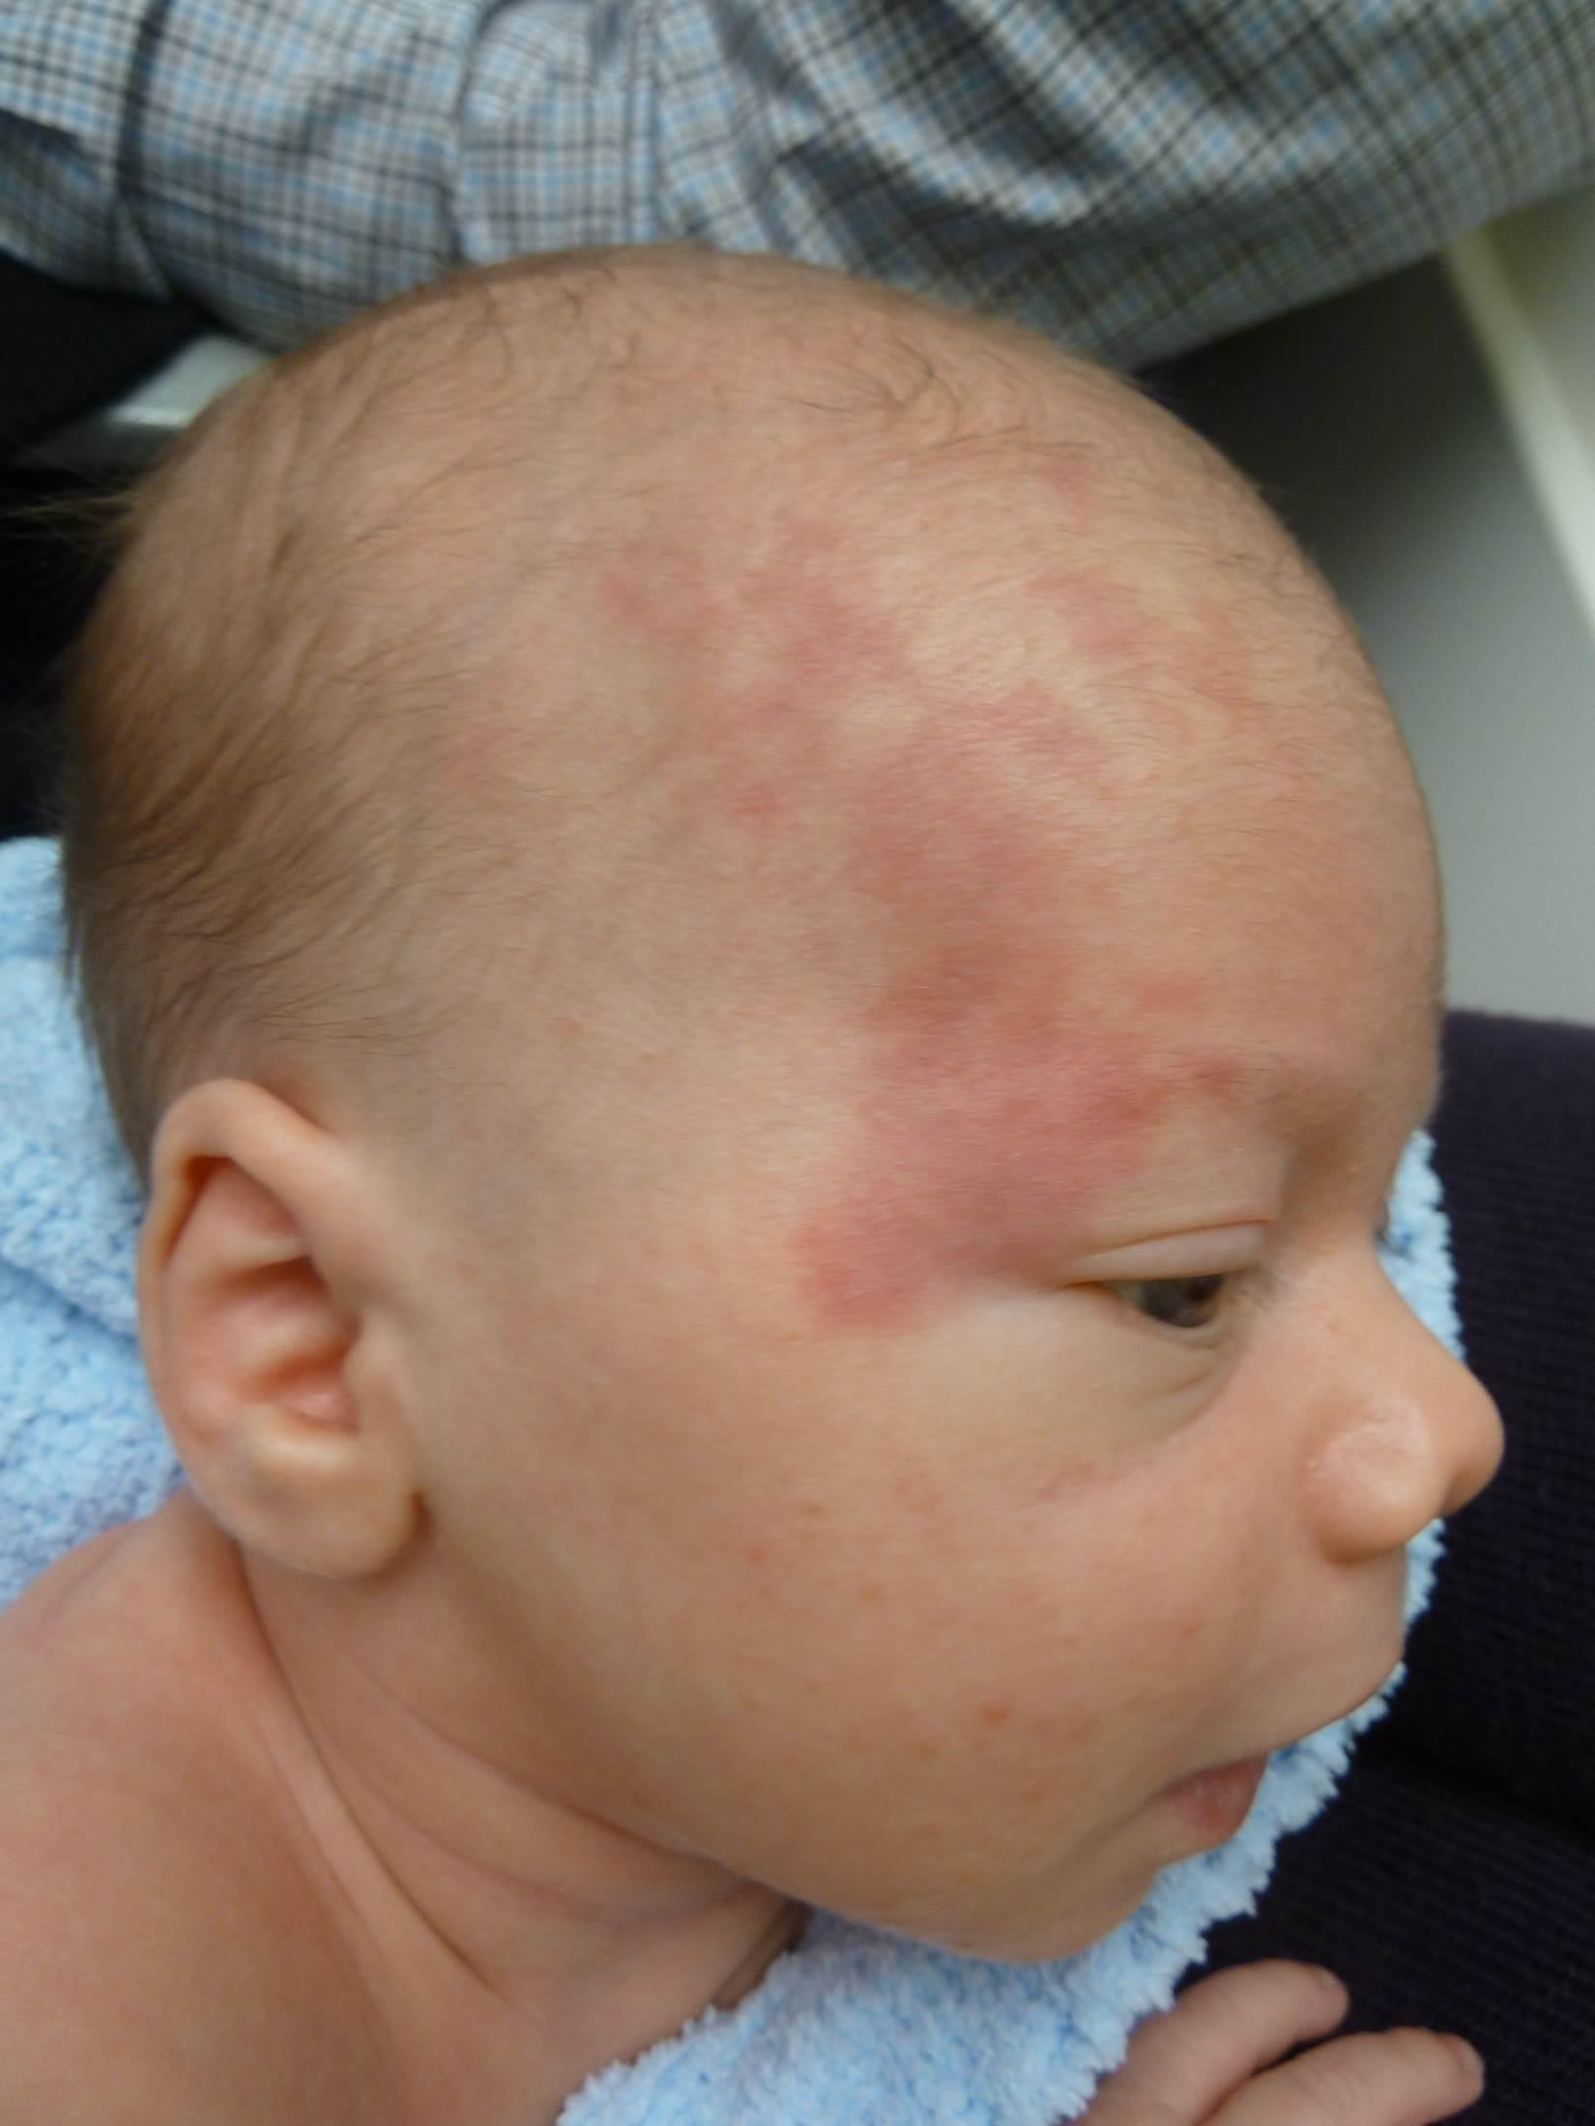
Dull red patch on the face involving the upper eyelid, forehead, temple and scalp

Slide 21
Port-wine stain
Present as pink to dark red patches that are often unilateral with midline cutoff
Can be found on any part of the body
Tend to darken and thicken slowly over years
May develop vascular papules and significant skin hypertrophy over many years
Capillary malformation present at birth

Slide 22
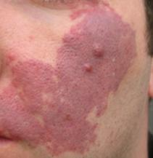
Port-wine stain

Slide 23
Management of Port-wine stain options include
Conservative management –
no treatment or use of cosmetics to conceal the lesions
Pulse dye laser (PDL) – causes intravascular coagulation in abnormal vasculature without damaging surrounding structures

