Slide 1
Cutaneous Viral Infections
Dr Sami Billal
MBBS,MSc,MD, PhD

Slide 2
Common viral infections
Viral warts
Molluscum contagiosum
Chicken pox
Herpes zoster

Slide 3
1- Viral Warts
Warts (or verrucae), are benign growths on the skin or mucous membranes that cause cosmetic problems and discomfort.
Are seen in all ages but commonly appear in children and teenagers.

Slide 4
Viral warts (verruca) are due to infection of the skin and mucus membranes by human papilloma virus (HPV).
More than 80 different types of HPV are identified.
Have affinity for different tissues of the body as type 36 & 38 for the skin and usually they are benign.
While type 16 & 18 have affinity to mucus membranes and can change into cancer

Slide 5
Clinical types of viral warts (Verrucae)
1. Skin Infections:
Common warts (verruca vulgaris),
Flat warts (verruca plana).
Plantar or foot warts (verruca plantaris).
2. Mucous membranes infection:
  Ano-genital warts (condyloma acuminata).

Slide 6
Pathogenesis
Incubation period is 2 - 9 months
Excessive proliferation of skin growth slowly develops
More than 50% disappear within 2 years without treatment.
HPV is passed from person to person by direct or indirect contact, and from one body location to another on the same person
The virus enters the body through:
  Area of skin that is moist, peeling, or cracked
  Sexually transmitted as in Condyloma acuminta.

Slide 7
Skin viral warts – Clinical features
1- Common warts
Appear most often on tops of fingers and hands
As rough, thick, papules
Develop as solitarily or in large numbers
Small satellite warts may surround the original lesion (because the virus is usually present in a one-centimeter radius surrounding the wart)

Slide 8
Skin viral warts – Clinical features
2- Flat warts
Are small, slightly elevated, flat-topped, pink or tan papules
Are smoother than the common wart
They occur primarily on the face, arms, and legs
A person can have several, even hundreds of them

Slide 9
Skin viral warts – Clinical features
3- Plantar warts
Occur on the soles of the feet
Often thick and callused, grow inward,
Can be painful

Slide 10
Mucosal viral warts – Clinical features
Ano-genital warts (condyloma acuminata)
Are gray in color that grow in mucous membranes
Vary in size from small, shiny papules, to large lesions
Can extend internally into the vagina and cervix, the rectal area, and inside the urethra
Are painless, but there can be itching and burning

Slide 11
Diagnosis
Is clinically
No specific investigation is done

Slide 12
Treatment
Common warts, especially in children, have a high rate of spontaneous remission, but without treatment, spread can occur
Treatment is by physical or chemical destruction of the lesion

Slide 13
1) Physical destruction:
Curettage: warts are anesthetized and then scraped with a curette
Cautery: electrical burning of lesions
Cryotherapy by Liquid nitrogen
Surgical removal or excision
LASER is used also for removal of warts

Slide 14
2) Chemicals destruction:
Podophyllin:
  Used for mucous membranes especially genital warts ,should be used cautiously as it is toxic.
Salicylic acid in high concentrations
Silver nitrate in form of pencils

Slide 15
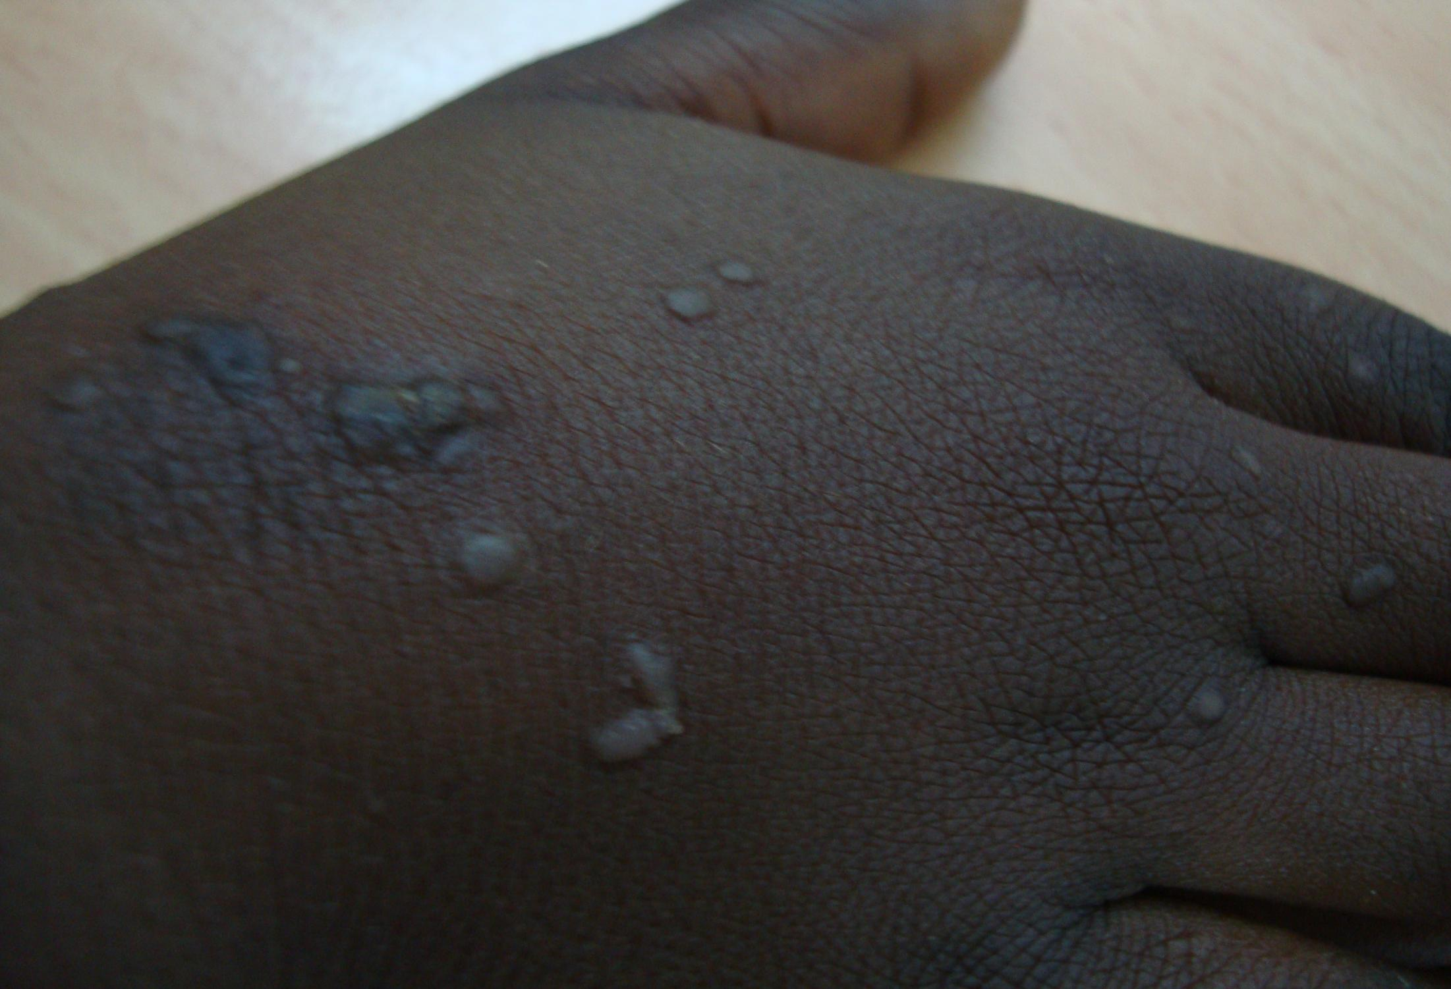

Slide 16
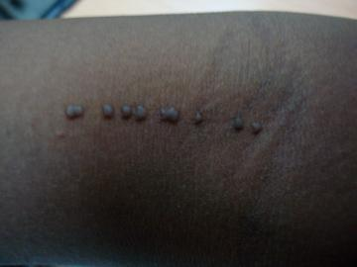

Slide 17
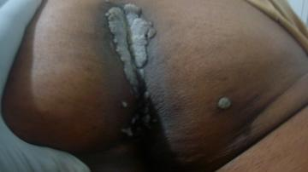

Slide 18
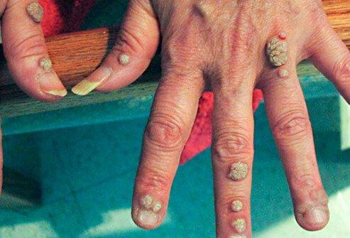
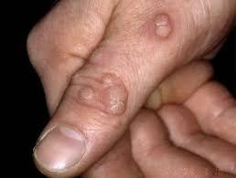
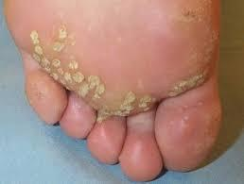

Slide 19
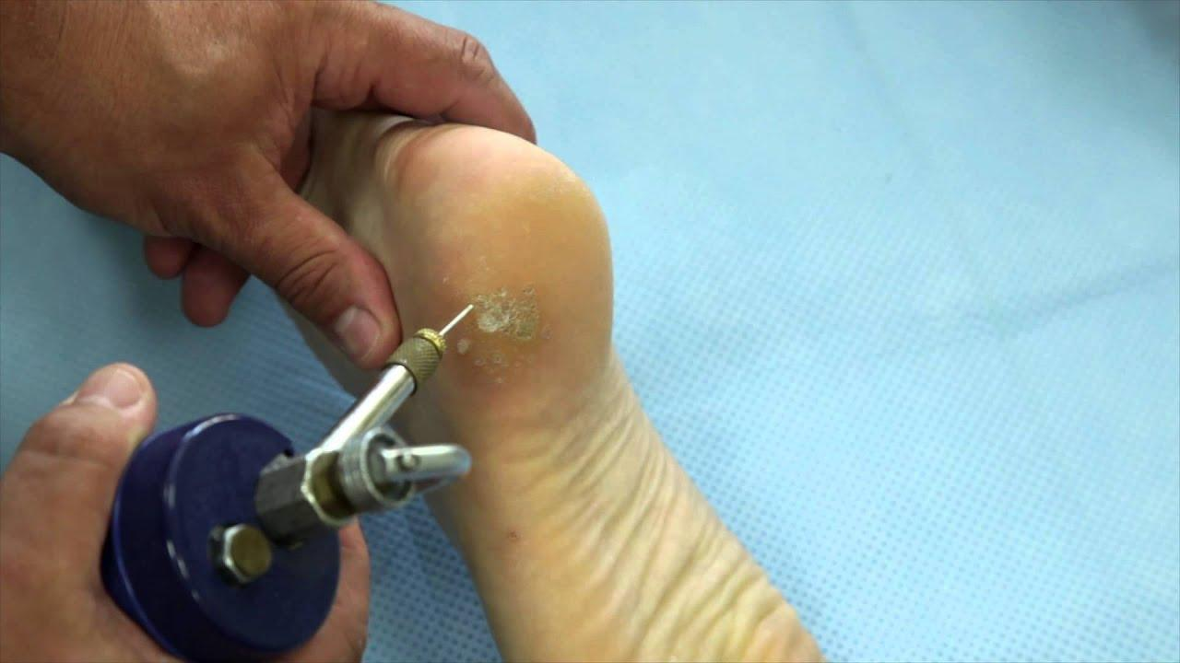
Cryotherpy

Slide 20
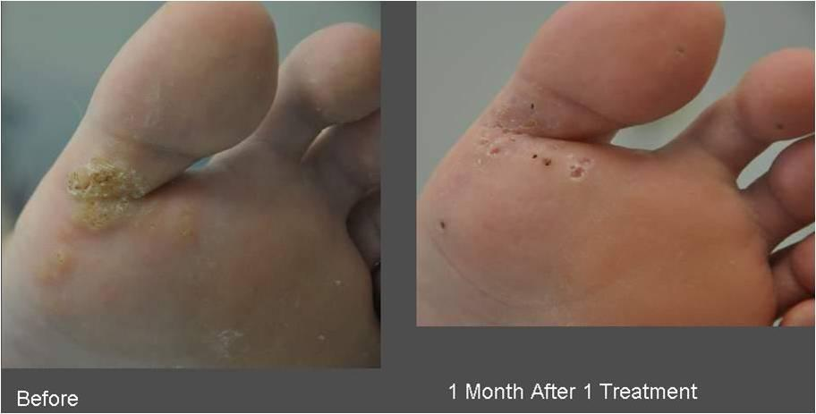

Slide 21
2- Molluscum Contagiosum
Molluscum contagiosum is a benign viral infection of the skin
Most commonly affects children.
May also occurs in adults particularly immunocompromised.

Slide 22
Cause
Is caused by a poxvirus (largest virus)
It is transmitted by:
Person-to-person contact
Through casual contact with contaminated objects (towels, sports equipment)
Sexually transmitted in adults
Auto infection by scratching the lesions

Slide 23
Clinical features
Lesions begin as tiny papules
Increase in size, reach an average size of 6 mm
Are smooth, shiny, skin colored with a central depression
Usually appear in groups.

Slide 24
Diagnosis
The lesions are distinctive and clinical diagnosis is typical

Slide 25
Treatment
In children, the infection is usually self-limiting and often resolves in about a year
Treatment is by physical or chemical destruction of the lesion
Treatment is similar to Viral warts mentioned previously

Slide 26
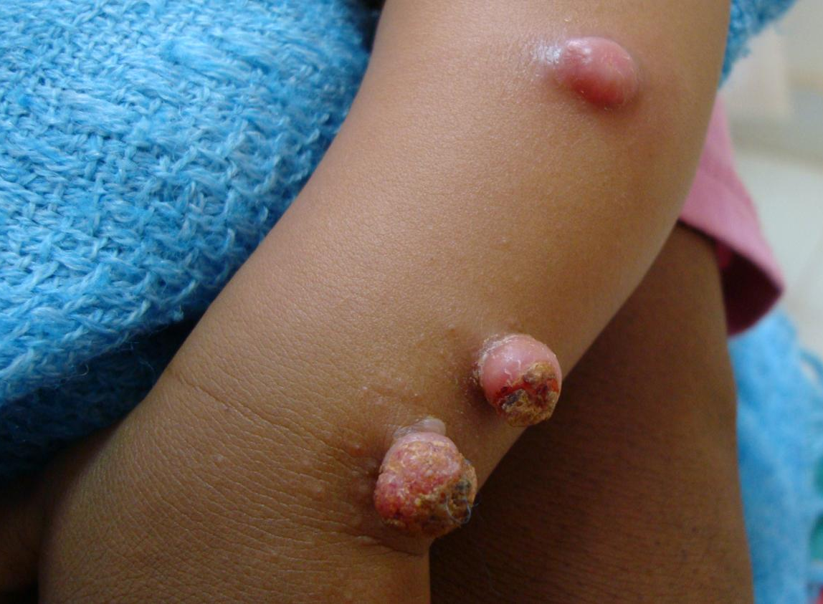
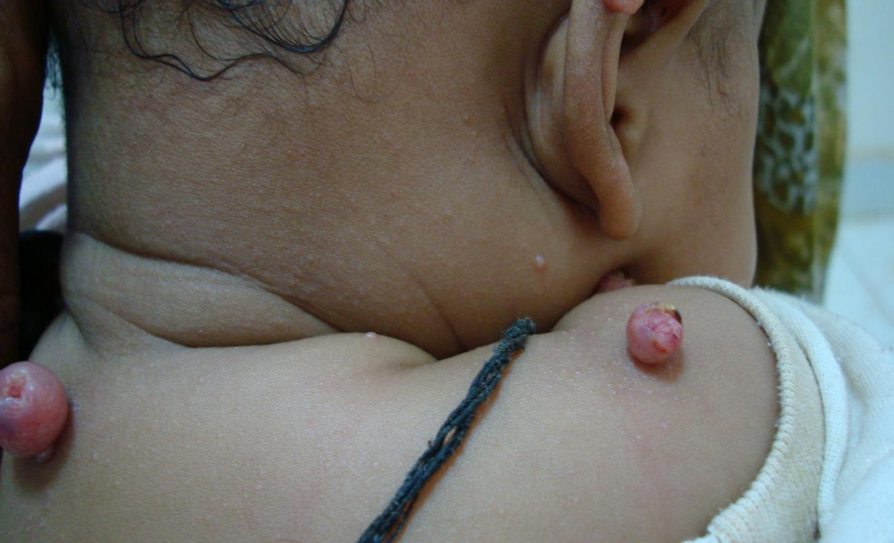

Slide 27
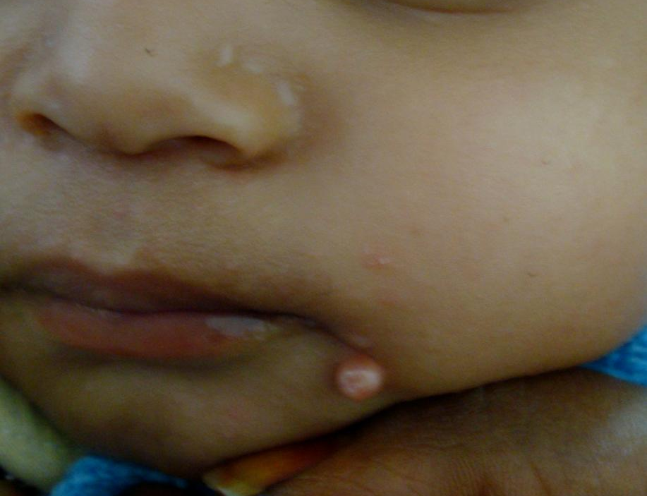
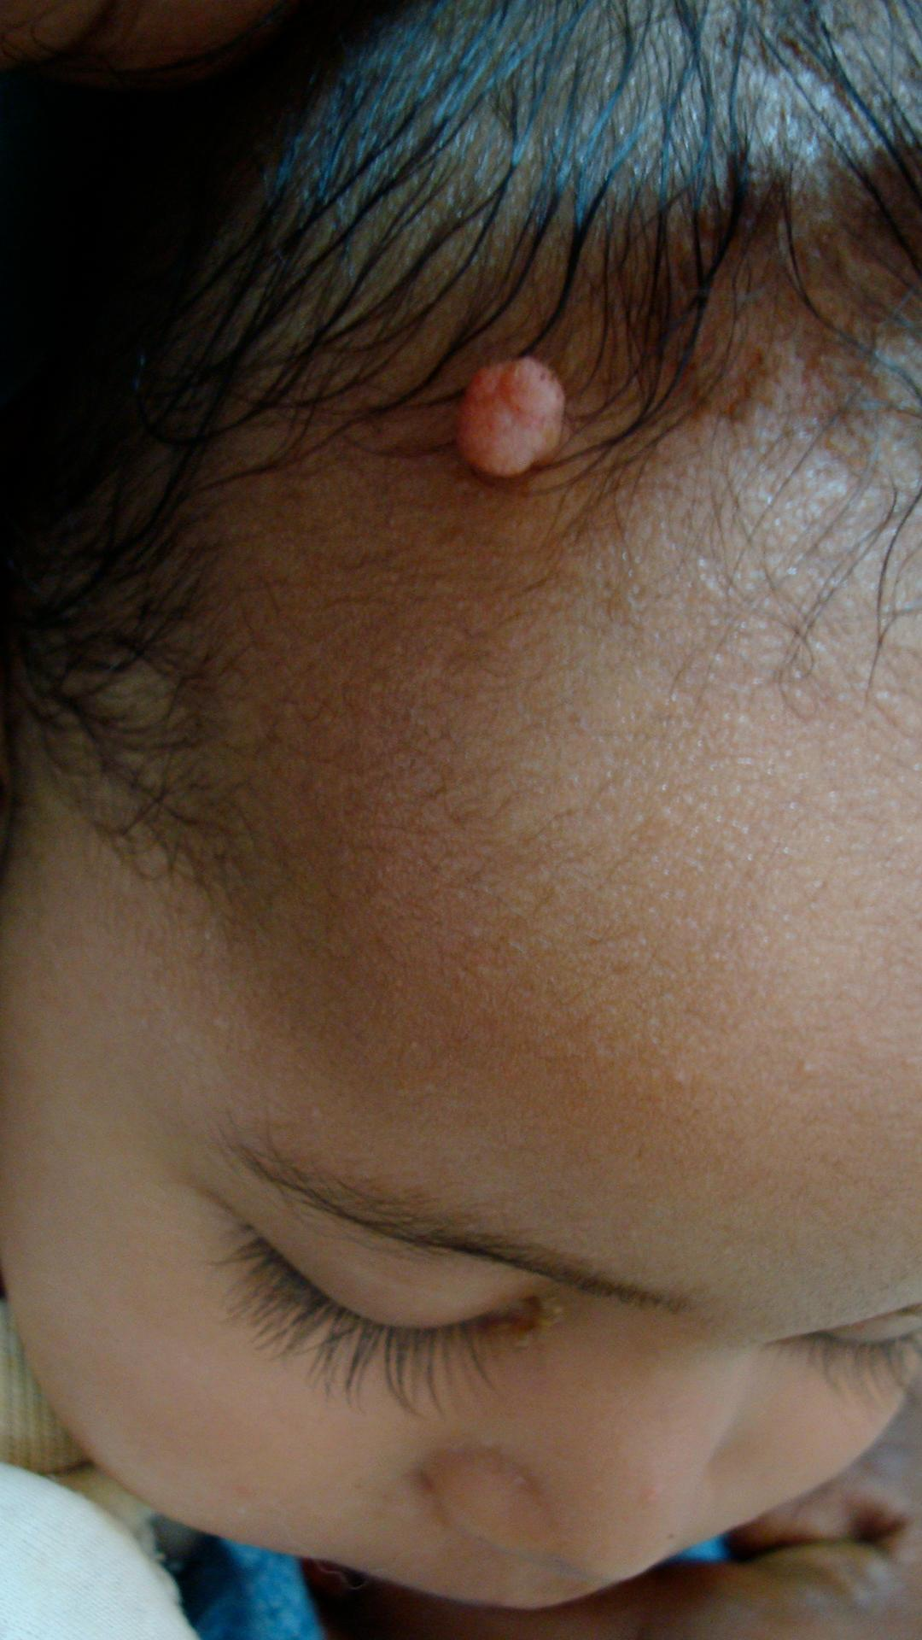

Slide 28
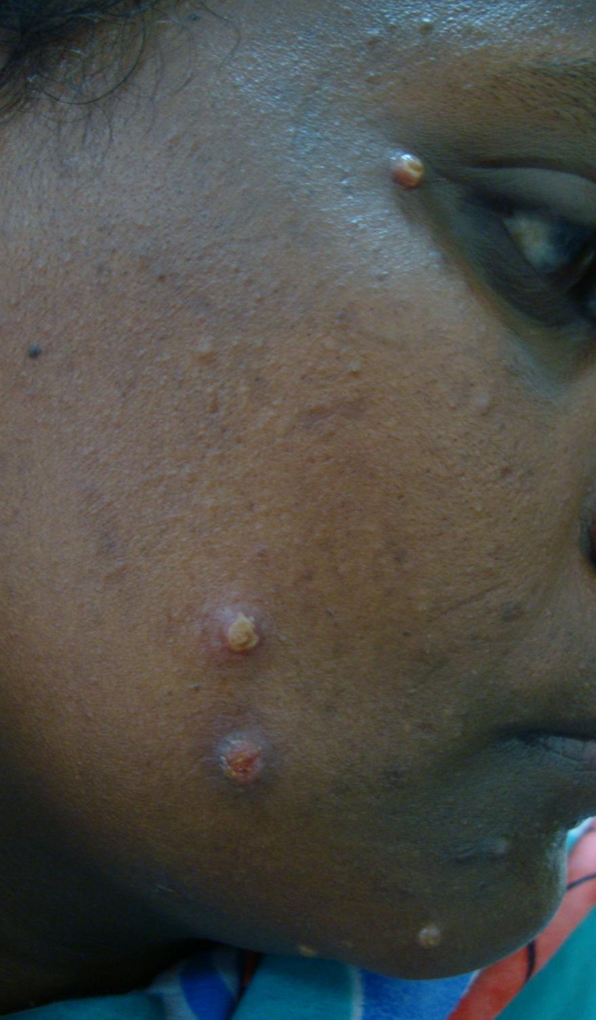

Slide 29
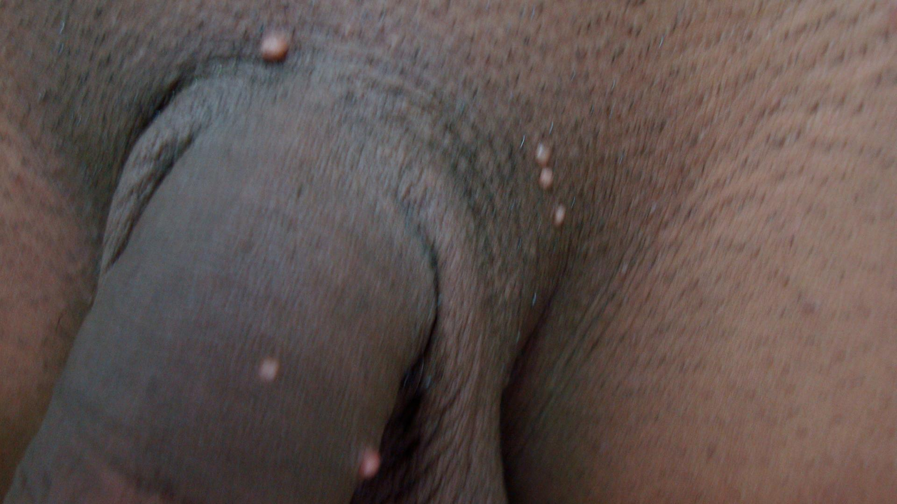

Slide 30
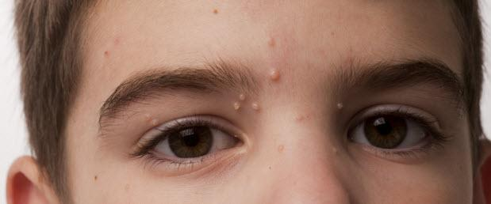
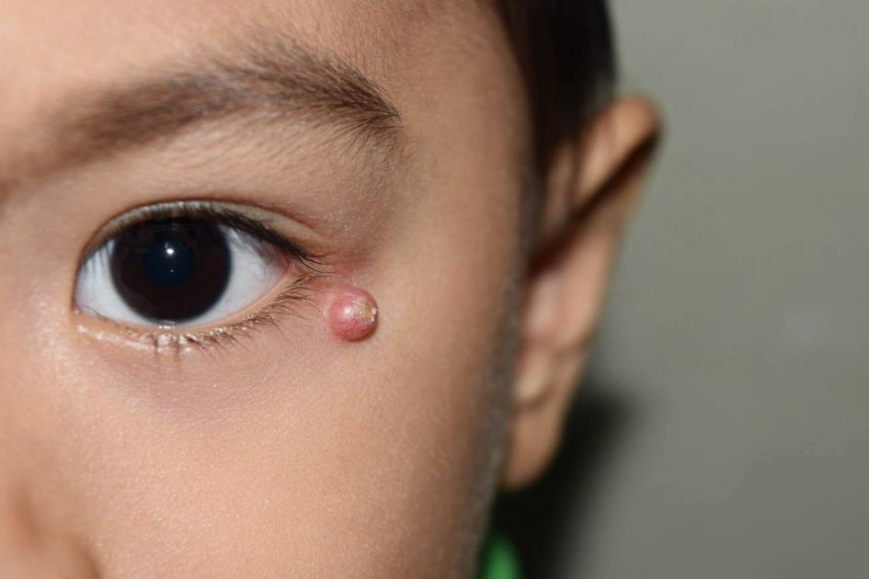
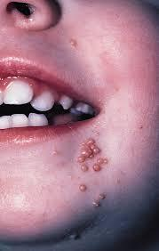

Slide 31
3- Chicken Pox
Chickenpox (varicella) and herpes zoster (shingles ) are distinct diseases caused by the varicella-zoster virus
Chickenpox is a bollus (blister disease).
Chickenpox is a highly contagious disease that usually occurs in childhood
It is the manifestation of a primary infection with varicella-zoster virus

Slide 32
Transmission
Approximately 90% of chickenpox cases occur in children under 10 years of age
The infection is transmitted by airborne droplets containing the virus
Incubation period is 2 weeks after exposure
The patient is contagious some few days before the rash appears

Slide 33
Clinical features
Before skin lesions (2 or 3 days) :
Young children have a low-grade fever, and general malaise
Adults have fever, chills, malaise, headache, and possibly, sore throat appear before the rash

Slide 34
Clinical features
Blisters appear first on the face and scalp, then on the trunk, and then on the arms and legs
Itchy blisters initially appear on erythematous base
Blisters are typically with central punctum
They resolve in 1 to 3 weeks, usually without scarring.
Once all the lesions are crusted over, patient is no longer contagious.

Slide 35
Treatment
No specific treatment is required
Symptomatic relief from itching an important part of treatment
Calamine lotion can be applied, the cool sensation helps control the itching
Systemic antibiotics is given in some cases to prevent secondary bacterial infection (but should not be a routine for all cases)

Slide 36
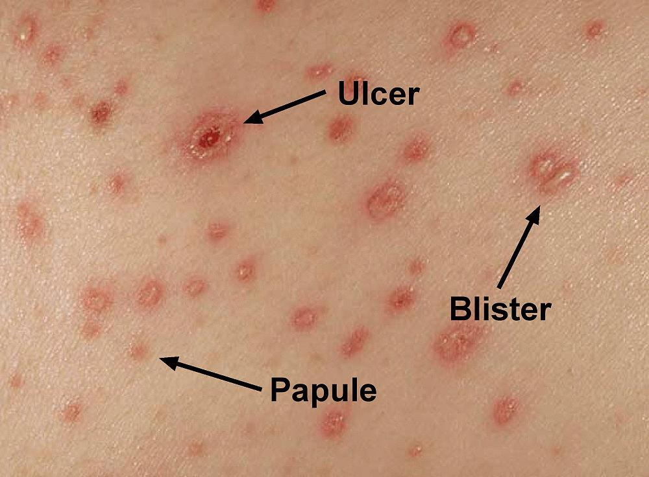
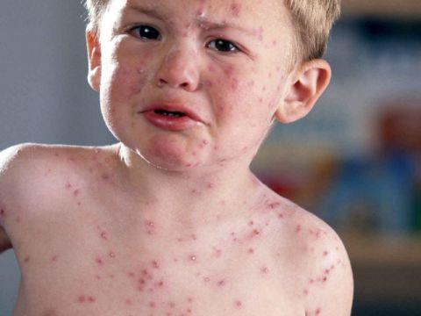

Slide 37
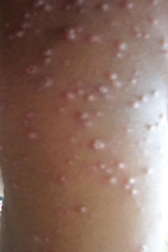
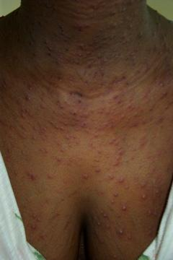

Slide 38
4- Herpes zooster
Herpes zoster is a localized, unilateral eruption
Varicella-zoster virus is found in the posterior root ganglia of all people who experience a chickenpox infection in the past
When the immunity of the individual decreases for any reason, the virus reactivated itself.
HZ is a result of the reactivation of a dormant varicella-zoster virus
HZ cannot be acquired from another person

Slide 39
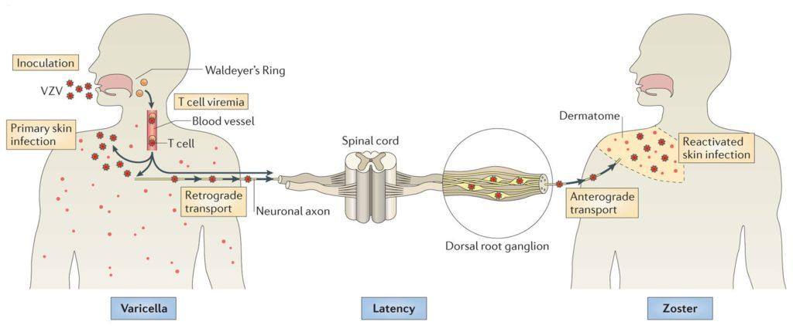

Slide 40
Clinical features
Prodromal phase
Is dominated by constitutional symptoms:
  Pain, burning, and discomfort in the area of nerve distribution
  Headache, photophobia, fever
2. Skin lesions
The lesion is usually seen as a band like eruption on one side of the body (dermatomal) mid line cut off.
3. Erythema (redness) is first seen in the area followed by papules that rapidly blister

Slide 41
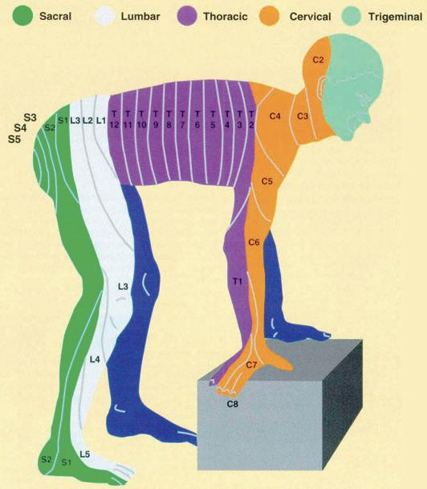

Slide 42
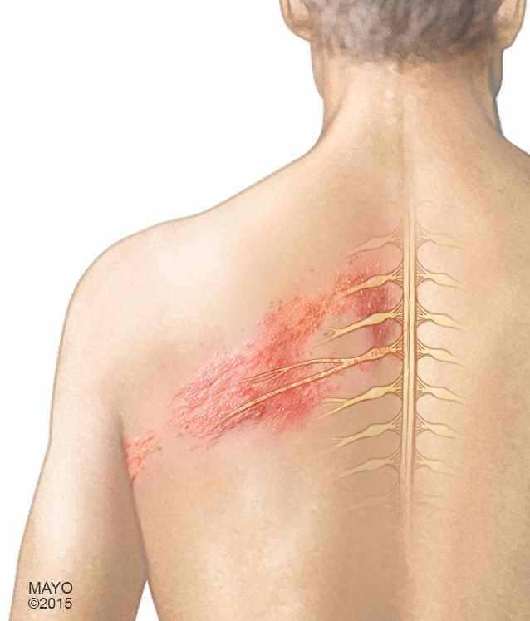

Slide 43
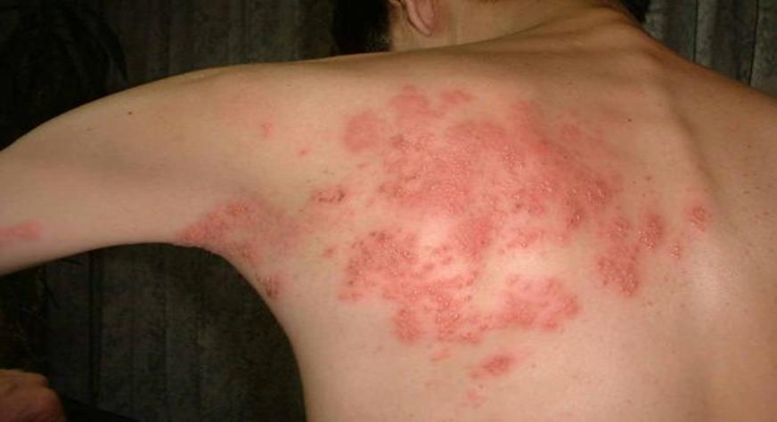

Slide 44
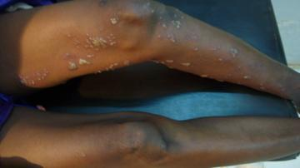

Slide 45
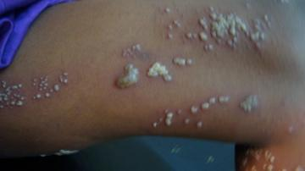

Slide 46
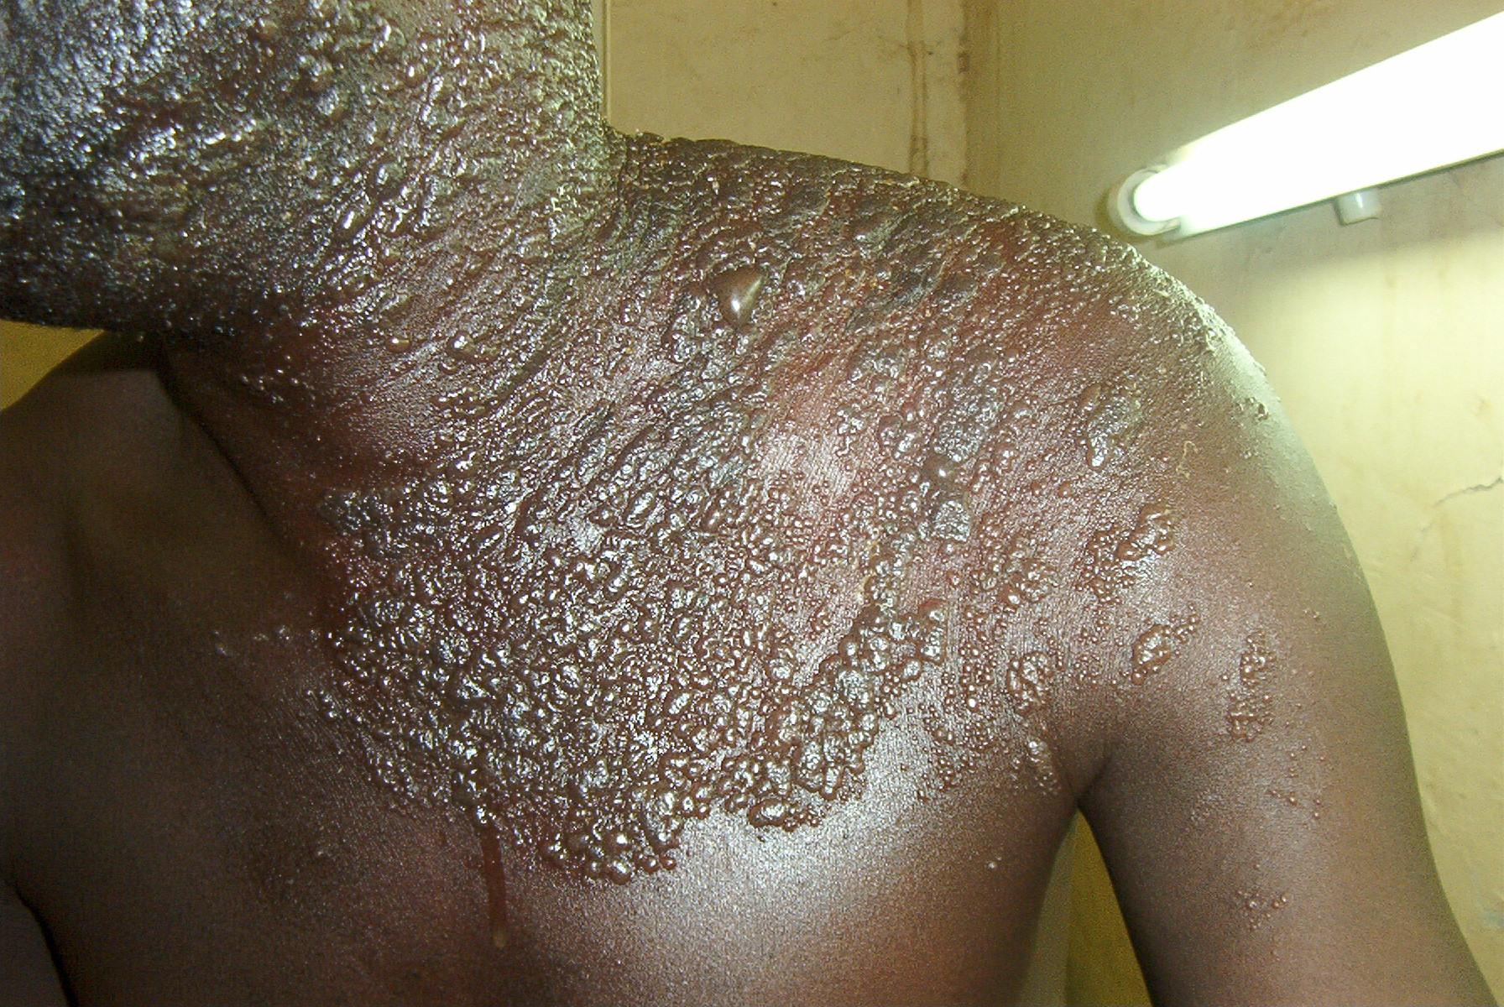

Slide 47
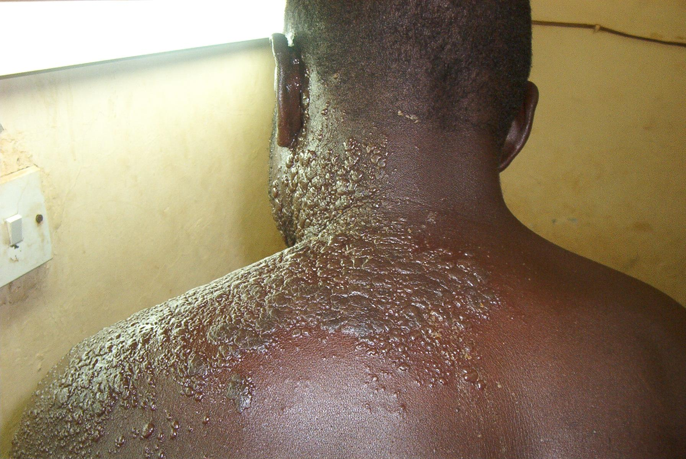

Slide 48
Complication
Post-herpetic neuralgia is a possible complication
PHN is a persistent, severe pain after the rash has subsided
Occurs in 10% to 15% of cases
Is common in extreme ages especially the elderly.

Slide 49
Treatment
Topical or systemic antiviral (acyclovir)
Initiating oral treatment within 72 hours of the onset of HZ can minimize pain and shorten the course of the outbreak.
Sometimes pain killer medication is prescribed

