Slide 1
Vitiligo
Dr Sami Aldaham

Slide 2
Introduction
Vitiligo is a common acquired disorder.
Characterized by well-marginated white spots resulting from loss of melanocytes.
Vitiligo is associated with some autoimmune disorders.
Is associated with social stigma.
Confusion with leprosy is partly responsible for this.

Slide 3
Aetiology & Pathogenesis
Susceptibility to the disease may be inherited.
1/4 to 1/3 of patients have family members affected with the disease.
A multifactorial pattern of inheritance is revealed in most studies.
There are three possible mechanisms that may cause destruction of melanocytes.
However, multiple mechanisms may be responsible for the causation of vitiligo in an individual.

Slide 4
The three possible mechanisms of vitiligo
1. The autoimmune hypothesis
Originated from the observation that vitiligo is associated with some autoimmune diseases.
Suggets that there is an autoimmune damage to melanocytes.
2. The autocytotoxic or self-destruct hypothesis
Suggests that some toxic molecules produced during the biosynthesis of melanin are responsible for melanocyte damage in susceptible individuals.
3. The neural hypothesis
Postulates that neurochemicals liberated from nerve endings are toxic to melanocytes.

Slide 5
Clinical Features
Vitiligo affects all races with an average frequency of 1% to 2% of the population.
Both sexes are affected equally.
The disease may develop at any age, the peak age of onset is between 10 and 30 years.
Stressful life events or physical trauma can often precipitate the onset of disease.

Slide 6
Clinical Features ...
Typically, macule of vitiligo is well-circumscribed depigmented of varying sizes.
The hairs on the patch may turn grey.
There may be a single or numerous depigmented macules distributed all over the body.
With time, the macules may enlarge and coalesce to produce extensive pigment loss.
The lesions are asymptomatic.

Slide 7
Clinical types
According to:
The extent of involvement
Pattern of distribution
Is clinically categorized into the following types:
Focal
Segmental
Generalized
Acrofacial
Universal

Slide 8
Clinical types ...
1.Focal vitiligo
Is an isolated macule or a few macules in a localized non-dermatomal distribution.
2.Segmental vitiligo
Is characterized by macules in a unilateral dermatomal distribution.

Slide 9
Clinical types ...
3.Generalized vitiligo
Is the most common type showing macules in a generalized widespread distribution.
There is often symmetry of affection.
Sites: Face (particularly around the orifices), neck, bony prominences of hands, legs, axillae and mucosal surfaces are particularly affected.

Slide 10
Clinical types ...
4.Acro-facial vitiligo
Affects distal end of fingers and facial orifices.
5.Universal Vitiligo
Implies loss of pigment over the entire body surface area with only isolated islands of normal pigmentation remaining.

Slide 11
Associated diseases
Patients with vitiligo have an increased risk of developing autoimmune diseases like:
Alopecia areata
Thyroid diseases
Addison's disease
Pernicious anaemia
Insulin-dependent diabetes mellitus.

Slide 12
Psychosocial impact of vitiligo
Although vitiligo by itself is asymptomatic and does not cause any physical discomfort or disability.
It may be associated with devastating psychological and social consequences.
Feeling of stress and embarrassment on social contacts, lowered self-esteem may be detrimental to the patients, particularly when the lesions are on visible area of the body.

Slide 13
Treatment
With treatment, re-pigmentation occurs around the hair follicles, which is achieved by stimulation and migration of follicular melanocytes.
Spread of pigmentation from the margin of the patch can also occur.
Whatever the mode of therapy, patient education and reassurance is very importance.
Explanation of the benign nature of the disease and psychological support is needed in all patients.
Notes:
Ultraviolet A 320 to 400nm range

Slide 14
Treatment
1- Topical steroids
Are effective in the management of disease limited to small area.
Lesions on face and neck respond better than other parts or the body. Hydrocortisone is the topical agent of choice.
More potent steroids can also be used intermittently.

Slide 15
Treatment ...
2- PUVA therapy
PUVA therapy (Psoralen + Ultraviolet A) is the mainstay of management of vitiligo.
Topical PUVA involves painting the area with psoralen solution and exposing the area to UVA.
Patients with limited involvement are best suited for this mode of therapy.
Is used in patients with extensive vitiligo.
Is avoided in children below the age of 12.
It is contraindicated in pregnancy and lactation.

Slide 16
Treatment ...
2-Surgical treatment
When topical steroids or PUVA therapy fails to repigment, surgical treatment may be undertaken.
Best suited for segmental and localized vitiligo.

Slide 17
Treatment ...
3- Depigmentation
In patients with extensive vitiligo.
Depigmentation of the remaining islands of normal skin may be more cosmetically acceptable.
To achieve this, hydroquinone in a concentration of 20% is applied twice a day on the pigmented skin.
It may take months to establish depigmentation, which is usually permanent.

Slide 18
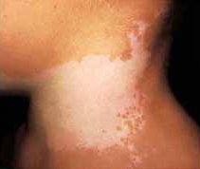
Focal vitiligo

Slide 19
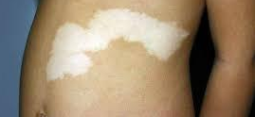
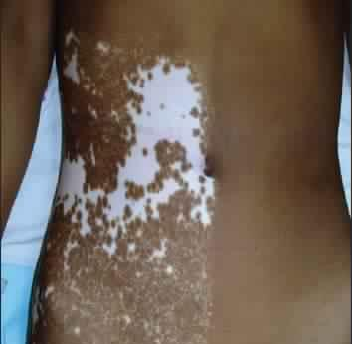
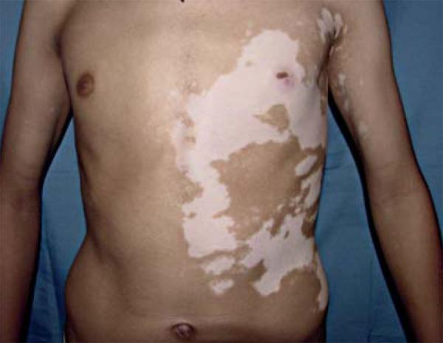
Segmental vitiligo

Slide 20
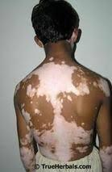
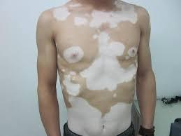
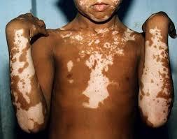
Generalized vitiligo

Slide 21
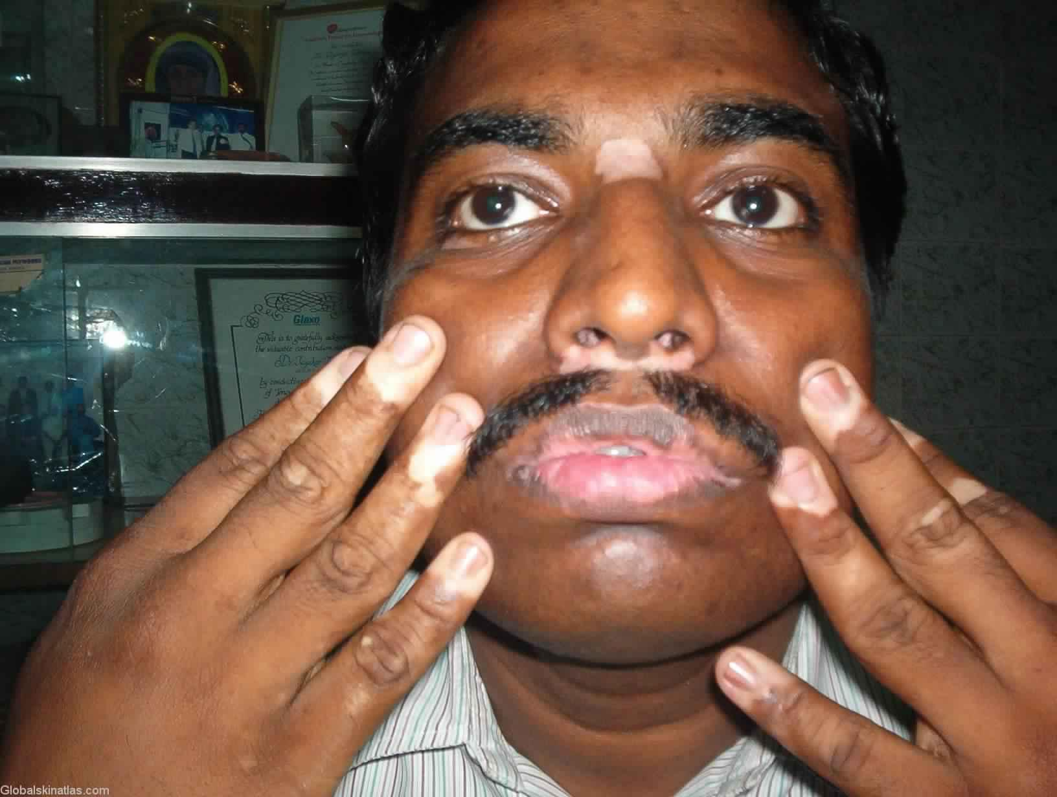
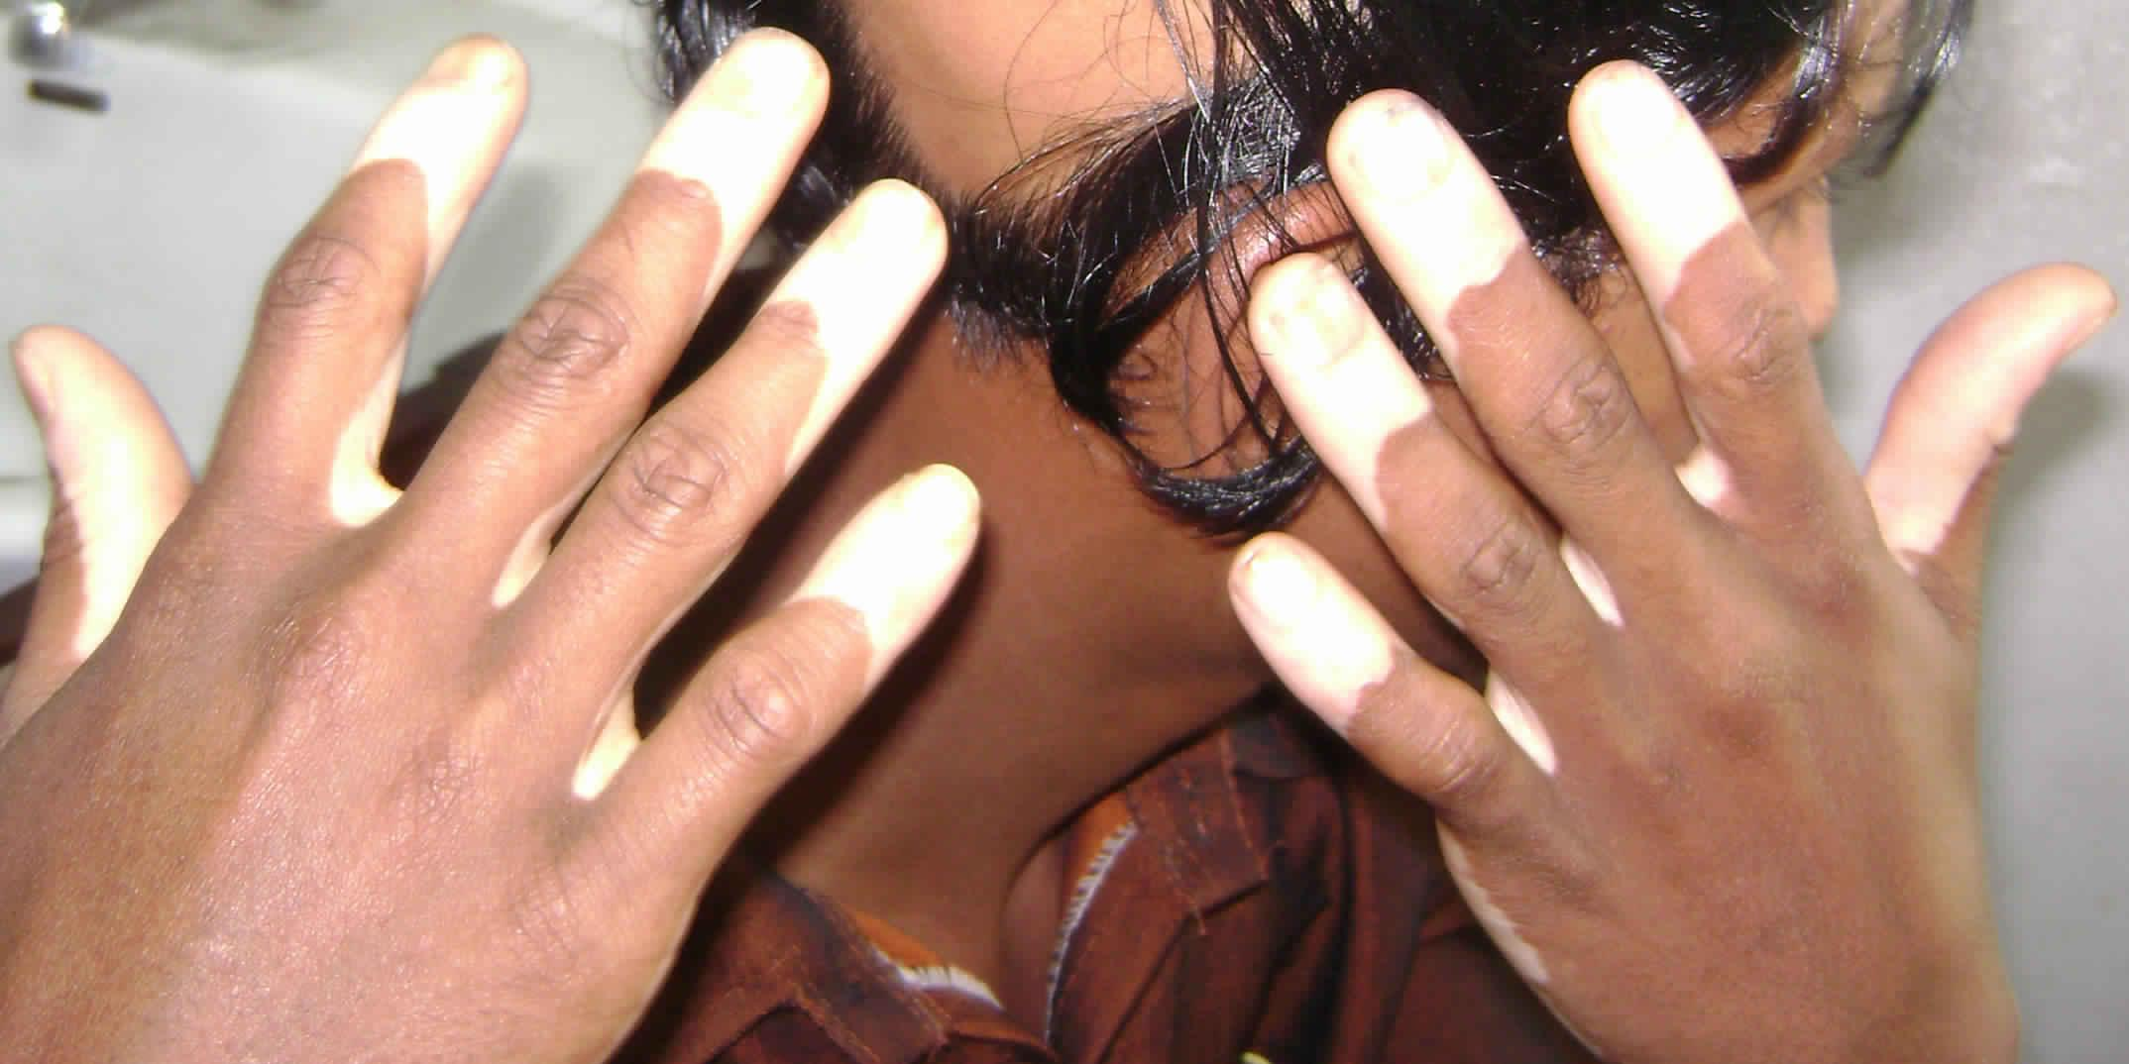

Acro-facial vitiligo

Slide 22
Thank you

