Slide 1
Benign Skin Lesions
Dr Sami Billal
MBBS,MSc,MD, PhD

Slide 2
Goals and Objectives
The purpose of this module is to help the learner recognize and manage some of the most common benign skin lesions
By completing this module, the student will be able to:
Identify and describe the morphology of common benign skin lesions
Educate patients about these lesions
Discuss management options of these lesions as appropriate

Slide 3
Case One
A 42-year-old male presents with a “new mole” on his back, first noticed by his wife 4 months ago
The lesion sometimes itches and it bled once after getting caught on his shirt

Slide 4
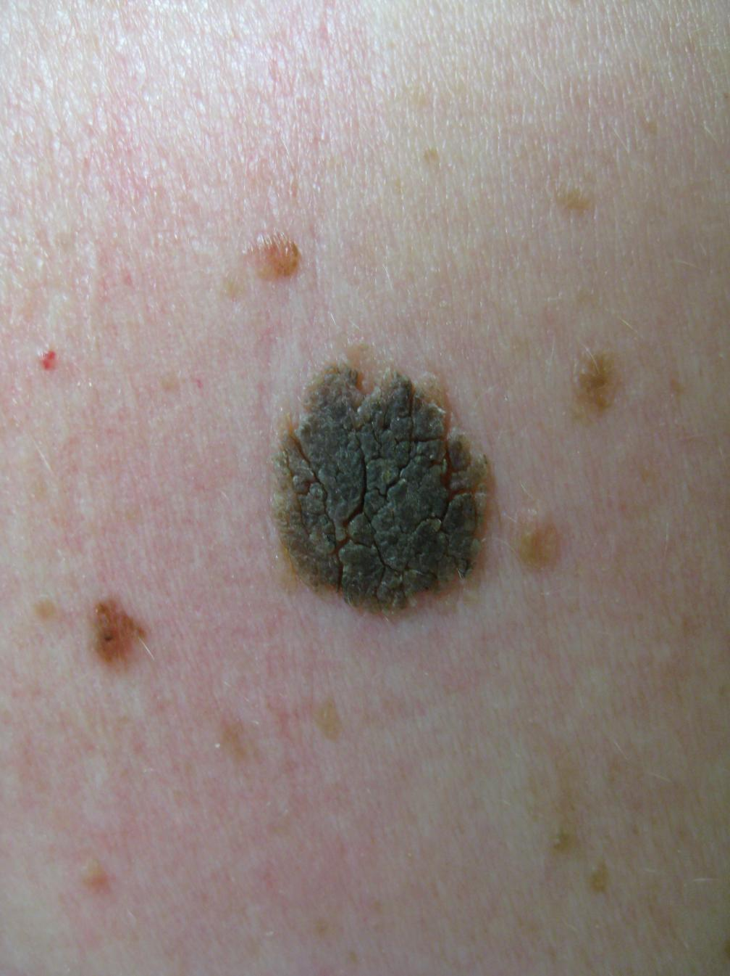
Seborrheic keratosis
It is Seborrheic keratosis
Typically appear as sharply marginated, pigmented lesions
Can arise on all body surfaces except palms and soles
Usually papular, but may appear macular

Slide 5
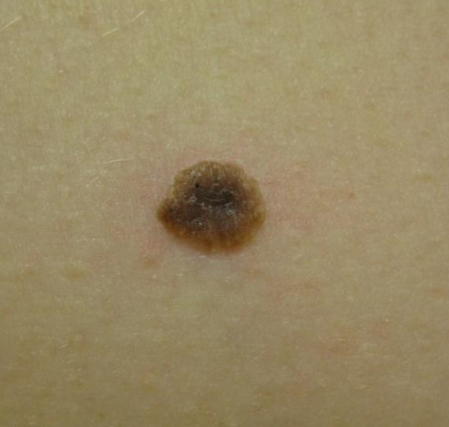
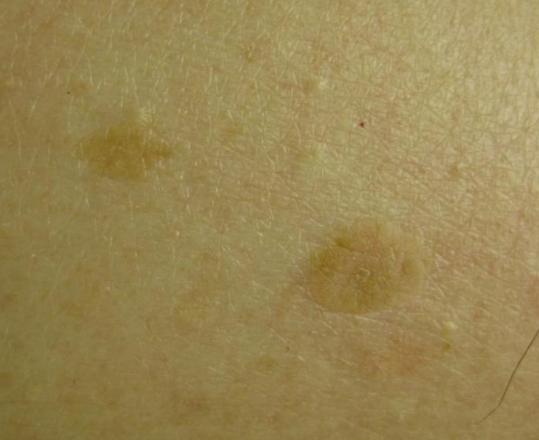
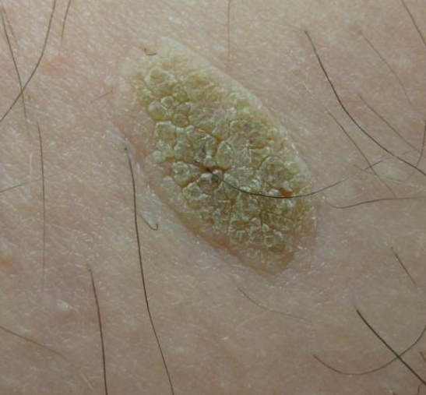
Seborrheic keratosis
Color is variable (black, tan, flesh colored, pink, and blue)
Texture can vary from velvety to verrucous (wart-like)…
Velvety, dark brown
Light tan or almost skin colored
Verrucous, tan

Slide 6
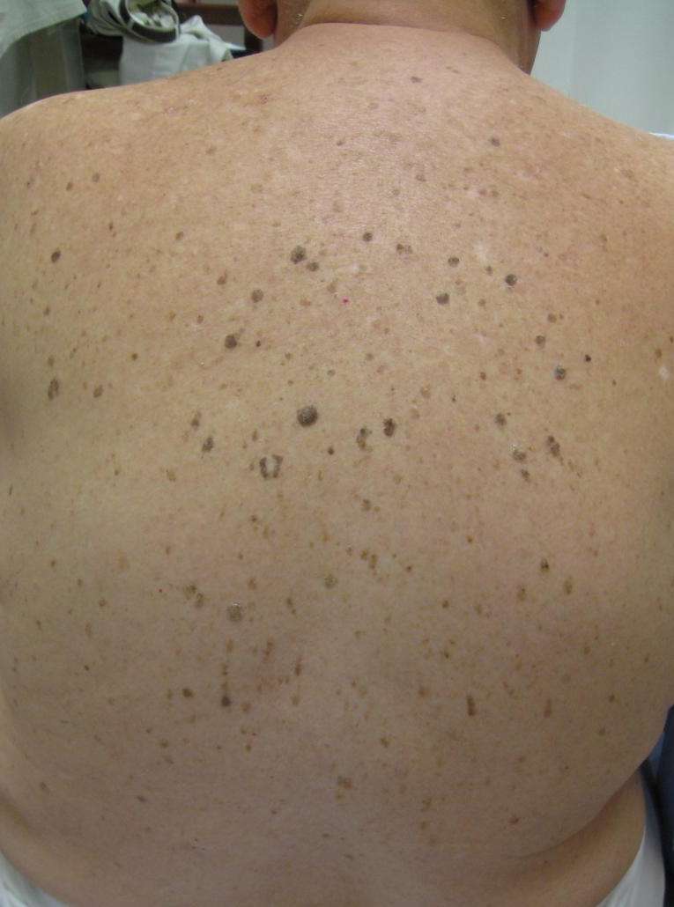
Seborrheic keratoses (SKs)
Often multiple and can be extensive
SKs usually begin to appear during and after the fourth decade and continue to arise throughout life
Contrast this with nevi, which typically appear in the first three decades of life
A new nevus at age 50 should raise suspicion of melanoma.

Slide 7
SKs are superficial epidermal growths.
They have a stuck-on quality, like a piece of wax pressed onto the skin.

Slide 8
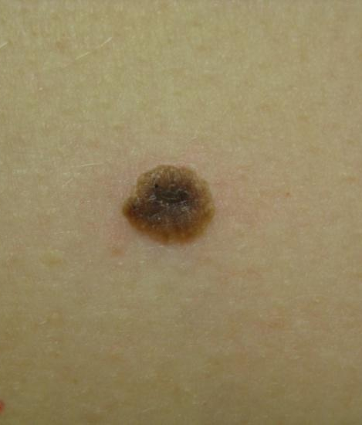
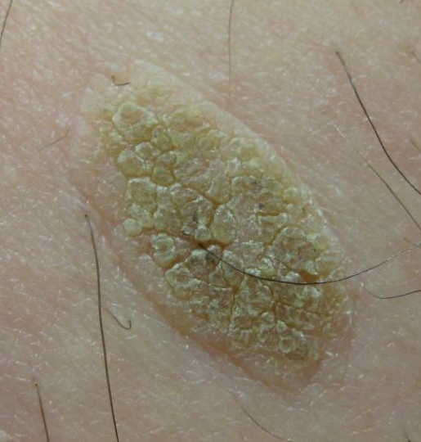

Slide 9
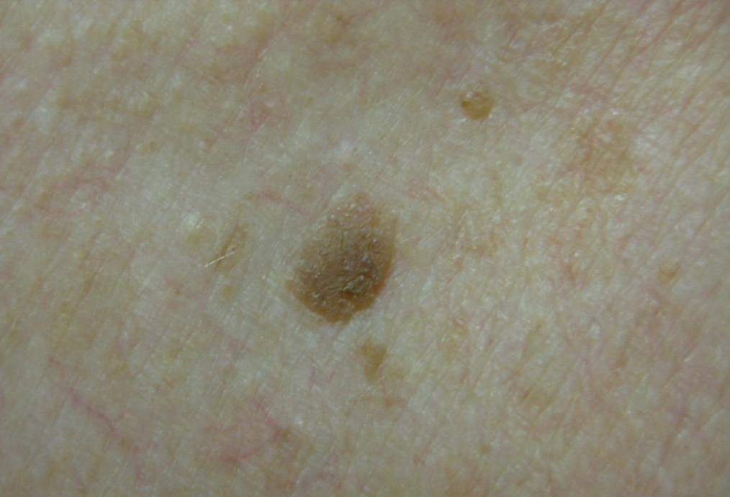
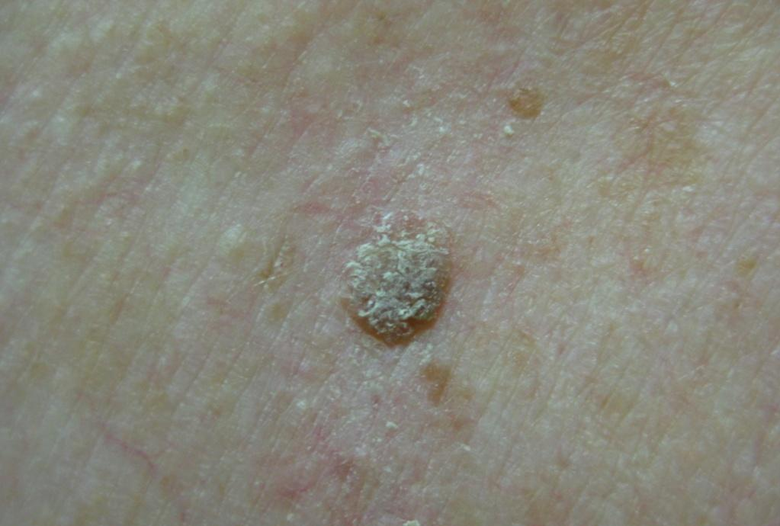
How can I tell if a lesion is a seborrheic keratosis?
If you are in doubt of the diagnosis, try gently picking or scratching the lesion.
It may crumble , flake, or lift off, revealing that superficial waxy character.

Slide 10
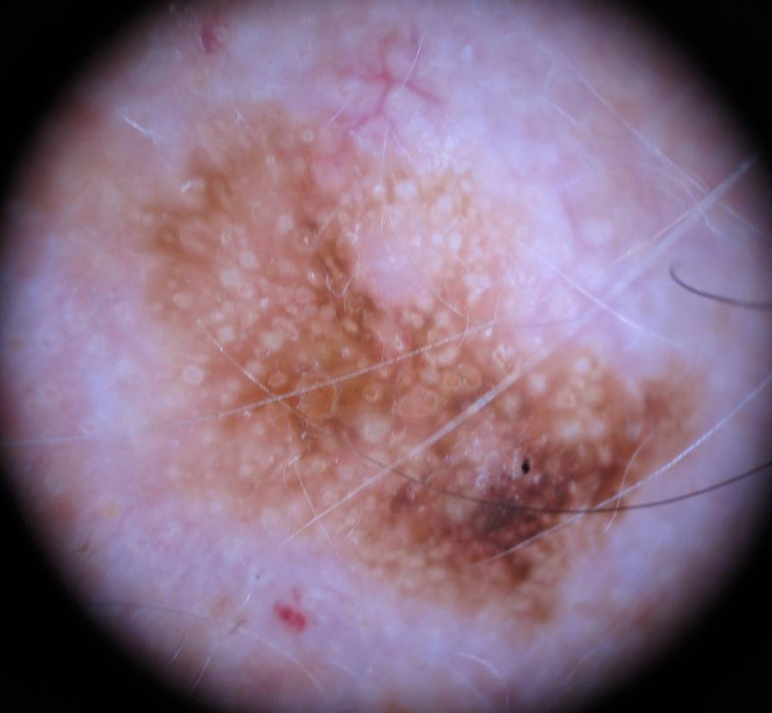
How can I tell if a lesion is a seborrheic keratosis?
Use dermoscopy to look for keratin pseudocysts
These are small white spots commonly found in seborrheic keratoses

Slide 11
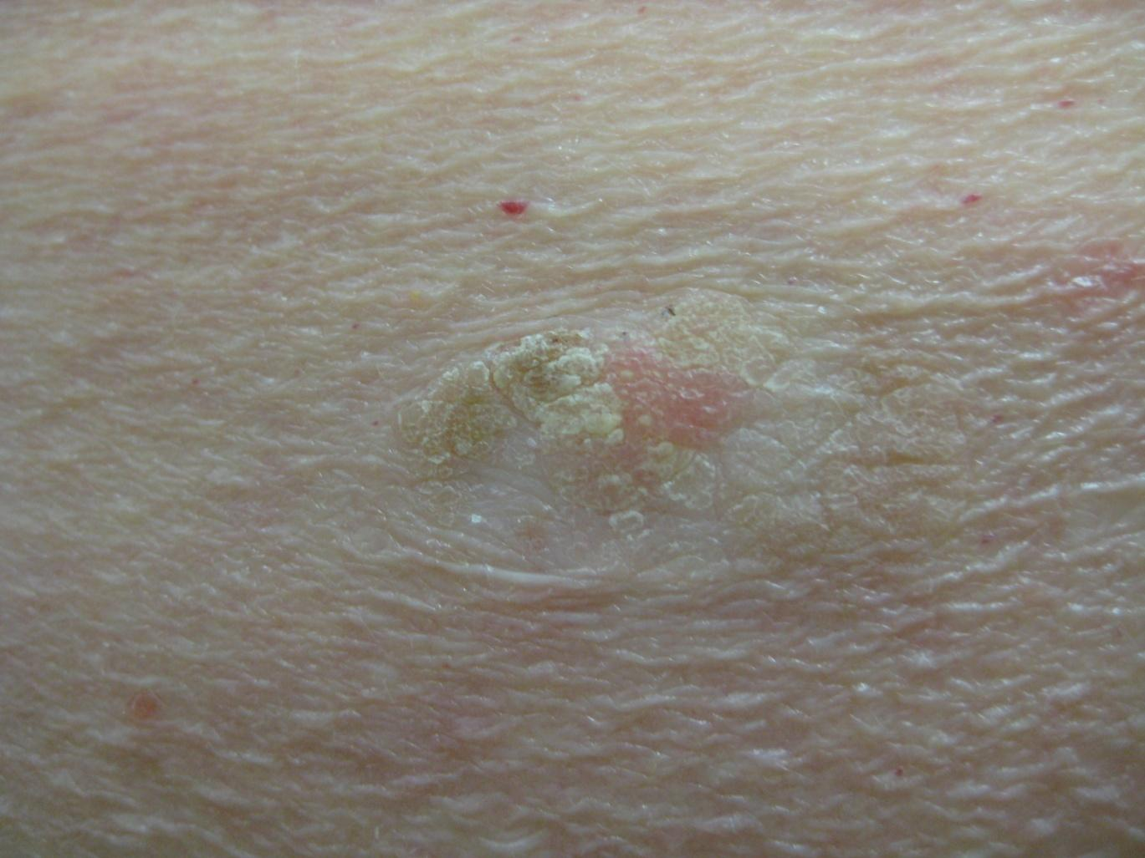
Treatment of seborrheic keratoses
Though harmless, SKs can occasionally become irritated or can be cosmetically bothersome
When necessary, SKs may be treated with curettage, cryotherapy, electrodessication and shave removal
If picked off or curetted, SKs will leave a pink moist base with minimal bleeding
This SK has been partially picked off

Slide 12
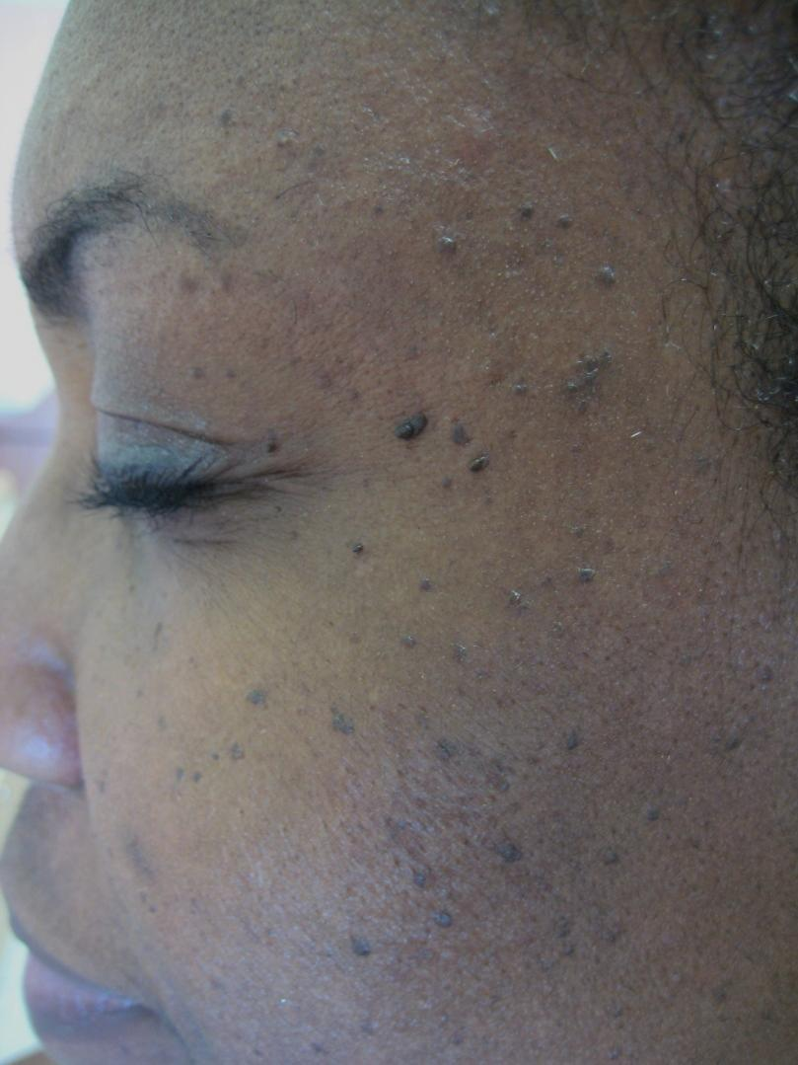
“Doctor, can you remove my freckles?”
Are these freckles?
No, they are considered a variant of SKs
Dermatosis papulosa nigra
Multiple, small, hyperpigmented, sessile to filiform, smooth-surfaced papules
Arise in darker skin types, usually on the cheeks and temples

Slide 13
Treatment of Dermatosis papulosa nigra
Harmless, but may be a cosmetic issue for some
Would you treat these lesions with liquid nitrogen?

Slide 14
Dermatosis papulosa nigra
No. Why not use liquid nitrogen?
Freezing could cause unsightly hypopigmentation
Melanocytes are very sensitive to cold
Which “treatment” might you choose?
Very light electrodessication is often safest (use of electric current to cause superficial destruction)

Slide 15
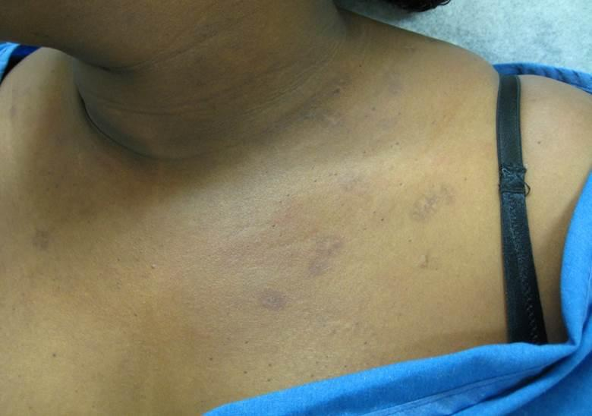
Dyspigmentation after cryotherapy
This patient had SKs treated with cryotherapy and now has permanent dyspigmentation
Even with electrodessication, a test spot is in order to determine how the patient is likely to react

Slide 16
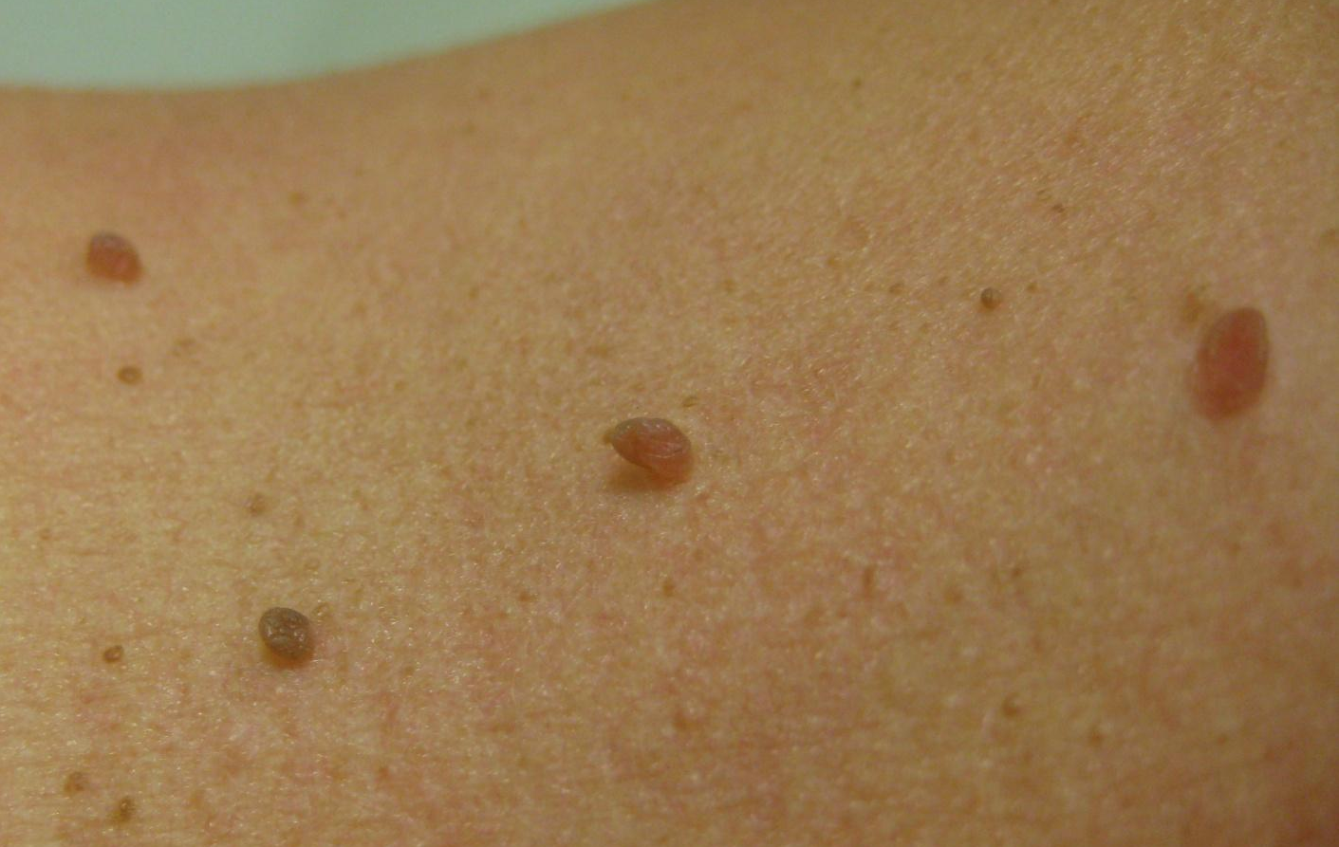
Case Two
“Doctor, these ‘moles’ keep getting caught on my necklaces. Can you remove them?”

Slide 17
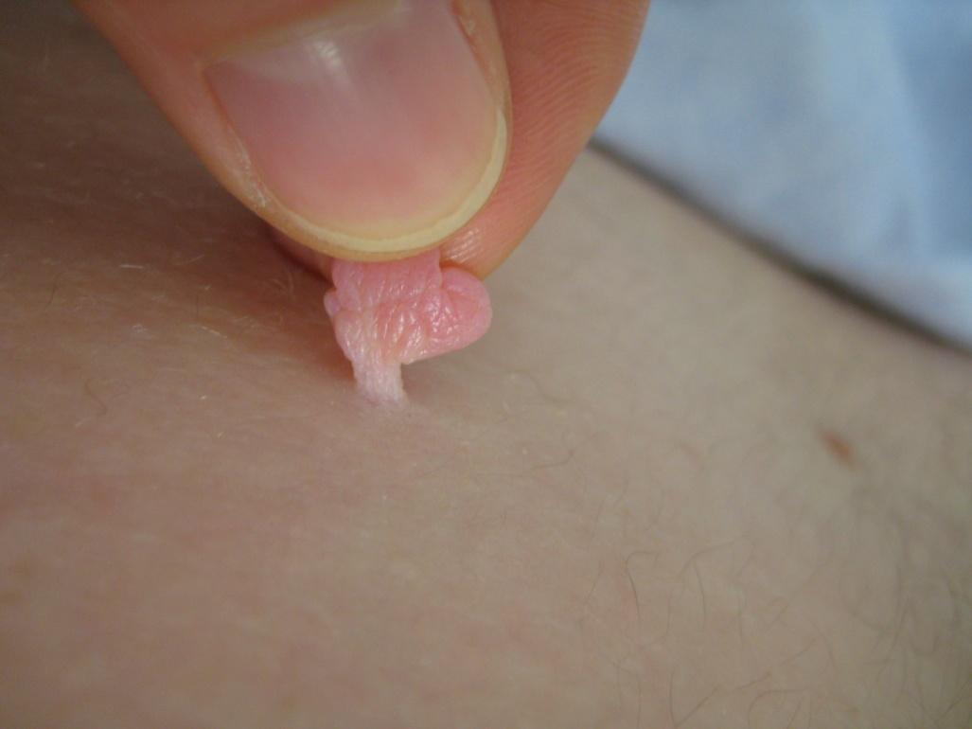

Skin tags
Acrochordons are skin-colored to brown, often pedunculated, fleshy papules
They arise on the eyelids, neck, axillae, and groin
Usually asymptomatic, but can become painful secondary to irritation or infarction

Slide 18
Causes
Genetics
Obesity
Friction may all play a role
common in pregnancy
marker for insulin resistance

Slide 19
Skin tag removal is elective
1- Snipping (use pressure or aluminum chloride for any bleeding)
2- Liquid nitrogen (for lighter skin types)
3-Electrodessication
Occasionally skin tags will outgrow their blood supply or become twisted such that their blood supply is cut off and they undergo necrosis, subsequently falling off on their own.

Slide 20
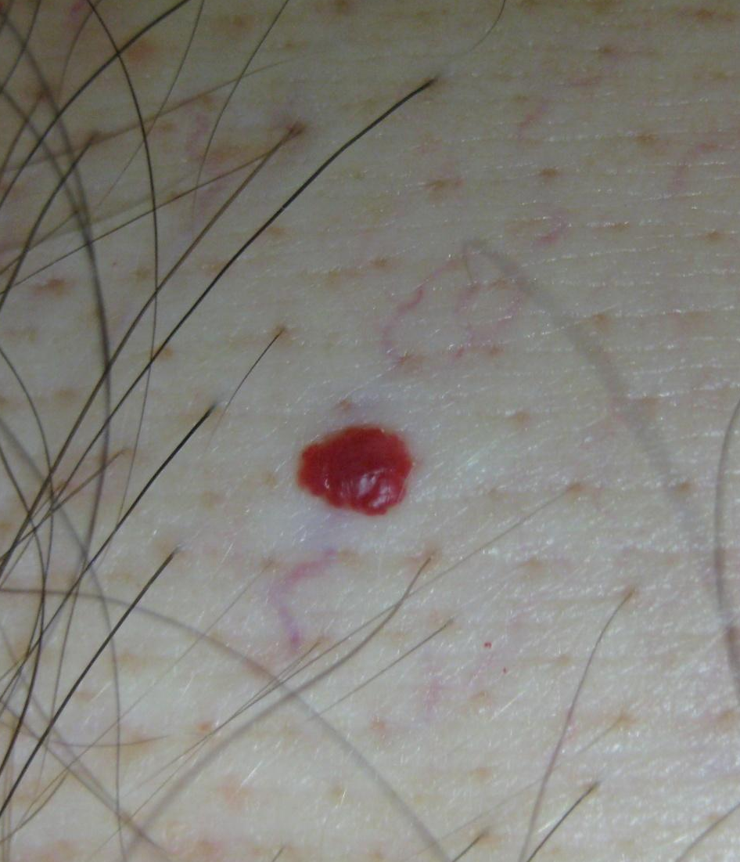
Case Three
A45-year-old male presents with a “red mole” which appeared 6 months ago and has increased in size
It is not tender and has not bled

Slide 21
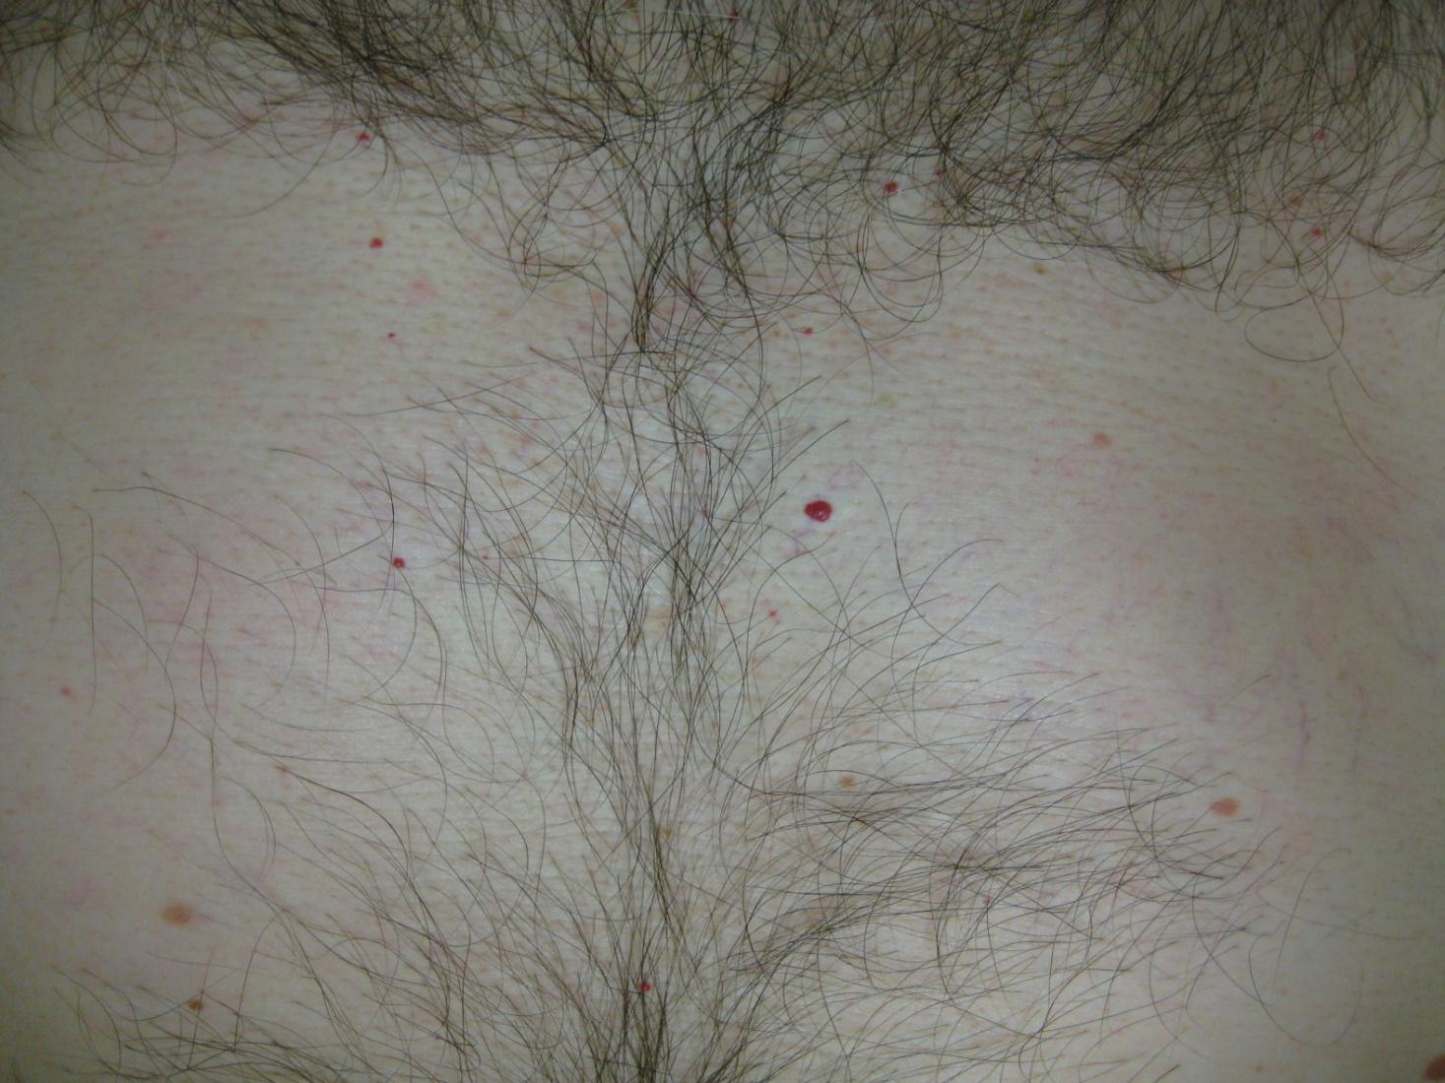
Cherry angiomas
Cherry angioma
Common acquired vascular proliferation
Usually develop in 4th decade and increase in number over time
Highest concentration on the trunk

Slide 22
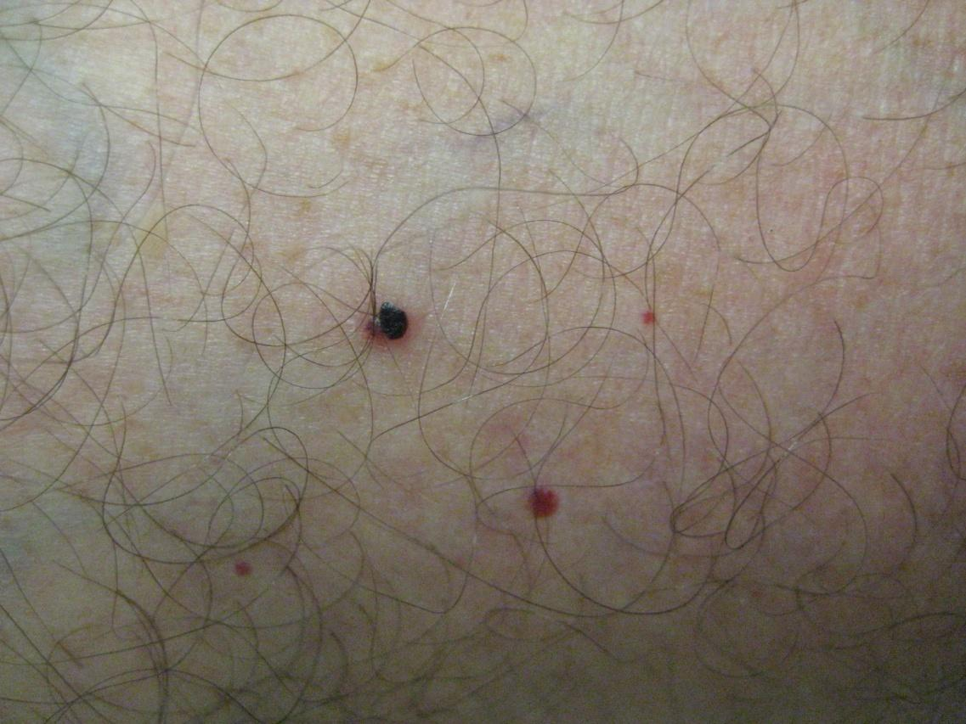
Traumatized cherry angioma
Occasionally cherry angiomas may bleed or thrombose, thereby mimicking melanoma
“When in doubt, biopsy or refer it out”

Slide 23
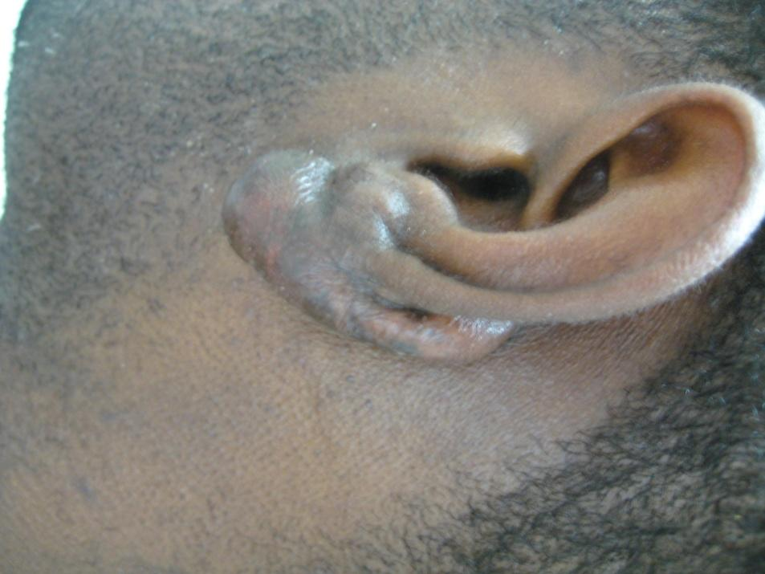
Case Four
A healthy 24-year-old African American male presents with an itchy, firm growth on the earlobe, which arose (gradually increasing in size) over several months after an ear piercing

Slide 24
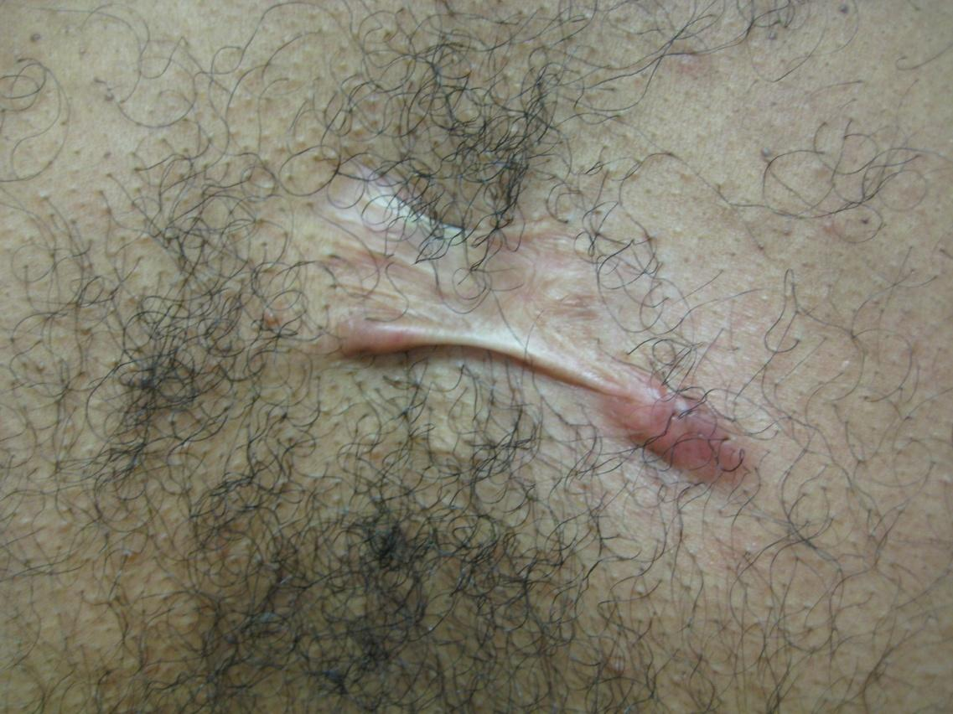
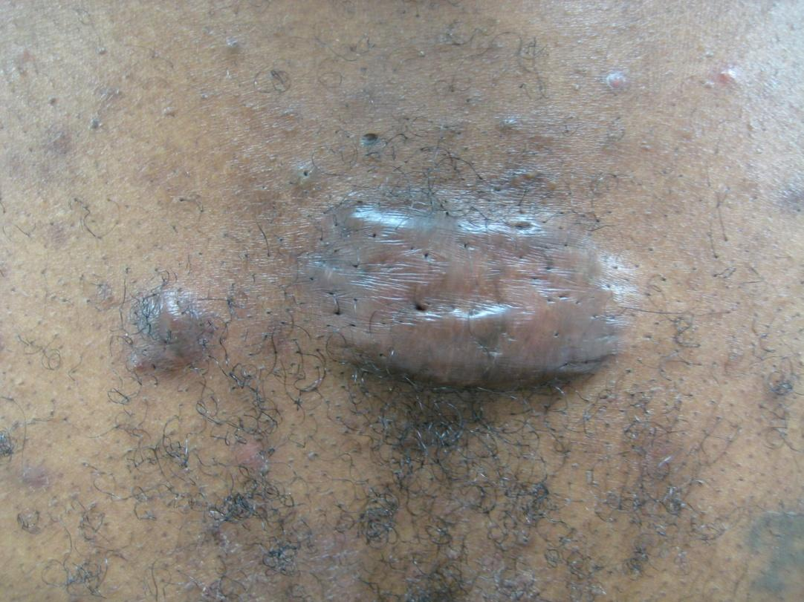
Keloids
Keloid result of abnormal wound healing leading to overgrowth of scar tissue beyond the original scar site
More common on upper trunk and earlobes
Genetic influence (most common in African-Americans) plus with some form of skin injury

Slide 25
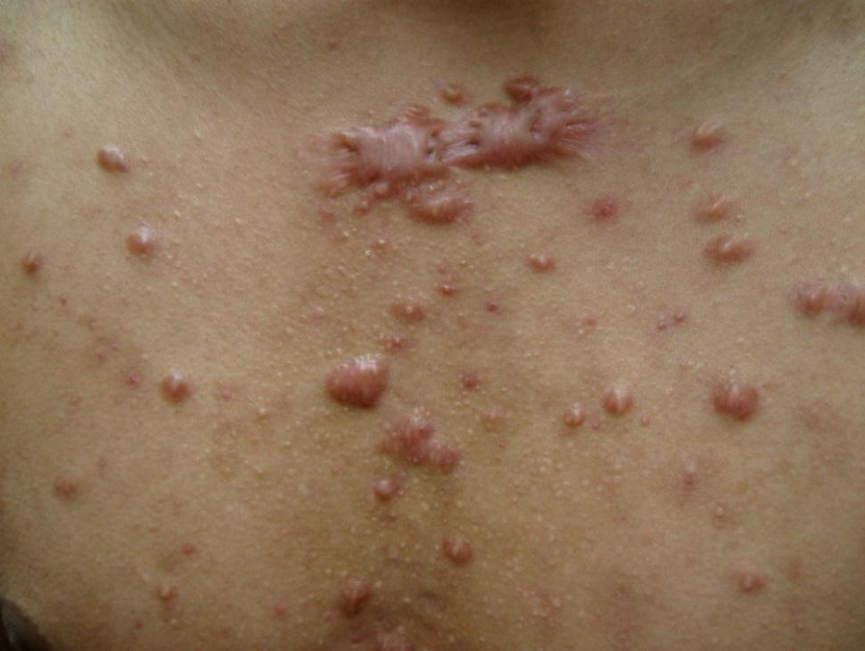
Clinical features
Color can vary from pink–purple (early lesions) to skin-colored to hypo- or hyperpigmented
Can be itchy or tender
Do not regress spontaneously
Can be cosmetically disfiguring

Slide 26
Treatment of keloids
Keloids are difficult to treat surgically, with a high recurrence rate
No single, reliably efficacious therapy available
Non-essential cosmetic surgery should be avoided in patients predisposed to developing keloids
Intralesional corticosteroid injection has been the mainstay of treatment for keloids
Most commonly used is triamcinolone acetonide in concentrations of 10–40 mg/mL at 4- to 6-week intervals

Slide 27
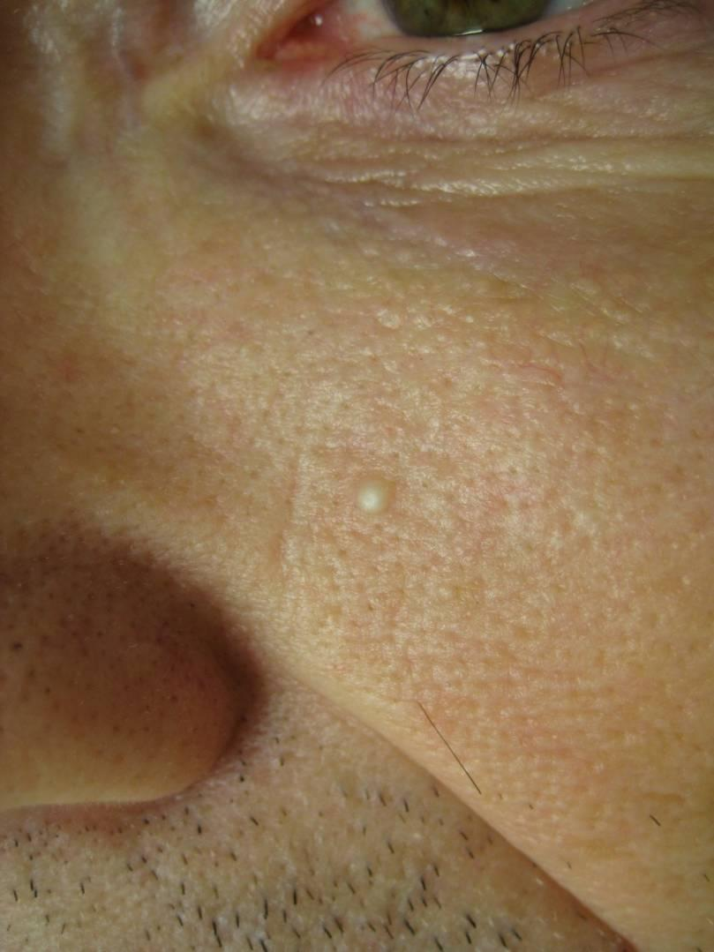
A 30-year-old male presents to your clinic and asks, “Doctor, this white bump on my cheek came up a few months ago and won’t go away. What is it?”

Slide 28
Diagnosis
Millia: tiny epidermoid cysts
1-2 mm white to yellow subepidermal papules
They are fixed and persistent
Occur in individuals of all ages
Children and adults commonly develop milia, especially on the cheeks, eyelids, forehead, and genitalia
40-50% of infants will have milia, which usually resolve during the 1st four weeks of life
Can be considered primary, appearing spontaneously, or secondary, resulting from trauma, a skin disease, or medication

Slide 29
Milia treatment
What will you tell the patient?
It can be easily extracted without scarring
Just wait for it to go away on its own; we see this in newborns all the time
Pop it like a pimple
The only treatment is surgical and the scar would be worse than the milia

Slide 30
Milia treatment
What will you tell the patient?
It can be easily extracted without scarring
Just wait for it to go away on its own; we see this in newborns all the time (Milia in newborns tend to resolve within weeks. Milia in adults tend to persist)
Pop it like a pimple (Not effective in treating milia)
The only treatment is surgical and the scar would be worse than the milia (Not true. Milia are easily extracted without causing a scar)

Slide 31
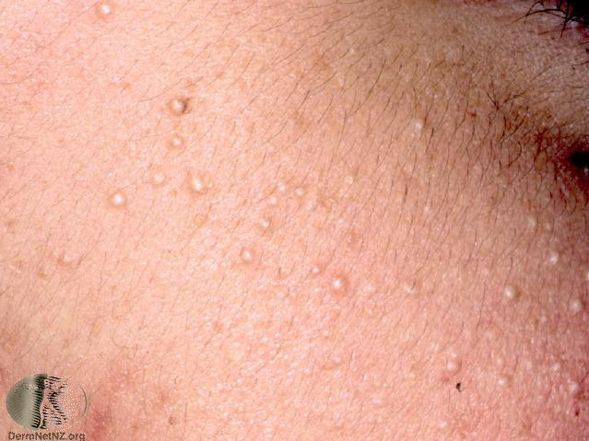
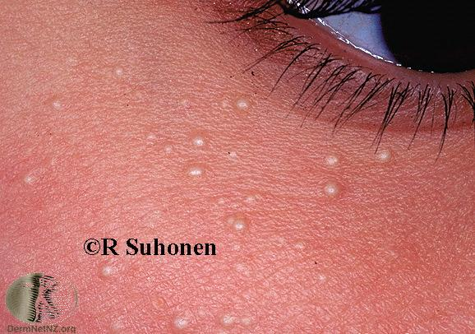
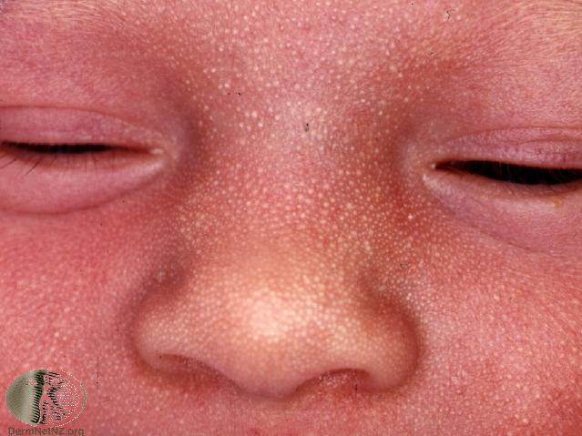

Slide 32
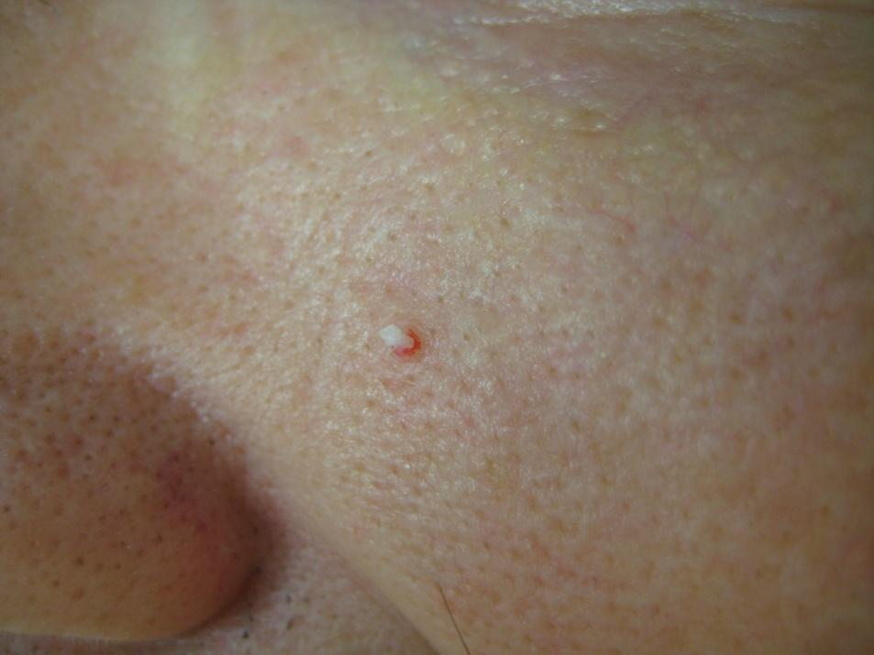
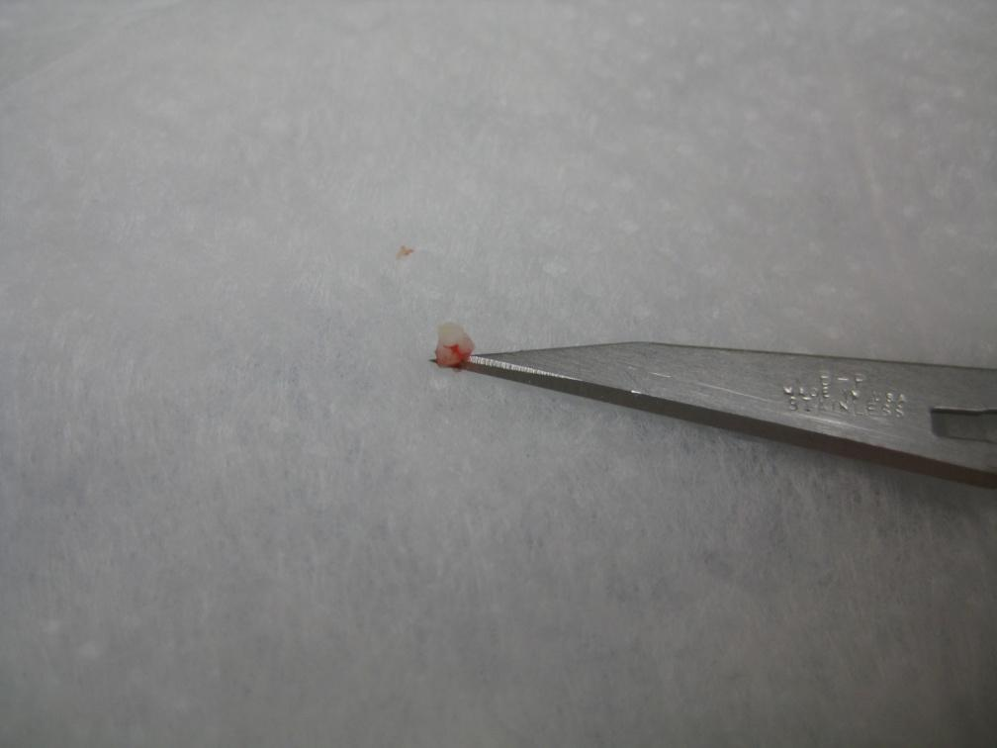
Elective removal for cosmesis
Groove the surface with an 11 blade or an 18 gauge needle, then gently express the entire cyst, lining and contents.
Dress with a dab of petrolatum.

