Slide 1
Approach to Patient with Abdominal pain

Slide 2
Approach to Patient with
IRRITABLE BOWEL SYNDROME

Slide 3
Learning Objectives:
At the end of this session the student will be able to:
Review the epidemiology of IBS.
Describe possible causes of IBS while appreciating the uncertainties.
Recognize the symptoms and accurately diagnose patients who have IBS on the basis of history and physical examination.
Recognize the symptoms that differentiate chronic constipation from IBS according to the Rome’s and Manning’s criteria

Slide 4
5. Identify alarming red flag features that indicate the need for further investigations and referral.
6. Distinguish which aspect of its multi-factorial pathophysiology might prompt the development of IBS in a given patient.
7. Initiate treatment, including dietary modifications and pharmacological treatment.
8. Advise patients on the prognosis of the condition

Slide 5
CASE SCENARIO
Fatima a 30-year-old teacher presents to you with H/O hard pellet-like stools and difficulty evacuating her bowel. She states that she constantly feels bloated but sometimes abdominal cramps. Her symptoms started when she was in her late teens and were tolerable until about 6 months ago. She attributes the worsening symptoms to increased stress at work and her recent appointment as the school principal.

Slide 6
CASE SCENARIO
She complains of abdominal pain and bloating almost continuously throughout the day for the past 2 months, although her symptoms are somewhat alleviated by passing stool. She tried taking laxative powder but could not stand the taste and wasn’t sure how much it was helping.

Slide 7
Physical examination
  BP 126/84 mmHg
  Weight 68 kg, Height 170 cm, WC 74 cm
  Abdomen resonant on percussion with slight tenderness LIF
  No abdominal or rectal masses, bowels sound normal
Additional examinations:
  Abdominal x-rays, abdomen ultrasound (2 months ago) both were normal
  Please, summarize the case, and some thoughts, what could be done??

Slide 8
  Please, write a short summary of the case, before you proceed further.
  Write some thoughts, what could be done for this patient?

Slide 9
Definition
IBS is defined as abdominal discomfort or pain associated with altered bowel habits for at least three days per month in the previous three months, with the absence of organic disease.

Slide 10
Irritable Bowel Syndrome
  First described in 1771.
  50% of patients present <35 years old.
  70% of sufferers are symptom free after 5 years.
  Family physician (FPs) will diagnose one new case per week.
  FPs will see 4-5 patients a week with IBS.
  Point prevalence of 40-50 patients per 2000 patients.

Slide 11
What Is IBS?
A syndrome.
One man’s constipation is another man’s diarrhoea.
Cause unknown.
20% seem to start after an episode of gastroenteritis.

Slide 12
Epidemiology
IBS: chronic, relapsing and often life‑long disorder.
Characterized by the presence of abdominal pain or discomfort.
People with IBS present to primary care with a wide range of symptoms.
Usually between 20 and 30 year of age.
Twice as common in women as in men,
IBS diagnosis should be a consideration when an older person presents with unexplained abdominal symptoms.

Slide 13
Causes
The exact cause of IBS not known.
Faulty communication between the brain and the intestinal tract is one cause of symptoms.
Miscommunication causes abnormal muscle contractions or spasms, which often cause cramping pain.

Slide 14
Cont.
Many people who have IBS seem to have unusually sensitive intestines.
It isn't known why their intestines are more likely to react strongly to the elements that contribute to IBS.

Slide 15
Contributing factors:
Eating (though no particular foods ).
Stress and psychological issues, such as anxiety and depression.
Hormonal changes, such as during the menstrual cycle.
Some medicines, such as antibiotics.
Infection of digestive tract, such as salmonella.
Genetics: IBS may be more likely to occur in people who have a family history of the disorder.

Slide 16
Pathophysiology
Gastrointestinal motility
Visceral hypersensitivity
Intestinal inflammation
Post infectious
Bacterial overgrowth
Food sensitivity

Slide 17
Diagnostic Criteria
Consider IBS when following symptoms for six months:
Abdominal pain or discomfort
Bloating
Change in bowel habit

Slide 18
Diagnostic Criteria
Rome’s Diagnostic criteria.
Manning’s Criteria.

Slide 19
Rome’s Diagnostic Criteria
At least 12 weeks history, which need not be consecutive in the last 12 months of abdominal discomfort or pain that has 2 or more of the following:
    Relieved by defecation.
    Onset associated with change in stool frequency.
    Onset associated with change in form of the stool

Slide 20
Rome’s Diagnostic Criteria.
Supportive symptoms:
  Constipation predominant: one or more of:
      Bowel movements less than 3 times a week.
      Hard or lumpy stools.
      Straining during a bowel movement.
  Diarrhoea predominant: one or more of:
      More than 3 bowel movements per day.
      Loose [mushy] or watery stools.
      Urgency.

Slide 21
Rome’s Diagnostic Criteria
  General:
    Feeling of incomplete evacuation.
    Passing mucus per rectum.
    Abdominal fullness, bloating or swelling.

Slide 22
Manning’s Criteria
Three or more features should have been present for at least 6 months:
    Pain relieved by defecation.
    Pain onset associated with more frequent stools.
    Looser stools with pain onset.
    Abdominal distension.
    Mucus in the stool.
    A feeling of incomplete evacuation after defecation.

Slide 23
Associated Symptoms
In people with IBS in OPD.
    25% have depression.
    25% have anxiety.
Patients with IBS symptoms who do not consult doctors have identical psychological health to general population.
In one study 70% of women IBS sufferers have dyspareunia.

Slide 24
Associated Symptoms
Stressful life events are associated.
Compared with controls, people with IBS are less well educated and have poorer general health.
Women: Men = 3:1.

Slide 25
Onset of IBS Symptoms
Symptoms usually occurs after infection – post infection, bile salt malabsorption
Use of antibiotic
Alteration in immune system
Emotions, depression, anxiety can affect GIT function
Psychological stress can increase GIT symptoms

Slide 26
Subtypes
Diarrhoea predominant.
Constipation predominant.
Pain predominant.

Slide 27
Differential Diagnosis
Inflammatory bowel disease.
Cancer.
Diverticulosis.
Endometriosis.
A positive diagnosis, based on Manning’s criteria may provoke less anxiety than extensive tests.

Slide 28
Examination
Results should be normal or non-specific.
Abdomen and rectal examination.
CBC, CRP.
No consensus as to whether faecal occult blood (FOBs) or sigmoidoscopy is needed.

Slide 29
Investigations(Not recommended as routine)
CBC
ESR
C-reactive protein (CRP)
Antibody testing for coeliac disease
  Routine testing for celiac disease should be considered in patients with diarrhea-predominant or mixed presentation IBS.

Slide 30
Investigations (Not confirmatory)
Ultrasound
Rigid/flexible sigmoidoscopy
Colonoscopy; barium enema
Thyroid function test
Faecal ova and parasite test
Faecal occult blood

Slide 31
Treatment
Treatment of IBS can be difficult because symptoms often are recurrent and resistant to therapy.
Three steps approach
    Patients’ concerns
    Explanation.
    Treatment approaches

Slide 32
Patients’ Concerns
Usually very concerned about a serious cause for their symptoms.
Take time to explore the patients agenda.
Remember that investigations may heighten anxiety.

Slide 33
Explanation
Must offer a plausible reason for symptoms.
Even if cause is unknown, patients require some explanation.
Drawing a parallel with baby colic may help.
Stress is currently a socially acceptable explanation for many symptoms in life.

Slide 34
Treatment Approaches
Placebo effect of up to 70% in all IBS treatments.
Treatment should depend on symptom sub-type.
Often considerable overlap between sub-groups.

Slide 35
Antidepressants
Poor evidence for efficacy.
Better evidence for tricyclics.
Very little evidence for SSRIs.

Slide 36
Diarrhoea Predominant.
Increasing dietary fibre is sensible advice.
Fibre varies, 55% of patients will get worse with bran.
“Medical fibre” adds to placebo effect.
Loperamide may help.

Slide 37
Constipation Predominant
Increased fibre.
Osmotic laxatives helpful. Ispaghula husk is one.
Stimulant laxatives make symptoms worse.
Lactulose may aggravate distension and flatulence.

Slide 38
Pain Predominant
Antispasmodics will help 66%.
Mebeverine is probably first choice.
Hyoscine 10mg qid can be added.
Bloating may be helped by peppermint oil.
Nausea may require metoclopramide.

Slide 39
Diet
Dietary manipulation may help.
Food intolerance is common food allergy is rare.
Relaxation therapies may be useful adjunct.

Slide 40
Psychological Thoughts
Should a mental health assessment always be done?
Should all therapy be directed at psychological causes?
Is IBS a physical or a somatisation disorder?

Slide 41
IBS red flags:
Evaluated for:
Anaemia
Abdominal masses
Rectal masses
Inflammatory bowel disease.
Measure serum CA125 in primary care in women with symptoms that suggest ovarian cancer.

Slide 42
IBS red flags:
Unintentional/unexplained weight loss
Rectal bleeding
Family history of bowel or ovarian cancer
In people aged >60,change in bowel habit lasting more than 6 weeks

Slide 43
Diet advice:
A. Having regular meals
B. Avoid leaving long gaps
C. Drink at least 8 cups of fluid a day (non-caffeinated)
D.limit that intake of high fiber food
E.limit fresh fruit to 3 portions per day
F. Reduce the intake of resistant starch

Slide 44
IBS management( first line)
Antispasmodic agents
Laxatives for constipation
Loperamide as antimotility agent for diarrhoea

Slide 45
IBS management (second line)
Laxatives
TCA's and SSRI's

Slide 46
Prognosis of IBS:
IBS does not increase the mortality or the risk of inflammatory bowel cancer
Patient with IBS may carry an increased risk of ectopic pregnancy and miscarriage

Slide 47
Referral
About 15% of patients seen by GPs with IBS are referred.
Gastroenterology – Mainly upper GI symptoms.
General Surgical – Lower GI symptoms.

Slide 48
Reasons to Refer
Age > 50 years at onset.
Family history of bowel cancer.
Failure of primary care management.
Uncertainty of diagnosis.
Abnormality on examination or investigation.

Slide 49
Urgent Referral
Constant abdominal pain.
Constant diarrhoea.
Constant distension.
Rectal bleeding.
Weight loss or malaise.

Slide 50
A 48- year –old hairdresser has been troubled with an altered bowel habit and abdominal discomfort for five months. She was told that she has irritable bowel syndrome and that no further investigation is deemed necessary.
The development of which one of the following symptoms warrants further evaluation?
A- Recent onset of nausea.
B- Diarrhoea with mucus discharge.
C- Persistence of symptoms for 24 weeks.
D - Weight loss.

Slide 51
Approach to patient with Dyspepsia

Slide 52
OBJECTIVES OF THE SESSION:
At the end of this session, students will be able to:
Identify differential diagnosis of a case presented with the symptoms of dyspepsia.
Differentiate between different causes of dyspepsia.
Identify non-ulcer dyspepsia.
Discuss briefly about Gastro-esophageal reflux disease (GERD).
Describe peptic ulcer diseases.

Slide 53
6. Identify importance of ALARM signs and symptoms in patients with dyspepsia.
7. Investigate appropriately a patient with dyspepsia.
8. Advice initial management plan for a patient with dyspepsia.
9. Discuss non-drug management of GERD.
10. Identify long term complications of dyspepsia.

Slide 54
Case Scenario:
A 43-year-old man, who works as a taxi driver for long time, has presented to the clinic today with the complaint of indigestion and upper abdominal pain. These complaints initiated for last 3 months. Pain and indigestion are usually felt after heavy meals. His bowel movements are normal. He does not use NSAID, but he is smoker, 10-20 cigarettes per day. No history of hematemesis or melena. No history of recent weight loss or generalized weakness. He is not known to have any other chronic illness.
Initially, he could manage this problem taking antacid brought over the counter, but during the last week he could not get relief by the antacid and has vomited 2-3 times

Slide 55
On examination:
Look well, not in pain, not pale or jaundiced
Abdominal examination was normal, apart from tenderness in the upper abdomen; in the gastric region
Please, summarize the case on a piece of paper.

Slide 56
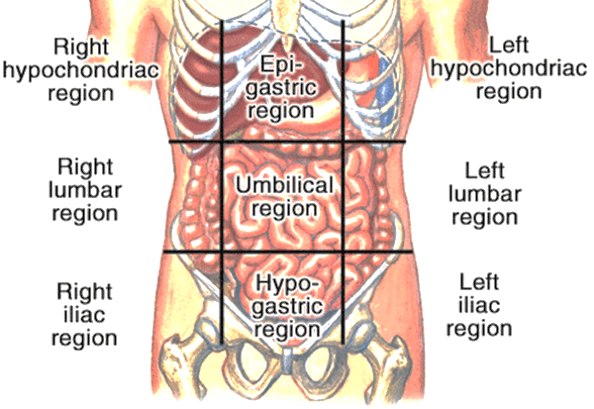

Slide 57
What is Dyspepsia?
Definition ?
Group of symptoms consist of:
upper abdominal /epigastric pain
or discomfort, heartburn,
or acid regurgitation.
Often associated with belching, bloating, nausea or vomiting

Slide 58
FIVE COMMON DIAGNOSIS
1. NUD 60-70%
2. GERD 15-20 %
3. Gastritis
4. Gastric Ulcer
5. Duodenal Ulcer
** Rare causes??

Slide 59
DRUGS ASSOCIATED WITH DYSPEPSIA
* NSAID *Antibiotic
* Iron *Orlistat
* Metformin *Corticosteroid
* Codeine *Theophyllin
* Digoxin * Quinidine
* Colchicine *Gemfibrozil
* Alendronate *Ca Antagonist
* Nitrates

Slide 60
1. Functional Dyspepsia (non-ulcer)
Most common functional gastrointestinal disorder.
Epigastric pain or discomfort, postprandial fullness, and early satiety within the last 3 months with symptom onset at least 6 months earlier
Patients cannot have any evidence of structural disease to explain symptoms and predominant symptoms.

Slide 61
1. Functional Dyspepsia (non-ulcer)
Younger age group more than later life
Causes?
GI motility?
Gastric secretion normal
Presence of H-Pylori
Incidence decrease with advancing age

Slide 62
Possible explanations of FD
Motility abnormalities
Visceral sensory abnormalities
Psychological factors

Slide 63
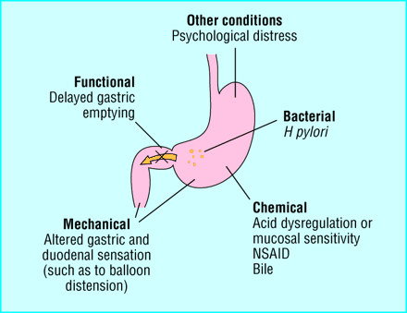

Slide 64
Diagnosis
When there is no evidence of structural disease and there have been at least three months of one or more of the following (with onset at least six months earlier):
  bothersome post-meal (postprandial) fullness
  early satiation
  epigastric pain
  epigastric burning

Slide 65
Management
A. Dietary and Lifestyle Modifications:
  Avoiding large portions at mealtime and eating smaller, more frequent meals is important to normalize upper gut motility
  Overweight individuals might find relief when they lose weight
  Quit smoking advise if available.

Slide 66
Treatment for functional dyspepsia(cont)
Resistant cases (failed initial treatment) :
Antacid
Antispasmodic agent (such as mebeverine)
H2 blocker or PPI
Antidepressant (such as SSRI or tricyclic drug)
Behavioral therapy or psychotherapy
H pylori eradication
No treatment is proved to be fully beneficial in these patients

Slide 67
2.Gastro-esophageal reflux disease (GERD)
A condition in which the stomach contents leak backwards from the stomach into the esophagus
Common which affects approximately 30% of the general population

Slide 68
2. GERD
Presents with:
  Heartburn , Sharp stabbing sub-sternal pain(probability :89%)
  Regurgitation (probability :95%)
  At night or after heavy meal
  Chronic cough, asthma like wheezing
  MI ??

Slide 69
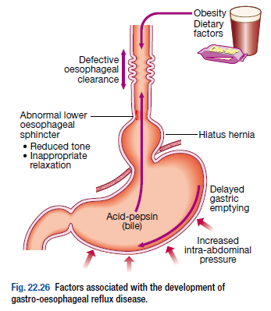
Fat
Chocolate
Coffee
Alcohol ingestion
Large meals
Pregnancy
Smoking
Drugs
Notes:
Drugs – antimuscarinic, calcium-channel blockers, nitrates

Slide 70
Diagnosis of GERD
Young patients who present with typical symptoms of gastro-oesophageal reflux
Without worrying features such as dysphagia, Weight loss or anaemia
Can be treated empirically without investigation

Slide 71
Diagnosis of GERD
If patients present in middle or late age
If symptoms are atypical, or
If a complication is suspected
Endoscopy is the investigation of choice
Esophageal manometry
24-h pH monitoring
Notes:
Assess oesophagitis and hiatal hernia by endoscopy. If there is oesophagitis or Barrett’s oesophagus reflux is confirmed
esophageal manometry : (study of esophageal motility) diagnose abnormal peristalsis and/or decreased LES tone
24-h pH monitoring: most accurate test, but rarely required or performed

Slide 72
Dx & Management of GERD
Dx : Hx , PPI test , Endoscopy
Life style modification ??
Medication :
Antacid
Antisecretory drug:
H₂ receptor blocker
* proton pump inhibitor (2months)
Prokinetics
Surgery : Laproscopic fundoplication or open ?

Slide 73
GERD Complications
Weakness or incompetence of lower esophageal sphincter
  Esophagitis,
  esophageal stricture
  Barret’s esophagus

Slide 74
PUD
Less than before
P/H ulcer, recurrence more likely
Risk factors include:
- H-pylori
- Family Hx
- NSAID
- Cigarette smoking
- Chronic renal failure
- Blood group “O”

Slide 75
Peptic ulcer disease (PUD(
Refers to an ulcer in the lower oesophagus, stomach or duodenum.
Ulcers in the stomach or duodenum may be acute or chronic; both penetrate the muscularis mucosae but the acute ulcer shows no evidence of fibrosis.
Erosions do not penetrate the muscularis mucosae.
Notes:
The term ‘peptic ulcer’ refers to an ulcer in the lower oesophagus, stomach or duodenum, in the jejunum after surgical anastomosis to the stomach or, rarely, in the ileum adjacent to a Meckel’s diverticulum.

Slide 76
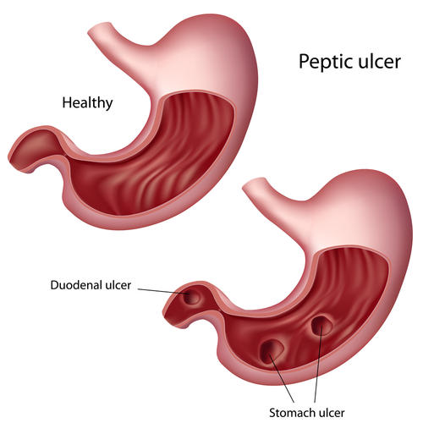
Peptic ulcer disease (PUD(

Slide 77
DIAGNOSTIC DIFFICULTIES
* Not text book presentation
* Early presentation
* History:
1. ALARM symptoms ??
2. Specific symptoms
3. NUD
* MI ??
* NSAID
* Smoking

Slide 78

Red Flags of Dyspepsia
Unintended weight loss
Severe vomiting
Progressive dysphagia
Odynophagia
Unexplained or iron deficiency anemia
Hematemesis
Jaundice
Palpable abdominal mass
lymphadenopathy
Family history of upper GI cancer
Notes:
Odynophagia (from the Greek roots odyno-, pain + -phagia, from phagein, to eat) is painful swallowing, in the mouth
(raise suspicion of gastric malignancy):

Slide 79
Alarm symptoms
Anorexia
Loss of weight (progressive & unintentional)
Anaemia due to iron deficiency
Recent onset of persistent symptoms :vomiting
Melaena, haematemesis
Dysphagia (progressive)
Epigastric mass or
Suspicious barium meal.

Slide 80
Diagnosis of peptic ulcer disease
Endoscopy is the preferred investigation
Gastric ulcers may occasionally be malignant and therefore must always be biopsied
Patients should also be screened for H. pylori infection
  Some are invasive and require endoscopy; others are non-invasive
  Overall, breath tests are best because of their accuracy, simplicity and non-invasiveness

Slide 81

Helicobacter pylori (h-pylori) bacteria
H. pylori is a slow-growing spiral Gram-negative flagellate urease-producing bacterium which plays a major role in gastritis and peptic ulcer disease
It colonizes the mucous layer in the gastric antrum
But is found in the duodenum only in areas of gastric metaplasia

Slide 82
H-Pylori
Gram –ve flagellated spiral
Casually related to:
- GU
- DU
- Gastritis
- Gastric B – cell lymphoma
- Gastric adenoma
Prevalence - high
More in developing countries
Roughly related to age
Saudi local study 67-89%

Slide 83
H-Pylori testing
Serology
Urea Breath test
Fecal antigen test
Endoscopy
Strip test

Slide 84
H-PYLORI ERADICATION
Benefits :
Cure rate
Recurrence
Bleeding
**All cases of dyspepsia ??

Slide 85
H-PYLORI ERADICATION
Triple regimen:
Proton pump inhibitor +
two antibiotics

Slide 86
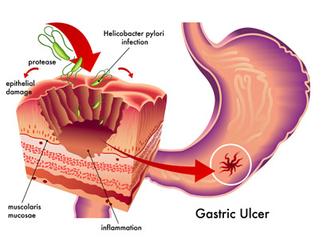
Helicobacter pylori (h-pylori) bacteria

Slide 87
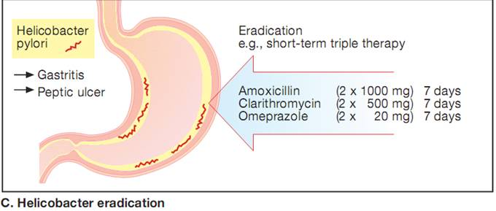
Treatment of Peptic ulcer disease
The aims of management are to relieve symptoms, induce healing and prevent recurrence
Helicobacter eradication
Notes:
All patients who are H.pylori-positive: eradication as primary therapy.
PPI taken simultaneously with two antibiotics (from amoxicillin, clarithromycinand metronidazole) for 7 days.
First-line therapy is a proton pump inhibitor (12-hourly), clarithromycin 500 mg 12-hourly, and amoxicillin 1 g 12-hourly or metronidazole 400 mg 12-hourly, for 7 days.
Second-line therapy should be offered to those patients who remain infected after initial therapy once the reasons for failure of first-line therapy have been established. For those who are still colonised after two treatments, the choice lies between a third attempt with quadruple therapy (bismuth, PPI and two antibiotics) or long-term maintenance therapy with acid suppression.
Success is achieved in over 90% of patients, although compliance, side-effects and metronidazole resistance influence the success of therapy.

Slide 88
Eradication of H-pylori
Patients who are not allergic to penicillin
  Standard dose PPI, clarithromycin, and amoxicillin for 10-14 days
Patients who are allergic to penicillin
  Standard dose PPI, clarithromycin, metronidazole for 10-14 days
Patients who are allergic to penicillin or failed one course (above) of H. pylori treatment
  Bismuth subsalicylate, metronidazole, tetracycline, standard dose PPI for 10-14 days
Notes:
Patients who are not allergic to penicillin and have not previously received a macrolide
Standard dose PPI (Lansoprazole 30 mg twice daily, omeprazole 20 mg twice daily, pantoprazole 40 mg twice daily, or rabeprazole 20 mg twice daily) twice daily (or esomeprazole 40 mg once daily) plus clarithromycin 500 mg twice daily, and amoxicillin 1000 mg twice daily for 10-14 days¶
Patients who are allergic to penicillin, and who have not previously received a macrolide or metronidazole or are unable to tolerate bismuth quadruple therapy
Standard dose PPI twice daily, clarithromycin 500 mg twice daily, metronidazole 500 mg twice daily for 10-14 days
Patients who are allergic to penicillin or failed one course (above) of H. pylori treatment
Bismuth subsalicylate 525 mg four times daily, metronidazole 250 mg four times daily, tetracycline 500 mg four times daily, standard dose PPI* twice daily for 10-14 days^{Δ}
Bismuth subcitrate 420 mg four times daily, metronidazole 375 mg four times daily, tetracycline 375 mg four times daily◊, standard dose PPI* twice daily for 10-14 days

Slide 89
Importance of h-pylori eradication
H. pylori eradication is the cornerstone of therapy for peptic ulcers as this will successfully
  Prevent relapse
  Eliminate the need for long-term therapy in the majority of patients

Slide 90
Gen.Management
1.Management of symptoms in primary care is appropriate for most patients rather than routinely
seeking a pathological diagnosis.
2.Alarm signals and signs are the major determinant of the need for endoscopy, not age on its own.
3.Long term care should emphasize patient empowerment with ‘on demand’ use of the lowest
effective dose PPI.

Slide 91
Gen.Management
Simple lifestyle advice:
healthy eating
weight reduction
smoking cessation
Offer empirical antacid,H2A
or therapy for one month to patients with dyspepsia.

Slide 92
ENDOSCOPY
Considered if :
ALARM signals and signs are the major determinant of the need for endoscopy, not age on its own.
No response to medication 7-10 days.
Symptoms persist after 6-8 wks
Signs of systemic illness
Recurrence after treatment
Long standing G0RD

Slide 93
Age Consideration ??
In patients aged 55 years and older with unexplained and persistent recent onset dyspepsia alone, an urgent referral for endoscopy should be made.

Slide 94
Urgent Referral for Endoscopy
Indicated for patients with dyspepsia of any age with any of the following conditions:

Slide 95
Urgent Referral for Endoscopy
Chronic gastrointestinal bleeding,
Progressive unintentional weight loss,
Progressive difficulty swallowing,
Persistent vomiting,
Iron deficiency anaemia,
Epigastric mass
Suspicious barium meal.

Slide 96
ENDOSCOPY
Patients undergoing endoscopy should be free from medication with either a PPI or an H2 receptor antagonist for a minimum of two weeks.

Slide 97
Assessment of Dyspepsia

Slide 98
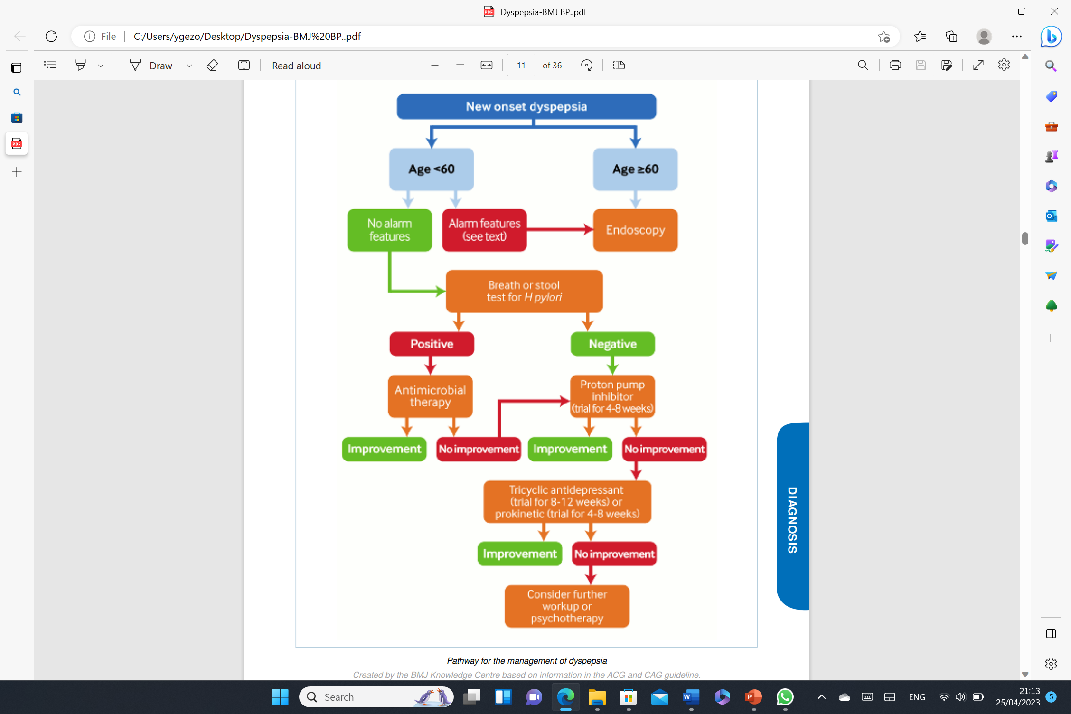

Slide 99
Reasons for referral
cancer suspected or proven;
diagnostic uncertainty;
treatments not available
failure of treatment, symptoms persisting;
patients' wishes

Slide 100
  A. Alarm features – absent:
  Two approaches are acceptable:
  1. Test for H. pylori infection
  2. Empiric Therapy
  A 4-week course a histamine-2 receptor
  antagonist or PPI
  **Failure to respond to treatment justifies further investigation and/or referral

Slide 101
Non-drug treatment
Cigarette smoking cessation
Aspirin and NSAIDS should be avoided
Alcohol consumption to be stopped
No special dietary advice is required

Slide 102
Summary
Initial treatment for dyspepsia (See the algorithm)
Probabilities to diagnose GERD clinically
ROME III criteria
Urgent specialist referral for endoscopy
Common cause of dyspepsia
Red flags for dyspepsia

Slide 103
Importance of good explanation for IBS
Drug of choice for IBS pain & diarrhea
Complications of long standing GERD
Celiac disease should be considered in patients with diarrhea-predominant or mixed presentation IBS.
H-pylori - Link/ Diagnosis/ Eradication
See (Assessment of dyspepsia) in The BMJ Best Practice –PDF – Page 11.

Slide 104
A 30-year-old businessman, who is complaining of dyspepsia for the last two years. He had received H-Pylori eradication therapy one year ago.
Now he is on PPI 20 mg/day. He has stressful work conditions and he is heavy smoker. Today he is insisting to refer him for urgent endoscopy.
You are going to discuss with the patient that the urgent specialist referral for endoscopy (to be seen within two Weeks) is indicated for patients of any who fulfill which one of the following criteria?
Epigastric discomfort of more than one year
Failed H-Pylori eradication
Significant acute gastrointestinal bleeding
Progressive unintentional weight loss

Slide 105
شكــــــراً
THANKS

