Slide 1

Routine ANC
Dr. Y. E. Elgezoli.
Consultant in Family Medicine.

Slide 2
Definition
The systematic supervision of women during pregnancy.
- ANC is a key component of a healthy pregnancy.
- Regular ANC helps to identify and treat complications and promote healthy behaviours.
- In addition to medical care, antenatal care includes counselling and education.

Slide 3

Aims:
1.Promote and maintain maternal and foetal health and welfare.
2.Detect early and treat problems that occur.
3.Prepare the woman and her family for the labour, delivery and care of the baby.

Slide 4
A 24-Year-Old Primigravida at 8 Weeks of Gestation comes to your office for her first prenatal visit. You Which of the following tests is not recommended at her initial prenatal visit?
A. Complete blood count (CBC)
B. Rapid plasma reagin (screening for syphilis)
C. Screening for gestational diabetes
D. Hepatitis B virus screen (HBSAG)
E. Blood typing (Rh and ABO).

Slide 5
Pre-conception care
Ideally, ANC begins before conception.
- Is a set of interventions to identify and modify biomedical, behavioural, and psychosocial risks to a woman's health or pregnancy outcome through prevention and management.
- e.g. healthy women should begin folic acid supplementation (400-800 micrograms/ day), ideally at least 3 months before conception and continue until at least 12 weeks' gestation.
- A history of illicit substance use, tobacco and alcohol consumption, medical conditions, medication, immunisation status, risk factors for sexually transmitted infections (STIs), psychosocial concerns (depression, domestic violence), and pregnancy spacing is required.

Slide 6
- Women with diabetes or chronic hypertension should be counselled on optimising glycaemic or blood pressure control, and pregnancy should be discouraged until control is achieved.
- relative risks and benefits of valproate use during pregnancy,
- Women should avoid pregnancy for 1 month after receiving a live attenuated vaccine (e.g., rubella or varicella),

Slide 7
ANC
- Early and regular ANC is recommended to improve pregnancy outcomes.
- Recommendations include antenatal visits, nutritional care, education, and other patient-specific issues.

Slide 8
Lead Maternity Caregiver (LMC).
Takes responsibility for the care of the woman during her pregnancy, labour, delivery and postnatal period.
(independent midwife, GP, obstetrician & team based at hospital)

Slide 9

The LMC role includes:
− Antenatal care during the pregnancy
− Support during labour and the birth of the baby (midwife)
− Postnatal care from the baby’s birth until
6 weeks after the birth.
- Refers to Well Child provider.

Slide 10
Diagnosis of Pregnancy
S igns and Symptoms
hCG
  home urine pregnanacy test
→ confirmatory testing for hCG in urine or blood
Ultrasound

Slide 11
What hCG level indicates pregnancy?
- An hCG level of less than 5 mIU/mL is considered negative for pregnancy,
- Anything above 25 mIU/mL is considered positive for pregnancy.
- An hCG level between 6 and 24 mIU/mL is considered a grey area, and you'll likely need to be retested.

Slide 12
Antenatal History
A thorough antenatal history is taken in an attempt to identify all existing factors which may compromise a healthy mother and baby.
These include:
-medical
-surgical,
-family,
-gynaecological,
-past obstetric, present obstetric

Slide 13
Calculating a Due Date (LMD & EDD).
A typical pregnancy lasts, on average, 280 days, or 40 weeks, starting with the first day of the last normal menstrual period as day 1. An estimated due date can be calculated by following steps:-
First, determine the first day of your last menstrual period.
Next, count back 3 calendar months from that date.
Lastly, add 1 year and 7 days to that date.

Slide 14

Routine assessments include:
1. Maternal status / wellbeing
-general health (physical and emotional)
-blood pressure

Slide 15

- Weight

Slide 16
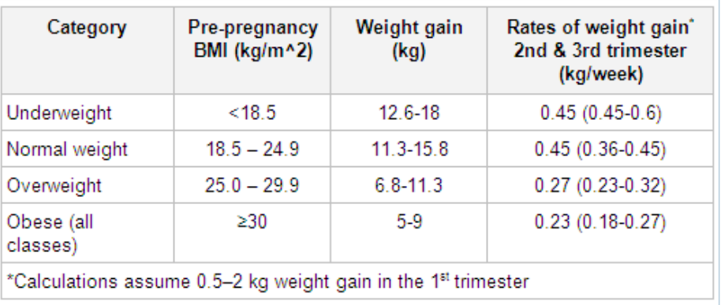
Nutritional counselling
- Calculate a woman’s BMI at the first antenatal visit.

Slide 17

Fetal status / wellbeing
- Abdominal examination (size, shape indicates gestation of the pregnancy)
-kick chart / fetal movement chart
-fetal heart rate.

Slide 18
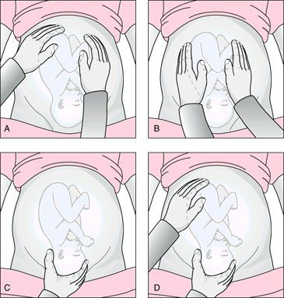
 Assessing the position of the fetus

Slide 19







Look for problems requiring additional care
28

Slide 20
When to contact your doctor?
-Vaginal bleeding
-Premature labour
-Rupture of the membranes
-Decreased fetal movements
-Severe headaches, visual blurring or
“Spotting of vision”,

Slide 21
Antenatal visits
Traditional antenatal care includes a series of between 7 and 11 visits; however, the number of visits necessary for adequate care is disputed.
- The typical frequency of visits in an uncomplicated pregnancy is as follows:
◊ Every 4 weeks for the first 28 weeks
◊ Every 2 to 3 weeks between 28 and 36 weeks
◊ Weekly after 36 weeks.

Slide 22
- Typical visits include evaluation of BP, weight, urine for protein levels, and checking the fetal heart rate. Psychosocial screening at least once each trimester.
- It is recommended that pregnant women initiate antenatal care by 10 to 12 weeks' gestation.
- The first antenatal visit should include a comprehensive history, laboratory work, and education about pregnancy health. Height and weight should be recorded to calculate BMI.

Slide 23
- At the first antenatal visit, all pregnant women should also have a blood test to check FBC, ABO blood group, Rh D status, and the presence of erythrocyte antibodies.
- Screening for depression, which is common during pregnancy and in the first 12 months after delivery, may be beneficial.

Slide 24
• Diet and physical activity-based interventions in pregnancy are beneficial and can reduce gestational weight gain, as well as the rate of caesarean delivery.
• Daily antenatal vitamins containing folate (400-800 micrograms/day) are recommended as tolerated throughout pregnancy, and at least through the first 3 months of pregnancy.
- Alcohol consumption is contraindicated in pregnancy.

Slide 25
Education
- Consider these specific issues:
◊ Smoking
◊ Substance misuse:
◊ Working
◊ Air travel: women with uncomplicated pregnancies can fly safely until 36 weeks' gestation.
◊ Exercise

Slide 26
◊ Childbirth education: relative risks and benefits of home versus hospital birth, labour and delivery, pain relief options, potential obstetric complications and procedures, normal newborn care, and postnatal adjustment
◊ Breastfeeding
◊ Miscellaneous: other educational issues to discuss include dental care, nutrition, wearing a seat belt, sleep position, sexual activity, postnatal contraception, and circumcision of male infants.

Slide 27
Routine testing
- Full blood count (FBC),
- ABO blood group, Rhesus status, presence of erythrocyte antibodies,
- Rubella status, hepatitis B screening,
- Screening for STIs (syphilis, HIV, gonorrhoea, and chlamydia),
- Urine dipstick and culture,
- BP measurement, gestational diabetes screening,
- Check of last cervical screening, and
- Ultrasound

Slide 28
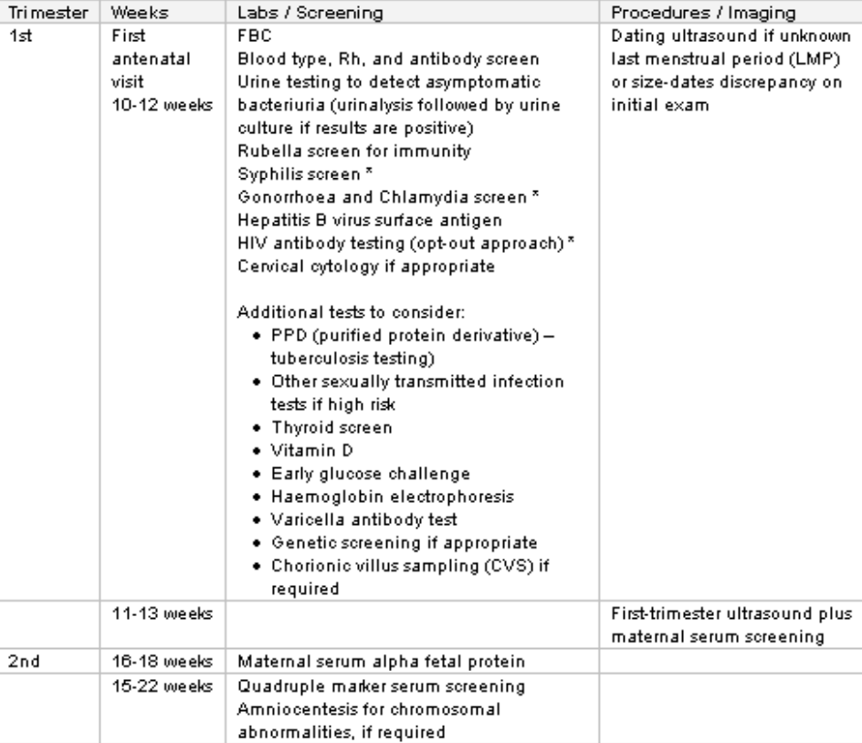

Slide 29
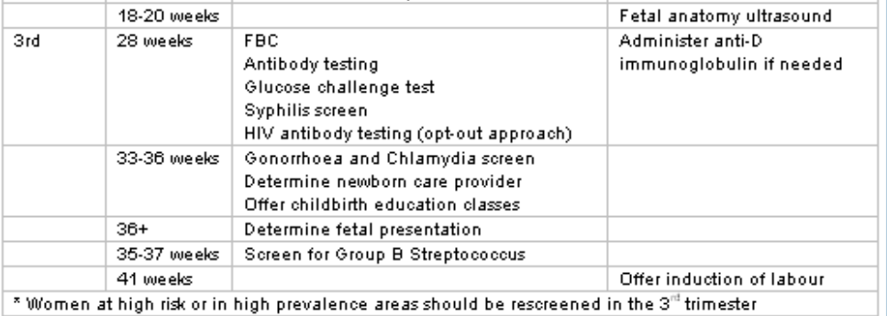

Slide 30
Ultrasonography
First-trimester ultrasound screening is optimal for pregnancy dating.
between 11+2 weeks and 14+1 weeks' gestation.
Advantages of first-trimester ultrasonography include its ability to help determine the presence of an intrauterine pregnancy, gestational age, and evaluate for multiple gestation.
An ultrasound examination performed in the second-trimester is optimal for a survey of the fetal anatomy and placental location. between 18 and 22 weeks' gestation.
- Obese patients should be informed that their fetus is at increased risk for congenital anomalies, including undiagnosed anomalies. Sonographic fetal anatomical assessment may be better performed at 20 to 22 weeks in obese patients.

Slide 31
- Routine second-trimester ultrasound examination will reveal placental location and relationship to the internal cervical os. Placenta praevia complicates 0.3% to 0.5% of pregnancies.
- The majority (>80%) of praevia cases diagnosed at 20 weeks' gestation resolve by term. Thus, a follow-up ultrasound in the third-trimester, usually around 32 weeks' gestation, is warranted.
- In women with a persistent low-lying placenta or placenta praevia at 32 weeks' gestation, a further ultrasound should be arranged at 36 weeks

Slide 32
WHO Recommendations on ANC
49 recommendations were grouped into five topic areas:
Nutritional interventions (14)
Maternal and fetal assessment (13)
Preventive measures (7)
Interventions for common physiological symptoms (6)
Health systems interventions to improve the utilization and quality of ANC (9)

Slide 33
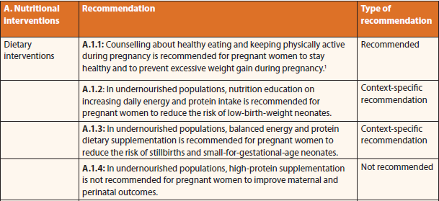
Nutritional assessment

Slide 34
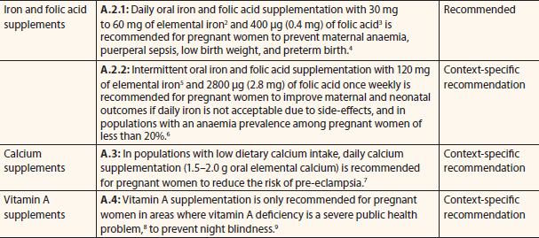

Slide 35
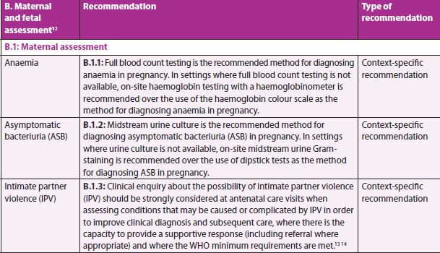
Maternal and fetal assessment

Slide 36
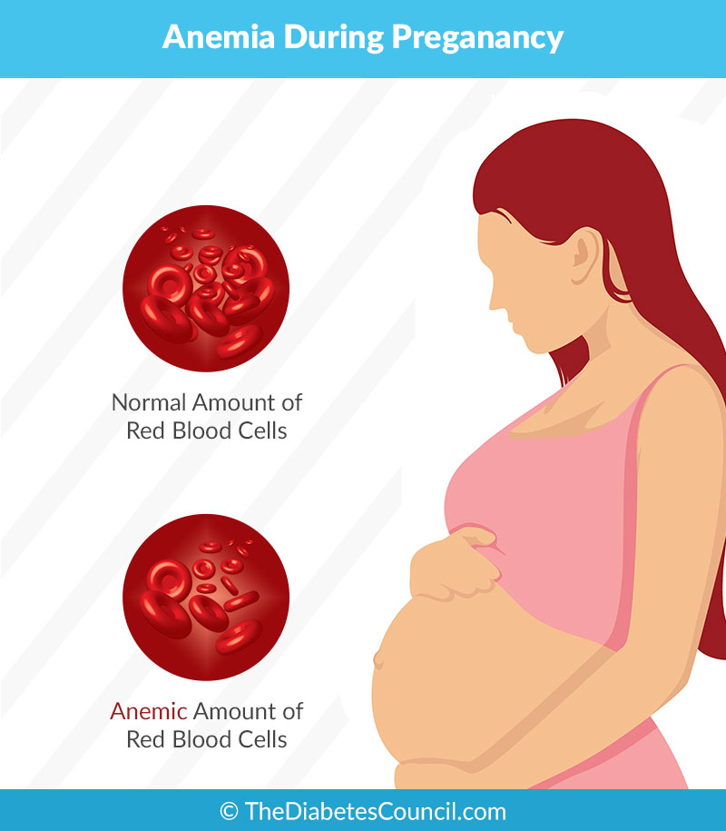
Anemia in pregnancy
First trimester: < 11 mg\dl
Second trimester: < 10.5 mg\dl
Third trimester : < 11 mg\dl
Prophylactic dose: 2-4 mg\kg
Therapeutic dose: 6-8 mg\kg

Slide 37
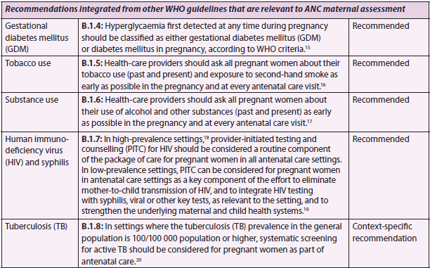

Slide 38
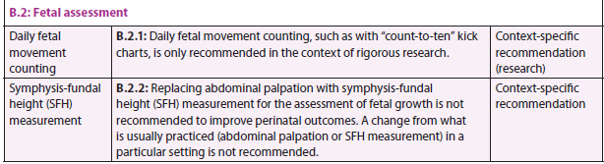
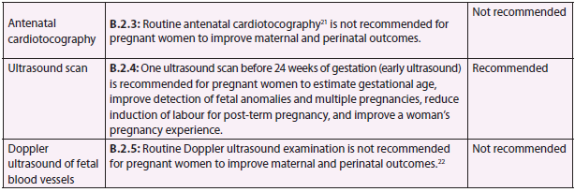

Slide 39
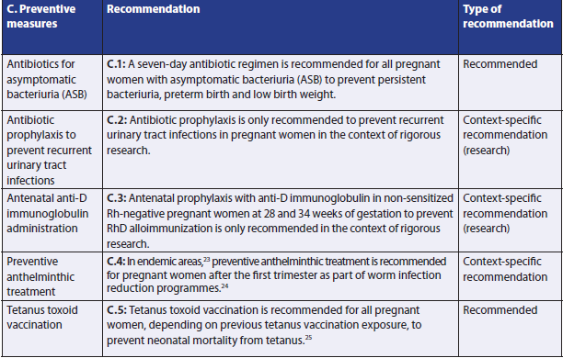
Preventive measures

Slide 40
FDA approved drugs
C

Slide 41
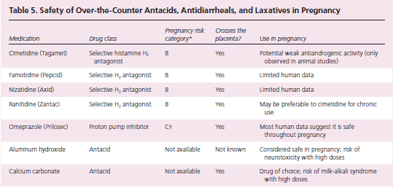

Slide 42
Antibiotics
Antibiotics without known teratogenic effects include: cephalosporins, penicillins, erythromycin , azithromycin, clindamycin, augmentin, and metronidazole.
Fluoroquinolones: contraindicated causing premature cartilage closure.
Trimethoprim: avoided in the first trimester; folic acid antagonist.

Slide 43
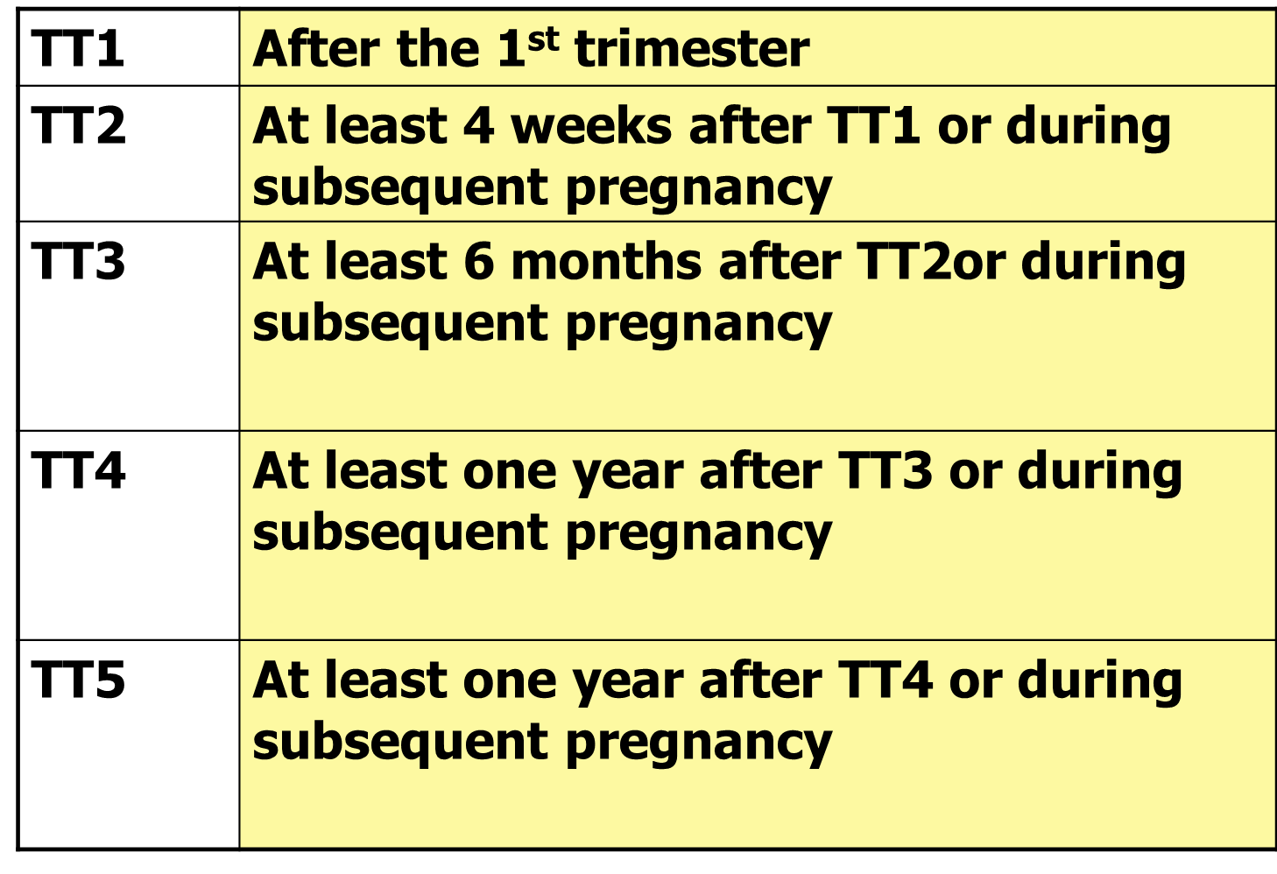
Tetanus immunization schedule

Slide 44
Screening for genetic abnormalities
Aneuploidy:
Defined as an abnormal number of chromosomes.
- All women, regardless of age, who present for antenatal care should be offered aneuploidy screening & for invasive antenatal testing (chorionic villus sampling [CVS] or amniocentesis) for diagnosis of fetal aneuploidy and other genetic anomalies.
- First-trimester screening can generally be performed from 10 to 14 weeks' gestation & second-trimester screening can generally be performed from 15 to 23 weeks' gestation.
- Fetal anatomical markers associated with aneuploidy include an echogenic intracardiac focus, absent nasal bone, short humerus or femur, and echogenic bowel.

Slide 45
Screening for neural tube defects (NTDs)
There are 2 approaches for NTD screening:
1. Maternal serum alpha-fetoprotein (MS-AFP) in the second-trimester (optimal at 15 to 18 weeks)
2. Ultrasound (optimal at 18 to 22 weeks).
- Amniocentesis can be performed to determine if amniotic fluid AFP is elevated and acetylcholinesterase is present, which are considered diagnostic of a NTD

Slide 46
Screening for hypertensive disorders of pregnancy
Most pregnant women with hypertensive disorders of pregnancy (gestational hypertension, pre-eclampsia or haemolysis, elevated liver enzymes, and low platelets [HELLP] syndrome) are asymptomatic.
- all pregnant women should be screened by having their blood pressure (BP) measured and testing for the presence of protein in their urine at every routine antenatal appointment.
- If the BP reading is >140/90 mmHg, a follow-up measurement must be obtained. All women with suspected pre-eclampsia, including those with non-specific symptoms such as nausea, vomiting or malaise, should be evaluated for possible HELLP syndrome.

Slide 47
Screening for gestational DM.
The following risk factors are recommended:
• BMI (kg/m²) >30
• Previous macrosomic baby weighing ≥ 4.5 kg
• Previous pregnancy involving gestational diabetes
• Family history of diabetes in a first-degree relative
• Ethnicity with a high prevalence of diabetes.

Slide 48
- All women with at least one risk factor be tested for gestational diabetes using:
- 2-hour, 75 g oral glucose tolerance test (OGTT).
- If the early screening test is negative, further screening with an OGTT between 24 and 28 weeks is recommended.
- For women with all other risk factors, a single OGTT at 24 to 28 weeks is recommended.
- Additionally, glycosuria of 2+ any time in pregnancy or 1+ on two or more visits should prompt further testing to exclude gestational diabetes.

Slide 49
Anti-D immunoglobulin administration
- Rhesus (Rh)-negative women should receive anti-D immunoglobulin within 72 hours of exposure to Rh D positive fetal blood or fetal blood of unknown Rh status if they have any of the following potentially sensitising events in the first-or-second-trimester.

Slide 50
Sensitising events
An ectopic pregnancy • Evacuation of molar pregnancy,
Threatened miscarriage or miscarriage,
Termination of pregnancy (medical or surgical),
Any invasive procedures (amniocentesis, chorionic villus sampling),
if the baby is Rh-positive.

Slide 51
Antenatal fetal-maternal haemorrhage (abdominal trauma, placental abruption),
Intrauterine fetal death,
External cephalic version,
If they deliver a neonate who is Rh-positive.
Rh-negative women should routinely be given a single antenatal dose of anti-D immunoglobulin at 28 weeks' gestation, followed by a second dose after delivery.

Slide 52
Diagnosis and treatment of anaemia in pregnancy
- Anaemia in pregnancy has been defined as Hb levels <110 g/L and haematocrit (Hct) levels <33% in first & third trimester and Hb levels < 105 g/l (< 10.5 g/dl) – Hct < 32% in 2nd trimester.
-Anaemia in pregnancy can be dilutional (physiological), due to iron, folate or other vitamin deficiency, a result of thalassemia, or result from other causes.
- Iron deficiency is the most common cause of anaemia in pregnancy, thus the risk of iron deficiency should be considered in all pregnant women.

Slide 53
Obesity
- Obese women are at risk for pregnancy complications, including gestational hypertension, gestational diabetes mellitus, cardiac disease, pulmonary disease, obstructive sleep apnoea, and caesarean delivery.
- Regular aerobic exercise during pregnancy may reduce some of these risks.
- Antenatal dietary modifications in obese pregnant women can reduce maternal weight gain during pregnancy without adversely influencing neonatal birth weight.
- Obese patients may also be at increased risk for venous thromboembolism, particularly if other risk factors are present.

Slide 54
Management of post-term pregnancy
Post-term pregnancy is defined as a gestation that has extended to or beyond 42+0 weeks' gestation.
- The risks of a prolonged pregnancy should be discussed with the pregnant woman so they can make a decision between induction or waiting for spontaneous onset of labour.
- There is a significantly reduced likelihood of perinatal mortality at 41 weeks' gestation, compared with 42 weeks' gestation, with risks increasing as the length of the post-term.
- Women may be offered induction of labour by 41 weeks' gestation (late-term). gestation) to avoid risks of post-term pregnancy.

