Slide 1
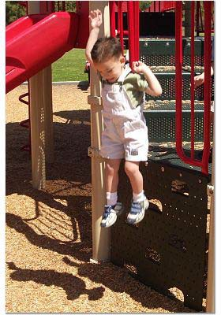
Well baby clinic

Slide 2


Slide 3
Well baby clinic’s rules
Growth assessments
Primary Prevention & Family Education.
Immunization.
4. Assessments of the baby's reflexes & neurological developments
5. Visual & hearing assessment
6. Systemic examinations to detect any childhood diseases from earlier stages.

Slide 4
Growth assessments
Using height‐for‐age measurement to monitor growth as well as weight‐for‐age
Use CDC chart for this purpose
Refer to specialist clinic as early as possible when a child's growth curve is abnormal
Encourage parents to come for growth
monitoring as they are dealing with the vaccination program

Slide 5
Growth and development
Growth is an increase in the size of the body & its organs.
Growth & development monitoring are essential component of WBC.
Growth can be monitored by growth charts.
Development can be monitored by developmental milestones checklist &
By risk assessment & eliciting parents concerns for growth & development.

Slide 6
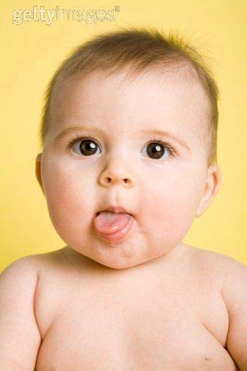
Early detection of growth disorders !!

Slide 7
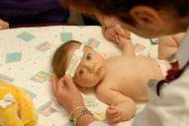
Normal infant growth
Head circumference (HC).
Approximately 35 cm at birth
Approximately 47 cm at 1 year of age
Use charts to detect any abnormalities:
– Large or small head

Slide 8
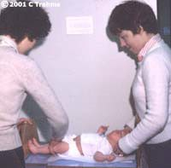
Normal infant growth
Length/ height (H).
Length at birth approximately 50 cm
Length at 1 year = 75 cm
Double birth length by 4 years (100 cm)
Use charts to detect any abnormalities:
– Under/ over growth

Slide 9
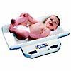
Normal infant growth
Weight (wt.)
Weight at birth = 2.5 -4 kg
4-6 months: birth weight doubles
1st year: birth weight triples
2nd year: birth weight quadruples
Gain rate:
1st month: 20-30 g / day
1st year: 10 g / day

Slide 10
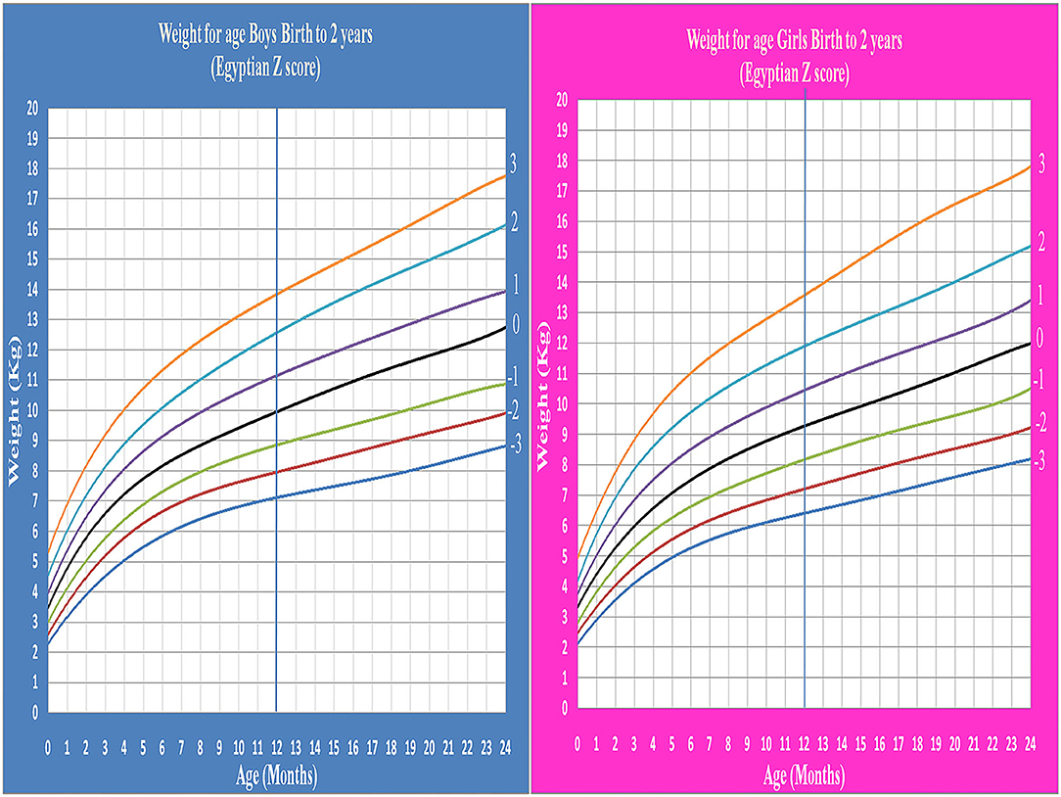

Slide 11
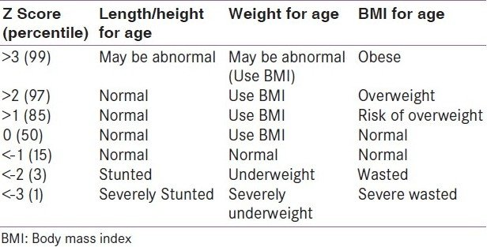

Slide 12
Definition of Z-Score Curves
Above 2,3 | Significantly > average
Above 1 | Moderately > than average
Above 0 | Average
Below -1 | Moderately < than the average
Below -2, -3 | Significantly < than average

Slide 13
A woman known of gestational DM brought her child for routine immunization: your nurse brought the girl immunization card, with this information:
Name | Sara Khalid
Age | 12 Months
File number | 2500-7-01
Date | 25/09/2019
Department | Almaarifa paediatric clinic
Code | 6822
Consultant name | Write your name
Consultant Number | 3178
Beep | 3070
n

Slide 14
Clinical Findings:
Head circumference | 46 cm
Body weight | 10 Kg
Length | 74 cm
Fill the form provided
What you are going to tell her mum about your findings:
The head circumference is: ----------------------------------------
Her length is: --------------------------------------------------------
Her body weight is: -------------------------------------------------

Slide 15
Fill the form provided
What you are going to tell her mum about your finding?
What is your explanation to the abnormal finding?
The head circumference is: ----------------------------------------
Her length is: --------------------------------------------------------
Her body weight is: -------------------------------------------------
Your explanation: -----------------------------------------------------------------------------------------------------------------------.

Slide 16
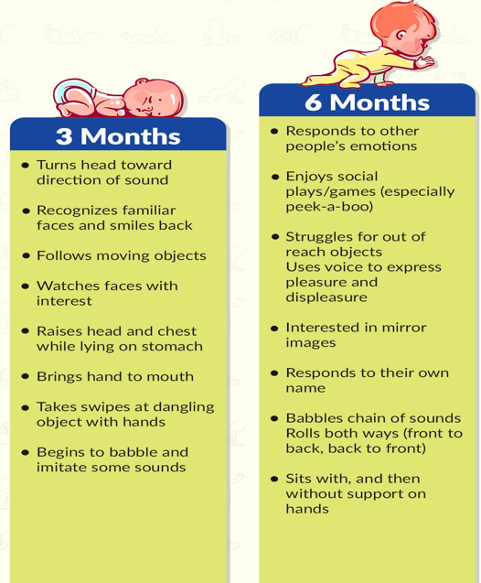
Developmental Milestones

Slide 17
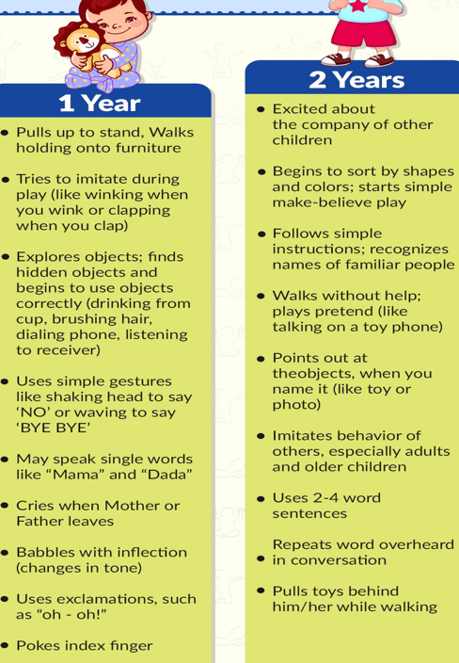

Slide 18
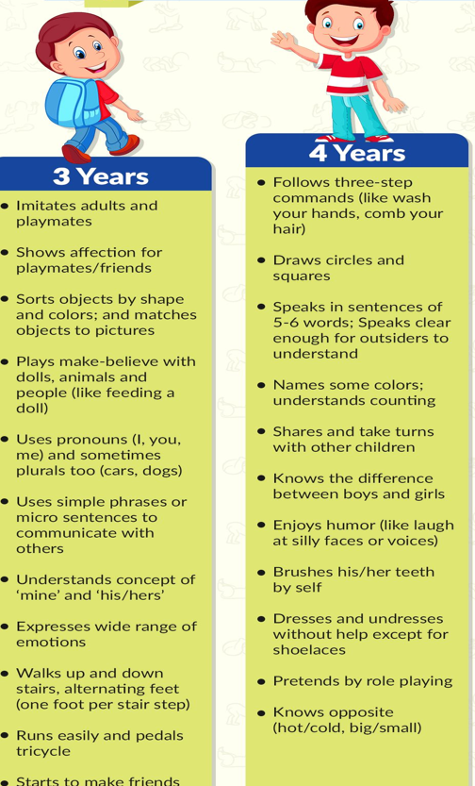

Slide 19
Gross Motor Skills
The acquisition of gross motor skills precedes the development of fine motor skills
Both processes occur in a cephalocaudal fashion
– Head control preceding arm & hand control, Followed by leg and foot control

Slide 20
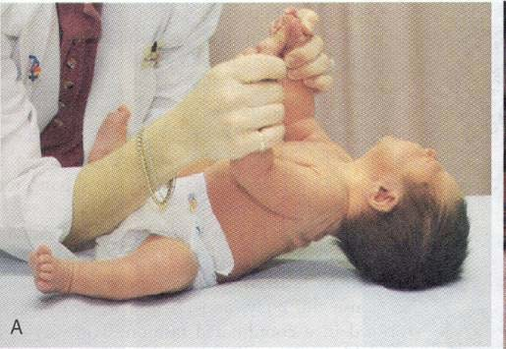
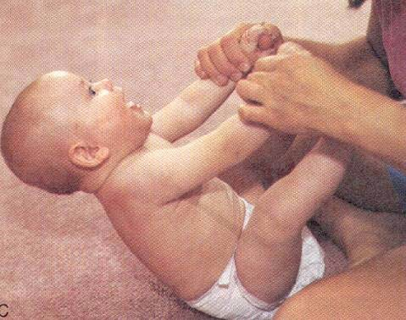
Head Control
Newborn
Age 6 months

Slide 21
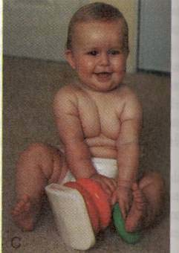
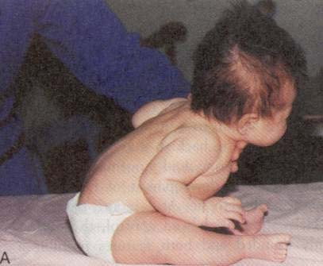
Sitting Up
Age 2 months
Age 8 months

Slide 22
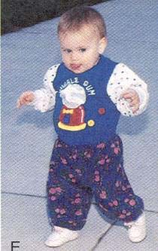
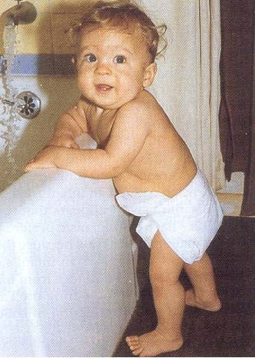
Ambulation
Nine to 12-months
13 month old

Slide 23
Fine motor development
Newborn has very little control
Objects will be involuntarily grasped & dropped without notice
6 month old: palmar grasp
uses entire hand to pick up an object
9 month old: pincer grasp
can grasp small objects using thumb & forefinger

Slide 24
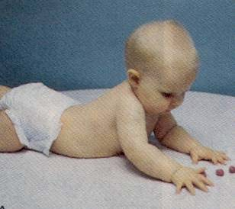
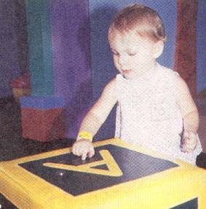
Fine Motor Development
6-month-old
12-month-old

Slide 25
Speech milestones
1-2 months: coos
2-6 months: laughs
8-9 months babbles: mama/dada as sounds
10-12 months: “mama/dada specific
18-20 months: 20 - 30 words (50% understood by strangers)
22-24 months: two word sentences, >50 words, 75% understood by strangers
30-36 months: almost all speech understood by strangers

Slide 26
Hearing
BAER hearing test done at birth
Ability to hear correlates with ability enunciate words properly
Always ask about history of otitis media – ear infection, placement of PET – tubes in ear
Early referral to ENT to assess for possible fluid in ears (effusion) to avoid speech delay
Repeat hearing screening test
Speech therapist as needed

Slide 27
Red Flags in infant development
Loss of developmental skills at any age
Parental or professional concerns about vision
Hearing loss at any age
Asymmetry of movements or other suggestive features of cerebral palsy
Not rolling, Not reaching for & holding toys, Not starting to babble by 6 months
Not siting unsupported, Can’t move toy from one hand to another, by 9 months
Not walking without support, No clear words, not saying dada, mama or other names, not following one-step direction by 18 months
Not pointing to pictures or body parts when named, Unable to run, Not use two-word phrases by 2 years
Not running well or walking up or down stairs, Not following two-step direction by 3 years

Slide 28
Benefits of breastfeeding:-
Provides all essential energy and nutrients
Protection against infectious diseases
Decreases rates of infant mortality
Decreases rates of other health outcomes
Enhances cognitive development
Enhances normal psychosocial behaviors
Reduces risk of development of autoimmune diseases
e.g. type 1 DM & allergic diseases later on life !!!

Slide 29
Breastfeeding encouragement
Please avoid adding formula feeding as much as possible !!
Age of introduction of solid food at six months of age not at 4th. Months of age
Iron & vitamin D supplements for breast - fed babies to prevent common diseases in our community e.g. rickets & IDA

Slide 30
Newborn screening
screening | Technique
Hypothyroidism | For full-term infants ( 2-7 days), initial (T4) assay, with follow-up [TSH]) assay if the blood T4 value is 10th percentile
Phenylketonuria | The AAFP recommends ordering screening test for Phenylketonuria in neonates.
Critical congenital heart defect | > 4 hour of age or before discharge, Pulse oximetry

Slide 31
Infant and children screening
Screening | Technique
Hip Dysplasia | Barlow and Ortolani tests
Vision screening | 1 mon.- 1.5 years: red reflex 1.5year – 3 years: Infants and young toddlers: Fixate and follow response

Slide 32
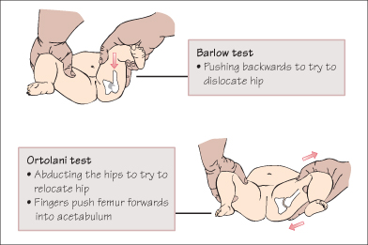

Slide 33
Barlow's Test
- Adduct the hip, then apply a downward pressure over the knee with your thumb. If the hip is unstable, the femoral head will slip out of the acetabulum, producing the palpable sensation of the hip dislocating. If the hip is dislocatable, then Barlow's test is positive.

Slide 34
The Ortolani Test:
The examiner's hands are placed over the child’s knees with his/her thumbs on the medial thigh and the fingers placing a gentle upward stress on the lateral thigh and greater trochanter area. With slow abduction, a dislocated and reducible hip will reduce with a described palpable “clunk.”

Slide 35
Hearing screening | At all health maintenance visits and periodic hearing screening at 4, 5, 6, 7, 8 and 10 years of age. Audiometry screening that includes 6000 and 8000 hertz frequencies is recommended once between 11 and 14 years, once between 15 and 17 years, and once between 18 and 21 years.
Behavior screening | At 18 and 24 months of age .
IDA | At four months of age and measurement of hemoglobin or hematocrit at 12 months of age and repeat risk assessment at 15, 18, 24, 30, and 36 months of age and annually thereafter.
Vit D | Recommends 400 IU of vitamin D daily for all children

Slide 36
Immunizations
Individual & series immunizations are started & continued at well-child visits.
Family should be provided with a schedule so that they know how many injections to expect at each visit as well additional optional vaccines.
Ask history of medications e.g. steroid or history of immunodeficiency prior of introduction of live – attenuated vaccines to avoid complications

Slide 37
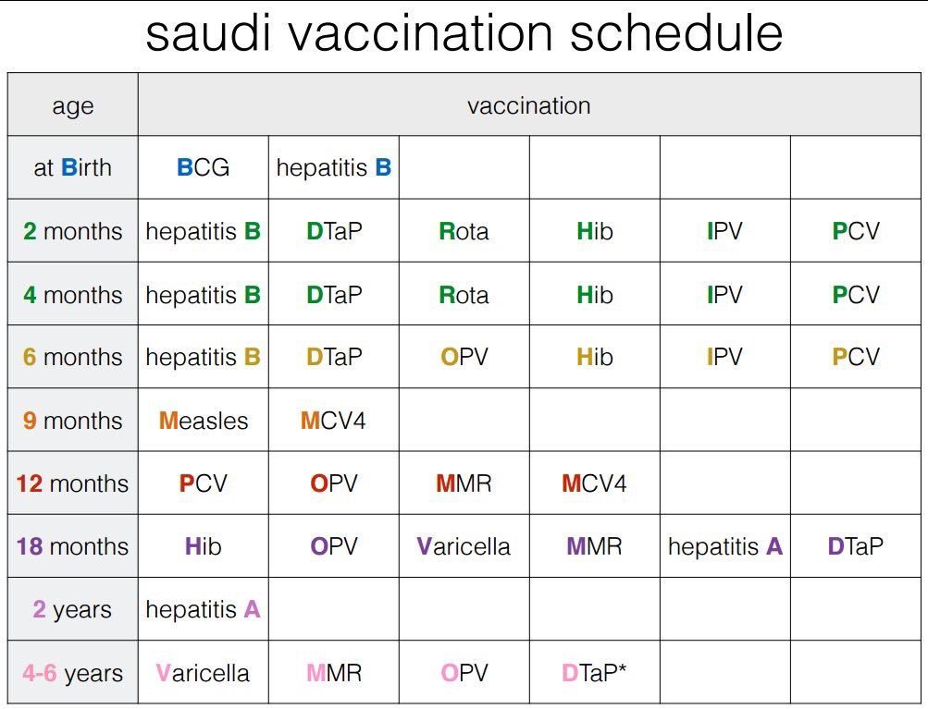
Immunization

Slide 38
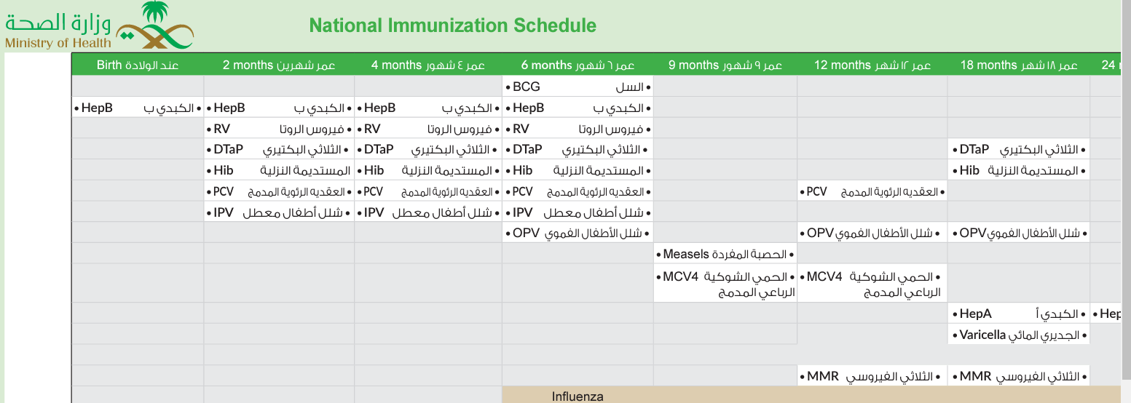

Slide 39
Contraindications to vaccination
- Only 2 absolute contraindications apply to all vaccines:
1. Anaphylaxis following a previous dose of the relevant vaccine
2. Anaphylaxis following any component of the relevant vaccine.

Slide 40
- 2 further CIs. apply to live vaccines:-
a) People who are significantly immunocompromised should not receive live vaccines.
b) Pregnant women should not receive live vaccines, in general.
- Women should be advised not to become pregnant within 28 days of receiving

Slide 41
Schedule for well-care visits. At birth and within 24 h.
Assessment and monitoring of health, | Prevention and protection
• Measurement and plotting of wt., H & HC • Signs of birth trauma, alertness, congenital anomalies or skin lesions or jaundice • assessment of breastfeeding • hip dislocation | Immunization • BCG vaccine • hepatitis B
Screening for eye abnormalities • hearing screening • neonatal hyperbilirubinemia • congenital heart disease | Supplementation • vitamin K supplementation

Slide 42
At 1 week of age
Assessment of danger signs • measurement and plotting of wt., H & HC. • Signs of birth trauma, alertness, congenital anomalies, skin lesions or jaundice • Assessment of breastfeeding • Hip dislocation | • Immunization • Catch up for missed at birth vaccines
Newborn screening • abnormalities of the eye • hearing and vision screening

Slide 43
At 2 weeks of age
Breast feeding assessment • Breastfeeding frequency • Breastfeeding positioning and attachment • Other foods or fluids • Complete physical examination • Assessment of danger signs • Measurement and plotting of wt., H & HC . • Observation for signs of congenital anomalies | Immunization • Check immunization status as per latest WHO or country recommendations. • Give catch up missed vaccines as appropriate
Newborn screening • vision screening

Slide 44
At 6 weeks of age
- Exclusive breast feeding assessment • other foods or fluids - Physical examination and growth monitoring • assessment of danger signs • measurement and plotting of wt., H & HC. • Signs of physical anomalies or skin lesions, neurologic tone, strength, and symmetry of movements. | • Immunization • Check immunization status. • Routine vaccination against: polio, hepatitis B, diphtheria, pertussis, tetanus, Haemophilus influenzae type B, pneumococci and rotavirus.
-Verbal and social language signs (e.g., looks in parent eyes, smiles, makes brief sounds) • gross motor and fine motor development (e.g., moves both arms and legs together and slightly opens fingers) • sleep and waking patterns.

Slide 45
At 10 weeks of age
- Exclusive breast feeding assessment - Physical examination and growth monitoring • assessment of danger signs • measurement and plotting of wt., H & HC. • Signs of neglect or abuse | • Routine vaccination against: polio, hepatitis B, diphtheria, pertussis, tetanus, Haemophilus influenzae type B, pneumococci and rotavirus
Developmental progress and milestones • gross motor and fine motor development (e.g., lists head and chest, keeps head stead, can bring hands together) • verbal and social language signs (e.g., makes short cooing, smiles when happy or cries when upset).

Slide 46
At 14 weeks of age
- Exclusive breast feeding assessment - Physical examination and growth monitoring • assessment of danger signs • measurement and plotting of wt., H & HC. • Signs of neglect or abuse | • Immunization • Routine vaccination against: polio, hepatitis B, diphtheria, pertussis, tetanus, Haemophilus influenzae type B, pneumococci and rotavirus.
Developmental progress and milestones • Gross motor and fine motor development (e.g., supports self on elbows and writs, can roll over from stomach to back). • Verbal and social language signs (e.g. laughs, responds more strongly, smiles on seeing faces, vocalizes and turns to voices, stays calm with a soothing lullaby).

Slide 47
At 6 Months of age
- Exclusive breast feeding assessment - Physical examination and growth monitoring • assessment of danger signs • measurement and plotting of wt for Length Z-Scores. • Signs of neglect or abuse | Immunization • Check immunization status. • Give catch up missed vaccines as Appropriate.
Developmental progress and milestones. look for signs of physical or skin anomalies; pupil opacification or red reflex, heart murmurs. | Developmental monitoring and milestones • gross motor (lifts head, sits with support, rolls from back to stomach) • verbal and social language (laughs aloud, vocalizes vowels “aa” or “uu” or “ma” or “ba” and looks when name called). • recognizes and engages by smiling to faces, makes sounds in response to play, brings objects to mouth).

Slide 48
At 9 Months of age
- Exclusive breast feeding assessment - Physical examination and growth monitoring • assessment of danger signs • measurement and plotting of wt. for Length Z-Scores. • Oral health screening | Immunization • Check immunization. • Routine vaccination against measles containing vaccine (MCV1) and rubella containing vaccine (RCV). • Give catch up missed vaccines as Appropriate.
• Developmental monitoring and milestones • Gross motor (sits without support, pulls self to stand, crawls) • Fine motor (picks small objects with finger and thumb and food to eat). | Developmental monitoring and milestones • Verbal and social language (uses basic gestures, looks for dropped objects, non specific words “Dada” or “Mama”, copies sounds) • relating and play (reaches out to be picked, plays hide and appear games, waves bye bye).

Slide 49
At 12 Months of age
Breastfeeding and family foods assessment • breastfeeding as child wants • transition to nutritious family foods Screening • dental care and check up • vision screening | • Immunization - Booster doses of diphtheria-, tetanus and pertussis-containing vaccine, or Pneumococcal.
Developmental monitoring and milestones • gross motor (stands without support, takes initial walking steps) • fine motor (picks food to eat) • verbal and social language (responds to gestures, says at least 1 word or name) • relating and play (plays hide and appear games, follows directions with gestures).

Slide 50
At 18 Months of age
• Nutrition and feeding practices assessment. • Breastfeeding as child wants • Nutritious family foods and snacks • Self feeding independence. • Screening • Developmental screening • Hearing or vision screening | • Immunization • Booster doses: measles vaccine (MCV2) and diphtheria-,tetanus- and pertussis containing vaccine, or pneumococcal conjugate Vaccine.
Developmental monitoring and milestones. • Gross motor (walks without support, carries toys, sits upright) • Fine motor (throws small objects while standing, scribbles). | • Verbal and social language (names familiar people, objects or body part, helps dress and undress, uses words to ask for help). • Relating and play (engages with others in play, points at objects or pictures to draw attention).

Slide 51
At 2 Years of age
Nutrition and feeding:- • nutritious family foods and snacks • self feeding independence. Assessment, physical examination and growth monitoring • assessment of health problems • measurement of wt. and H. | • Immunization • check immunization status as per latest WHO or country recommendations • catch up missed vaccines as appropriate
Developmental monitoring and milestones • observe and assess for running, scribbling, and ability to follow commands • gross motor (walks, runs and jumps, kicks a ball, climbs) • fine motor (holds pencil or stick, scribbles on ground or paper). | • Verbal and social language (combines at least 2 words, responds to command, names body parts). • Relating and play (imitates and initiates play alongside others, checks how objects or toys work,) • Self help activities or autonomy (uses finger or spoon for feeding, takes off clothing).

Slide 52
At 3 Years of age
• Nutrition and feeding practices assessment. • Nutritious family foods and snacks • Self feeding independence • Screening • vision screening and eye exam. • Blood pressure. | • Immunization • Catch up on missed vaccines as Appropriate.
Developmental monitoring and milestones. • Gross motor (climbs on and off, jumps off a sofa, pedals a tricycle) • Fine motor (precise 3 finger grip, manipulates small objects, draws a circle). | • Uses 3-word sentence & pronouns like “I”, “me” or “you”, tells a story). • Relating and play (warm interaction with people, engages in imaginary play and involves others, shares) • Self help activities or autonomy (feeds self, takes off clothing, washes hands with assistance).

Slide 53
At 4 Years of age
• Screening • Vision screening • Hearing screening • Dental screening | • Immunization Booster dose with Td/DT-containing vaccines as per national schedule (4 years between booster doses).
Developmental monitoring and milestones. • gross motor (hops over pieces of paper, climbs stairs) • fine motor (holds a pencil properly with 3 fingers, draws a simple cross, unbuttons) | • verbal and social language (asks “why”, “how” or “where”, uses 4-word sentences, tells story in logical sequence) • relating and play (plays with others, role play, follows rules) • Dresses and undresses with little help, brushes teeth, uses toilet by self).

Slide 54
At 5-6 Years of age
Measurement and plotting of weight, height & body mass index (BMI). • Screening • vision screening • hearing screening • oral health screening | • Immunization • Check vaccination status as per latest WHO or country recommendations • Catch up on missed vaccines as appropriate
Developmental monitoring and milestones. • Gross motor (jumps and stands on one leg, hops and skips) • Fine motor (holds a pen like an adult, writes letters and numbers, can draw a person with body parts) | Verbal and social language (good articulation & language skills, counts up to 10). • relating and play (plays with others, willing to share in role playing, tolerates mild disappointment) • Dresses and undresses without help, follows directions).

Slide 55
Take Home messages
Well baby clinic IS Not only for vaccinations
Growth assessments are very important in every visit
Use CDC chart or Saudi local charts
Growth Charts are very important tool for detection any growth disorders
Well baby clinic is an excellent place for primary prevention & family Education

Slide 56
Take Home messages
To encourage exclusive breastfeeding for first six months of life with emphasis on mother’s iron & calcium good intake
Not to introduce cow’s milk in first year of life
Prevention & education will prevent common nutritional diseases in community especially iron deficiency anemia & rickets (common in Saudi Arabia).

Slide 57
Take Home messages
Prevention of iron deficiency & rickets should be of paramount effort for all parties caring for healthy childhood !!
For exclusive breast-feeding:
Vitamin D supplementation of 400- 800 IU daily
Iron drops of 2-3 mg/ kg/ day
Development assessment is very crucial in the first five years of life.

Slide 58

The End
Thank You

