Slide 1
Approach to patients with Low Back Pain

Slide 2
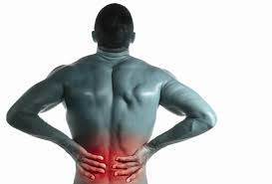

Slide 3
Objectives
1) Assess the patient presenting with acute back pain
2) Identify red flag symptoms to exclude serious disease,
3) Recognize yellow flag symptoms for psycho-social aspects of backache
4) Examine appropriately, a patient with back pain in primary care
5) Conduct a focused history and physical examination to help place patients with low back pain into 1 of 3 broad categories: nonspecific low back pain, radiculopathy and specific spinal cause.

Slide 4
6) Recognize importance of people with disabling long-term back pain, and so
reduce the personal, social and economic impact of low back pain.
7) Identify the limitation of images for the diagnosis of back pain,
8) Act as a gate-keeper and not wasting valuable health resources,
9) Identify preventive strategies available for back pain,
10) Recognize when to refer appropriately.

Slide 5
Case Scenario
A 28-year-old married auto mechanic with no prior history of back problems reports that he experienced sudden onset of back pain while bending forward and to the side as he was picking up a tire yesterday morning. Bed rest slightly improved his pain and he returned to work today.
However his back pain progressively increased throughout the day, and by the end of the day he was unable to bend and had to leave work.

Slide 6
He denies any radiation of back pain down either legs. His past medical history is unremarkable.
Physical examination reveals markedly limited bending forward and right lateral flexion. Palpation of the right para-spinal muscle revealed spasm and tenderness but no loss of lumbar lordosis. Straight leg raising (SLR) test is negative. Motor, sensory and reflex tests are normal.

Slide 7
Back Pain
Back pain is second to the common cold as a cause of lost days at work .
About 80% of people have at least one episode of low back pain during their lifetime.
The most common age groups are the 30s - 50s.
It usually feels like an ache, tension or stiffness in your back.

Slide 8
3 Broad Categories:
1. Nonspecific low back pain,
2. Radiculopathy or spinal stenosis, &
3. Back pain potentially associated with another specific spinal cause

Slide 9
Size in General Practice
Compression Fracture | 4%
Spondylolisthesis | 3%
Tumours | 0.7%
Ankylosing Spondylitis | 0.3%
Infections | 0.01%
Non-specific LBP | 90%

Slide 10
Non-specific low back pain
• Tension, soreness and/or stiffness in the lower back region for which it is not possible to identify a specific cause of the pain.
• Several structures in the back, including the joints, discs and connective tissues, may contribute to symptoms.

Slide 11
Mechanical problems
A mechanical problem is a problem with the way your spine moves or the way you feel when you move your spine in certain ways.
The most common mechanical cause of back pain is a condition called intervertebral disk degeneration.
Muscle tension: happens when the muscle is over-stretched or torn, resulting in damage to the muscle fibers.

Slide 12
Site of Lower Back
• The lower back is commonly defined as the area between the bottom of the rib cage and the buttock creases.
• Some people with non-specific low back pain may also feel pain in their upper legs, but the low back pain usually predominates.

Slide 13
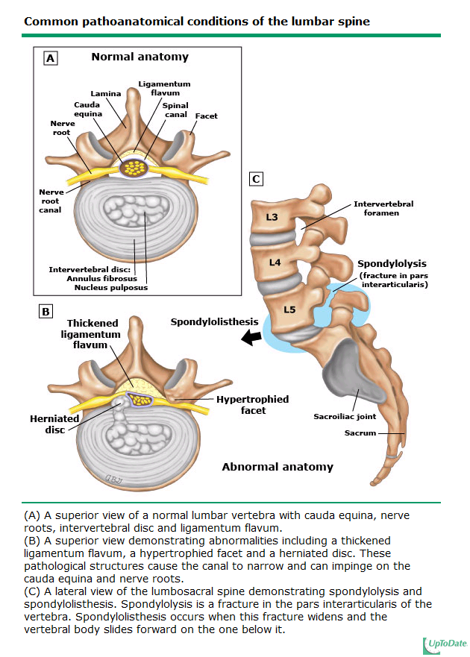
Mechanical problems
spondylolisthesis
(displacement):
is a condition in which one vertebra slip forward over the one below it.

Slide 14
Specific causes of low back pain
Degeneration | Of discs, joints
Inflammation | Ankylosing spondylitis , rheumatoid arthritis
Infection | Osteomylitis, abscess, tuberculosis
Neoplastic | Myeloma, lymphoma, cancer
Metabolic | Osteoporosis, osteomalacia, Paget’s disease
Others | Sickle-cell disease, claudication

Slide 15
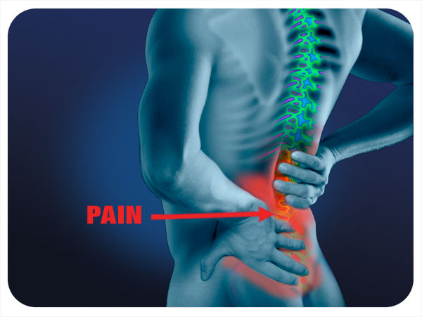
Causes Of Low Back Pain
- Mechanical, most common cause (Sprains and strains)
- Metabolic
- Inflammatory
- Active infection-
- Fracture
- Neoplastic
- Referred pain
- Pregnancy

Slide 16
Symptoms
80% to 90% of attacks of low back pain resolve in about 6 weeks.
Back pain can range from a dull, constant ache to a sudden, sharp pain.
Duration of pain:
acute (less than 4 weeks).
subacute (4 – 12 weeks).
chronic (greater than 12 weeks).

Slide 17
Red flags
Onset, age either <20 or >55 years.
Bowel or bladder dysfunction.
Spinal deformity.
Wight loss.
Lymphadenopathy.
Neurological symptoms.
History of HIV, corticosteroid therapy.
Unexplained fever.
Duration more than 6 weeks.

Slide 18
Yellow Flags
Belief: If patient believe that the back pain is serious -usually cancer.
Compensation - Is the patient awaiting payment for an accident/ injury at work/ RTA?
Emotions - Patients with other emotional difficulties such as ongoing depression and/or anxiety.
Work related factor.
Family - problems with families, either over bearing or under supportive.

Slide 19
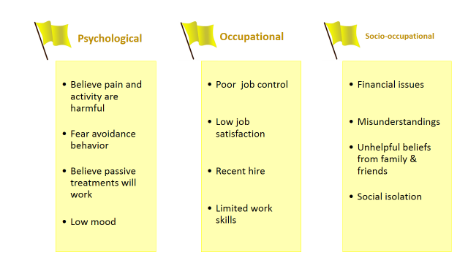

Slide 20
Sciatica
Is a bulging or herniated disk presses on the sciatic nerve that travels down the leg, it can cause sharp, shooting pain through the buttock and back of the leg.
there may be numbness, muscular weakness, pins and needles or tingling and difficulty in moving or controlling the leg. Typically, the symptoms are only felt on one side of the body.

Slide 21
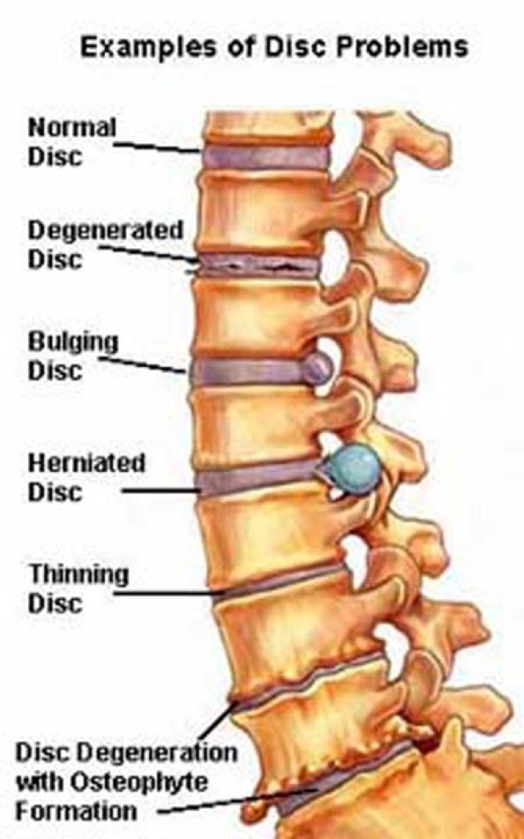

Slide 22
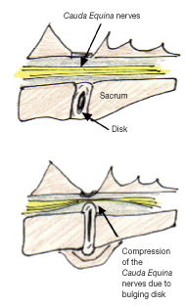
Cauda equina syndrome
Rare but serious condition
It can cause weakness in the legs, numbness in the "saddle" or groin area, and loss of bowel or bladder control.

Slide 23
Diagnosis of back pain
History

Slide 24
History:
The course of pain.
Is there evidence of a systemic disease.
Is there evidence of neurologic problems.
Occupational history.
Risk factors.
Red flags.
Yellow flags.

Slide 25
History:
Circumstances associated with pain onset.
Factors altering pain (stiffness at rest or at night, decrease with movement)
Is pain present continuously or on & off?
Effect of pain on activities.
Effect of pain on sleep.

Slide 26
Mechanical back pain
Deep dull pain
Moderate in nature.
Relieved by rest , and increase by activity.
Diffuse and unilateral.
Intensity increase at the end of the day and after activity.

Slide 27
Inflammatory back pain
Gradually in onset.
Throbbing in nature.
Morning stiffness.
Exacerbates by rest and relived by activity.
Intensity increase in night and early morning.
It is chronic backache.

Slide 28
Nerve root compression
Intense sharp or stabbing pain.
Numbness and paraesthesia in same distribution
Radiation to dermatome like : foot or toe.

Slide 29
Diagnosis of back pain

Slide 30
Examination
1- Inspection of back and posture
2- Palpation/Percussion of spine
3- Range of motion
4- Neurologic examination
5- Straight Leg Raising (SLR)

Slide 31
General :
  Permission
  Explain
  Privacy
Vital signs
Patient should be standing with the whole trunk exposed.

Slide 32
Examination Steps
look
feel
movement
Neurological test

Slide 33
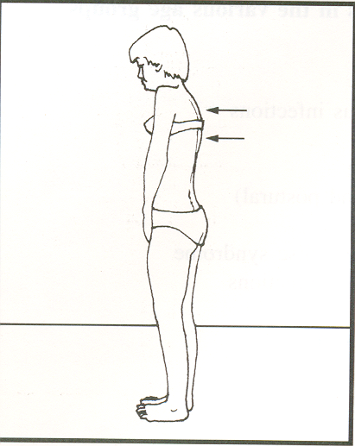
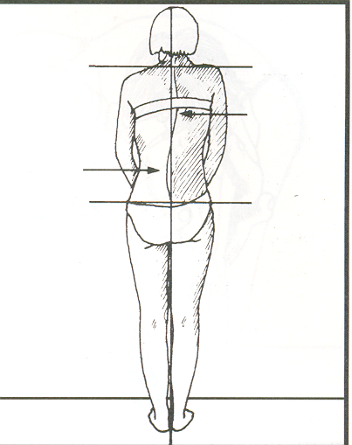
INSPECTION
- Gait
- Posture
  -- head/shoulders, listing, flxn/extn, pelvic tilt
- Muscle balance, Habitus
- Alignment

Slide 34
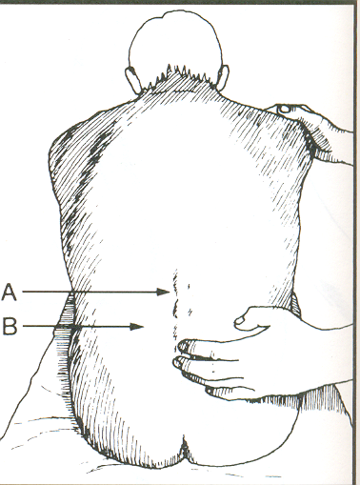
PALPATION AND PERCUSSION
Bone
  - tenderness or deformity over spinous processes
Joints
  - facet and sacroiliac joint tenderness
Muscles
  - paraspinal tension and trigger points

Slide 35
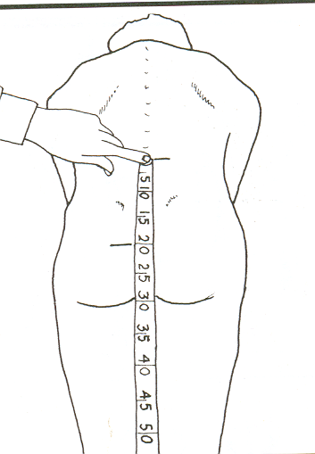
RANGE OF MOTION
-often very limited globally secondary to pain
- perform slowly with physical support
Flexion (normal = 90 degrees)

Slide 36
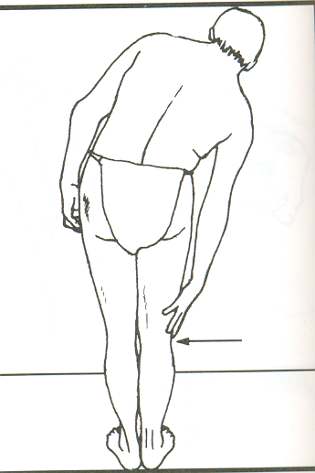
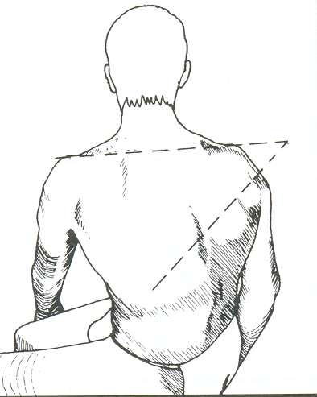
Lateral bending (normal = 45 degrees, hand to knee)
Rotation (normal = 90 degrees, stabilize hips)
Extension (normal = 30 degrees)
  - narrows canal, loads facet joints

Slide 37
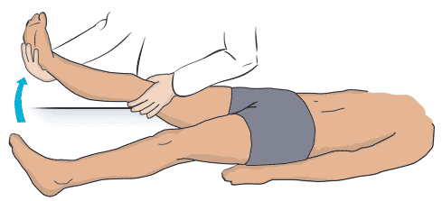
Straight leg raising (SLR)
raise the patient's extended leg with the ankle dorsiflexed.
Normally 80 – 90 degrees no pain
It will be limited by sciatica pain in lumbar disc prolapse. ( <70 ) → ( exactly from 30 to 70 )

Slide 38
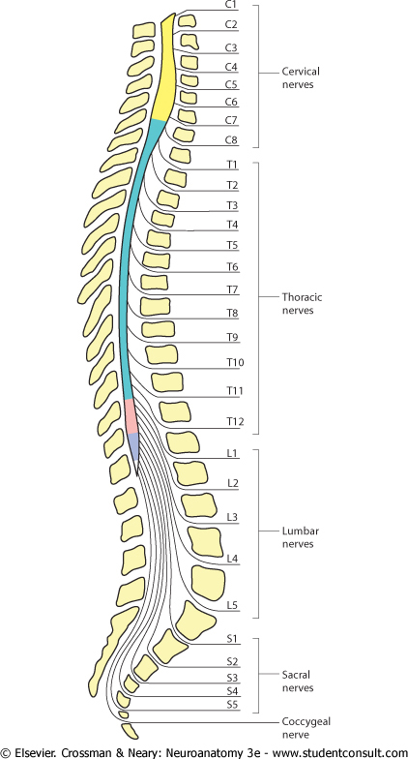
Neurologic testing
We should focus on the L5 and S1 nerve roots
98% of disc herniation occur at L4-5 and L5-S1
Then we test the Reflexes:
L4 – The knee reflex.
S1 – The ankle reflex.
Reflexes
Motor
sensory

Slide 39
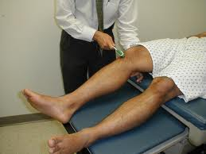
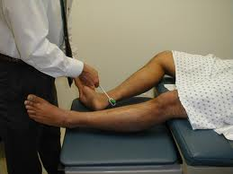
Reflexes
Knee (L3-4)
Ankle (S1-2)

Slide 40
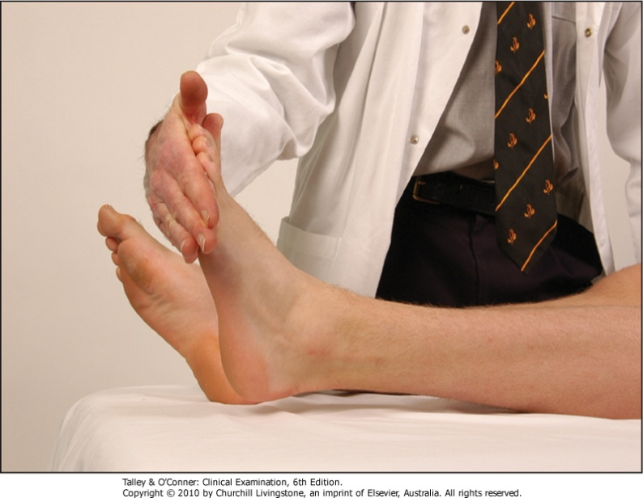
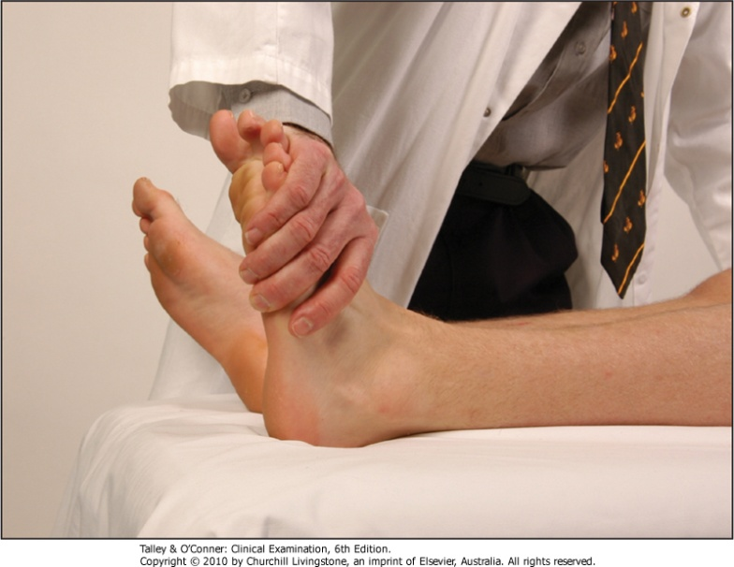
Motor
Ankle plantar flexion
Ankle dorsiflexion

Slide 41
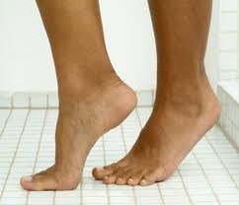
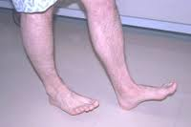
Motor
Walking on toes
Walking on heels
S1
L5

Slide 42
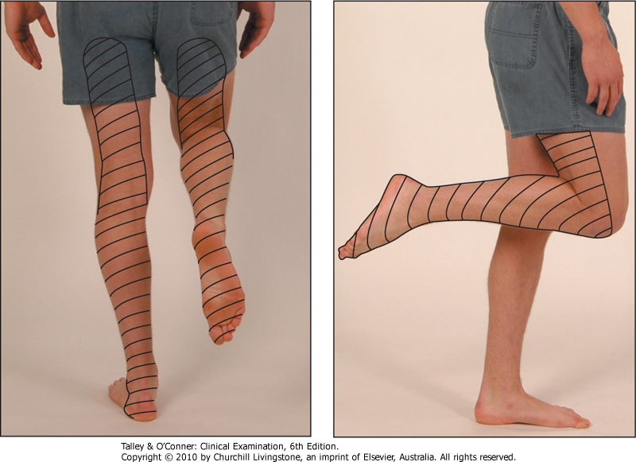
Sensory
Sciatic nerve (L4,5,S1,2)
Sensory distribution of the sciatic nerve

Slide 43
When to consider MRI?
- Spinal malignancy
- Cauda equina syndrome
- Infection
- Ankylosing spondylitis
- Fracture
- Inflammatory disorder.

Slide 44
Role of Primary Health Care in Management

Slide 45
Goals for treatment :
Educate patient about the natural history of back pain.
Ask about and address the patient’s concerns and goals.
Reduce pain.
Maximize functional status and increase quality of life.
Exercises: to help them return to normal activities and work. These exercises usually involve stretching maneuvers.
The management is according to the cause

Slide 46
Pharmacological
Pharmacological
Oral drugs
Local injection
Non-drug
NSAID
“Ibuprofen”
Analgesics
Antidepresent
Muscle relaxant
Epidural Steroid
Trigger point and ligaments
Heat therapy
Physiotherapy
Acupuncture
Notes:
Heat therapy: it dilates the blood vessels of the muscles surrounding the lumbar spine. Heat application facilitates stretching the soft tissues around the spine, including muscles, connective tissue, and adhesions, decrease in stiffness as well as injury, with an increase in flexibility and overall feeling of comfort.
Acupuncture: For back pain, it involves inserting very thin needles to various depths into strategic points on the body. Acupuncture is generally recognized as safe if done by a competent, certified acupuncture practitioner. Possible side effects and complications can occur, which include soreness, bleeding, infection or bruising at the needle sites.

Slide 47
When should patients be referred to a specialist?

Slide 48
Cauda equina syndrome. (Immediate referral)
Severe or progressive neurologic deficits.
Infections.
Tumors.
Fractures compressing the spinal cord.
No response to conservative therapy.

Slide 49
Prevention
of
Back Pain

Slide 50
Recommendations for the General Population:
Explain non specific causes of low back pain.
Encourage active life style and to make exercise such as, walking, jogging, swimming… etc.
Occupational health must be emphasized on to prevent lots of diseases and one of them is back pain.

Slide 51
How to protect your back:
In sitting: support your back against a hard chair. Make sure your hips level is higher than your knees.
In standing: Never lean forward without bending your knees.
Sleeping: Don’t sleep on your stomach.
Lifting: Avoid sudden movements. Bend both knees with leg muscles to lift them up. Keep the load closer to your body and try not to lift anything higher than your waist.

Slide 52
POST TEST

Slide 53
Which of the following is not a risk factor for back pain:
Obesity.
Heavy physical work.
Ethnicity.
Stress and distress.

Slide 54
A patient came with lower back pain with morning stiffness exacerbates by rest and relived by activity :
Mechanical back pain
Inflammatory back pain
Tumor
Nerve root compression

Slide 55
All of the following is a red flag signs of back pain except :
Onset age either <20 or >55 years.
Duration less than 6 weeks.
Bowel or bladder dysfunction.
Spinal deformity.

Slide 56
30 year old women had low backache 3 days ago, while taking further history, she said that they were moving to a new house and she was lifting heavy objects, the most probable diagnosis is:
Spinal stenosis.
Prolapsed disc.
Rheumatoid arthritis.
Fracture.
Non-Specific LBP

Slide 57
Most common site for disk prolapsed is:
L4 and L5
S1 and S2
C4
L1 and L2

Slide 58
Thank you

