Slide 1

Approach to Patients with
Shortness of Breath
FAM 530

Slide 2
Objectives
At the end of this session, students will be able to:
1. Identify differential diagnosis for shortness of breath.
2. Differentiate different phases of bronchial asthma.
3. Discuss briefly about bronchial asthma in adult.
4. Discuss briefly about bronchial asthma in children.
5. Enumerate and discuss the importance signs & symptoms.
6. Investigate appropriately a patient with bronchial asthma.
7. Advice initial management plan according to (SINA 2024).
8. Identify long term complications.

Slide 3
Definition
Asthma is a common heterogeneous chronic disorder of the airways, characterized by variable, usually reversible and recurring symptoms related to one or more of airflow obstruction, bronchial hyper-responsiveness, and underlying inflammation.
It is one of the most common chronic diseases in Saudi Arabia, affecting more than 2 million Saudis.

Slide 4
Case scenario
Khalid 14-year-old, comes to the clinic with the complaint of shortness of breath for one day duration.
He is a known as asthmatic patient for more than 8 years; he use to visit A/E department frequently.
His school performance is below average, with frequent absence from the school due to his illness.

Slide 5
Physical exam: BP 130/78
Pulse 98bpm
RR: 20 /min
SPO2: 97 %
Chest exam shows prolonged expiration with expiratory wheezing all over. Heart and abdomen exam is normal.

Slide 6
DDs.of SOB.
lung diseases
• Asthma
• Bronchitis
• Chronic obstructive pulmonary disease
• Cystic fibrosis
• Emphysema
Disorders affecting breathing nerves and muscles
• Amyotrophic lateral sclerosis
• Guillain-Barré syndrome
• Multiple sclerosis
• Myasthenia gravis
• Parsonage Turner syndrome
• Eaton-Lambert syndrome

Slide 7
Disorders of the blood and metabolism
• Anemia
• Hypothyroidism
• Adrenal insufficiency
• Metabolic acidosis
• Sepsis
• Leukemia
Psychological conditions
• Anxiety disorders and panic attacks
Cardiac
acute myocardial infarction
congestive heart failure

Slide 8
Epidemiology
Epidemiological studies in Saudi Arabia revealed an increasing prevalence of asthma in the past three decades, which may be attributed to rapid lifestyle changes related to the modernization of Saudi society, changes in dietary habits, and exposure to environmental factors such as indoor allergens, dust, sand storms, and tobacco.

Slide 9
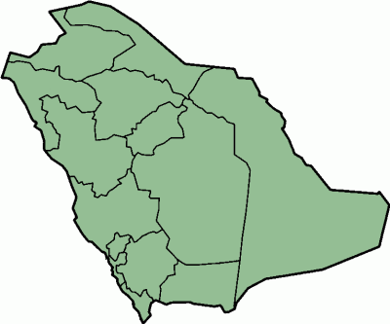
Epidemiology
Asthma is one of the most common chronic diseases worldwide with an estimation of 300 million affected individuals.
Prevalence is increasing in many countries, especially among children.
A major cause of school/work absence.
250,000 asthma deaths per year reported worldwide
Range 4%-23%
Hail 22%
Khobar 6%
Qaseem 13%
Taif 23%
Jeddah 12%
Riyadh 10 %
Abha 17%
Gizan 21%
( AL Frayh, et al, 2001 )

Slide 10
It is one of the most common chronic diseases in Saudi Arabia
According to Saudi Initiative for Asthma (SINA) , BA affecting more than 2 million Saudis.
Its impact is manifested in patients, their families, and the community as a whole in terms of lost work and school days, poor quality of life, frequent emergency department visits, hospitalizations, and deaths.

Slide 11

What is Asthma :
Asthma is a common heterogeneous chronic disorder of the airways, characterized by variable usually reversible and recurring symptoms related to one or more of airflow obstruction, bronchial hyper-responsiveness, and underlying inflammation.

Slide 12
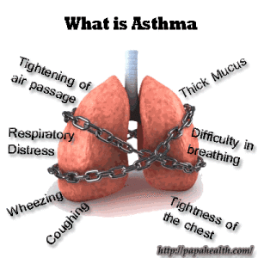

Slide 13
Pathophysiology
Asthma is an inflammatory disease and not simply a result of excessive smooth muscle contraction.
- Increased airway inflammation follows exposure to inducers such as allergens or viruses, exercise, or inhalation of nonspecific irritants.
- Increased inflammation leads to exacerbations characterized by dyspnea, wheezing, cough, and chest tightness.
- Abnormal histopathology including edema, epithelial cell desquamation, and inflammatory cell infiltration

Slide 14
It has 2 phases:
Early phase (Acute):
Due to bronchial smooth muscle spasm & excessive secretion of mucus.
Chronic phase:
Continuous Inflammation, fibrosis, oedma, necrosis of bronchial epithelial cells.

Slide 15
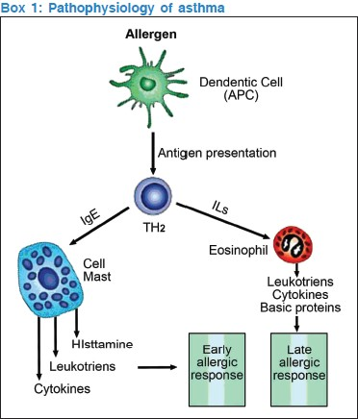

Slide 16
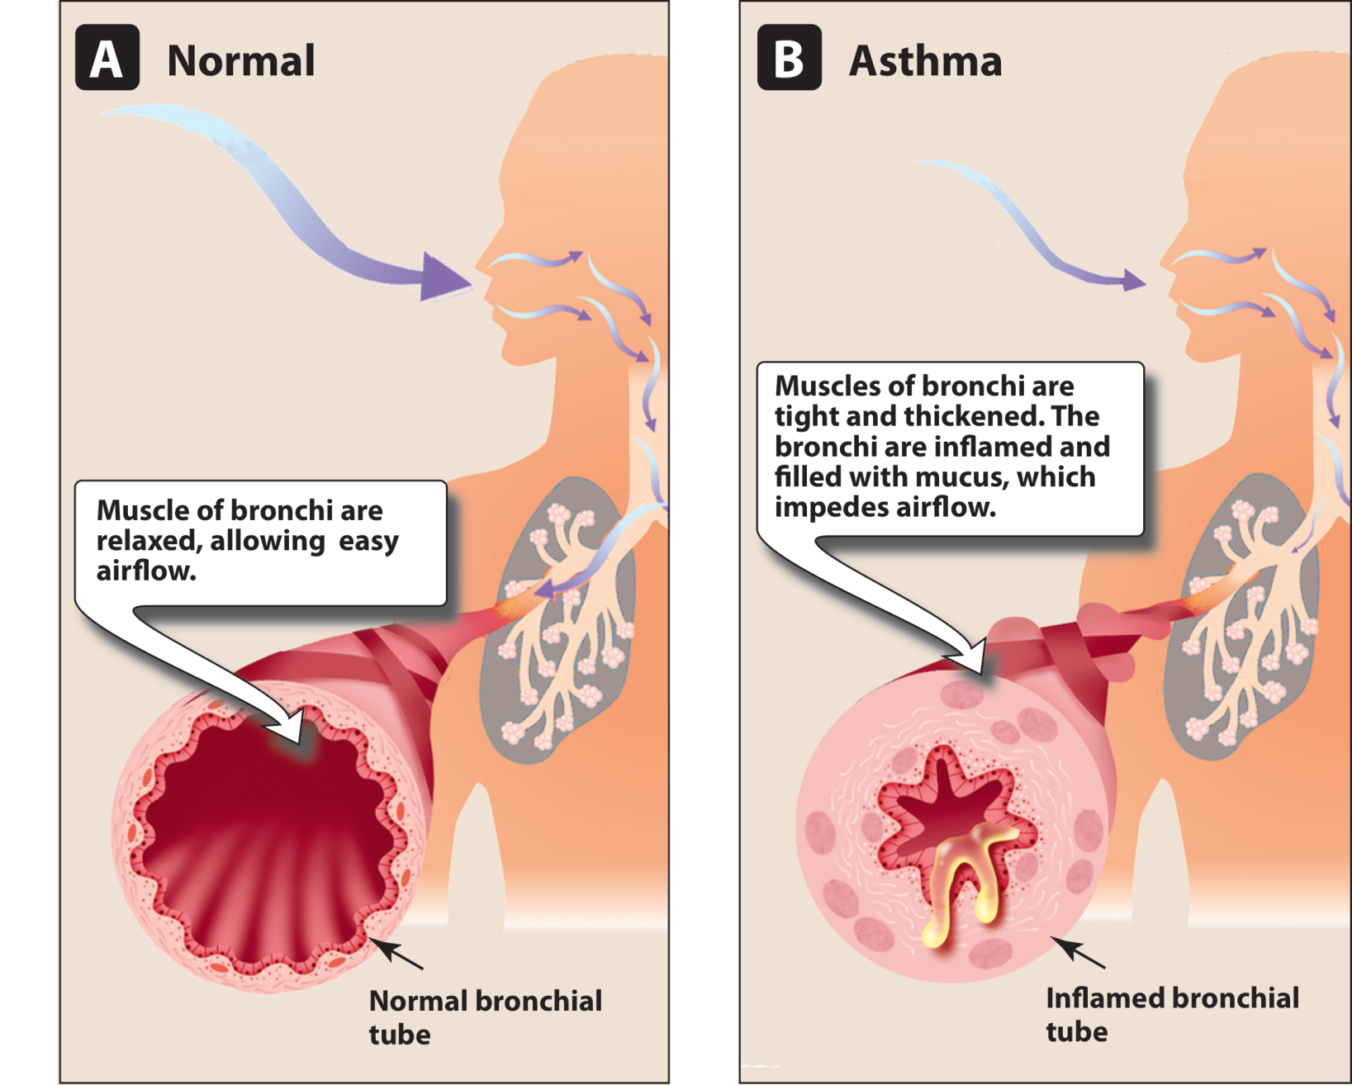
Figure 27.2 (still)
Chapter 27 MENU >

Slide 17
Types of asthma
1. Allergic asthma (extrinsic)
2. Non-allergic asthma (intrinsic)
3. Cough variant asthma
4. Occupational asthma
5. Exercise induced asthma
6. Medication induced asthma
7. Nocturnal asthma

Slide 18
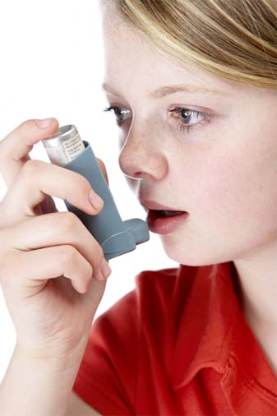
Triggers
Allergies
Tobacco Smoke
Environmental Factors
Obesity
Pregnancy
Stress
Genes
Atopy
Notes:
Allergies
Almost all asthma sufferers have allergies. In fact, over 25% of people who have hay fever (allergic rhinitis) also develop asthma. Allergic reactions triggered by antibodies in the blood often lead to the airway inflammation that is associated with asthma.
Common sources of indoor allergens include animal proteins (mostly cat and dog allergens), dust mites, cockroaches, and fungi. It is possible that the push towards energy-efficient homes has increased exposure to these causes of asthma.
Tobacco Smoke
Tobacco smoke has been linked to a higher risk of asthma as well as a higher risk of death due to asthma, wheezing, and respiratory infections. In addition, children of mothers who smoke - and other people exposed to second-hand smoke - have a higher risk of asthma prevalence. Adolescent smoking has also been associated with increases in asthma risk.
Environmental Factors
Allergic reactions and asthma symptoms are often the result of indoor air pollution from mold or noxious fumes from household cleaners and paints. Other indoor environmental factors associated with asthma include nitrogen oxide from gas stoves. In fact, people who cook with gas are more likely to have symptoms such as wheezing, breathlessness, asthma attacks, and hay fever.
Pollution, sulfur dioxide, nitrogen oxide, ozone, cold temperatures, and high humidity have all been shown to trigger asthma in some individuals.
During periods of heavy air pollution, there tend to be increases in asthma symptoms and hospital admissions. Smoggy conditions release the destructive ingredient known as ozone, causing coughing, shortness of breath, and even chest pain. These same conditions emit sulfur dioxide, which also results in asthma attacks by constricting airways.
Weather changes have also been known to stimulate asthma attacks. Cold air can lead to airway congestion, bronchoconstriction (airways constriction), secretions, and decreased mucociliary clearance (another type of airway inefficiency). In some populations, humidity causes breathing difficulties as well.
Obesity
Overweight adults - those with a body mass index (BMI) between 25 and 30 - are 38% more likely to have asthma compared to adults who are not overweight. Obese adults - those with a BMI of 30 or greater - have twice the risk of asthma. According to some researchers, the risk may be greater for nonallergic asthma than allergic asthma.
Pregnancy
The way you enter the world seems to impact your susceptibility to asthma. Babies born by Caesarean sections have a 20% increase in asthma prevalence compared to babies born by vaginal birth. It is possible that immune system-modifying infections from bacterial exposure during Cesarean sections are responsible for this difference.
When mothers smoke during pregnancy, their children have lower pulmonary function. This may pose additional asthma risks. Research has also shown that premature birth is a risk factor for developing asthma.
Stress
People who undergo stress have higher asthma rates. Part of this may be explained by increases in asthma-related behaviors such as smoking that are encouraged by stress. However, recent research has suggested that the immune system is modified by stress as well.
Genes
It is possible that some 100 genes are linked to asthma - 25 of which have been associated with separate populations as of 2005.
Genes linked to asthma also play roles in managing the immune system and inflammation. There have not, however, been consistent results from genetic studies across populations - so further investigations are required to figure out the complex interactions that cause asthma.
Mom and Dad may be partially to blame for asthma, since three-fifths of all asthma cases are hereditary. The Centers for Disease Control (USA) say that having a parent with asthma increases a person's risk by three to six times.
Genetics may also be interacting with environmental factors. For example, exposure to the bacterial product endotoxin and having the genetic trait CD14 (single nucleotide polymorphism (SNP) C-159T) have remained a well-replicated example of a gene-environment interaction that is associated with asthma.
Airway Hyperreactivity
Researchers are not sure why airway hyperreactivity is another risk factor for asthma, but allergens or cold air may trigger hyperreactive airways to become inflamed. Some people do not develop asthma from airway hyperreactivity, but hyperreactivity still appears to increase the risk of asthma.
Atopy
Atopy - such as eczema (atopic dermatitis), allergic rhinitis (hay fever), allergic conjunctivitis (an eye condition) - is a general class of allergic hypersensitivity that affects different parts of the body that do not come in contact with allergens. Atopy is a risk factor for developing asthma.
Some 40% to 50% of children with atopic dermatitis also develop asthma, and it is probable that children with atopic dermatitis have more severe and persistent asthma as adults.

Slide 19
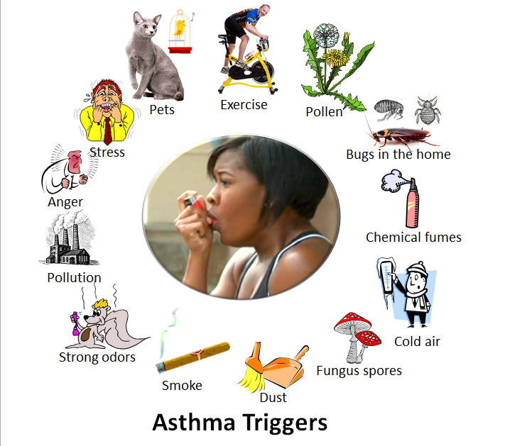
Notes:
Factors that can contribute to asthma or airway hyperreactivity may include any of the following:
Environmental allergens (eg, house dust mites; animal allergens, especially cat and dog; cockroach allergens; and fungi)
Viral respiratory tract infections
Exercise, hyperventilation
Gastroesophageal reflux disease
Chronic sinusitis or rhinitis
Aspirin or nonsteroidal anti-inflammatory drug (NSAID) hypersensitivity, sulfite sensitivity
Use of beta-adrenergic receptor blockers (including ophthalmic preparations)
Obesity ^{[13]}
Environmental pollutants, tobacco smoke
Occupational exposure
Irritants (eg, household sprays, paint fumes)
Various high- and low-molecular-weight compounds (eg, insects, plants, latex, gums, diisocyanates, anhydrides, wood dust, and fluxes; associated with occupational asthma)
Emotional factors or stress
Perinatal factors (prematurity and increased maternal age; maternal smoking and prenatal exposure to tobacco smoke; breastfeeding has not been definitely shown to be protective)

Slide 20
Drugs causing B. Asthma
Aspirin or nonsteroidal anti-inflammatory drug (NSAID) hypersensitivity, sulfite sensitivity
Use of beta-adrenergic receptor blockers (including ophthalmic preparations)
Oral contraceptive pill
Cholinergic agents
Prostaglandin F₂

Slide 21
Diagnosis of Asthma in Adults and Adolescents

Slide 22
Signs and symptoms:-
Cough
Wheezing
Chest tightness.
Shortness of breath.
Notes:
Coughing, especially at night, during exercise or when laughing.Shortness of breath.Chest tightness.Wheezing (a whistling or squeaky sound in your chest when you breathe, especially when exhaling)Any asthma symptom is serious and can become deadly if left untreated

Slide 23
History
Family history of asthma or other atopic conditions?
Any recurrent attacks of wheezing?
Does the patient have a troublesome cough at night?
Does the patient wheeze or cough after exercise?
Does the patient experience symptoms after exposure to any of the triggers?
Is there worsening of symptoms after taking the causative medications?
Does the patient’s cold “go to the chest” or take more than 10 days to clear up?
Are symptoms improved by appropriate asthma treatment?
Are there any features suggestive of occupational asthma?

Slide 24
Physical Examination
May be normal in stable and controlled asthma
Bilateral expiratory wheezing
Examination of the upper airways
Other allergic manifestations: e.g., atopic dermatitis/eczema
Consider alternative diagnosis when there is localized wheeze, crackles, stridor, clubbing or heart murmurs.

Slide 25
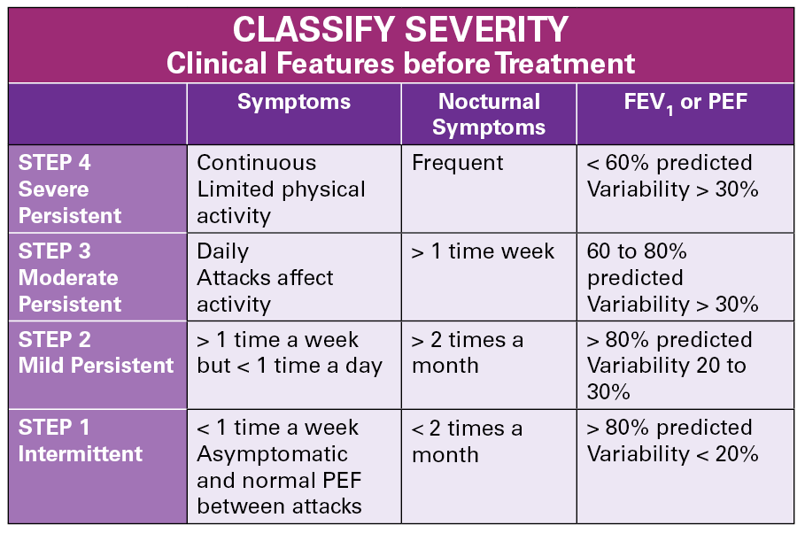
Classification of asthma severity

Slide 26
Investigations
Spirometry:
Is the primary method for confirming variable airflow limitation. Can confirm airflow obstruction and demonstrates significant reversibility.
The degree of significant reversibility is defined as an improvement in forced expiratory volume in 1 s (FEV1) ≥12% and ≥200 ml from the pre-bronchodilator value.
Bronchodilator response: to assess bronchodilator reversibility in almost all adult and adolescent patients with airflow limitation on their baseline spirometry

Slide 27
Broncho provocation testing: Is a useful tool for diagnosing asthma in patients with normal baseline airflow.
Peak expiratory flow (PEF). Measured during a brief, forceful exhalation, We typically use PEF measurements to monitor patients with a known diagnosis of asthma or to assess the role of a particular occupational exposure or trigger, rather than as a tool for the primary diagnosis of asthma .
Peripheral eosinophilia and elevated IgE levels are supportive of the diagnosis but are not routinely recommended unless dealing with moderate to severe asthma.

Slide 28
Investigation
Blood tests: For screening of eosinophilia & anemia.
Tests for allergy: Allergy tests are not useful for the diagnosis of asthma, but they can be helpful to confirm sensitivity to suspected allergic triggers of respiratory symptoms and to guide on-going management of asthma
Imaging: chest radiographs are not routinely recommended unless the diagnosis is in doubt e.g. - evaluating severe or "difficult-to-control" asthma and when co-morbid conditions (eg, allergic bronchopulmonary aspergillosis, eosinophilic pneumonia, or atelectasis due to mucus plugging) are suspected.

Slide 29
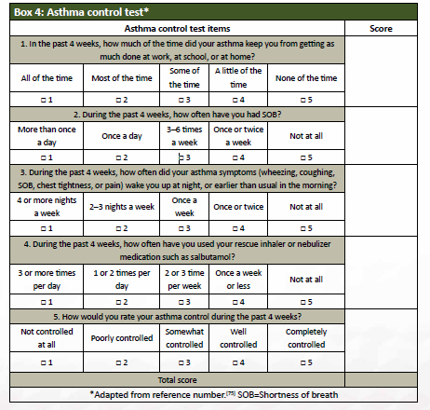

Slide 30
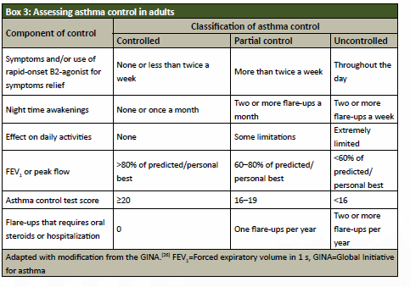

Slide 31
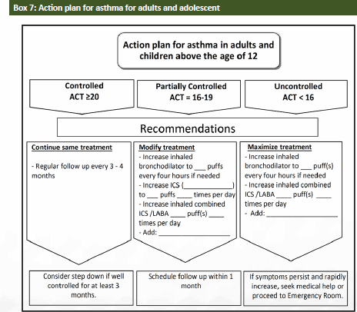

Slide 32
Managements
Non pharmacological:-
Understanding asthma — The patient and family should understand the characteristics of asthma, the principles of effective treatment, the effects of various medications, and the resources available.

Slide 33
Avoid your triggers
Use your air conditioner.
Decontaminate your décor Maintain optimal humidity
Prevent mold spores.
Reduce pet dander
Clean regularly.
Cover your nose and mouth if it's cold out
Notes:
Avoid your triggers
Taking steps to reduce your exposure to things that trigger asthma symptoms is a key part of asthma control. It may help to:
Use your air conditioner. Air conditioning reduces the amount of airborne pollen from trees, grasses and weeds that finds its way indoors. Air conditioning also lowers indoor humidity and can reduce your exposure to dust mites. If you don't have air conditioning, try to keep your windows closed during pollen season.
Decontaminate your decor. Minimize dust that may worsen nighttime symptoms by replacing certain items in your bedroom. For example, encase pillows, mattresses and box springs in dustproof covers. Remove carpeting and install hardwood or linoleum flooring. Use washable curtains and blinds.
Maintain optimal humidity. If you live in a damp climate, talk to your doctor about using a dehumidifier.
Prevent mold spores. Clean damp areas in the bath, kitchen and around the house to keep mold spores from developing. Get rid of moldy leaves or damp firewood in the yard.
Reduce pet dander. If you're allergic to dander, avoid pets with fur or feathers. Having pets regularly bathed or groomed also may reduce the amount of dander in your surroundings.
Clean regularly. Clean your home at least once a week. If you're likely to stir up dust, wear a mask or have someone else do the cleaning.
Cover your nose and mouth if it's cold out. If your asthma is worsened by cold or dry air, wearing a face mask can help.
Stay healthy
Taking care of yourself and treating other conditions linked to asthma will help keep your symptoms under control. For example:
Get regular exercise. Having asthma doesn't mean you have to be less active. Treatment can prevent asthma attacks and control symptoms during activity. Regular exercise can strengthen your heart and lungs, which helps relieve asthma symptoms. If you exercise in cold temperatures, wear a face mask to warm the air you breathe.
Maintain a healthy weight. Being overweight can worsen asthma symptoms, and it puts you at higher risk of other health problems.
Eat fruits and vegetables. Eating plenty of fruits and vegetables may increase lung function and reduce asthma symptoms. These foods are rich in protective nutrients (antioxidants) that boost the immune system.
Control heartburn and gastroesophageal reflux disease (GERD). It's possible that the acid reflux that causes heartburn may damage lung airways and worsen asthma symptoms. If you have frequent or constant heartburn, talk to your doctor about treatment options. You may need treatment for GERD before your asthma symptoms improve.

Slide 34
Stay healthy
Taking care of yourself and treating other conditions linked to asthma will help keep your symptoms under control. For example:
Get regular exercise.
Maintain a healthy weight.
Eat fruits and vegetables.
Control heartburn and gastroesophageal reflux disease (GERD).

Slide 35
The long-term goals of asthma management
Control asthma symptoms (cough, wheezing, or shortness of breath)
Infrequent and minimal use (≤2 days a week) of reliever therapy
Maintain (near) normal pulmonary function
Maintain normal exercise and physical activity levels
Prevent recurrent exacerbations of asthma, and minimize the need for emergency room (ER) visits or hospitalizations
Optimize asthma control with the minimal dose of medications
Reduce mortality
Optimize quality of life

Slide 36
Pharmacological Management in Adults and Adolescents
The SINA panel recommends asthma treatment to be based on the following phases:
• Initiation of treatment
• Adjustment of treatment
• Maintenance of treatment.
- At each phase, the patient is recommended to have a clinical assessment that includes symptoms assessment by ACT – Then the patient can be placed on appropriate treatment Step.

Slide 37
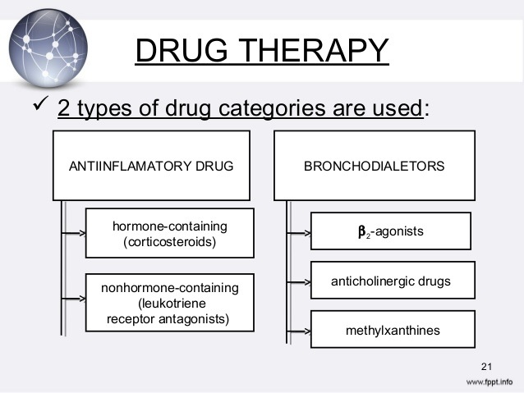

Slide 38
Management - Pharmacological:
β2-Agonists
Are the most effective bronchodilators available.
This results in smooth muscle relaxation, mast cell membrane stabilization, and skeletal muscle stimulation.
Short acting agents: Albuterol, levalbuterol or pirbuterol
Long acting agents: Salmeterol, formoterol and arformoterol

Slide 39
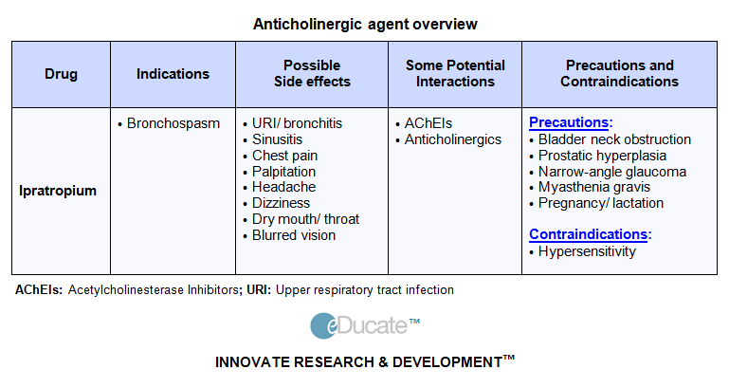
Anticholinergics:
Ipratropium bromide and tiotropium bromide are competitive inhibitors of muscarinic receptors; they produce bronchodilation only in cholinergic mediated bronchoconstriction.

Slide 40
Corticosteroids:
Corticosteroids increase the number of β2-adrenergic receptors and improve receptor responsiveness to β2 -adrenergic stimulation, thereby reducing mucus production and hyper-secretion, reducing BHR, and reducing airway edema and exudation.
Systemic toxicity of inhaled corticosteroids is minimal with low to moderate inhaled doses, but the risk of systemic effects increases with high doses.
Local adverse effects include oropharyngeal candidiasis and hoarseness of voice.

Slide 41
Leukotriene Modifiers:
Zafirlukast (Accolate) and montelukast (Singulair) are oral leukotriene receptor antagonists that reduce the proinflammatory (increased microvascular permeability and airway edema) and bronchoconstriction effects of leukotriene D4.
In adults and children with persistent asthma, they improve pulmonary function tests, decrease nocturnal awakenings and β2-agonist use, and improve asthma symptoms.

Slide 42
Omalizumab
Omalizumab (Xolair) is an anti-IgE antibody approved for the treatment of allergic asthma not well controlled by oral or inhaled corticosteroids.
Because of its high cost, it is only indicated as step 5 or 6 care for patients who have allergies and severe persistent asthma that is inadequately controlled with the combination of high-dose inhaled corticosteroids and long-acting β2-agonists.

Slide 43
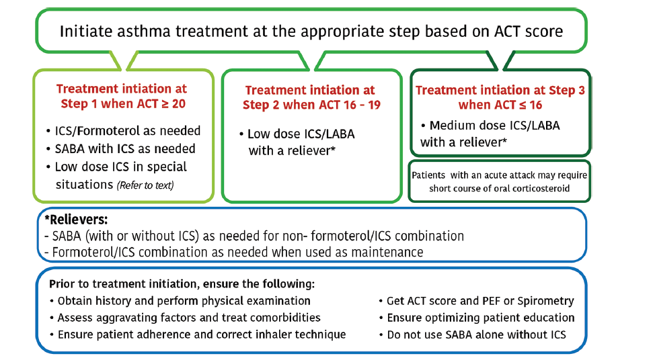

Slide 44
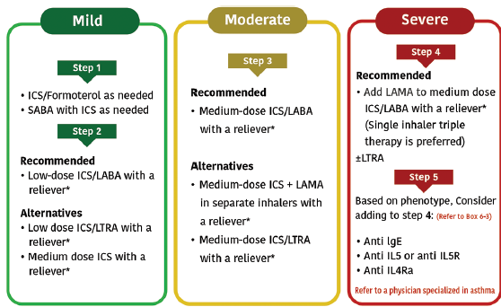

Slide 45
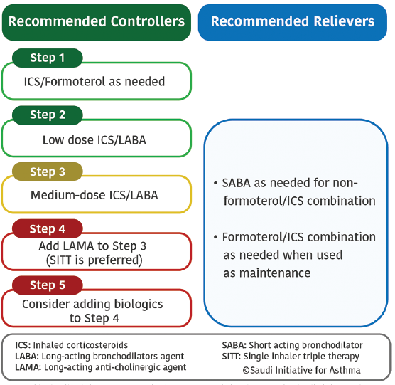

Slide 46
Treatment at step 1
Symptoms are usually mild and infrequent,
(usually < twice a week) with an ACT score of ≥20 points and no risk factors for asthma exacerbations.
At this step, SABA alone on an as-needed basis is not anymore recommended.
Recommended option: It is recommended to use ICS/formoterol on an as-needed basis (Evidence A).

Slide 47
Treatment at step 2
Recommended options: It is recommended to use a daily fixed-dose combination of low-dose ICS/LABA with an as-needed reliever for symptom relief (Evidence A).
Alternative options:
• The addition of LTRA to a low-dose ICS is another option, especially in patients with concomitant rhinitis (Evidence A)

Slide 48
Treatment at step 3
• Recommended options: The fixed-dose combination of medium-dose ICS/LABA was found to improve asthma control and reduce asthma exacerbations for patients whose asthma is not controlled at step 2 (Evidence A).
- Alternative options: Evidence has shown that when tiotropium is added to an ICS delivered by multiple inhalers; it improves symptoms, reduces the risk of exacerbation, and improves lung function in patients with inadequately controlled asthma.

Slide 49
Treatment at step 4
• Recommended options:
Add LAMA in a single inhaler is recommended (Evidence A). This novel approach of SITT was found to be a safe and effective therapeutic approach. Moreover, when compared to multiple inhalers triple therapy (MITT), SITT usage is cost-effective and is associated with better adherence.
Once-a-day SITT combination of fluticasone furoate/umeclidinium/vilanterol 200/62.5/25 μg (Trelegy Ellipta®) is a recommended option.

Slide 50
Treatment at step 5
Early consideration of biological therapy may lead to clinical remission and save the patient from frequent or chronic use of OCS and reduce asthma exacerbations.
Consultation with an asthma specialist is strongly recommended.
Available biological agents like:-
• Anti-IgE therapy: Omalizumab
• Anti-IL 5 therapy: Mepolizumab

Slide 51
Criteria for admission
Patients whose peak flow is ≥ 60% best or predicted one hour after initial treatment can be discharged from the emergency department
Criteria for admission:
  Any feature of a life threatening, near fatal attack
  Any feature of a severe attack that persists after initial treatment.
  unless any of the following is present:
  still suffering from significant symptoms
  previous history of near fatal or brittle asthma
  concerns about compliance and pregnancy

Slide 52
Referral to a specialist center
  Status asthmatics
  Deteriorating PEF
  Persisting or worsening hypoxia
  Hypercapnea, respiratory acidosis (pH <7.3)
  Severe exhaustion
  Increase work of breathing
  Drowsiness
  Confusion
  Coma
  Respiratory arrest

Slide 53
Complication
Airway Remodeling
Hospitalization
Lifestyle Disruption
Sleep
Physical activity
Productivity
Death

Slide 54
Management of acute asthma in adults and adolescents:
Acute asthma exacerbation is a challenging clinical scenario that requires a systemic approach to rapidly diagnose the condition.
The first step is the early recognition to prevent the occurrence of exacerbations. event.
The most specific marker associated with increased asthma mortality would be a history of repeated hospital admissions.

Slide 55
Clinical assessment of acute asthma:
The presence of the following features should be sought:
Previous history of near-fatal asthma
Whether the patient is taking three or more medications
Heavy use of SABA
Repeated visits to the ED
Brittle asthma.

Slide 56
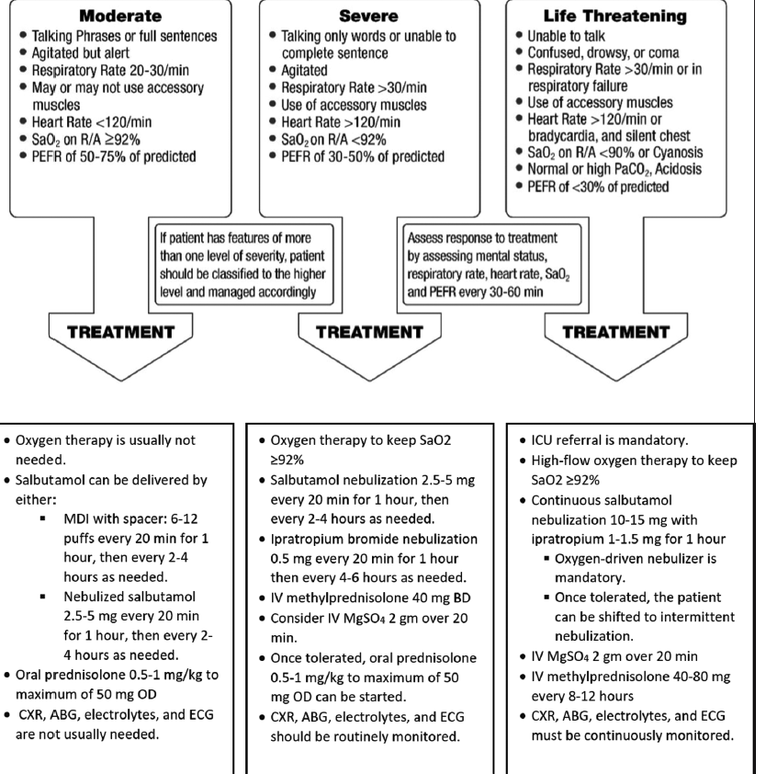

Slide 57
Management of asthma in children
Asthma represents the commonest chronic illness of childhood.
It is also considered a leading cause for childhood morbidity as measured by school absences, ED visits, and hospitalizations.

Slide 58
Asthma diagnosis in children
should be based on a careful clinical assessment that includes:
Recurrent or chronic symptoms related to airway obstruction, such as wheezing, coughing, night symptoms, activity limitation, and shortness of breath.
The diagnosis can be further be supported by the presence of atopy, early sensitization, and a family history of atopy.
Whenever possible, spirometry is recommended to be performed to show reversibility of airway obstruction after bronchodilator therapy.
In general, spirometry can be performed in children aged ≥5 years.

Slide 59
Asthma in preschool children:
Diagnosis and management differs from that of older children and adolescent
In addition to the diagnosis of asthma, wheezing in preschool children can be due to unique differential diagnoses e.g.,
Congenital defects,
Infections especially viral bronchiolitis,
Bronchopulmonary dysplasia, and
Cystic fibrosis.

Slide 60
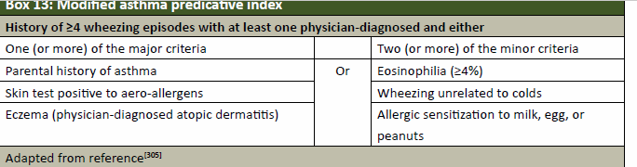
Prediction of asthma in preschool children:

Slide 61
Asthma mimics:
should be suspected when any of the following is present:
Failure to thrive,
Onset of symptoms during infancy,
Vomiting associated with respiratory symptoms,
Continuous wheezing,
- Failure to respond to asthma controller medication,
- Clubbing or focal auscultation signs.

Slide 62
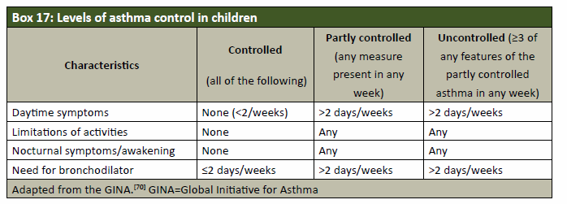

Slide 63
The childhood-ACT (C-ACT).
The C-ACT is a validated test for 4–12 years old children.
Is a two-part questionnaire with a total of seven questions. The first part is to be answered by the patient and the second part by the caregiver.
The final C-ACT score is made up of the sum of the scores of the two parts, ranging from 0 (poorest asthma control) to 27 (optimal asthma control).
A score of ≤19 points suggests that a child’s asthma is not adequately controlled.
See box 18 – Page 66

Slide 64
Age group <5 years: The Test for Respiratory and Asthma Control in Kids (TRACK).
This is a validated test for children <5 years.
It is a 5-item standardized questionnaire,
Four questions that address the impairment domain and one question that addresses the risk domain of asthma control.
Each item is scored from 0 to 20 points on a 5-point Likert-type scale.
For a total score ranging from 0 to 100. Higher scores would indicate better respiratory and asthma control;
A score of <80 points suggests that a child’s asthma is not controlled.

Slide 65
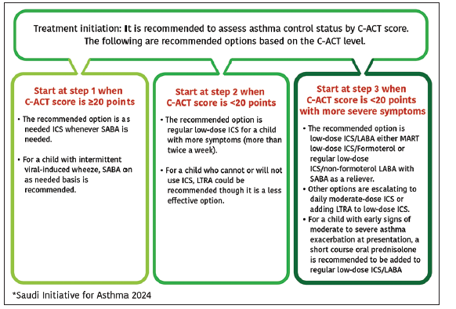
Outpatient management of asthma in children aged 5–12 years

Slide 66
Step 1
The recommended option is as needed ICS whenever SABA is required.
Step 2
The recommended option is low dose-ICS (step 2).
Alternatively, either use of ICS whenever SABA is required, or daily LTRA that are less effective option at this step
For a child with intermittent viral-induced wheeze daily low-dose ICS is recommended.

Slide 67
Step 3
The recommended option is low dose ICS/LABA either MART of ICS/Formoterol or regular ICS/non-formoterol LABA with SABA as a reliever.
Other options are escalating to daily moderate-dose ICS or adding LTRA to low-dose ICS

Slide 68
Step 4
The recommended option is medium-dose ICS/LABA either MART of ICS/Formoterol or daily of ICS/non-formoterol LABA inhaler with SABA as a reliever.
Tiotropium or LTRA may be added to this combination if control is not achieved

Slide 69
Step 5
It is recommended to refer the child to a physician specialized in asthma as there are growing evidence to support biologics for children with uncontrolled asthma at Step 4. The following are SINA expert panel recommendations for biological therapy at step 5 for this age group:
Anti-IgE therapy is a well-established therapy in children aged ≥6 years with uncontrolled asthma at Step 4 who fulfil the following criteria: severe persistent allergic asthma with frequent daytime symptoms or night-time awakenings, and who have multiple documented severe asthma attacks despite treatment at Step 4

Slide 70
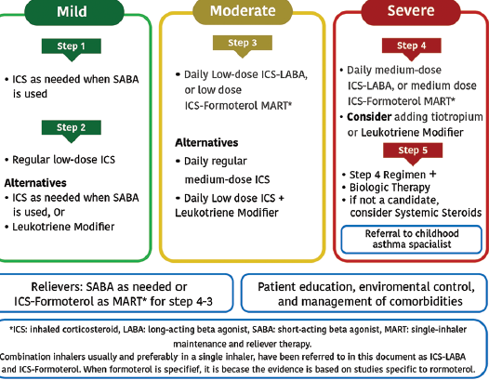
Outpatient management of Asthma for children age 5-12

Slide 71
Outpatient management of asthma in children aged <5 years
Step 1
• The recommended option is as needed SABA for a child with minimal symptoms (less than twice a week). This can be also applied for a child with intermittent viral-induced wheeze.
Step 2
• The recommended option is regular low-dose ICS.
• Alternatively, daily LTRA for a child who cannot or will not use regular ICSs, though it is a less effective option (Evidence B).[400-402] Additionally, short course low dose ICS is recommended for URTI triggered exacerbations if regular use of ICS not applied.

Slide 72
Step 3
The recommended option is regular double the “low-dose” of ICS (Evidence A)
Alternatively, adding LTRA to low dose ICS is a less effective option.
It is recommended to refer the patient to a physician specialized in asthma for further evaluation and options whenever management is escalated beyond step 3.

Slide 73
Step 4
• The recommended option is adding regular LTRA to the daily double “low-dose” ICS
• There is no evidence to support the use of LABA for patients younger than 5 years
• It is strongly recommended to refer the patient to a physician specialized in asthma for further evaluation and options whenever management is escalated beyond step 3.

Slide 74
Step 5
At this Step, regular use of systemic steroids shall be added to step 4 regimen, and the patient should be referred to an asthma specialist
• There is no evidence to support the use of either LABA or biologics for children <5 years.

Slide 75
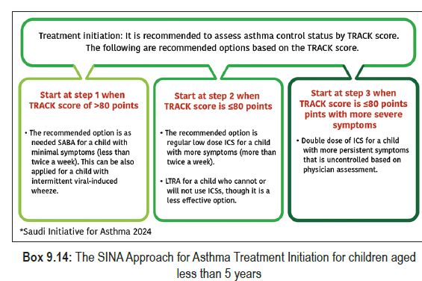

Slide 76
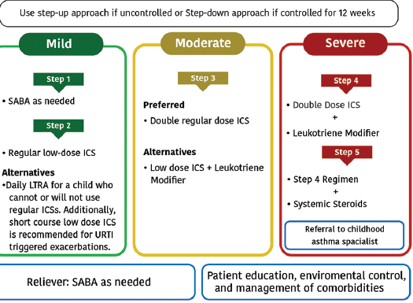
The Saudi Initiative for Asthma approach for outpatient management of asthma for children aged <5 years

Slide 77
References
1- The Saudi Initiative for Asthma :Guidelines for the diagnosis and management of asthma in adults and children SINA 2016.

