Slide 1
COMMUNICATION SKILLS
DR. Yousif Elgizoli
Consultant in Family Medicine
MRCGP (UK),
JMHPE-MAASRTICHT

Slide 2
PRE-TEST

Slide 3
1.Which of the followings, best differentiate b/w pt-centred & dr-centred approach?
a). Pt.-centred is always best than Dr.-Centred approach.
b). Dr-Centred approach takes less time.
c). Dr-Centred is better with incompetent Pts.
d). In hospital consultations, they used both approaches.

Slide 4
2. Which of the followings is considered a core value of GPs.?
a). GPs often adopt a holistic approach with Pts.
B). GPs. Deal with different ailments superficially.
c). GPs. Are gatekeepers.
d). GPs. Maintain good relationship with their patients.

Slide 5
3. In Pendleton’s Model, The 1st. Task, include the patient ICE. - when & how you use the (E) in your consultation?
a).During gathering information, history taking, asking the Pt. To tell me more about that.
b). At the end of consultation, ask the Pt. To tell me what you are going to tell your mum.
c). When I come to the management options, ask the patient ‘ In what way, I can help you?’.
d). At any time, ask my Pt. Directly, what is your expectations from this meeting.

Slide 6
4. The best skill for information gathering (History taking) is:
a). Maintain eye contact with the pt.
b). Attentive listening.
c), Ask open questions.
d). Paraphrasing & summarize the pt. history

Slide 7
What is Communication?

Slide 8
Communication has been derived from the Latin word "communis", meaning to share.
Two-way process of reaching mutual understanding, in which participants not only exchange (encode-decode) information but also create and share meaning.
"sending, giving, or exchanging information and ideas.

Slide 9
(cont)
Communication requires a sender, a message, and an intended recipient.

Slide 10
Most common ways to communicate
Visual Images
Speaking
Writing
Body Language

Slide 11
Purposes of Communication

Slide 12
To solve problems Reassurance To form and maintain
relationship
alleviate distress COMMUNICATION convey feelings
give information make decisions persuade

Slide 13
Benefits
identify patients' problems more accurately:
Improve Pts understanding & Information retention
Increase adherence to treatment
Patients adjust better psychologically
Pts more satisfied with their care

Slide 14
Benefits
Doctors with good communication skills have greater job satisfaction and less work stress,
Delivery of high-quality health care.
(Roter 1987, Betakis 1991, Stewart 1995)

Slide 15
Communication skills - why bother?
Why learn communication skills?
Can you learn communication skills?
What is there to learn?
How is it taught?
Where next?

Slide 16
Why learn communication skills?
l reasons for the patient's attendance
l gathering information
l explanation and planning
l adherence to plans
l medico-legal
Enables us to become better doctors clinically
Improves patient care and disease outcomes

Slide 17
Can communication skills be taught?
communication is a clinical skill
it is a series of learnt skills
experience is a poor teacher
there is conclusive evidence that communication skills can be taught
and that communication skills teaching is retained

Slide 18
How to teach communication skills?
Observation
Video or audio playback
Well-intentioned feedback
Rehearsal
Active small group or 1:1 learning

Slide 19
Effective communication is essential to the practice of high quality medicine

Slide 20
Effect on Health Outcomes
The reduction of anxiety.
The reduction of psychological distress.
Pain relief.
Symptom resolution.
Mood improvement.
Reduction of high blood pressure.
(Stewart 1995).

Slide 21
“The main remarks made by patients in the PHC centers in Riyadh was that:
“physicians were not listening enough to their complaints.”
( Saeed 2001)

Slide 22
Setting:-
Privacy,
Avoid interruptions,
Comfortable lighting & temperature,
Arrangement of seats,
Distance,
Level.

Slide 23
ACTIVE LISTENING…(cntd…)
Use Non-verbal Communication:
Smile,
Gestures,
Eye contact,
Your posture.

Slide 24
Techniques to improve listening skills
SUMMARIZE
Pull together the main points of a speaker
PARAPHRASE
Restate what was said in your own words
QUESTION
Challenge speaker to think further, clarifying both your and their understanding

Slide 25
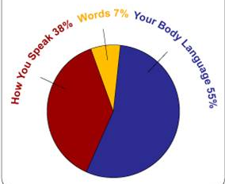
Non-Verbal Communication
55%
Face and body: non-verbal communication or face and body language.
38%
voice dynamics:
tone + inflection + volume + accent + non-word sounds; and...

Slide 26


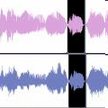
RECOGNIZING NON VERBAL COMMUNICATION
FACIAL EXPRESSION
GESTURES & POSTURES
VOCAL CHARACTRISTICS

Slide 27



RECOGNIZING NON VERBAL COMMUNICATION
PERSONAL APPREARENCE
TOUCH
TIME & SPACE

Slide 28
Example of body language
Folded arms and leg crossed away from you:
Rejection
Tapping fingers:
Impatience
Avoiding eye contact:
Untrustworthy

Slide 29
Example of body language
Sitting with legs crossed, foot kicking slightly:
Boredom
Biting nails:
Anxiety
Shoulder hunched, hands in pockets
Depression/Dejection

Slide 30
in Communication with Pts
PITFALLS

Slide 31
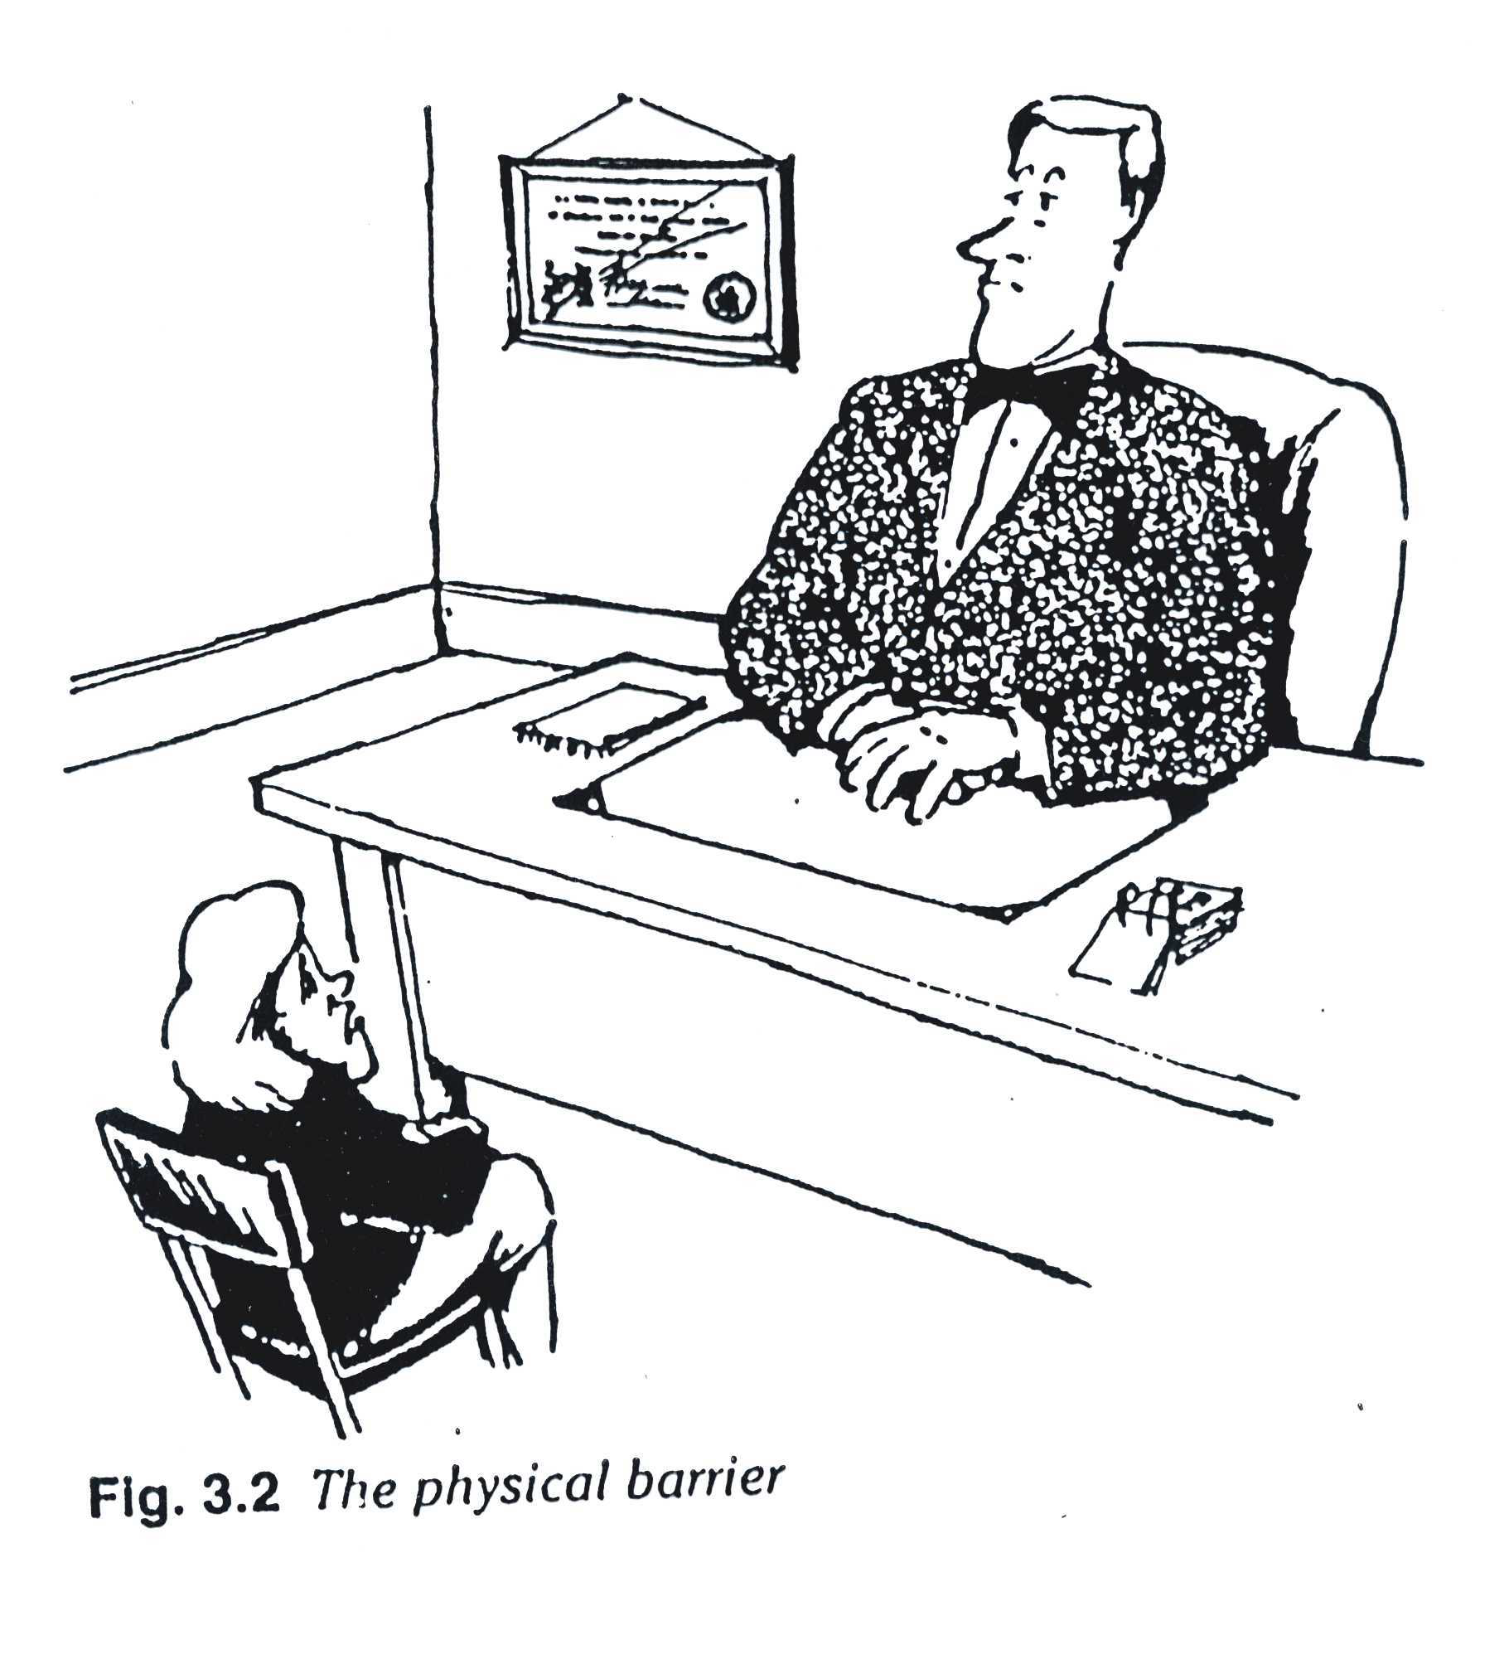

Slide 32
Blocking behavior
Interrupting;
Offering advice and reassurance before the main problems have been identified;
Lack of concern;
Attending to physical aspects only;
Switching the topic.

Slide 33
Core values of Family Physicians
Generalist: GP is open to all possible complaints, problems and questions about illnesses and health from everyone, young and old alike.
Patient-oriented
Gate-Keeper
Patient Advocator
Continuous General practice medical care is continuous care.

Slide 34
Breaking Bad News

Slide 35
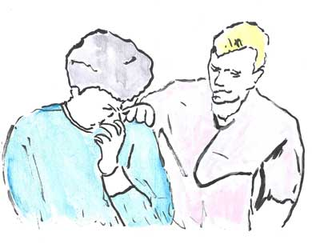

Slide 36
Questions for discussion
What is bad news?
Give examples of bad news?
Why breaking bad news is difficult?
What are the benefits when effectively breaking bad news?

Slide 37
What S.P.I.K.E.S (6 Steps Protocol stand for)?
What are the causes of fear in bad news?
If a patient with lung cancer asked you “patient like me survive for how long” what is your reply?
What not to do in BBNs?

Slide 38
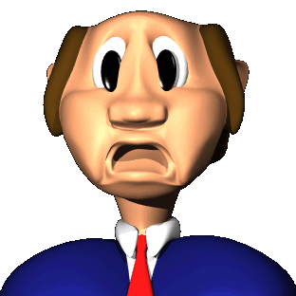
1. What is Bad News?

Slide 39
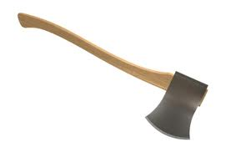
BBN: a definition
Bad news is any news that seriously and adversely affects the patient’s view of his or her future.
Buckman 1992

Slide 40
What is bad news?
Bad news can mean different things to different people
“any information, which adversely and seriously affects an individuals view of his or her future”
A message which conveys to an individual fewer choices in his or her life.

Slide 41
situations where there is either
- a feeling of no hope,
- a threat to a person's mental or physical well-being
- a risk of upsetting an established lifestyle
The common denominator is that bad news is a message, which has the potential to shatter hopes and dreams leading to very different lifestyles and futures.

Slide 42
b) Examples
A patient who is told he / she is HIV positive.
The man who is told his partner has Alzheimer's disease.
The patient who is told the lump has been diagnosed as cancer.
The couple who are told they cannot have children.

Slide 43
S.P.I.K.E.S (6 Steps Protocol)

Slide 44
Breaking Bad News
S - SETTING
Anticipate the possibility of bad news, and arrange a follow-up visit after significant scans, biopsies etc.
Avoid telephone
Private setting, sitting down
Turn off beeper, no interruptions
Ensure adequate time

Slide 45
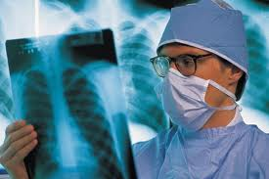
Breaking Bad News
S – SETTING(cont)
Lab reports, X-rays present
Support person present , if desired
Review the condition, basic prognosis and treatments before the visit
HOPEFUL TONE

Slide 46
Breaking Bad News
P - Finding out what the patient knows or PERCEIVES
- Before you tell, ask ……
What do they Know? e.g. “what have you been told so far?”
How much do you understand about your illness? . How do you feel?
What is troubling you the most?
- Note denial (if present) or misinformation

Slide 47
Breaking Bad News
I - INVITATION by the patient to share the information
From the patient to give the information. Would you like me to explain ……..? Are you the sort of person who wants to know what’s happening?
Different ways of asking
e.g. “Are you the sort of person who...”
- Accept their right not to know
- Aim to get clear invitation

Slide 48
Breaking Bad News
K - Giving the KNOWLEDGE and medical facts
Giving information
Warning shots
Small chunks
Check understanding

Slide 49
Breaking Bad News
Emotions
Observe for and allow emotional reactions
Kleenex handy, use of touch
- Naming the feeling “I know this is upsetting”
- Understanding “It would be for anyone”
- Respecting “You’re asking all the right questions”
- Supporting “I’ll do everything I can to help you through this.”
Summarise & Strategy
Have a plan

Slide 50
Video 1

Slide 51
Kaye’s Model
Breaking Bad News

Slide 52
1 - Preparation
Know all the facts.
Ensure privacy.
Find out who the patient wants present.
Introduce yourself.

Slide 53

2 - What Does the Patient Know?
Open ended questions.
Statements may make the best questions.
“How did it all start?”

Slide 54

3 - Is More Information Wanted?
Not forced on them.
“Would you like me to explain a bit more?”

Slide 55
4 - Give a Warning Shot
Not straight out with it!
“I’m afraid it looks rather serious”

Slide 56
6 - Explain If Requested
Step by step.
Detail will not be remembered but the way you explain it will be.

Slide 57
7 - Listen to Concerns
“What are your concerns at the moment?”
Allow time and space for answers.

Slide 58
8 - Encourage Ventilation of Feelings
Acknowledge the feelings.
Non-judgmental.
Vital step for patient satisfaction.

Slide 59
9 - Summarise
Concerns.
Plans for treatment.
Foster hope.
? Written information.

Slide 60
10 - Offer Further
Availability.
Information.
Future needs will change.

Slide 61
4- Why is Breaking Bad News Difficult?
What are your thoughts?

Slide 62
Why is Breaking Bad News Difficult?
Concern for how the news will affect client
Client’s fears of social stigma and impact of
disability and illness
Fear of client’s reaction to the news
Uncertainty in dealing with intense emotional response

Slide 63
Why is BBN Difficult?
Fear of being blamed
Fear of how this affects your emotion
Challenge of delivering the news appropriately
and sensitively for this client
Not wanting to take away hope

Slide 64
BBN: Why is it important?
Relatively common in clinical practice; includes:
- Diagnosis of life limiting illness
- Disease recurrence
- Spread of disease
- Irreversible side effects
- Positive results of genetic tests
- Discussing palliative and end of life care

Slide 65
BBN: why is it important?
* Majority of patients want the truth
How bad news is discussed can affect important outcomes, including:
- Comprehension of information
- Satisfaction with medical care

Slide 66
BBN: why is it important?
- Level of hopefulness
- Subsequent psychological adjustment
- Comfort with breaking bad news may be associated with less stress and burnout in physicians

Slide 67
The interviews

Slide 68
Video 2

Slide 69

Reactions
Fear
Anger
Despair
Isolation
Disappointment
Depression
Relief ?
Disbelief/Denial

Slide 70
BBN: Is there a need for training?
Less than 10% report any formal BBN training
Ability to break bad news rated by:
53% as good to very good
39% as fair
8% as poor

Slide 71

Causes of Fear in people with a life threatening illness
Fear of separation from a loved one, home, jobs.
Fear of becoming a burden to others
Fear of losing control
Fear for dependents
Fear of pain

Slide 72
Causes of Fear in people with a life threatening illness
Fear of dying
Fear of not being able to complete their role
Fear of being dead
Fear of the fear of others
Parkes 1998

Slide 73
Take home message
7- Areas

Slide 74
Prepare yourself
Prepare your setting
Prepare your patient
Providing information
Proving support
Proving a plan
After the interview

Slide 75
1- Prepare yourself
Have your facts right first
Familiarised yourself with the Patient’ background, medical history, test results & possible future management
Mentally rehearse the interview including likely questions & potential responses
Relatives can be in attendance, however you should be guided by the wishes of the patient.

Slide 76
2- Prepare your setting
Meet in a quiet room
Arrange some privacy & ensure you are not going to be disturbed
If you have recently examined the patient, allow him to dress before the interview

Slide 77
3- Prepare your patient
Assess the patient understanding of their condition
What do they know already?
What have they been led to expect?
Never impose information, respect patient wishes
Build up gradually.

Slide 78
4- Providing information
Use basic communication skills: use simple language, listen, follow up verbal & non-verbal cues
Start at the level of comprehension & vocabulary of the patient
Avoid excessive bluntness; as it is likely to leave the patient isolated & later angry
Set the tone. “ I am afraid, I have some bad news”.

Slide 79
Give the information in small chunks
Avoid using terms e.g. “there is nothing more we can do for you”
Be truthful, gentle & courteous
Offer hope
Emphasize the positive
Allow questions.

Slide 80
5- Providing support
Acknowledge & identify emotions; when a patient is silent, use open Q. “How are you feeling now?”
Do not say “I know how you feel”
Allow the patient time to express their emotions
Unless the patient’s emotions are adequately addressed, it is difficult to move on to discuss other issues, remember it is the patient crises, is not your crises; listen.

Slide 81
6- Providing a plan
Provide a clear plan for the future, with treatment options & management plan discussed
Identify support systems; involve relatives & friends
Offer to meet & talk to the family if not present
Make written materials available
Summarized.

Slide 82
7- After the interview
Make a clear record of the interview, the terms used, the options discussed & the future plan.
Inform other people looking after the patient what you have done.
May need to have a number of meetings.
Follow up the patient.

Slide 83
×× What not to do ××
× BBNs over the phone
× Avoid the patient
× Leave patient in suspense
× Lie to the patient
× Tell patient if he or she doesn't want to know
× Interrupt excessively
× Use jargon

Slide 84
×× What not to do ××
× Give excessive information as this causes confusion
× Collude
× Be judgmental
× Give a definite time span (as days to Weeks) or (months to Years) etc.
× Pretend treatment is working if it isn’t
× Say “Nothing can be done”.

Slide 85
One of the famous strategies for breaking bad news is the S1PIKES2 Protocol:
Explain briefly what SPIKES stand for?
S1 ---------------------------------------------
P ---------------------------------------------
I ---------------------------------------------
K ---------------------------------------------
E ---------------------------------------------
S2 ---------------------------------------------

Slide 86
Match the following phrases in their appropriate place of THE S1-P-I-K-E-S2 Protocol of BBN
1 | “What are your concerns at the moment?”
2 | Support person present , if desired
3 | Offer to meet & talk to the family if not present
4 | It is more serious than infection.
5 | “what have you been told so far?”
6 | Accept the patient right not to know

Slide 87
In SPIKES Protocol, which of the following statement is best describe the Perception?
Making sure that the patient will receive the best possible treatment.
“Before you tell, ask.” What is your understanding?
Mental rehearsal is a useful way for preparing for stressful tasks.
Respect patient wishes not to know.

Slide 88
In preparing the setting for effective breaking bad news before you prepare the physical setting and prepare your patient.
- What you need to do first?
Know all the facts.
Ensure privacy.
Find out who the patient wants present.
Call the reception not interrupt you.

Slide 89


