Slide 1
The consultation skills and models
Dr Khalid I AlQumaizi
1446-2024

Slide 2
The aims
By the end of this session , the student will be able to:
Know the definition of the consultation.
Know the different types of consultation.
Appreciate the importance of effective consultation.
Understand the utilization of each type.
Recognize the barriers of effective consultation.
Recognize the essential skills for effective consultation.
Modify the consultation in special situation.

Slide 3
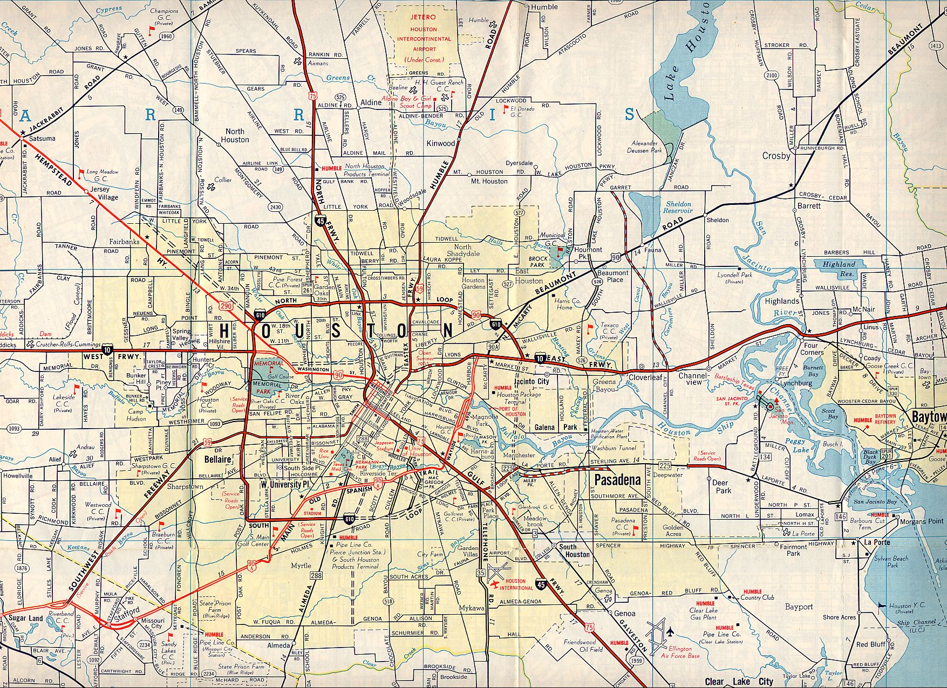

Slide 4
What is the consultation?
It is the central act of medicine .

Slide 5
Why do we talk about the consultation?
Communication skills are a core clinical skill (WHO; GMC).
Diagnoses made more frequently from interview data than all other sources added together.
Drs conduct up to 200000 interviews over 40 year career ( 5000 / year ).
Doctors identify their patients' problems more accurately. Maguire et al. BMJ 1986; 292: 1573-1578 .

Slide 6
Why do we talk about the consultation?
Patients are more satisfied with their care and can better understand their problems, investigations, and treatment options with fewer complaints
Patients are more likely to adhere to treatment and to follow advice on behaviour change. Silverman, Kurtz, Draper. Skills for communicating with patients. Radcliffe Medical Press, 1998.
Patients' distress and their vulnerability to anxiety and depression are lessened. Roter et al. Arch Intern Med 1995; 155: 1877-1884
Doctor is more time-efficient
Doctors' own wellbeing is improved. Ramirez et al.. Lancet 1995; 16: 724-728

Slide 7
Check point
"It is more important to know what sort of person has a disease than to know what sort of disease a person has."
Hippocrates (circa 400 BC).

Slide 8
The consultation models
‘Physical, Psychological and Social’ (1972)
The RCGP model encourages the doctor to extend his thinking practice beyond the purely organic approach to patients, i.e. to include the patient’s emotional, family, social and environmental circumstances.

Slide 9
The consultation models
Stott and Davis ( 1979)
“The exceptional potential in each primary care consultation” suggests that four areas can be systematically explored each time a patient consults.
(a) Management of presenting problems
(b) Modification of help-seeking behaviours
(c) Management of continuing problems
(d) Opportunistic health promotion

Slide 10


Slide 11
The consultation models
Byrne and Long (1976)
“Doctors talking to patients”. Six phases which form a logical structure to the consultation:
Phase I The doctor establishes a relationship with the patient
Phase II The doctor either attempts to discover or actually discovers the reason for the patient’s attendance
Phase III The doctor conducts a verbal or physical examination or both
Phase IV The doctor, or the doctor and the patient , or the patient (in that order of probability) consider the condition
Phase V The doctor, and occasionally the patient, detail further treatment or further investigation
Phase VI The consultation is terminated usually by the doctor.

Slide 12
The consultation models
Helman’s ‘Folk Model’ (1981)
Cecil Helman is a Medical Anthropologist, with constantly enlightening insights into the cultural factors in health and illness. He suggests that a patient with a problem comes to a doctor seeing answers to six questions:
(1) What has happened?
(2) Why has it happened?
(3) Why to me?
(4) Why now?
(5) What would happen if nothing was done about it?
(6) What should I do about it or whom should I consult for further help?

Slide 13
The consultation models
Transactional Analysis (1964)
Many doctors will be familiar with Eric Berne’s model of the human psyche as consisting of three ‘ego-states’ - Parent, Adult and Child. At any given moment each of us is in a state of mind when we think, feel, behave, react and have attitudes as if we were either a critical or caring Parent, a logical Adult, or a spontaneous or dependent Child. Many general practice consultations are conducted between a Parental doctor and a Child-like patient.This transaction is not always in the best interests of either party, and a familiarity with TA introduces a welcome flexibility into the doctor’s repertoire which can break out of the repetitious cycles of behaviour (‘games’) into which some consultations can degenerate.

Slide 14
The consultation models
Pendleton, Schofield, Tate and Havelock (1984, 2003)
‘The Consultation - An Approach to Learning and Teaching’ describe seven tasks which taken together form comprehensive and coherent aims for any consultation.
(1) To define the reason for the patient’s attendance, including:
i) the nature and history of the problems
ii) their aetiology
iii) the patient’s ideas, concerns and expectations
iv) the effects of the problems
(2) To consider other problems:
i) continuing problems
ii) at-risk factors

Slide 15
The consultation models
Pendleton, Schofield, Tate and Havelock (1984, 2003)
(3) With the patient, to choose an appropriate action for each problem.
(4) To achieve a shared understanding of the problems with the patient.
(5) To involve the patient in the management and encourage him to accept appropriate responsibility.
(6) To use time and resources appropriately:
i)in the consultation
ii)in the long term
(7) To establish or maintain a relationship with the patient which helps to achieve the other tasks.

Slide 16
The consultation models
Neighbour (1987)
Five check points: ‘where shall we make for next and how shall we get there?’
(1) Connecting Establishing rapport with the patient
(2) Summarizing Getting to the point of why the patient has come using eliciting skills to discover their ideas, concerns, expectations and summarizing back to the patient.
(3) Handing over Doctors’ and patients’ agendas are agreed. Negotiating, influencing and gift wrapping.
(4) Safety netting What if?’: consider what the doctor might do in each case.
(5) Housekeeping Am I in good enough shape for the next patient?’

Slide 17
The consultation models
Abridged Calgary-Cambridge Guide
TASK 1: INITIATING THE SESSION
Establishing initial rapport
1. Greets patient and obtains patient’s name
2. Introduces self, role and nature of interview; obtains consent if necessary
Identifying the reason(s) for the consultation
3. Identifies the patient’s problems or the issues that the patient wishes to address (e.g. “What problems brought you to the hospital?” or “What would you like to discuss today?” or “What questions did you hope to get answered today?”)

Slide 18
The consultation models
Abridged Calgary-Cambridge Guide
TASK 2: GATHERING INFORMATION
Exploration of patient’s problems
Discover the biomedical perspective, patient’s perspective and the background information
4. Uses open and closed questioning technique, moving from open to closed
5. Listens attentively, allowing patient to complete statements without interruption and leaving space for patient to think before answering or go on after pausing
6. Facilitates patient's responses verbally and non–verbally e.g. use of encouragement, silence, repetition, paraphrasing, interpretation
TASK 3: PROVIDING STRUCTURE
7. Summarises at the end of a specific line of enquiry
8. Attends to timing and keeping interview on task

Slide 19
The consultation models
Abridged Calgary-Cambridge Guide
TASK 4: BUILDING RELATIONSHIP
Using appropriate non-verbal behaviour
9. Demonstrates appropriate non–verbal behavior. Eye contact, facial expression, posture, vocal cues e.g. rate, volume, tone
Developing rapport
10. Uses empathy to communicate understanding and appreciation of the patient’s feelings or predicament; overtly acknowledges patient's views and feelings
TASK 5: CLOSING THE SESSION
Forward planning
11. Safety nets, explaining possible unexpected outcomes, what to do if plan is not working, when and how to seek help
Ensuring appropriate point of closure
12. Final check that patient agrees and is comfortable with plan and asks if any corrections, questions or other items to discuss.

Slide 20
The consultation models
Abridged Calgary-Cambridge Guide
TASK 6: EXPLANATION AND PLANNING
Providing the correct amount and type of information
13. Chunks and checks: gives information in manageable chunks, checks for understanding, uses patient’s response as a guide to how to proceed
Aiding accurate recall and understanding
14. Organises explanation: divides into sections, develops a logical sequence
Achieving a shared understanding: incorporating the patient’s perspective
15. Provides opportunities and encourages patient to contribute
Planning: shared decision making
16. Involves patient by making suggestions and checks if patient accepts plans.

Slide 21
Why it is important to improve our consultation skills ?
Safe, efficient and effective healthcare.
Understanding patients’ problems.
Improving communication leads to better patient outcomes.

Slide 22
Barriers of effective consultation.
The doctor
The patient
The place
The system

Slide 23
Essential skills for effective consultation.
Verbal
Non-verbal

Slide 24
The consultation in special situation.
Age groups
Handicapped
Mental instability
Angry patient
Bad news

Slide 25


