Slide 1

Approach to patient with Diabetes Mellitus
29/09/2024
Notes:
By Design : Naif AlHarbi - Almaarefa University

Slide 2


Slide 3
Definition
Definition
Type 2 diabetes mellitus is a progressive disorder defined by deficits in insulin secretion and increased insulin resistance that lead to abnormal glucose metabolism and related metabolic derangements.[
Approach to patient with Diabetes Mellitus
3

Slide 4
Prevention in general practice
Approach to patient with Diabetes Mellitus
4

Slide 5
From the past
Those labouring with this Disease, piss a great deal more than they drink. Authors who affirm the drink to be little or nothing changed are very far from the truth, because the urine very much differed both from the drink taken in and also in being wonderfully sweet as if it were imbued with honey or sugar.
THOMAS WILLIS (1621–1675), THE PISSING EVIL
Approach to patient with Diabetes Mellitus
5

Slide 6
Epidemiology
Diabetes prevalence is increasing worldwide, compounded by population growth and an ageing population. In 1980, the global age-standardised diabetes prevalence was 4.3%. In 2019, diabetes prevalence was estimated at 8.3%. Most cases of diabetes (around 90%) are type 2.
In some countries, there is downward trend due to public health education and preventive strategies.
Patients with type 2 diabetes have a very high risk of concurrent hypertension (80% to 90%), lipid disorders (70% to 80%), and overweight or obesity (60% to 70%).
When diabetes is diagnosed at age 40 years, men lose an average of 5.8 years of life, and women lose an average of 6.8 years of life, highlighting the importance of primary prevention of diabetes.
Onset of diabetes at older ages has much less effect on life expectancy if acceptable glucose, blood pressure, and lipid control can be achieved and maintained.
Approach to patient with Diabetes Mellitus
6

Slide 7
Risk Factors
Older age
Older patients are at increased risk. However, the incidence of type 2 diabetes in children and adolescents is increasing.
Overweight/obesity
Appears to be the precipitating factor leading to clinical expression of diabetes.[11] The mean body mass index (BMI) at the time of diagnosis of diabetes in several studies is around 31 kg/m², and there is a graded increase in risk of diabetes with increasing BMI.
Gestational diabetes
About 50% of women who have gestational diabetes mellitus will go on to develop overt diabetes mellitus within 10 years of delivery.
Non-diabetic hyperglycaemia
Non-diabetic hyperglycaemia (sometimes termed pre-diabetes) is major risk factor for onset of type 2 diabetes.
Family history of type 2 diabetes
Although the specific genetic profile that confers risk has yet to be fully elucidated, epidemiological observations leave little doubt of a substantial genetic component.
Approach to patient with Diabetes Mellitus
7

Slide 8
Risk factors
Non-white ethnicity
Prevalence of diabetes varies by ethnic group. In the UK, type 2 diabetes is more common in people of African, African-Caribbean, and South Asian family origin due to an interplay of diet, lifestyle, and genetic factors.
Polycystic ovary syndrome
Elevated risk; should be periodically screened for diabetes.
Hypertension
Often associated with type 2 diabetes. Periodic screening is recommended in people with essential hypertension due to increased prevalence of diabetes.
Dyslipidaemia
Especially with low high-density lipoprotein (HDL) and/or high triglycerides: periodic diabetes screening is recommended due to the high prevalence of diabetes in patients with dyslipidaemia.
Cardiovascular disease
High prevalence of diabetes in patients with peripheral vascular and coronary artery disease.
Stress
Stress provokes release of hormones that elevate glucose, and there is some evidence that life stress may predispose to onset of type 2 diabetes.[
Approach to patient with Diabetes Mellitus
8

Slide 9
Diagnostic tests
Results | Tests
≥7.0 mmol/L (≥126 mg/dL) | Fasting plasma glucose • Order after a minimum 8-hour fast. Bear in mind that a repeat confirmatory test is required for diagnosis in most cases.
≥6.5% | HbA1c • Reflects degree of hyperglycaemia over the preceding 3 months. • Bear in mind that a repeat confirmatory test is required for diagnosis in most cases. • HbA1c is also used to monitor glycaemic control.
≥11.1 mmol/L (≥200 mg/dL) | 2-hour post-load glucose after 75 g oral glucose • Plasma glucose is measured 2 hours after 75 g oral glucose load. • Bear in mind that a repeat confirmatory test is required for diagnosis in most cases.
≥11.1 mmol/L (≥200 mg/dL) | Random plasma glucose • Non-fasting test. Bear in mind that a repeat confirmatory test is required for diagnosis in most cases. • Used for rapid assessment of glucose status if symptoms such as polyuria, polydipsia, or weight loss are present.
Approach to patient with Diabetes Mellitus
9

Slide 10
Screening in general practice
Result | Test
May show high LDL, low HDL, and/or high triglycerides | The fasting lipid profile Dyslipidaemia is common in type 2 diabetes.
Positive in instances of ketoacidosis | Urine ketones Check urine ketones at diagnosis if the patient is symptomatic of hyperglycaemia (polyuria, polydipsia, weakness) and volume depletion (dry mucous membranes, poor skin turgor, tachycardia, hypotension, and, in severe cases, shock).
May be increased; ACR ≥3 mg/mmol indicates clinically important proteinuria[ | Albumin to creatinine ratio (ACR) • Indicates nephropathy and suggests possible other microvascular damage. • Monitored yearly.
May indicate renal insufeciency | Serum creatinine and estimated GFR
May indicate prior ischemia | ECG
≤0.9 is abnormal | Ankle-brachial pressure index (ABPI)
Normal or high | C-peptide
May be elevated | Liver function tests May identify people with non-alcoholic fatty liver disease (NAFLD).
Approach to patient with Diabetes Mellitus
10

Slide 11
Screening
The National Institute for Health and Care Excellence (NICE) in the UK recommends that general practitioners should identify people on their practice register who may be at high risk of type 2 diabetes.
Risk assessment should be offered to:
• All adults aged 40 and above (except pregnant women)
• People aged 25 to 39 of South Asian, Chinese, African-Caribbean, and black African ethnicity (except pregnant women)
• Adults with any other condition that increases the risk of type 2 diabetes.
Those with a high risk score should be offered a fasting plasma glucose or HbA1c test; a blood test should be considered regardless of risk score for those aged 25 and over of South Asian or Chinese descent whose body mass index (BMI) is greater than 23 kg/m².
The US Preventive Services Task Force recommends screening for glucose status for adults ages 35 to 70 years who have BMI ≥25 kg/m².
The American Diabetes Association recommends routine screening of non-pregnant asymptomatic adults of any age with BMI 25 or more plus one or more additional risk factors for diabetes.[
Approach to patient with Diabetes Mellitus
11

Slide 12
Management
Individualised care
Take an individualised approach to management that is tailored to the specific needs and circumstances of your patient. Take into account the patient’s:
• Personal preferences
• Comorbidities
• Risks from polypharmacy
• Ability to benefit from long‑term interventions because of reduced life expectancy
• Disabilities (e.g., visual impairment).
Approach to patient with Diabetes Mellitus
12

Slide 13
Management
Diet, physical activity, and sleep
Nutritional advice should be tailored to the needs of the individual patient, and be provided by a healthcare professional with specific expertise and competencies in nutrition.
Encourage the patient to:
• Include high-fibre, low-glycaemic-index sources of carbohydrate in their diet, such as fruit, vegetables, wholegrains, and pulses
• Eat low-fat dairy products and oily fish
• Limit their intake of foods containing saturated and trans fatty acids.
Approach to patient with Diabetes Mellitus
13

Slide 14
Management
Diet, physical activity, and sleep
In terms of physical activity, encourage the patient to:
• Reduce sedentary behaviour and be more physically active
• Incorporate activity into their daily life (e.g., brisk walking, gardening, cycling). In this way,the patient can gradually increase the amount and intensity of activity they do.
• Do at least 30 minutes of moderate (or greater intensity) physical activity on 5 or more days a week.
If the patient is overweight, set an initial body weight loss target of 5% to 10%. Evidence suggests this is the minimum weight loss in obese patients to improve glycaemic control, lipid levels, and blood pressure.
Approach to patient with Diabetes Mellitus
14

Slide 15
Management
Cardiovascular risk management
Blood pressure (BP)
The National Institute for Health and Care Excellence (NICE) in the UK recommends maintaining blood pressure at:
• Below 135/85 mmHg for adults aged under 80, based on ambulatory or home BP monitoring (or <140/90 mmHg based on clinic BP)
• Below 145/85 mmHg for patients aged 80 and over, based on ambulatory or home BP monitoring (or <150/90 mmHg based on clinic BP).
Approach to patient with Diabetes Mellitus
15

Slide 16
Management
Cardiovascular risk management
Lipids
Based on these categories, the ESC recommends in patients with type 2 diabetes who are:
• At moderate cardiovascular risk: an LDL-cholesterol target of <2.6 mmol/L (<100 mg/dL)
• At high cardiovascular risk: an LDL-cholesterol target of <1.8 mmol/L (<70 mg/dL) and LDLcholesterol reduction of at least 50%; a secondary goal of a non-HDL-cholesterol target of <2.6 mmol/L (<100 mg/dL)
• At very high cardiovascular risk: an LDL-cholesterol target of <1.4 mmol/L (<55 mg/dL) and LDLcholesterol reduction of at least 50%; a secondary goal of a non-HDL-cholesterol target of <2.2 mmol/L (<85 mg/dL).
Approach to patient with Diabetes Mellitus
16

Slide 17
Management
Cardiovascular risk management
Antiplatelets
Chronic kidney disease
Approach to patient with Diabetes Mellitus
17

Slide 18
Management
Antihyperglycemic medications
In the UK, NICE recommends:
• If the patient manages their type 2 diabetes either with lifestyle and diet, or with lifestyle and diet
combined with a single drug that is not associated with hypoglycaemia, support them to aim for an
HbA1c level of 48 mmol/mol (6.5%)
• If the patient is on a drug associated with hypoglycaemia, support them to aim for an HbA1c level of
53 mmol/mol (7.0%).
Consider a slightly higher HbA1c level on a case-by-case basis for:
• Patients who are older frail, or unlikely to achieve longer-term risk-reduction benefits (e.g., those with a reduced life expectancy)
• Patients for whom tight blood glucose control poses a high risk of the consequences of hypoglycaemia, including: people who are at risk of falling; people who have impaired awareness of hypoglycaemia; those who drive or operate machinery as part of their job
• Patients for whom intensive management is not appropriate (e.g., people with significant comorbidities).
Approach to patient with Diabetes Mellitus
18

Slide 19
Management
Antihyperglycemic medications
In the UK, NICE recommends:
• If the patient manages their type 2 diabetes either with lifestyle and diet, or with lifestyle and diet
combined with a single drug that is not associated with hypoglycaemia, support them to aim for an
HbA1c level of 48 mmol/mol (6.5%)
• If the patient is on a drug associated with hypoglycaemia, support them to aim for an HbA1c level of
53 mmol/mol (7.0%).
Consider a slightly higher HbA1c level on a case-by-case basis for:
• Patients who are older frail, or unlikely to achieve longer-term risk-reduction benefits (e.g., those with a reduced life expectancy)
• Patients for whom tight blood glucose control poses a high risk of the consequences of hypoglycaemia, including: people who are at risk of falling; people who have impaired awareness of hypoglycaemia; those who drive or operate machinery as part of their job
• Patients for whom intensive management is not appropriate (e.g., people with significant comorbidities).
Approach to patient with Diabetes Mellitus
19

Slide 20
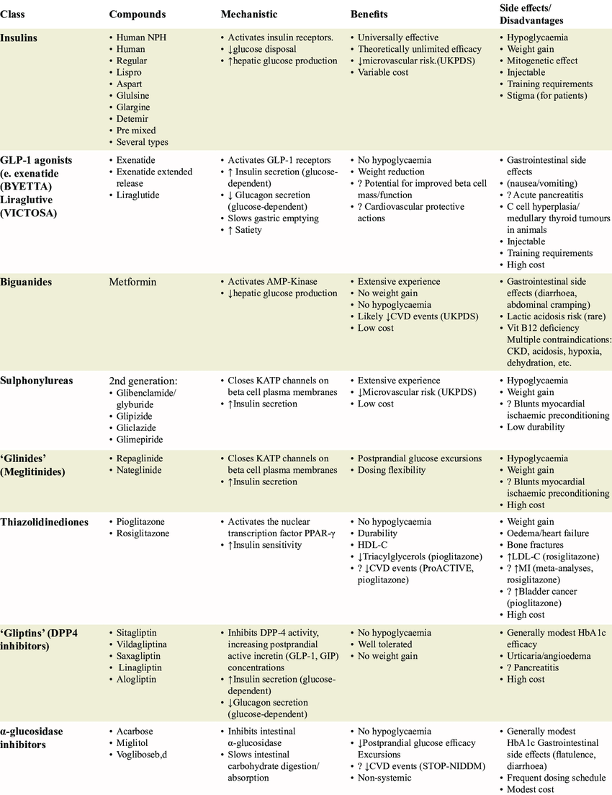
Management
Antihyperglycemic medications
In the UK, NICE recommends:
• If the patient manages their type 2 diabetes either with lifestyle and diet, or with lifestyle and diet
combined with a single drug that is not associated with hypoglycaemia, support them to aim for an
HbA1c level of 48 mmol/mol (6.5%)
• If the patient is on a drug associated with hypoglycaemia, support them to aim for an HbA1c level of
53 mmol/mol (7.0%).
Consider a slightly higher HbA1c level on a case-by-case basis for:
• Patients who are older frail, or unlikely to achieve longer-term risk-reduction benefits (e.g., those with a reduced life expectancy)
• Patients for whom tight blood glucose control poses a high risk of the consequences of hypoglycaemia, including: people who are at risk of falling; people who have impaired awareness of hypoglycaemia; those who drive or operate machinery as part of their job
• Patients for whom intensive management is not appropriate (e.g., people with significant comorbidities).
Approach to patient with Diabetes Mellitus
20

Slide 21
Management
Antihyperglycemic medications
In the UK, NICE recommends:
• If the patient manages their type 2 diabetes either with lifestyle and diet, or with lifestyle and diet
combined with a single drug that is not associated with hypoglycaemia, support them to aim for an
HbA1c level of 48 mmol/mol (6.5%)
• If the patient is on a drug associated with hypoglycaemia, support them to aim for an HbA1c level of
53 mmol/mol (7.0%).
Consider a slightly higher HbA1c level on a case-by-case basis for:
• Patients who are older frail, or unlikely to achieve longer-term risk-reduction benefits (e.g., those with a reduced life expectancy)
• Patients for whom tight blood glucose control poses a high risk of the consequences of hypoglycaemia, including: people who are at risk of falling; people who have impaired awareness of hypoglycaemia; those who drive or operate machinery as part of their job
• Patients for whom intensive management is not appropriate (e.g., people with significant comorbidities).
Approach to patient with Diabetes Mellitus
21

Slide 22
Management
Prevention and managing commplicatios
Macrovasular
Microvascular
Approach to patient with Diabetes Mellitus
22

Slide 23


“
920011909
Notes:
By Design : Naif AlHarbi - Almaarefa University

