Slide 1



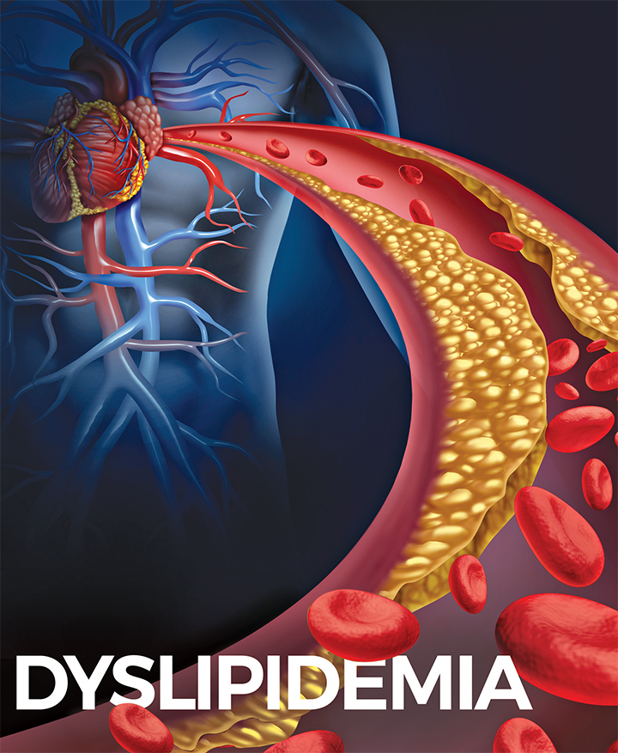
DYSLIPIDEMIA
Updated guidelines

Slide 2
Contenct
Basic of lipids in body.
Definition Dyslipidemia.
Types of Dyslipidemia .
ASCVD Risk Factor .
Screening .
Dyslipidemia Management Guidelines .
Guidelines for DLP Prevention .
Dyslipidemia treatment .

Slide 3
Objectives
Screen appropriate patients for hyperlipidemia .
Take an appropriate history , examine and test the patient for modifiable causes .
Treat hyperlipidemia patients, and establish target lipid levels bases on overall CV risk .
Give approprite lifestyle and dietary advice .

Slide 4
Case Presentation (1)
Mohammed 55 years old male , smoker , Known case of knee OA and Asthma ,
His father died at the age of 52, because of Myocardial infarction.
Came today to check his lab results.
On examination :
Looks well , not in pain or discomfort
Height: 164 cm Weight: 94 kg.
BMI :34.9
Blood pressure: 145/86 mmHg,
Pulse 80/minute RR: 20/minute.
How would you like to approach this patient?

Slide 5
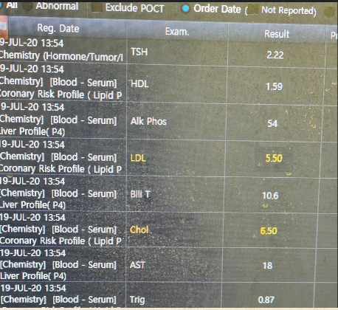
Lab results as shown,
What is your next step?

Slide 6
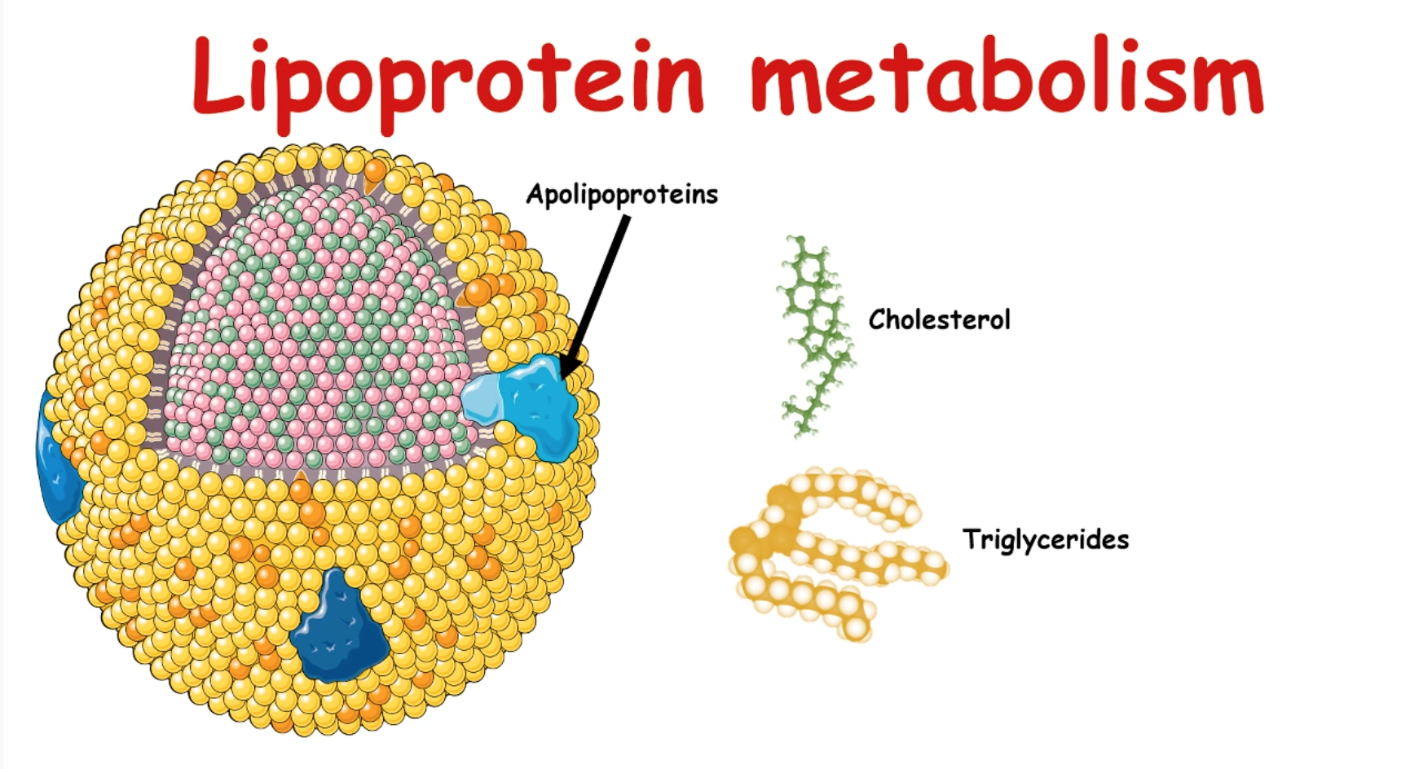
Notes:
what are lipoproteins? Lipids cover by protein ( by it’s name = lipo prteins)
Lipids are insoluable in water – so they cannot dissolve in the blood
In order to transport the lipid in the blood it has to be covered by a hydrophilic surfce .. protein – hydrophobi core: cholesterol/TG and hydrophilic surface

Slide 7
Lipoproteins:
  Lipoproteins are macro molecules aggregate composed of lipids and proteins
  In serum, cholesterol is carried primarily on three different lipoproteins—the VLDL, LDL, and HDL molecules.
  Total cholesterol equals the sum of these three components
  Plasma lipoproteins are important for lipid solubilization in order to:
    transport triglycerides, an important energy source, and to transport cholesterol between different places of absorption, synthesis, catabolism, and elimination.

Slide 8
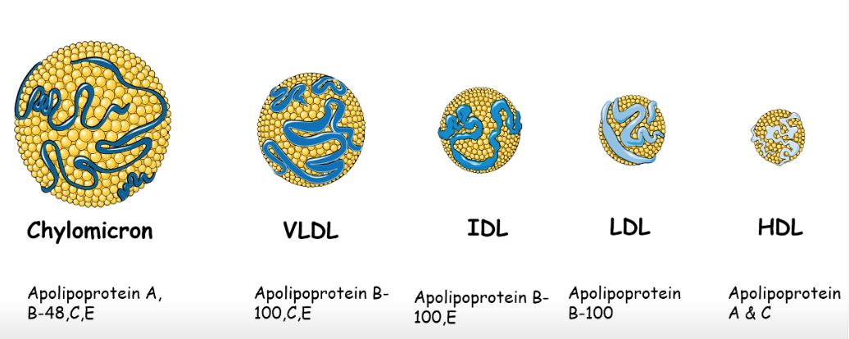

Slide 9
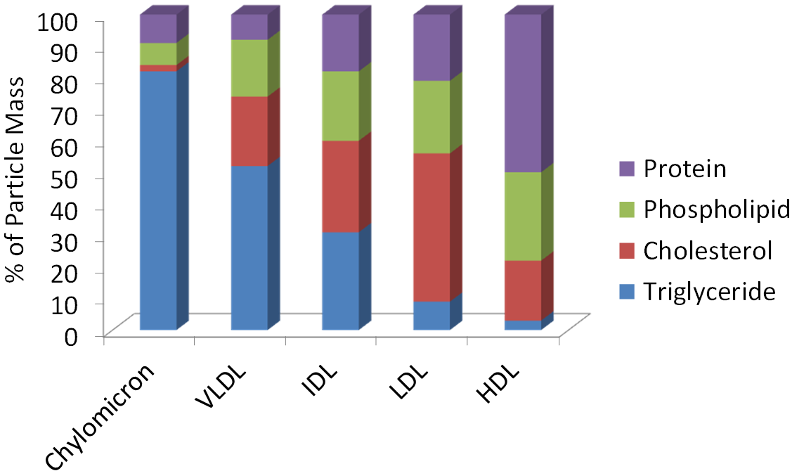
Notes:
Rfytdxtdxzwa`*But why LDL is considered the “bad” one ? It has the highest concentration of cholesterol.
*Is cholesterol important ? Yes in synthesis of hormones (estrogen /progesterone/ testosterone ..etc) but it is considered bad if we have high amount of it because it has high cholesterol.
* Why HDL is considered the Good lipoprotein ?

Slide 10
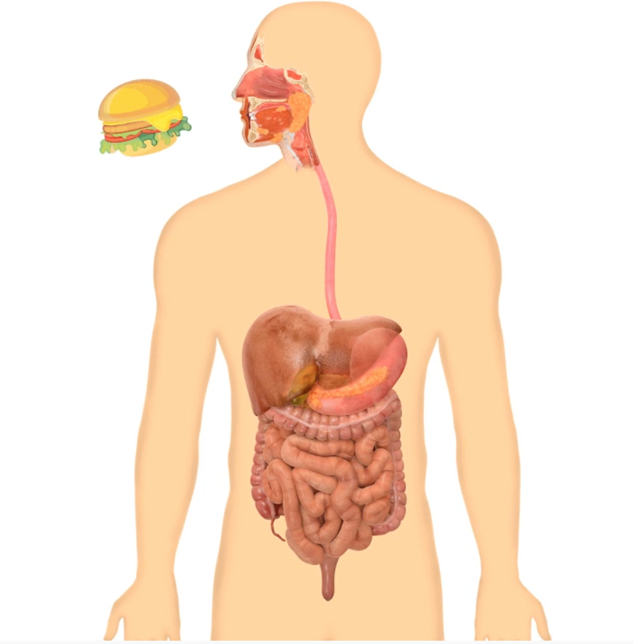
What happen when we eat fatty food?
(Quick Review)

Slide 11
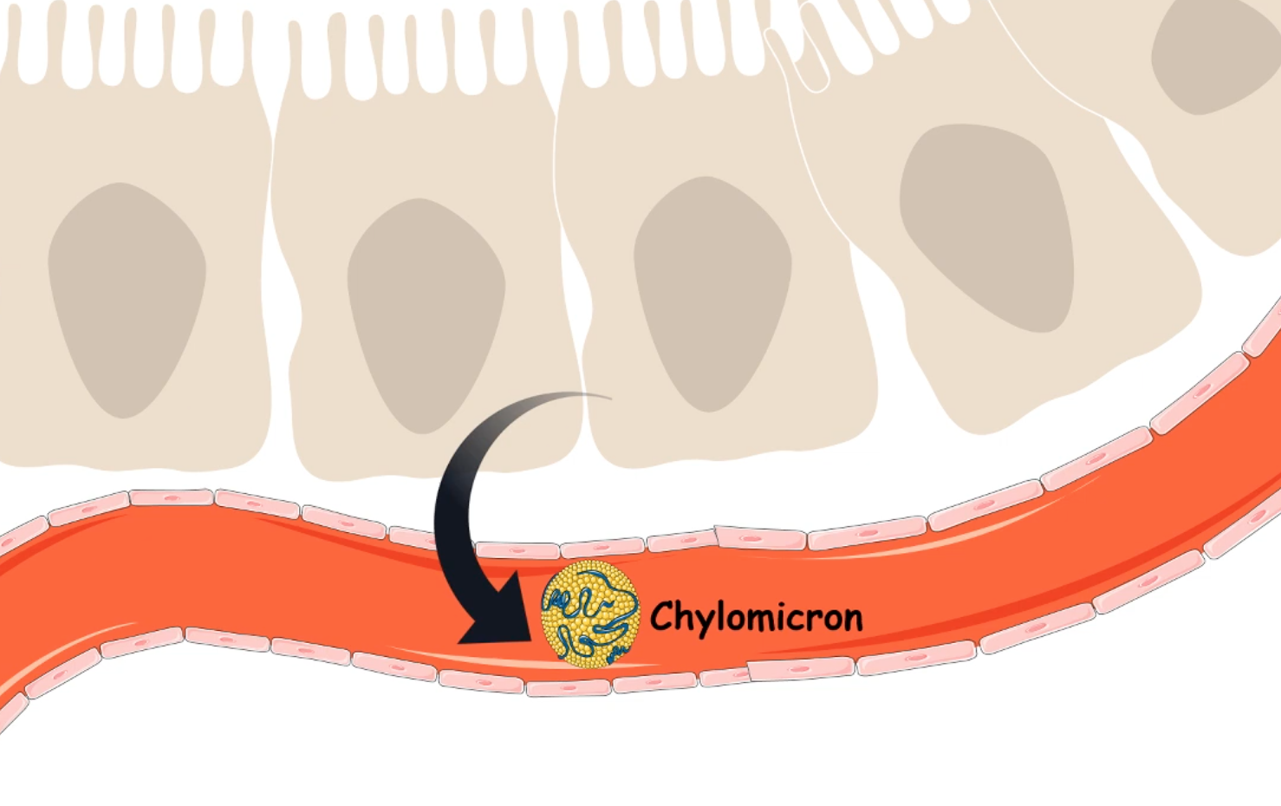
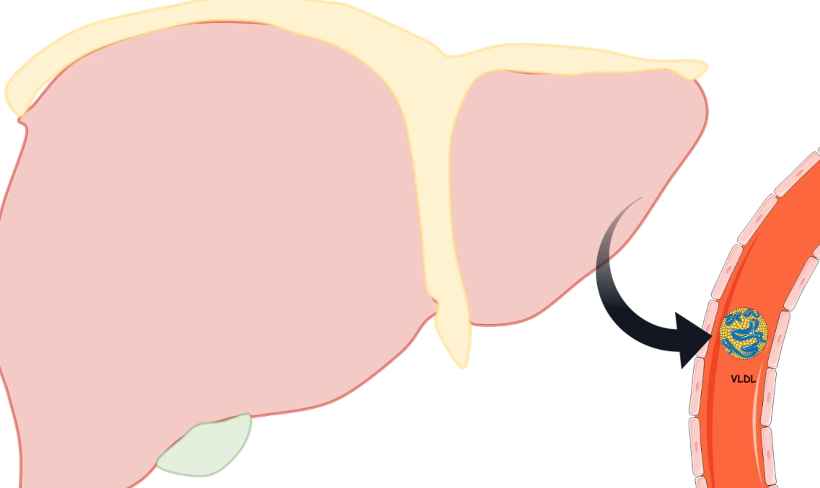
Chylomicrons:
Origin: enterocytes.
Released from Intestinal epithelial cells
Transport of dietary Tag
Function: transport lipids to adipose tissue ( fatty acids are stord (by the adipose) or used for energy (by the muscles)
VLDL:
Origin: liver
Secreted by the liver hepatocytes into the blood.
Transport endogenously synthesised TAG to other tissues.
Transport lipids from liver to adipose tissue ( break down TAG and take it) – where IDL is formed

Slide 12
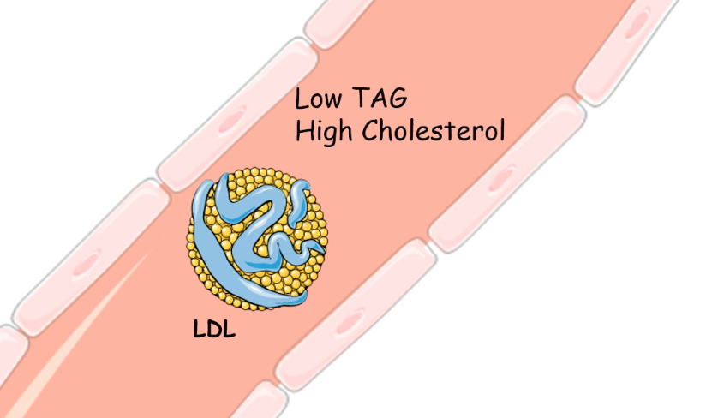
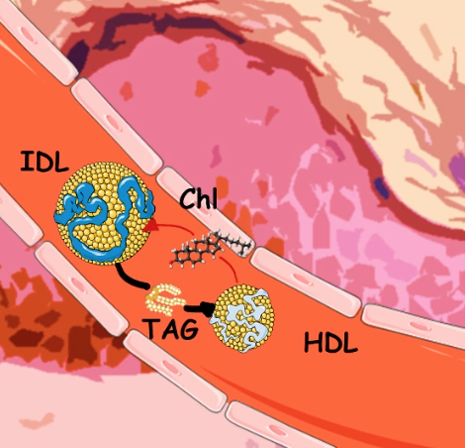
LDL:
Origin: plasma
Formed in circulation by partial breakdown of IDL
Delivers cholesterol to peripheral tissues,
carry cholesterol to (testes/adrenal glands ..etc) for hormones.
HDL:
Origin: Liver
Remevoes excess cholesterol from tissues and take it to liver.

Slide 13
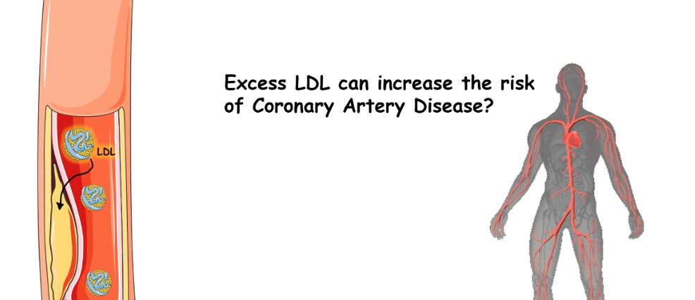

Slide 14
Serum cholesterol and its lipoprotein are known to be related to ASCVD.
LDL-C is the dominant form of atherogenic cholesterol.
VLDL is the chief carrier of triglycerides, and VLDL cholesterol (VLDL-C) is also atherogenic.
HDL-C is seemingly not atherogenic

Slide 15
Dyslipidemia

Slide 16
Dyslipidemia
Dyslipidemia, defined as elevated lipids (total cholesterol , low-density lipoprotein (LDL) levels , Triglyceride one or all ) , or decreased levels of high-density lipoprotein (HDL) cholesterol.
Is an important risk factor for coronary heart disease (CHD) and stroke
Detected by laboratory tests, and usually occur without signs or symptoms
These disorders can be primary or secondary.
Notes:
Dyslipidemia vs hyperlipedemia

Slide 17
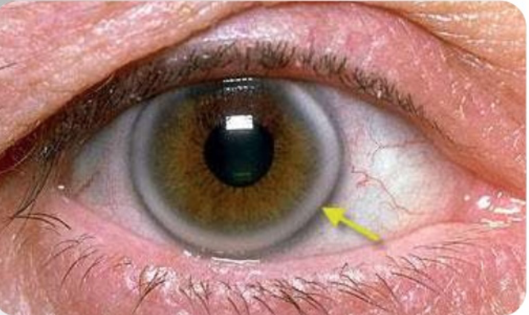

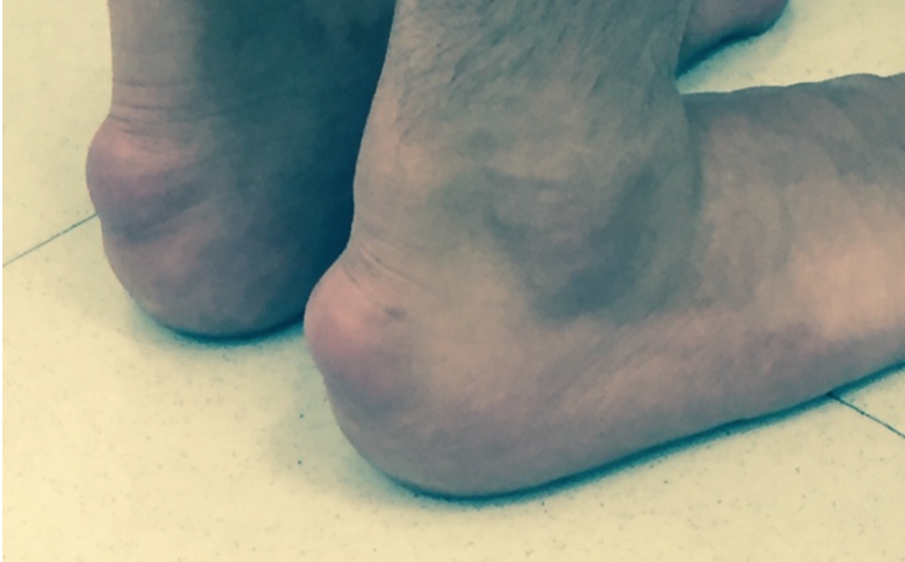
Primary Dyslipidemia
Familial hypercholesterolemia (hereditary) is a common genetic disease caused by mutation of one or more of the genes critical for low density lipoprotein cholesterol (LDL-C) catabolism
Autosomal dominant genetic disease.
The diagnosis can be made with genetic testing or clinical criteria like the Dutch Lipid Clinic Network criteria.
Once we identify familial hypercholesterolemia (FH) in a patient, we recommend screening of all first degree relatives
Image courtesy of Michael H. Davidson, MD.
Notes:
Autosomal dominant: get the abnormal gene from only one parent – you will get the disease.

Slide 18
Secondary Dyslipidemia
Secondary Cause | Elevated LDL | Elevated Triglycerides
Diet | Saturated or trans fats, wt. gain, anorexia | Weight gain, very low fat diet, high intake of refined carbohydrates, excessive Alcohol intake
Diseases | Biliary obstruction, nephrotic syndrome | Nephrotic syndrome, CKD, lipodystrophies
Disorders and altered states of metabolism | Hypothyroidism, obesity, pregnancy | DM (poorly controlled), hypothyroidism, obesity; pregnancy
Drugs | Diuretics, cyclosporine, glucocorticoids, Amiodarone | Oral estrogens, glucocorticoids, bile acid sequestrants, protease inhibitors, retinoic acid
Notes:
Why is it important to know about Secondary DLP? To treat the cause .. Guid us in manegment
Secondary Causes of Dyslipidemia,

Slide 19
Drug-Induced Dyslipidemia
Thiazide & loop diuretics: ↑ TG 50% & ↑LDL 5%
Beta-blockers: ↑ TG (20-50%); ↓ HDL 10-15%
Estrogens: ↓LDL 10-25%, ↑HDL (10-20%), ↑TG 10-20%
Tamoxifen: like estrogen on lipids
Progestins: ↑ 5-20% LDL-C, ↓HDL 5-10%, ↑ 10-45% TG.
Contraceptive: ↑ LDL(5-20%); ↑ TG (10-45%),
Alcohol: ↑ TG up to 50%, ▲HDL
Glucocorticoids: ↑ TG 15-20%, ↑ LDL 5-10%;.
Isotretinoin: ↑TG 50-60%, ↑LDL 5-20 %, ↓HDL.C 10-15%
Cyclosporines: ↑TC 15-20%, ↑ LDL

Slide 20
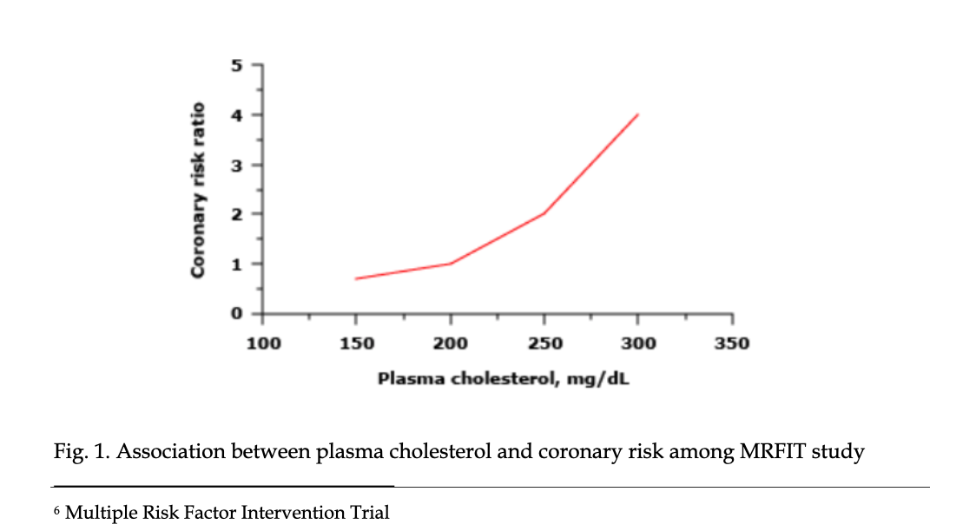
Why to treat Dyslipdemia ?
Major modifiable risk factor for ASCVD
(Cardiovascular disease (CVD) has been
recognized as the number one killer
in the world for decades.)
Notes:
Evidence that serum cholesterol contributes to ASCVD comes from several sources:
Animal studies,
Genetic forms of hypercholesterolemia,
Epidemiological studies, and
RCTs.

Slide 21
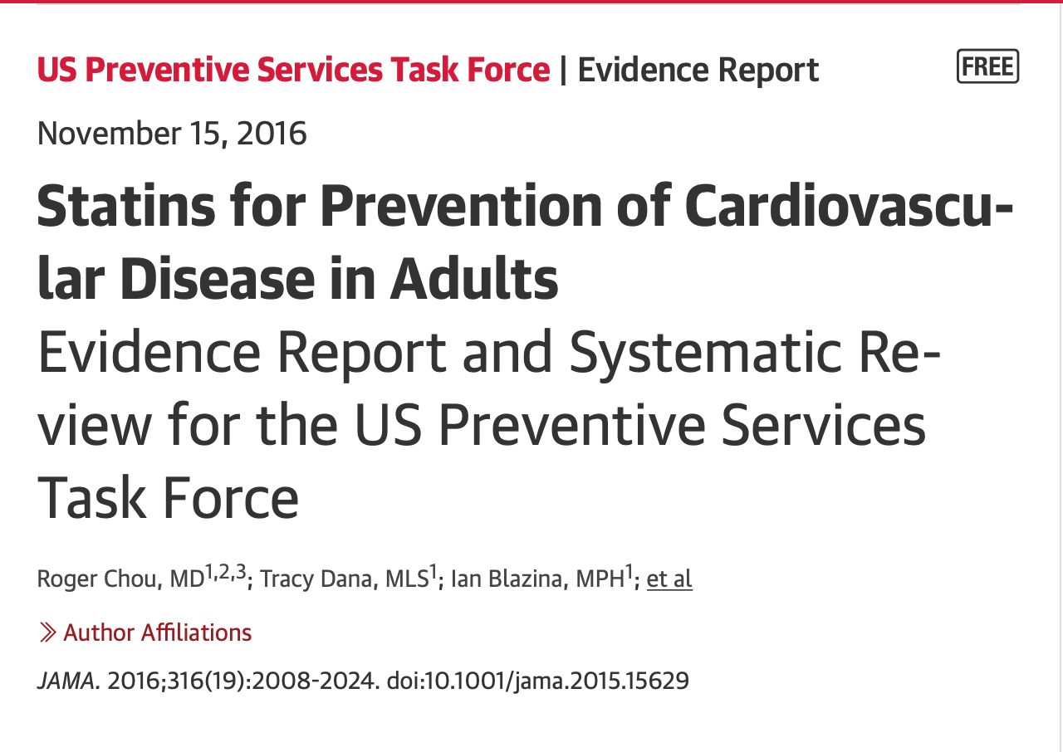
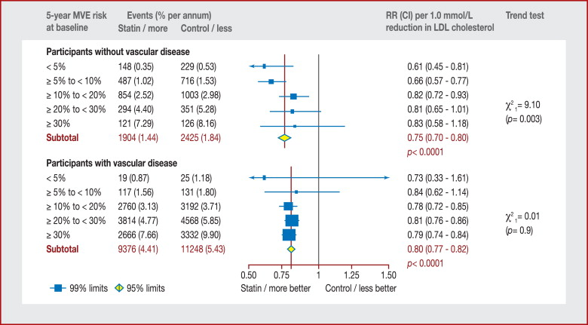
Why to treat Dyslipdemia ?
2) Multiple evidence supports the use of statins
in prevention of ASCVD.

Slide 22
Dyslipidemia treatment
Primary prevention
Secondary prevention
People with history of ASCVD.
Trials have shown the largest benefit in mortality and CV events)
People Without CHD
Prevneting first event
Is beneficial for reducing CV
morbidity and mortality

Slide 23
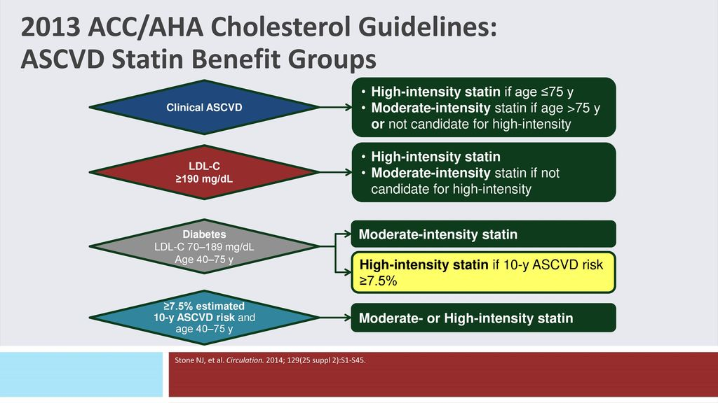

Primary prevention
Notes:
<20 years ➔ only treat if familial dyslipidaemia
20-40 years ➔ Consider treat if LDL ≥4.1 (160) + FH premature ASCVD
> 40 - 75/85yrs we calculate the 10 year risk ASCVD , but if DM give statin.
( ≥85 years NICE) (≥75 ACC) ➔ no need to calculate risk just assess clinically the need and discuss

Slide 24
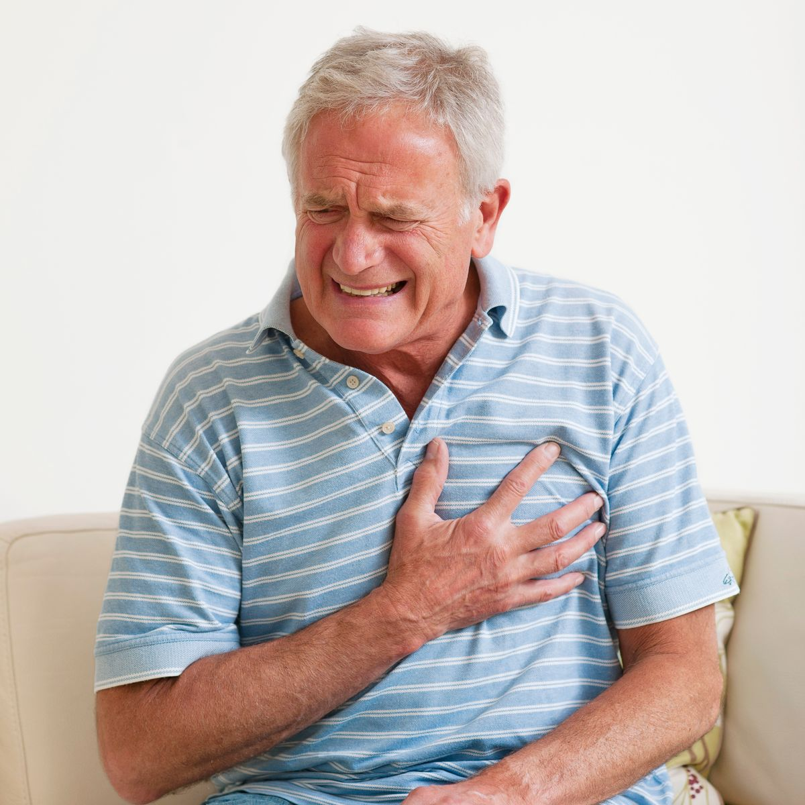
Secondary prevention
Notes:
- Secondary prevention refers to patients with clinical atherosclerotic cardiovascular disease (ASCVD).
High-intensity statin therapy is recommended for all patients with atherosclerotic cardiovascular disease, including acute coronary syndromes, myocardial infarction, stable or unstable angina, or with a history of coronary or other arterial revascularization, stroke, transient ischemic attack, or peripheral artery disease including aortic aneurysm, all of atherosclerotic origin.
acute coronary syndrome (ACS)
¨ History of myocardial infarction (MI)
¨ Stable or unstable angina
¨ coronary or other arterial revascularization
¨ Stroke
¨ Transient ischemic attack (TIA)
¨ Peripheral artery disease (PAD) including aortic
aneurysm

Slide 25
Who should receive a secondary prevention?
All patients with clinically signficant atherosclerotic cardiovascular disease (ASCVD)
History of myocardial infarction (STMEI or NSTEMI)
History of angina ( stable or unstable angina)
History of prior revascularization
History of stroke or transient ischemic attack
Symptomatic periphral vascular disease
Notes:
- Secondary prevention refers to patients with clinical atherosclerotic cardiovascular disease (ASCVD).
High-intensity statin therapy is recommended for all patients with atherosclerotic cardiovascular disease, including acute coronary syndromes, myocardial infarction, stable or unstable angina, or with a history of coronary or other arterial revascularization, stroke, transient ischemic attack, or peripheral artery disease including aortic aneurysm, all of atherosclerotic origin.
acute coronary syndrome (ACS)
¨ History of myocardial infarction (MI)
¨ Stable or unstable angina
¨ coronary or other arterial revascularization
¨ Stroke
¨ Transient ischemic attack (TIA)
¨ Peripheral artery disease (PAD) including aortic
aneurysm

Slide 26

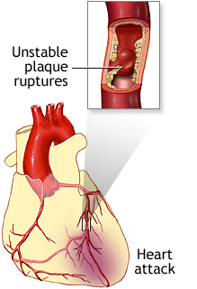
ASCVD
Condition affecting the heart and blood vessels due to atherosclerosis:
- Coronary artery disease (e.g. IHD , MI )
- Cerebrovascular disease (e.g. stroke)
- Diseases of the aorta and arteries, ( e.g. peripheral vascular disease)
CVDs are the leading causes of death and disability in the world.
17.9 million people die each year from CVDs, an estimated 31% of all deaths worldwide.
Although a large proportion of the disease is preventable they continue to rise
mainly because preventive measures are inadequate.
Notes:
Acute coronary syndrome
Hx of myocardial infarction
Stable or unstable angina
Stroke or TIA
Peripheral artery disease

Slide 27
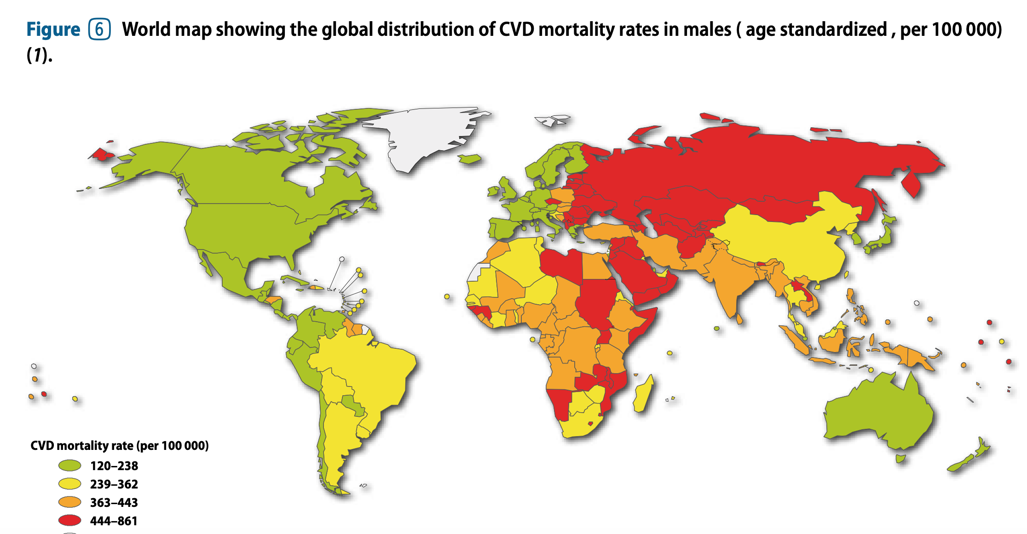

Slide 28
Age
What are the ASCVD Risk Factors ?
Modifiable risk factors (Behavioral ):
1. Smoking
2. Physical inactivity
3. Unhealthy adiet (rich in salt, fat and calories)
4. Harmful use of alcohol.
Modifiable risk factors (Metabolic):
5. HTN
6. DM ( Risk equvalent)
7. Dyslipidemia (LDL – Major risk factor ASCVD)
8. Overweight and obesity.
Non- modifiable risk factors:
1. Advancing age
2. Gender
3. Inherited (genetic) disposition
DM
Genetic
factors
HTN
ASCVD
Ethnicity
Smoking
Dyslipidemia
Obesity
Physical Inactivity

Slide 29
DM
Age
HTN
Genetic
factors
Cardiovascular
Disease
Smoking
Ethnicity
Obesity
Dyslipidemia
Physical Inactivity
To be reviewd at your own peace:
Primary prevention of ASCVD: Follow a healthy lifestyle anf control modifiable risk factors.
Control DM: https://care.diabetesjournals.org/content/43/Supplement_1/S111#sec-23 (ADA Guidelines 2020)
Control High BP:https://www.ahajournals.org/doi/epub/10.1161/HYPERTENSIONAHA.120.15026 (Hypertension, 2020)
Tobacco treatments: https://www.aafp.org/afp/2012/0315/p591.html ( AAFP)
Obesity and weight loss: https://www.cmaj.ca/content/192/31/E875 (CMAJ 2020)
Control Dyslipdemia: Today’s Lecture, Enjoy !

Slide 30
Case
38 years ago , male , smoker came compline sore throat since 4 days , he is getting improving last day with conserative management
What do you want to do next ?

Slide 31


Slide 32

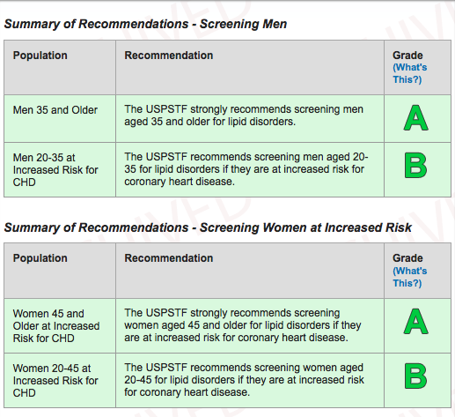

Slide 33
The USPSTF strongly recommends that clinicians routinely screen men 35 years and older and women 45 years and older for lipid disorders and treat abnormal lipid levels in persons who are at increased risk of coronary heart disease (A recommendation).
The USPSTF recommends screening men 20 to 35 years of age for lipid disorders if they are at increased risk of coronary heart disease (CHD). B recommendation.
The USPSTF recommends screening women 20 to 45 years of age for lipid disorders if they are at increased risk of CHD. B recommendation.

Slide 34
Children:
If has FHX either early ASCVD or significant Hypercholesteremia, you may start screening from age 2 y
If found moderate to severe Hypercholesteremia: screen first and second-degree relatives

Slide 35
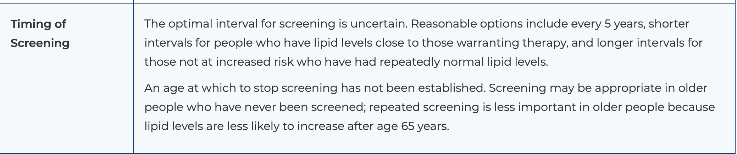

Slide 36
Case
Ahmad a 42 years-old male , K\C HTN , has history of MI three years back , On antihypertensive medications only.
Presents to your clinic for Lab result check up , He is doing well , with no complains.
How would you like to approach this patient and management plan ?

Slide 37
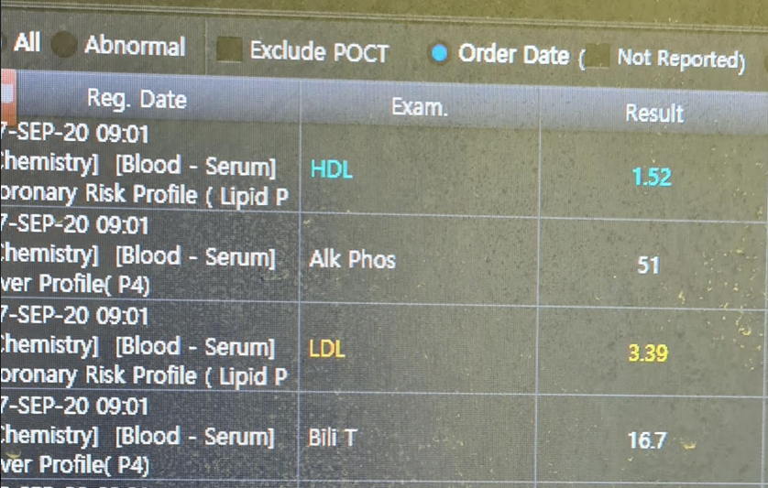
His Lipid profile results as shown ,
Q1. Which of the following is the best next step?
Counsel on diet and exercise only, as his lipids ar not very high.
B. Give Niacin to increase HDL level.
Give high intensity statin
( As the patient has hx of ASCVD)
D. Trial of Ezetimibe.
Notes:
Primar / secondary prevention
Statin benefit group .. Yes ( Hx ASCVD)

Slide 38
Dyslipidemia Management Guidelines

Slide 39

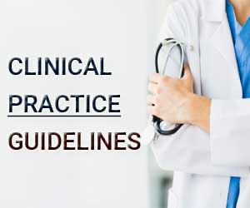




Guidelines / Viewpoints to consider:
DYSLIPIDEMIA
Notes:
but they are some common themes that you will see and there are some common patients that all these guidelines feel that would benefit from treatment , specifically statin
statin benefit group along the way

Slide 40

Statin benefit group
Notes:
-- its going to be our job to recognize which patientsare going to be treated with lifestyle vs which patient are going to be treated with lifestyle plus statin
-- so at the end of the day if its Statin benefit group ( independent of what lipid profile they give you Low HDL of hight Tag) u r going to give statin no other first line treatment on board.
4 major statin benefit groups: \
Focus on ASCVD Risk Reduction: 4 Statin Benefit Groups
This guideline is based on a comprehensive set of data from RCTs from which 4 statin benefit groups were identified that focus efforts to reduce ASCVD events in secondary and primary prevention.
This guideline identifies high-intensity and moderate-intensity statin therapy for use ina secondary and primary prevention.

Slide 41
Secondary prevention
Primary prevention

Slide 42
Guidelines for Primary Prevention

Slide 43
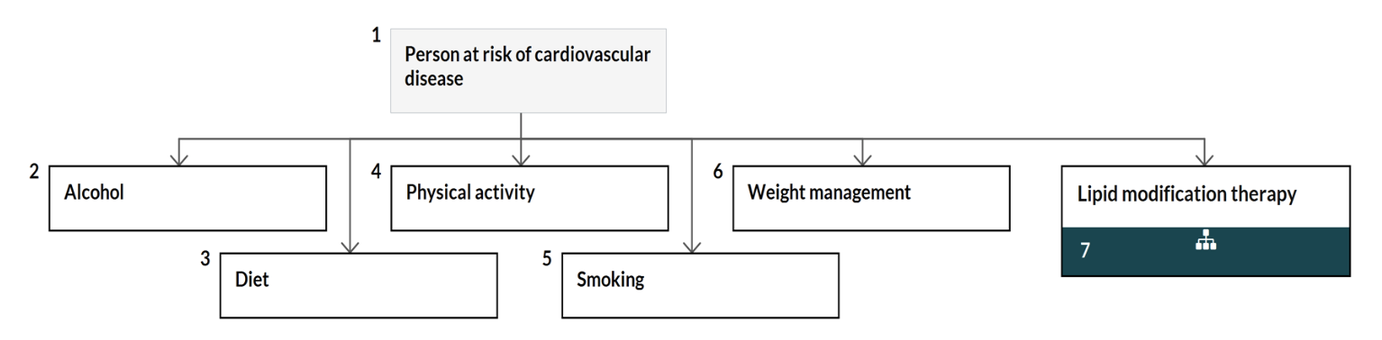
Lifestyle changes for preventing cardiovascular disease
Notes:
Therapeutic lifestyle modification first !
Physical activirty – weight reduction

Slide 44

Diet Therapy

Slide 45
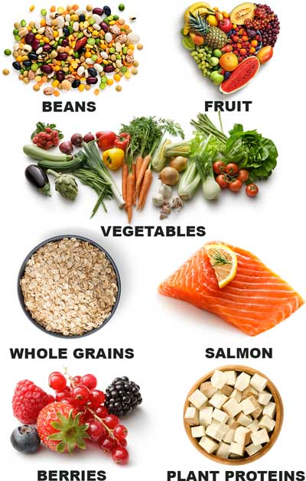
Diet Therapy
(Always initiated firstly in the management.
Except patients with familial hypercholesterolemia and Statin benefit group in which both drugs and diet should begin together.)
Total fat restriction→↓hypertriglyceridemia
Cholesterol & Saturated fat→↓Hypercholesterolemia (LDL)
Decrease CHO (Sucrose & simple sugars) →↓VLDL.
Increase dietary fibers (oat or rice bran)→↓LDL

Slide 46
Increase vegetables, fresh fruit, cereals, whole grain.
No alcohol→↓Hypertriglyceridemia
Decrease caloric intake and stabilization of weight.
Total fat calories should be 20-25% with saturated fat < 8%,

Slide 47
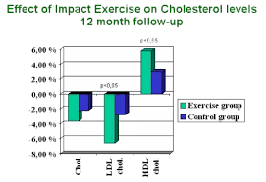
Exercise
Aerobic physical activity
Minimum 3-4 sessions per week,
Lasting on average 40 minutes per session
Involving moderate-to vigorous-intensity physical activity.
▼TG, ▼VLDL-C, and ▲HDL-C
Notes:
Modrate:
Brisk walking (2.4-4mile per hour), bikng (5-9 mph), active yoga, recreational swimming.
Vigorous:
Jogging/ running, biking (>10mph), swimming labs, single tennis

Slide 48
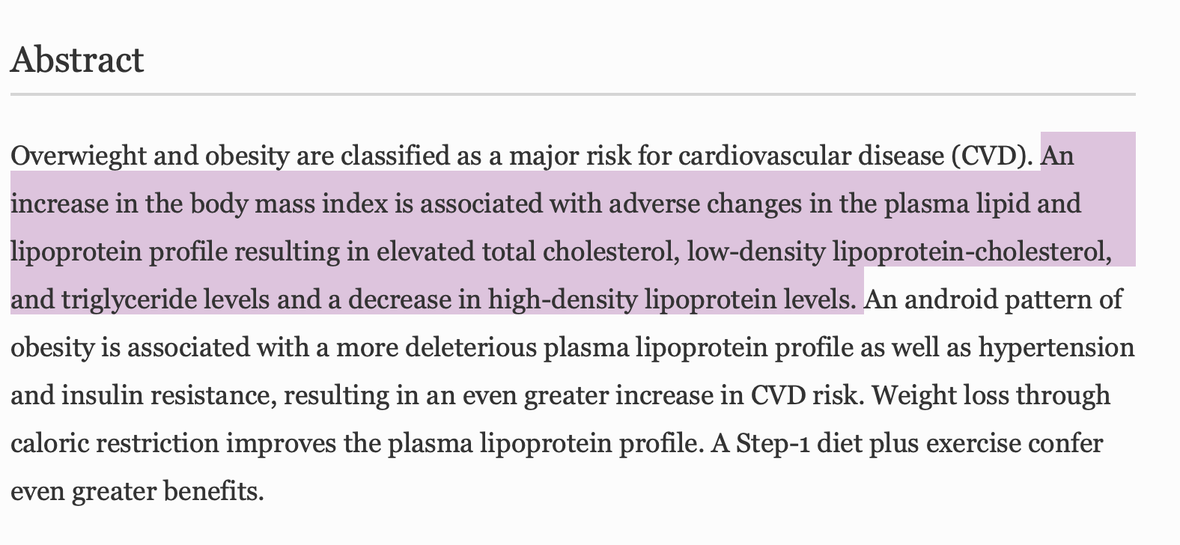
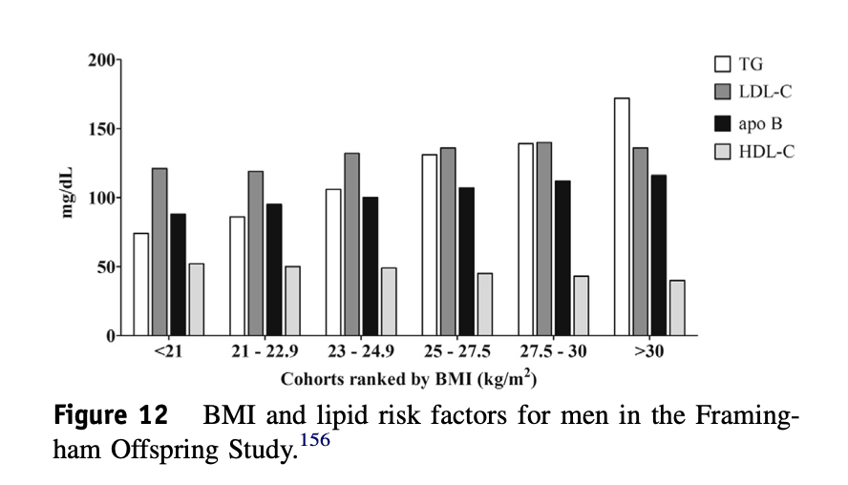
Weight loss
Weight loss improves the plasma lipoprotein profile.
reductions in LDL-C and VLDL-C
Manegment options:
https://www.cmaj.ca/content/192/31/E875 (CMAJ 2020)
Notes:
We recommend adjunctive pharmacotherapy for weight loss and weight-loss maintenance for individuals with BMI ≥ 30 kg/m² or BMI ≥ 27 kg/m² with adiposity-related complications, to support medical nutrition therapy, physical activity and psychological interventions. Options include liraglutide 3.0 mg, naltrexone-bupropion combination and orlistat.
Bariatric surgery
Bariatric surgery may be considered for people with BMI ≥ 40 kg/m² or BMI ≥ 35 kg/m² with at least 1 obesity-related disease.

Slide 49
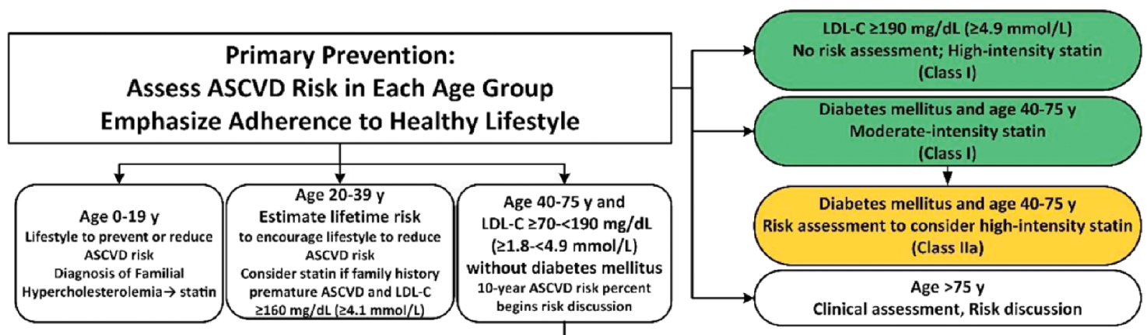
Recommendation:
Risk Calculation
Notes:
---------------------------------------
<20 years ➔ only treat if familial dyslipidaemia
20-40 years ➔ Consider treat if LDL ≥4.1 (160) + high lifetime ASCVD risk / FH premature ASCVD
We treat 40-75/85 we calculate the 10 year risk ASCVD percent and act accordingly.
( ≥85 years NICE) (≥75 ACC) ➔ no need to calculate risk just assess clinically the need and discuss

Slide 50
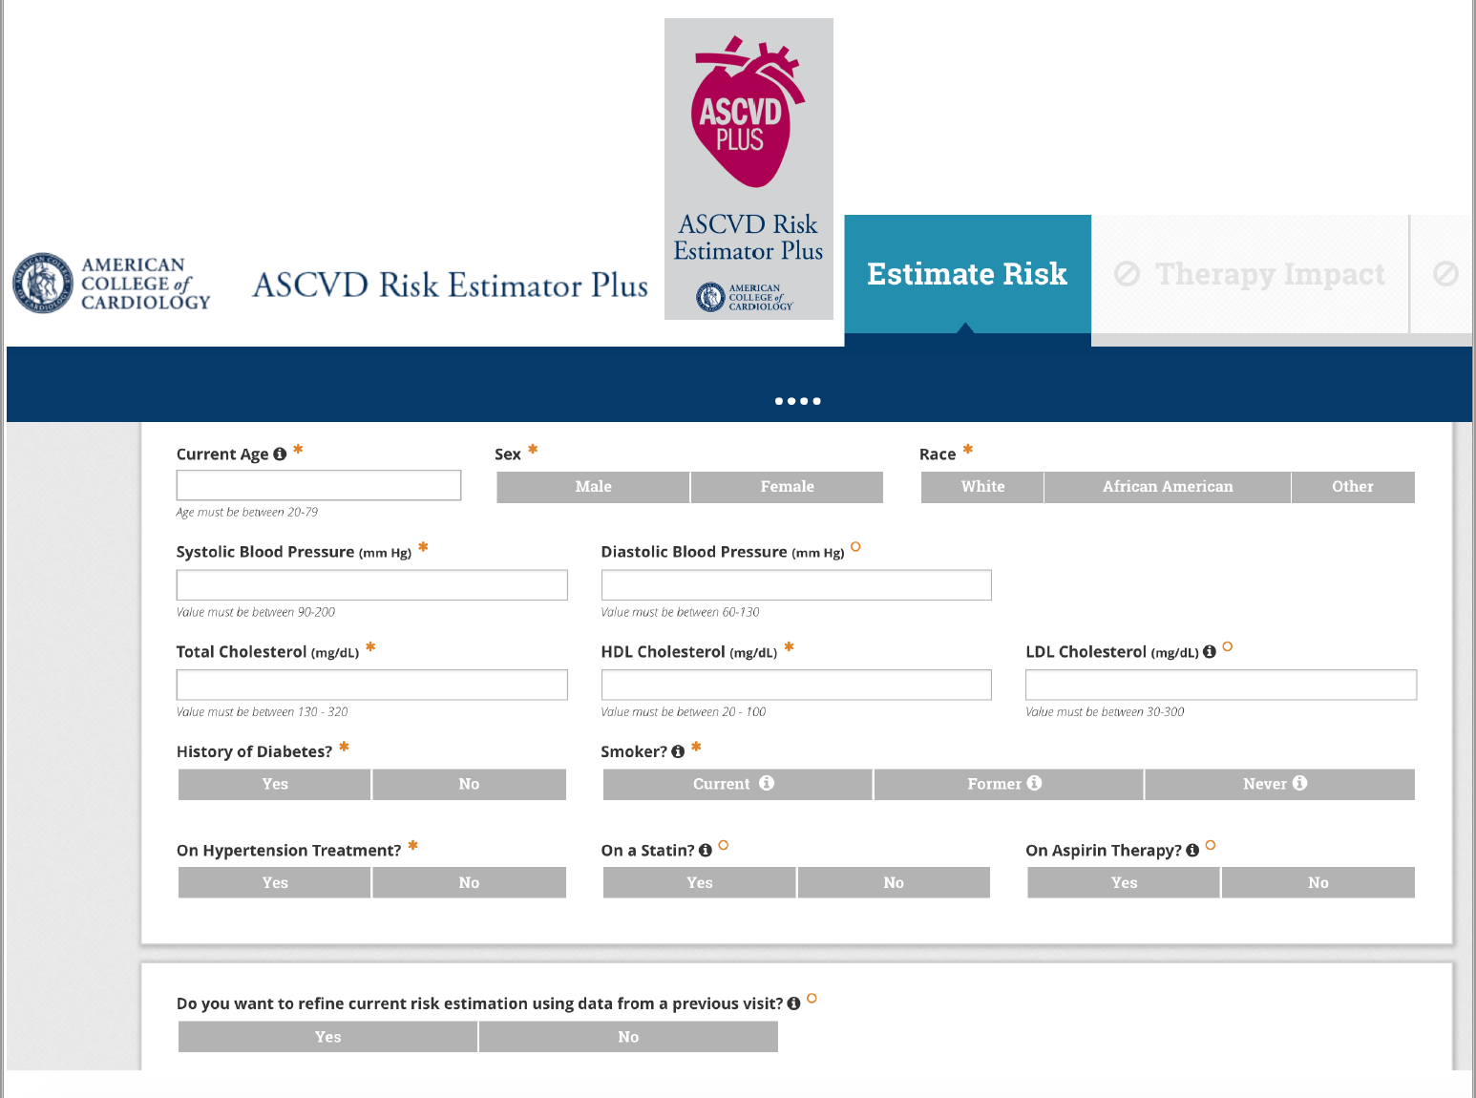
  Pooled Cohort Equation
US: ASCVD Risk Score Calculator:
http://tools.acc.org/ASCVD-Risk-Estimator-Plus/#!/calculate/estimate/

Slide 51
Guidelines for Secondary Prevention

Slide 52
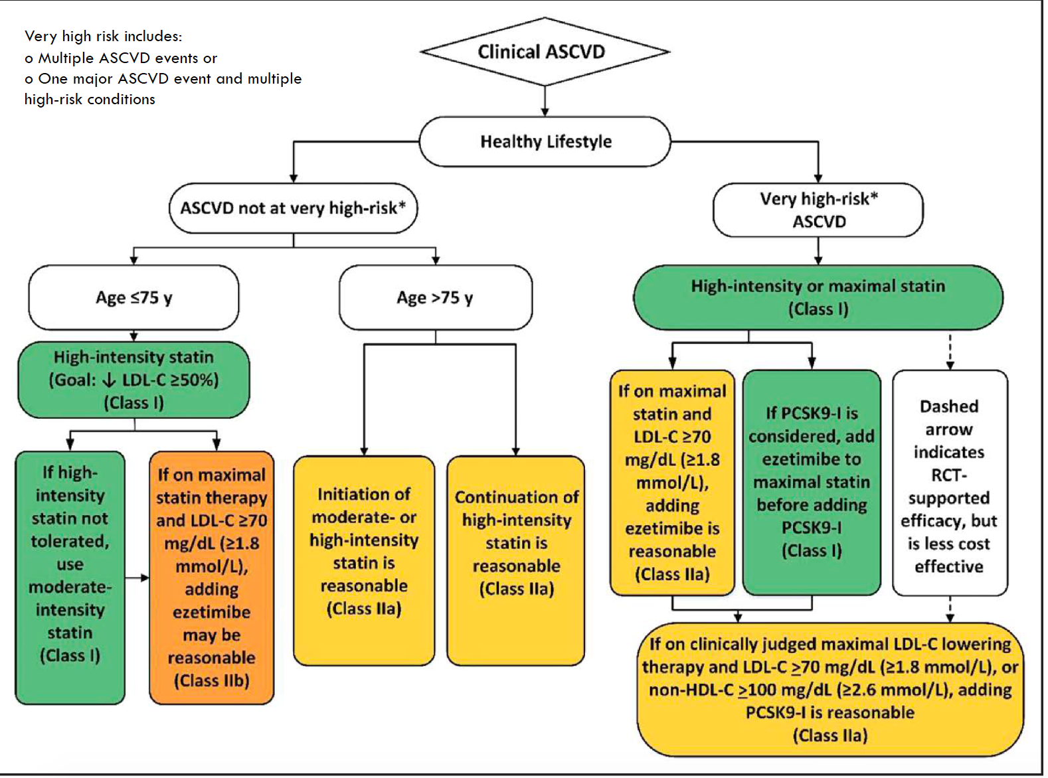
Recommendation:

Slide 53
Very high risk
Includes:
  Multiple ASCVD events or
  One major ASCVD event and multiple high-risk conditions

Slide 54
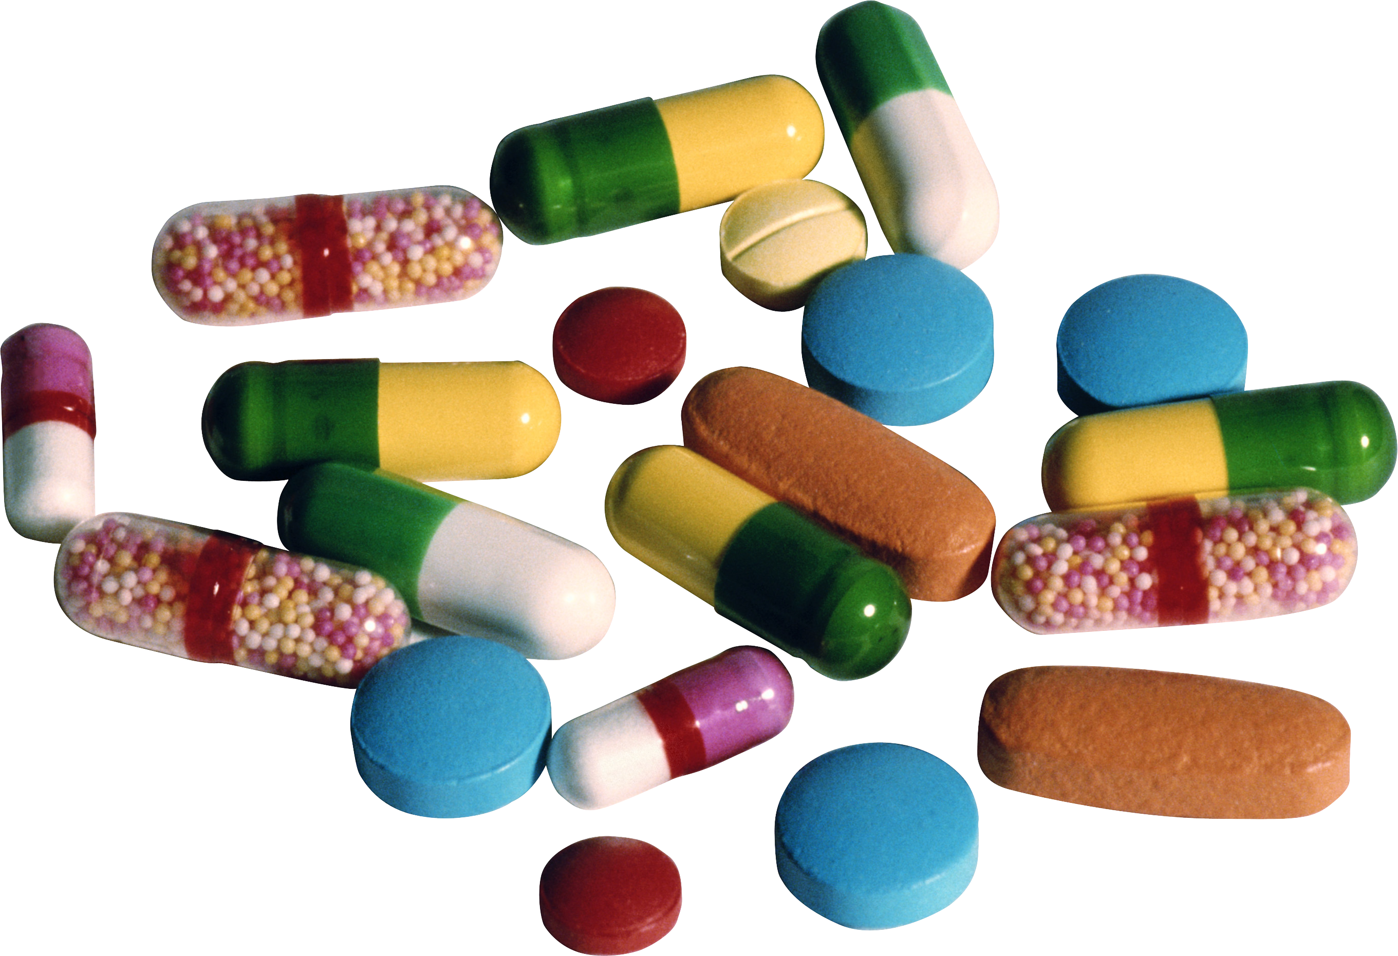
Lipid
Lowering
Medications

Slide 55
Lipid-Lowering Drugs
Pharmacotherpay:
  HMG-CoA Reductase Inhibitors: Statins
  Simvastatin, Fluvastatin, lovastatin, pravastatin,, atorvastatin, rosuvastatin
  2. Specific cholesterol absorption inhibitors: ezetimibe
  Bile Acid binding (RESINS)
  Cholestyramine and Colestipol, colesevelam.
  Fibrates
  Gemfibrozil, Clofibrate,, Bezafibrate,and Fenofibrate, ciprofibrate
  5. Nicotinic Acid (NIACIN), Acipimox
  6. Others: PCSK9 inhibitors

Slide 56
Effect of Lipid-modifying Therapies
Therapy | TC | LDL | HDL | TG | Patient tolerability
Bile acid sequestrants (Resins) | ↓ 7-10% | ↓ 10-18% | 3% | Neutral or | Poor
Nicotinic acid (Niacin) | ↓ 10-20% | ↓ 10-20% | 14-35% | ↓ 30-50% | Poor to reasonable
Fibrates (gemfibrozil) | ↓ 19% | ↓ 4-21% or ▲ | 11-13% | ↓ 30-60% | Good
Statins* | ↓ 19-37% | ↓ 25-60% | 4-12% | ↓ 14-29% | Good
Ezetimibe | ↓ 13% | ↓ 18% | 1% | ↓ 9% | Good
.
Notes:
if its Statin benefit group ( independent of what lipid profile they give you Low HDL of hight Tag) u r going to give statin no other first line treatment on board.

Slide 57
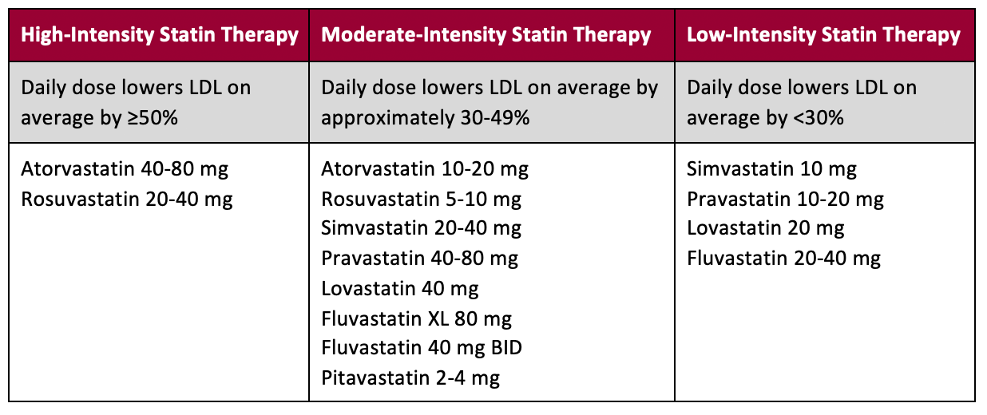
Target

Slide 58
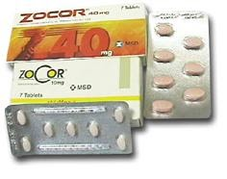
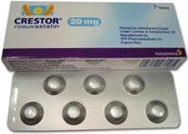
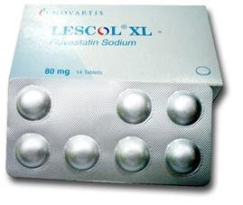
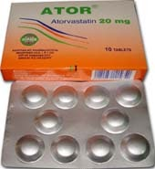
Simvastatin (Zocor)
Rosuvastatin (Crestor)
Fluvastatin (Lescol XL)
Atorvastatin (Ator)

Slide 59
When to refer?
TG >20mmol/L ➔ refer urgently (if not a result of excess alcohol or poor glycemic control.).
If between 10 and 20 ➔ repeat fasting after 5 days= consult if it remains >10
Familial hypercholesterolemia: (First exclude: excessive alcohol, poorly controlled diabetes, hypothyroidism, liver disease/ nephrotic syndrome)
  T. cholesterol >7.5 + a family history of premature heart disease
  T. cholesterol >9.0mmol/L
  non-HDL cholesterol >7.5mmol/L (or LDL >13 in adult, or 11 in children)
  Xanthomata & Arcus
In high risk patients who are intolerant of 3 different statins, obtain specialist advice
Seek specialist advice if non-HDL cholesterol concentration is >7.5 mmol/L

Slide 60

(Dyslipidemia)
https://www.ccjm.org/content/87/4/231

Slide 61
Other guidelines, you can view..
https://pathways.nice.org.uk/pathways/cardiovascular-disease-prevention#path=view%3A/pathways/cardiovascular-disease-prevention/lipid-modification-therapy-for-preventing-cardiovascular-disease.xml&content=view-node%3Anodes-secondary-prevention (NICE Pathway last updated: 29 June 2020)
https://care.diabetesjournals.org/content/43/Supplement_1/S111#sec-23
Diabetes Care 2020 Jan
https://pro.aace.com/pdfs/lipids/CS-2020-0490-slides.pdf

Slide 62
( THANK YOU )
Any questions? Please ask !

