Slide 1
Welcome to Family Medicine Course FAM530
Orientation

Slide 2


Slide 3
Tutors:-
Dr. Khalid Al Quamaizi
Dean College of Medicine
Dr. Yousif Elgezoli, MRCGP-UK/ JMHPE- Maastricht.
Consultant in Family Medicine. 0567234117
ygezoli1954@gmail.com
Dr. Osama Al-Nafesa

Slide 4
Family Medicine Course: FAM 530
Course Learning Outcomes
Contents of the Course
Topics
Schedule
Objectives
Teaching & Learning Strategies
Assessment

Slide 5
Course Learning Outcomes (CLOs)
Knowledge
& Understanding
Skills
Values

Slide 6
Ground rules for the Course
- What factors made this activity a success or more effective?
Brainstorming:-
Starting and finishing on time
Coming prepared
Listening to others without interruptions
Participating

Slide 7
Saying when you don’t understand
When anyone is speaking, addressing the whole group and not just the teacher
Switching off mobile phones
Treating others’ contributions with respect
Keeping personal issues out of the session
Maintaining confidentiality within the group.

Slide 8
Three Weeks Plan
    Week-1: Tuesday-Thursday (Basic Principles).
    Week-2: - Clinical
    Week-3: - Clinical / OSPE/OSCE – REVISIONS & EXAMS.

Slide 9
First Week
    PART-1: FM First Three days (Tuesday -Thursday)
    FM Principles & Concepts (Six Topics).
    Communication / BBNs.
    Consultation
    PHC System
    Prescribing/Referrals
    EBM &
    Prevention in Primary Care.

Slide 10
2nd. & 3d. Weeks.
    PART-2: Clinical Topics: (Approach to the following clinical topics: Theory & Clinical Skills)
    1. HTN, 2. Sore throat.
    3. Chest pain, 4. Child Well Care.
    5. Thyroid disorders 6. LBP
    7. B. Asthma, 8. Anemia
    9. DM, 10. Dyslipidemia 11.Headache
    12. Osteoarthritis 13. Abdominal pain
    14. BPH
    15. Comprehensive Geriatric Care 16. Depression & Anxiety
    17. Smoking 18. ANC
    19. Obesity 20. Dizziness.
    21. UTI
PART-3: Revision, Consolidation and Exam

Slide 11
The Schedule

Slide 12
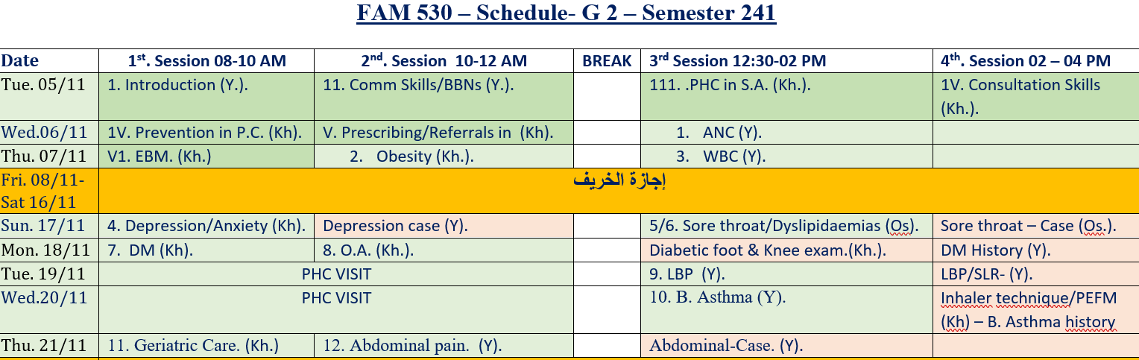

Slide 13
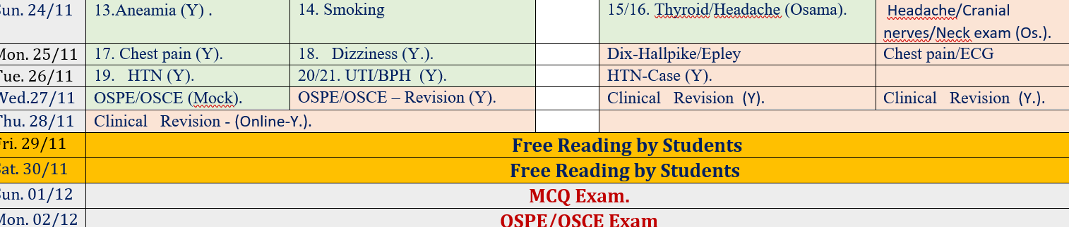

Slide 14
FAM 530 – Topics & Tutors
Basic principles in PHC
1 | PHC in Saudi Arabia | Khalid
2 | Consultation | Khalid
3 | Prevention in P.C. | Khalid
4 | Communication/Breaking Bad News | Yousif
5 | Evidence-Based Medicine | Khalid
6 | Prescribing/Referrals in PC | Khalid

Slide 15
B- Clinical Topics
1 | DM | Khalid
2 | Geriatric Care | Khalid
3 | Depression/Anxiety | Khalid
4 | Obesity | Khalid
5 | Osteoarthritis | Khalid
6 | Sore throat | Osama
7 | Dyslipidaemias | Osama
8 | Thyroid | Osama
9 | Headache | Osama

Slide 16
10 | UTI/BPH | Yousif
11 | WBC | Yousif
12 | HTN | Yousif
13 | Headache | Yousif
14 | LBP | Yousif
15 | Thyroid disorders | Yousif
16 | Abdominal Pain | Yousif
17 | Chest Pain | Yousif
18 | Smoking | Yousif
19 | Dizziness | Yousif
20 | ANC | Yousif

Slide 17
Tutorials:-
1 | DM | Khalid/Yousif
2 | Dizziness | Yousif
3 | Sore throat | Osama
4 | Headache/Cranial nerves | Osama
5 | Hypothyroidism/Neck exam. | Osama
6 | Chest pain | Yousif
7 | HTN | Yousif
8 | B. Asthma | Khalid/Yousif
9 | Abdominal pain | Yousif
10 | O. Arthritis – Knee exam. | Khalid
11 | LBP | Yousif
12 | Depression | Yousif

Slide 18
OSPE/OSCE
1 | Mock | Yousif
2 | Revision | Yousif

Slide 19

Teaching & Learning
Strategies
We should have strategic teaching from our side (Tutors) and strategic learning from your side (Students)

Slide 20
Very Active and Deep Teaching/Learning
All topics are based on specific objectives Interactive presentation, based on the specific questions Your participation and prior reading is very important You will achieve very high in knowledge, skills competencies as well as in assessment | First Six Topics: Consultation & Communication. Breaking Bad News Primary Health Care Prescribing/Referrals. Screening EBM

Slide 21
Teaching/Learning Strategies
(Second 19 Topics)
All ------ students will be divided into 4 groups of --- + --- students
Daily we will discuss two/three topics all about applied theory.
You will be provided with the power points, applied questions, 1-2 reference and a clinical scenario, possibly an article.
All topics are based on their specific objectives.
Your participation and prior reading is very important, and essential.

Slide 22
Example of a Case
A 50-year-old gentleman is presented to your clinic with the complaint of hesitancy, urgency and increase frequency of urination for past few month. He is not known to have any medical problem in the recent past. No previous investigation is available.
Discussion Questions:
What are the differential diagnosis of such presentation?
What are the questions to be included in taking history from the patient?
What are the clinical examinations to be performed?
What are the management plan for such case?
What are the complications if this patients has been diagnosed as BPH?
ALL 20 CLINICAL PROBLEMS ARE BASED IN THIS STYLE for theoretical sessions. Same things will be applied for the clinical sessions with simulated patients.

Slide 23

Assessment

Slide 24
Assessment
Active clinical participation……………………30%
OSPE/OSCE ……………….…30%
MCQ Paper…………………………………40%

Slide 25
First Six Topics by MCQs
    FM Principles & Concepts (Six Topics)
    Consultation.
    PHC System
    Communication/Breaking Bad News
    Prevention in PHC.
    Prescribing/Referrals &
    EBM.

Slide 26
Second 20 Topics by MCQs & OSPE/OSCE
    Clinical Topics: (Approach to the following clinical problems)
    1. HTN, 2. Sore throat.
    3. Chest pain, 4. Well child care.
    5. Thyroid, 6. LBP
    7. SOB, 8. Anemia
    9. DM, 10. Dyslipidemia
    11. OA, 12. Headache
    13. ANC 14. Abdominal pain
    15UTI 16. Comprehensive Geriatric Care 17. Common psychiatric problems 18. Smoking
    19. Obesity 20. Dizziness.
    21. UTI.

Slide 27
OSPE

Slide 28
OSCE

Slide 29
Continuous Clinical Assessment (30%)
There will be a continuous assessment, this will score 30% = 30 marks out of the 100 marks.
Student will be asked questions individually, to get their assessment.
If you are absent even with some valid reasons your mark will be decreased.
There are 6 Assessment Specific Domains for attendance:

Slide 30
1 | A | Attend on time
2 | L1 | Come late ≥ 15 minutes
3 | L2 | Come late ≥ 30 minutes
4 | AB | Absent
5 | D | Disturb, side talk or use mobile
6 | LE | Left Early

Slide 31
FAM-530 – Continuous Assessment
First Semester- Group B- Girls
5/11 – 02/12/2024.
Absent X | Dist. - | Partic. P | Bonus + | Late or early x | Att. √ | الرقم الجامعي | الأسم | تسلسل
 |  |  |  |  |  | 172220380 | رغد المطيري | 1
 |  |  |  |  |  | 181220136 | شروق الهسي | 2
 |  |  |  |  |  | 181220202 | نورس الحناكي | 3
 |  |  |  |  |  | 191220013 | الجوهرة عيسي | 4
 |  |  |  |  |  | 191220027 | راما ضاهر | 5
 |  |  |  |  |  | 191220057 | دعاء عبد الرحمن | 6
 |  |  |  |  |  | 191220146 | رهف ال فريان | 7
 |  |  |  |  |  | 191220191 | ميرال بالفاس | 8

Slide 32
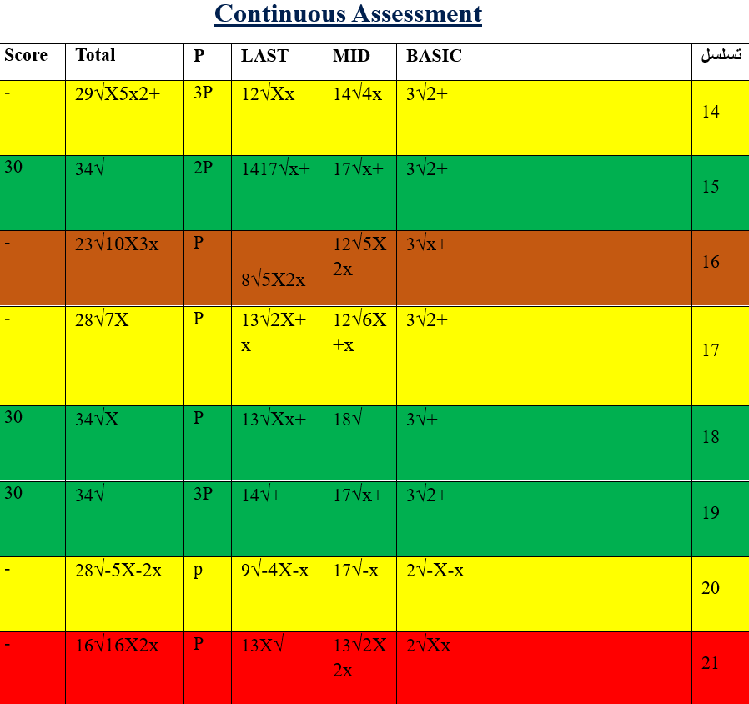

Slide 33
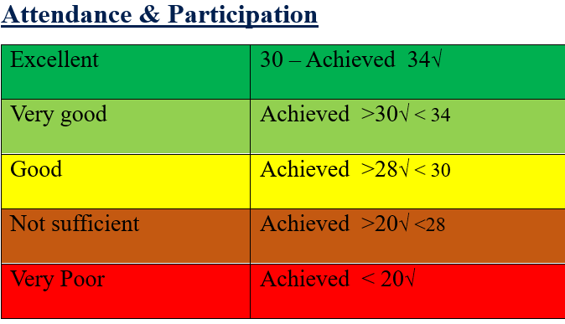

Slide 34
Group-Leader Roles:-
Lead & facilitate constructive communication between the tutors and students.
Receive and distribute the send materials sent through email (PowerPoint/Questions for discussion/references).
Allocating & managing resources including the tools & instruments needed for clinical sessions.
Be sure and prepare the smart board, the stability of the net & the needed audiovisual materials.

Slide 35
Upload the PowerPoint & videos to the smart board.
Contact & direct poor attending students.
Help in distributing the group into subgroups.

Slide 36
Instruments and tools needed for the course -Clinical- FAM-530
Audiovisual facilities
    Smart Board
    Projector
    Loud Speaker
    Internet facilities
    PPT and Video presentation

Slide 37
Clinical Instruments
    Stethoscope
    Sphygmomanometer
    Placebo Inhaler
    Peak Flow Meter
    Auroscope
    Urine dipstick
    Glucometer

Slide 38
    Torch and tongue depressor
    BMI chart, Blood sugar convertor chart
    Framingham Risk Calculation Chart
    Smoking Device Calculator for CO/ NRT patches
    CNS Evaluation instrument
      Tuning Fork
      Hammer
      Cotton and needle
      Microfilament to check DM foot

Slide 39
Summary
1. Be on time, active, prepared, and mobile mute
2. Read daily, No absenties
3. Learn how to learn and prepare
4. Outcomes of these hard work will reflect on your knowledge, skills assessment results

Slide 40
PERFORMANCE OF STUDENTS IN FAM 530- NOV EXAM FOR THE ACADEMIC YEAR 1437 - 38 H.

Slide 41

Any Questions or Clarification

Slide 42
References
Required Textbooks | Swanson’s /A Problem-Oriented Approach-FAMILY MEDICINE REVIEW- 9th. Edition (Alfred F. Tallia / Joseph E Scherger / Nancy W. Dickey -2023).
Essential References Materials | OSCE AID for Family Medicine Saudi Board Program Family Medicine Guide Handbook (Dr. Hadi Alenazy / Dr. Abdulelah Shihab) Methods of Medical Examination (Prof. M. Salah Ibrahem).
Electronic Materials | https:// amboss.com Links for Videos From Saudi Commission for Health Specialities on BBNs/Well & Bad Consultations/ Dix-Halpike & Epley – Cranial nerves exam – Diabetic foot exam – Knee exam – SLR etc.
Other Learning Materials | BMJ, American Family Physician, NICE Guidelines, SIGN Guidelines, SHAMS, SINA Guidelines 2024. BMJ Best Practice.
CCTD | Handouts to Scearios for clinical cases for role-play.

Slide 43
Thank you

