Slide 1

The future of primary care in Saudi Arabia
Dr. Khalid I. AlQumaizi
24/09/2024
Notes:
By Design : Naif AlHarbi - Almaarefa University

Slide 2
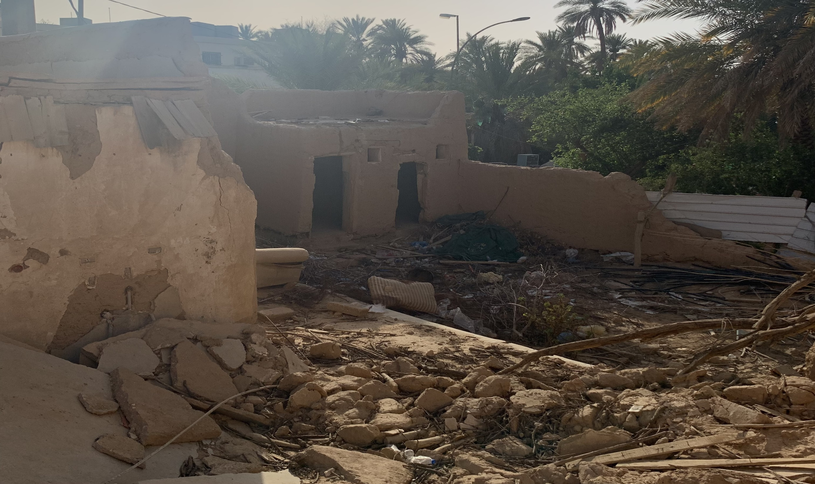

The future of primary care in Saudi Arabia

Slide 3

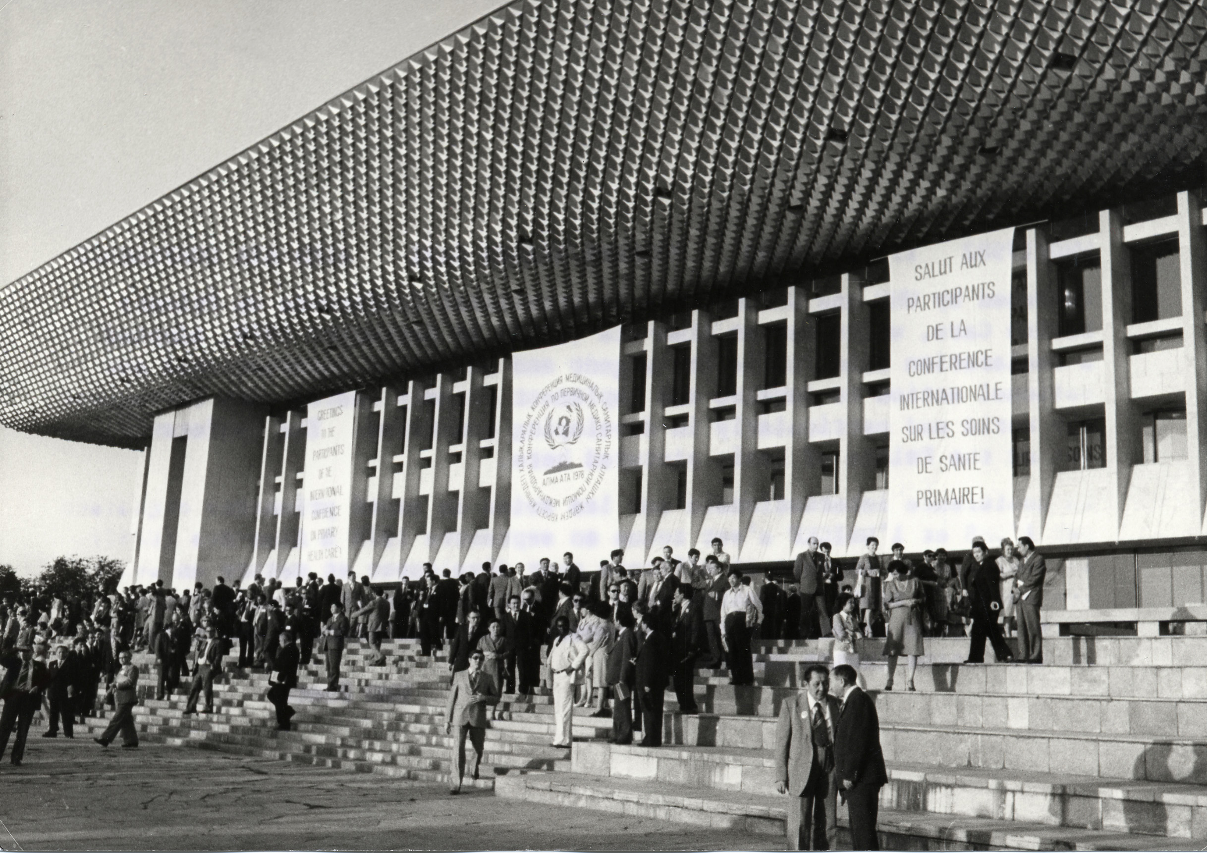
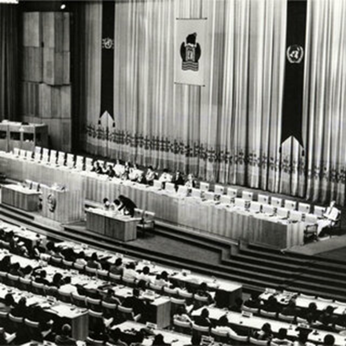


“
Historical background
920011909
Notes:
By Design : Naif AlHarbi - Almaarefa University

Slide 4
Alma’ Ata Declaration
The Conference strongly reaffirms that health is a fundamental human right
02
01
The existing gross inequality in the health status of the people is politically, socially, and economically unacceptable.
The people have a right and duty to participate individually and collectively in the planning and implementation of their health care.
03
04
Primary health care is essential health care based on practical, scientifically sound, and socially acceptable methods and technology.
The future of primary care in Saudi Arabia
05
An acceptable level of health for all the people of the world by the year 2000 can be attained through a better use of the world's resources.
04

Slide 5
The beginning of the newly structured primary care services
01
In accordance with the Alma-Ata declaration, Saudi Arabia has committed to develop its primary health care services.
02
The Ministry of Health integrated both preventive and basic curative health care services in 1984.
The future of primary care in Saudi Arabia
03
These services targeted individuals, families and the community, and provided a range of health care services including maternal and child health, immunization for communicable diseases, follow-up for patients with chronic diseases, dental care services, health education and essential drugs.
05

Slide 6
Whole-person care—is the hallmark of the good Primary Care.
The patient-centered consultation not only takes into account the diagnosed disease and its management but also adds another dimension—that of the psychosocial hallmarks of the patient, including details about:
The patient as a person
Emotional reactions to the illness
The family
The effect on relationships
Work and leisure
Lifestyle
The environment
The future of primary care in Saudi Arabia
6

Slide 7
The main elements of Primary Care.
There are eight essential components of PHC:
Health education, on prevailing health problems and the methods of preventing and controlling them.
Nutritional promotion including food supply.
Supply of adequate safe water and sanitization.
Maternal and child health care.
Immunization against major infectious diseases.
Prevention and control of locally endemic diseases.
Appropriate treatment of common diseases and injuries.
Provisions for essential drugs.
All these basic requirements are incorporated in the SDGs for 2030 from goal 2 to goal 4.
The future of primary care in Saudi Arabia
7

Slide 8
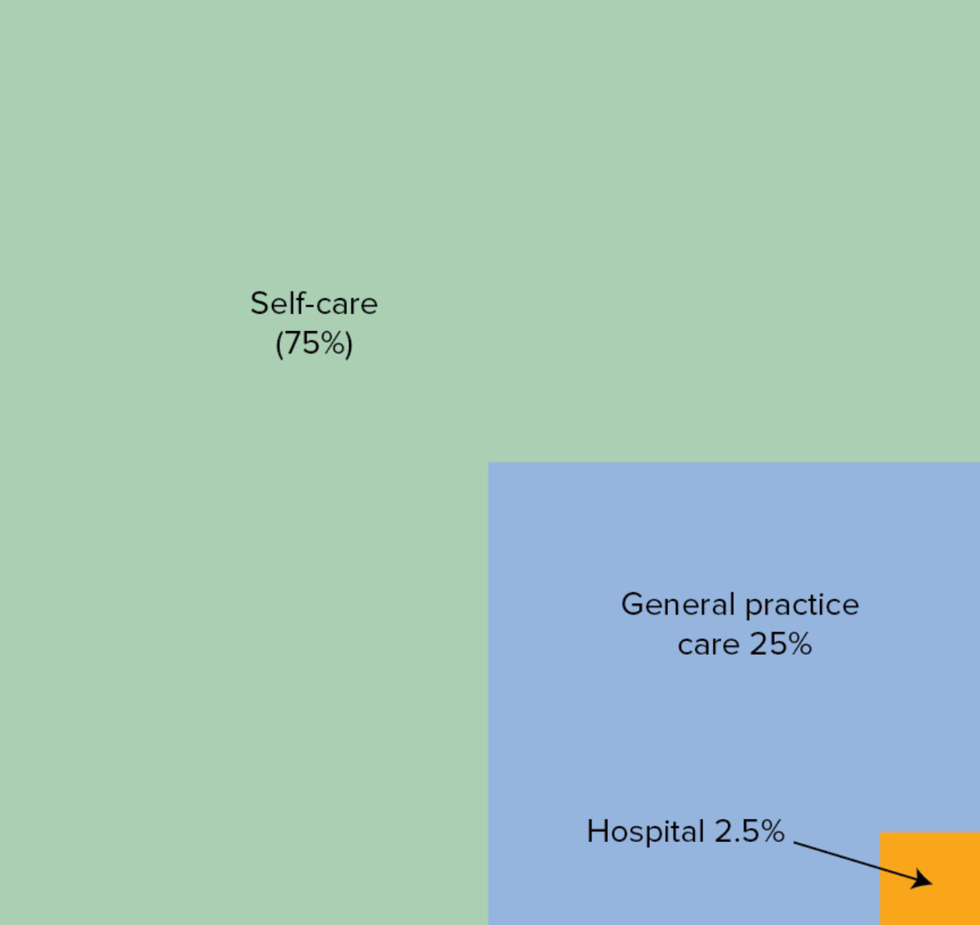
The degrees of care
The future of primary care in Saudi Arabia
8

Slide 9
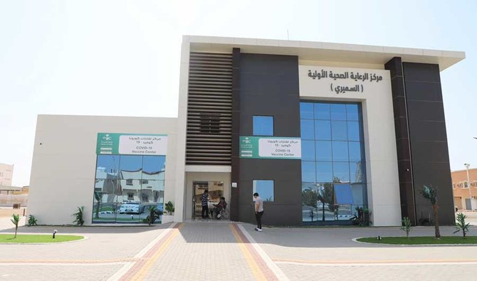

“
Enhancement of primary care project
920011909
Notes:
By Design : Naif AlHarbi - Almaarefa University

Slide 10
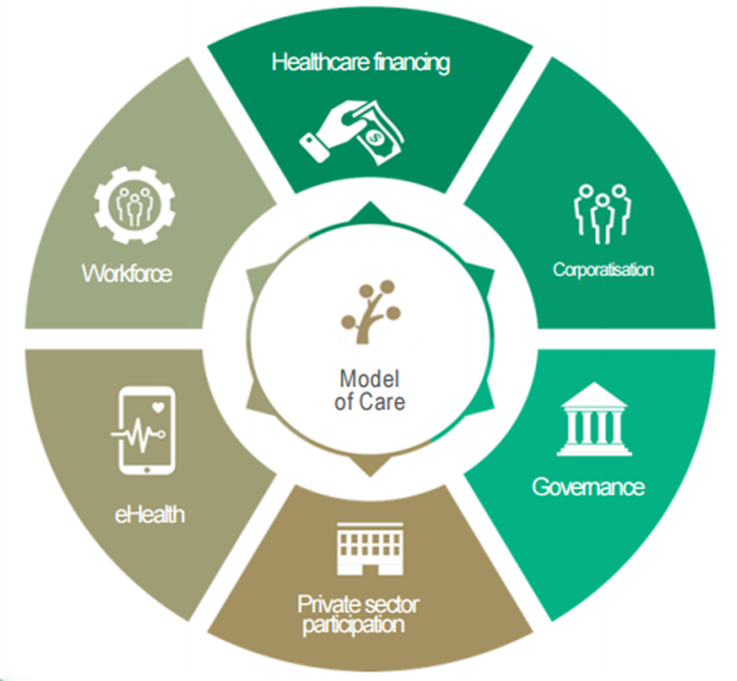
The Saudi healthcare transformation
Healthcare Financing
Establish a value based payment system
Workforce
Enhance quality and quantity of workforce
National Healthcare Workforce Planning Unit
Corporatisation
Corporatize health services delivery.
Create local clusters that ultimately form accountable care organisations.
The future of primary care in Saudi Arabia
eHealth
Provide digital tools (apps) for patients and workforce
Accelerate IT infrastructure build up at MoH
Governance
Strengthen MoH to lead sector reform and transform it to be more strategic.
Create a range of regulatory bodies
010
Private Sector Participation
Privatization of healthcare services
Support localisation of pharmaceutical and medical devices.

Slide 11
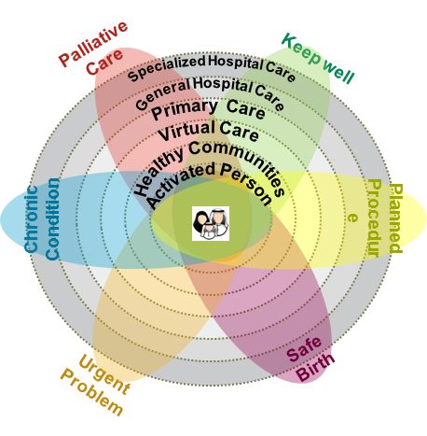

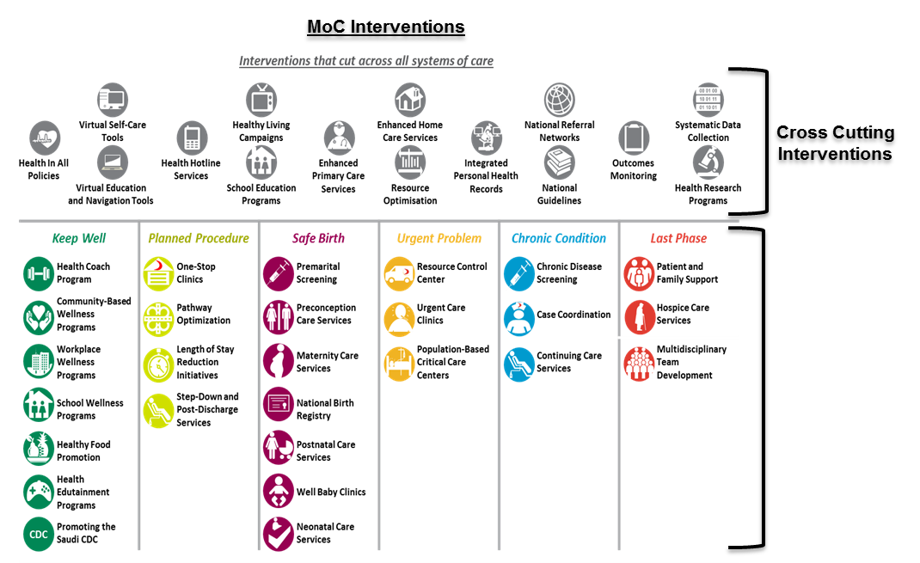
Model of care
The future of primary care in Saudi Arabia
Soc special
interventions
011

Slide 12
Shifting the mind set
Treating sickness
Promoting wellness
Hospital based/ specialized care
Community based / primary care
Facility based (silos)
Cluster based ( integrated )
The future of primary care in Saudi Arabia
Paying for infrastrucure
Paying for services
Focusing on inputs
Focusing on outputs/ outcomes
Delivering care
Delivering value
Bringing patients to doctors
Bringing doctors to patients
12

Slide 13
Enhancement of Primary care framework
6. Funding
7. Regulations
5. Governance
3. Capabilities
The future of primary care in Saudi Arabia
1. Services
People
4. Population Health
2. Engagement
13

Slide 14
Enhancement of Primary care framework
6. Funding
7. Regulations
Services
Defining the scope of services
Essential and essential plus
Mega centers
Urban vs rural
Extended working hours
Urgent Care Centers
5. Governance
3. Capabilities
The future of primary care in Saudi Arabia
People
4. Population Health
2. Engagement
14

Slide 15
Enhancement of Primary care framework
6. Funding
7. Regulations
2. Engagement
Defining catchment population
Population registration
Empanelment
Improving access
Patients satisfaction
5. Governance
3. Capabilities
The future of primary care in Saudi Arabia
1. Services
People
4. Population Health
15

Slide 16
Enhancement of Primary care framework
6. Funding
7. Regulations
3. Capabilities
Capabilities profiling
Assessment methodology
Leadership training
Family medicine residency
Case coordinator , health coach
Repurposing of the staff
Building teams capabilities
Change management
Physical and IT capabilities
5. Governance
The future of primary care in Saudi Arabia
1. Services
People
4. Population Health
2. Engagement
16

Slide 17
Enhancement of Primary care framework
6. Funding
7. Regulations
4. Population Health
Defining population health KPIs
Population health need
assessment
Defining the contractual
requirements with payer
Training the PHM teams
5. Governance
3. Capabilities
1. Services
The future of primary care in Saudi Arabia
People
2. Engagement
17

Slide 18
Enhancement of Primary care framework
6. Funding
7. Regulations
5. Governance
Designing the governance of Primary care
The authority matrix within the ecosystem and within the clusters
Interaction with other stakeholders
Culture of accountability
Reporting requirments
3. Capabilities
The future of primary care in Saudi Arabia
1. Services
People
4. Population Health
2. Engagement
18

Slide 19
Enhancement of Primary care framework
7. Regulations
6. Funding
Defining funding strategy
Incentivize mobilization of services to primary care
Funding the Capex by PPP
Measuring the ROI
5. Governance
3. Capabilities
The future of primary care in Saudi Arabia
1. Services
People
4. Population Health
2. Engagement
19

Slide 20
Enhancement of Primary care framework
6. Funding
7. Regulations
Revising the policies that hinder the empowerment
Regulating the private sector to adopt family medicine based approach
Revising the privileges of the PHC staff
Clinical guidelines
Professional licenses
Infrastructure standards
Non clinical standards
5. Governance
3. Capabilities
The future of primary care in Saudi Arabia
1. Services
People
4. Population Health
2. Engagement
20

Slide 21
Guiding principles for improvement
Safety
Equity
Time constrains
Efficiency
Timeliness
Patient centricity
Effectiveness
people
the future of primary care in Saudi Arabia
21

Slide 22
“
Complexity of enhancement of primary care
920011909
Notes:
By Design : Naif AlHarbi - Almaarefa University

Slide 23
Complexity of enhancement of primary care
Fragmented delivery of care
Multifaceted healthcare system
Time constrains
Political buy in
Limited resources
Policy and regulatory environment
Increasing patient complexity
Social determinants
Data management and analytics
Changing healthcare landscape
the future of primary care in Saudi Arabia
23

Slide 24
The future drivers of Primary Care
Notes:
By Design : Naif AlHarbi - Almaarefa University

Slide 25
The future drivers of primary care in Saudi Arabia
Data driven decisions
Integrated approach to problems
Advanced technology
Value based care
Sharing of resources
Policy and regulatory enhancement
Increasing patient engagement
addressing Social determinants
Interdisciplinary collaboration
Prediction and prevention
the future of primary care in Saudi Arabia
25

Slide 26
“
920011909
Notes:
By Design : Naif AlHarbi - Almaarefa University

