Slide 1

Geriatric Care
30/09/2024
Notes:
By Design : Naif AlHarbi - Almaarefa University

Slide 2
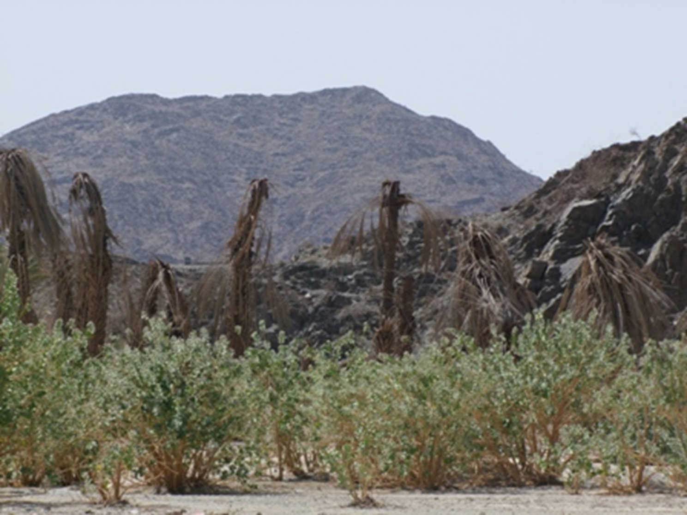

Slide 3
Definition
Aging
The gradual deterioration of a mature organism resulting from time-dependent, irreversible changes in structure that are intrinsic to the particular species, and that eventually lead to decreased ability to cope with the stresses of the environment thereby increasing the probability of death
(Stedman’s Med Dictionary 2000)
Is a process that converts healthy adults into frail ones with diminished reserves in most physiologic systems and exponentially increasing vulnerability to most diseases and to death
(W. Hazzard, Principles of Geriatric Medicine & Gerontology 2003)
Geriatric Care
3

Slide 4
Definition
Elderly
WHO
UN
Saudi Arabia
Geriatric Care
4

Slide 5
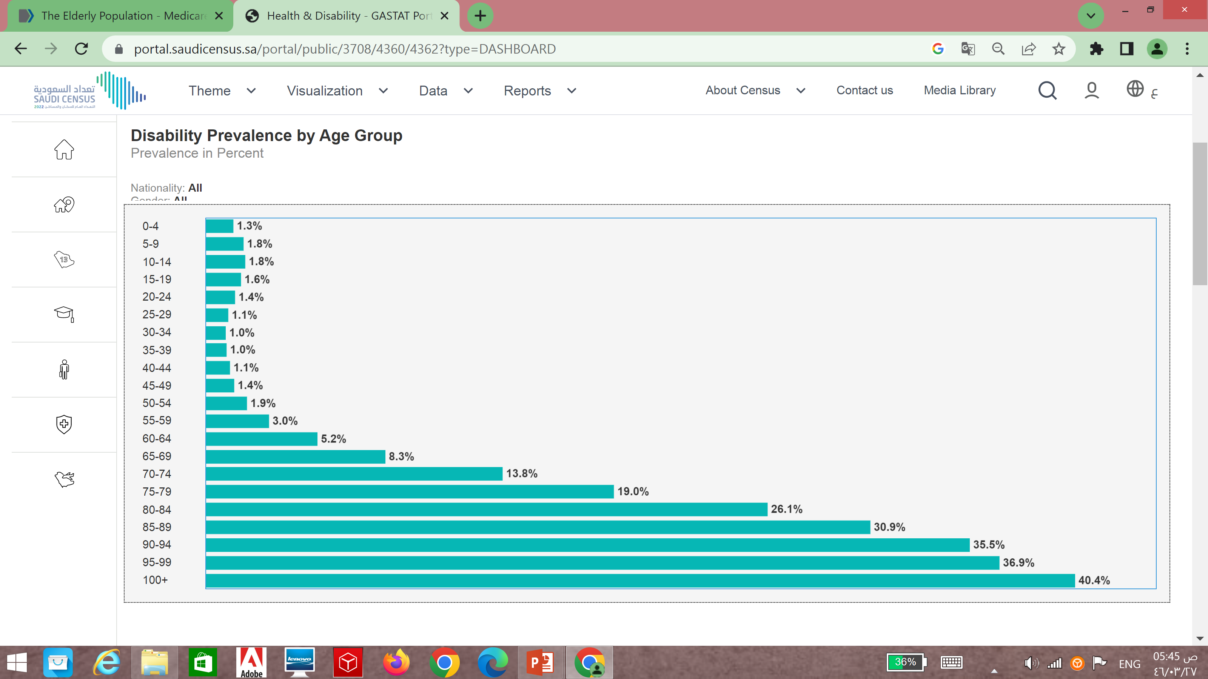
Definition
Aging
The gradual deterioration of a mature organism resulting from time-dependent, irreversible changes in structure that are intrinsic to the particular species, and that eventually lead to decreased ability to cope with the stresses of the environment thereby increasing the probability of death
(Stedman’s Med Dictionary 2000)
Is a process that converts healthy adults into frail ones with diminished reserves in most physiologic systems and exponentially increasing vulnerability to most diseases and to death
(W. Hazzard, Principles of Geriatric Medicine & Gerontology 2003)
Geriatric Care
5

Slide 6
Some facts about aging
Chronologic age is not an accurate predictor of physical condition or behavior .
Poor health in later life is not inevitable.
The rate of physiologic decline can be modified.
A lot of the illnesses and disabilities associated with aging is related to modifiable lifestyle factors that are present in middle age
Geriatric Care
6

Slide 7
Physiological changes among elderly
Cardiovascular
Valves calcium deposits
Pacemaker cell loss (SA node)Fibrous tissue/fat deposits
Baroreceptors
Arteries thicken/stiffen Ventricular cardiomyocytes hypertrophy
Geriatric Care
7

Slide 8
Physiological changes among elderly
Respiratory
Vital capacity reduced ,FEV reduced
Chest wall compliance reduced
Reduced alveolar elasticity and reduced number of functional alveoli
Cilia activity reduced
Glandular cells reduced
Lung macrophages less effective
Cough less forceful
Geriatric Care
8

Slide 9
Physiological changes among elderly
Renal
Renal mass and size reduced
Average Creatinine clearance is reduced 10ml/decade
Renal tubular cells reduced, thickened tubular walls
Thirst is blunted
↓ serum renin and aldosterone (30-50%)
Increased prostaglandins
Reduction of urine acidification and impairment in excreting
Geriatric Care
9

Slide 10
Physiological changes among elderly
Hematological
Maintains adequate function with aging
Overall, cell counts and parameters in the peripheral blood are not significantly different from in young adult life
EPO response to anemia in older subjects is similar to that of younger subjects
Functional reserves are reduced with age due to a decreased bone marrow mass and an increase in fat
Total circulating white cells counts do not change with age in healthy older people, but the function of several cell types is reduced
Geriatric Care
10

Slide 11
Physiological changes among elderly
Gastrointestinal
Gastric cells reduced
Increased post prandial gastric pH
Less effective mastication
Decreased food clearance
Muscle tone reduced, peristalsis reduced
Hepatic size reduced, blood flow reduced
Geriatric Care
11

Slide 12
Physiological changes among elderly
Endocrine
Glucose homeostasis
Reproductive function
Calcium metabolism
Adrenal function
Thyroid function
Geriatric Care
12

Slide 13
Physiological changes among elderly
Genitourinary
Urinary incontinence
Urinary tract infection
Erectile dysfunction
Dyspareunia
Decrease in detrusor muscle contractility
Decrease in maximum bladder capacity
Decrease ability to withhold voiding
An increase in postvoid residual
Geriatric Care
13

Slide 14
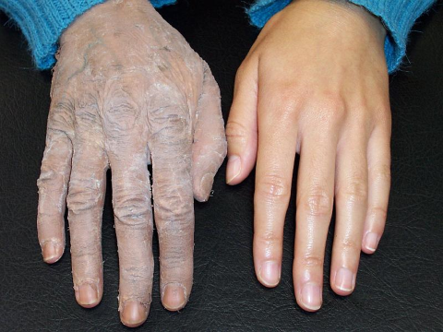

Slide 15
Physiological changes among elderly
Musculoskeletal
Loss of muscle is greater and faster from the legs than from the arms
Activity may decrease rate of decline
The loss of muscle contributes to age-related changes in body composition, and distribution for water soluble drugs
Decrease bone density
Increase liability to fracture
Geriatric Care
15

Slide 16
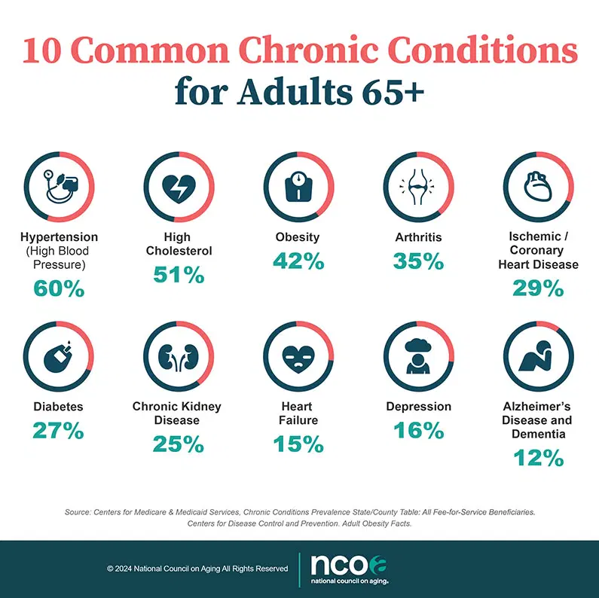
Common medical problems among elderly
Arthritis
Hypertensive Disease
Heart Disease
Hearing Impairments
Musculoskeletal impairments
Chronic kidney disease
Diabetes
Visual Impairments
Cancer
Depression
Sleep disorder
Neurological problems
Geriatric Care
16

Slide 17
Determinants of active healthy aging
Examples | Determinants
Income, work and social protection | Economic determinants
Access to quality health and social services | Health and social service systems
Housing, neighbourhood and surroundings, transportation | Physical environment
Social support and degree of social interaction | Social environment
Cultural values, norms and traditions, genetic influenc | Cultural and personal determinants
Life-style behaviour, well-balanced diet, physical activity, smoking cessation, moderate alcohol consumption, appropriate use of medications | Behavioural determinants
Geriatric Care
17

Slide 18
Immunization
COVID-19
Seasonal Flu (Influenza)
Pneumonia (pneumococcal)
Tetanus, diphtheria, pertussis (Tdap or Td)
Shingles (Zoster)
Others
Geriatric Care
18

Slide 19
Domains where the health sector can promote good health
Better prescription and adherence to medical plans for older patients
Personalized health management, starting with a Falls Prevention Initiative
Prevention and early diagnosis of frailty and functional decline, both physical and cognitive, in older people
Replicating and tutoring integrated care for chronic diseases, including remote monitoring at regional level
Development of interoperable independent living solutions, including guidelines for business models
Social Innovation for age-friendly buildings, cities and environment
Geriatric Care
19

Slide 20


“
920011909
Notes:
By Design : Naif AlHarbi - Almaarefa University

