Slide 1
Approach to Patient with Headache

Slide 2
Case scenario
A 27-year-old single female , she is a primary school teacher. She presents to the Surgery C/O headache for the past few months. She describes the headache as the band like around her head. The headache increase in intensity towards the evening times. It relieved by taking Paracetamol for some times but it recurs .She mentioned that the headache is progressive throughout the day to become more intense , by the end of the day .She denies any other symptoms like nausea, vomiting, diplopia or flash of lights. Her past medical history and the physical examinations are unremarkable .

Slide 3
^{OBJECTIVES}
Classify the headaches based on primary and secondary causes .
^{Identify} Common causes of primary headache.
Conduct a focused history for a patient presented with headache to identify the etiological factors.
Identify important related physical examination to exclude serious causes
Assess and treat the patient presenting with headache,
Identify red flag symptoms to exclude serious causes.

Slide 4
Identify some rare but serious and treatable causes of headache.
Recognize the limitations of images for the diagnosis of headache,
Recognize the preventive and prophylactic strategies available for some ^{types of chronic headache.}
Identify the referral criteria for headache.
Act as a gate –keeper not to waste the resources

Slide 5
Definition
Headache is pain localised to any part of the head, behind the eyes or ears, or in the upper neck.
Headaches represent 2% of all emergency department visits.
About 90% of men and 95% of women have at least one headache per year.

Slide 6
Classification Of Headaches
Primary: headache disorders, here the etiology is unknown
Secondary: headache disorders, where the headache is attributed to a specific underlying cause in head or neck
Chronic headache: Occurs on more than 15 days per month for more than three months.

Slide 7
Cont. classifications
Primary
-Tension-type headache
- Migraine headache
- Cluster headache
Secondary - infectious (dental, sinusitis, meningitis ) - Traumatic - Rebound - Intra-cranial hypertension
( idiopathic, brain tumor)
Temporal Arteritis

Slide 8
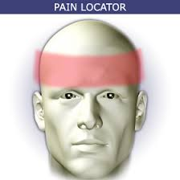
Tension-type headache

Slide 9
Tension-type headache
Most common type of primary headache
More in women than men .
Mild to moderate in intensity
Bilateral
Pressing and tightening (non-pulsating) headache
Not aggravated by movement such as walking or climbing stairs.

Slide 10
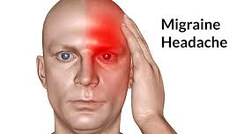
Migraine headache

Slide 11
Migraine headache
Unilateral
Pounding
Moderate to severe pain
Worse with exercise
Associated with nausea, vomiting, photophobia, or phonophobia

Slide 12
Cont.
Migraine with aura (in 15-33% of patients with migraine).
Migraine without aura
Aura refers to feelings and some neurological symptoms person notices it shortly before the headache begins, and it differs from one person to another.
It include: Nausea, Fatigue, Difficulty concentrating, Stiff neck, and repetitive yawning.
The most common aura is a visual one that can involve sensitivity to light or blurred vision .

Slide 13
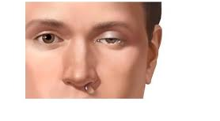
Cluster headache

Slide 14
Cluster headache
Very Severe
Frequent
Associated with parasympathetic autonomic features:
injected sclera
Lacrimation
rhinorrhea
facial sweating
eyelid swelling

Slide 15

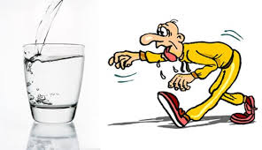
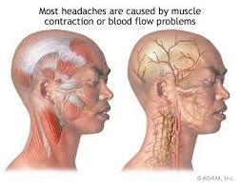
Causes of primary headache
Contraction of the muscles that cover the skull
Physical or emotional stress
Dehydration

Slide 16
History Taking
Age at onset
Presence or absence of aura and prodrom?
Frequency, intensity, and duration of attack
Number of headache days per month
Family history of migraine

Slide 17
Associated Symptoms | Condition
Fever | Systemic infection: meningitis, encephalitis, brain abscess, otitis media.
Vomiting | Mass lesion, brain abscess, migraine, carbon monoxide poisoning.
Seizure | Mass lesion, stroke, meningitis, encephalitis, metabolic, toxic.
Dizziness | Ischaemic or haemorrhagic infarct (posterior fossa), migraine.

Slide 18
Neck pain | Meningitis, subarachnoid haemorrhage, tension headache, musculoskeletal pain (cervical paraspinal muscle pain).
Facial pain | Temporal area: giant cell arteritis, trigeminal neuralgia • Eye area: glaucoma • Ear area: otitis media • Sinusitis.
Visual disturbance | Migraine, acute angle-closure glaucoma.
Neck pain | Meningitis, subarachnoid haemorrhage, tension headache, musculoskeletal pain (cervical paraspinal muscle pain).
Lacrimation, rhinorrhoea | Cluster headache • Sinus headache.

Slide 19
Urgent considerations - Meningitis
• Presents with fever, headache, stiff neck.
• Patients may develop meningococcal sepsis, presenting with hypotension, altered mental state, and purpuric or petechial rash.
• Patients should have a lumbar puncture (LP) within 1 hour of arrival at hospital, provided it is safe to do so, and commence antibiotic treatment immediately afterwards.
- If high suspicion, antibiotics should be administered empirically before LP.
• If LP is delayed for CT, blood cultures should be obtained and broad-spectrum antibiotics given before CT.

Slide 20
Subarachnoid haemorrhage (SAH)
- About 1% of all patients presenting to the emergency department with headaches have SAH.
- It may present with a 'thunderclap' headache (sudden onset of severe headache, seen in 12% of SAH).
• Sudden onset, worst headache of life
• Immediate CT

Slide 21
Hypertensive encephalopathy
• Elevated BP, mean arterial pressure >150 to 200 mmHg
• Immediate CT
• BP should be quickly lowered by 20% to 25% (labetalol, nicardipine).

Slide 22
Giant cell arteritis
• Patient >50 years, with their first severe headache
• Erythrocyte sedimentation rate is checked
• Immediate treatment with corticosteroids is required to prevent blindness if diagnosis is suspected.

Slide 23
Acute angle-closure glaucoma
• Headache in older person (>50 years)
• Decreased visual acuity, nausea/vomiting, eye pain, mid-dilated fixed pupil
• Intra-ocular pressure should be reduced (pilocarpine, timolol, acetazolamide)
• Ophthalmology consultation.

Slide 24
Raised intracranial pressure
• Untreated may lead to permanent sight loss, permanent neurological deficit, and death.
• Constant, severe headache. May be aggravated by coughing, straining, or bending.
- One third of patients report a headache that is worse on waking.
• Patients also experience visual symptoms including blurred or double vision, and transient losses of vision.
• Examine fundi for papilloedema.
• Urgent neuroimaging looking for mass lesion, followed by lumbar puncture if safe.

Slide 25
CONT.
Effect of pain on activity
Relationship with food
Response to any previous treatment
Any recent change in vision
Association with recent trauma
State of general health

Slide 26
Physical Examination
The majority of patients with a headache will have a normal physical examination. There are a few clues and important aspects of the physical examination that require close attention.

Slide 27
Vital signs
• Elevated BP: consider hypertensive emergency, hypertensive urgency • Temperature: consider infectious source.
Head, eyes, ears, nose, and throat (HEENT)
• Listening for bruit at neck, eyes, and head: atrioventricular malformation
• Palpation of head and neck for tenderness: paraspinal muscle tenderness/tension headache
• Tenderness over frontal and/or maxillary sinuses: consider sinusitis

Slide 28
• Tenderness over temporomandibular joint (TMJ): TMJ dysfunction
• Neck stiffness/meningismus: meningitis
• Palpation of temporal artery for tenderness: giant cell arteritis
• Fundoscopy and Snellen chart: papilloedema (causes of raised intracranial pressure)
• Dental examination: caries/wisdom tooth impaction
• Ear examination: otitis media.

Slide 29
Focused physical examination
• Extracranial structure evaluation such as carotid arteries, sinuses, scalp arteries, cervical paraspinal muscles
• Examination of the neck in flexion versus lateral rotation for meningeal irritation.
Even a subtle limitation of neck flexion may be considered an abnormality

Slide 30
Neurological examination
• Assessment of orientation, consciousness (Glasgow coma scale), presence of confusion and memory impairment
• Ophthalmology examination to include pupillary symmetry and reactivity, optic fundi, visual fields, and ocular motility
• Cranial nerve examination to include corneal reflexes, facial sensation, and facial symmetry
• Symmetrical muscle tone, strength (may be as subtle as arm or leg drift), or deep tendon reflexes
• Sensation • Plantar response(s): gait, arm, and leg co-ordination • Abnormal plantar reflex (Babinski's sign): positive in central nervous system lesions
• Painful knee extension with hip flexed (Kernig's sign); 5% positive in meningism• Hip flexion with neck flexion (Brudzinski's sign): 5% positive in meningism.

Slide 31
Investigations Non-contrast computed tomography (CT) brain
• Consider if the patient has:
• Sudden onset severe headache that reaches maximal severity within one hour.
• Headache with ≥1 of the following red flags: increasing frequency or severity, fever or neurological deficit, history of cancer or immunocompromise, older age (>50 years) of onset, or post-traumatic onset
• Headache with new onset or pattern during pregnancy or peripartum period
• Headache with features of intracranial hypertension (e.g., papilleodema, pulsatile tinnitus, visual symptoms worse on Valsalva).

Slide 32
(MRI) brain
- Consider if the patient:
• Headache with features of intracranial hypertension (e.g., papilloedema, pulsatile tinnitus, visual symptoms worse on Valsalva).
• Headache with features of intracranial hypotension (e.g., positional, worse when upright, better when lying down).
• Headache with new onset or pattern during pregnancy or peripartum period.
• Headache with one or more of the following red flags: increasing frequency or severity, fever or neurological deficit, history of cancer or immunocompromise, older age (>50 years) of onset, or post-traumatic onset.
• New primary headache of suspected trigeminal autonomic origin.

Slide 33
Lumbar puncture (LP)
- Order an LP after a negative CT without contrast:
• If the patient has the worst headache of their life, or a 'thunder-clap headache' (SAH)
• If the patient has a fever (brain abscess, meningitis, encephalitis)
• If the patient has neck stiffness (SAH, meningitis)
• If the patient is young, overweight, and female (sinus venous thrombosis, pseudotumor cerebri)
• After negative CT when considering SAH, meningitis, pseudotumor cerebri.

Slide 34
Laboratory tests
• Erythrocyte sedimentation rate, when considering giant cell arteritis
• ABG, when considering hypoxia or hypercapnia
• Carboxyhaemoglobin, when considering carbon monoxide poisoning • A pulse CO-oximeter may reveal elevated CO levels, but this test is not widely available.
• FBC and liver function tests are performed if pre-eclampsia is suspected. Urinalysis is also required in these patients.

Slide 35
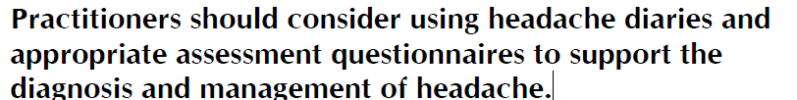
Diagnosis:

Slide 36
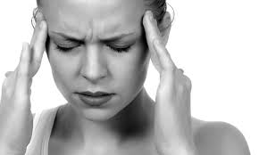
Treatment
Identify and remove the triggers
Educate the patient.
Exercise and diet
Pharmacological (paracetamol).
Regular sleep.

Slide 37
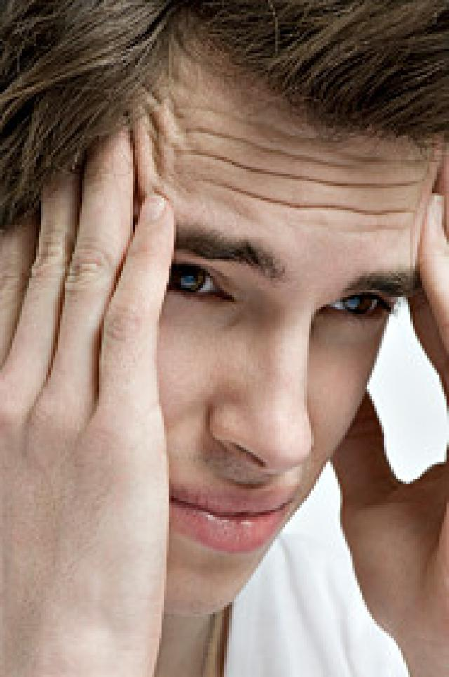
Tension-type headache
OCT pain relieves: Aspirin or ibuprofen.
Combination therapy: Aspirin or acetaminophen with caffeine or a sedative drug.
Preventive involves the use of daily prophylactic medications antidepressants (amitriptyline) behavioral therapies and physical therapy.

Slide 38
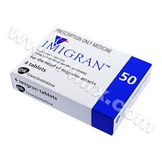
Migraine
Acute attack:
Simple Analgesia with paracetamol
or aspirin with an anti-emetic.
Severe SUMATRIPTAN (5HT agonist)
Prevention:
Beta blockers: propranolol.
Antidepressant: amitriptyline.
Anti-seizure drugs: valproate soduim.

Slide 39
Contraindications to Triptan
Because of their vasoconstricting properties, triptan medications are contraindicated in patients with:-
Established coronary artery disease, cerebrovascular disease, or peripheral vascular disease;
Patients with uncontrolled or multiple cardiovascular risk factors;
Patients with certain high-risk migraine syndromes, including basilar and hemiplegic migraines.

Slide 40
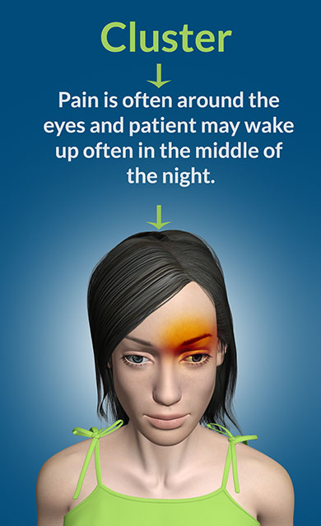
Cluster headache
Acute treatment:
Subcutaneous sumatriptan
oxygen inhalation.
Prevention:
Verapamil – corticosteroids -
lithium - Methysergide.

Slide 41
What are the Criteria for Low Risk Headache?
Age younger than 30 years, Features typical of primary headaches. History of similar headache No abnormal neurologic findings No concerning change in usual headache pattern No high-risk comorbid conditions (e.g., human immunodeficiency virus infection).

Slide 42
Prevention:

Slide 43
Red flags
Old age of onset of headache (>50 years of age)
Acute onset (thunderclap) headache
New headaches
Significant change in the characteristics of prior headaches
Signs or symptoms of systemic illness (eg, fever, chills, weight loss, vomiting)

Slide 44
Temporal arteritis
Temporal arteritis (giant cell arteritis) is where the arteries, particularly those at the side of the head (the temples), become inflamed (Vasculitis). It's serious and needs urgent treatment.
- Commonly affects elderly female.
- The ESR is markidly elevated.

Slide 45
Symptoms
Fatigue.
Fever.
Jaw pain that may become worse after chewing.
Tenderness at the scalp or temples.
Vision problems, such as double vision, blurry vision, or transient (brief) vision loss; if this is not treated, it could be followed by permanent, irreversible vision loss

Slide 46
Treatment
The mainstay of therapy for temporal arteritis is glucocorticoids, such as oral prednisone in high dose.
Patients sometimes need to take glucorticoids for up to two years.

Slide 47
Thunderclap Headaches
Sudden-onset headache pain, with peak intensity occur­ring within several minutes.
Causes:-
- Subarachnoid hemorrhage,
- Hypertensive emergencies,
- Vertebral artery dissections, and
- Acute angle–closure glaucoma.

Slide 48
Cont.
Known systemic illnesses that predispose to secondary headaches (cancer, HIV).
Alter mental status
History of trauma
History of malignancy
Pregnancy.
Neck stiffness

Slide 49
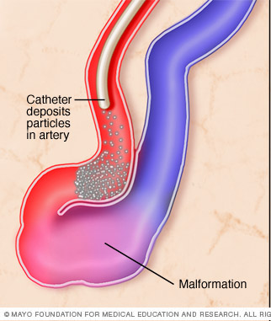
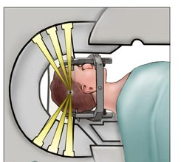
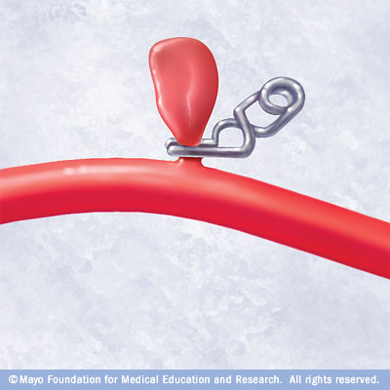
Rare/serious:
Cough Headache – secondary-.
Brain AVM (arteriovenous malformation).
Brain aneurysm.
Treatable

Slide 50

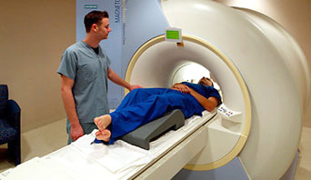
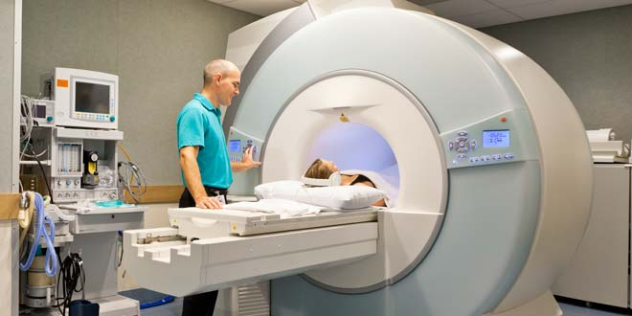
Limit of Imaging

Slide 51
Limit of Imaging SNOOP
Systemic symptoms, illness, or condition (eg, fever, weight loss, cancer, pregnancy, immunocompromised state including HIV)
Neurologic symptoms or abnormal signs (eg, confusion, impaired alertness or consciousness, papilledema, focal neurologic symptoms or signs, meningismus, or seizures)
Onset is new (particularly for age >40 years) or sudden (eg, "thunderclap")

Slide 52
Cont.
Other associated conditions or features (e.g. head trauma, illicit drug use, or toxic exposure; headache awakens from sleep, is worse with Valsalva maneuvers, or is precipitated by cough, exertion, or sexual activity)
Previous headache history with headache progression or change in attack frequency, severity, or clinical features.

Slide 53
Secondary Headache Source
Impaired vision or seeing halos around light (glaucoma)
Subacute angle closure glaucoma.
Visual field defects (lesion of the optic pathway e.g. pituitary mass).
Sudden, severe, unilateral vision loss (optic neuritis)
Morning headache is nonspecific (primary headache syndrome ,sleep apnea, chronic obstructive pulmonary disease, obesity hypoventilation syndrome)

Slide 54
Cont..
The presence of nausea, vomiting, worsening of headache with changes in body position (particularly bending over), an abnormal neurologic examination, and/or a significant change in prior headache pattern (tumor).
Intermittent headaches with high blood pressure (pheochromocytoma)

Slide 55

Detecting edema
Vascular lesions
Intracranial pathology (posterior fossa)
Available
Urgent or Emergency care
Concern for subarachnoid hemorrhage (thunderclap headach)

Slide 56




Prevention
Good sleep hygiene
Routine meal schedules
Regular exercise
Avoidance of triggers
Water ,Water, Water.

Slide 57
Summary
Always look for common primary headaches
All cases RED flag sign and symptoms to be excluded.
Start with simple analgesia in primary headaches
Patients education is an important steps in management.
Controled use of radiological images to be utilized.

